Slide 1
How is the stability of reanalysis products affected by the increasing number of observations assimilated?
Ruben Urraca, Nadine Gobron
Vienna, 27 April 2023

Slide 2
Reanalysis & climate monitoring
Reanalysis are an increasingly popular option for monitoring climate:
(i) gap-free, (ii) global, (ii) long-term (back to the 1940s) coverage of (iv) multiple variables
ERA5 has been one of the most cited dataset in the last IPCC AR6 report
How the assimilation of increasing number of observations affects their temporal stability?
-----------------------------------------------------------------------------------------------------------------------
CASE STUDY: SNOW COVER from ERA5, ERA5LAND (COPERNICUS C3S)
ERA5 assimilates snow depth observations
Increasing number of in-situ observations
2004: start assimilation NOAA IMS snow cover

Slide 3
Stability of the bias: snow depth

Slide 4
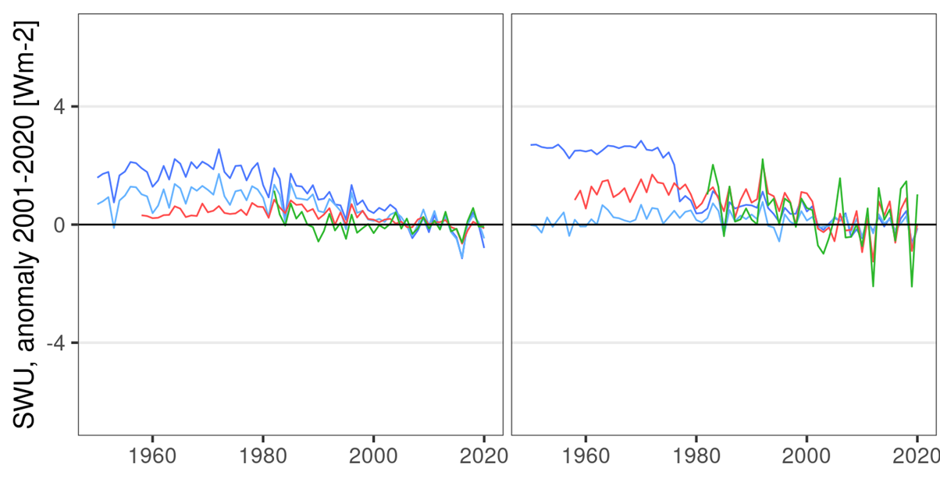
Global snow cover extent
Regional SW reflected radiation
NH continental Greenland

Slide 5
Conclusions
Trade-off uncertainty vs temporal stability when assimilating new observations into reanalyses
The artificial steps/discontinuities can be amplified or mitigated through the model to variables without direct assimilation of observations
A more systematic approach is needed to evaluate the fitness of reanalyes for climate monitoring. Specific metrics for each variable based on the GCOS stability requirements.
Urraca R, Gobron N. Temporal stability of long-term satellite and reanalysis products to monitor snow cover trends. The Cryosphere 17(2), 2023. DOI: 10.5194/tc-17-1023-2023

