Slide 1
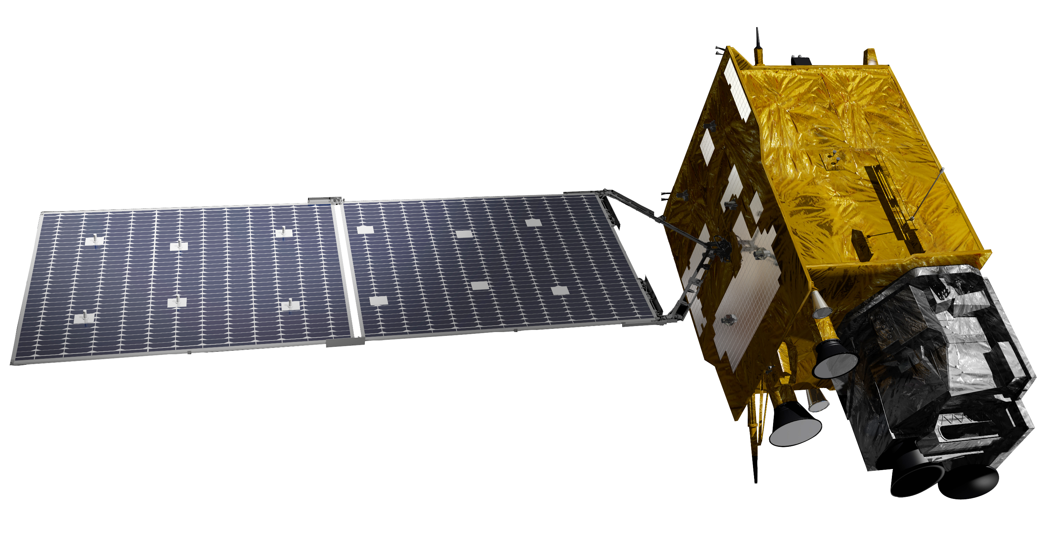

Estimation of geostationary satellite-based hourly daytime and nighttime AOD using machine learning
24 April 2023
Sanghyeon Song, Yoojin Kang, Jungho Im
Department of Urban and Environmental Engineering,
Ulsan National Institute of Science and Technology, Ulsan, South Korea

Slide 2


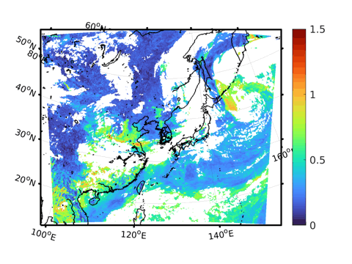
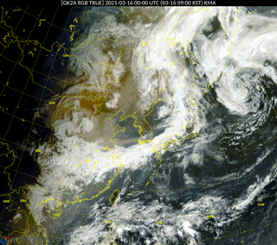
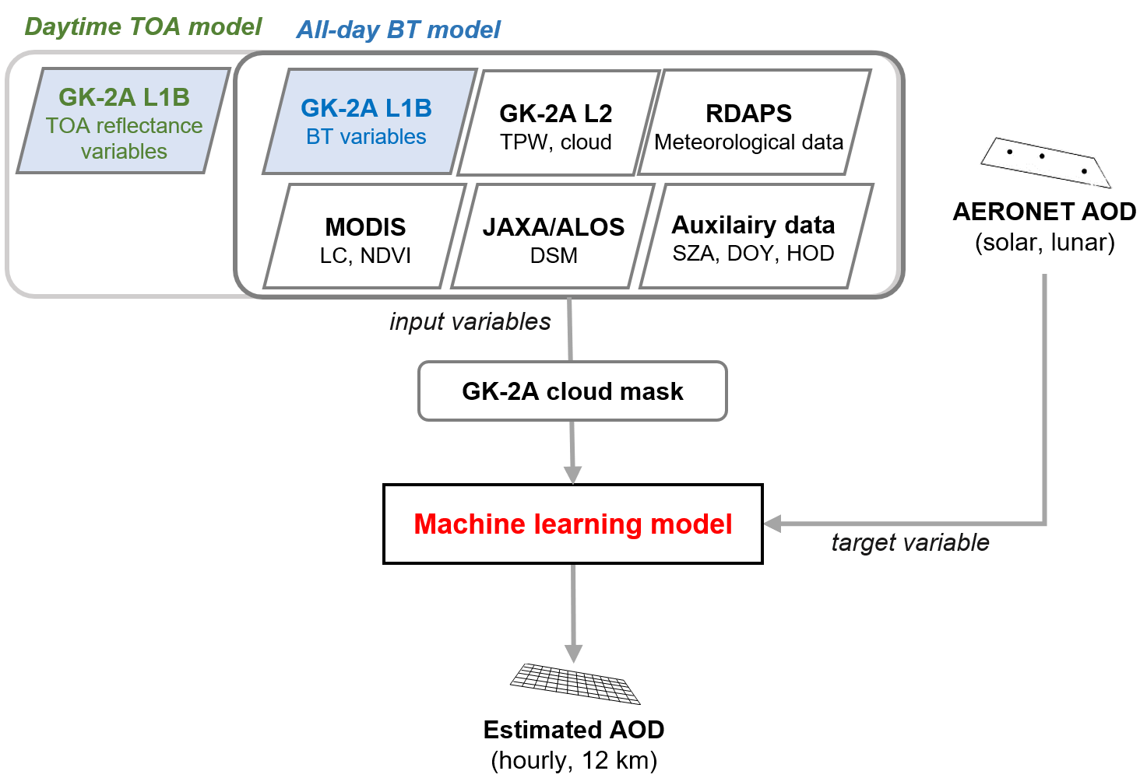
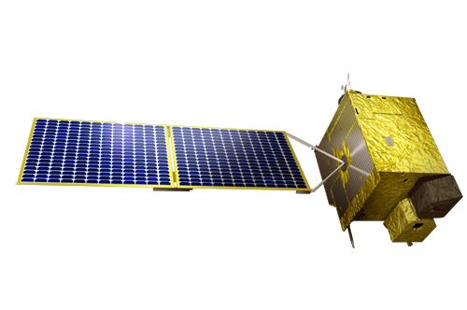
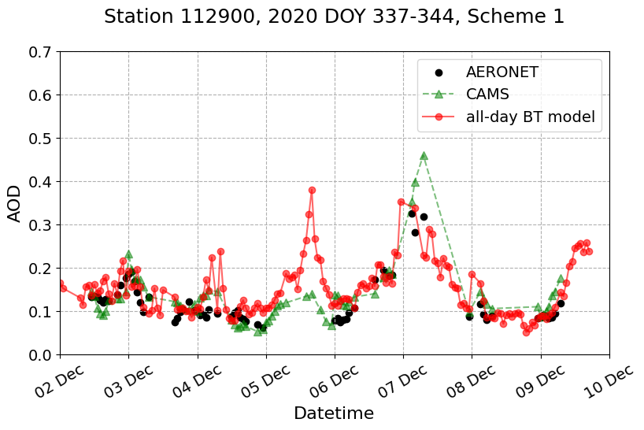

Estimation of geostationary satellite-based hourly daytime and nighttime AOD using machine learning
PICO 5.11
Abstract
Sanghyeon Song, Yoojin Kang, Jungho Im
Department of Urban and Environmental Engineering, Ulsan National Institute of Science and Technology, Ulsan, South Korea
Background
GK-2A RGB image
AOD by All-day BT model (proposed)
In East Asia, continuous and frequent aerosol monitoring is highly required due to large-scale natural and artificial aerosol emissions.
Geostationary satellite provides continuous aerosol retrieval over a specific area, however, the observation is limited to the daytime.
Study Object
Development of a machine learning-based model for estimation of temporally continuous aerosol optical depth (AOD) at 550 nm during both daytime and nighttime using geostationary satellite (i.e., GK-2A) and other data
Study flow
Models
All-day BT model
  - Daytime + Nightime estimation
  - BT variables
Daytime TOA model (for comparison)
  - Daytime estimation
  - TOA reflectance + BT variables
Novelty
Time series comparison
First study to …
estimate nighttime AOD using geostationary satellite data
estimate of the satellite-based nocturnal variation of AOD
monitor nighttime aerosol transport in East Asia by geostationary satellite
Notes:
In East Asia, due to large-scale aerosol emissions from natural and artificial sources, it is essential to continuously monitor the atmospheric aerosols.
Geostationary satellite provides temporally continuous monitoring of aerosol over a specific area, however, the observation is only limited to the daytime.
In this study, developed machine learning-based models for estimating temporally continuous aerosol optical depth (AOD) over East Asia including nighttime using the geostationary satellite, GK-2A, and other data.
Using the model proposed in this study, it is possible to continuously monitor the diurnal variation of AOD in the local area, and the aerosol transport in East Asia, including nighttime. To our knowledge, it is the first attempt at hourly continuous aerosol monitoring including nighttime over East Asia from the geostationary satellite.

Slide 3



Overview
1
Introduction
2
Data
3
Method
4
Result
5
Conclusion

Slide 4


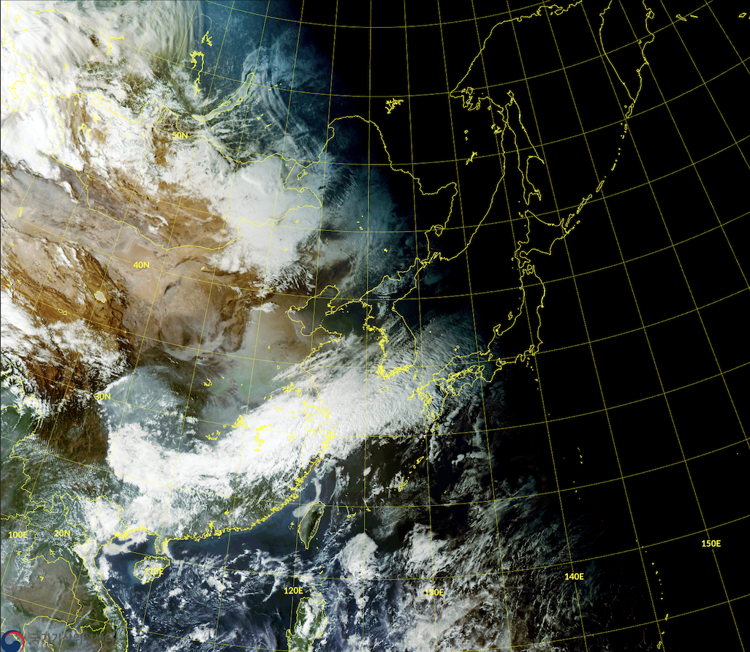
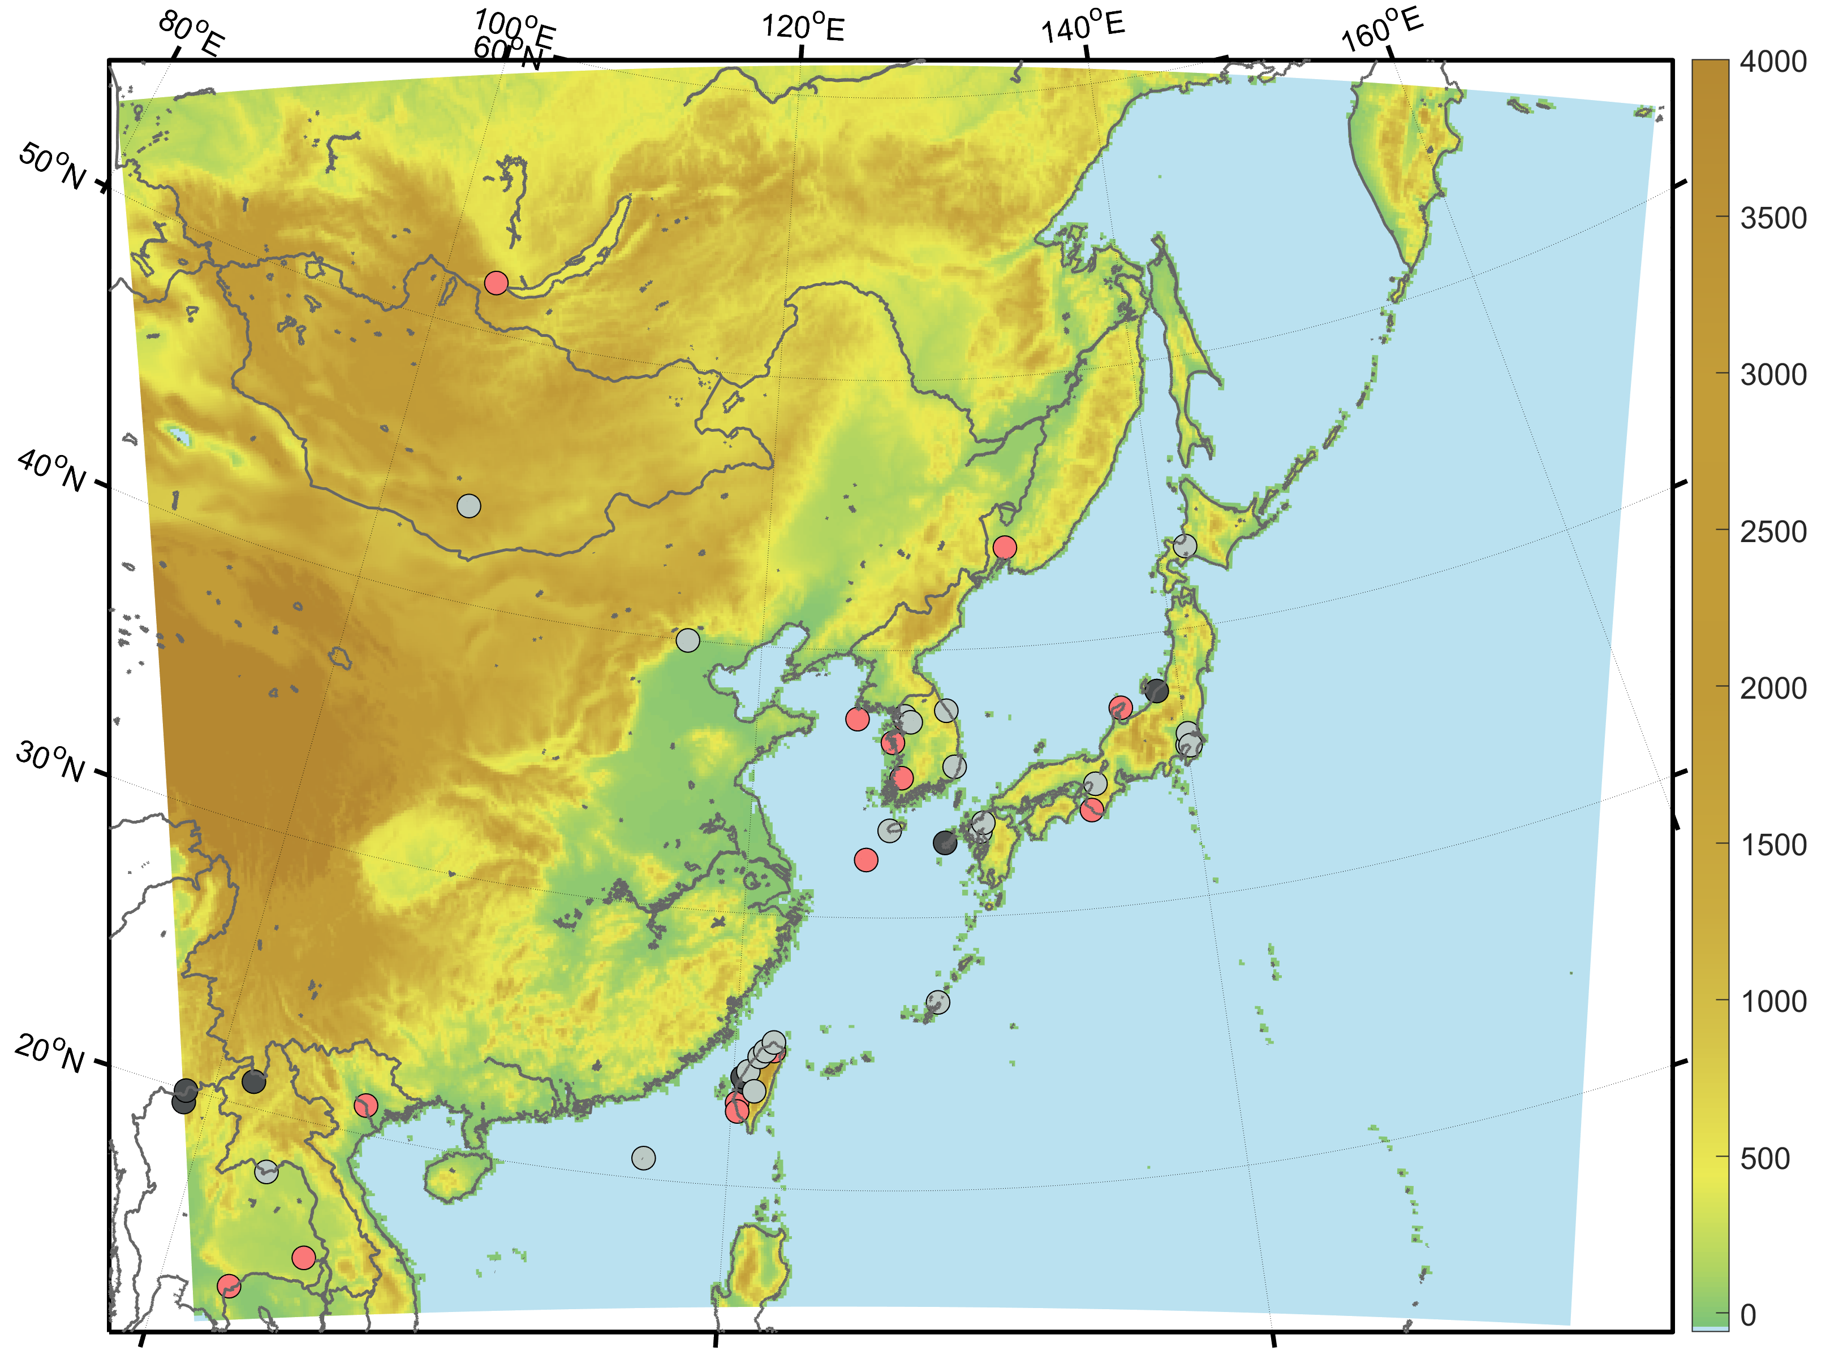

Estimation of geostationary satellite-based hourly daytime and nighttime AOD using machine learning
Overview
Sanghyeon Song, Yoojin Kang, Jungho Im
shsong15@unist.ac.kr
Department of Urban and Environmental Engineering, Ulsan National Institute of Science and Technology, Ulsan, South Korea
Introduction
Method
Background
In East Asia, continuous aerosol monitoring is highly required due to large-scale natural and artificial aerosol emission
Geostationary satellite provides temporally continuous aerosol optical depth (AOD) retrieval over a specific area, however, the observation is only limited to the daytime
Models
All-day BT model
  - Daytime + Nightime estimation
  - BT variables
Daytime TOA model
  - Daytime estimation
  - TOA reflectance + BT variables
Dataset split
Asian dust
DOY:
not multiple of 5
DOY:
multiple of 5
Source: KMA
43 stations
Training
Test days
Objective
Development of a machine learning-based model for estimation of temporally continuous AOD at 550 nm during both daytime and nighttime over East Asia using a geostationary satellite (i.e., GK-2A) and other data
1 station
Test station
Data
Study domain
East Asia
August 2019 – August 2021
Data
Study flow for model training
Source | Variables
GK-2A | Level 1B Reflectances variables (ch01-ch06): Top-of-atmosphere (TOA) reflectances differences with recent 30-day minimum Brightness Temperature (BT) variables (ch07-ch16): BT differences and ratios between channels, BT differences with recent 30-day maximum Level 2 Cloud, TPW
Meteorological data | RDAPS numerical weather forecasting model Temp, Dew, RH, WS, U_wind, V_wind, PBLH, Visibility, Psrf
Geographical data | MODIS Land Cover ratio, NDVI SRTM DSM
Auxiliary data | SZA (Solar Zenith Angle), DOY (Day Of Year), HOD (Hour Of Day)
Reference data | AERONET AOD (Solar, Lunar)
Daytime TOA model
All-day BT model
GK-2A L1B
TOA reflectance variables
GK-2A L1B
BT variables
GK-2A L2
TPW, cloud
RDAPS
Meteorological data
MODIS
LC, NDVI
JAXA/ALOS
DSM
Auxilairy data
SZA, DOY, HOD
AERONET AOD
(solar, lunar)
input variables
GK-2A cloud mask
Machine learning based model
LightGBM
(Light Gradient Boosting Machine)
target variable
AERONET (AErosol RObotic NETwork) ground-based observation stations
Abstract
Solar AOD (Level 2.0): 15 stations
Lunar AOD (Level 1.5): 7 stations
Estimated AOD
(hourly, 12 km)
Both Solar and Lunar AOD: 22 stations

Slide 5

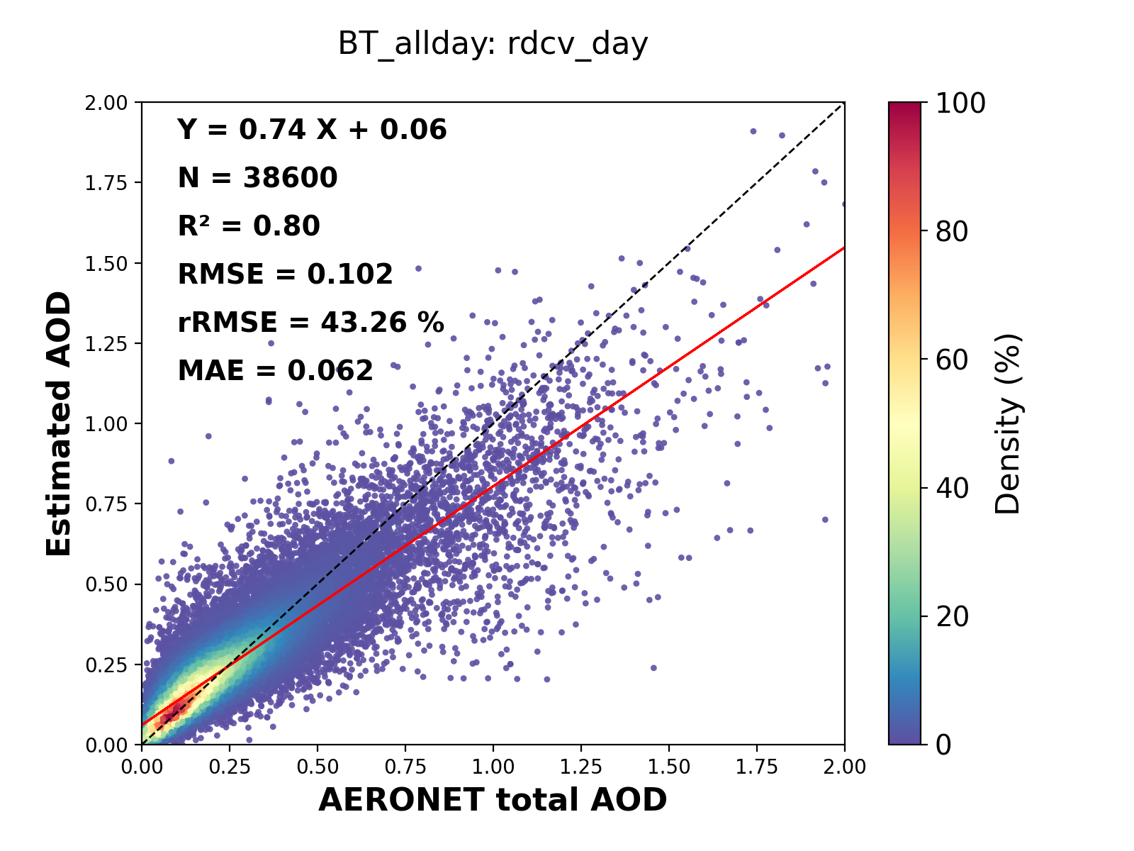
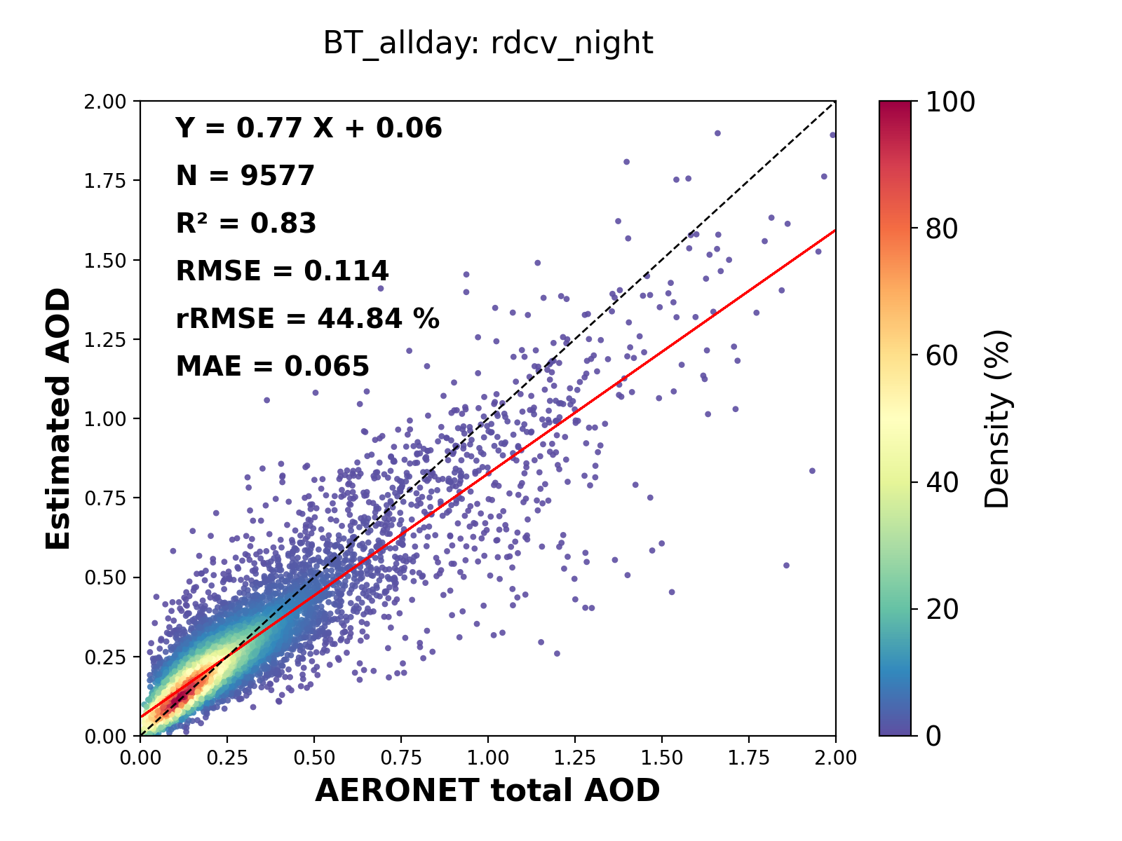
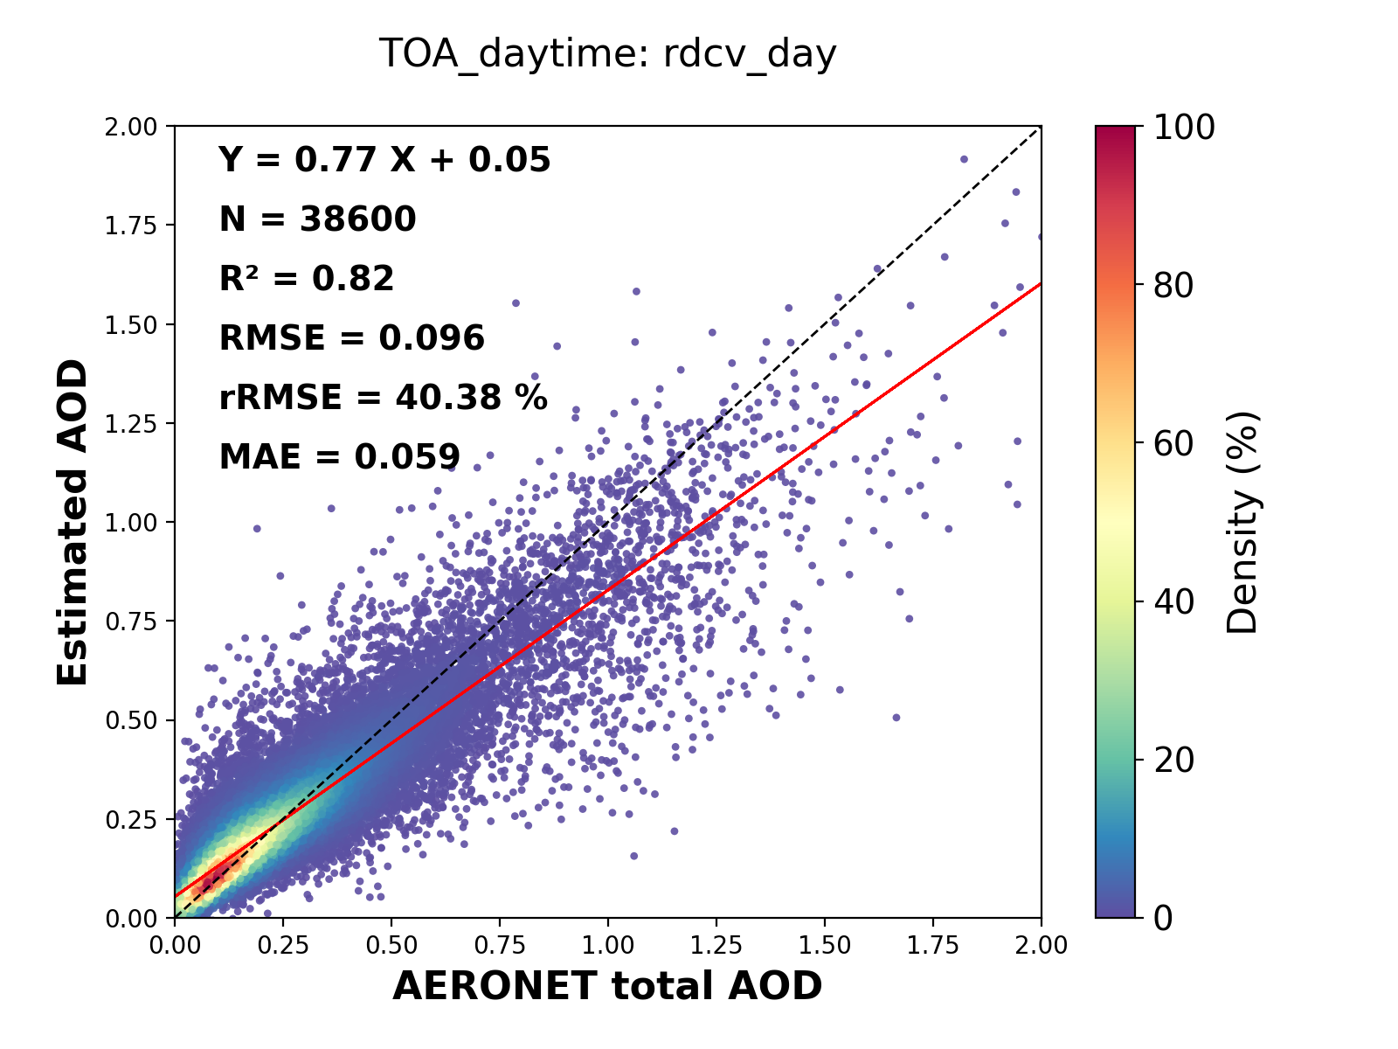
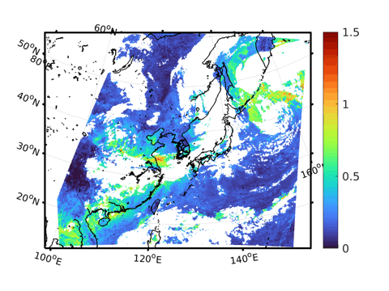
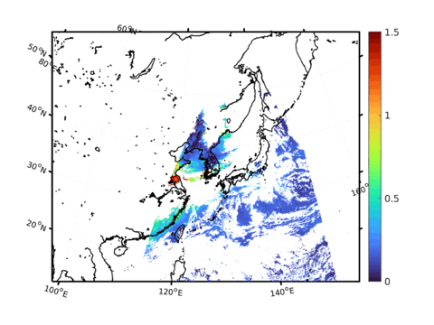

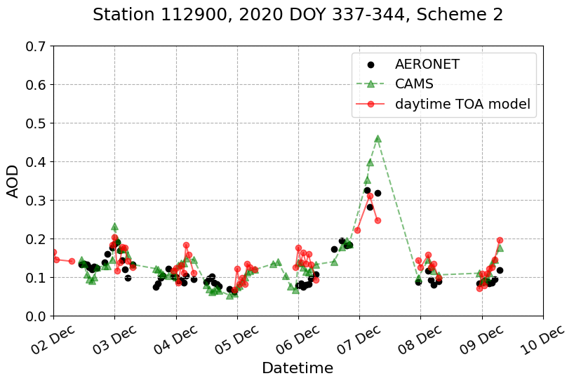
Estimation of geostationary satellite-based hourly daytime and nighttime AOD using machine learning
Overview
Sanghyeon Song, Yoojin Kang, Jungho Im
shsong15@unist.ac.kr
Department of Urban and Environmental Engineering, Ulsan National Institute of Science and Technology, Ulsan, South Korea
Result
Spatial distribution comparison
The spatial distribution of AOD estimated from the proposed models with AHI-YAER AOD during the test day (2021 DOY 75)
All-day BT model can provides continuous aerosol monitoring over East Asia during both day and night
Model Performance
The scatter plots of random 10-fold cross validation of the proposed models on the training data
Daytime TOA model shows slightly higher performance than Daytime result of All-day BT model
All-day BT model
Daytime TOA model
, 16 March (DOY 75), 2021
Day
Night
Day
All-day BT model
Daytime TOA model
AHI-YAER
Time series comparison
The time series from the proposed models with CAMS and AERONET AOD on the test AERONET station (KORUS_UNIST_ULSAN)
Overall, the proposed models estimate with similar patterns to CAMS and AERONET AOD
All-day BT model provides continuous diurnal variation of AOD on specific location
  AHI-YAER: Advanced Himawari Imager (AHI) Yonsei Aerosol Retrieval (YAER) algorithm
0
0.5
1.0
1.5
Conclusion
All-day BT model
Daytime TOA model
Summary
Temporally continuous AOD at 550 nm during both daytime and nighttime is estimated using geostationary satellite (i.e., GK-2A) and other data thgouth a machine learning approach.
Based on geostationary satellite data, it is possible to …
  estimate the diurnal variation of AOD
  monitor aerosol transport in East Asia including nighttime
Novelty
First study to …
estimate nighttime AOD using geostationary satellite data
estimate of the satellite-based nocturnal variation of AOD
monitor nighttime aerosol transport in East Asia by geostationary satellite
Abstract

Slide 6
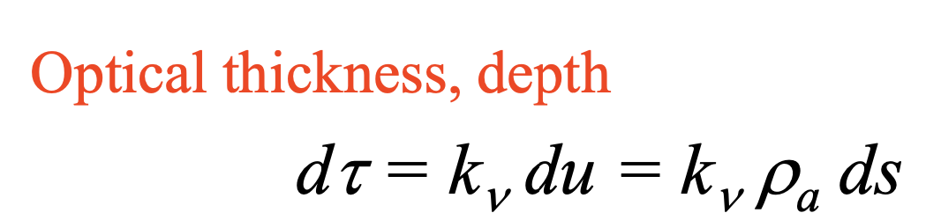
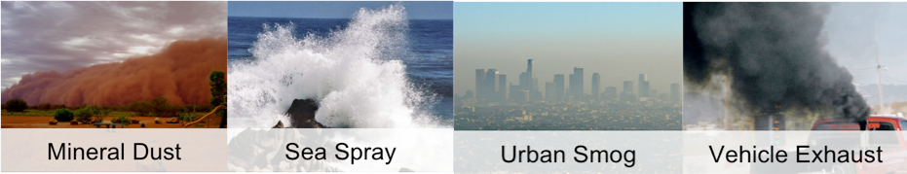
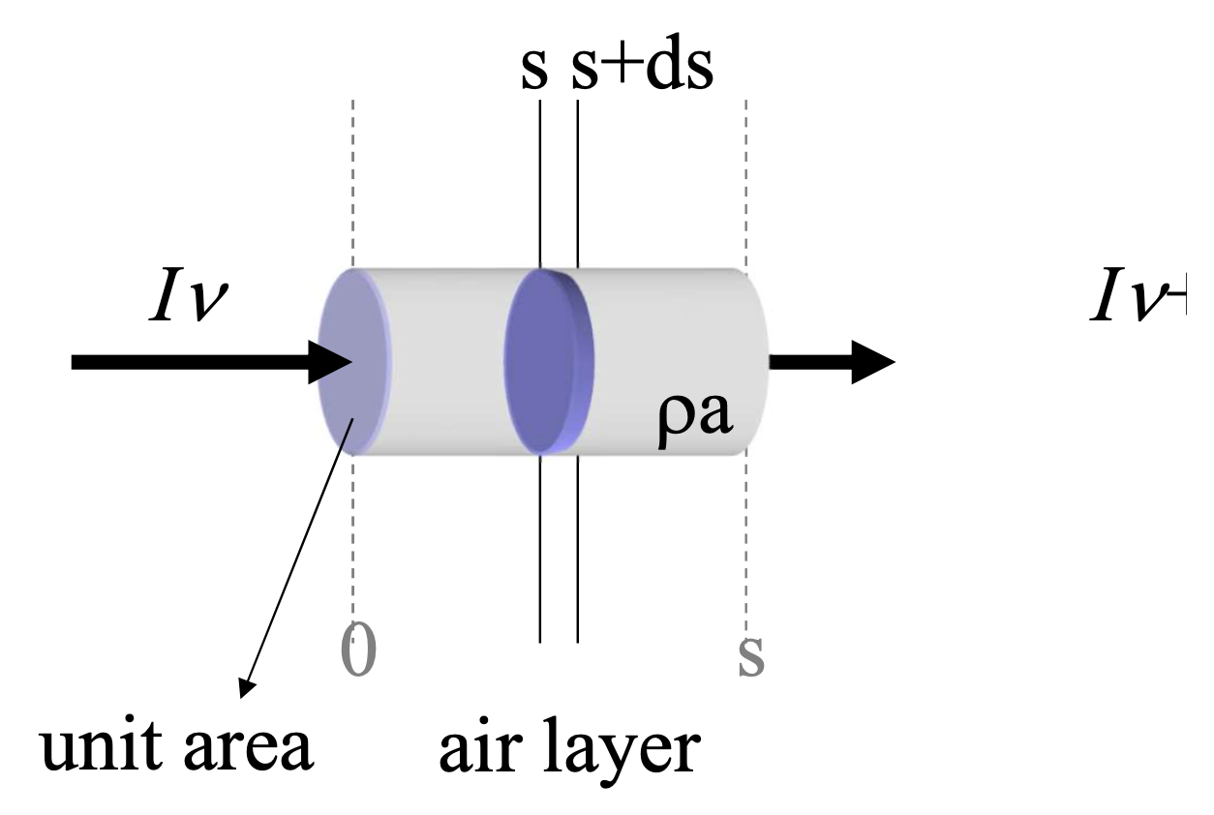
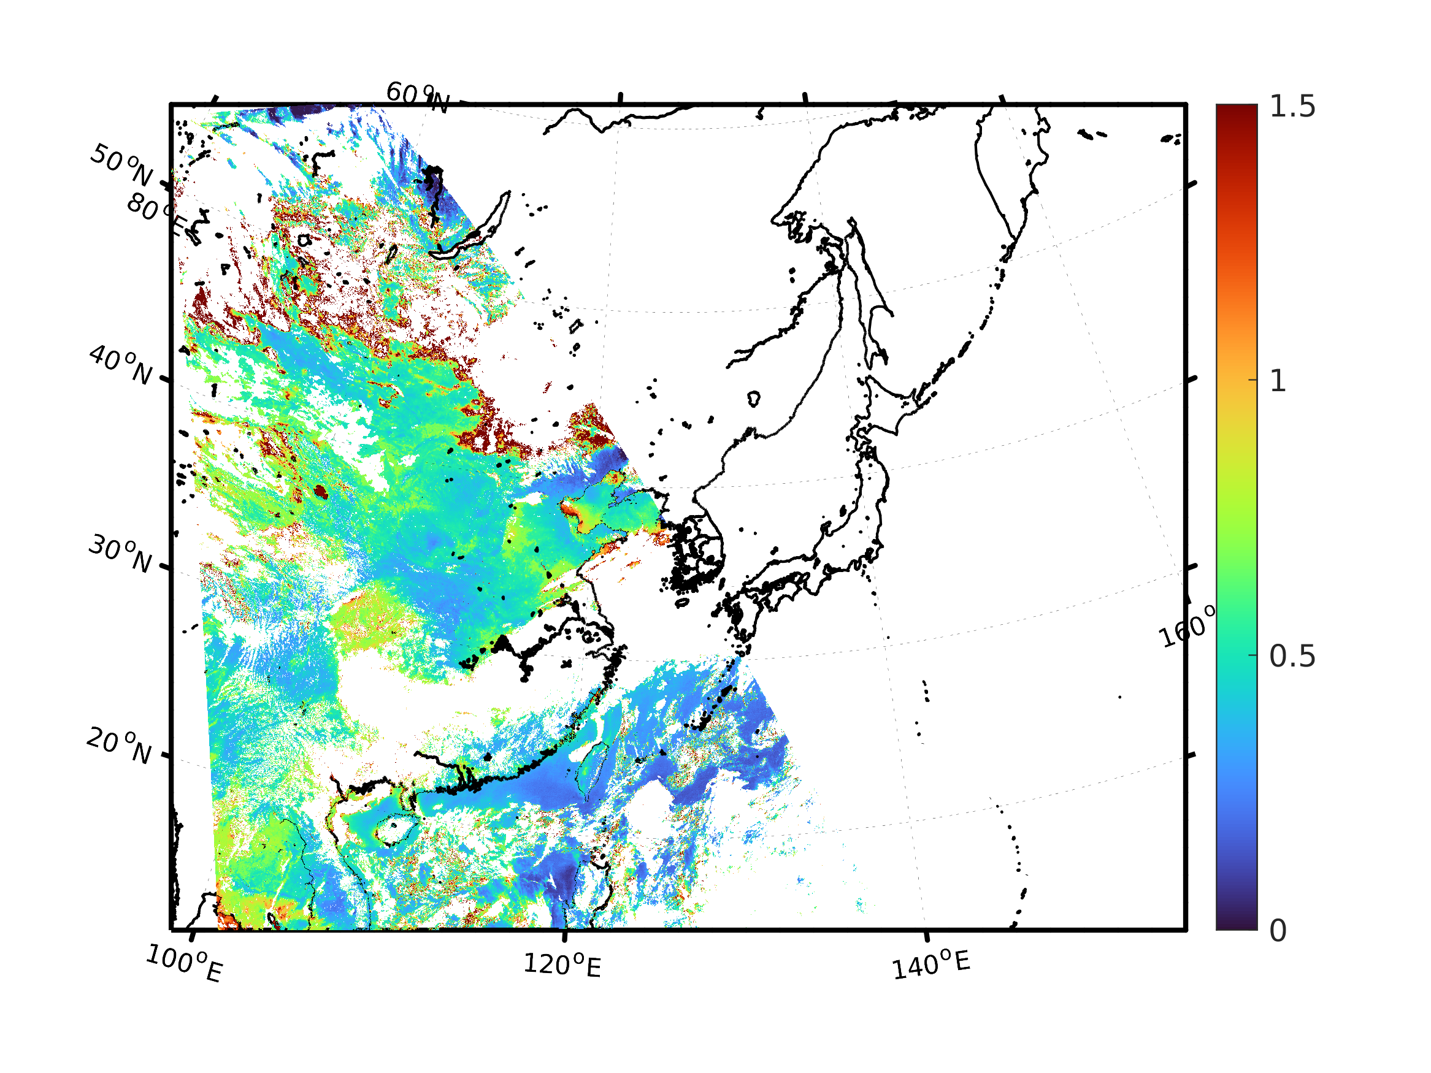
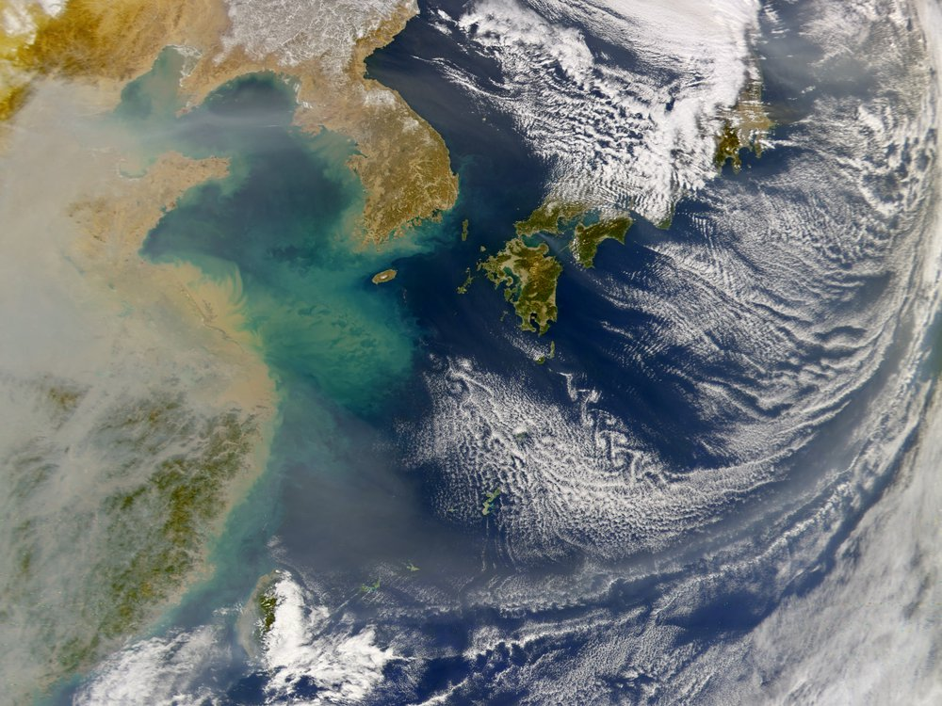
Background
1. Introduction
shsong15@unist.ac.kr
Atmospheric Aerosol
Atmospheric aerosol affects human health, the ecosystem, Earth's radiative budget and the climate.
Aerosol is quantified by aerosol optical depth (AOD):
  the extinction of radiation due to the atmospheric aerosol integrated over the atmospheric column as a function of wavelength.
https://caice.ucsd.edu/introduction-to-aerosols/
Aerosol Monitoring
In East Asia, continuous and frequent aerosol monitoring is highly required due to large-scale natural and artificial aerosol emissions:
  Natural sources: dust, volcano, smoke, plants
  Artificial sources: industry, urban, transport, agriculture
Geostationary satellites provide temporally continuous AOD retrieval over a specific area, however, the observation is only limited to the daytime.
Day
Night
https://climate.nasa.gov/news/3065/nasa-funded-network-tracks-the-recent-rise-and-fall-of-ozone-depleting-pollutants/
GK-2A AOD
UTC 08, 1 Feb. 2021

Slide 7

Study object
1. Introduction
shsong15@unist.ac.kr
Study Object
Novelty
Development of a machine learning-based model for estimation of temporally continuous AOD at 550 nm during both daytime and nighttime using geostationary satellite (i.e., GK-2A) and other data
Based on geostationary satellite data …
  Estimating the diurnal variation of AOD
  Monitoring aerosol transport in East Asia
First study to …
estimate of the diurnal variation of AOD in the local area
monitor aerosol transport in East Asia including nighttime
estimate nighttime AOD using geostationary satellite data
Temporally continuous all-day AOD estimation from GK-2A satellite using machine learning

Slide 8
Study domain and data
2. Data
shsong15@unist.ac.kr
Study area and period
Data
TOA reflectance: Top-of-Atmosphere reflectance
BT: Brightness Temperature
East Asia
August 2019 –August 2021
GK-2A AMI Spectral Channels
Source | Variables | Spatial resolution
GK-2A L1B | TOA reflectance differences with recent 30-day minimum: ch01_diff, ch02_diff, ch03_diff, ch04_diff, ch05_diff, ch06_diff | 0.5 - 2 km
 | BT differences (BTD) between channels (3): ch07 - ch13 ch13 - ch15 ch11 - ch13 BT ratios (BTR) between channels (2): ch13 / ch11 ch13 / ch15 BT differences with recent 30-day maximum (4): ch11_diff, ch13_diff, ch14_diff, ch15_diff | 2 km
GK-2A L2 | Cloud TPW (total precipitable water) | 2 km 6 km
RDAPS | Temp, Dew, RH, WS, U_wind, V_wind, Visibility, PBLH, Psrf | 12 km
MODIS | Land Cover ratio (3): vegetation, water, urban Normalized Difference Vegetation Index | 0.5 km 1 km
Auxiliary Data | SZA (Solar Zenith Angle) DOY (Day Of Year) HOD (Hour Of Day) | - - -
AERONET (reference) | AOD | Point
Channel (type) | Central Wavelength
1 (vis) | 0.47 μm
2 (vis) | 0.51 μm
3 (vis) | 0.64 μm
4 (vis) | 0.86 μm
5 (NIR) | 1.38 μm
6 (NIR) | 1.6 μm
7 (SWIR) | 3.8 μm
8 (WV) | 6.3 μm
9 (WV) | 6.9 μm
10 (WV) | 7.3 μm
11 (IR) | 8.7 μm
12 (IR) | 9.6 μm
13 (IR) | 10.5 μm
14 (IR) | 11.2 μm
15 (IR) | 12.3 μm
16 (IR) | 13.3 μm
AERONET (AErosol RObotic NETwork) ground-based observation stations
Solar AOD (Level 2.0): 15 stations
Lunar AOD (Level 1.5): 7 stations
Both Solar and Lunar AOD: 22 stations

Slide 9
Study flow
3. Method
shsong15@unist.ac.kr
Process flow
Models
Daytime TOA model
All-day BT model
The all-day BT model uses the same variable combination during both daytime and nighttime
The daytime TOA model uses GK-2A L1B TOA reflectance as input variables additionally with the same variable combination of the all-day BT model
GK-2A L1B
TOA reflectance variables
GK-2A L1B
BT variables
GK-2A L2
TPW, cloud
RDAPS
Meteorological data
MODIS
LC, NDVI
JAXA/ALOS
DSM
Auxilairy data
SZA, DOY, HOD
AERONET AOD (solar, lunar)
Analysis
1. Model validation
10-fold cross validation
Comparison of validation results by two models
2. Spatial distribution comparison of AOD
Analysis of spatiotemporal AOD map over study area
Comparison of the estimated AOD with other AOD products from YAER, CAMS, GK-2A and AERONET
3. Time series comparison of AOD
Time series analysis of model-estimated AOD with CAMS and AERONET AOD
input variables
GK-2A cloud mask
Machine learning based model
LightGBM
(Light Gradient Boosting Machine)
target variable
Estimated AOD
(hourly, 12 km)

Slide 10
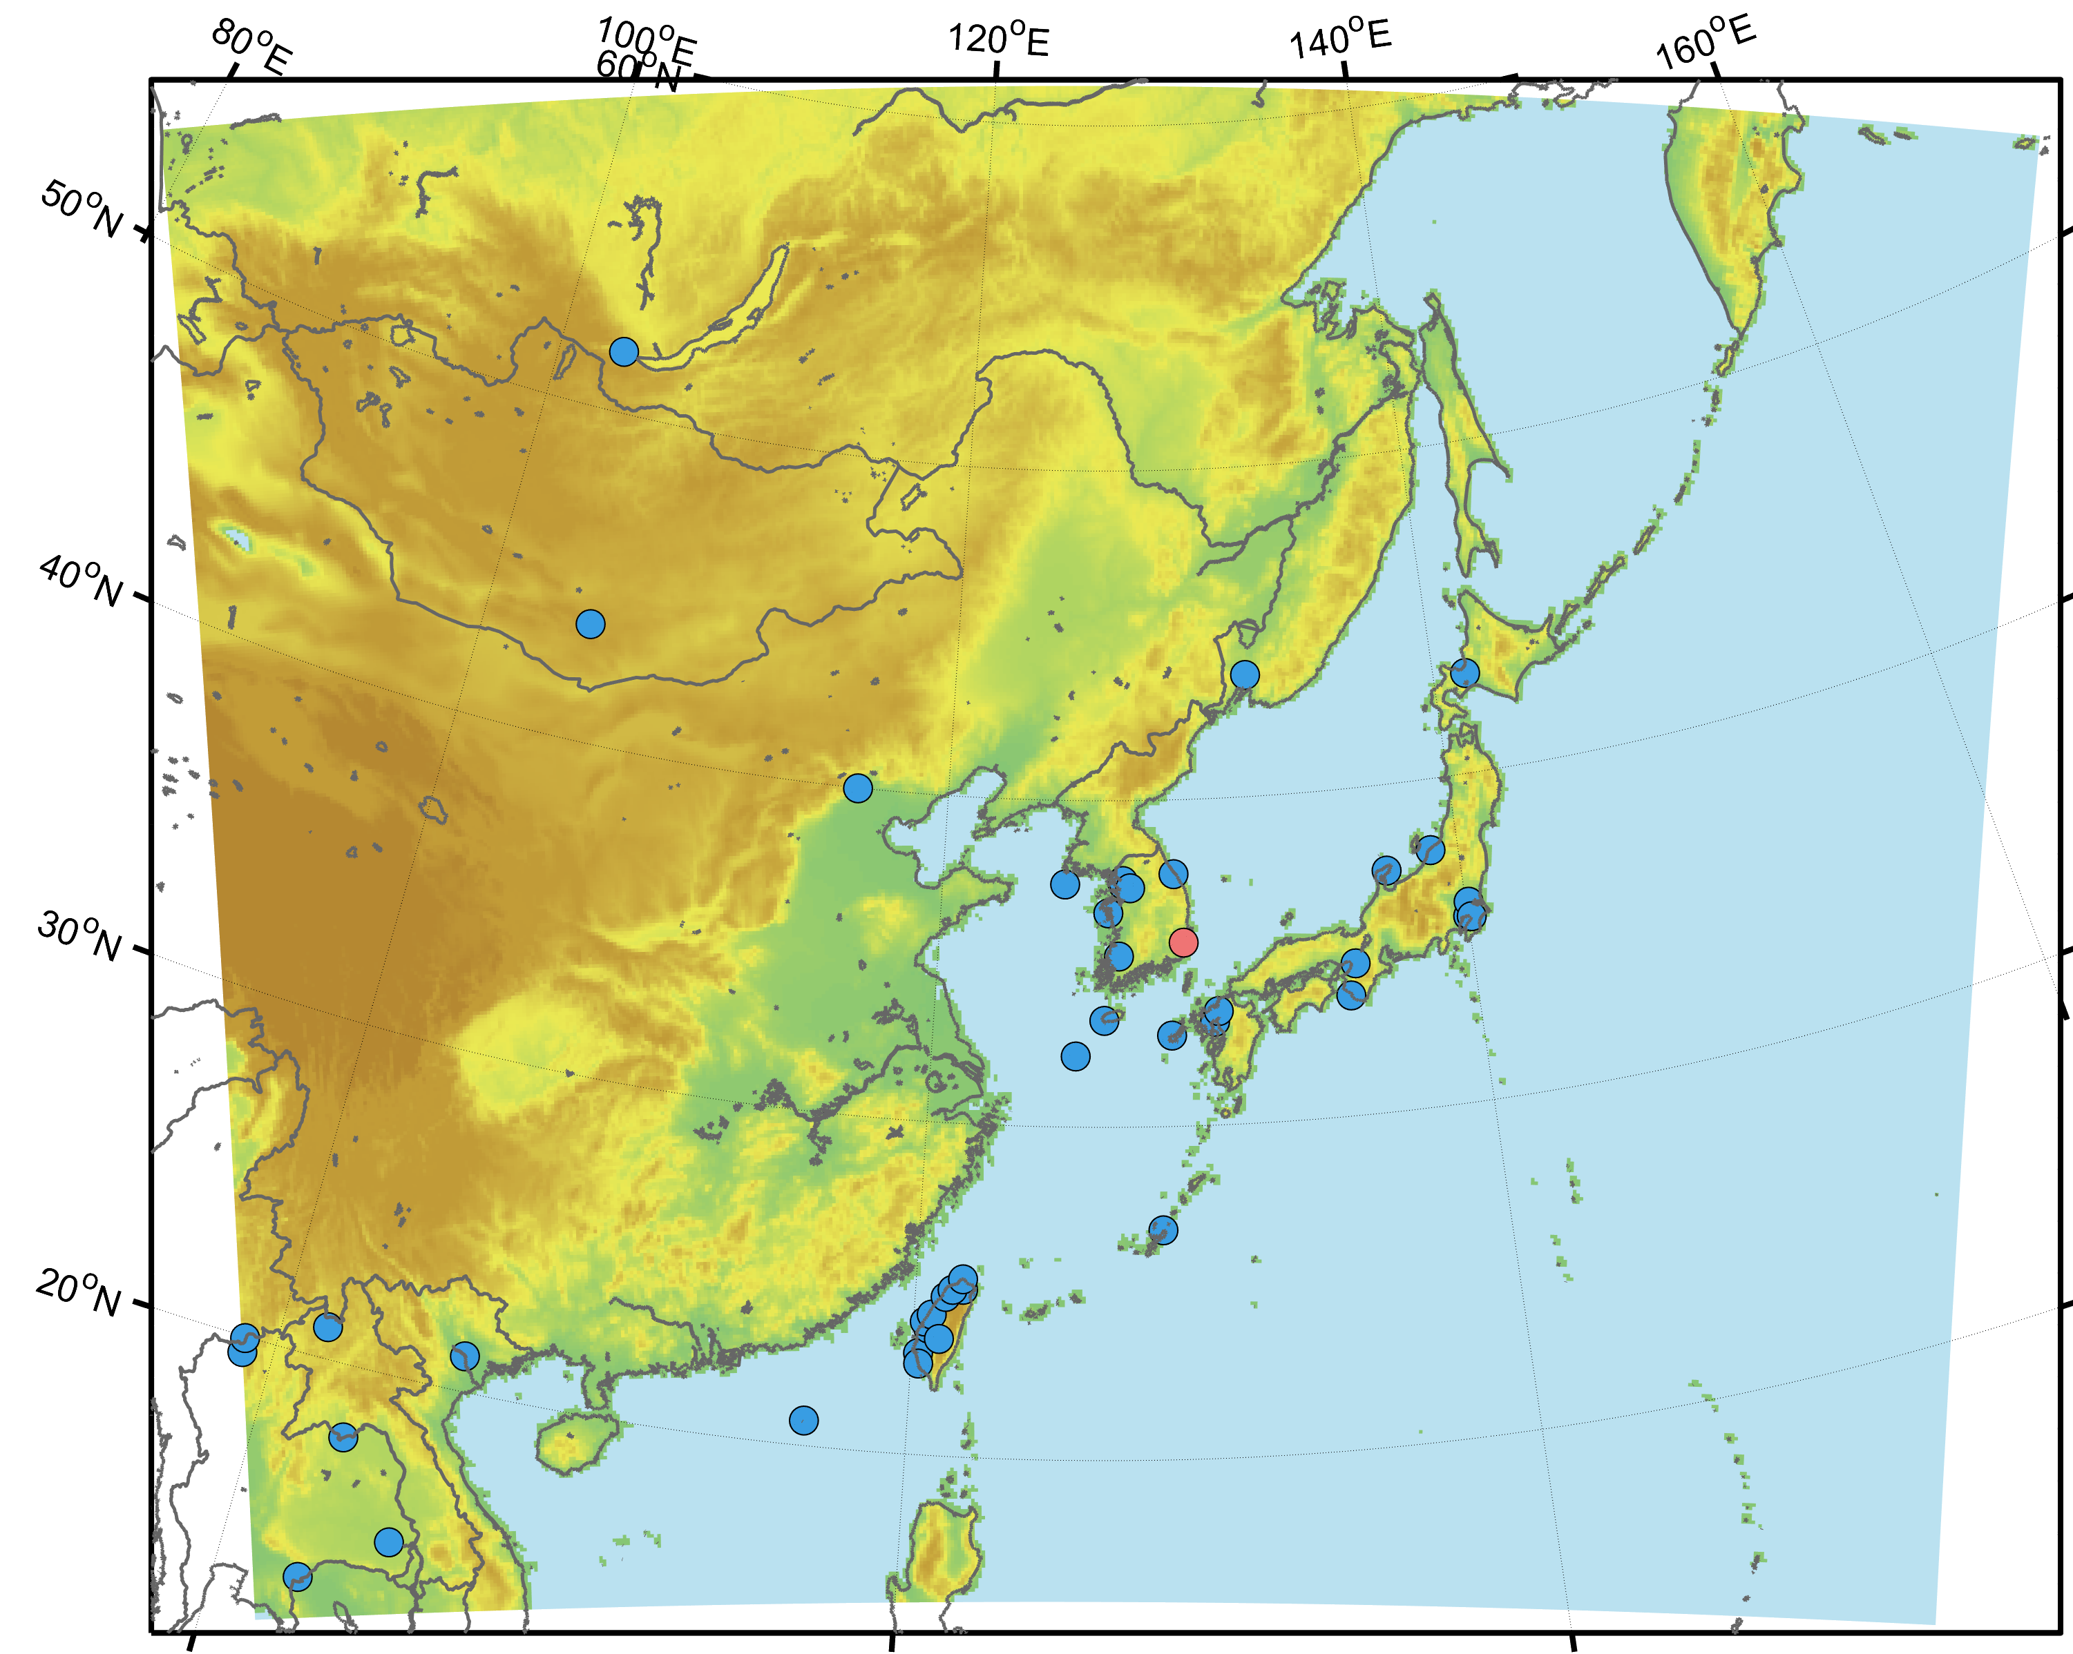
Dataset split and validation
3. Method
shsong15@unist.ac.kr
Dataset split
1
2
3
4
5
6
7
8
9
10
11
…
DOY
DOY: not multiple of 5
DOY :multiple of 5
Training and Test stations
10-fold Cross Validation
Training
Validation
Test
k iterations
Training
Validation
Test
43 stations
Test days
…
Training
Validation
Training
43 stations
1 station
Dataset used during training
1 station
Test station
Dataset not used for training
(unseen data)
1 AERONET station was leaved out for a spatial test
Among the remaining AERONET stations, the data with DOY of multiple of 5 was leaved out for a temporal test
The remaining datasets were used for training the model and conducting 10-fold cross validation.

Slide 11
Scatter plots: LightGBM, 10-fold CV
4. Result
shsong15@unist.ac.kr
DOY
Test (DOY)
Day (BT)
Night (BT)
Day (TOA+BT)
Stations
Training
Test (station)
Random 10-fold CV
Performance comparison
BT model < TOA model (daytime)
daytime < nighttime (by R²)
daytime > nighttime (by error)
The scatter plots of random 10-fold cross validations for the all-day BT model and the daytime TOA model
In the all-day BT model, R² is higher at nighttime than at daytime, however, RMSE and MAE are also higher at night.
Compared to the daytime result of the all-day BT model, the daytime TOA model shows slightly higher performance.

Slide 12
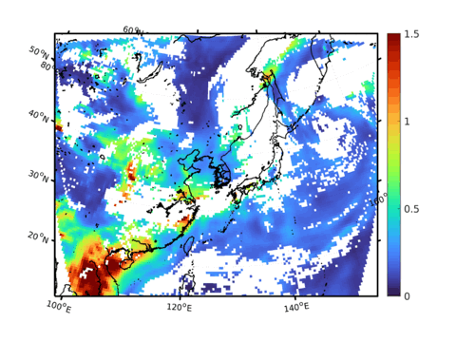
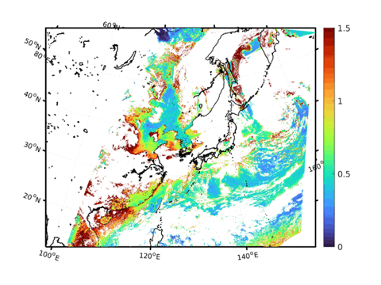
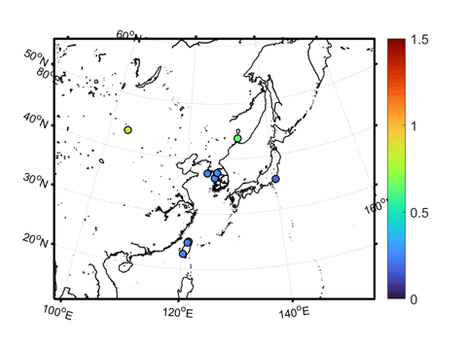
Spatial distribution and comparison
4. Result
shsong15@unist.ac.kr
DOY
All-day BT model
Daytime TOA model
AHI-YAER
Training
Test (DOY)
Stations
Test (station)
16 March, 2021
(DOY 75)
CAMS forecast
GK-2A
AERONET
The comparison of estimated AOD with other AOD products
The estimated AOD showed similar spatial distribution pattern to AHI YAER, CAMS AODs
  AHI-YAER: AHI Yonsei Aerosol Retrieval (YAER) algorithm
  CAMS: Copernicus Atmosphere Monitoring Service (CAMS) global atmospheric composition forecasts
  GK-2A: Level 2 AOD product

Slide 13
Time series comparison on the test station
4. Result
shsong15@unist.ac.kr
DOY
AERONET station: KORUS_UNIST_Ulsan
Training
Test (DOY)
Stations
Test (station)
The time series of LightGBM-based estimated AOD for both model with CAMS and AERONET AOD for December 2020 at AERONET test station (Ulsan, South Korea)
Overall, the LightGBM-based model estimates AOD with similar patterns to AERONET and CAMS AOD
The daytime TOA model shows more similar time series pattern to AERONET AOD than the all-day BT model

Slide 14
Summary and conclusion
5. Conclusion
shsong15@unist.ac.kr
Summary
Hourly AOD at 550 nm was estimated using data from geostationary satellite, GK-2A, through machine learning-based models (i.e., LightGBM)
The estimated AOD was validated with in-situ reference AERONET AOD by k-fold cross validation (random and temporal), and tested using test datasets separated by DOY and station which were not used for training
The estimated AODs during day and night by each scheme were mapped and its spatiotemporal distributions were compared with AHI-YAER, CAMS, GK-2A, and AERONET AOD product
Time series comparison of estimated AOD with CAMS and AERONET AOD was conducted for the in-situ test station
Conclusion
The model using TOA reflectance as input variables (Daytime TOA model) shows slightly better performance than the model without using TOA reflectance (All-day BT model)
The nighttime AOD was estimated based on a machine learning-based model using geostationary satellite data.
The continuous AOD monitoring will be possible during all-day including nighttime in East Asia

Slide 15
Reference
shsong15@unist.ac.kr
Kang, Y., Kim, M., Kang, E., Cho, D., & Im, J. (2022). Improved retrievals of aerosol optical depth and fine mode fraction from GOCI geostationary satellite data using machine learning over East Asia. ISPRS Journal of Photogrammetry and Remote Sensing, 183, 253-268.
Park, S. S., Kim, J., Lee, J., Lee, S., Kim, J. S., Chang, L. S., & Ou, S. (2014). Combined dust detection algorithm by using MODIS infrared channels over East Asia. Remote sensing of environment, 141, 24-39.
Seidel, F. C., & Popp, C. (2011). Critical surface albedo and its implications to aerosol remote sensing. Atmospheric Measurement Techniques Discussions, 4(6), 7725-7750.
shsong15@unist.ac.kr

Slide 16



Thank you
Our Research Group
https://iris.unist.ac.kr
Facebook @UNIST.IRIS
Instagram @iris.unist
Twitter @IRIS_UNIST
Sanghyeon Song (shsong15@unist.ac.kr)

Slide 17
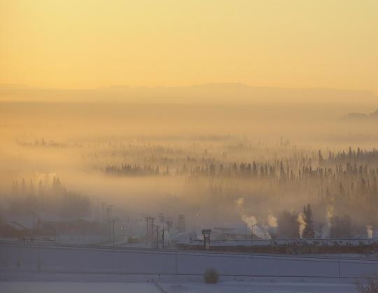
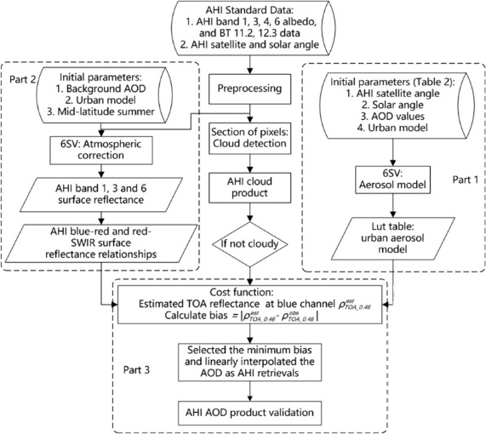
Atmospheric Aerosols
Supplementary
Atmospheric aerosols consist of solid particles and liquid droplets suspended in the air that are originated from both anthropogenic and natural sources
Atmospheric aerosols affect the climate the radiation energy budget of the earth by scattering and absorbing solar radiation and indirectly affect the climate
Aerosols are quantified using the Aerosol Optical Depth (AOD)
  extinction of solar radiation due to aerosols and integrated over the atmospheric column
AOD is one of the important optical parameters for characterizing the distribution of atmospheric aerosols and estimating ground-level particulate matter (PM) concentrations from satellite remote sensing
AOD products are retrieved from top of atmosphere (TOA) reflectance through an atmospheric radiative transfer model (RTM)
https://www.gi.alaska.edu/news/research-aims-understand-chemical-compound-discovered-fairbanks-winter-air
https://caice.ucsd.edu/introduction-to-aerosols/
Wang, L., Yu, C., Cai, K., Zheng, F., & Li, S. (2020). Retrieval of aerosol optical depth from the Himawari-8 advanced Himawari imager data: Application over Beijing in the summer of 2016. Atmospheric Environment, 241, 117788.

Slide 18
Aerosol Monitoring of East Asia
Supplementary
In East Asia, continuous and frequent aerosol monitoring is highly required due to large-scale natural emissions and artificial aerosol emissions:
  Natural source: dust, volcano, smoke, plants
  Artificial source: industry, urban, transport, agriculture
Asian dust
https://climate.nasa.gov/news/3065/nasa-funded-network-tracks-the-recent-rise-and-fall-of-ozone-depleting-pollutants/
Geostationary satellite provides temporally continuous AOD retrieval over a specific area, however, the observation is only limited to the daytime.
  Daytime: satellite-based AOD is retrieved by attenuation of solar radiation
  Nighttime: multispectral satellite sensors do not provide AOD products due to the absence of solar radiation
Currently, there is no operational algorithm for retrieving nighttime AOD from geostationary satellite with full-time coverage over specific region
1 Feb. 2021, UTC 08
GK-2A RGB image
GK-2A AOD

Slide 19


Supplementary
GK-2A L1B data
TOA reflectance
Decoupling surface and aerosol reflectances
Atmospheric aerosols …
  increase TOA reflectance
  reduce BT
Solar radiation
TOA reflectance
surface reflectance
background
contribution of aerosol
scattering
-
absorption
TOA reflectance
minimum TOA reflectance within the recent 30 days
=
TOA reflectance contributed by aerosol
BT
-
maximum BT within the recent 30 days
=
BT contributed by aerosol
BT differences and ratios
BT difference between two wavelength channels has been used in dust detection methods.
BT ratio between two wavelength channels has been used to distinguish between the dust and surface signals more accurately
Notes:
atmospheric aerosol increases TOA reflectance
Seidel, F. C., & Popp, C. (2011). Critical surface albedo and its implications to aerosol remote sensing. Atmospheric Measurement Techniques Discussions, 4(6), 7725-7750.
BT, BTD, BTR
Park, S. S., Kim, J., Lee, J., Lee, S., Kim, J. S., Chang, L. S., & Ou, S. (2014). Combined dust detection algorithm by using MODIS infrared channels over East Asia. Remote sensing of environment, 141, 24-39.

Slide 20
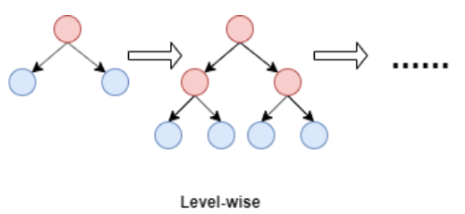
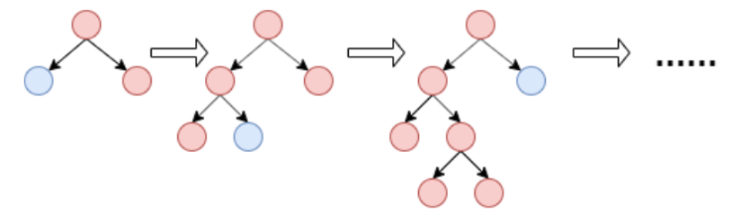
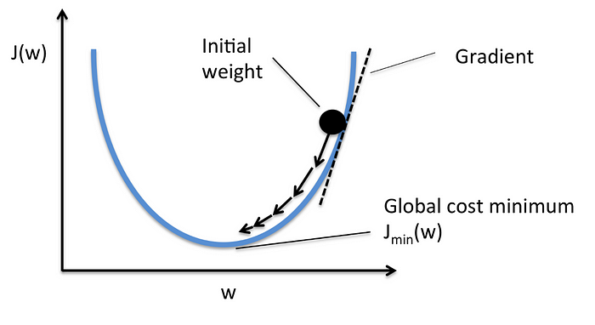
Machine Learning Model
Supplementary
LightGBM (Light Gradient Boosting Machine)
A tree-based ensemble learning algorithm based on the Gradient Boosting framework.
While other tree-based machine learning models grow trees horizontally (level-wise tree growth), LightGBM grows trees vertically (leaf-wise tree growth)
LightGBM features …
  Gradient-based One-Side Sampling (GOSS)
    The samples with large gradients are retained, while samples with small gradient are randomly selected and given constant weights
  Exclusive Feature Bundling (EFB)
    The mutually exclusive features in sparse features are bound together to reduce the number of features
Level-wise growth: XGBoost, CatBoost
Leaf-wise growth: LightGBM
Gradient descent graph
https://towardsdatascience.com/what-makes-lightgbm-lightning-fast-a27cf0d9785e

Slide 21
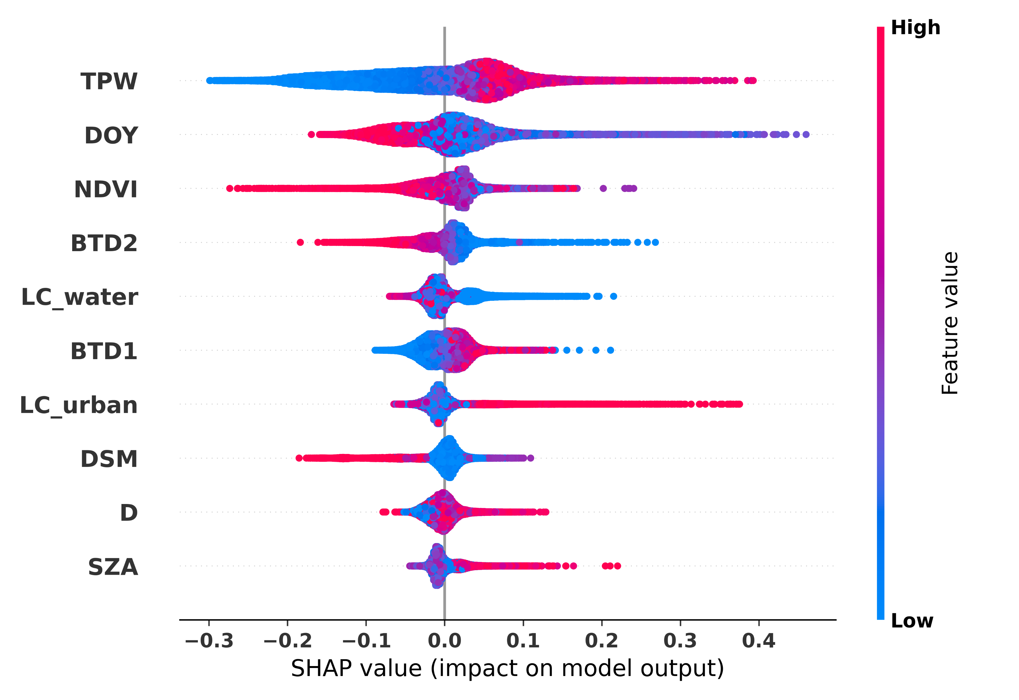
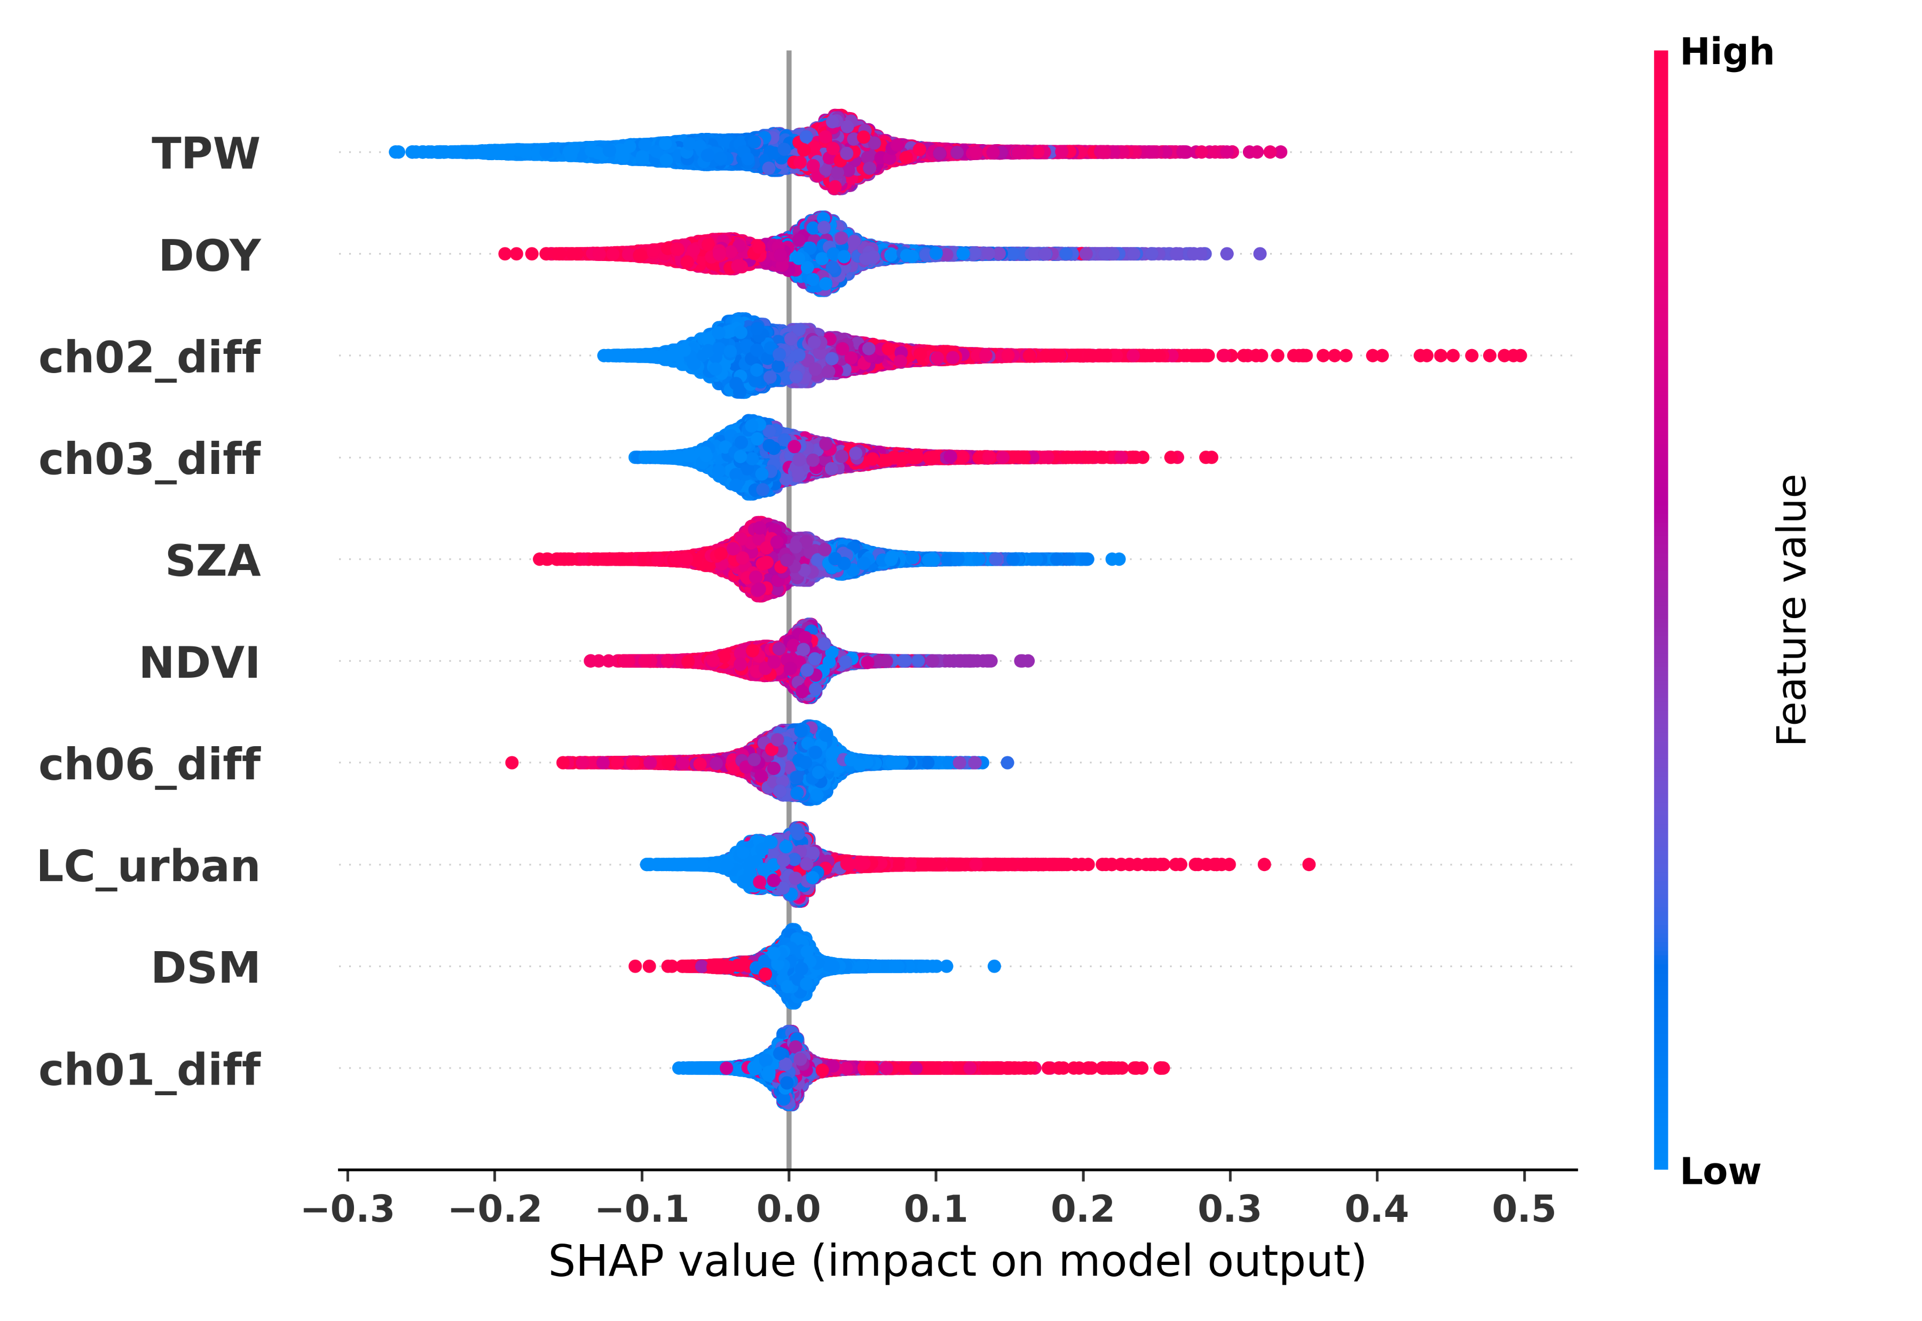
Model interpretation: LightGBM, SHAP
Supplementary
All-day BT model
Daytime TOA model
ch13 - ch15
ch07 - ch13
SHAP summary plots with feature importance and contribution for the all-day model with BT as input variables and the daytime model with additional TOA reflectance as input variables for LightGBM model. (only top-10 variables)
TPW and DOY has a dominant contribution to estimating the AOD
In the all-day BT model, variables of BT differences were important, which are usually used for dust aerosol or cloud detection
The additionally used TOA reflectance difference variables, which represent the aerosol reflectance, were important variables that highly contribute to the model result.

Slide 22
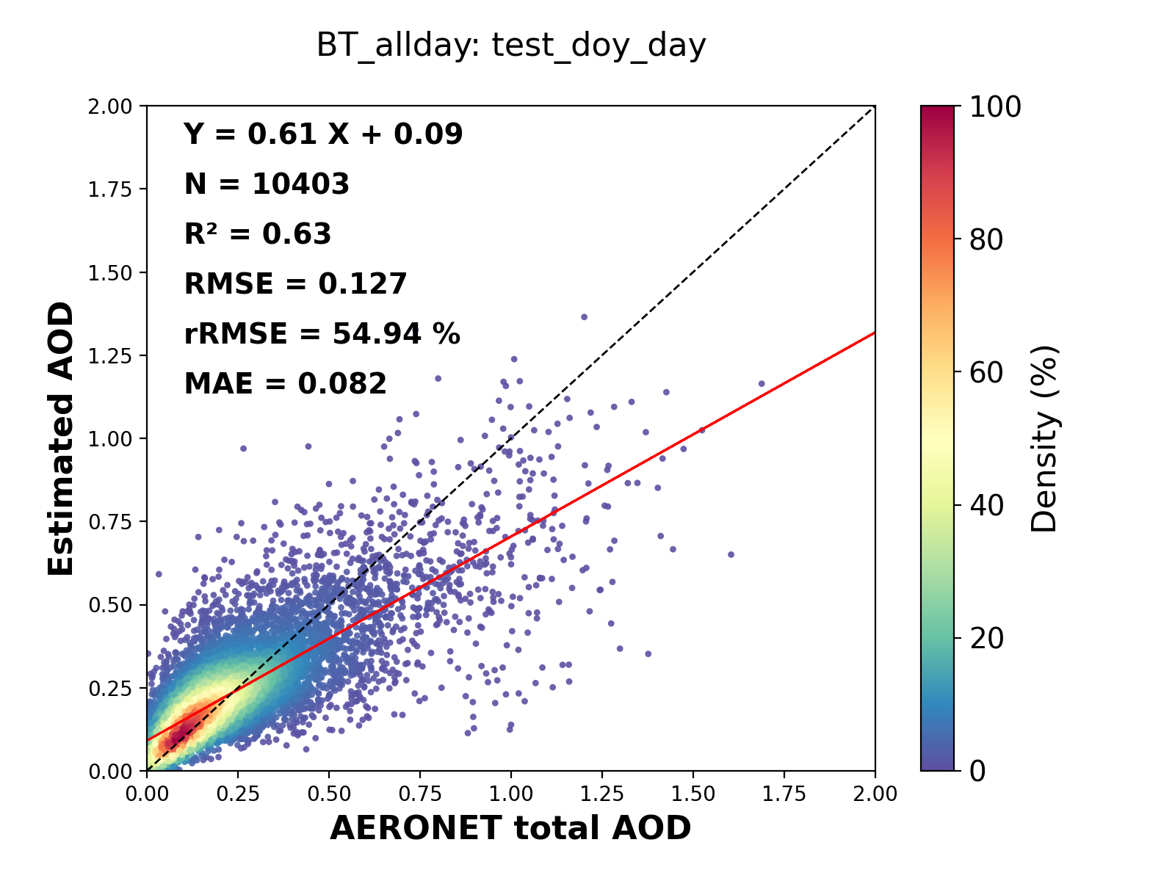
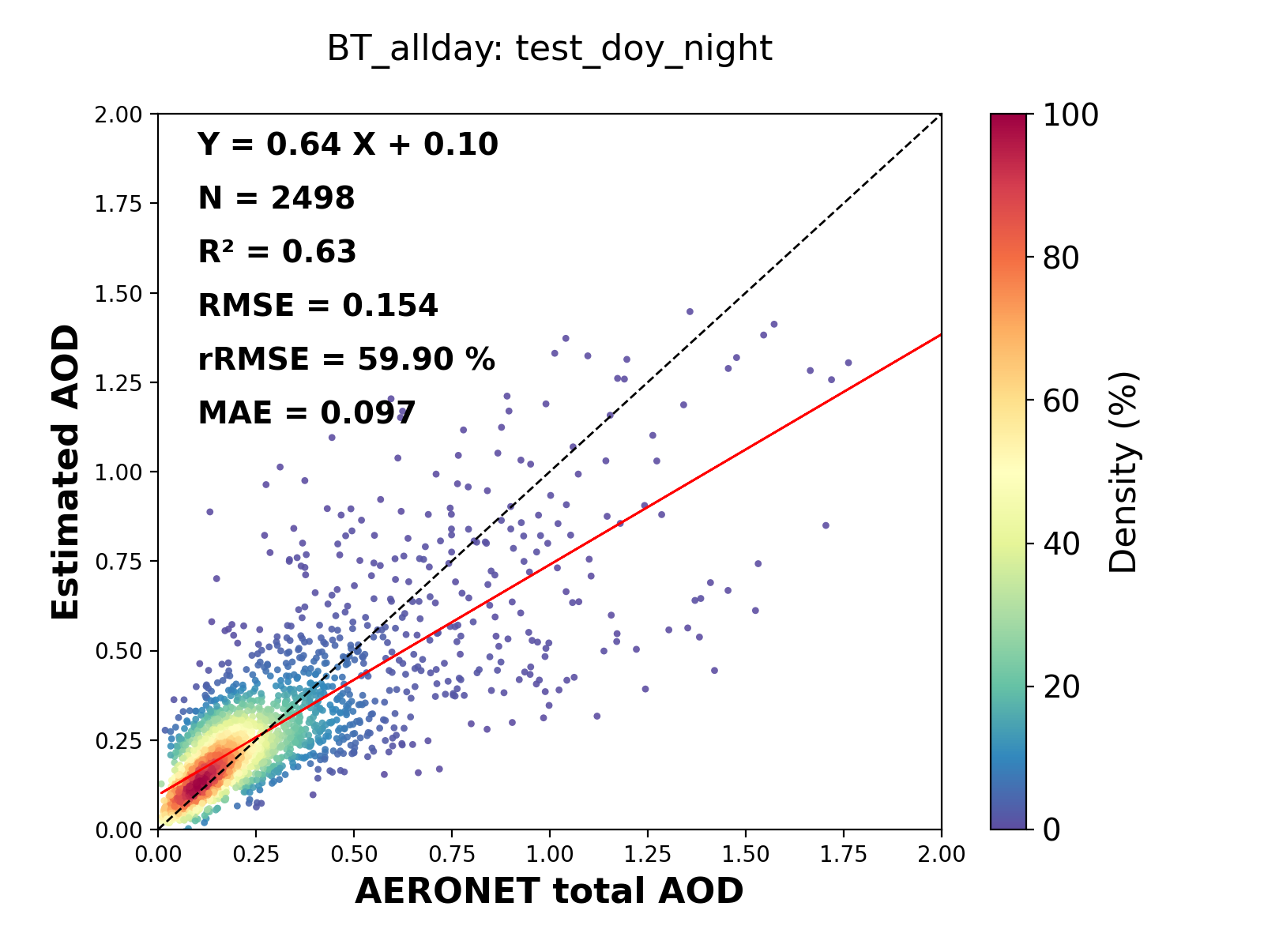

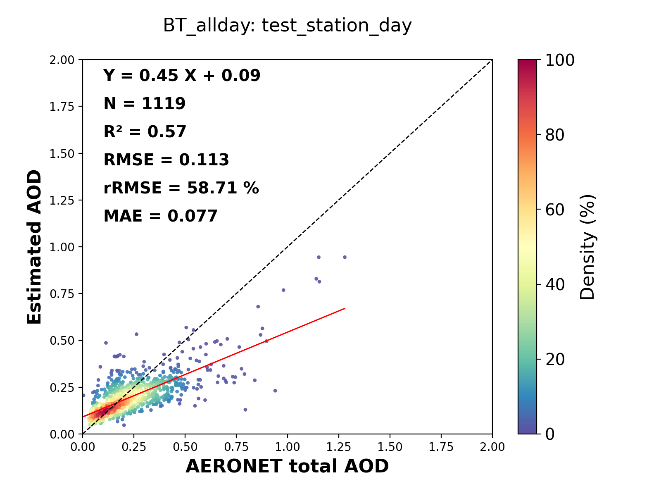
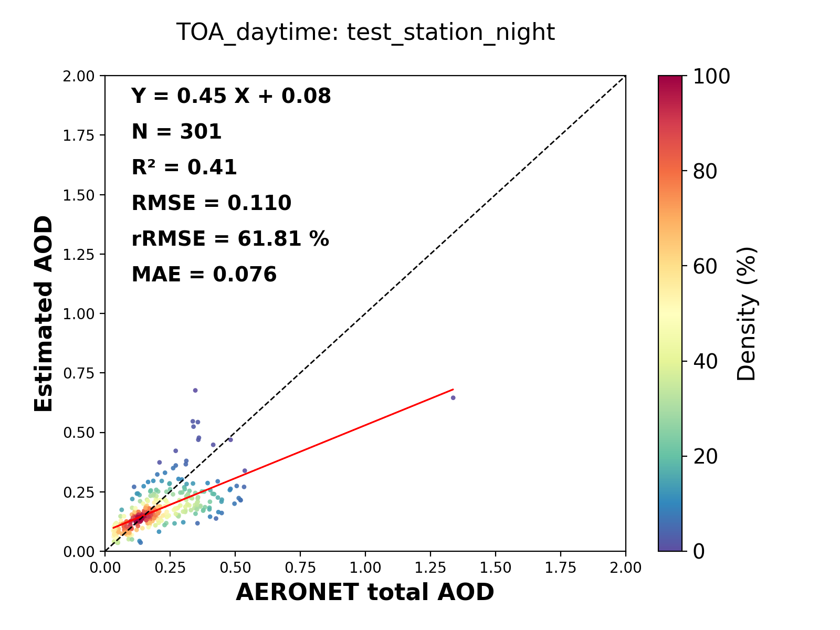
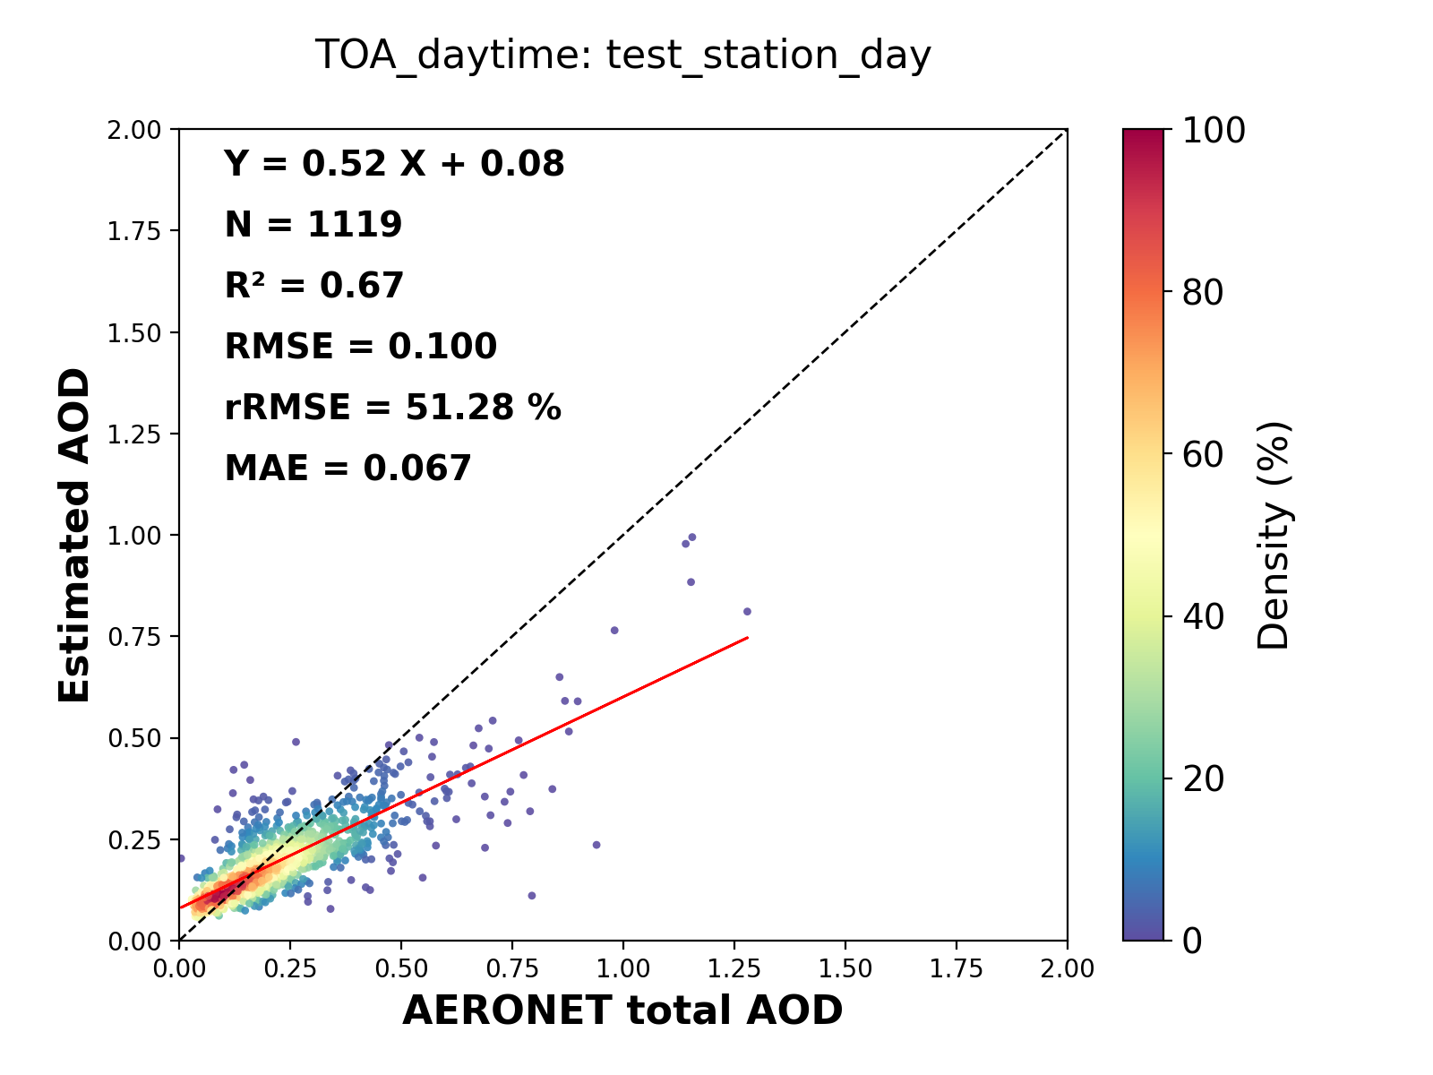
Scatter plots: LightGBM, Tests
Supplementary
DOY
Day (BT)
Night (BT)
Day (TOA+BT)
Training
Test (DOY)
Stations
Test (station)
Test (DOY)
Performance comparison
temporal test > spatial test
BT model < TOA model (daytime)
daytime > nighttime
Test (station)
The scatter plots of test results (for test dataset by DOY and station) for the all-day BT model and the daytime TOA model
For the both tests, the daytime result is better than the nighttime, and during the daytime, daytime TOA model shows better performance than the all-day BT model.

