Slide 1
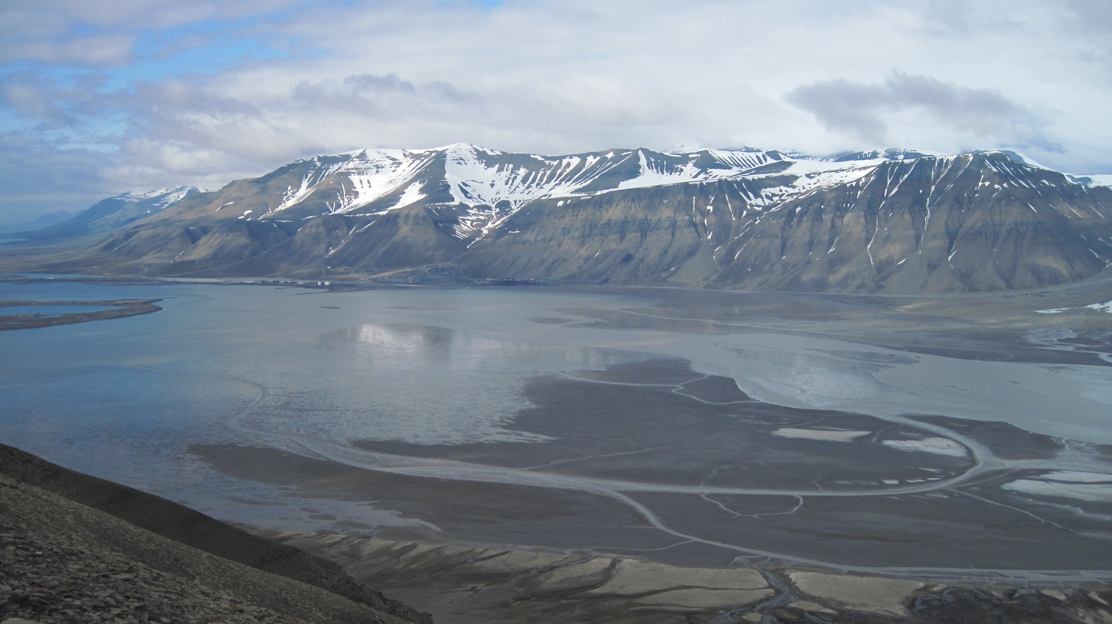
Palaeo-coastal and vegetation response to a warming high Arctic
- using the Paleocene – Eocene in Svalbard, Arctic Norway as a laboratory for future change
Maria Ansine Jensen¹, Mads Jelby², Malte Jochmann¹, and Chris Marshall³
1) University Centre in Svalbard - UNIS, Norway 2) University of Bergen, Norway, 3)University of the Highlands and the Islands, UK
SSP2.1 - Integrated Stratigraphy - Reconstructing environmental change across the Earth System

Slide 2
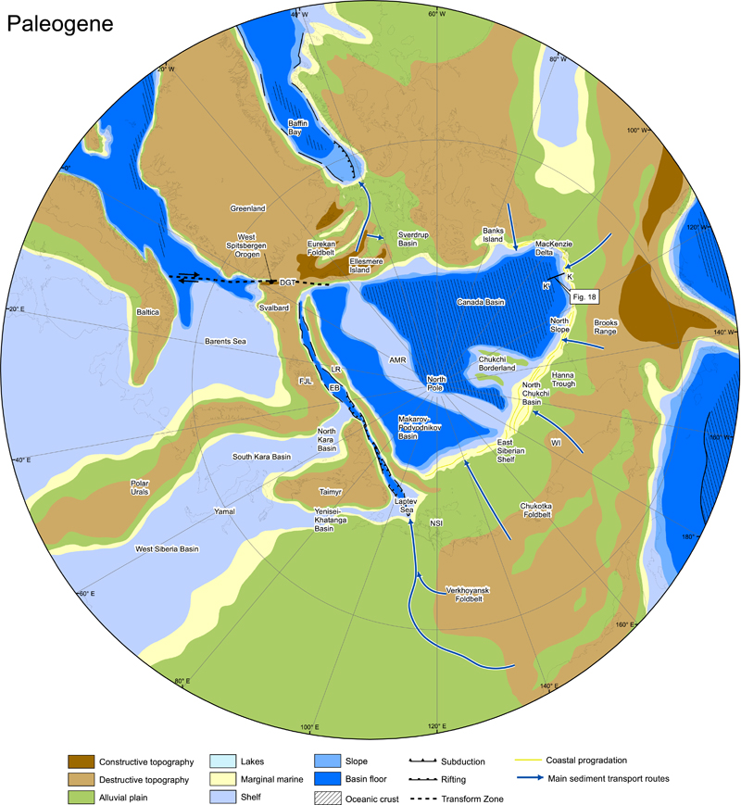
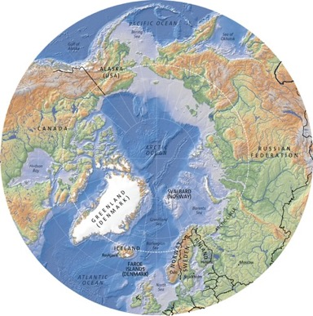
Present
Svalbard in the Palaeogene:
Palaeolatitude c. 75 degrees N
Associated with an emerging orogen (Eurekan)
Paralic to shallow marine environment
(Map: Hugo Ahlenius,
UNEP/GRID-Arendal)
(Sømme et al., 2018)

Slide 3
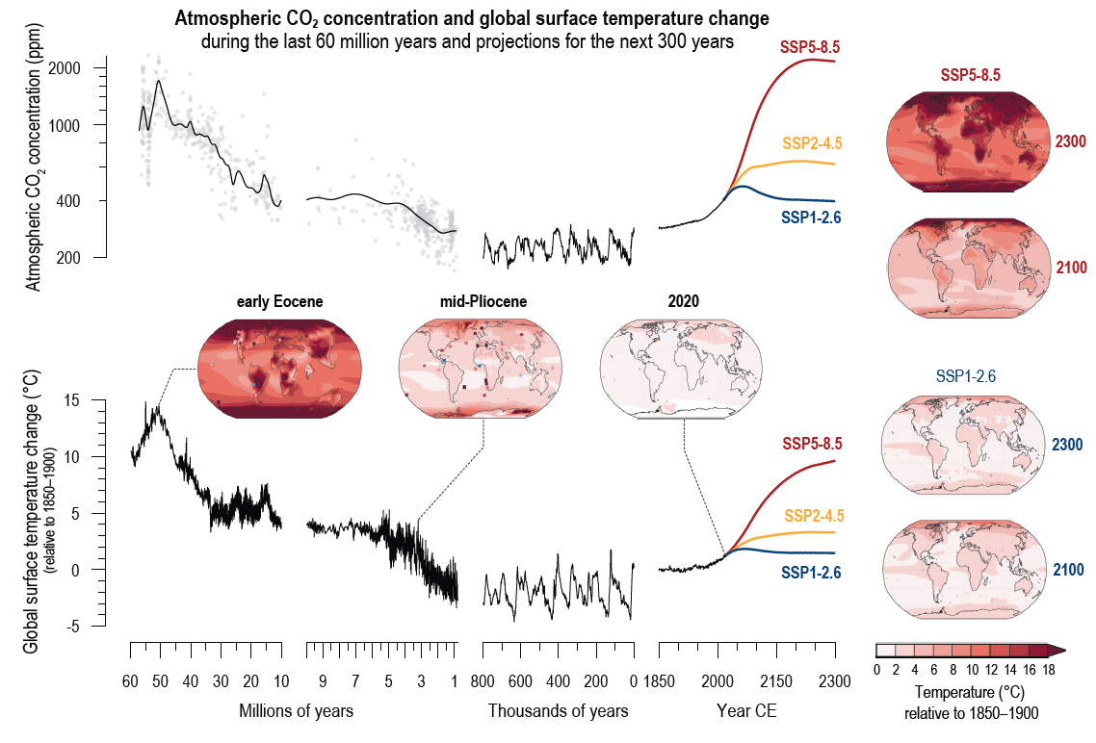
(IPCC AR6 Technical Summary)

Slide 4
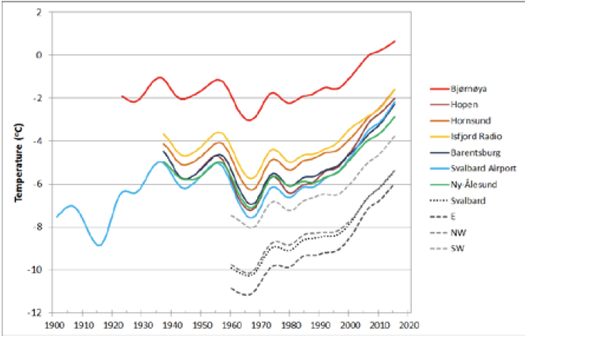
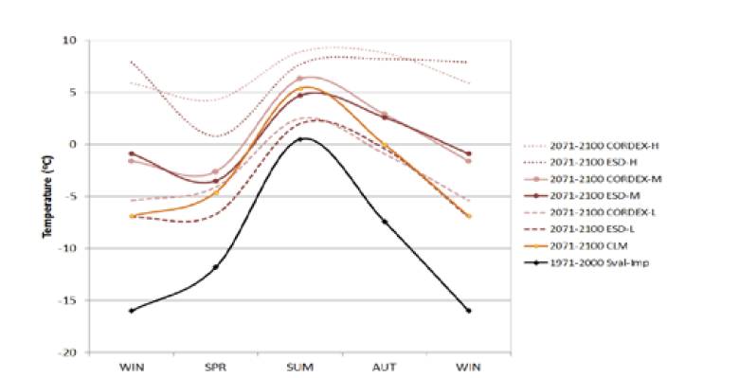
Present climate change in Svalbard
4,0°C increase in average temperature 1971-2017
7,3°C increase in winter temperatures 1971-2017
Global average temperature increase for same time: 0.87°C.
Projected 2071 – 2100 (seasonal temperatures)
For emission scenario RCP 8.5
Observed (annual mean temperatures)
(Hanssen-Bauer et al. 2019)

Slide 5
Palaeocene- Eocene deposits –Central Tertiary Basin
Continental - paralic
Shoreface
Offshore
2,3 km
thickness
PETM
(Marshall 2013)
(modified from Steel 1985)

Slide 6
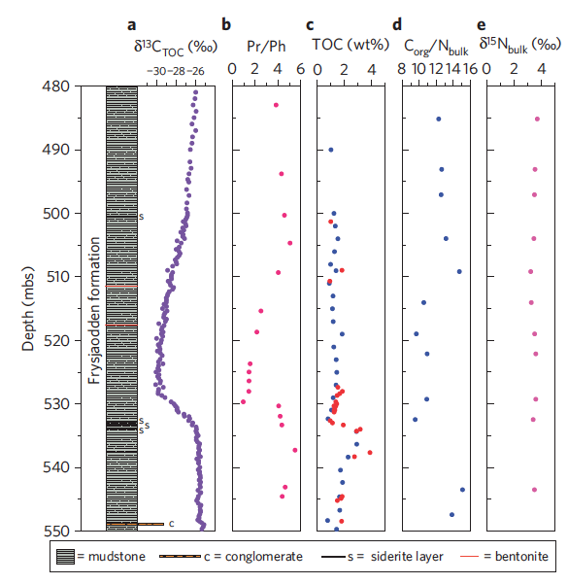
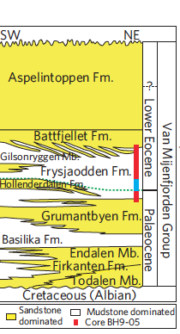
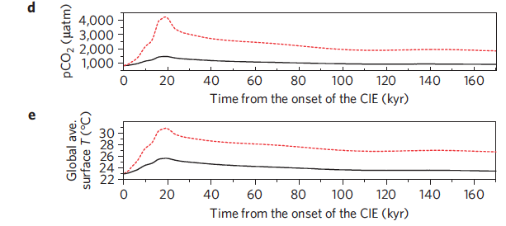
Palaeoclimate:
Carbon isotope curve from PETM
Cui et al., 2011
Model results of carbon release rates (Cui et al. 2011)

Slide 7
Glendonites
Other palaeoclimate indicators
CLAMP analysis of Eocene leaves
CLAMP analysis of leaves
(Clifton 2012)
19.5°C
Warm month mean
PETM: C-isotopes, geochemistry,
Microfossils (Cui et. 2011, 2021; Dypvik et al., 2011;
Nagy et al., 2013)
Growing season length
11.7°C
Mean annual temperature
7
months
C- isotopes & charcoal,
geochemistry from coal
Cold month mean
3.8°C
(Spielhagen & Tripati, 2009)
(Clifton 2012)

Slide 8
Age control - Bentonites
Jones et al 2017

Slide 9
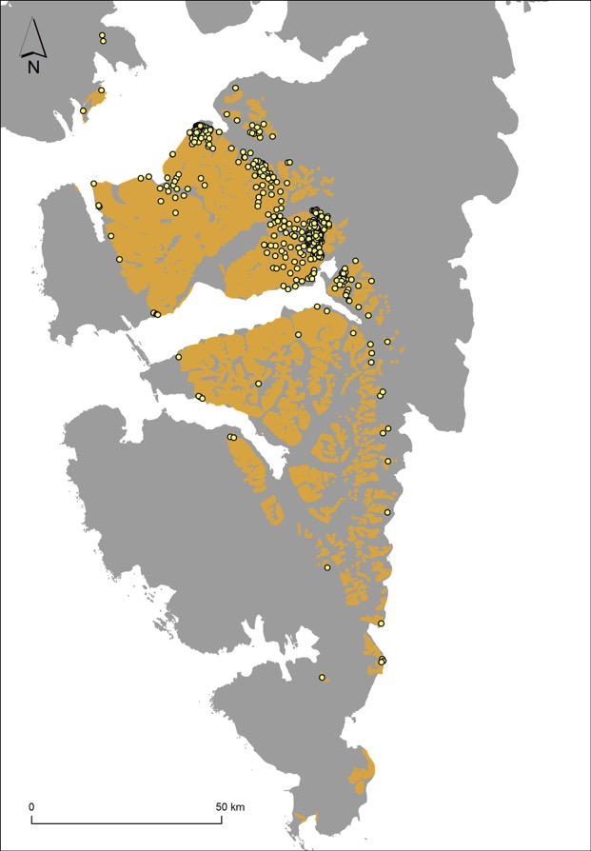
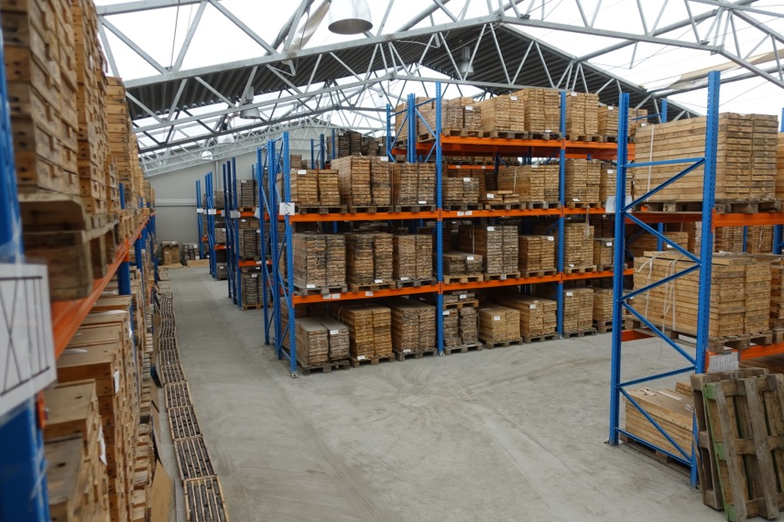
Palaeolandscape control
More than 500 exploration and technical drill cores from
coal exploration combined with outcrop access over a 150 km transect.
Detailed archive of a coastal landscape in a warm Arctic under
changing sea level

Slide 10
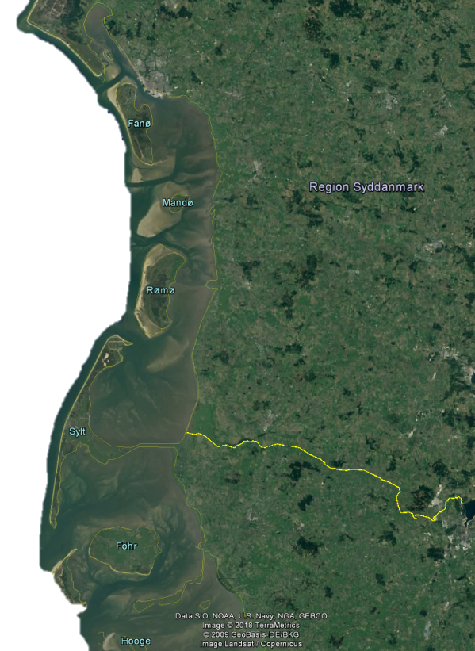
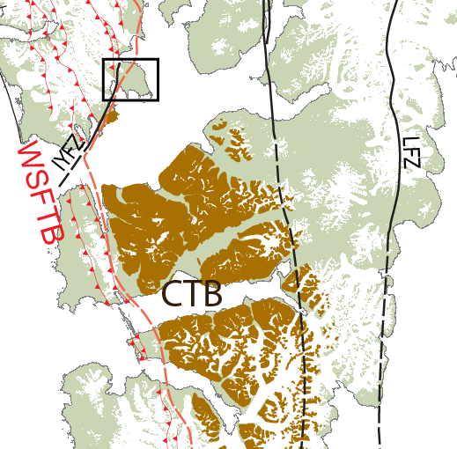
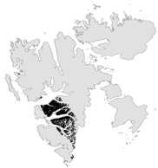
Todalen Member (Firkanten Fm)
bentonite as an isochron gives excellent correlation
Sylfjellet
Longyearbyen
Barentsburg
Sveagruva

Slide 11
Example of high resolution sea level barrier resconstruction Endalen Mb – Adventdalen area
(Grasdal, 2018)

Slide 12
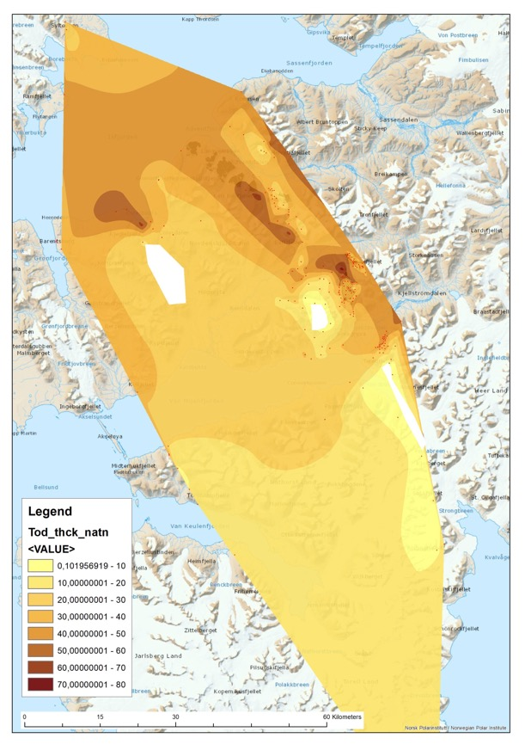
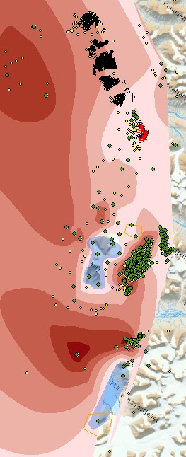
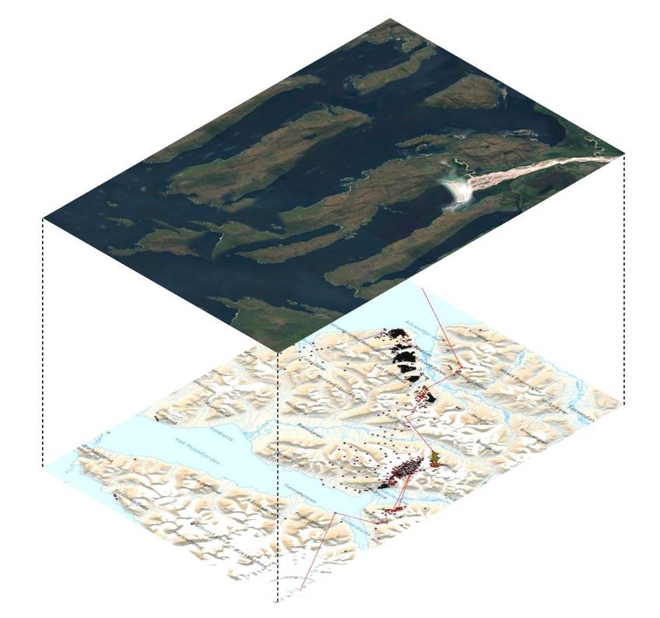
Thickness maps, bentonite as an isochron and high resolution lateral control yields palaeotopography
Detailed understanding of where landform elements develop (peatlands, rivers, barrier island and how the coastline develop during transgression
Todalen Member
Above bentonite
Data from ongoing PhD project (Jochmann et al. in prep)

Slide 13
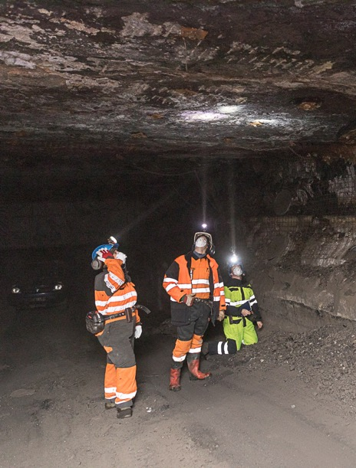
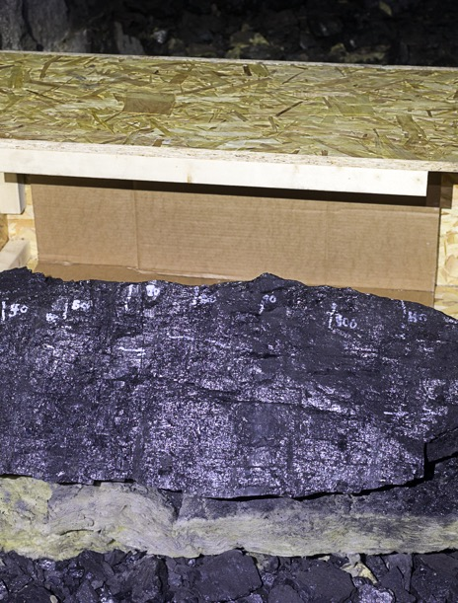
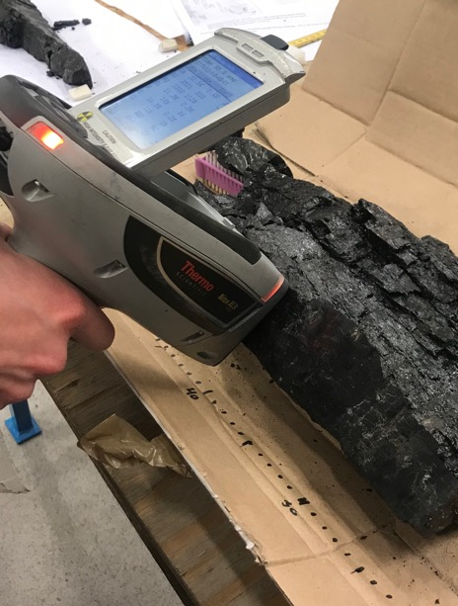
Coal seams as a palaeoclimate archive:

Slide 14
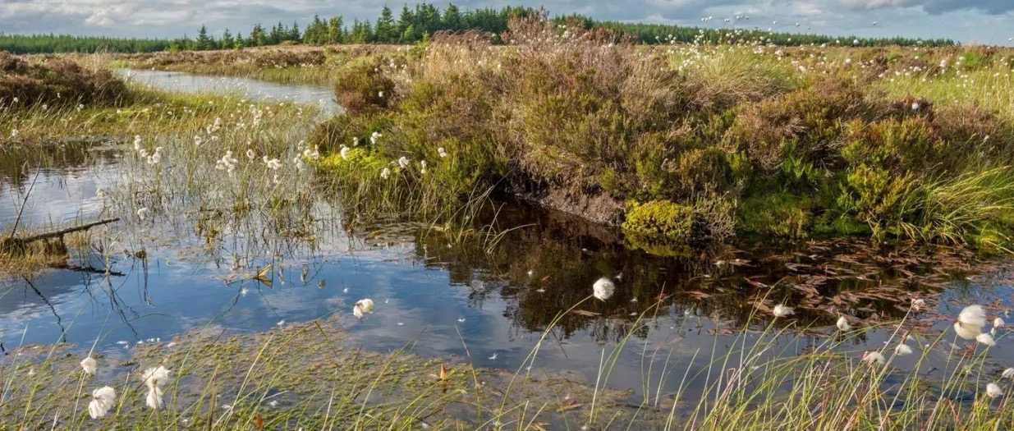
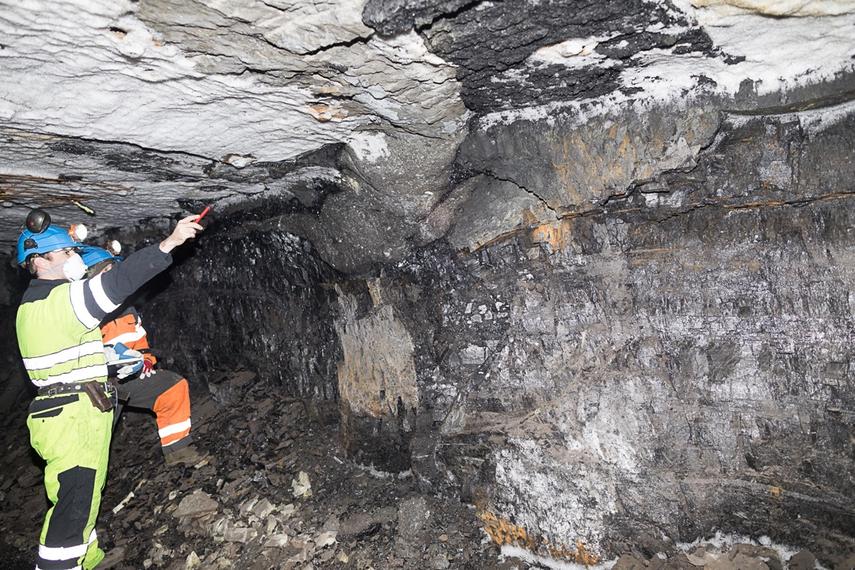
Peat – a hydrology sensitive carbon storage
and «passive» storage of atmospheric
particles
(Photo:https://www.northumberlandnationalpark.org.uk)

Slide 15
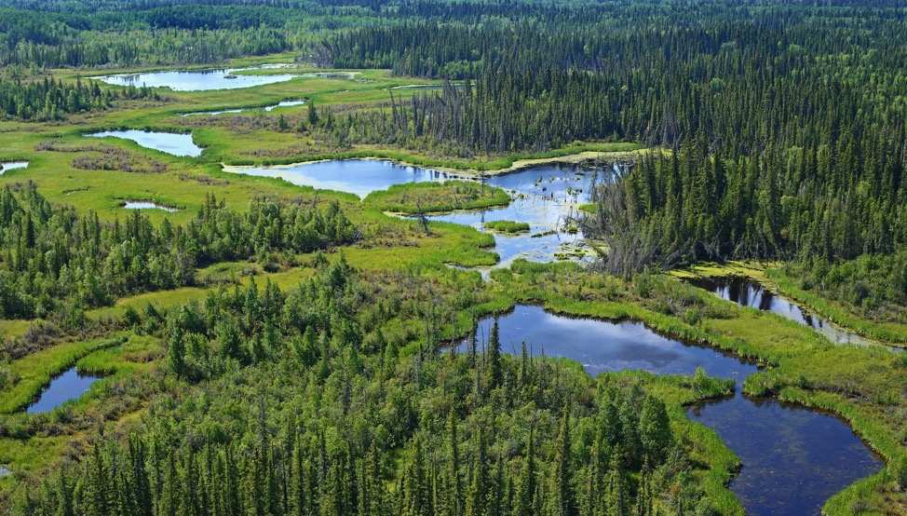
Carbon accumulation rates in Holocene peat and variation with latitude
(Large and Marshall 2015)

Slide 16
Age Model
(Large and Marshall 2015)
Age model: 1 m coal seam c. 80 -110 kyr

Slide 17
Dust/winds
Vegetation/water
δ¹³C generally corresponds with Al and Ti contents within the coal
Clear trends within data potentially reflecting orbital cycles
Less negative values of δ¹³C appears to correspond with elevated Al contents linked previously to drier conditions
Less negative values of δ¹³C might relate to increased water stress within the peatland during these periods
Further work required to compare with the marine δ¹³C record to examine whether the trends seen sample atmospheric CO₂
Dry

Slide 18
Closely spaced drill cores allow for comparing high resolution palaeoclimate data directly to adjacent siliciclastic landscape
(Marshall et al. In prep)

Slide 19
Conclusions
The Central Tertiary Basin of Svalbard is a unique laboratory for studying climate change impact on a warm Arctic
Landscape.
Palaeotopographic control and palaeovegetation distribution allows for studying surface response to temperature and
precipitation change during hyperthermals
Coal seams in the lower part of the succession (Selandian) are a valuable source of isotope data, inorganic atmospheric
particles and charchoal levels
Future work
Sampling for c-isotopes throughout the succession will be done this year, within our current project
A field campaign this summer will focus on coastal response to the palaeoclimate reconstruction from the coal seams
We are open to collaboration

