Slide 1
EGU23-12471
Mid Infrared analysis of Jupiter South Pole from JWST MIRI-MRS observations: Thermo-chemical disturbances caused by auroral activity
Pablo Rodriguez-Ovalle¹, Thierry Fouchet¹, Imke De Pater², Dominique Bockelee-Morvan¹, Emmanuel Lellouch¹, Manuel Lopez-Puertas³, Prisca Briens¹, James Sinclair⁴, Ricardo Hueso⁵ and the ERS-1373 Team
LESIA, Observatoire de Paris, Meudon, France
University of Berkeley, California, USA
Instituto de Astrofísica de Andalucia, Granada, Spain
NASA - Jet Propulsion Laboratory, Pasadena, USA
Universidad del Pais Vasco UPV-EHU, Bilbao, Spain

Slide 2
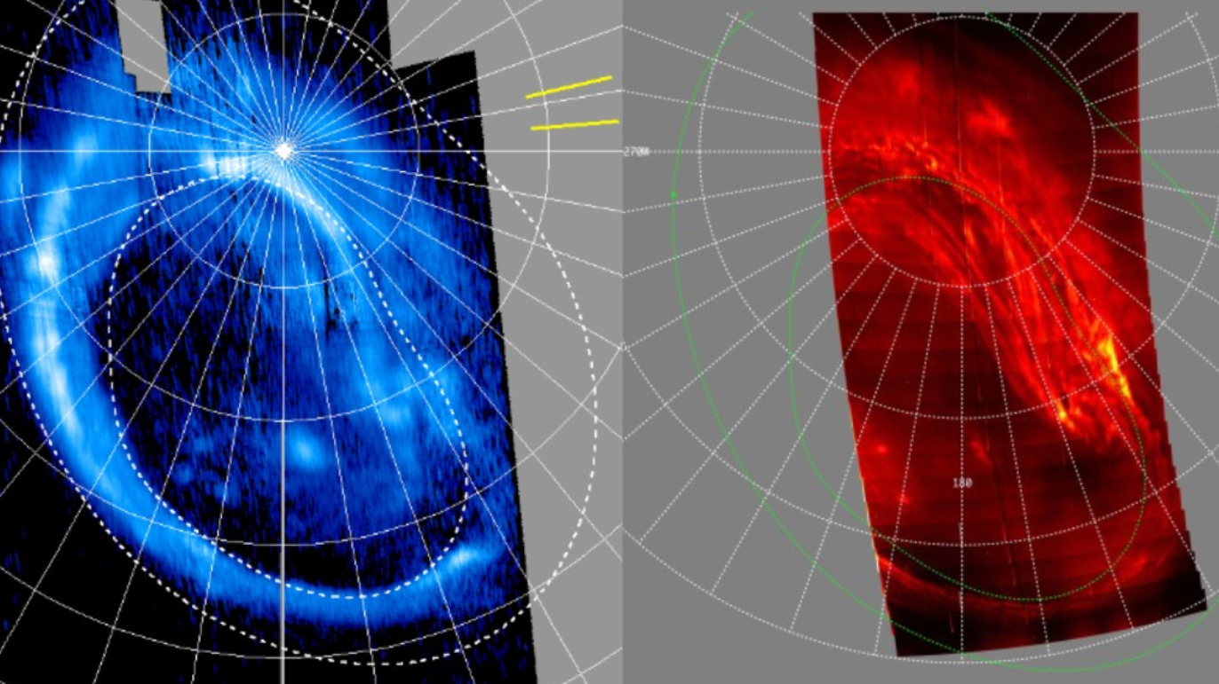
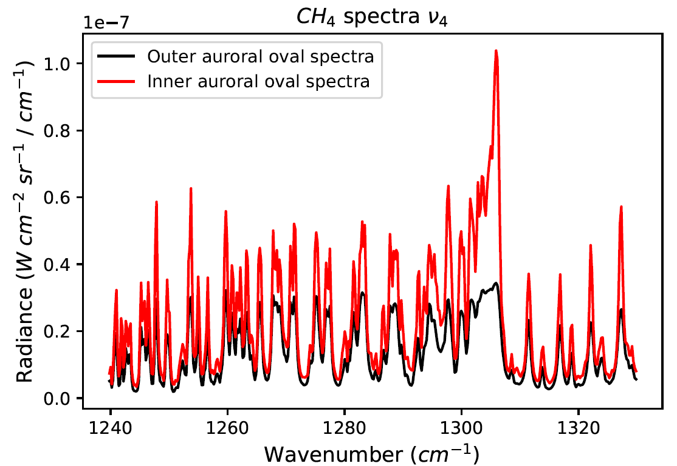
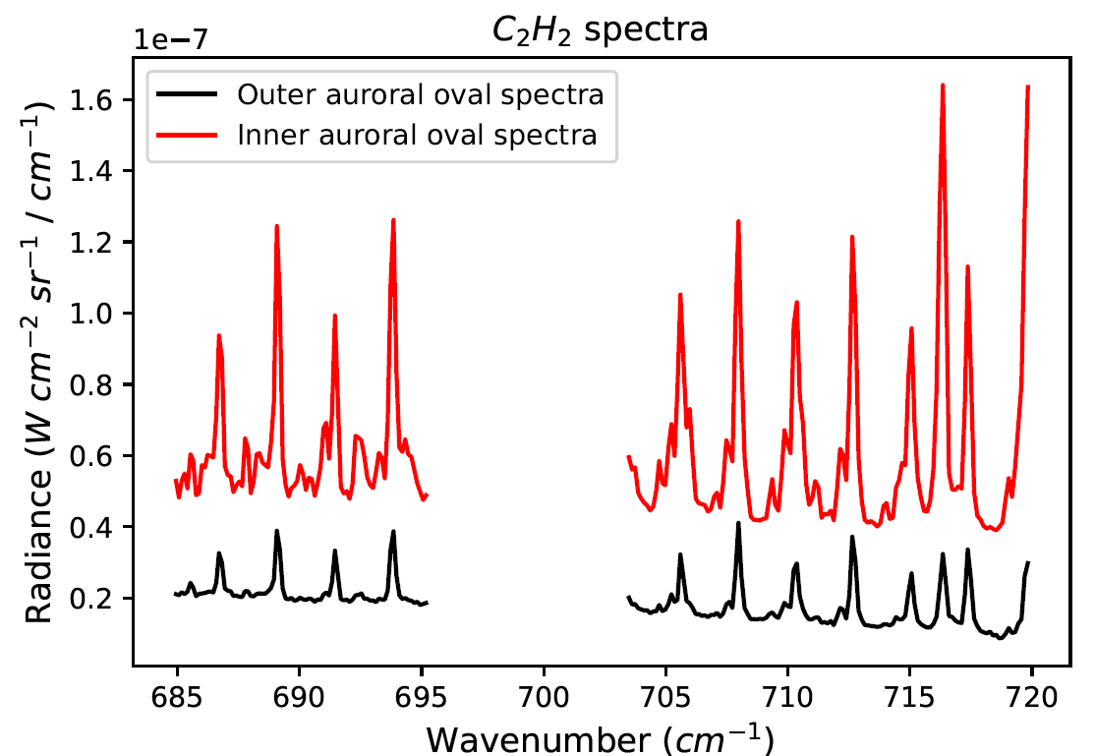
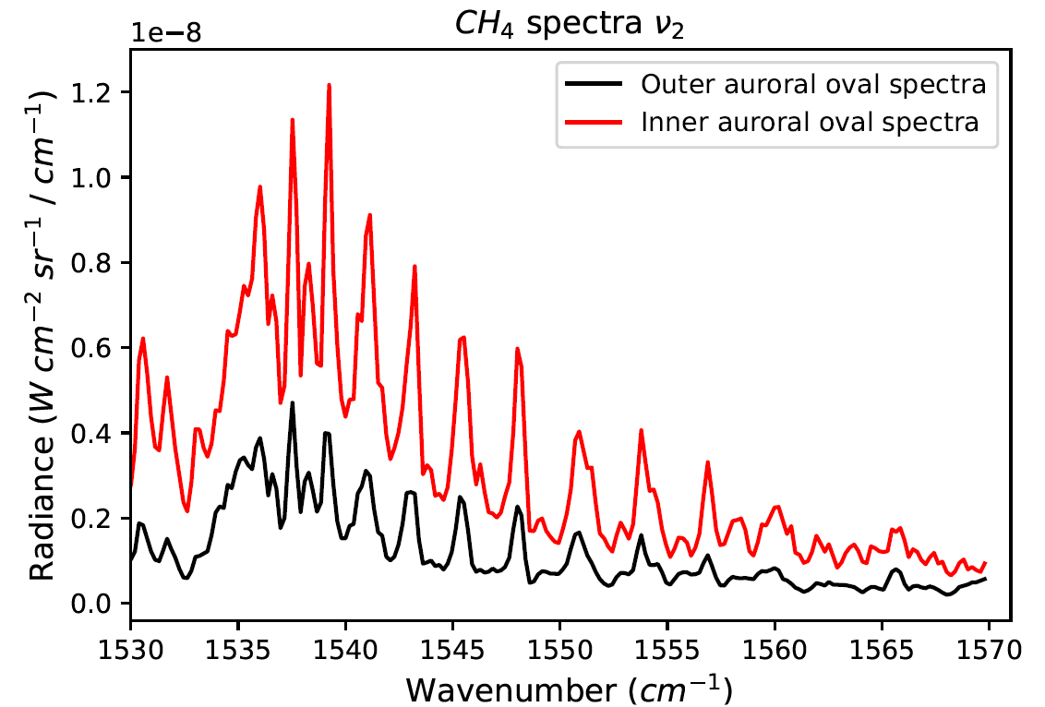
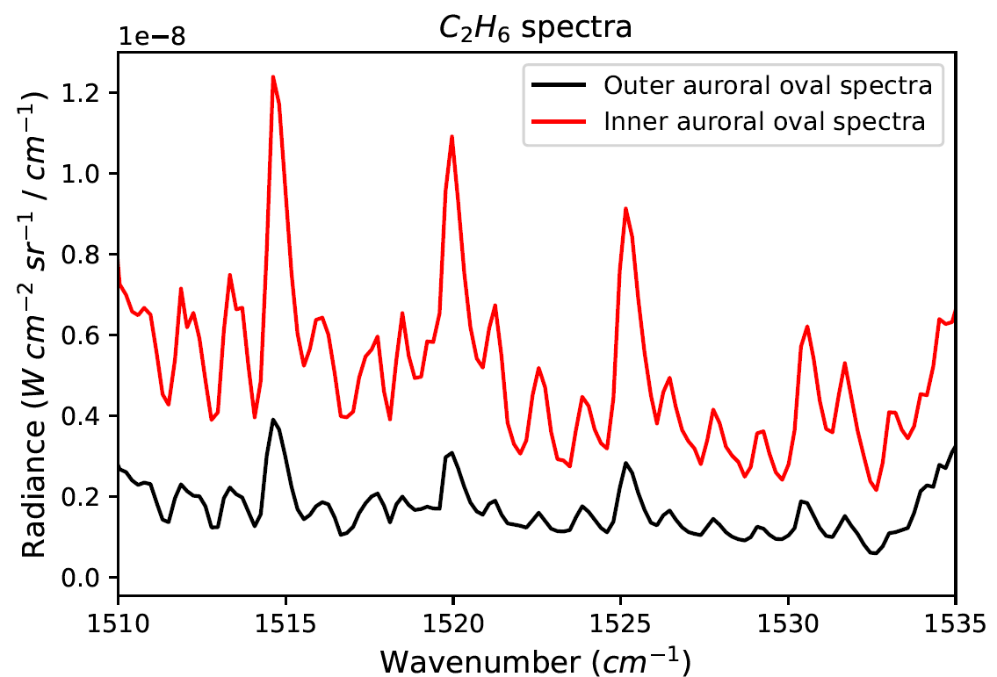
EGU23-12471
The auroral region of Jupiter shows an increase of the radiance un UV, NIR and MIR.
The auroral region shows a thermal hotspot, and a variation of hydrocarbon abundances due to the effect of the ionic chemistry.
JWST MIRI-MRS observed the south polar region for the first time on 24th December 2022, acquiring spectra from 5 to 18 microns (MIR)
0.1 µm
3.3 µm
Gérard, J. C. et al., 2018
Rodriguez-Ovalle et al., 2023 (in prep)
7.6 µm

Slide 3
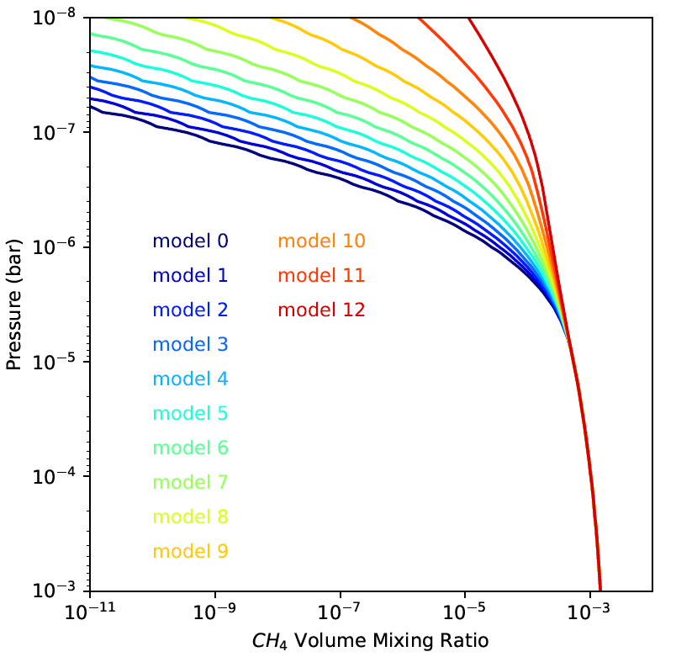
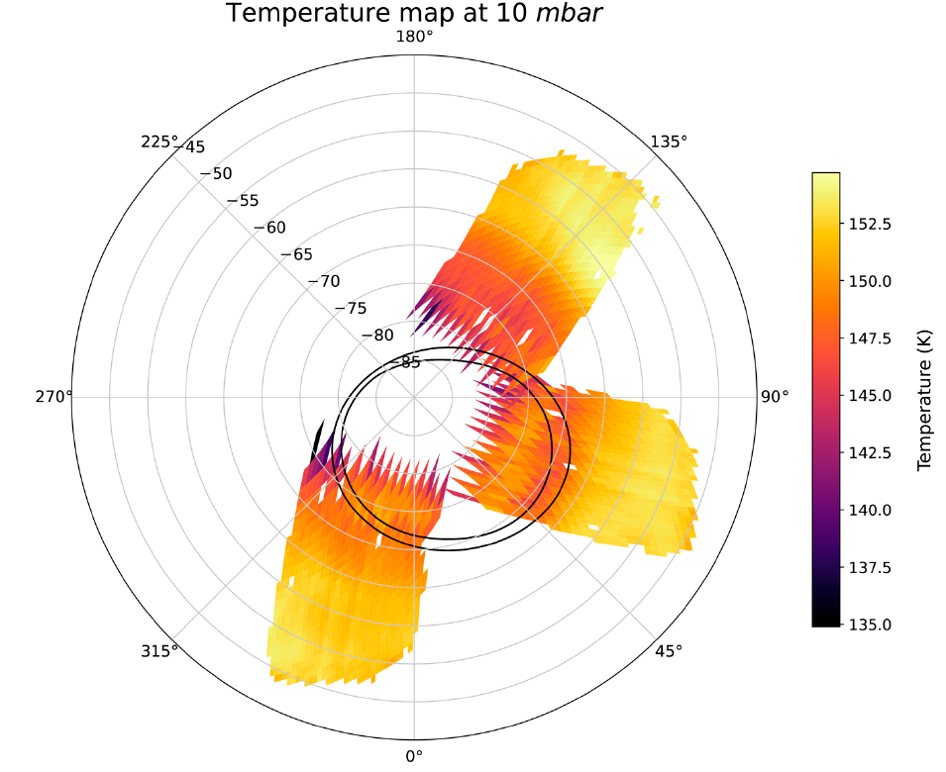
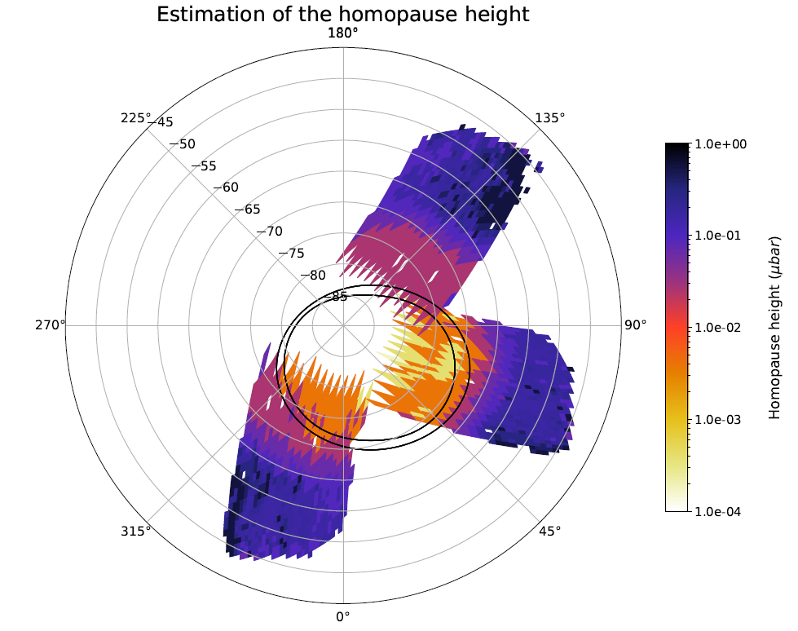
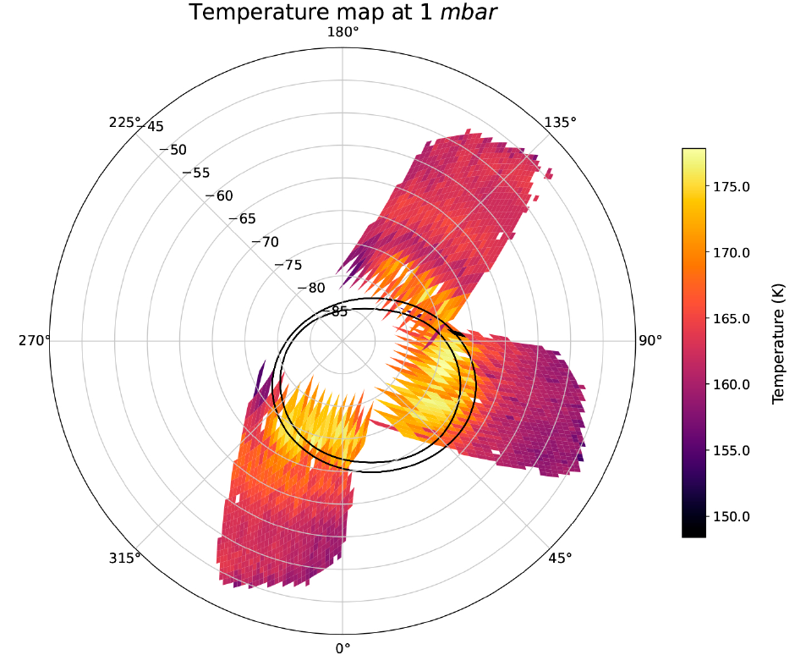
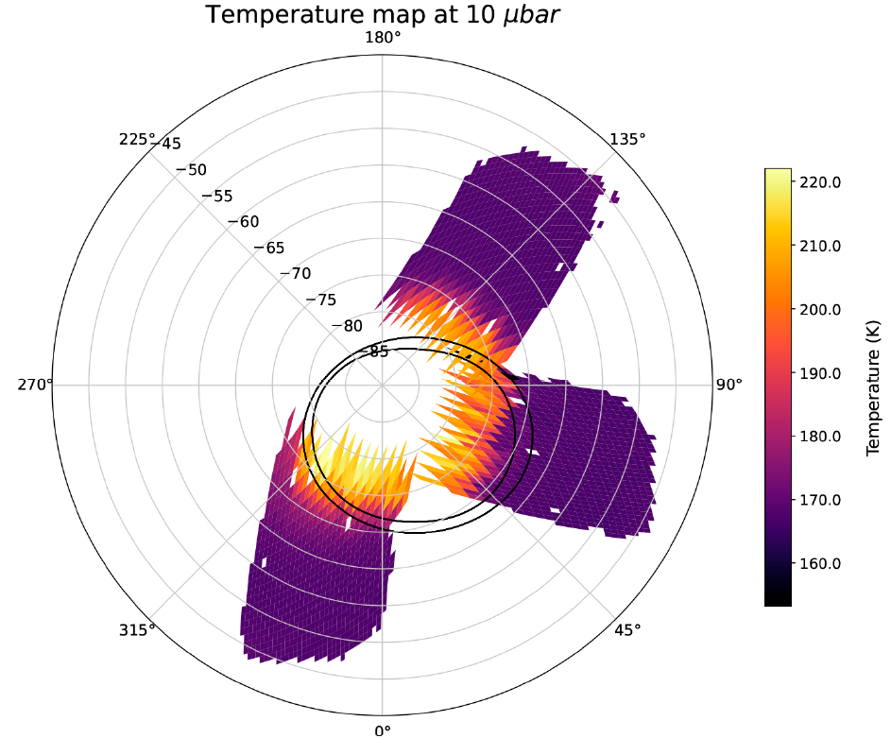
EGU23-12471
We retrieved the homopause height following the methodology in Sinclair et al., 2020
We retrieved the thermal profile taking into account the homopause location variation
Nature of the hotspot? Hazes? Dynamics?
Rodriguez-Ovalle et al., 2023 (in prep)

Slide 4
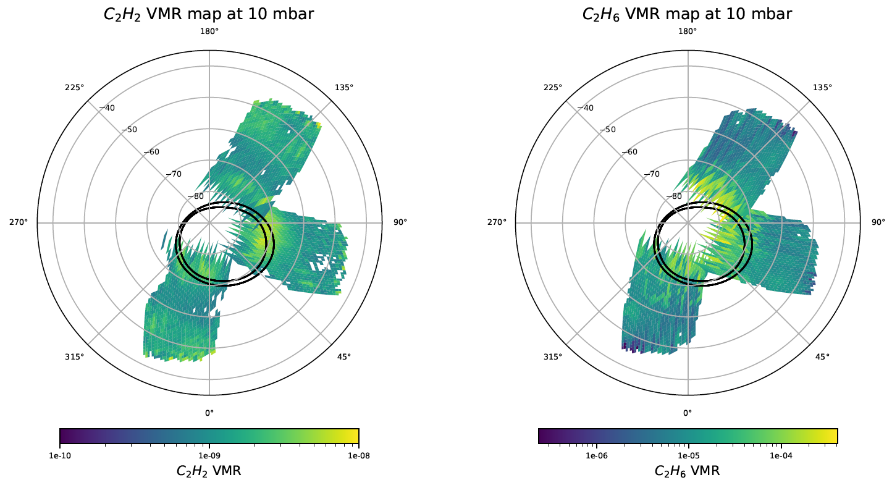
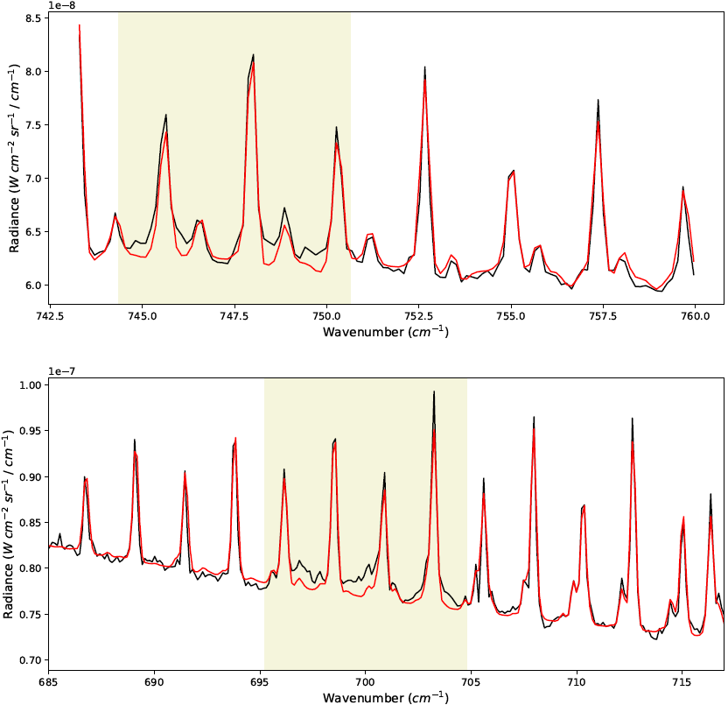
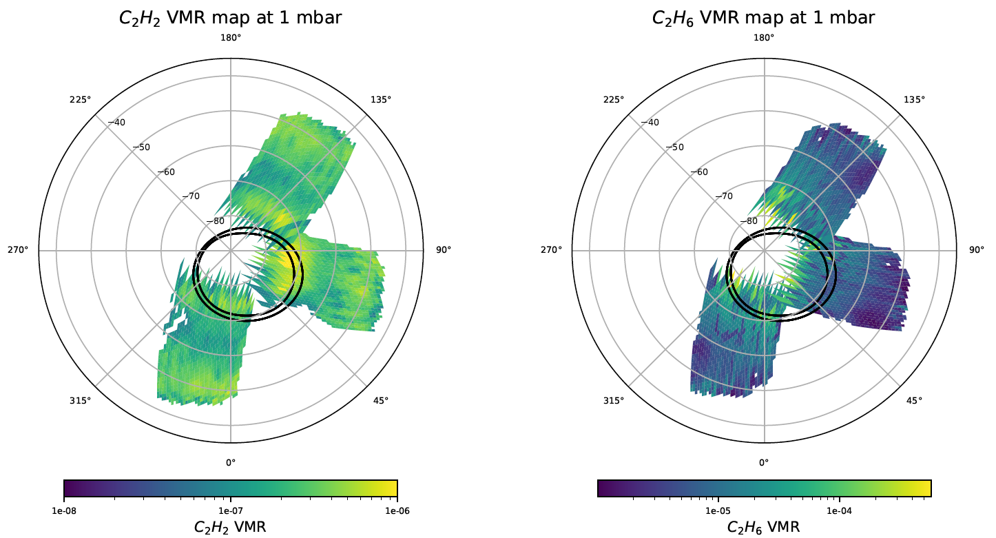
EGU23-12471
Retrieved abundances of hydrocarbons.
Spectral signature of hazes.

Slide 5
EGU23-12471
Mid Infrared analysis of Jupiter South Pole from JWST MIRI-MRS observations: Thermo-chemical disturbances caused by auroral activity
Pablo Rodriguez-Ovalle¹, Thierry Fouchet¹, Imke De Pater², Dominique Bockelee-Morvan¹, Emmanuel Lellouch¹, Manuel Lopez-Puertas³, Prisca Briens¹, James Sinclair⁴, Ricardo Hueso⁵ and the ERS-1373 Team
LESIA, Observatoire de Paris, Meudon, France
University of Berkeley, California, USA
Instituto de Astrofísica de Andalucia, Granada, Spain
NASA - Jet Propulsion Laboratory, Pasadena, USA
Universidad del Pais Vasco UPV-EHU, Bilbao, Spain

