Slide 1



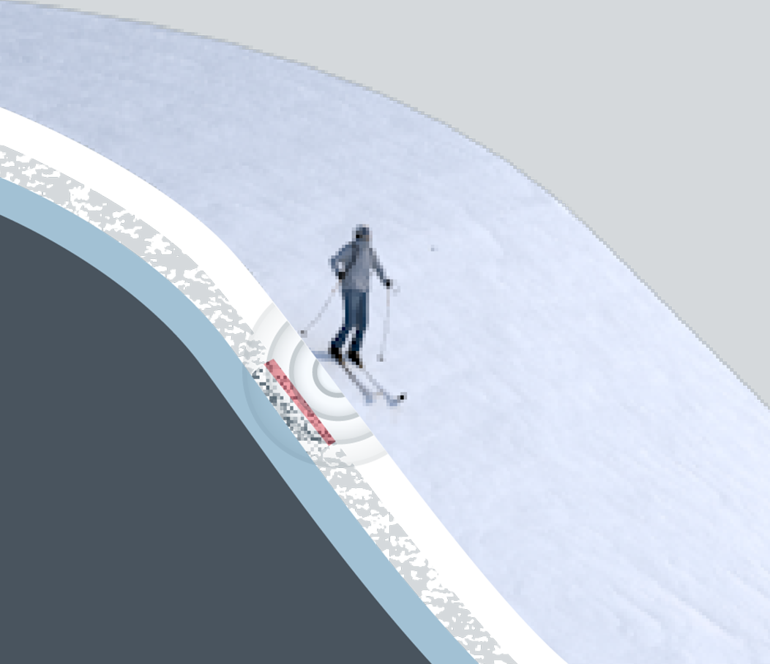
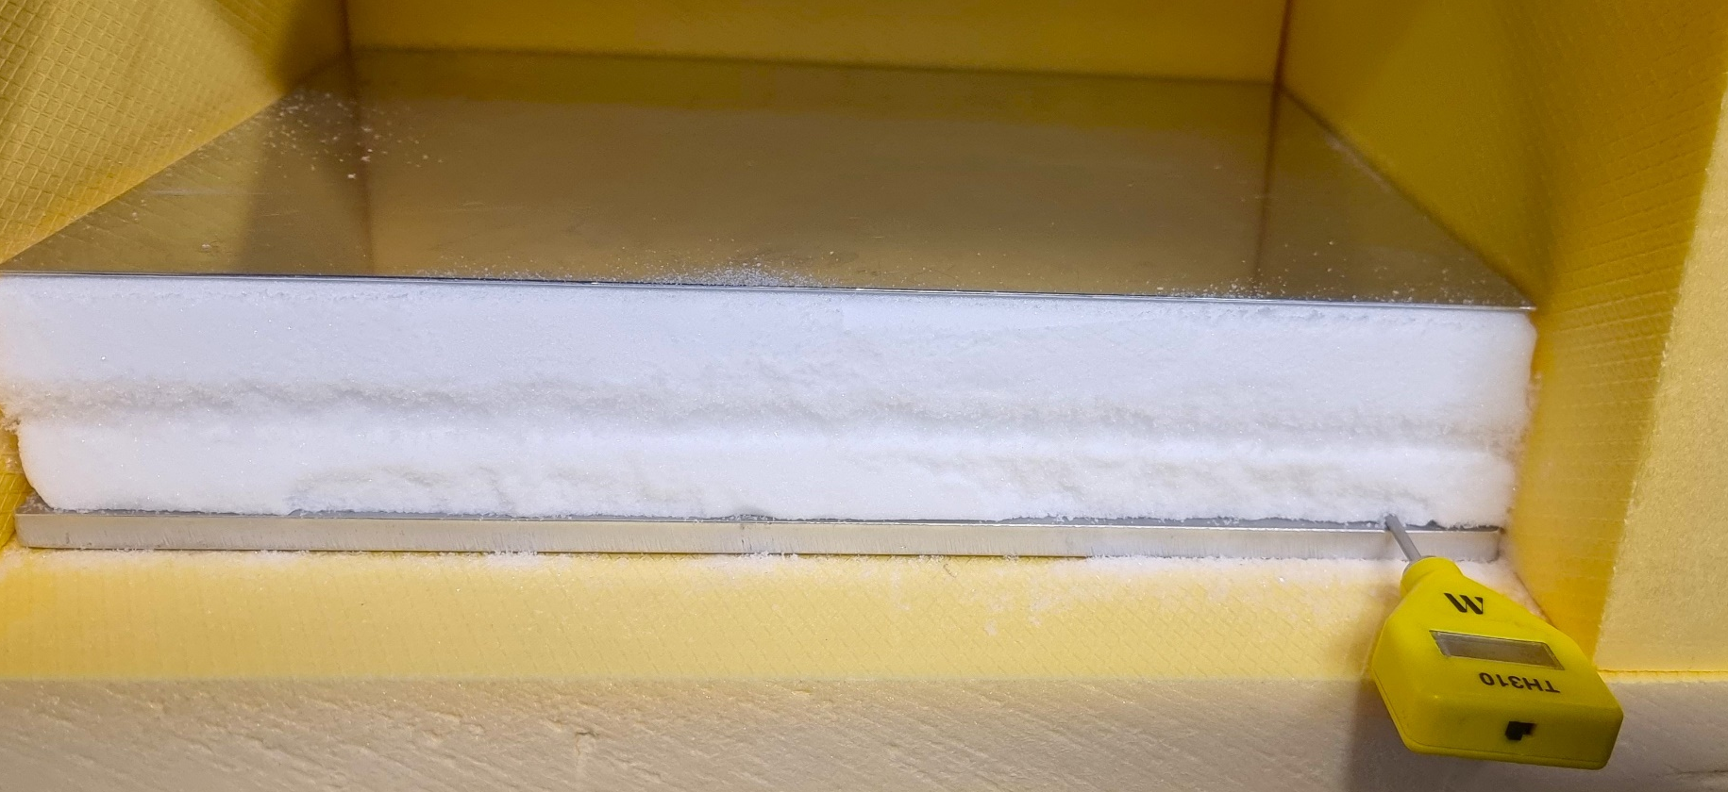

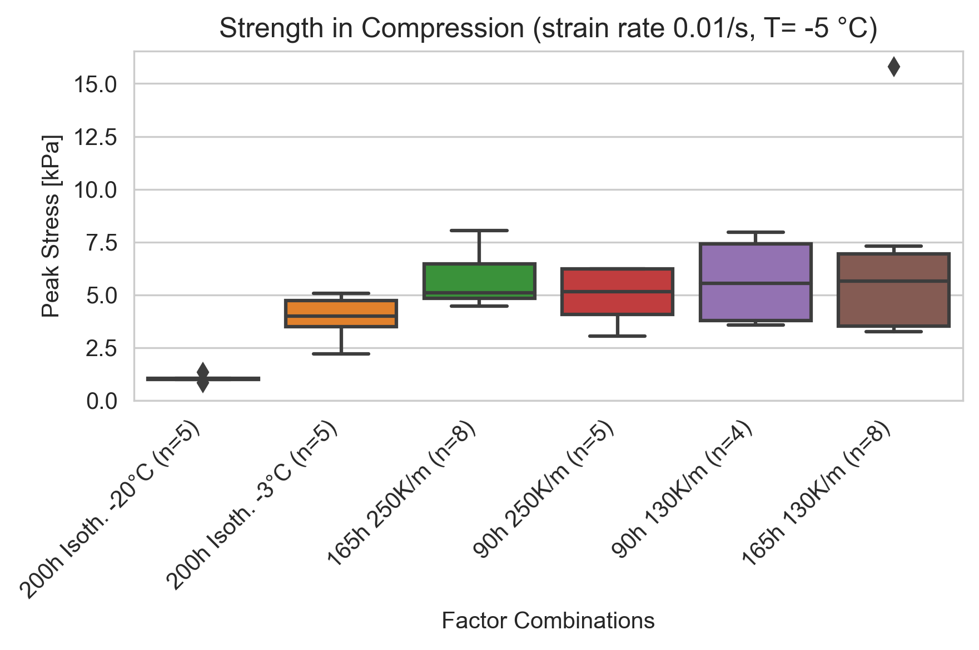
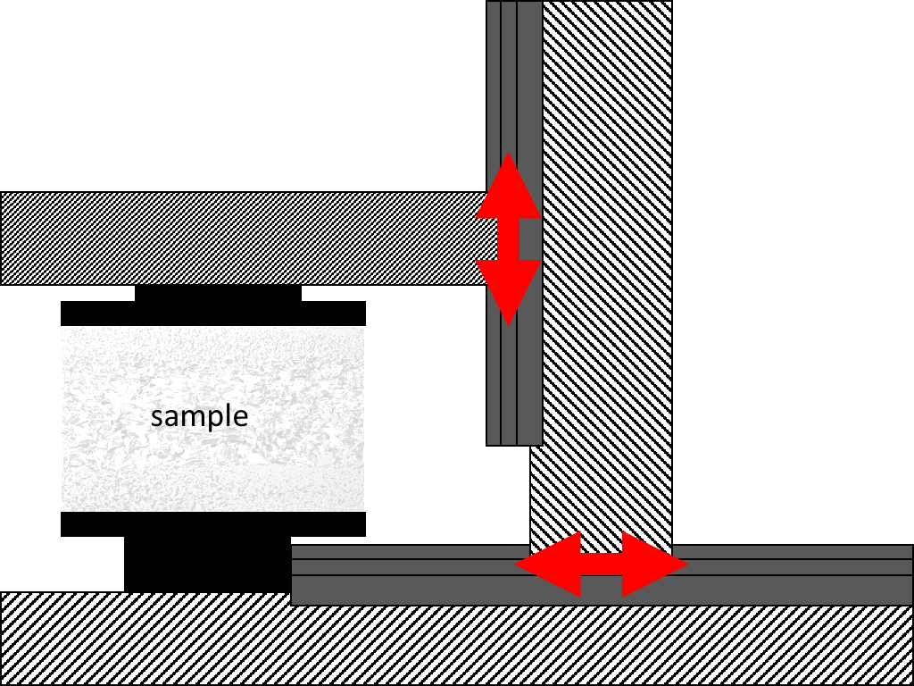
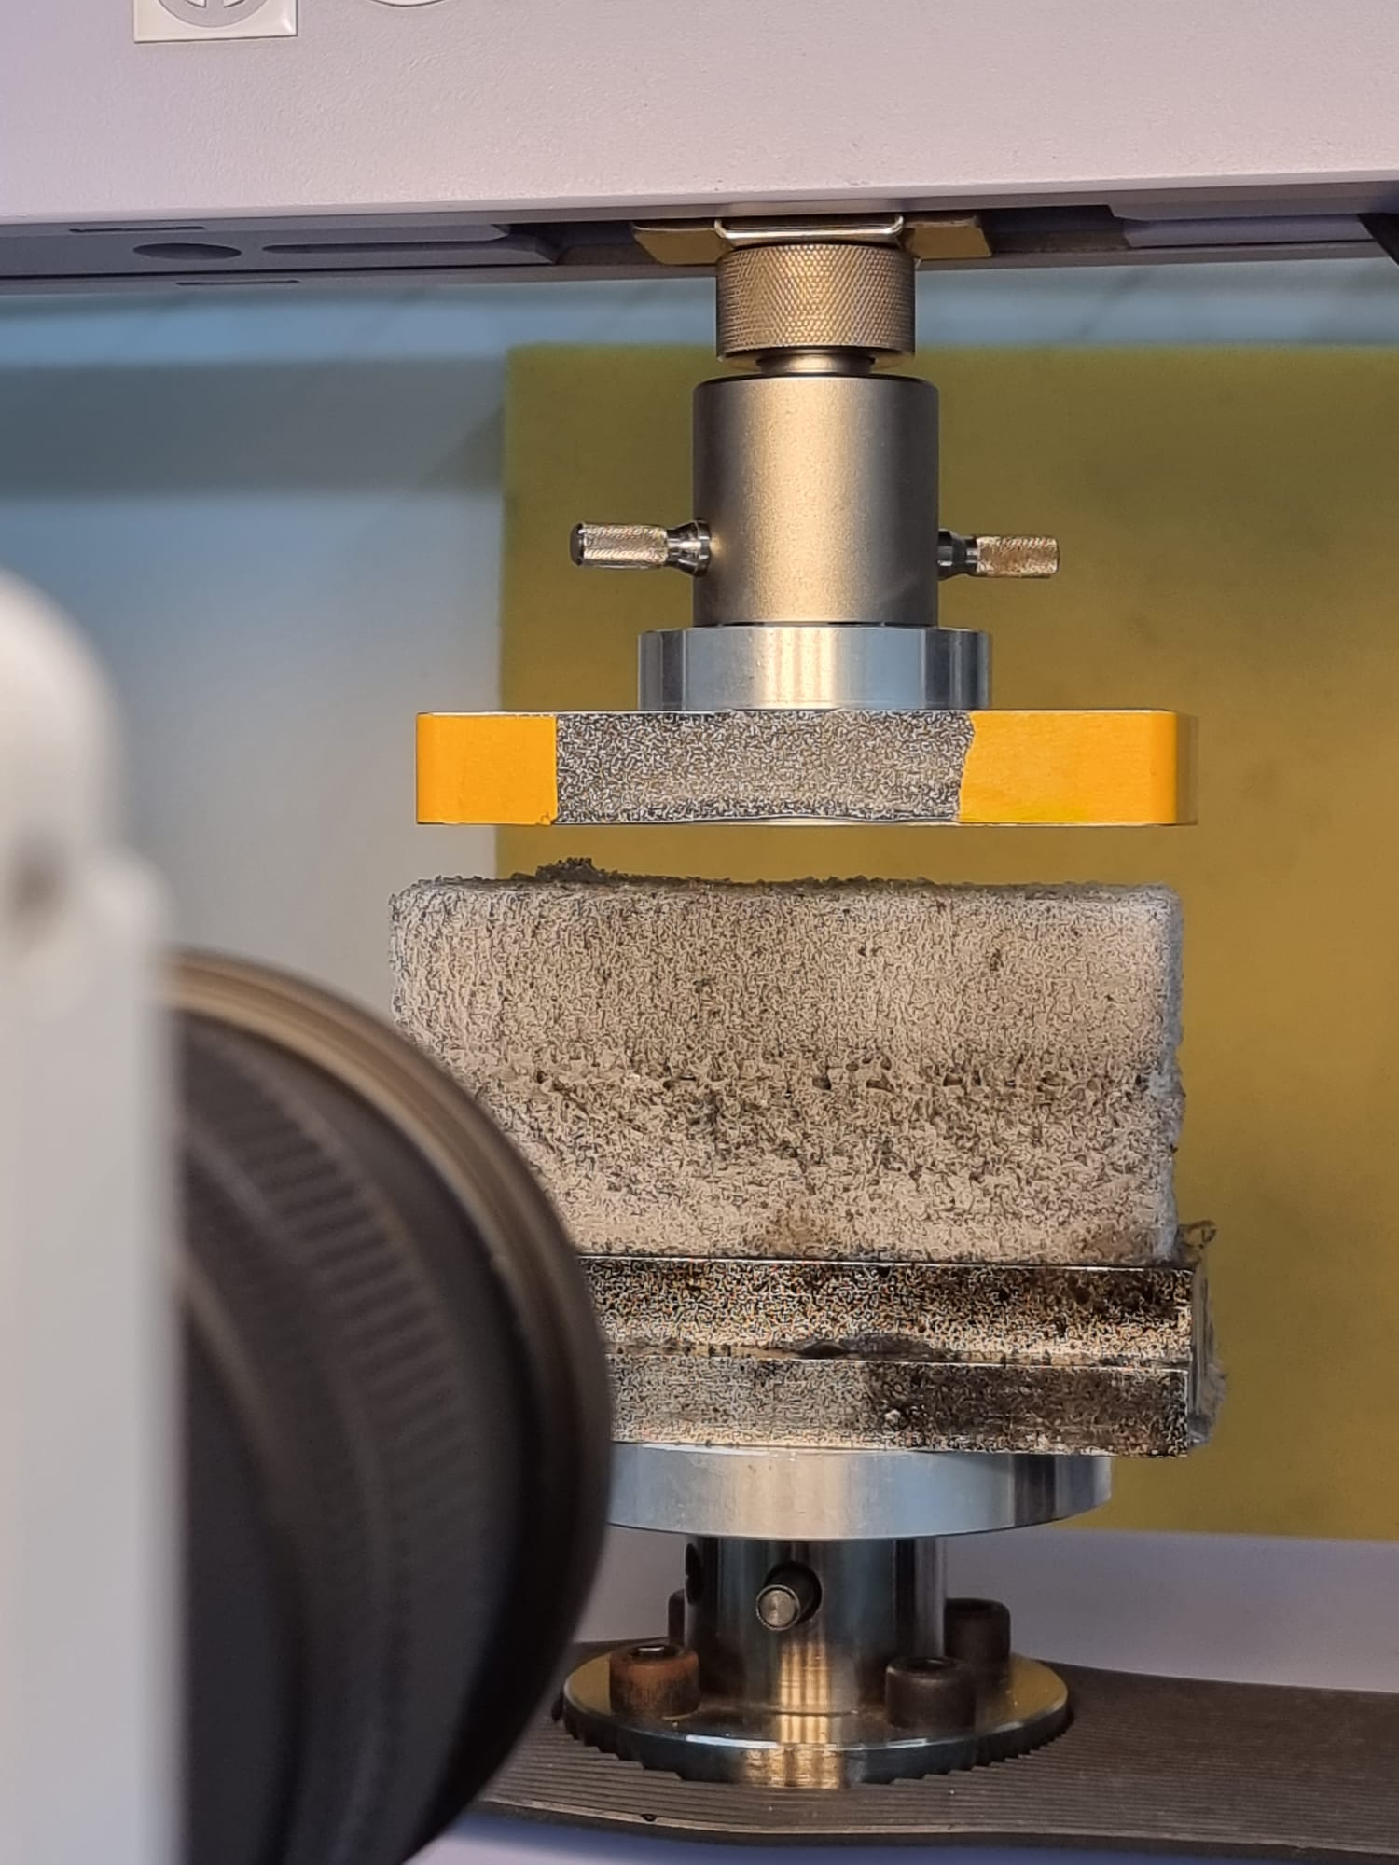
Systematic production and characterization of artificially produced weak layers of depth hoar
Jakob Schöttner, Melin Walet, Alec van Herwijnen, and Jürg Schweizer
WSL Institute for Snow and Avalanche Research SLF, Davos, Switzerland
Motivation
Methods
Results
Conclusions
v
Slab avalanches are the most relevant for avalanche forecasting causing more than 90% of the avalanche fatalities.
Prerequisites:
Cohesive snow slab
Weak layer
Trigger
Steep terrain
Deterministic investigation and ava-lanche forecasting requires knowledge of material parameters.
Dependency on snow density but also on microstructure
Artificially produced samples enable us to investigate the properties of a wide range of microstructural morphologies
Independent of the season
Controlled environment
Easier characterization of the micro-structure (µCT)
Artificially produced weak layers allow to investigate a wide range of micro-structure morphologies.
Sample production:
Sieved new snow between two compressed slabs
Exposing to temperature gradient forms depth hoar.
Sample testing:
Compressive tests to determine the compressive strength
Digital image correlation to record dis-placements
Sample production:
The workflow results in reproducible artificial depth hoar weak layers
Sample testing:
Comparable strength values for depth hoar grown under different conditions
Artificial depth hoar sample production is feasible.
Samples with differently developed weak layers show comparable com-pressive strengths.
Samples break in the upper half of the weak layer
Depth hoar cups form first at the top of the weak layer.
Improve workflow to achieve more homogenous depth hoar weak layers.
Other types of weak layers (surface hoar, facetted crystals, …)
Characterization of microstructures
Extending experiments to shear and multiaxial stress states:
Future Work
1 cm
Snow Mechanics
Snow Micro-structure

Slide 2


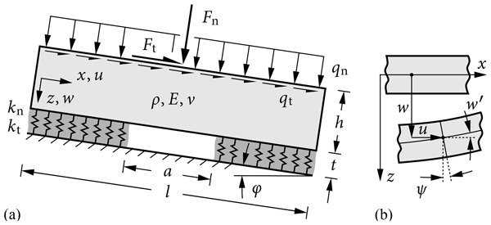
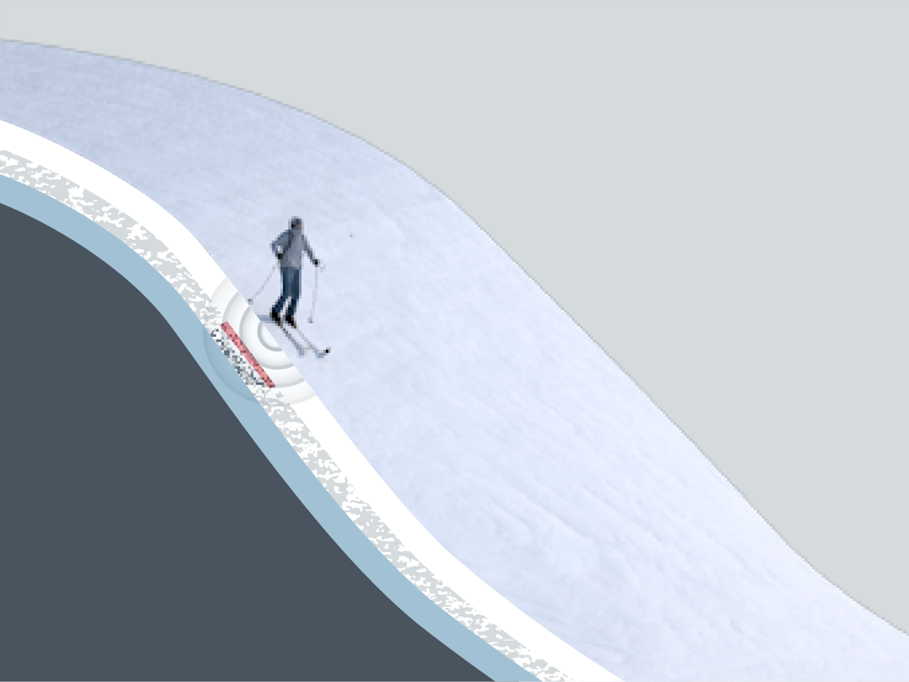
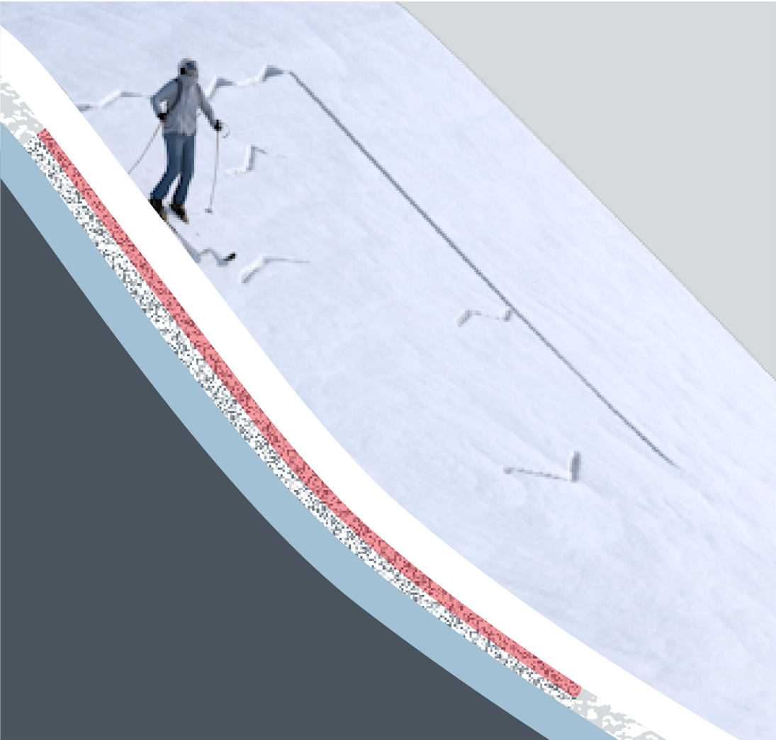
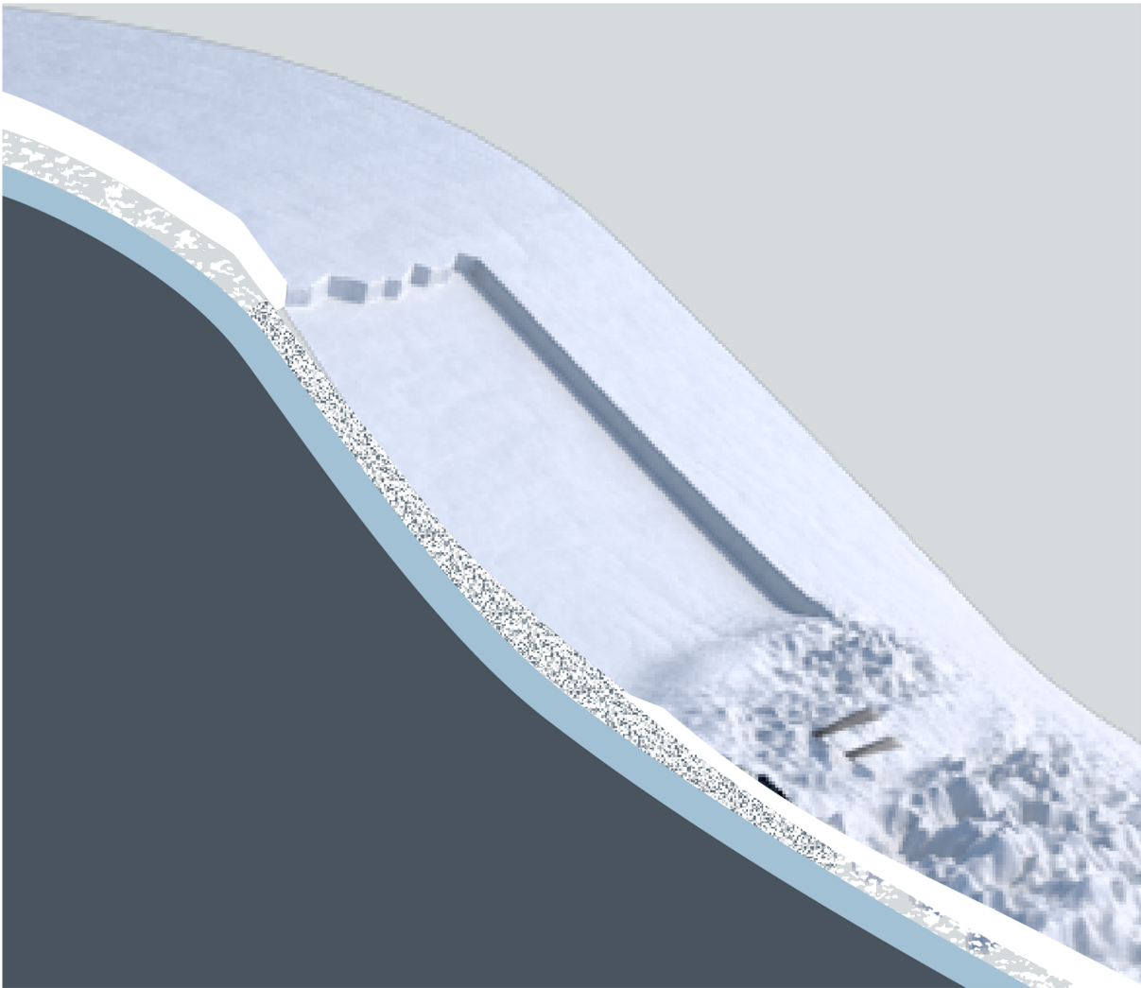
Systematic production and characterization of artificially produced weak layers of depth hoar
Jakob Schöttner, Melin Walet, Alec van Herwijnen, and Jürg Schweizer
WSL Institute for Snow and Avalanche Research SLF, Davos, Switzerland
Motivation
Background
Research Gap
Deterministic investigation and avalanche forecasting requires knowledge of material parameters.
Elastic modulus, strength, fracture toughness
Dependency on snow density but also on microstructure
Artificially produced samples allow us to investigate the properties of a wide range of microstructural morphologies.
Independent of the season
Controlled environment
Easier characterization of the microstructure (µCT)
Slab avalanches are the most relevant for avalanche forecasting causing more than 90% of avalanche fatalities.
1. Cohesive snow slab
2. Weak layer
3. Trigger
4. Steep terrain
The release process of an avalanche can be seen as a sequence of fractures:
[2]
Elastic modulus
Strength
Fracture toughness
Failure initiation
Crack Propagation
Tensile fracture of the overlying slab and avalanche release
Research Goal
Snow mechanics
Snow microstructure
[1]

Slide 3
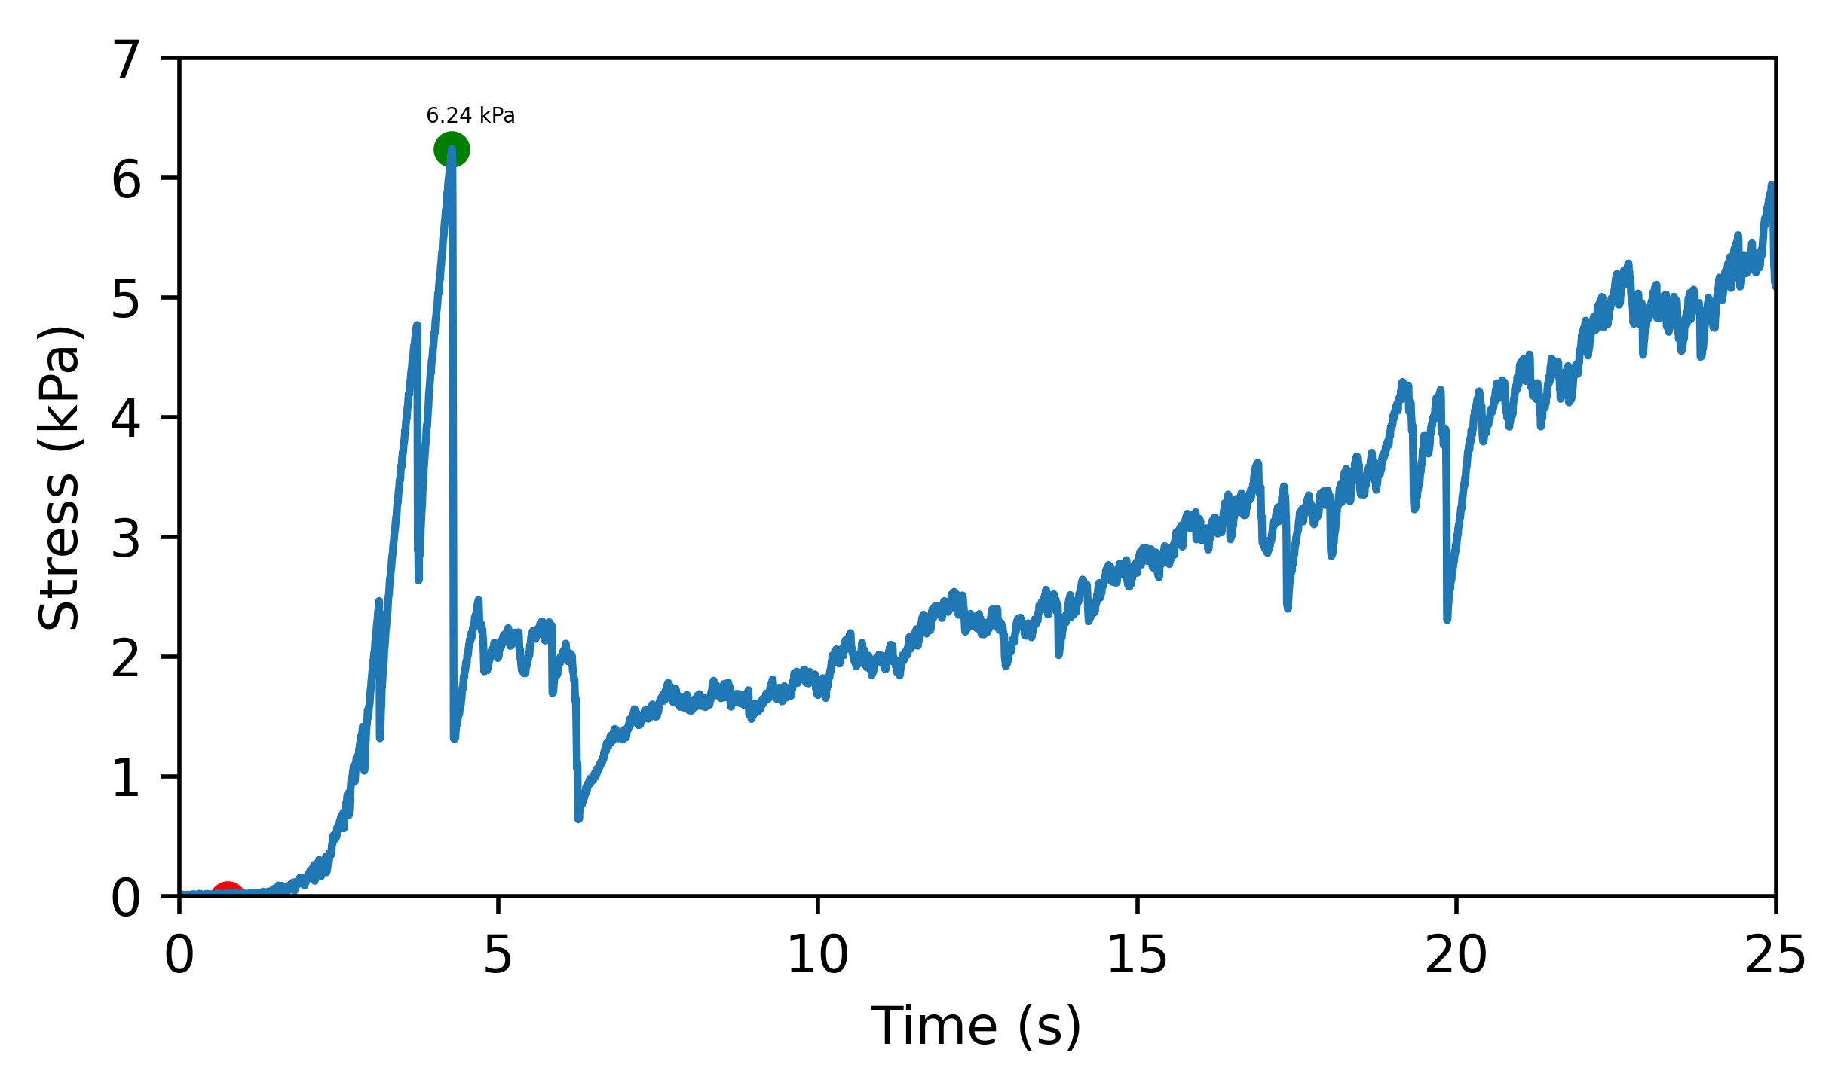

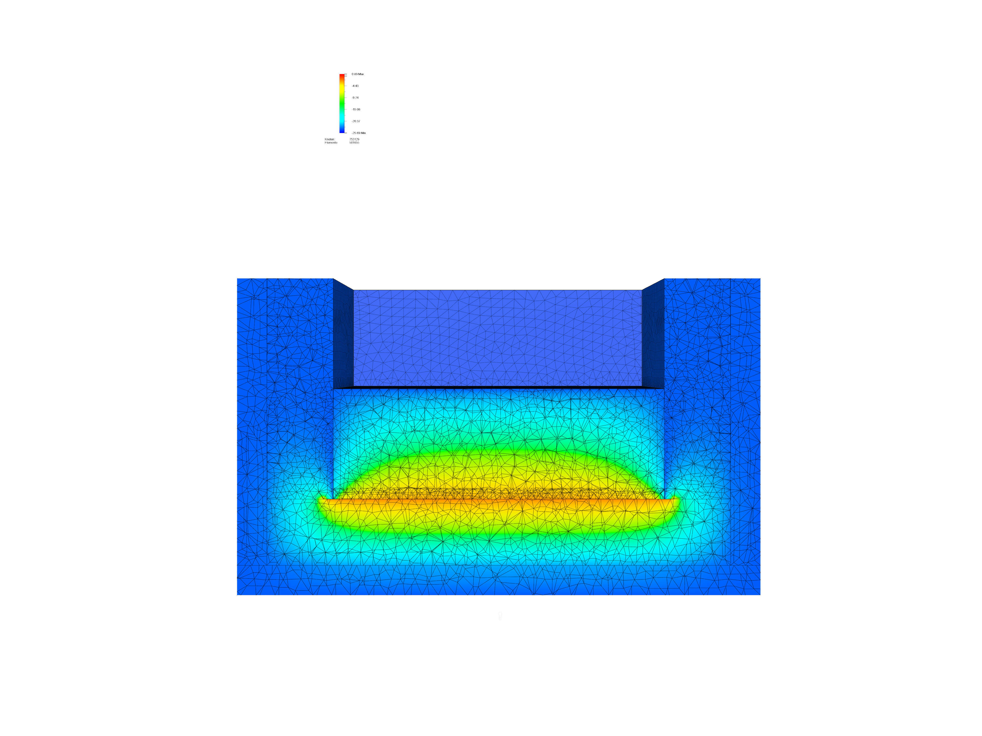
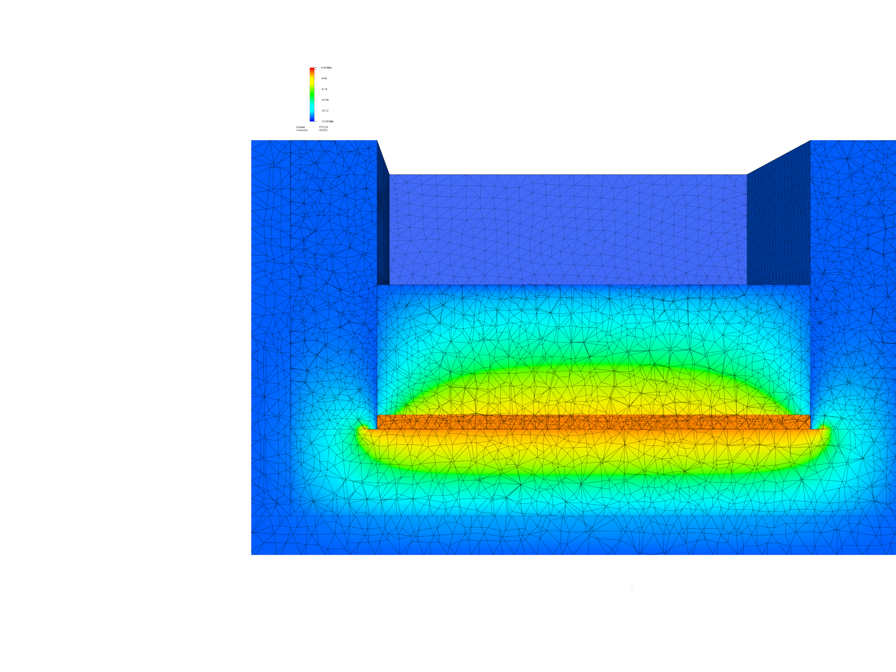
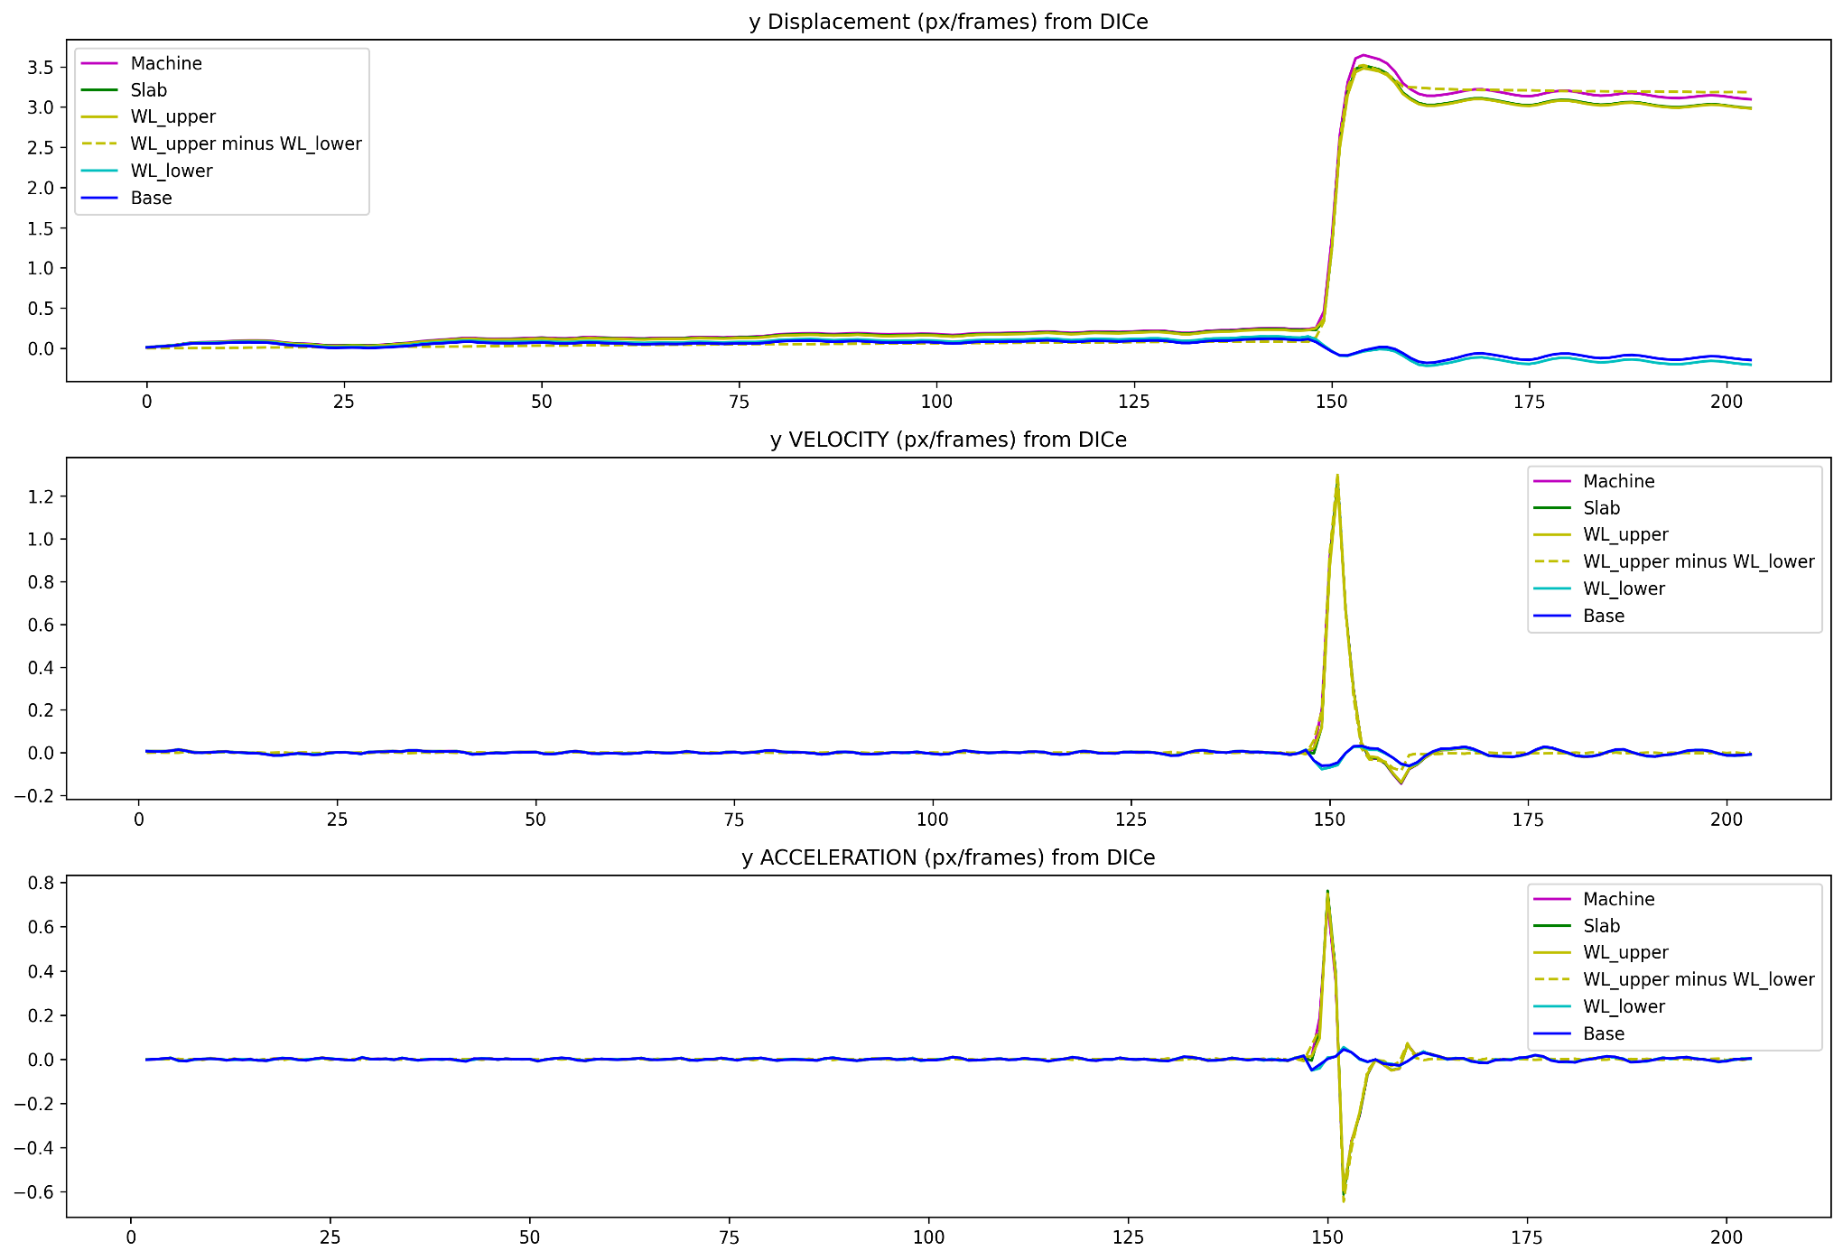
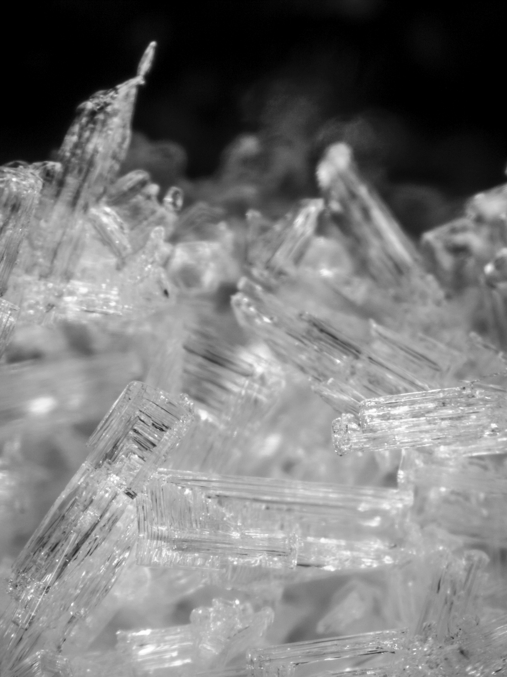
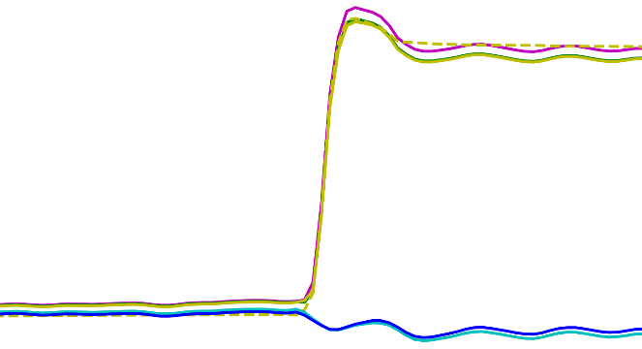
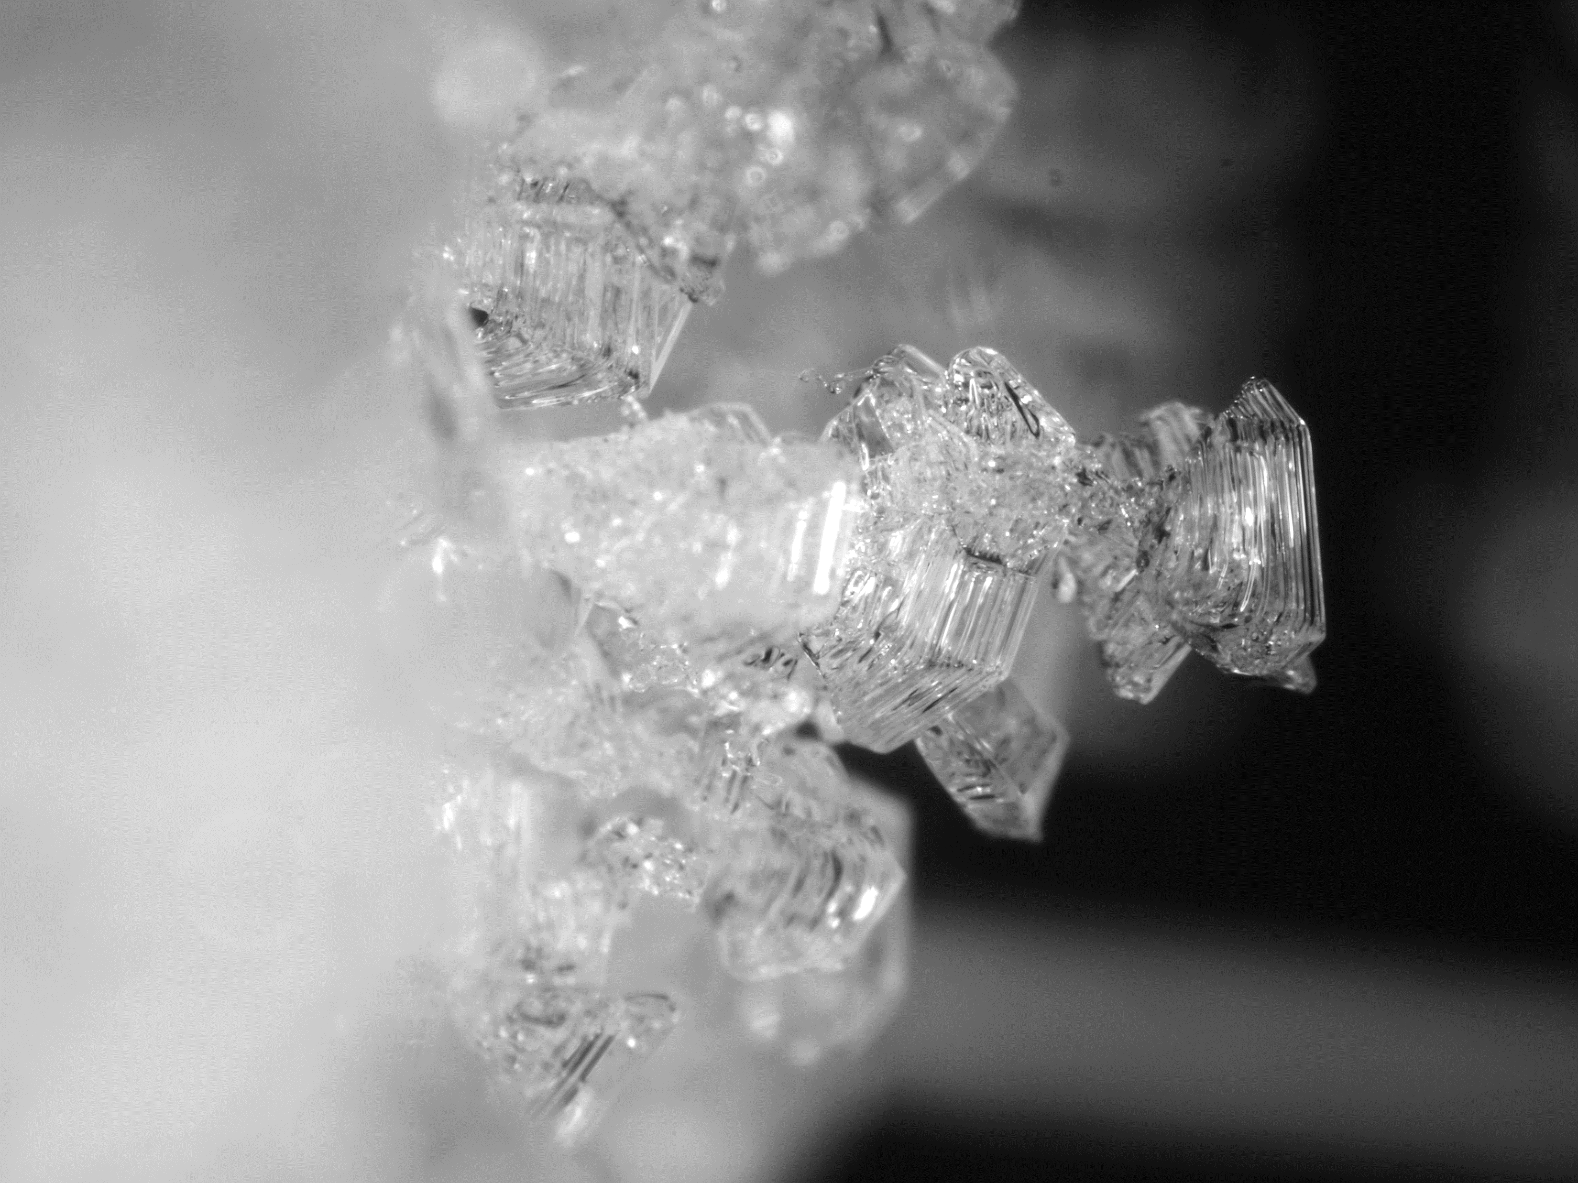
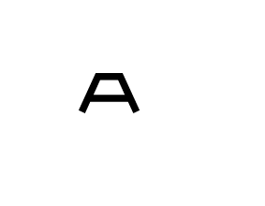
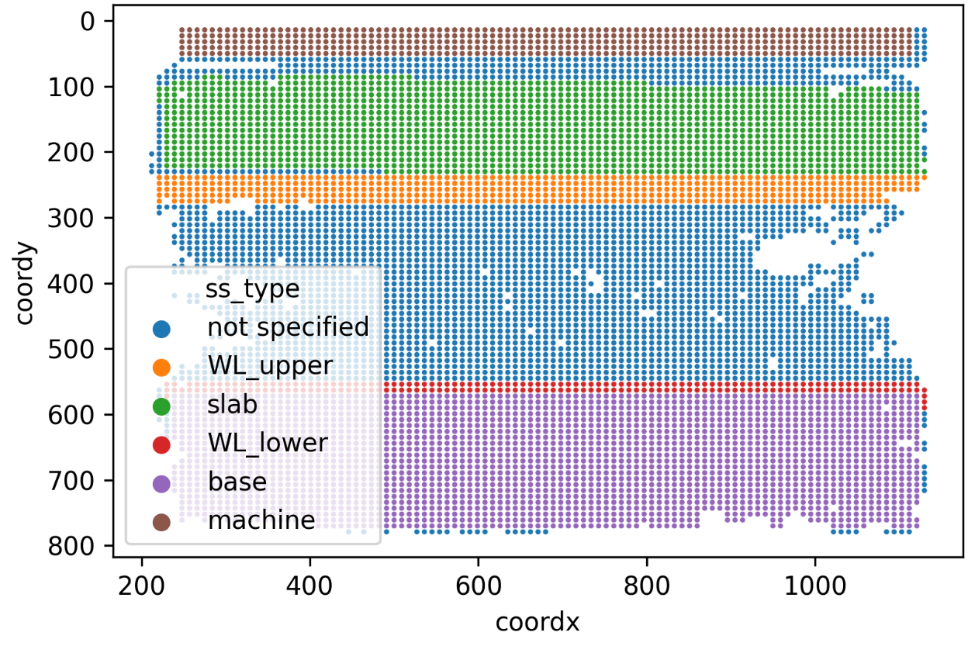

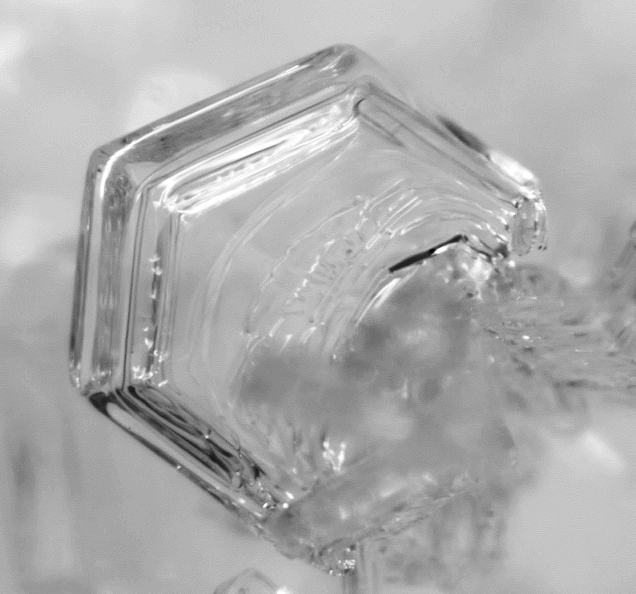



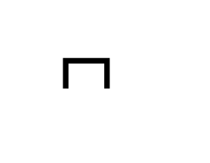
Systematic production and characterization of artificially produced weak layers of depth hoar
Jakob Schöttner, Melin Walet, Alec van Herwijnen, and Jürg Schweizer
WSL Institute for Snow and Avalanche Research SLF, Davos, Switzerland
Methods
Sample production
Sieve new snow between two compressed slabs
Expose sample to temperature gradient for prolonged time
After several days, the new snow changes to depth hoar
Sample Testing
Samples are tested for their compressive strength.
Strain rate 10⁻² s⁻¹ → displacement rate ~ 0.2 mm/s
6.24 kPa
Time (s)
Displacement (px)
3
2
1
0
0 [ms]
25
50
75
Regions of interest
Velocity (px/s)
1
Digital Image Correlation
0.5
0
0 [ms]
25
50
75
Acceleration (px/s²)
0.5
1 cm
0
-0.5
0 [ms]
25
50
75

Slide 4
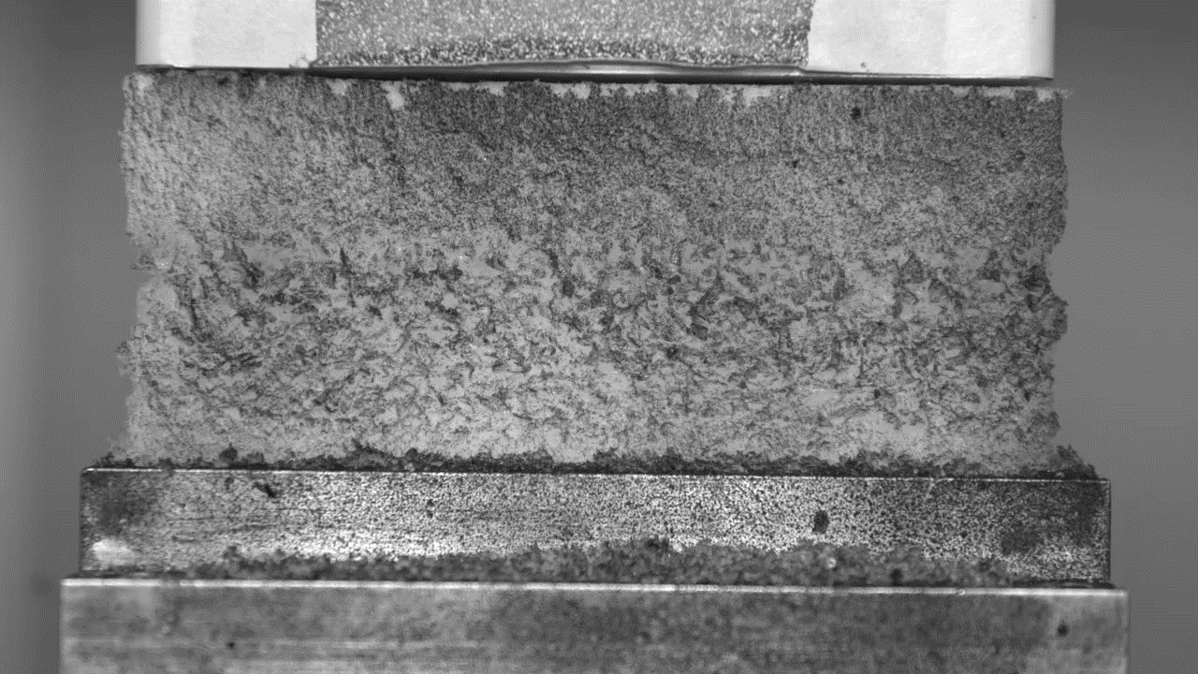
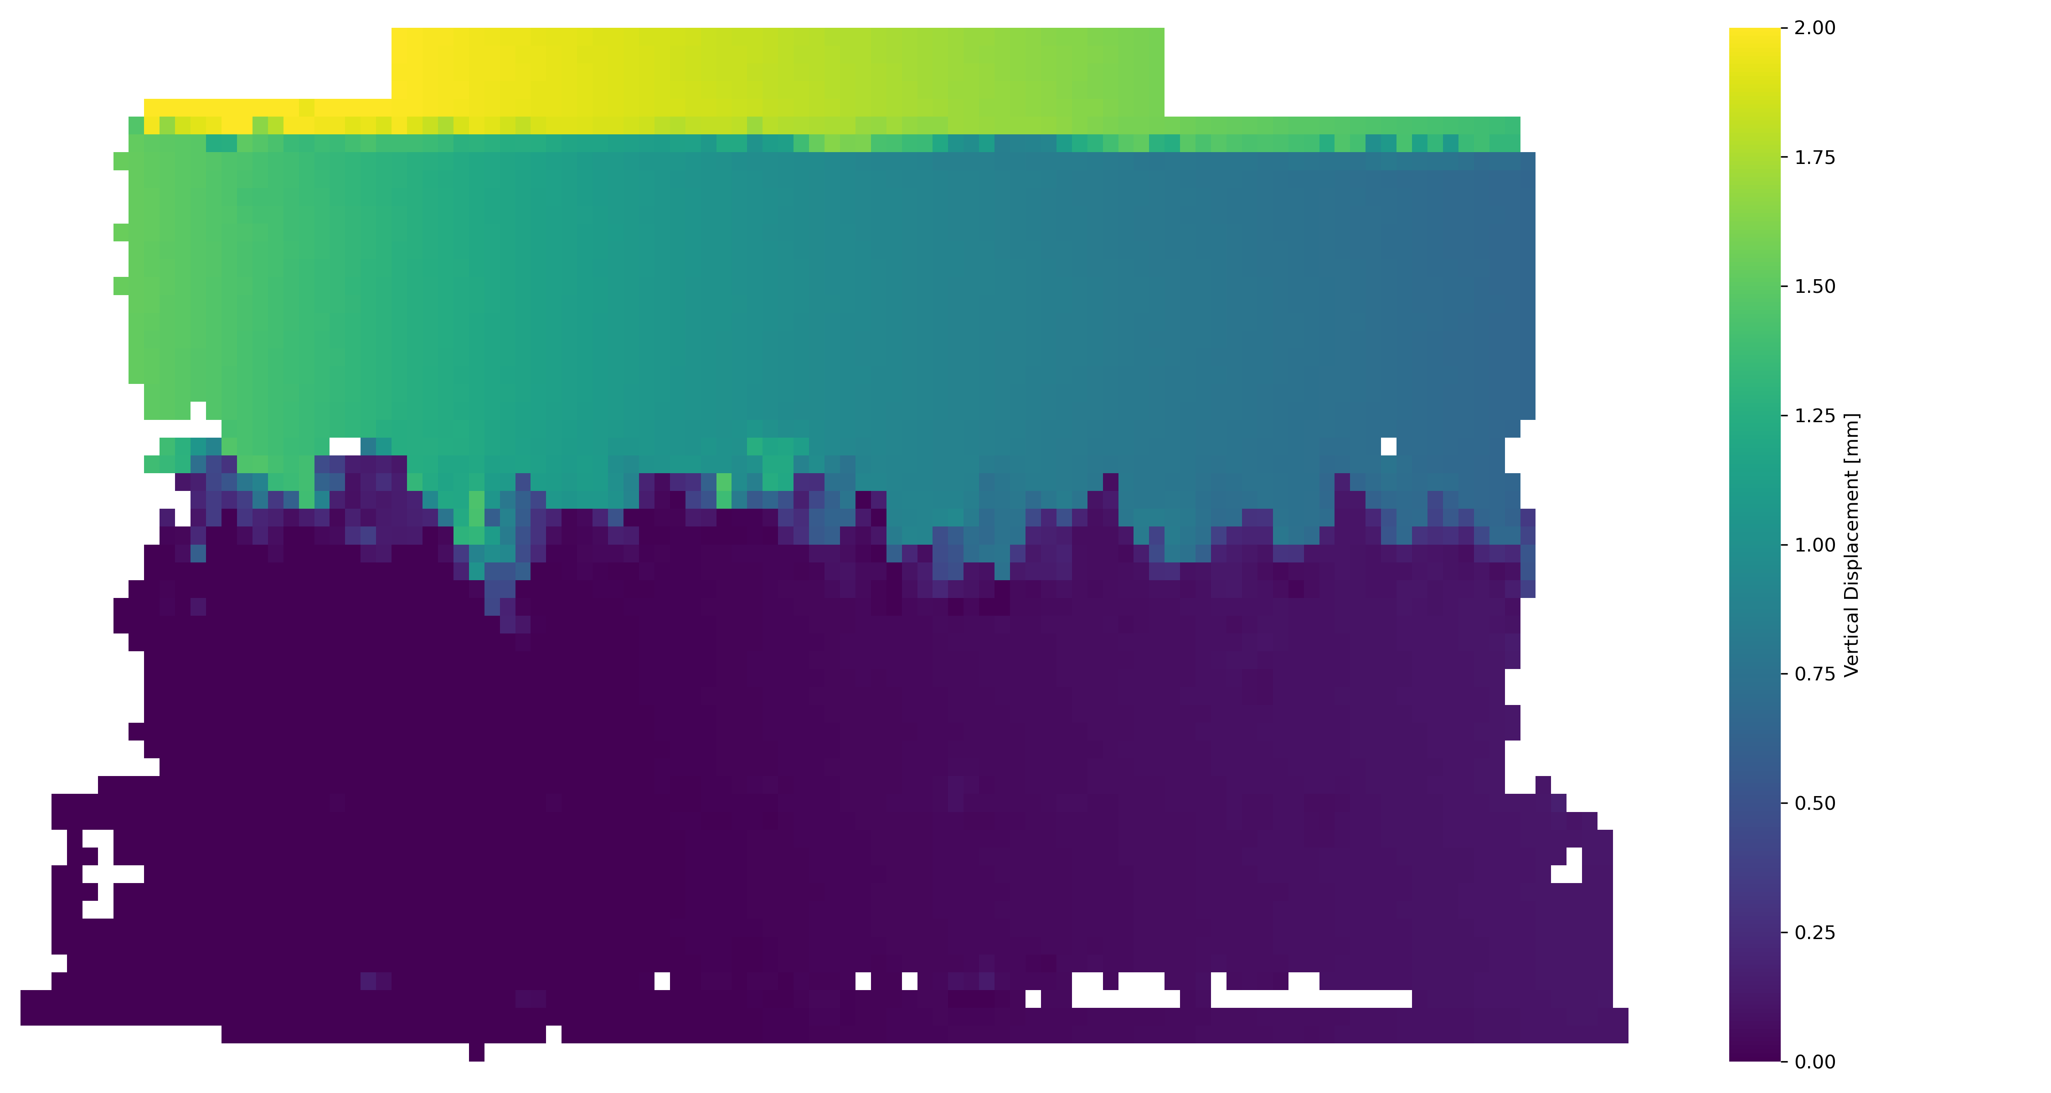
Systematic production and characterization of artificially produced weak layers of depth hoar
Jakob Schöttner, Melin Walet, Alec van Herwijnen, and Jürg Schweizer
WSL Institute for Snow and Avalanche Research SLF, Davos, Switzerland
Results
Non-trivial failure behavior
6.24 kPa
Local failures prior to global failure
Resulting load distribution and tilting could influence the result
Comparable compressive strengths
Isothermal metamorphism
Gradient induced metamorphism
Samples were subjected to different temperature gradients and different durations
Differently developed microstructures of the weak layers

Slide 5
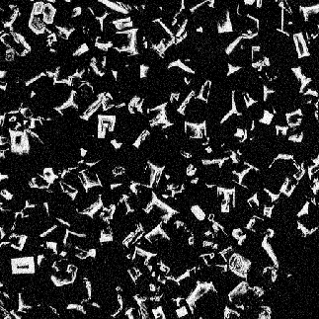
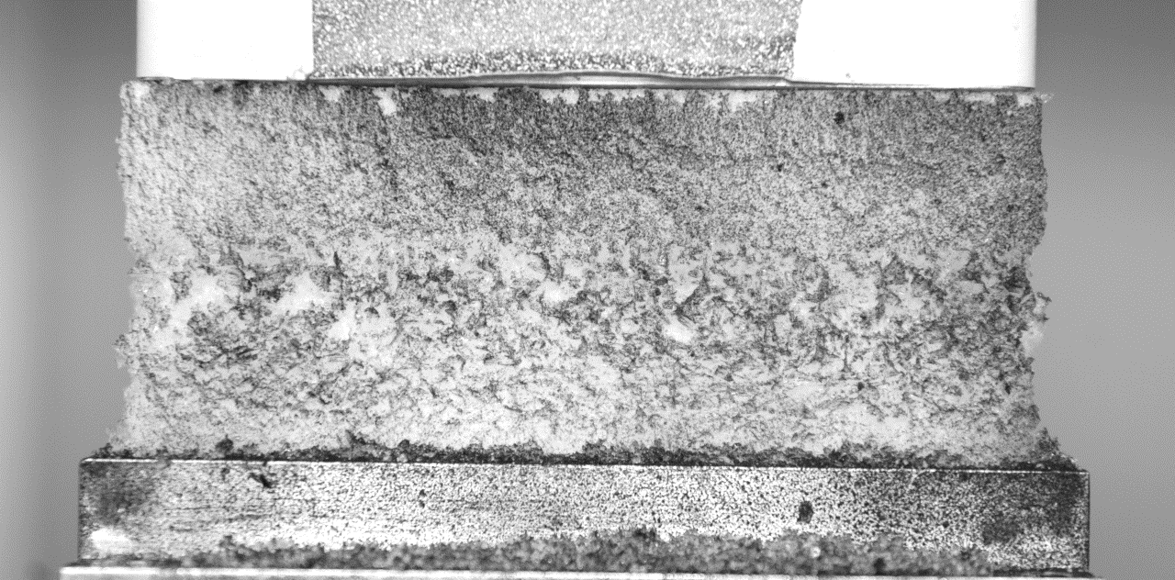
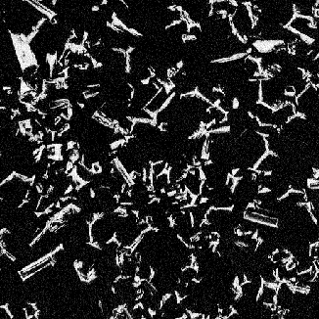
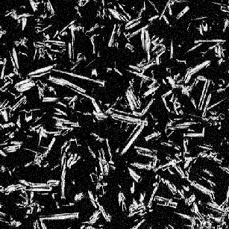
Systematic production and characterization of artificially produced weak layers of depth hoar
Jakob Schöttner, Melin Walet, Alec van Herwijnen, and Jürg Schweizer
WSL Institute for Snow and Avalanche Research SLF, Davos, Switzerland
Conclusions and Future Work
Different microstructures within one weak layer
Next steps
Artificial sample production:
Find way to grow more homogenous weak layers (e.g. smaller gradients and longer durations)
Investigate influence of weak layer density
Produce different types of weak layers (e.g. surface hoar)
Mechanical testing:
A new developed machine will enable us to test samples under multiaxial stress states:
Failure usually happens here!
→ Artificial depth hoar sample production is feasible
Measured strength values are comparable to reported values in literature [3]
→ Difficult to determine the relevant microstructural properties because of small dimension of the “super weak layer”
Samples with differently developed weak layers show comparable compressive strengths
Samples usually break in the upper half of the weak layer, sometimes even at the interface with the upper slab
Micro Tomography scans show larger crystals with few interconnections in this area
References:
[1]: White Risk Pro
[2]: Rosendahl, Philipp L., and Philipp Weißgraeber. "Modeling snow slab avalanches caused by weak-layer failure–Part 1: Slabs on compliant and collapsible weak layers." The Cryosphere 14.1 (2020): 115-130.
[3]: Reiweger, I., J. Gaume, and J. Schweizer. "A new mixed‐mode failure criterion for weak snowpack layers." Geophysical Research Letters 42.5 (2015): 1427-1432.

Slide 6

Systematic production and characterization of artificially produced weak layers of depth hoar
Jakob Schöttner, Melin Walet, Alec van Herwijnen, and Jürg Schweizer
WSL Institute for Snow and Avalanche Research SLF, Davos, Switzerland
Background
Summary
Slab avalanches are the most relevant for avalanche forecasting causing more than 90% of the avalanche fatalities.
Deterministic investigation and avalanche forecasting requires knowledge of material parameters.
Elastic modulus, strength, fracture toughness
Dependency on snow density but also on microstructure
Artificially produced samples allow us to investigate the properties of a wide range of microstructural morphologies.
Independent of the season
Controlled environment
Easier characterization of the microstructure (µCT)
Artificial production of samples containing a weak layer of depth hoar
Destructive testing in order to determine the compressive strength
Failure initiation
Crack Propagation
Tensile fracture of the overlying slab and avalanche release
1 cm

