Slide 1
Radar forward modelling as a precursor for statistical inference
Leah Sophie Muhle, Guy Moss, A. Clara J. Henry, and Reinhard Drews
Skip intro, start PICO

Slide 2
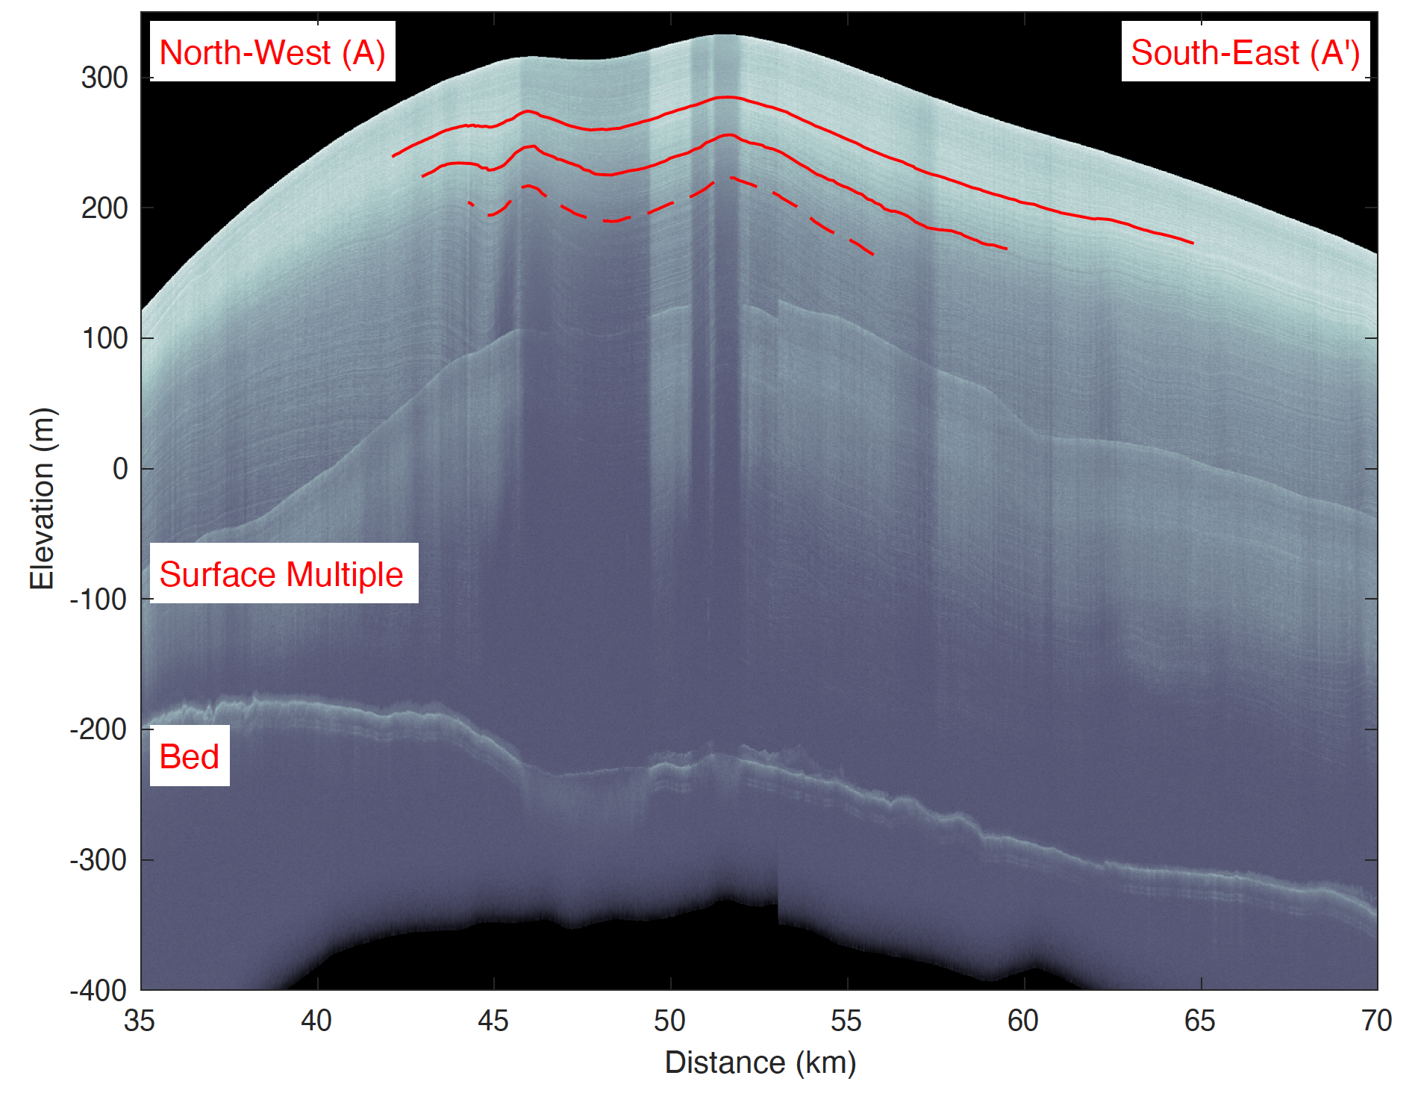
What can radargrams tell us?
Internal stratigraphy
Attenuation
Basal reflectivity
AWI airborne Ultra-Wideband Radar

Slide 3
What is planned?

Slide 4
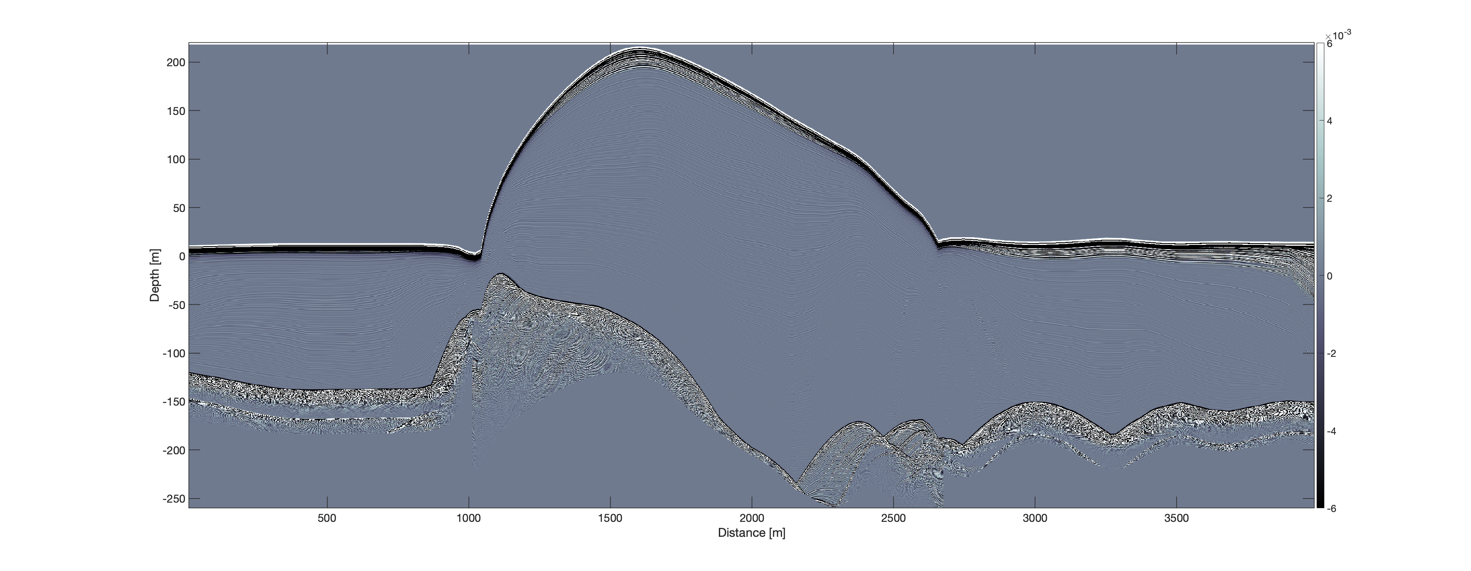
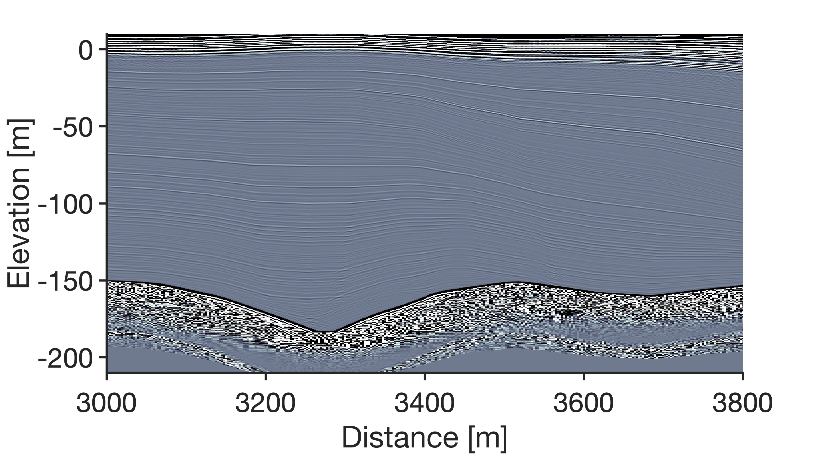
Could this radargram fool you?

Slide 5
Let’s start at the beginning. How do we create synthetic radargrams?

Slide 6
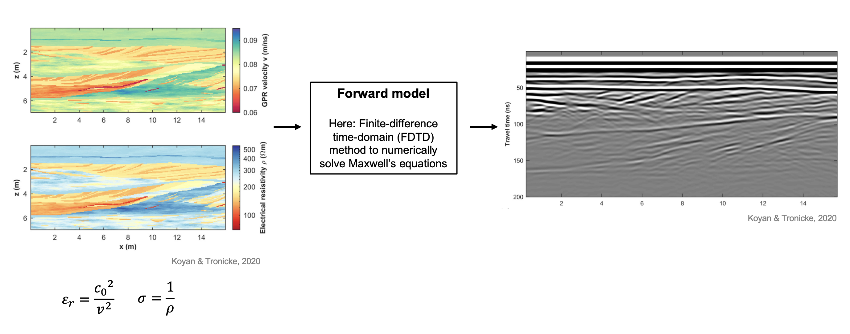
How does radar forward modelling work?
Synthetic radargram
Advantageous for modelling the internal radar stratigraphy of ice
Layers are prescribed in the conductivity/permittivity input and should appear at the same positions in the synthetic radargrams. Thus, the positions of the input layers could be used as layer labels/for layer tracing in the synthetic radargrams.
Electrical conductivity and relative permittivity fields are passed to forward model

Slide 7
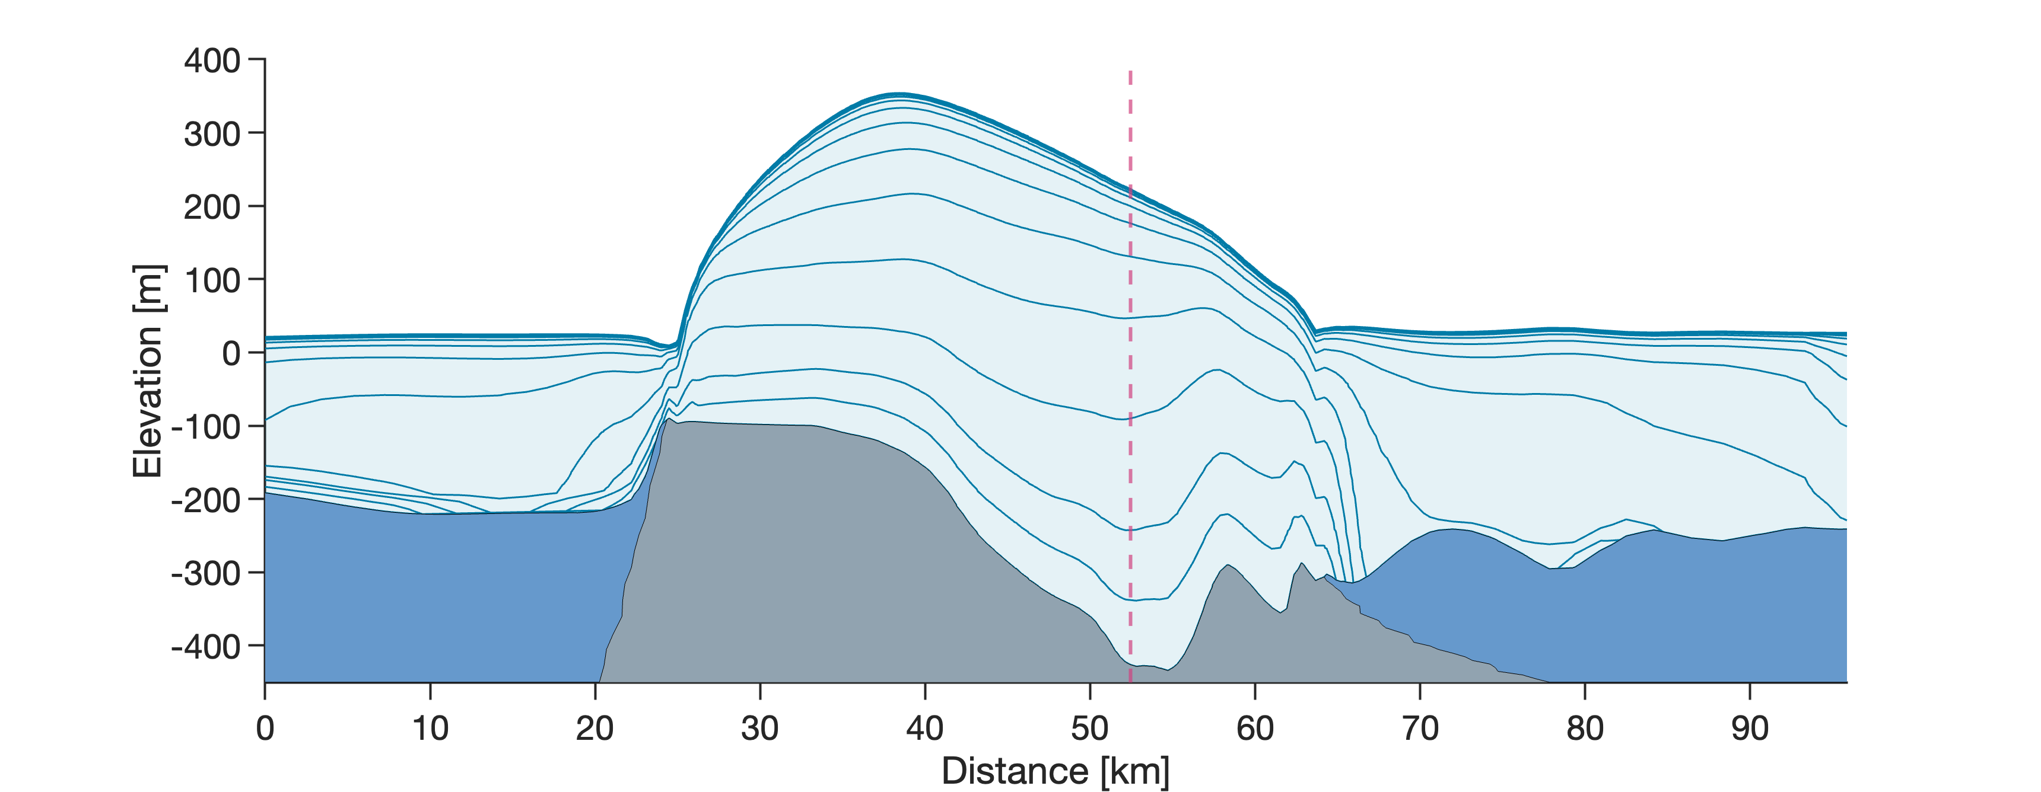
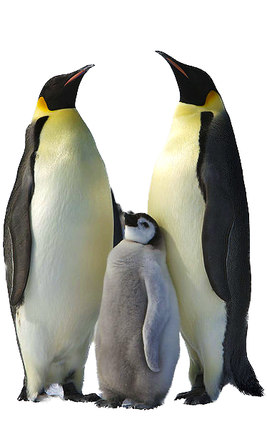
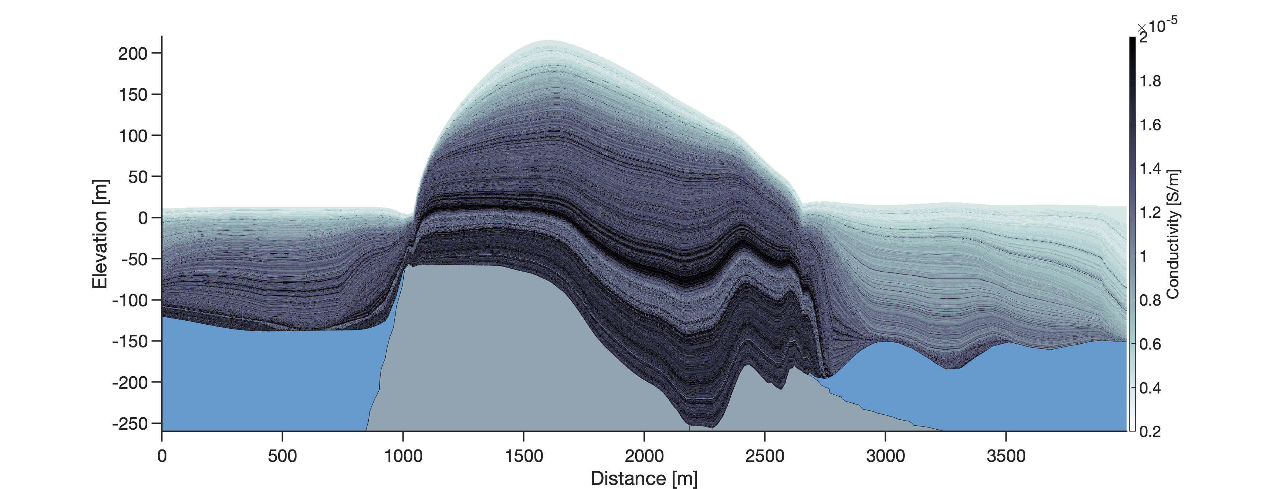
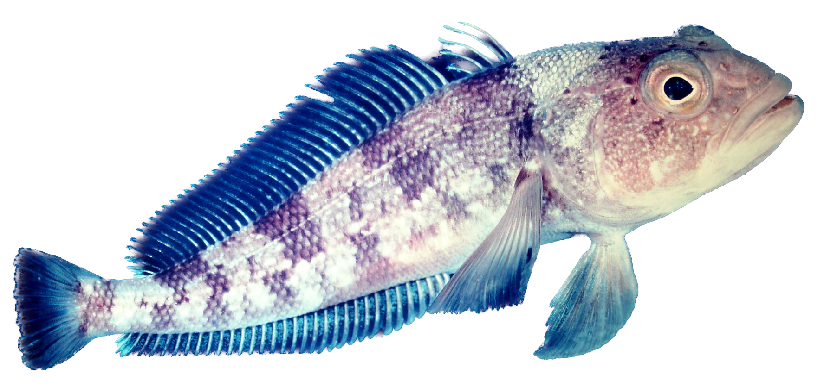
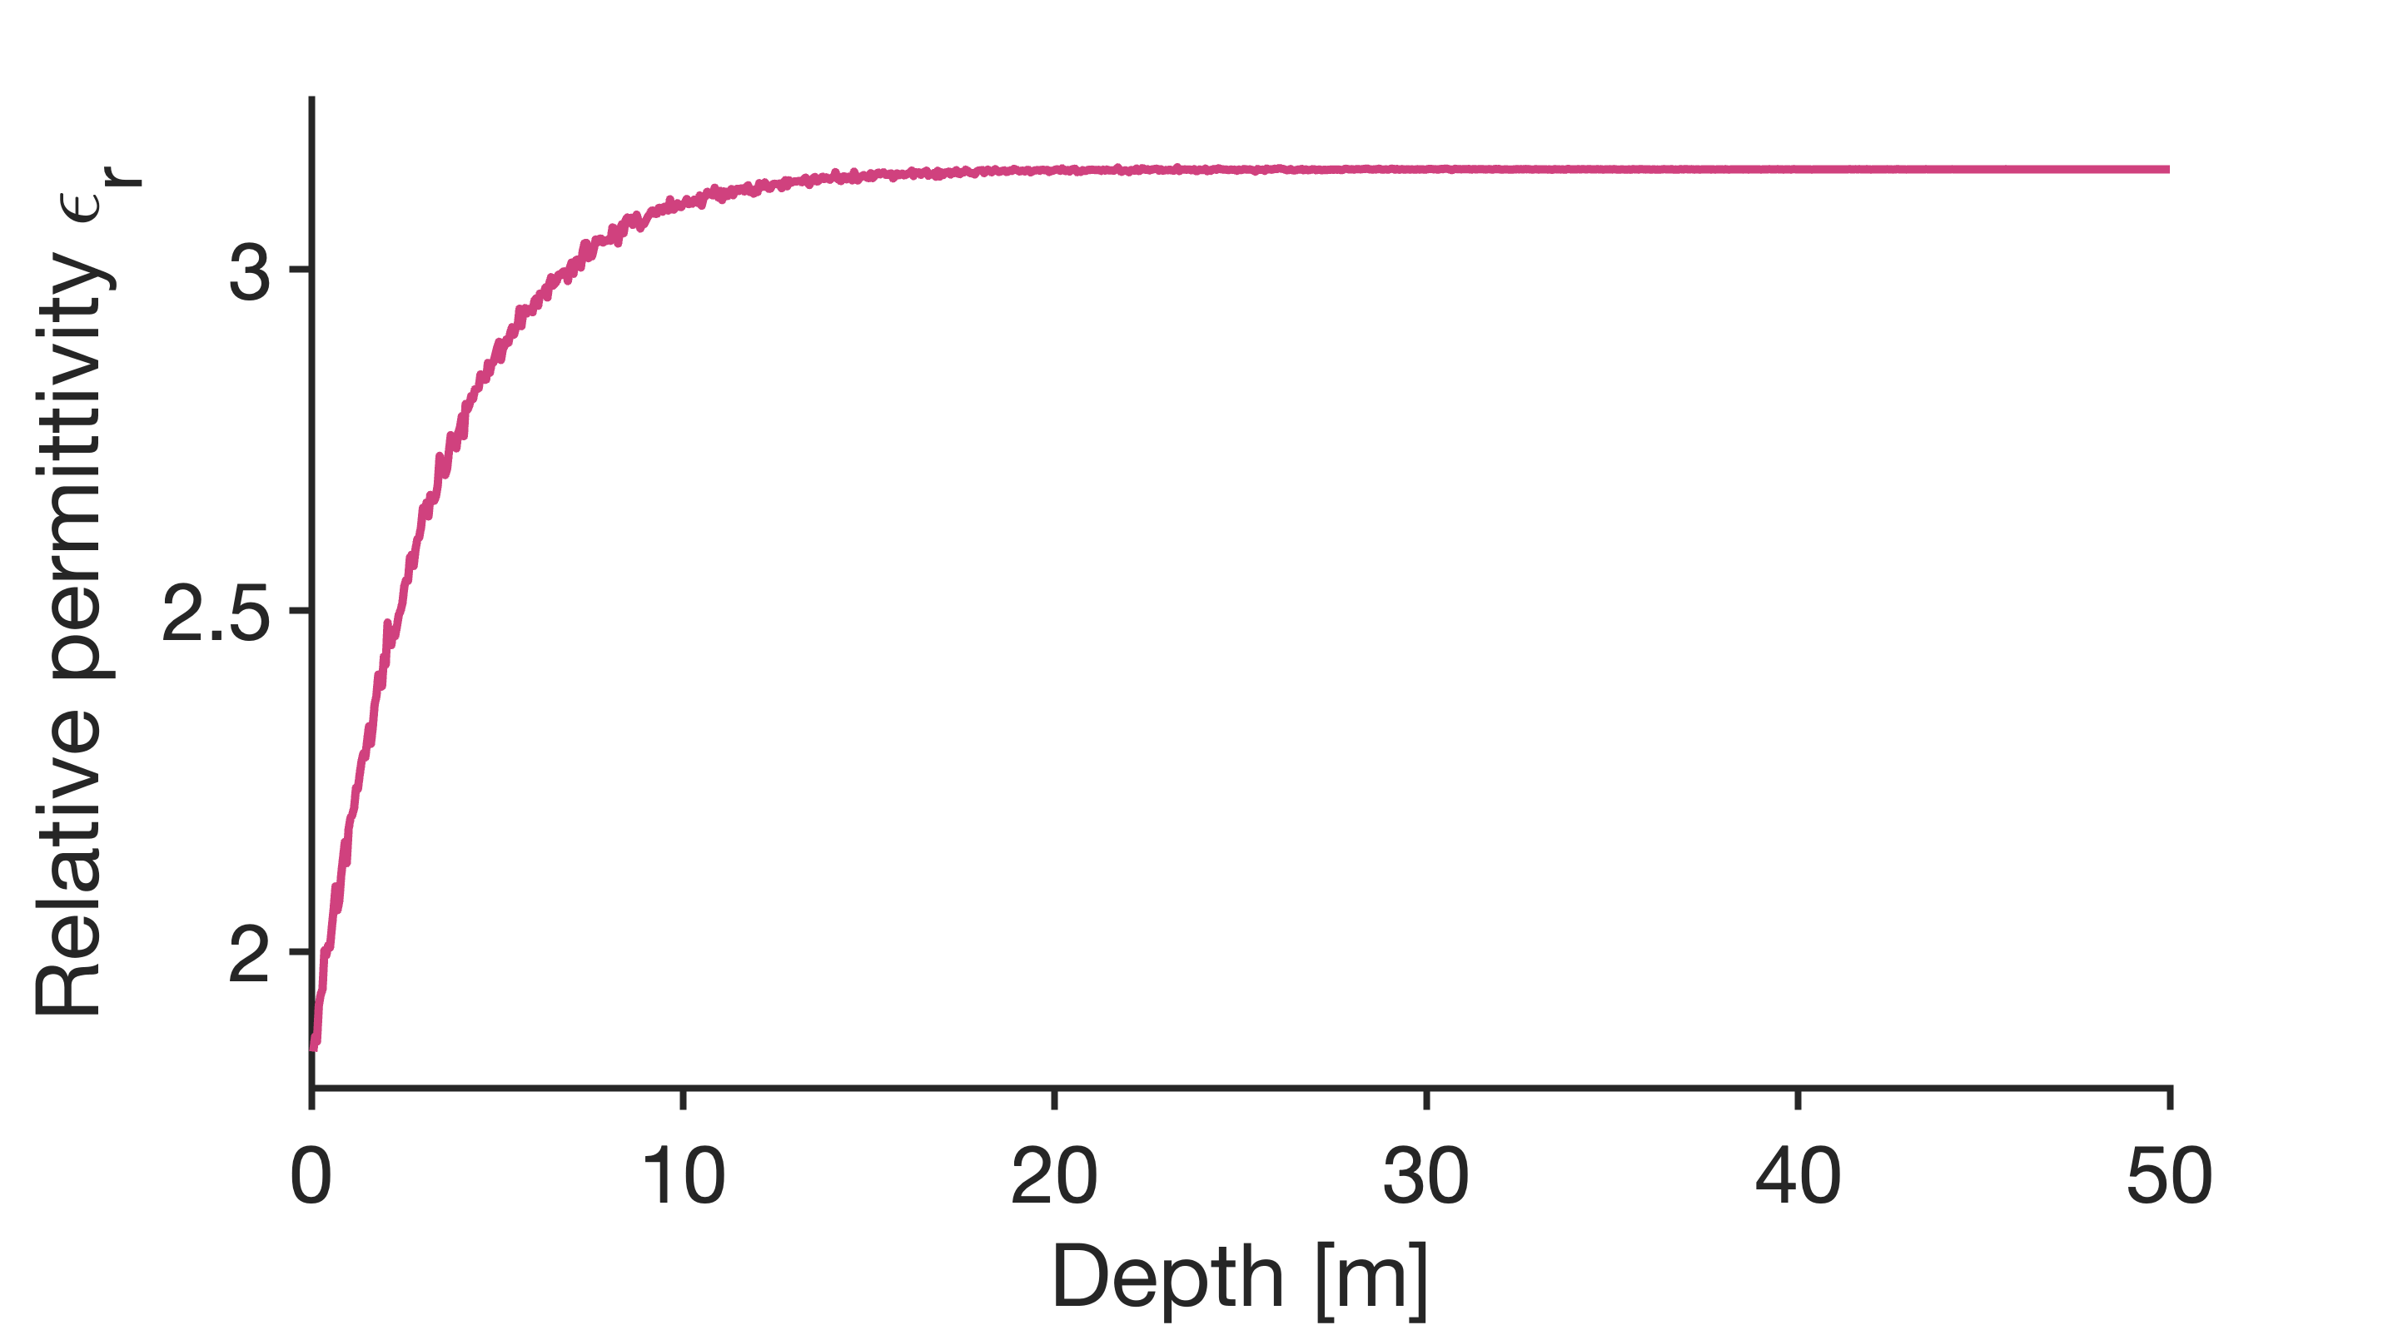
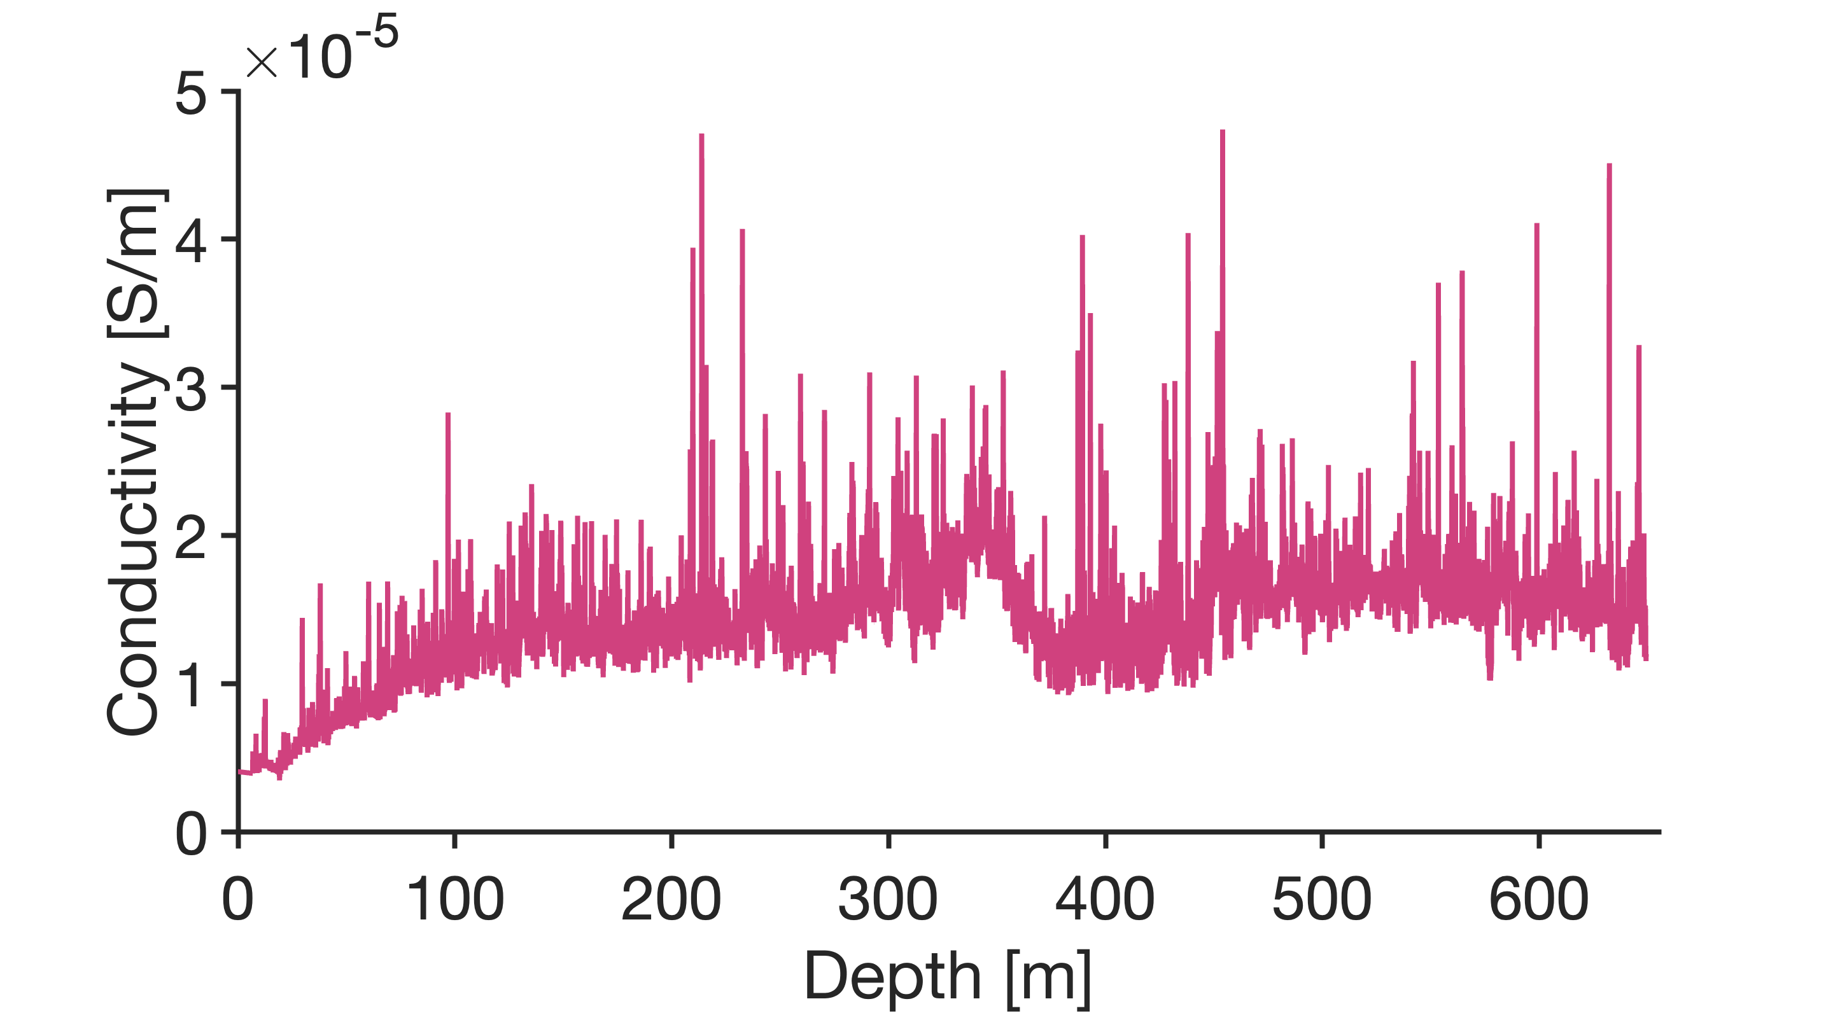
From modeled stratigraphy to synthetic radargrams
Want to know more about gprMax? Click here!
Arrhenius-like temperature
relationship
Open-source software simulating electromagnetic wave propagation
https://commons.wikimedia.org/wiki/File:Aptenodytes_forsteri_-Snow_Hill_Island,_Antarctica_-adults_and_juvenile-8.jpg
https://commons.wikimedia.org/wiki/File:Emerald_rockcod,_Trematomus_bernacchii.jpg
How is the gprMax input created?
Place conductivity and permittivity profiles where ice is thickest as a reference
Use the distances between the modeled layers as a measure to stretch and compress the profiles at the other points of the profile
Scale the domain size down as gprMax cannot handle big domain sizes
Where do these data come from?
Stratigraphy: Thermo-mechanically-coupled full-Stokes ice-flow model (Elmer/Ice)
Conductivities: Dielectric profiling from Parrenin et al. (2012)
Permittivities: Adapted (and modified) from Hubbard et al. (2013)
Notes:
A

Slide 8
Hurray, a synthetic radargram!
Click on the hands to zoom in!
We even see a multiple here….
Compare basal reflection power between bedrock and water
Learn more about our gprMax setup!

Slide 9
But we were searching for a way to create synthetic radargrams with automatically labeled layers. Does this work now?
Notes:
compare real radargram with simulations

Slide 10
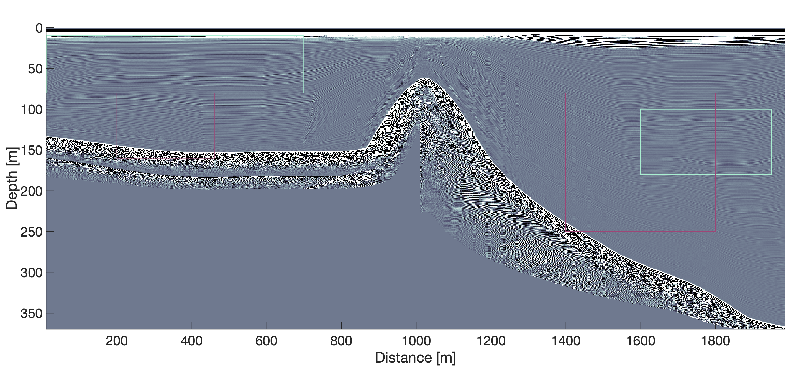
How well does the labeling work?
Click on the hands in the boxes to examine the labels more closely!
Nicely!
Not so nicely…
Labels are not reliable for steep reflectors
Labels work best for horizontal layers
Notes:
Add some labeled lines in this plot as well

Slide 11
Let’s talk numbers…
4000 m x 400 m domain is split into three overlapping subdomains of 2000 m x 400 m size
790 traces are modeled for each subdomain on four NVIDIA H100 GPUs
Duration of whole simulation
Subdomain 1: 1 day, 9 hours, 50 minutes
Subdomain 2: 1 day, 9 hours, 15 minutes
Subdomain 3: 1 day, 9 hours, 30 minutes
One trace can be modeled in roughly 2 minutes and 30 seconds

Slide 12
Problems and how to (possibly) solve them
Synthetic radargrams are very clean
Use 50 MHz PulseEKKO data to get a noise estimate and add noise to synthetic radargrams
Labeling of synthetic radar data does not work well everywhere
Only simulate short domains to ensure that slopes are not too steep
Using gprMax with GPUs limits the number of combinations of relative permittivities and electrical conductivities that can be specified
Here, we only model continuous layers. In reality, layers are often interrupted.

Slide 13
Possible applications and next steps
Use the synthetic data for training machine learning algorithms to infer…
internal stratigraphy
ice temperature
basal reflectivity
attenuation
... from radargrams.
AWI airborne Ultra-Wideband Radar

Slide 14
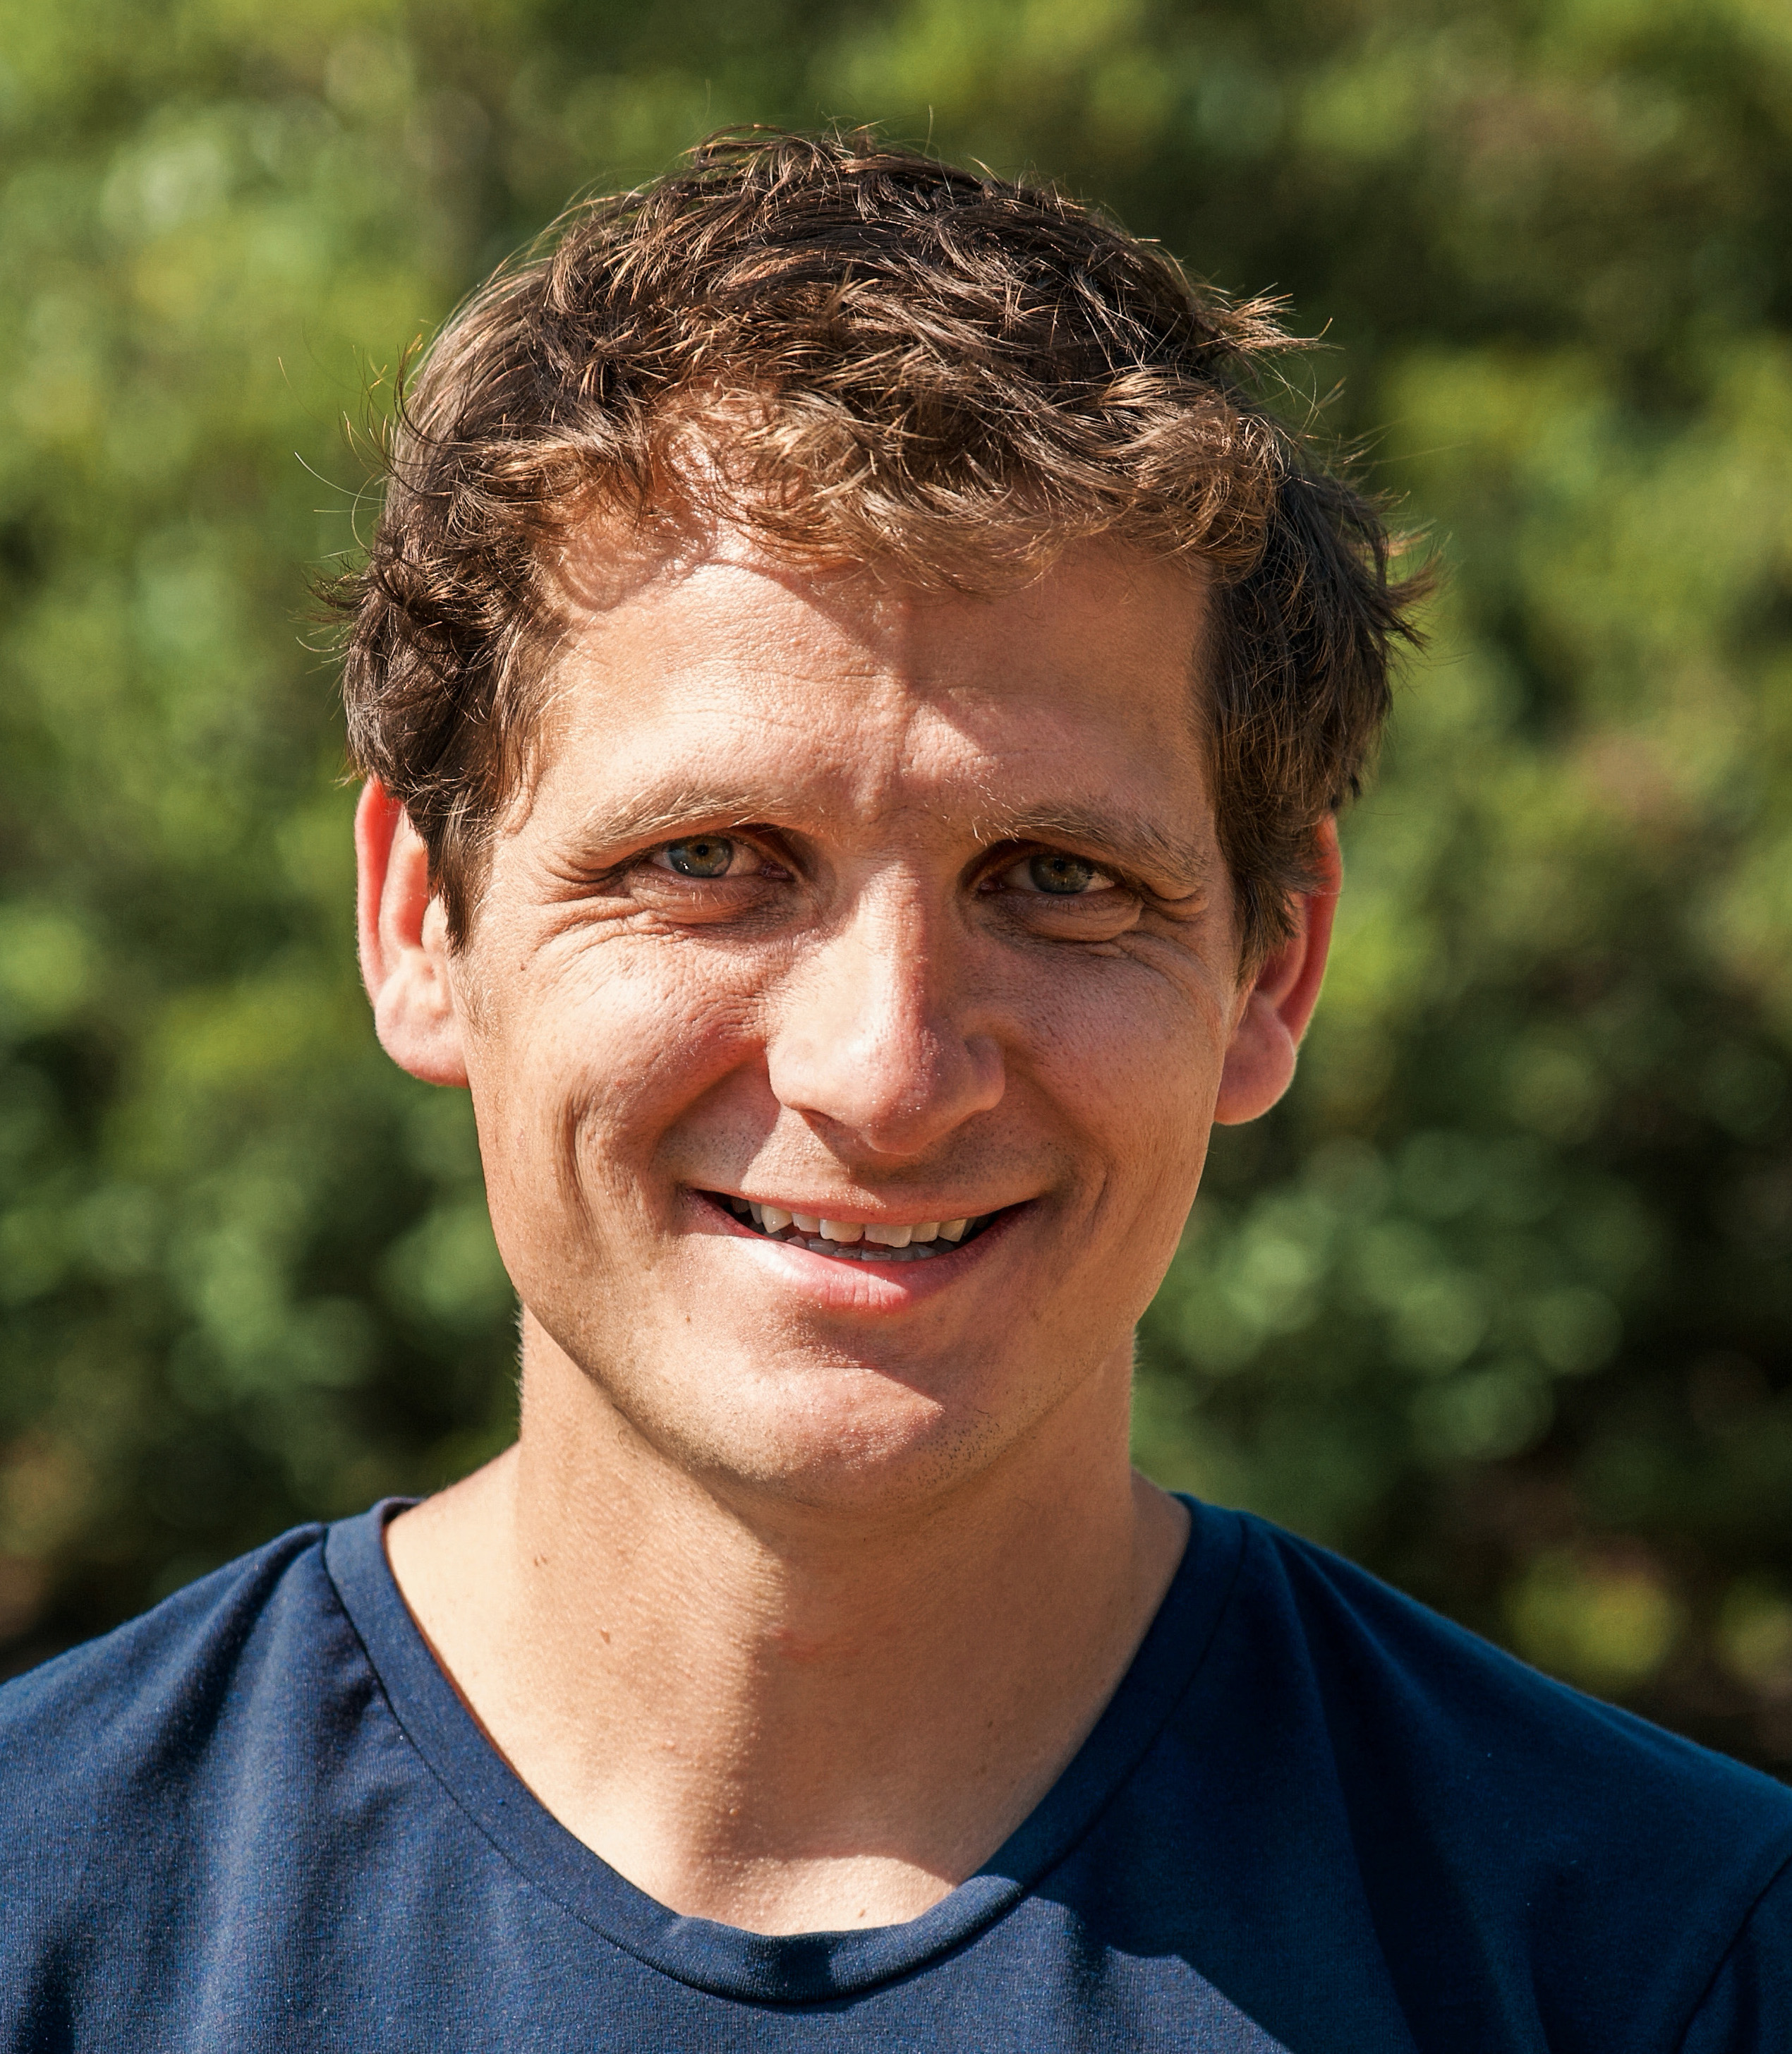
Acknowledgments
A. Clara J. Henry
Guy Moss
Reinhard Drews
Vjeran Višnjević
Contact details
leah-sophie.muhle@student.uni-tuebingen.de

Slide 15
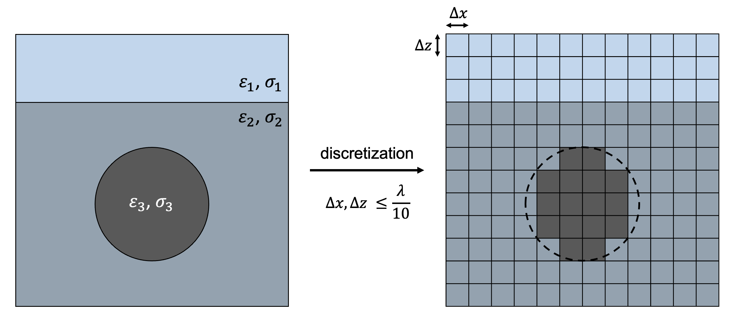
What is gprMax and how does it work?
Take me back
Create gprMax input
Represent and discretize geometry as cell array
Each cell gets assigned a relative permittivity $ε_{r}$ and conductivity $σ$ representing a certain material, e.g., water
Cell size/resolution depends on frequency or the smallest wavelength of the propagating field $λ$, respectively
Strongly limits the possible domain size
Open-source software simulating electromagnetic wave propagation
Solves Maxwell’s equations numerically with finite-difference time-domain (FDTD) method for ground-penetrating radar (GPR)
Employs Perfectly Matched Layer (PML) boundary conditions
FDTD solver can be accelerated with GPUs

Slide 16
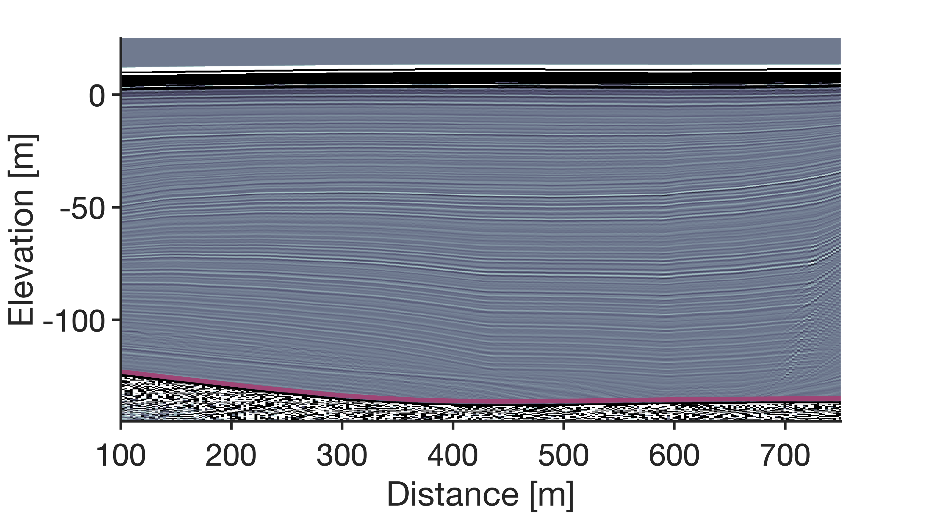
Take me back
In areas with flat topography, the synthetic radargrams reflect the real topography well.
Actual bottom of ice

Slide 17
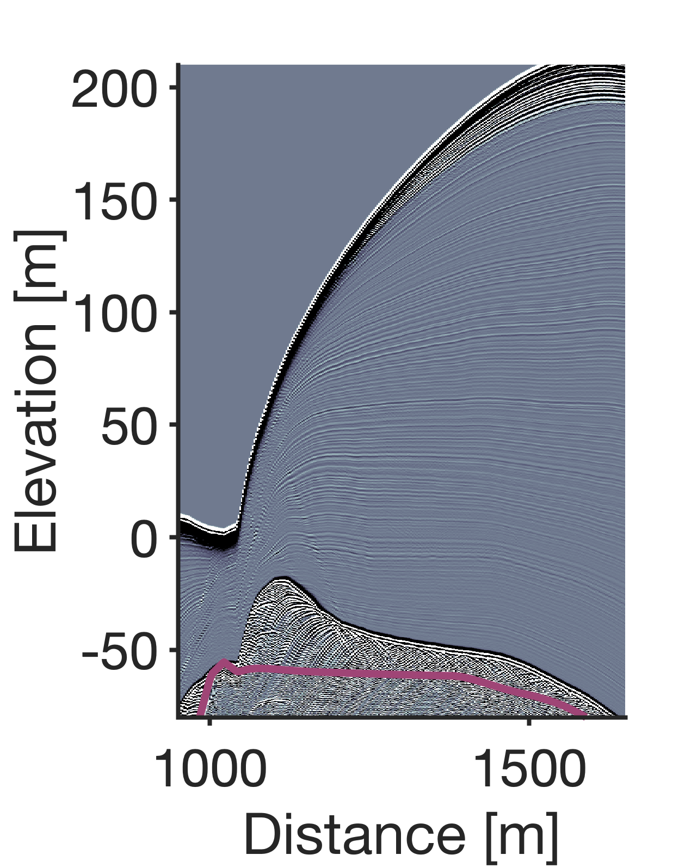
Take me back
In areas with steep slopes, the synthetic radargrams differ from the real topography.
To avoid this…
Only model topographies with low slopes.
Don’t scale long domains down too much!
Actual bottom of ice

Slide 18
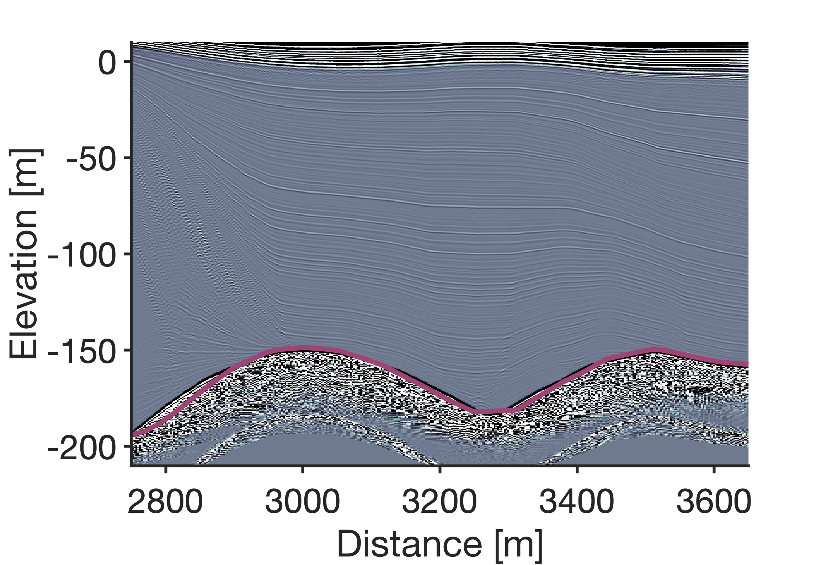
Take me back
In areas with low slopes, the synthetic radargram reflects the real topography well. With increasing slopes, the deviation of the synthetic radargrams from the real topography grows.
Actual bottom of ice

Slide 19
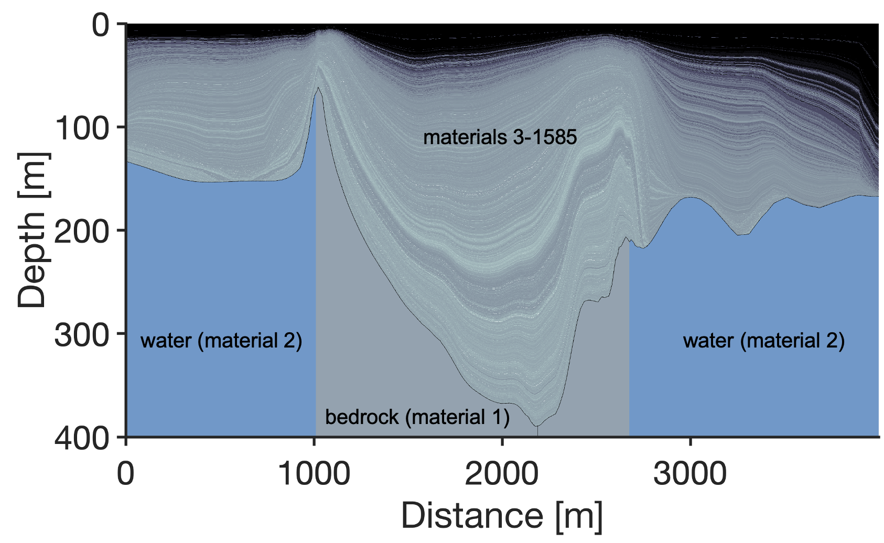
gprMax setup
Take me back
gprMax input:
Array of integers representing different materials
Each material is defined by a combination of relative permittivity and conductivity
Input array needs to be flattened
gprMax parameters:
Frequency: 50 MHz
Wavelet: Ricker
GPUs: 4 NVIDIA H100
Resolution: 0.05 m x 0.05 m
Domain size: 4000 m x 400 m
Split into 3 subdomains of 2000 m length with 1000 m overlap

Slide 20
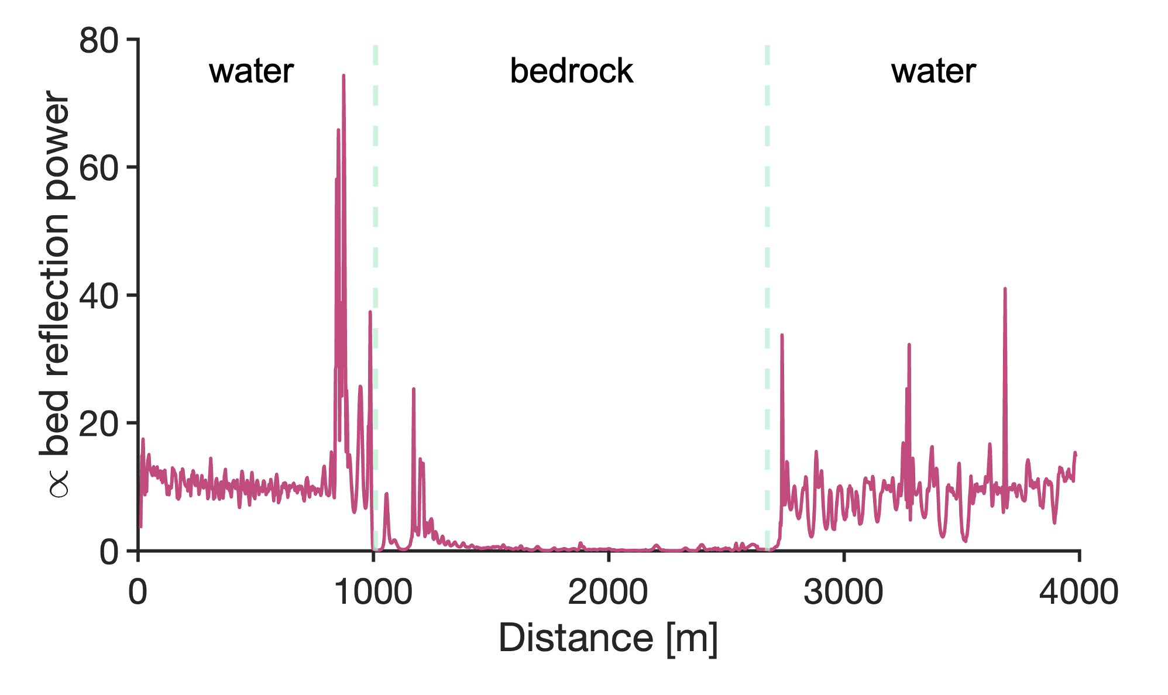
Maximal basal reflection
Take me back
Due to the higher permittivity contrast, reflection at the ice-water interface is considerably stronger than at the ice-bedrock interface.

Slide 21
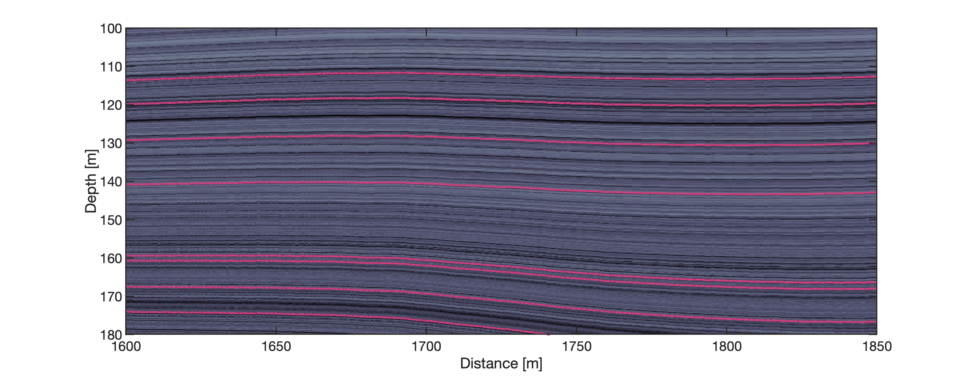
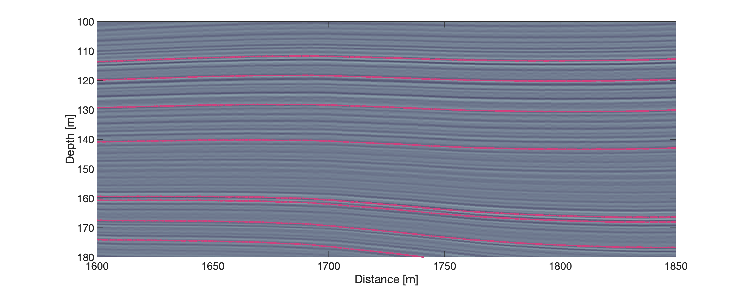
Labels work best for horizontal layers
Take me back
Layers defined by conductivity input
Good overlap of input layers with layers in synthetic radargram

Slide 22
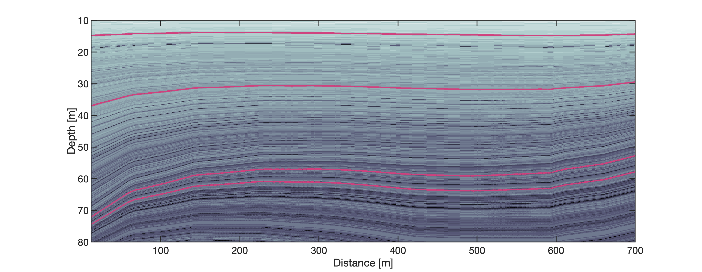
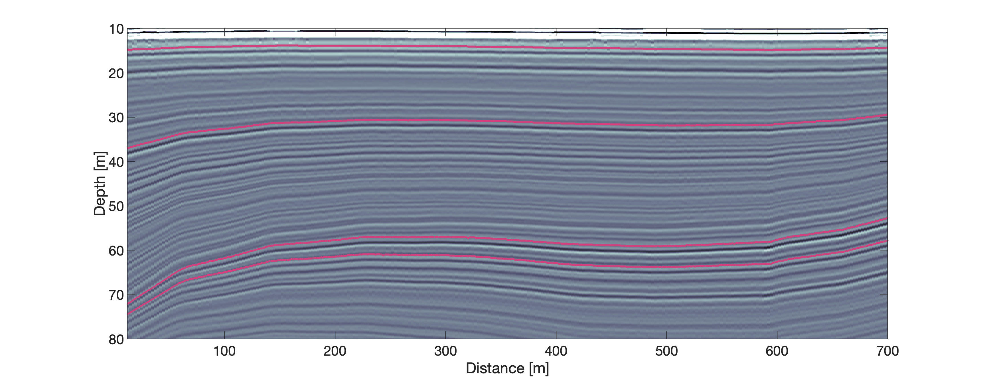
Labels work best for horizontal layers
Take me back
Layers defined by conductivity input
Good overlap of input layers with layers in synthetic radargram

Slide 23
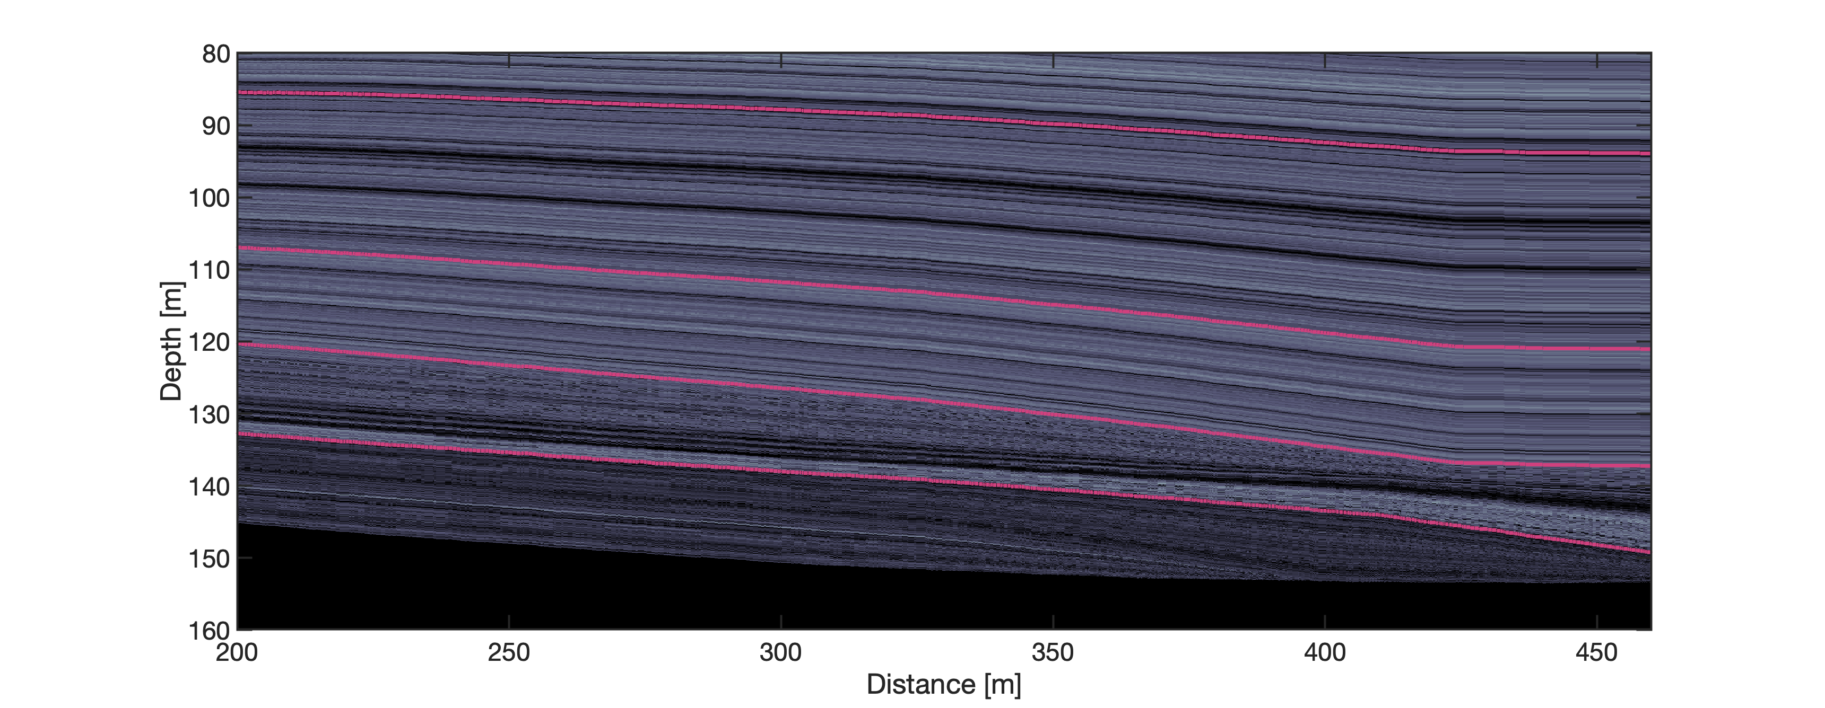
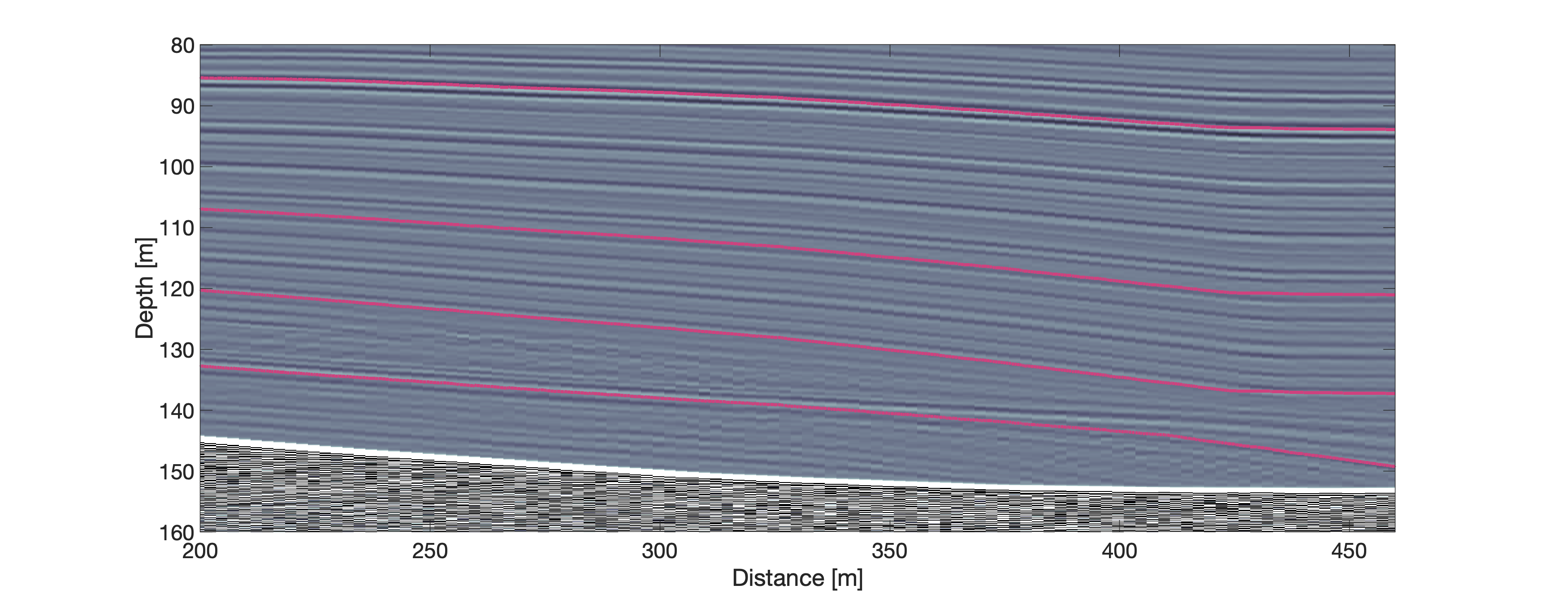
Labels are not reliable for steep reflectors
Take me back
Layers defined by conductivity input
Only partial overlap of input layers with layers in synthetic radargram
indicates how layers in radargram would be correctly propagated

Slide 24
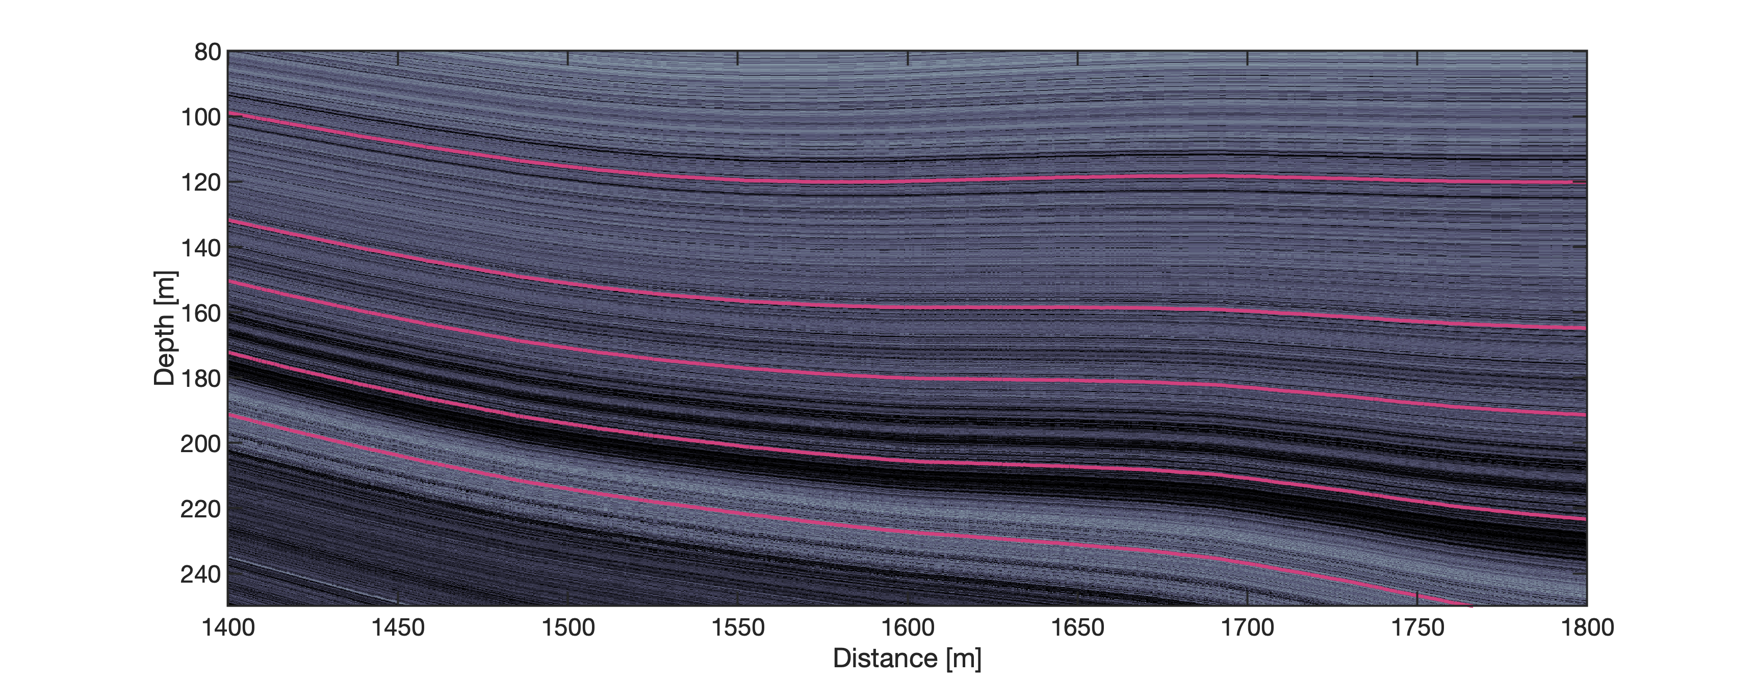
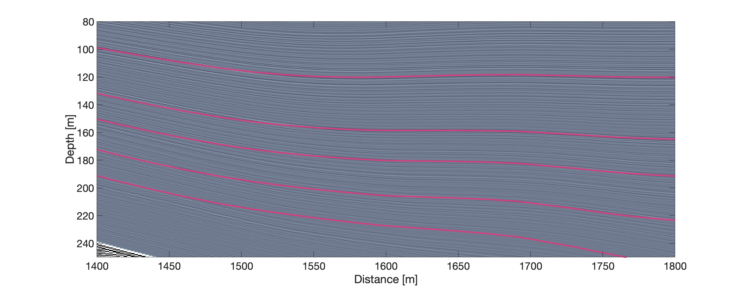
Labels are not reliable for steep reflectors
Take me back
Layers defined by conductivity input
Only partial overlap of input layers with layers in synthetic radargram
indicates how layers in radargram would be correctly propagated

