Slide 1
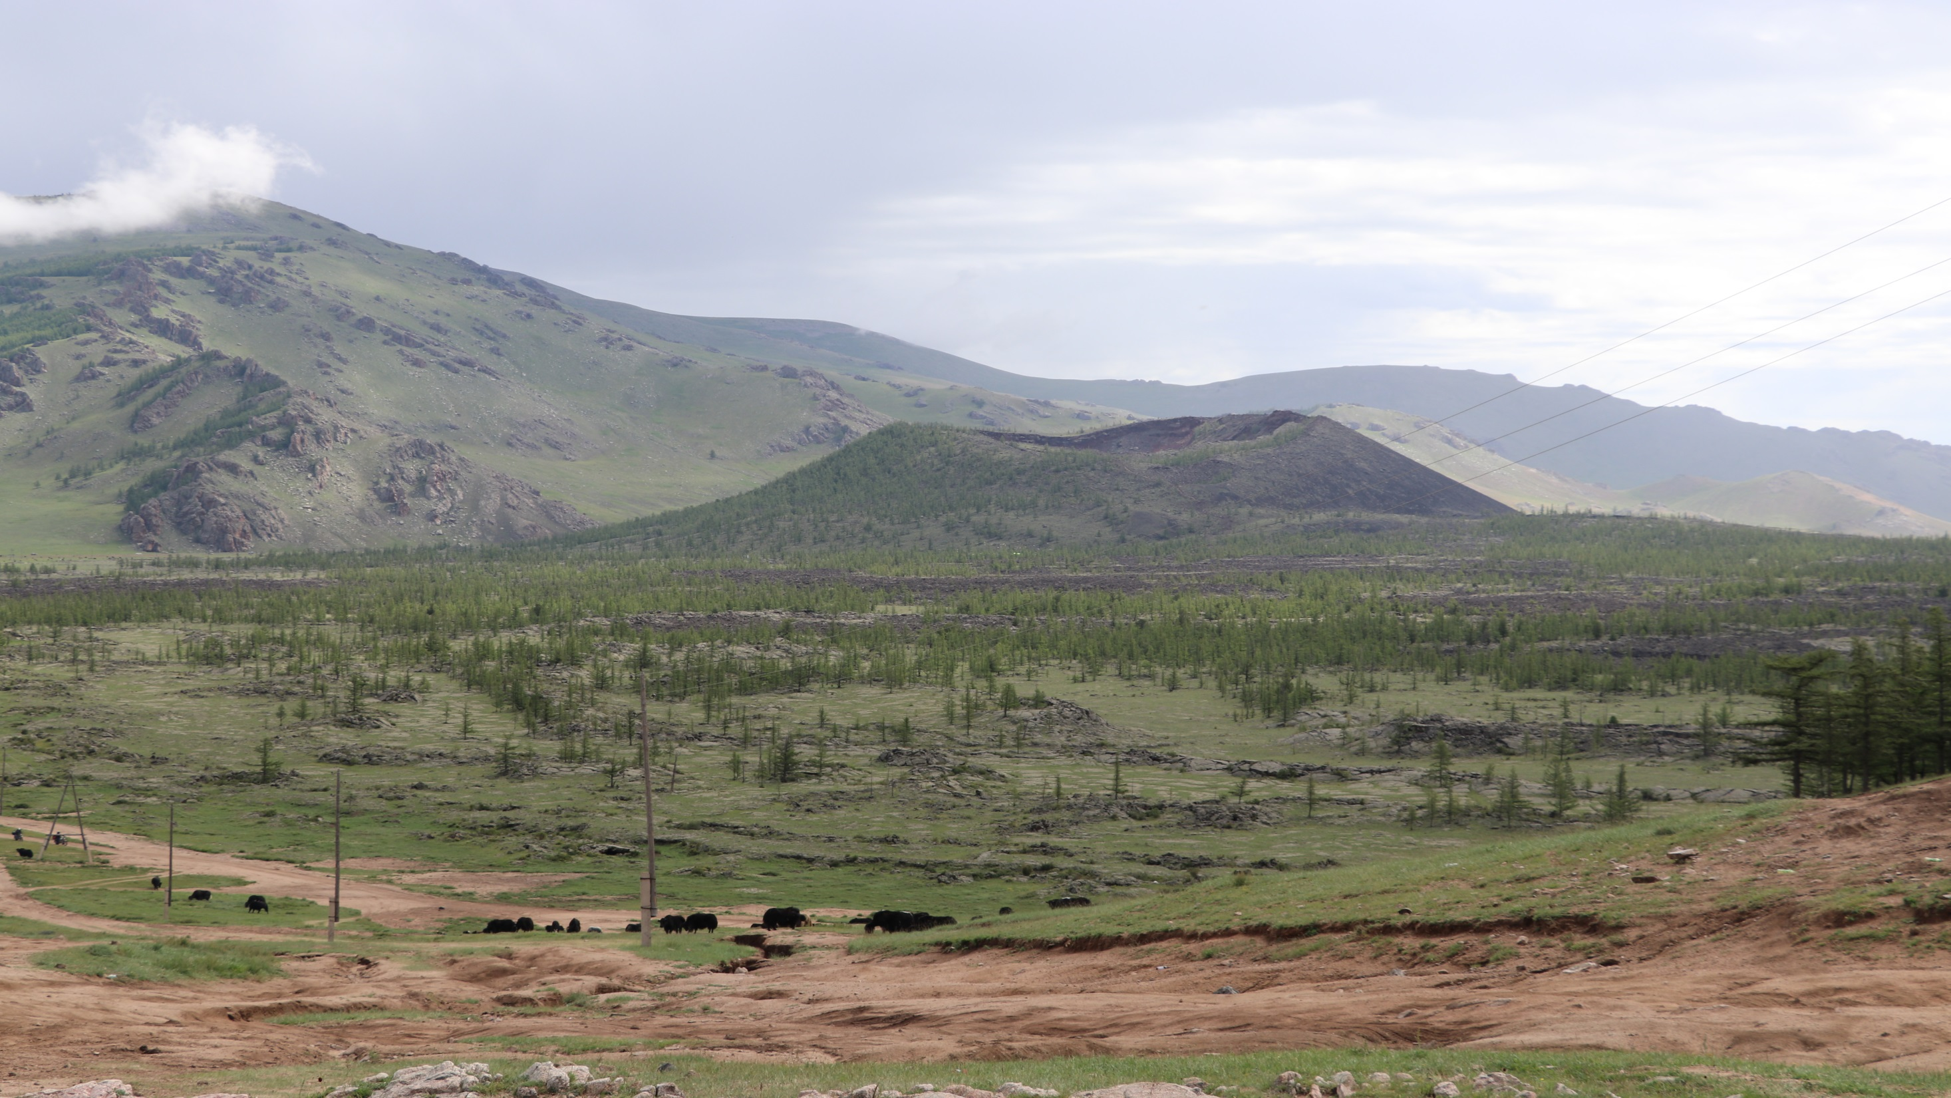
Evidence for long-lived continental intraplate magmatism: A case study from Mongolia
Supplementary materials
Martha Papadopoulou, Tiffany L. Barry, Batulzii Dash, Alison M. Halton, Sarah C. Sherlock, Alison C. Hunt

Slide 2
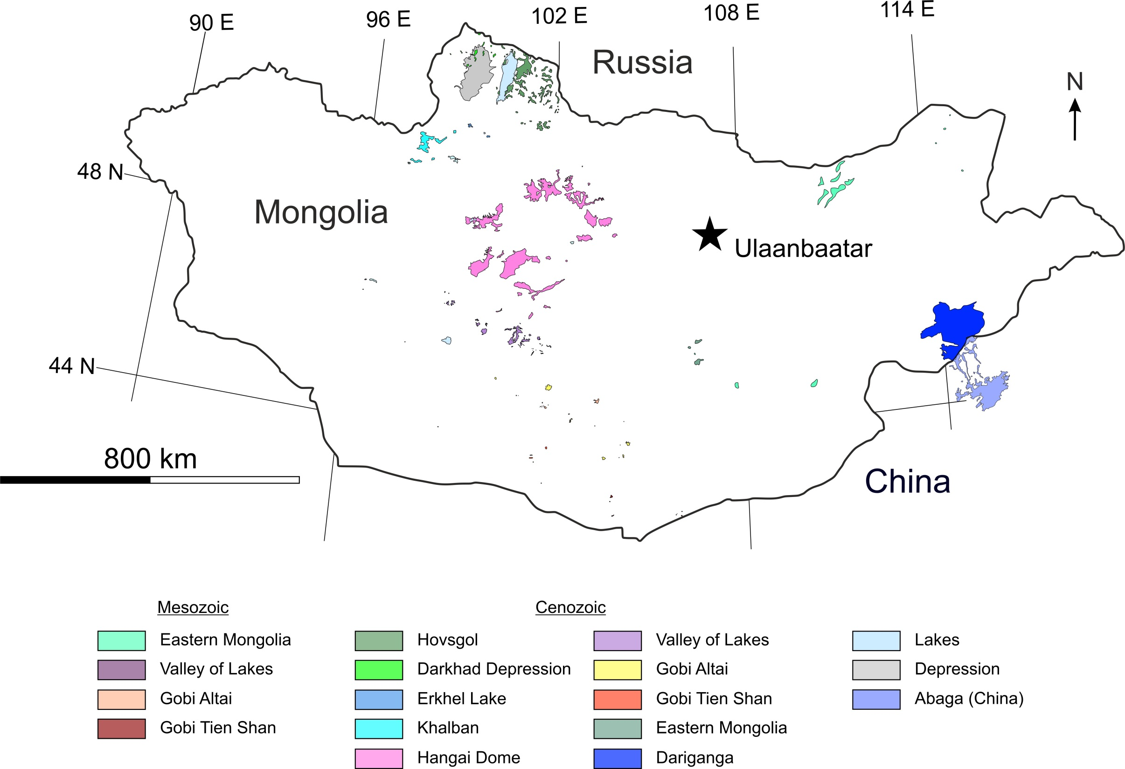
Papadopoulou et al. In Review

Slide 3
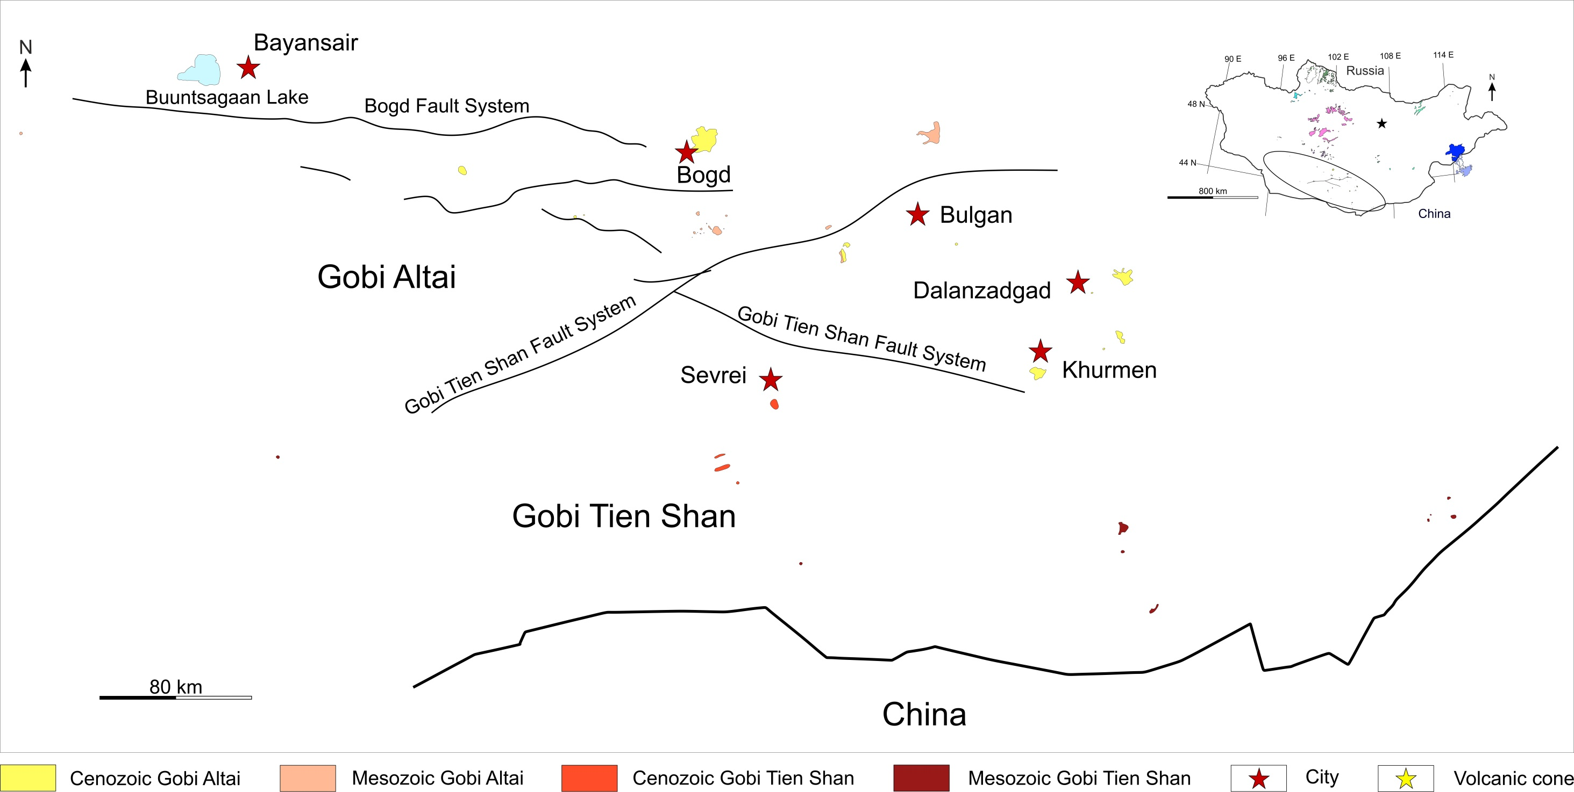
Papadopoulou et al. In Review

Slide 4
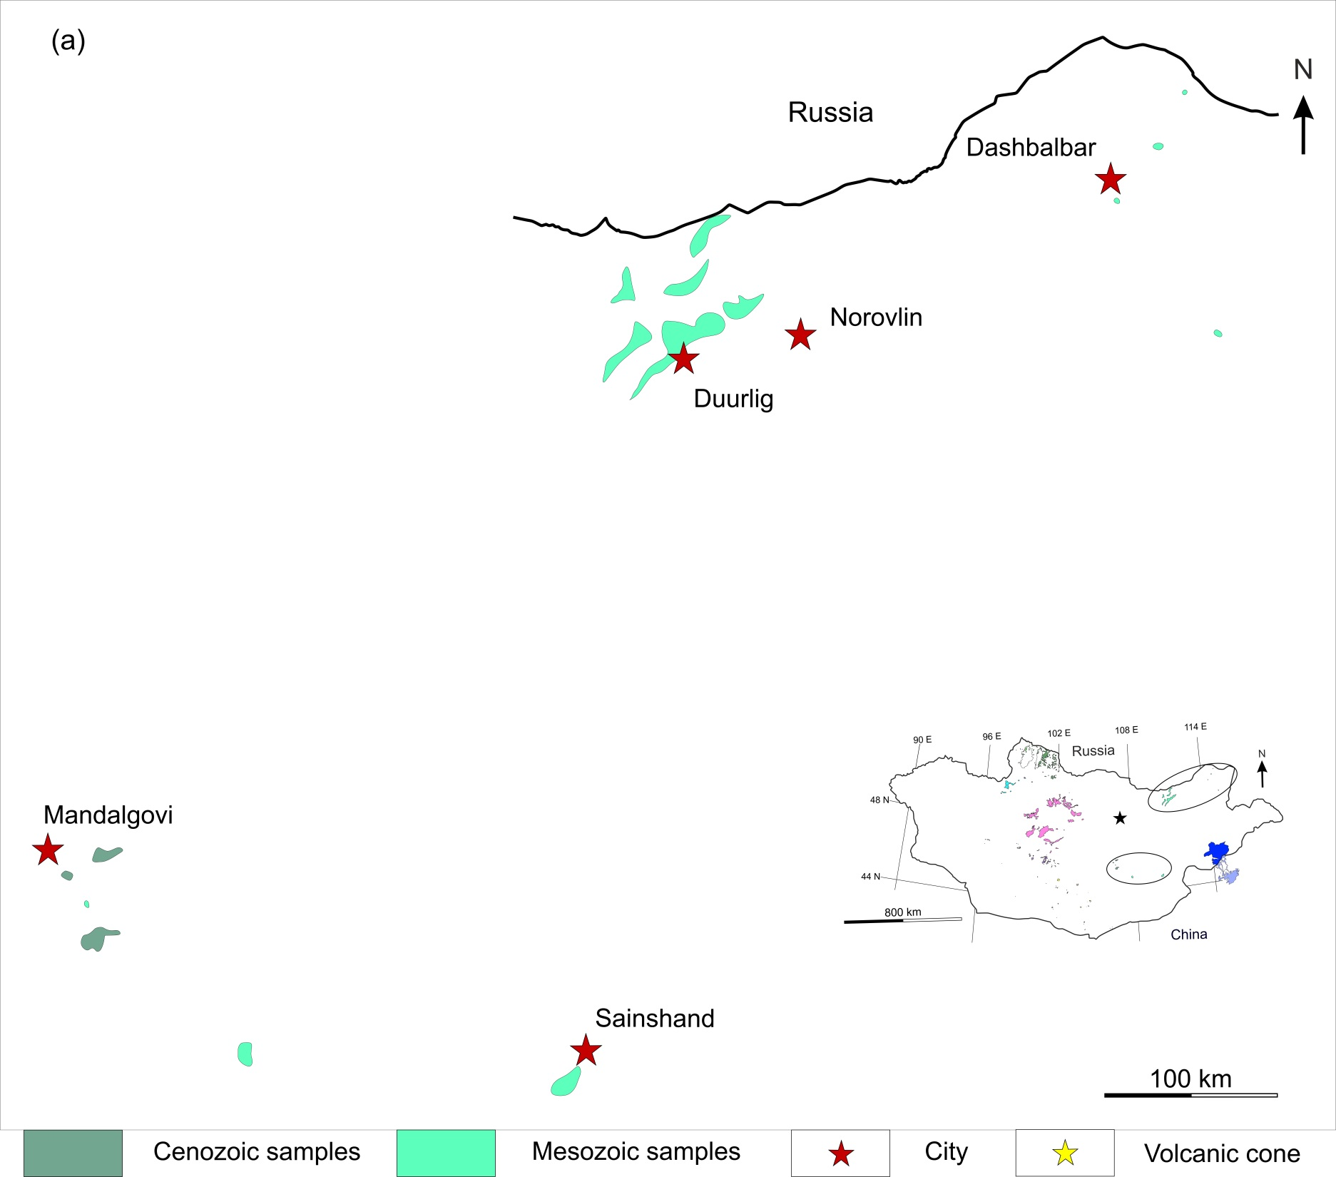
Papadopoulou et al. In Review

Slide 5
References
For the extent of the various volcanic provinces: Ancuta et al., 2018; Barry et al., 2003; Chen et al., 2015; Chuvasova et al., 2012; Cunningham et al., 2003; Daxner-Höck et al., 2017; Hankard et al., 2007a; Kuznetsov et al., 2022; Perepelov et al., 2020; Rasskazov et al., 2003; Tsypukova et al., 2014, 2022, Yarmolyuk et al., 2007a, 2008, 2015, 2019, 2020; This study; Google Earth surficial exposures of volcanic rocks
For ΔNb vs age figure: Ancuta et al., 2018; Barry et al., 2003; Dash et al., 2015; Enkhtuvshin, 1995; Kuznetsov et al., 2022; Papadopoulou et al., 2020; Sheldrick et al., 2018, 2020; Tsypukova et al., 2014, 2022, Yarmolyuk et al., 1995, 2003, 2007a, 2007b, 2008, 2015, 2019, 2020
For the geochemical evolution with time figure:
Mongolian field: references as above
Post-collisional magmatism: Duggen et al., 2005
Normal mid-ocean ridges basalt: Gale et al., 2013
Continental arc basalt: Kelemen et al., 2003
Ocean island basalt: Sun & McDonough, 1989

Slide 6
References
For the age constraints:
Hovsgol: Amirkhanov et al., 1985; Ivanenko et al., 1988; Rasskazov et al., 2003; Yarmolyuk et al., 2003; Tsypukova et al., 2014; Ivanov et al., 2015; Ancuta et al., 2018
Darkhad Depression: Ivanenko et al., 1988; Rasskazov et al., 2003; Yarmolyuk et al., 2003; Ivanov et al., 2015; Ancuta et al., 2018; Tsypukova et al., 2022
Erkhel Lake: Ancuta et al., 2018
Khalban: Ancuta et al., 2018
Hangai Dome: Devyatkin et al., 1973; Gabuniya et al., 1975; Devyatkin & Smelov, 1980; Devyatkin et al., 1981; Saltykovsky et al., 1984; Ionov et al., 1992; Enkhtuvshin, 1995; Schlupp, 1996; Barry et al., 2003; Devyatkin, 2004; Yarmolyuk et al., 2007a, 2008, 2015; Ivanov et al., 2015; Ancuta et al., 2018;
Valley of Lakes: Mellet, 1968; Badamgarav et al., 1973; Gabuniya et al., 1975; Devyatkin & Smelov, 1980; Devyatkin, 1981; Gorshkov et al., 1991; Schlupp, 1996; Devyatkin et al., 2002; Yarmolyuk et al., 2015; Daxner-Höck et al., 2017; Ancuta et al., 2018; This study
Gobi Altai: Gabuniya et al., 1975; Chichagov, 1976; Devyatkin & Smelov, 1980; Samoylov & Kovalenko, 1983; Shuvalov & Nikolaeva, 1985; Gorshkov et al., 1991; Enkhtuvshin, 1995; Schlupp, 1996; Hankard et al., 2005, 2007a, 2007b; Yarmolyuk et al., 1995, 2007b, 2015; Sheldrick et al., 2018; Togtokh et al., 2019; This study

Slide 7
References
For the age constraints:
Gobi Tien Shan: Shuvalov & Nikolaeva, 1985; Barry et al., 2003; Yarmolyuk et al., 1995, 2007b, 2015
Eastern Mongolia: Chichagov, 1976; Enkhtuvshin, 1995; Dash et al., 2015; Bars et al., 2018; Yarmolyuk et al., 2019, 2020; Kuznetsov et al., 2022
Dariganga: This study

