Slide 1
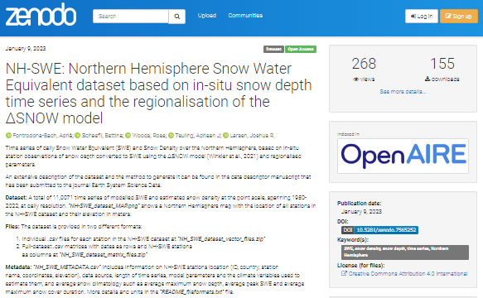
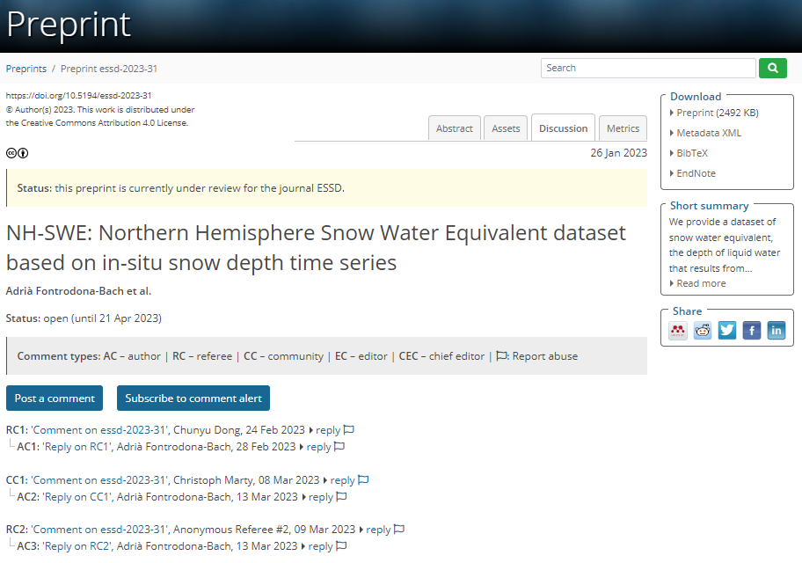
NH-SWE: A new Northern Hemisphere Snow Water Equivalent dataset based on in-situ snow depth time series (1950-2022)
OSPP Participant
Background picture: Pic de l’Orri, 2.436 m.a.s.l (Pyrenees)
Dataset
zenodo.org/record/7515603
axf984@bham.ac.uk
Fontrodona-Bach et al., 2023a
@Fontro22
Adrià Fontrodona-Bach¹, Bettina Schaefli², Ross Woods³, Ryan Teuling⁴ and Josh Larsen¹
Data paper
¹ School of Geography, University of Birmingham, UK; ² Department of Civil Engineering, University of Bristol, UK;
³ Institute of Geography, University of Bern, Switzerland; ⁴ Hydrology and Quantitative Water Management group, Wageningen University, The Netherlands;
essd.copernicus.org/preprints/essd-2023-31/
Fontrodona-Bach et al., 2023b
(in review at ESSD)

Slide 2
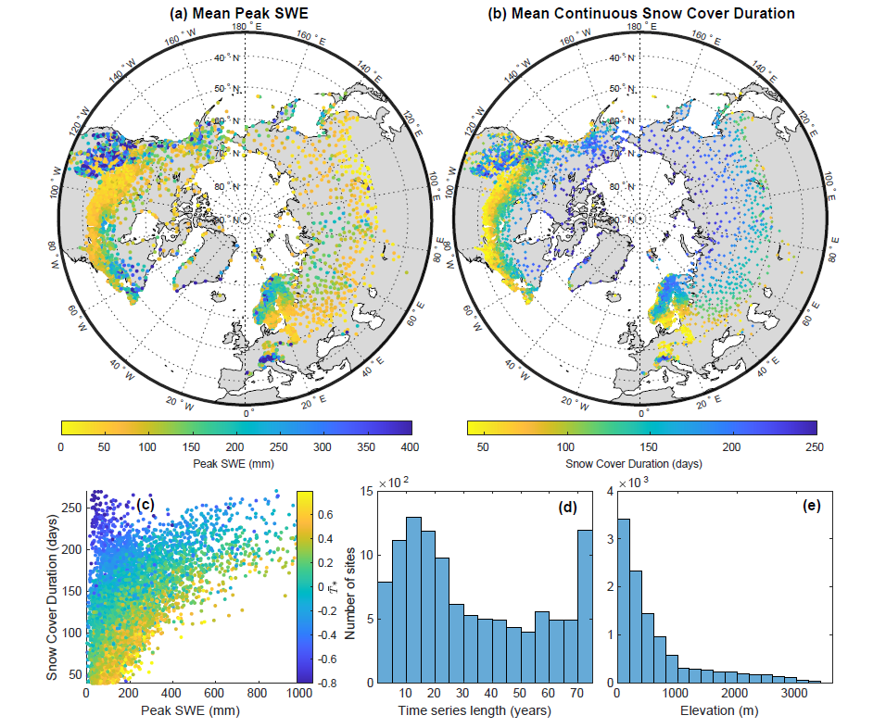
NH-SWE: A new Northern Hemisphere Snow Water Equivalent dataset based on in-situ snow depth time series (1950-2022)
OSPP Participant
Dataset
Adrià Fontrodona-Bach¹, Bettina Schaefli², Ross Woods³, Ryan Teuling⁴ and Josh Larsen¹
¹ School of Geography, University of Birmingham, UK; ² Department of Civil Engineering, University of Bristol, UK; ³ Institute of Geography, University of Bern, Switzerland; ⁴ Hydrology and Quantitative Water Management group, Wageningen University, The Netherlands;
NH-SWE dataset
Free to use and available
Main dataset features:
11,071 stations
Daily SWE time series
Point scale
1950-2022 period
1-73 full gap-free years
Mountains included
zenodo.org/record/7515603
Fontrodona-Bach et al., 2023a
Data paper
Data description paper
Modelled SWE, but based on observed snow data
essd.copernicus.org/preprints/essd-2023-31/
Fontrodona-Bach et al., 2023b
(in review at ESSD)
Figure 1. NH-SWE dataset characteristics. Taken from Fontrodona-Bach et al., (2023) (in review)
To overview
axf984@bham.ac.uk
@Fontro22

Slide 3
NH-SWE: A new Northern Hemisphere Snow Water Equivalent dataset based on in-situ snow depth time series (1950-2022)
OSPP Participant
Dataset
Adrià Fontrodona-Bach¹, Bettina Schaefli², Ross Woods³, Ryan Teuling⁴ and Josh Larsen¹
¹ School of Geography, University of Birmingham, UK; ² Department of Civil Engineering, University of Bristol, UK; ³ Institute of Geography, University of Bern, Switzerland; ⁴ Hydrology and Quantitative Water Management group, Wageningen University, The Netherlands;
Back to 2-min intro
Overview
zenodo.org/record/7515603
How did we generate the dataset?
Fontrodona-Bach et al., 2023a
Lack of reliable SWE data
Data paper
Background:
Why do we need a SWE dataset?
Northern Hemisphere in-situ Snow Depth time series
Lots of snow depth data
NH-SWE dataset
Many HS-SWE conversion models
∆SNOW model (Winkler et al., 2021)
Parameter regionalisation
Model performance & Evaluation
essd.copernicus.org/preprints/essd-2023-31/
How reliable is it?
Touch coloured boxes to move to the different sections!
Fontrodona-Bach et al., 2023b
(in review at ESSD)
References
axf984@bham.ac.uk
@Fontro22

Slide 4
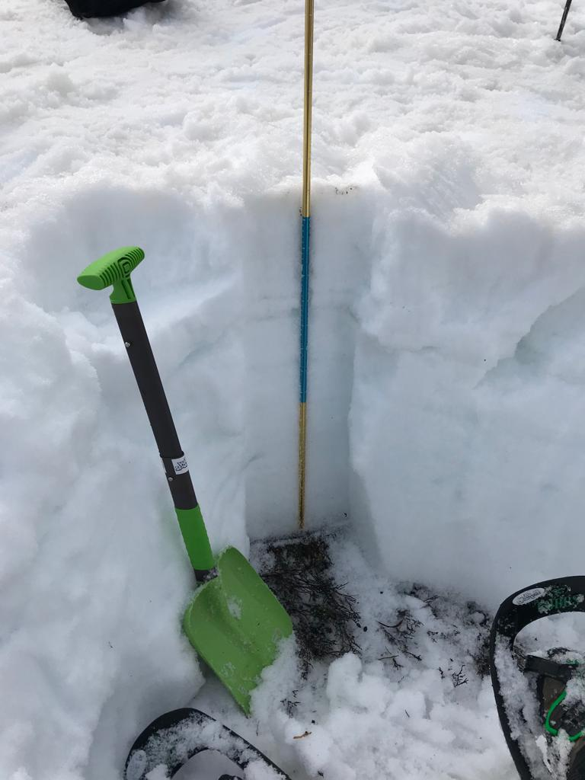
NH-SWE: A new Northern Hemisphere Snow Water Equivalent dataset based on in-situ snow depth time series (1950-2022)
OSPP Participant
Dataset
Adrià Fontrodona-Bach¹, Bettina Schaefli², Ross Woods³, Ryan Teuling⁴ and Josh Larsen¹
¹ School of Geography, University of Birmingham, UK; ² Department of Civil Engineering, University of Bristol, UK; ³ Institute of Geography, University of Bern, Switzerland; ⁴ Hydrology and Quantitative Water Management group, Wageningen University, The Netherlands;
Background: Why do we need a SWE dataset?
zenodo.org/record/7515603
Measuring snow depth
vs Measuring SWE
Fontrodona-Bach et al., 2023a
Next
Data paper
essd.copernicus.org/preprints/essd-2023-31/
So… many snow depth observations available!
Back to overview
References
Fontrodona-Bach et al., 2023b
(in review at ESSD)
Background
Snow Depth data
Model regionalisation
Model Evaluation
NH-SWE dataset
axf984@bham.ac.uk
@Fontro22

Slide 5
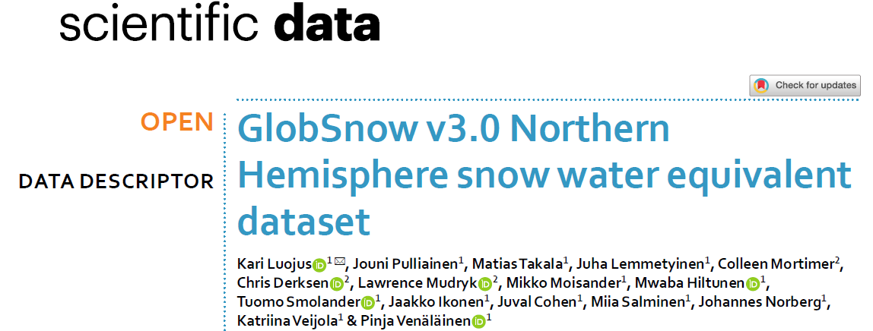
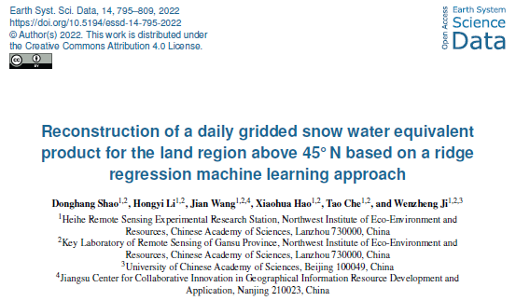
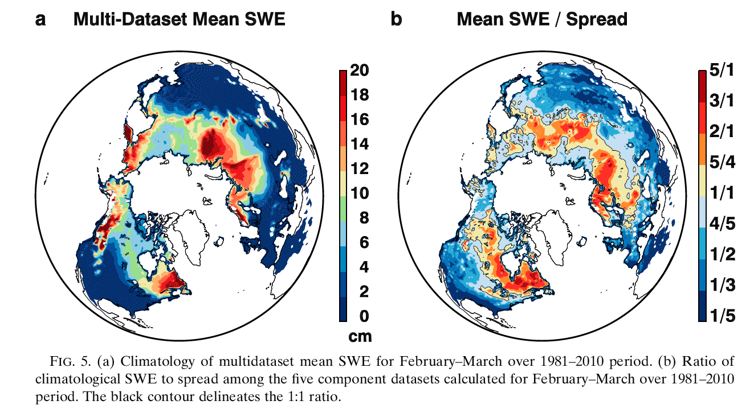
NH-SWE: A new Northern Hemisphere Snow Water Equivalent dataset based on in-situ snow depth time series (1950-2022)
OSPP Participant
Dataset
Adrià Fontrodona-Bach¹, Bettina Schaefli², Ross Woods³, Ryan Teuling⁴ and Josh Larsen¹
¹ School of Geography, University of Birmingham, UK; ² Department of Civil Engineering, University of Bristol, UK; ³ Institute of Geography, University of Bern, Switzerland; ⁴ Hydrology and Quantitative Water Management group, Wageningen University, The Netherlands;
Background: Why do we need a SWE dataset?
Lack of SWE data
zenodo.org/record/7515603
Measuring snow depth
vs Measuring SWE
Fontrodona-Bach et al., 2023a
Next
Data paper
Large differences between gridded SWE estimates
Difficulty to estimate SWE over mountain regions
Often inaccessible SWE observations
Mudryk et al., 2015
essd.copernicus.org/preprints/essd-2023-31/
So… many snow depth observations available!
Back to overview
References
Fontrodona-Bach et al., 2023b
(in review at ESSD)
Background
Snow Depth data
Model regionalisation
Model Evaluation
NH-SWE dataset
axf984@bham.ac.uk
@Fontro22

Slide 6
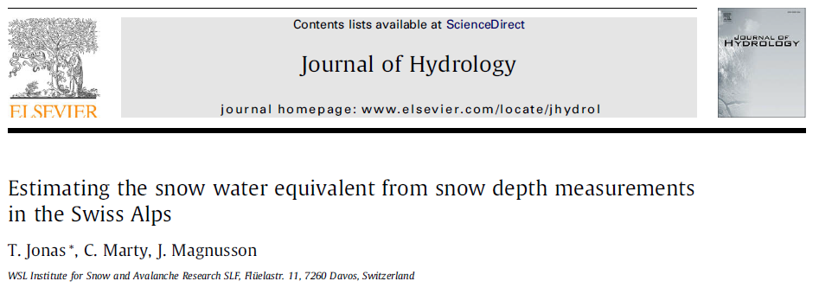
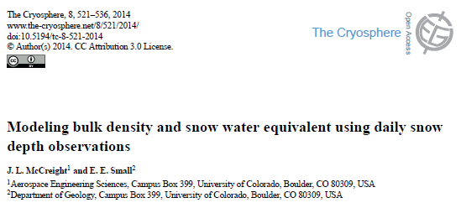
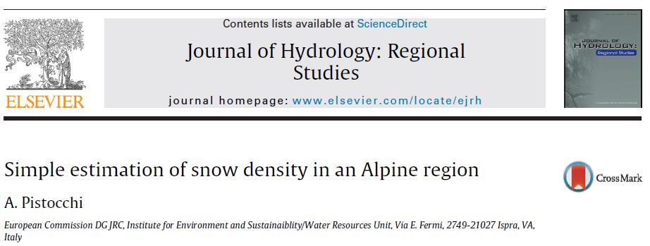
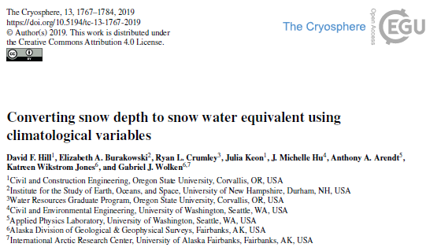
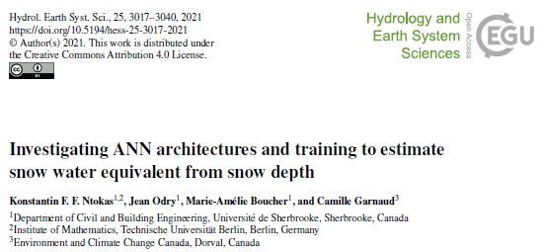
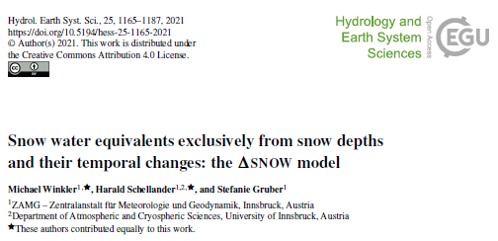
NH-SWE: A new Northern Hemisphere Snow Water Equivalent dataset based on in-situ snow depth time series (1950-2022)
OSPP Participant
Dataset
Adrià Fontrodona-Bach¹, Bettina Schaefli², Ross Woods³, Ryan Teuling⁴ and Josh Larsen¹
¹ School of Geography, University of Birmingham, UK; ² Department of Civil Engineering, University of Bristol, UK; ³ Institute of Geography, University of Bern, Switzerland; ⁴ Hydrology and Quantitative Water Management group, Wageningen University, The Netherlands;
Background: Why do we need a SWE dataset?
Many HS-SWE conversions models!
Lack of SWE data
zenodo.org/record/7515603
Measuring snow depth
vs Measuring SWE
Fontrodona-Bach et al., 2023a
Data paper
Large differences between gridded SWE estimates
Difficulty to estimate SWE over mountain regions
Often inaccessible SWE observations
Mudryk et al., 2015
essd.copernicus.org/preprints/essd-2023-31/
So… many snow depth observations available!
We bring together the availability of snow depth data and conversion models
Back to overview
References
Fontrodona-Bach et al., 2023b
(in review at ESSD)
Background
Snow Depth data
Model regionalisation
Model Evaluation
NH-SWE dataset
axf984@bham.ac.uk
@Fontro22

Slide 7
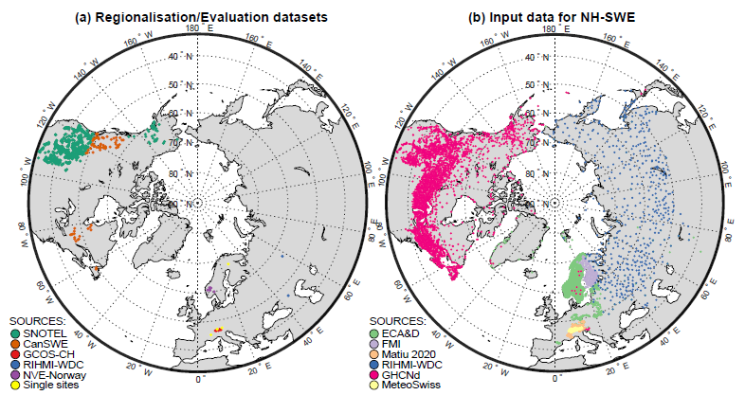
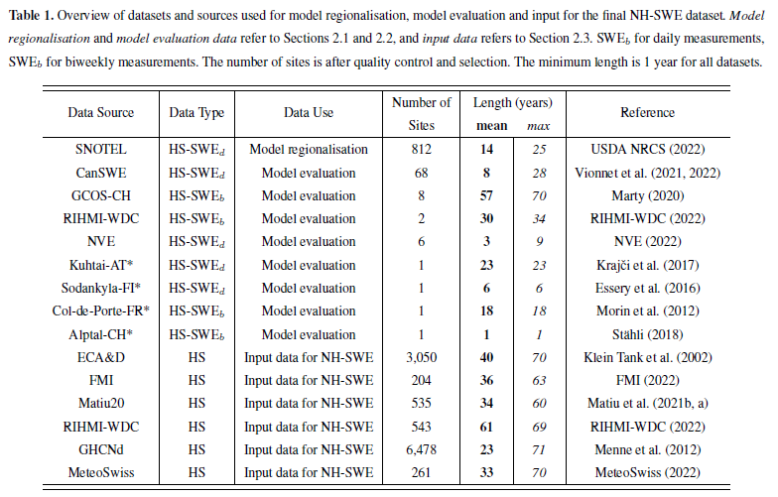
NH-SWE: A new Northern Hemisphere Snow Water Equivalent dataset based on in-situ snow depth time series (1950-2022)
OSPP Participant
Dataset
Adrià Fontrodona-Bach¹, Bettina Schaefli², Ross Woods³, Ryan Teuling⁴ and Josh Larsen¹
¹ School of Geography, University of Birmingham, UK; ² Department of Civil Engineering, University of Bristol, UK; ³ Institute of Geography, University of Bern, Switzerland; ⁴ Hydrology and Quantitative Water Management group, Wageningen University, The Netherlands;
Northern Hemisphere in-situ Snow Depth time series
Figure taken from Fontrodona-Bach et al., 2023 (in review)
Table taken from Fontrodona-Bach et al., 2023 (in review)
zenodo.org/record/7515603
Fontrodona-Bach et al., 2023a
Data paper
But how do we convert them to SWE?
Snow depth collection from 6 different sources over the NH
11,071 snow depth time series after quality control, selection and
Minimum 40 years of yearly snow cover duration on average
Minimum one full snow season available between 1950-2022
essd.copernicus.org/preprints/essd-2023-31/
gap filling
Back to overview
References
Fontrodona-Bach et al., 2023b
(in review at ESSD)
Snow Depth data
Background
Model regionalisation
Model Evaluation
NH-SWE dataset
axf984@bham.ac.uk
@Fontro22

Slide 8
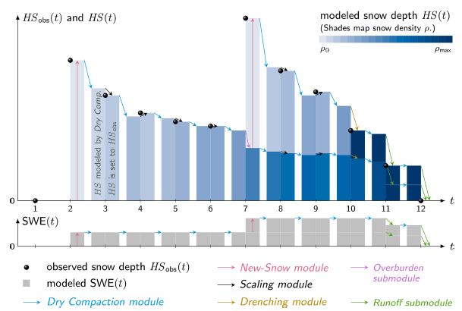
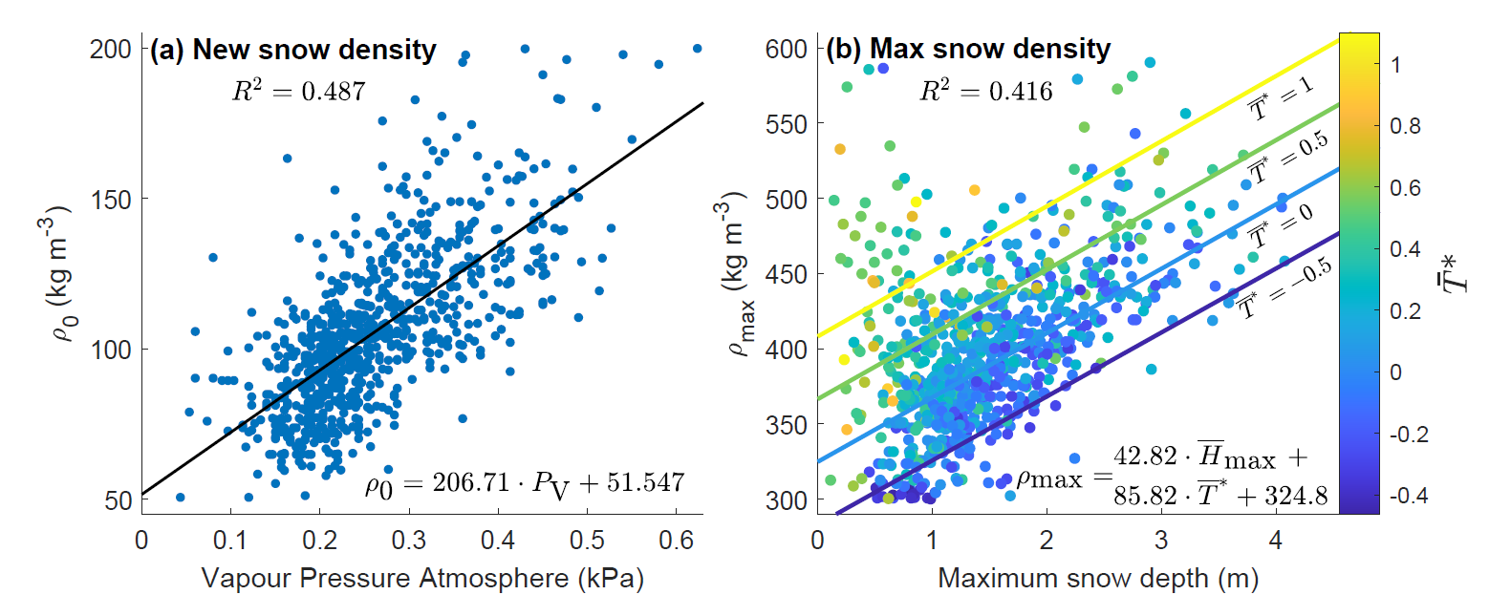
NH-SWE: A new Northern Hemisphere Snow Water Equivalent dataset based on in-situ snow depth time series (1950-2022)
OSPP Participant
Dataset
Adrià Fontrodona-Bach¹, Bettina Schaefli², Ross Woods³, Ryan Teuling⁴ and Josh Larsen¹
¹ School of Geography, University of Birmingham, UK; ² Department of Civil Engineering, University of Bristol, UK; ³ Institute of Geography, University of Bern, Switzerland; ⁴ Hydrology and Quantitative Water Management group, Wageningen University, The Netherlands;
∆SNOW model parameter regionalisation
The ∆SNOW model (Winkler et al., 2021)
zenodo.org/record/7515603
Regionalisation of snow density parameters
Fontrodona-Bach et al., 2023a
Data paper
Taken from Winkler et al., 2021
1) We use the ∆SNOW model from Winkler et al. (2021) to convert daily time-series of HS to daily time series of SWE.
2) The model uses 7 parameters and the temporal evolution of HS to model SWE
3) We used the SNOTEL dataset to regionalize the model parameters based on climate variables
Taken from Fontrodona-Bach et al., 2023 (in review)
We found a link between the two most important model parameters and climate variables
essd.copernicus.org/preprints/essd-2023-31/
Figure and Table taken from Fontrodona-Bach et al., 2023 (in review)
But how well does it perform?
References
Back to overview
Fontrodona-Bach et al., 2023b
(in review at ESSD)
Model regionalisation
Background
Snow Depth data
Model Evaluation
NH-SWE dataset
axf984@bham.ac.uk
@Fontro22

Slide 9
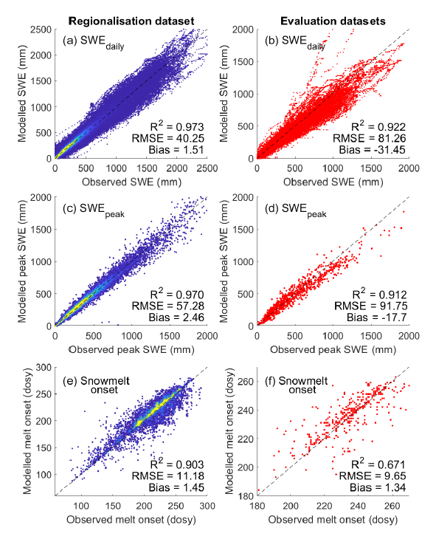
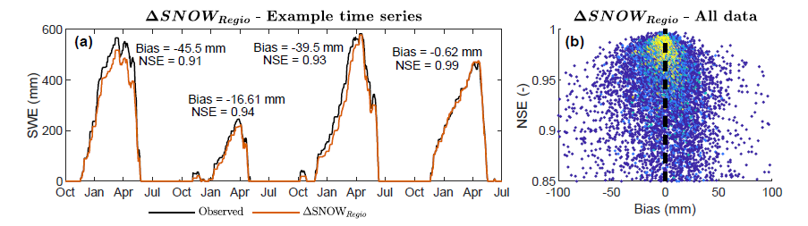
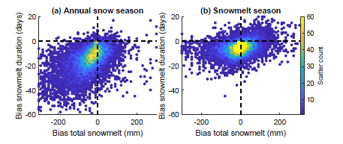
NH-SWE: A new Northern Hemisphere Snow Water Equivalent dataset based on in-situ snow depth time series (1950-2022)
OSPP Participant
Dataset
Adrià Fontrodona-Bach¹, Bettina Schaefli², Ross Woods³, Ryan Teuling⁴ and Josh Larsen¹
¹ School of Geography, University of Birmingham, UK; ² Department of Civil Engineering, University of Bristol, UK; ³ Institute of Geography, University of Bern, Switzerland; ⁴ Hydrology and Quantitative Water Management group, Wageningen University, The Netherlands;
Model performance & Evaluation
KEY MODEL STRENGTHS
Based on real observed snow depth on the ground
Excellent daily temporal SWE dynamics
Small relative bias in peak SWE (-1.7% across all datasets)
Very small model delay in timing of snowmelt onset (1 day late)
zenodo.org/record/7515603
Figure 2. Model performance for daily time series . Nash and Sutcliffe Efficiency (NSE) vs Bias of daily SWE for the ΔSNOWRegio. Colours show scatter point density.
Taken from Fontrodona-Bach et al., 2023 (in review)
Fontrodona-Bach et al., 2023a
Data paper
Figure 1. Model performance for daily SWE, peak SWE, and timing of snowmelt onset.
Left column: Model performance for the SNOTEL dataset (used to regionalize the model parameters)
Right column: Model evaluation for independent datasets. Taken from Fontrodona-Bach et al., 2023 (in review)
Figure 3. Bias in snowmelt duration vs bias in snowmelt depth for ΔSNOWRegio.
(a) annual snow season bias and (b) snowmelt season bias only.
Taken from Fontrodona-Bach et al., 2023 (in review)
So we run the regionalised ∆SNOW model over the 11,071 time series of snow depth and…
essd.copernicus.org/preprints/essd-2023-31/
See definitions figure
References
Back to overview
Fontrodona-Bach et al., 2023b
(in review at ESSD)
Model Evaluation
Background
Snow Depth data
Model regionalisation
NH-SWE dataset
axf984@bham.ac.uk
@Fontro22

Slide 10
NH-SWE: A new Northern Hemisphere Snow Water Equivalent dataset based on in-situ snow depth time series (1950-2022)
OSPP Participant
Dataset
Adrià Fontrodona-Bach¹, Bettina Schaefli², Ross Woods³, Ryan Teuling⁴ and Josh Larsen¹
¹ School of Geography, University of Birmingham, UK; ² Department of Civil Engineering, University of Bristol, UK; ³ Institute of Geography, University of Bern, Switzerland; ⁴ Hydrology and Quantitative Water Management group, Wageningen University, The Netherlands;
NH-SWE dataset
Free to use and available
Main dataset features:
11,071 stations
1950-2022 period
1-73 full gap-free years
Mountains included
Point-scale
Daily resolution
zenodo.org/record/7515603
Fontrodona-Bach et al., 2023a
Data availability
Data paper
Data description paper
Modelled SWE, but based on observed snow data
essd.copernicus.org/preprints/essd-2023-31/
What can we do with it?
Back to overview
Figure 1. NH-SWE dataset characteristics. Taken from Fontrodona-Bach et al., (2023) (in review)
Fontrodona-Bach et al., 2023b
(in review at ESSD)
References
NH-SWE dataset
Background
Snow Depth data
Model regionalisation
Model Evaluation
axf984@bham.ac.uk
@Fontro22

Slide 11
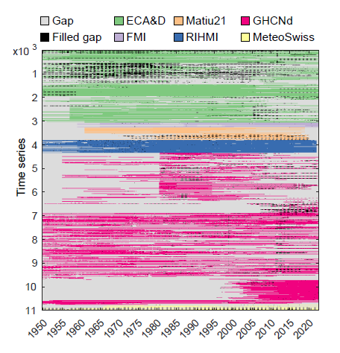
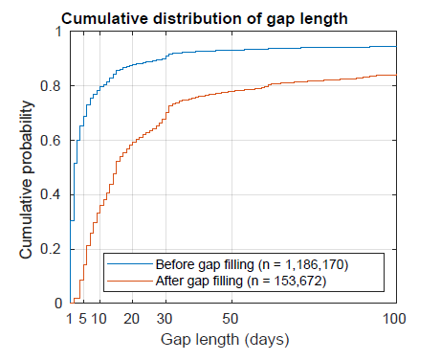
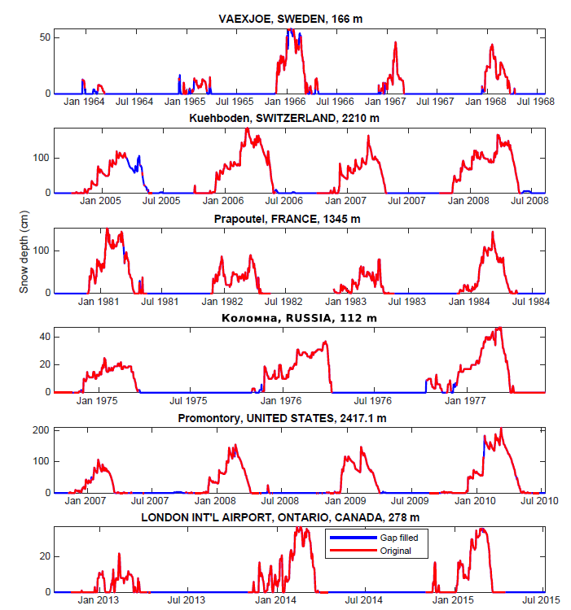
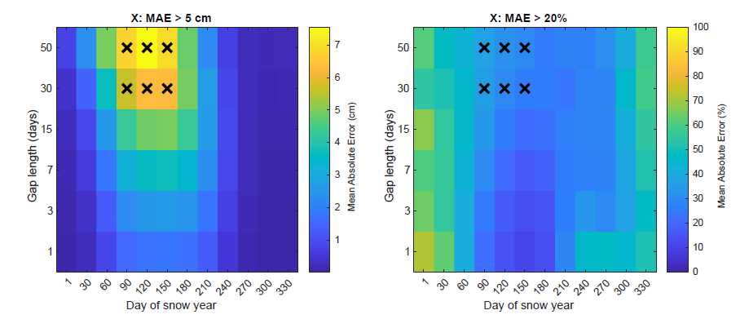
NH-SWE: A new Northern Hemisphere Snow Water Equivalent dataset based on in-situ snow depth time series (1950-2022)
OSPP Participant
Dataset
Adrià Fontrodona-Bach¹, Bettina Schaefli², Ross Woods³, Ryan Teuling⁴ and Josh Larsen¹
¹ School of Geography, University of Birmingham, UK; ² Department of Civil Engineering, University of Bristol, UK; ³ Institute of Geography, University of Bern, Switzerland; ⁴ Hydrology and Quantitative Water Management group, Wageningen University, The Netherlands;
Back to snow depth data
zenodo.org/record/7515603
Fontrodona-Bach et al., 2023a
Data paper
Figure 2. Cumulative distribution of gap length before and after gap-filling. Taken from Fontrodona-Bach et al., (2023) (in review)
Figure 1. Dataset matrix coloured by data sources and gaps.
Taken from Fontrodona-Bach et al., (2023) (in review)
essd.copernicus.org/preprints/essd-2023-31/
Figure 4. Example gap-filled time series.
Taken from Fontrodona-Bach et al., (2023) (in review)
Figure 3. Performance of NARX neural network gap-filling.
Taken from Fontrodona-Bach et al., (2023) (in review)
References
Back to overview
Fontrodona-Bach et al., 2023b
(in review at ESSD)
Background
Snow Depth data
Model regionalisation
Model Evaluation
NH-SWE dataset
axf984@bham.ac.uk
@Fontro22

Slide 12
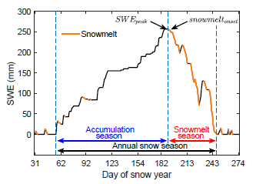
NH-SWE: A new Northern Hemisphere Snow Water Equivalent dataset based on in-situ snow depth time series (1950-2022)
OSPP Participant
Dataset
Adrià Fontrodona-Bach¹, Bettina Schaefli², Ross Woods³, Ryan Teuling⁴ and Josh Larsen¹
¹ School of Geography, University of Birmingham, UK; ² Department of Civil Engineering, University of Bristol, UK; ³ Institute of Geography, University of Bern, Switzerland; ⁴ Hydrology and Quantitative Water Management group, Wageningen University, The Netherlands;
zenodo.org/record/7515603
Fontrodona-Bach et al., 2023a
Data paper
Figure 1. Snow season definitions.
Taken from Fontrodona-Bach et al., (2023) (in review)
essd.copernicus.org/preprints/essd-2023-31/
Back to model evaluation
References
Back to overview
Fontrodona-Bach et al., 2023b
(in review at ESSD)
Background
Snow Depth data
Model regionalisation
Model Evaluation
NH-SWE dataset
axf984@bham.ac.uk
@Fontro22

Slide 13
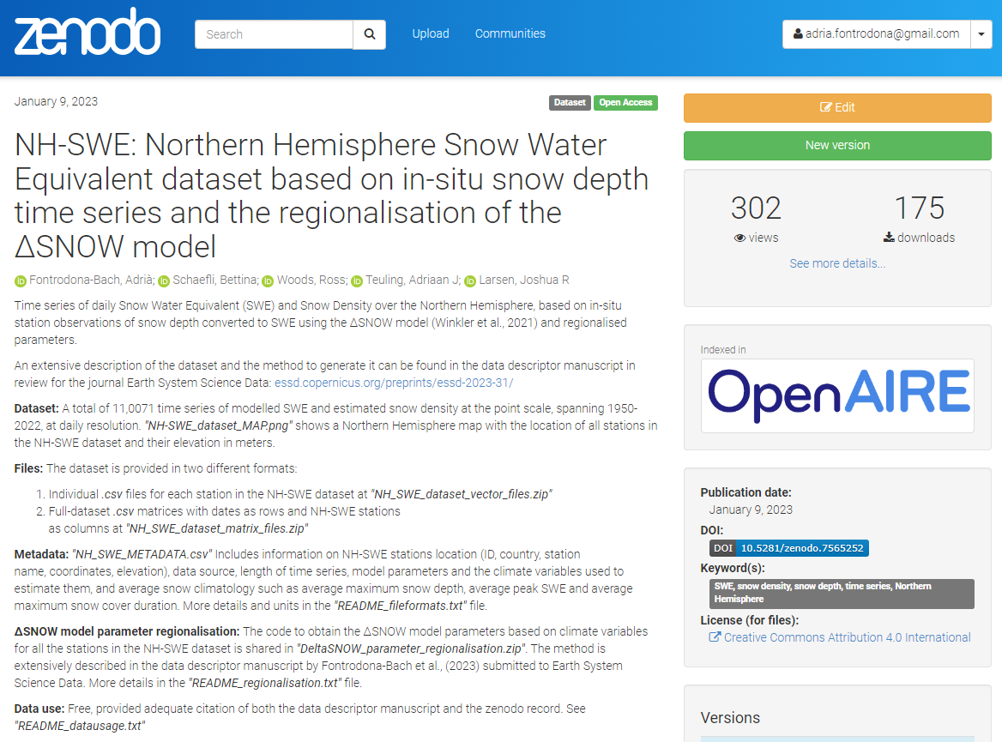
NH-SWE: A new Northern Hemisphere Snow Water Equivalent dataset based on in-situ snow depth time series (1950-2022)
OSPP Participant
Dataset
Adrià Fontrodona-Bach¹, Bettina Schaefli², Ross Woods³, Ryan Teuling⁴ and Josh Larsen¹
¹ School of Geography, University of Birmingham, UK; ² Department of Civil Engineering, University of Bristol, UK; ³ Institute of Geography, University of Bern, Switzerland; ⁴ Hydrology and Quantitative Water Management group, Wageningen University, The Netherlands;
zenodo.org/record/7515603
Fontrodona-Bach et al., 2023a
Data paper
essd.copernicus.org/preprints/essd-2023-31/
References
Back to overview
Fontrodona-Bach et al., 2023b
(in review at ESSD)
Background
Snow Depth data
Model regionalisation
Model Evaluation
NH-SWE dataset
axf984@bham.ac.uk
@Fontro22

Slide 14
NH-SWE: A new Northern Hemisphere Snow Water Equivalent dataset based on in-situ snow depth time series (1950-2022)
OSPP Participant
Dataset
Adrià Fontrodona-Bach¹, Bettina Schaefli², Ross Woods³, Ryan Teuling⁴ and Josh Larsen¹
¹ School of Geography, University of Birmingham, UK; ² Department of Civil Engineering, University of Bristol, UK; ³ Institute of Geography, University of Bern, Switzerland; ⁴ Hydrology and Quantitative Water Management group, Wageningen University, The Netherlands;
zenodo.org/record/7515603
Fontrodona-Bach et al., 2023a
Data paper
essd.copernicus.org/preprints/essd-2023-31/
References
Back to overview
Fontrodona-Bach et al., 2023b
(in review at ESSD)
Background
Snow Depth data
Model regionalisation
Model Evaluation
NH-SWE dataset
axf984@bham.ac.uk
@Fontro22

Slide 15
NH-SWE: A new Northern Hemisphere Snow Water Equivalent dataset based on in-situ snow depth time series (1950-2022)
OSPP Participant
Dataset
Adrià Fontrodona-Bach¹, Bettina Schaefli², Ross Woods³, Ryan Teuling⁴ and Josh Larsen¹
¹ School of Geography, University of Birmingham, UK; ² Department of Civil Engineering, University of Bristol, UK; ³ Institute of Geography, University of Bern, Switzerland; ⁴ Hydrology and Quantitative Water Management group, Wageningen University, The Netherlands;
References:
Fontrodona-Bach, Adrià, Schaefli, Bettina, Woods, Ross, Teuling, Adriaan J, & Larsen, Joshua R. (2023). NH-SWE: Northern Hemisphere Snow Water Equivalent dataset based on in-situ snow depth time series and the regionalisation of the ΔSNOW model [Data set]. Zenodo. https://doi.org/10.5281/zenodo.7565252
Fontrodona-Bach, A., Schaefli, B., Woods, R., Teuling, A. J., & Larsen, J. R. (2023). NH-SWE: Northern Hemisphere Snow Water Equivalent dataset based on in-situ snow depth time series. Earth System Science Data Discussions, 2023, 1-33.
Mudryk, L. R., Derksen, C., Kushner, P. J., & Brown, R. (2015). Characterization of Northern Hemisphere snow water equivalent datasets, 1981–2010. Journal of Climate, 28(20), 8037-8051.
Musselman, Keith N., et al. "Slower snowmelt in a warmer world." Nature Climate Change 7.3 (2017): 214-219.
Winkler, M., Schellander, H., and Gruber, S.: Snow water equivalents exclusively from snow depths and their temporal changes: the ∆ snow model, Hydrology and Earth System Sciences, 25, 1165–1187, 2021.
zenodo.org/record/7515603
Fontrodona-Bach et al., 2023a
Data paper
essd.copernicus.org/preprints/essd-2023-31/
References
Back to overview
Fontrodona-Bach et al., 2023b
(in review at ESSD)
Background
Snow Depth data
Model regionalisation
Model Evaluation
NH-SWE dataset
axf984@bham.ac.uk
@Fontro22

