Slide 1
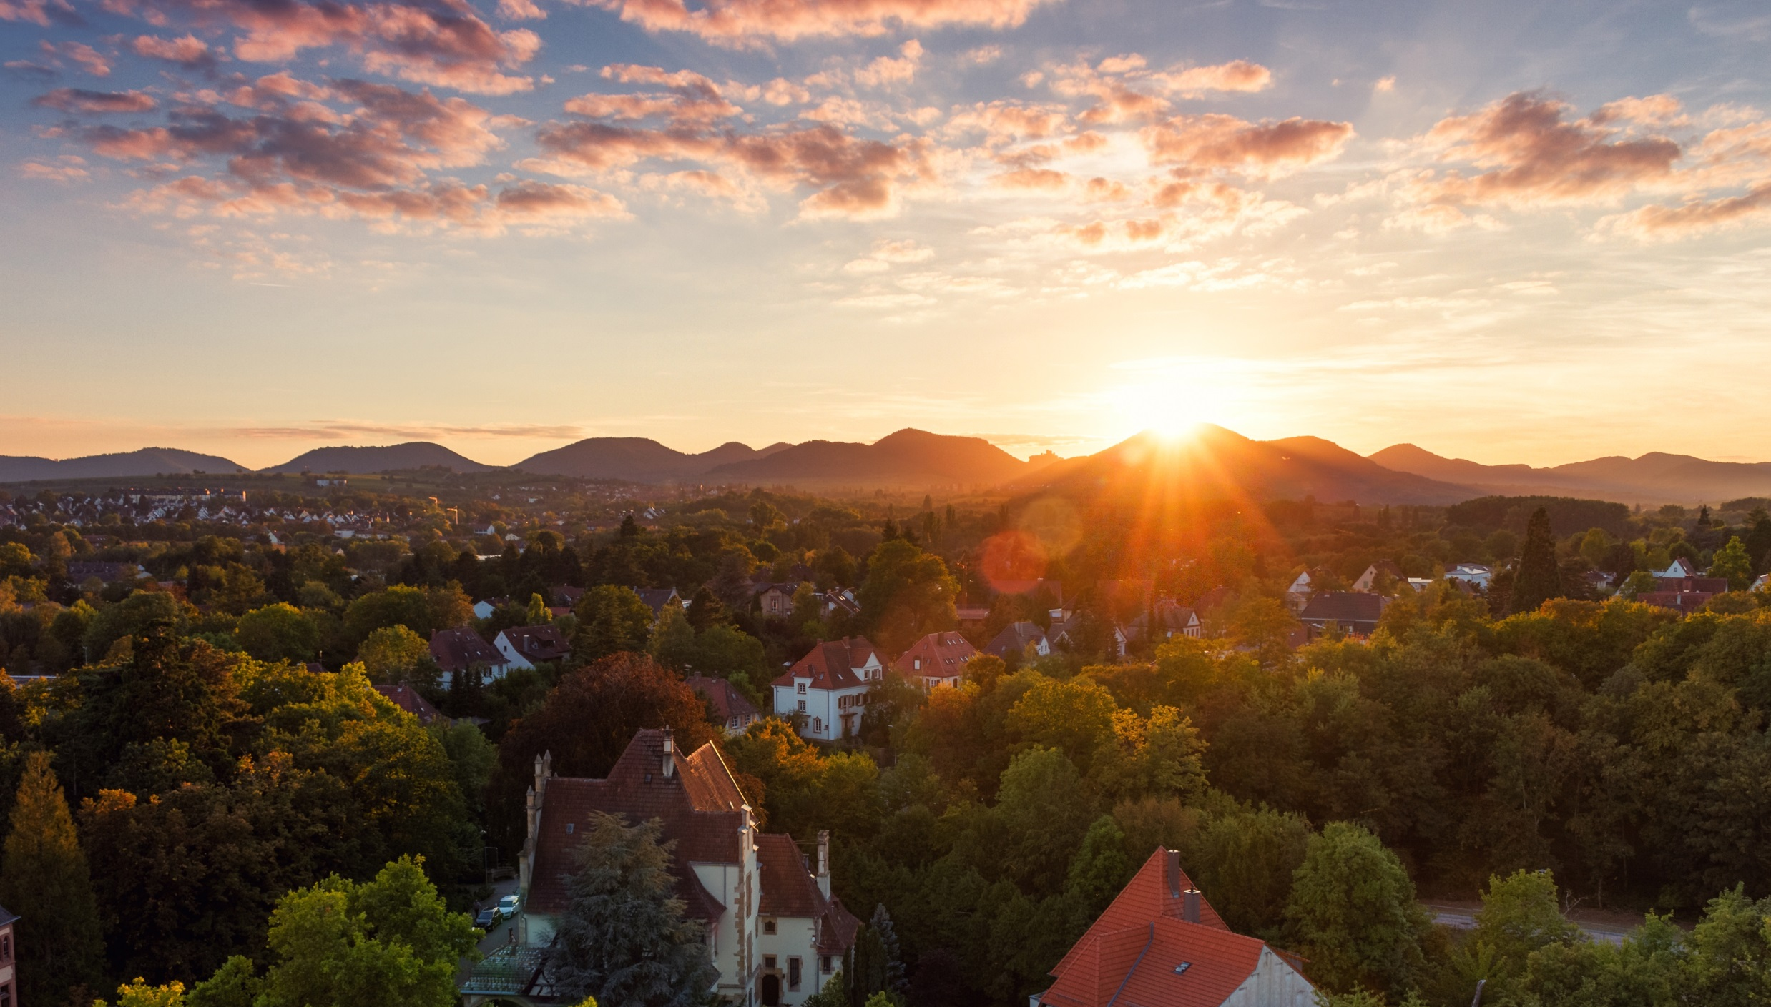
Mobility of total carbon, nitrogen and polyphenols from grape pomace in the soil column
S. Korz, C. More, S. Sadzik, C. Buchmann, E. Richling and K. MuÑoz
EGU General Assembly 2023 – EGU23-12659 – Supplement Version

Slide 2
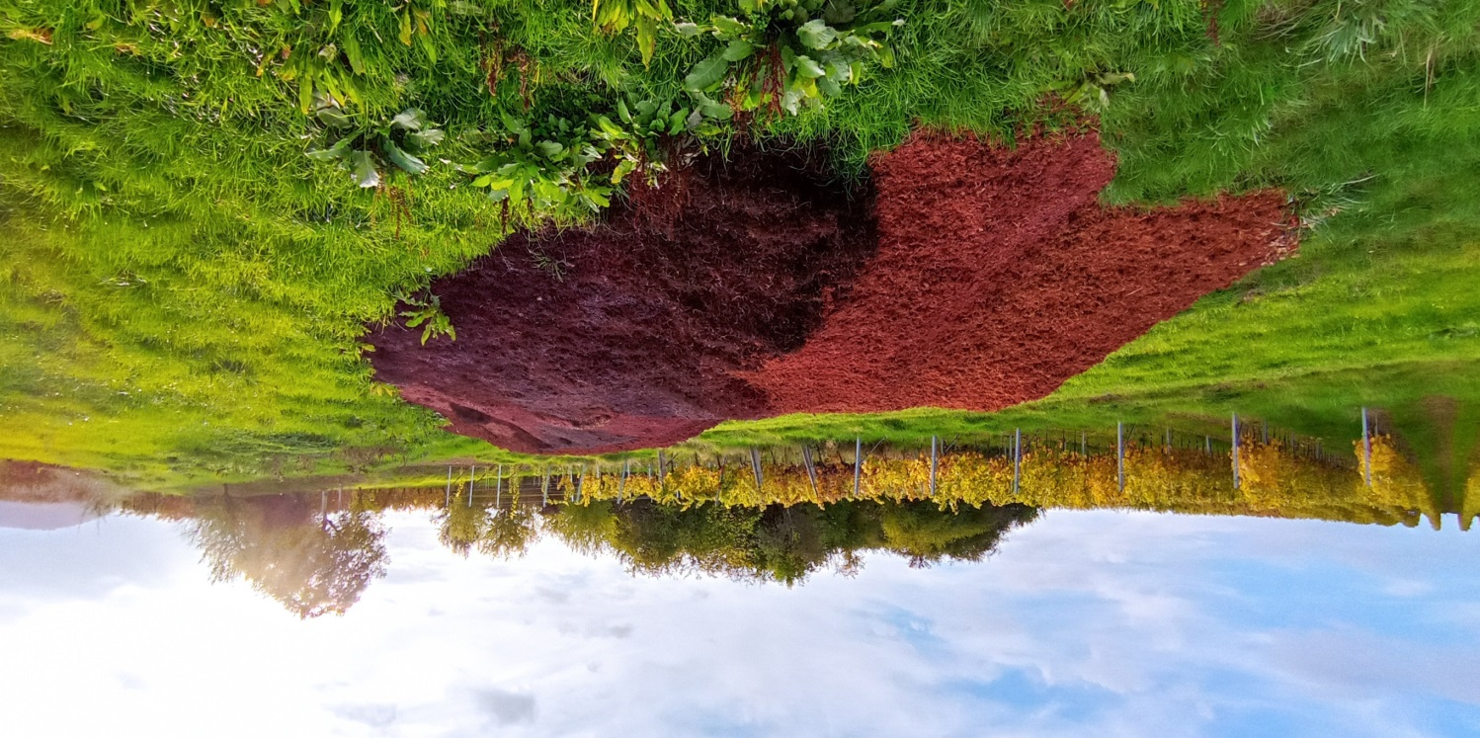
Relevance
Use of grape pomace (GP) as an organic fertilizer
→ Rich in nutrients (N,P,K) → Cheap and readily available
→ Closing nutrient cycles
but
→ Wide C/N ratio
→ Rich in phenolics
→ Low pH → Seasonality depended

Slide 3
Relevance
Use of grape pomace (GP) as an organic fertilizer
→ Focus on industrial use of GP
→ Maximization of extraction efficacy
→ Environmentally relevant processes neglected
→ Nutrient mobility between varieties in different soil types is almost unknown

Slide 4
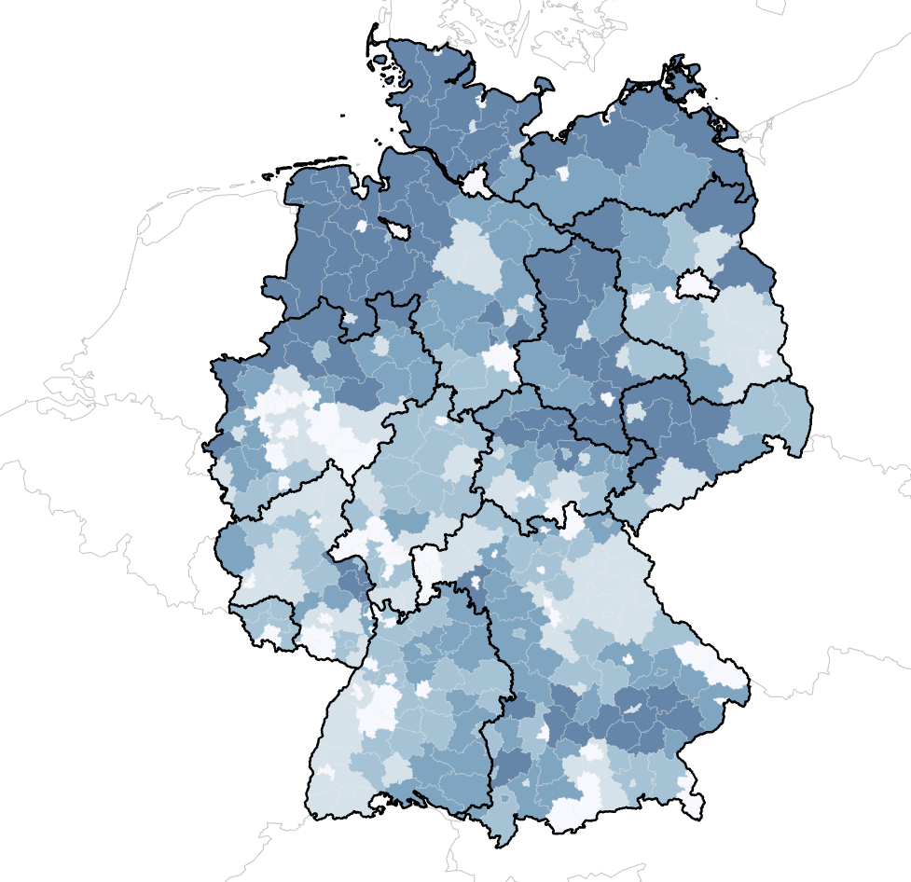
Pomace and soil sampling
Proportion of total area in use for agriculture
Sampling in Neustadt (Weinstraße, Rhineland-Palatinate, Germany)
Grape pomace from 4 Vitis varieties: Dornfelder (DF), Pinot Noir (PN), Riesling (RS) and Pinot Blanc (PB) during the harvesting season of 2021 (fresh, directly after pressing)
A representative soil sample from the Vineyard + reference soils (sand and silt loam)
3 % 80 %
Fig. 1: Sampling site (Map data: Destatis, Federal Statistical Office, 2023)

Slide 5
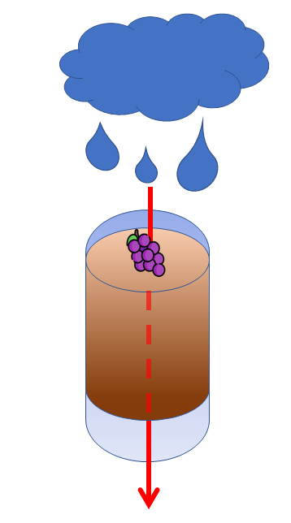
Methods (Based on OECD)
E1) GP and soil characterization
Freeze drying and pulverization
Elementary analysis (C and N)
Polyphenols via SPE and Folin-Ciocalteu photometrical assay
E2) Rainwater extraction
Ex. in 1:5 sterilized artificial rainwater (0.01 M CaCl₂ + 0.05 % NaN₃)
Rainwater analysis (TOC and TN)
Polyphenols directly via FCR
E3) Soil column and leachate
Fresh GP application at max. allowed dose
Simulation of a heavy rainfall event
Soil elementary analysis (C and N)
TPC via aqueous soil extraction

Slide 6
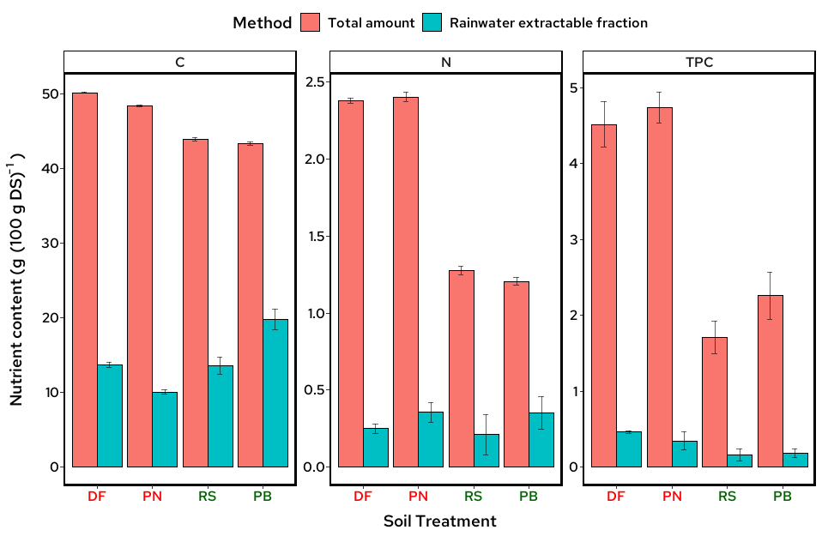
Pomace characterization
Despite lower total C content, the water extractable amount is higher in white GP
Despite drastically lower total N, the water extractable amount is equal in red and white GP
TPC in red GP is ~twice as high as in white GP
Fig. 2: Nutrient content in GP and rainwater extraction. Error bars indicate the standard deviation of four replicates. DF=Dornfelder, RS=Riesling, PN=Pinot noir, PB=Pinot blanc

Slide 7
Soil characterization
Table 1: Parameter of used soils
 | R01A | R02A | Vineyard NW
Texture | Sandy loam | Silt loam | Sandy clay loam
Total C (%) | 0.95 | 1.06 | 1.5±0.4
Total N (g kg⁻¹) | 0.08 | 0.11 | 0.12±0.01
WHC (g % d.w.) | 29.3 | 47.1 | 46.8±1.3
pH (CaCl₂) | 5.6 | 6.5 | 7.3±0.1
Basal respiration (µg CO₂-C g⁻¹ soil h⁻¹) | < LOD | 0.05±0.01 | 0.10±0.06
Glucose respiration (µg CO₂-C g⁻¹ soil h⁻¹) | 0.02±0.02 | 0.26±0.06 | 1.0 ±0.12
C_{mic} (mg kg⁻¹) | 174 | 794 | 449±20

Slide 8
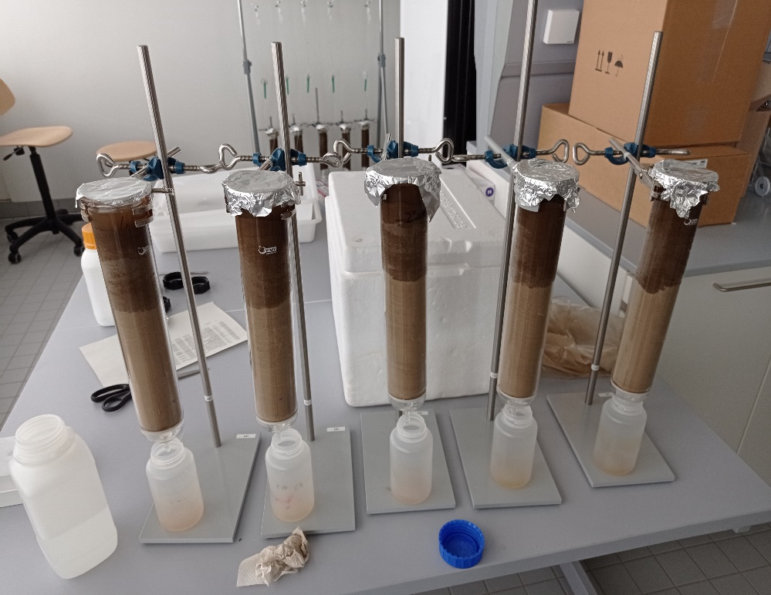
Leaching parameters
Column dimensions Glass, 300 mm x 50 mm (Length x inner diameter)
Soil filling
Dry filling of fixed volume, saturation to 100 % WHC
GP Application rate 30 t ha⁻¹ or 1:100 (GP:Soil)
Rainfall event simulation 200 mm over 48 h or 400 mL of artificial rainwater
Soil sample preparation Freezing → fractionating by depth → homogenization → freeze drying
Fig. 3: Soil columns

Slide 9
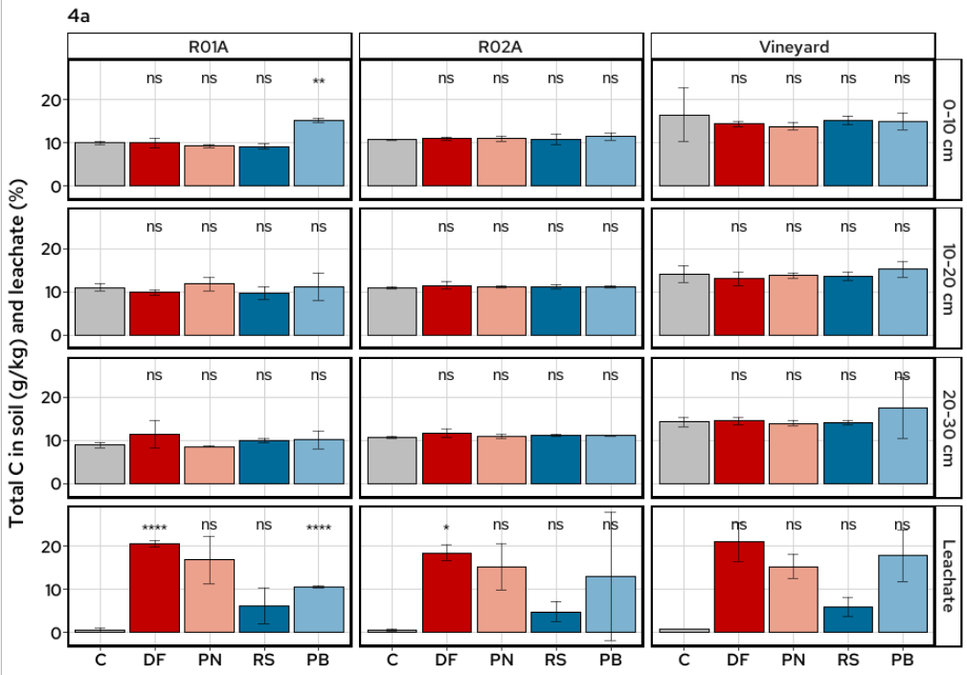
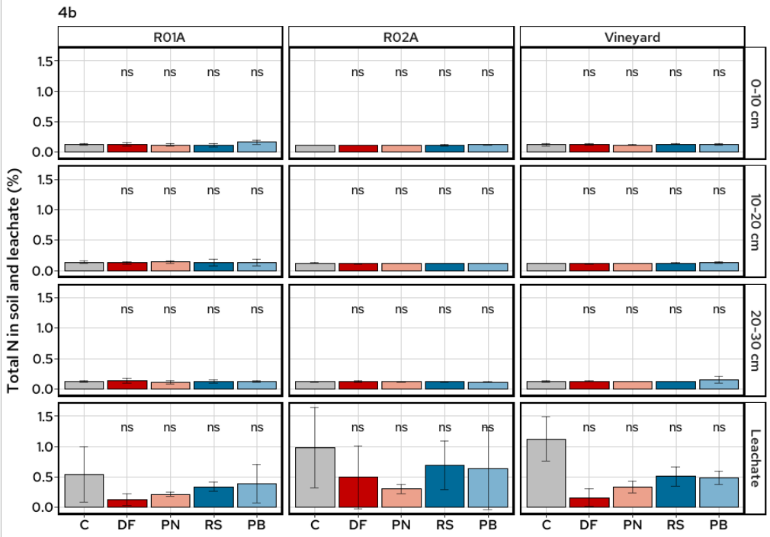
Total Carbon and Nitrogen
Fig. 4: Total C (4a) and N (4b) content in soils and leachate compared to non-treated soil. Error bars indicate the standard deviation of three column replicates. Statistical differences are analyzed by a Dunnett test comparing the values to the untreated reference group via a t-test. C=Control, DF=Dornfelder, RS=Riesling, PN=Pinot noir, PB=Pinot blanc Significant differences are indicated as: ns: p > 0.05, *: p <= 0.05, **: p <= 0.01, ***: p <= 0.001, ****: p <= 0.0001

Slide 10
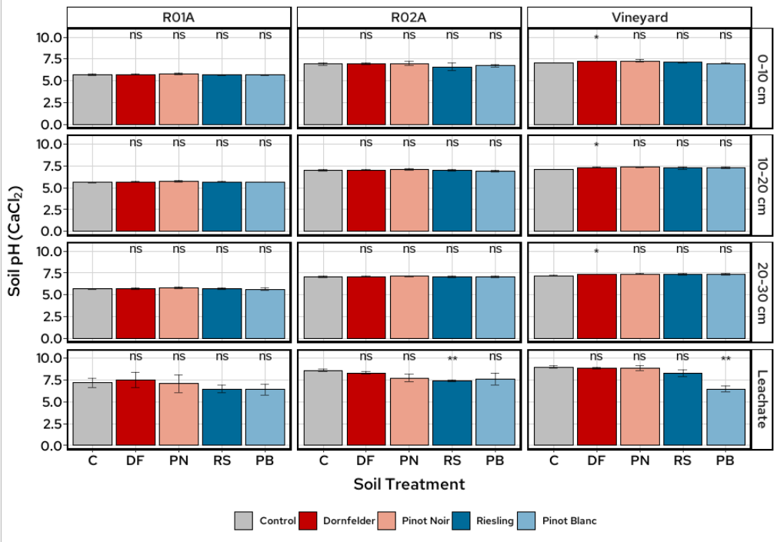
Soil and leachate pH
DF increased the pH in the vineyard soil
In two cases leachate pH was decreased
Leachate pH higher than soil pH
Fig. 4: Soil and leachate pH compared to non-treated soil. Error bars indicate the standard deviation of three column replicates. Statistical differences are analyzed by a Dunnett test comparing the values to the untreated reference group via a t-test. C=Control, DF=Dornfelder, RS=Riesling, PN=Pinot noir, PB=Pinot blanc Significant differences are indicated as: ns: p > 0.05, *: p <= 0.05, **: p <= 0.01, ***: p <= 0.001, ****: p <= 0.0001

Slide 11
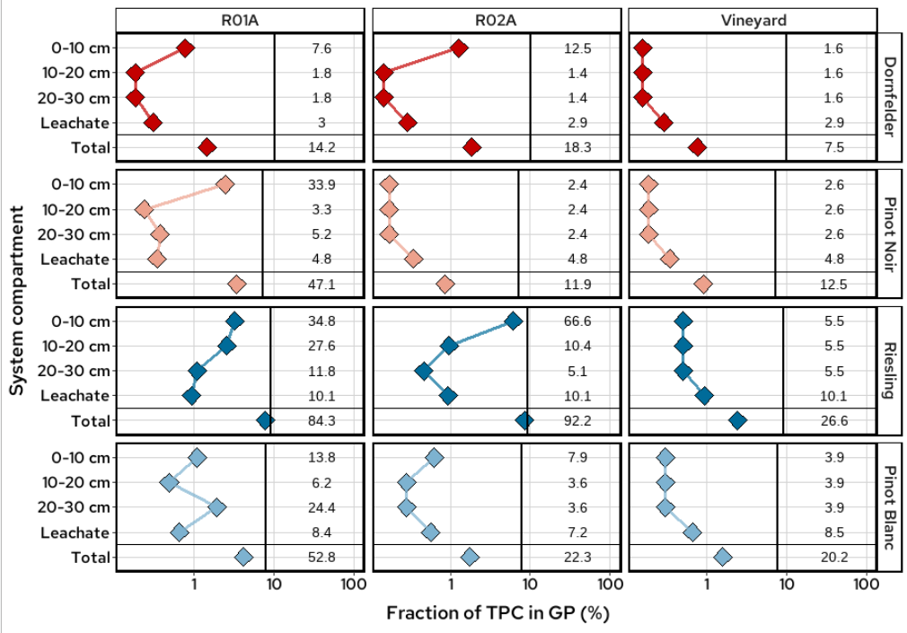
Total polyphenolic content
Highest recovery in the upper soil layer
Lowest recovery in the vineyard soil
Highest recovery in the RS treated ref. soils
Fig. 5: : TPC in three different soil depths, leachate and total content. Vertical lines indicate the mass balance between leaching and maximum aqueous extractable TPC of fresh GP (rainwater experiment). Points indicate the recovery (%) between total and soil water extractable TPC. Mean values of the total content were set to 100%. Numbers indicate the recovery (%) of soil water-extractable content based on maximum aqueous-extractable TPC. Blank treatments were subtracted from GP treatments.

Slide 12
Soil content after pomace treatment
 | C | N | TPC | pH
Soil | No effect (Exception: Increased in Sand-PB) | No effect | ↑ increased Silt < Sand, Lower < Upper, No effect of GP variety | No effect (Exception: Increased in Vineyard-DF)
Leachate | ↑ increased RS<PB<PN<DF, No effect of soil type | ↓ decreased Red < White, No effect of soil type | ↑ increased DF<PN<PB<RS, No effect of soil type | ↑ increased No effect of GP and soil type (Exception: Decreased in Vineyard-PB and 02A-RS)

Slide 13
Take home messages
C and N are more mobile from white GP
→ water solubility
C is hardly retained, especially by sandy soils
→ C leaching
N input from GP is mainly due to mineralization and not due to initial leaching
→ Seasonality needs to be taken into consideration
In silty soils, polyphenols from GP are most relevant in the upper 10 cm
→ highest microbial activity → need for incubation studies
Strong dependency on soil parameters
→ chemical stability (soil pH) and sorption processes
Soil buffer capacity stable against acid GP medium

Slide 14
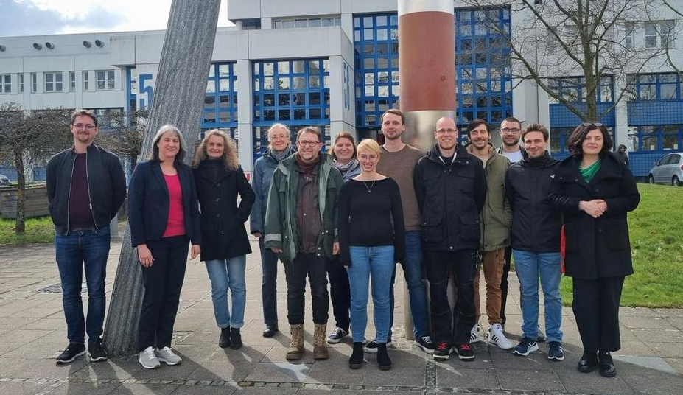
Acknowledgements
Contact:
Institute for Environmental Sciences
Working Group of Soil Chemistry
https://nuw.rptu.de/ags/uchemie
Department of Chemistry Division of Food Chemistry and Toxicology
https://chem.rptu.de/ags/ag-richling
The project is being funded by Carl-Zeiss-Foundation, project number P2021-00-004

