Slide 1
Development of Geostationary Satellite Atmospheric Motion Vectors
Forecasting Algorithm by CNN Model
Hwayon Choi, Yong-Sang Choi, and Gyuyeon Kim
Ewha Womans University, Climate and Energy Systems Engineering, Seoul, South Korea

Slide 2
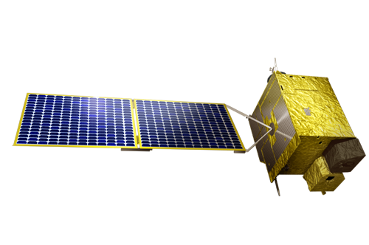
01. Introduction
Traditional Method of Tracking – CCC(Cross Correlation Coefficient) Method
Three consecutive images were used
The backward vector( ): The first (t-1) and second (t) images
The forward vector ( ): The second (t) and third (t+1) images
The final vector ( ) : Average of backward and forward vectors
t-1
t
t+1

Slide 3
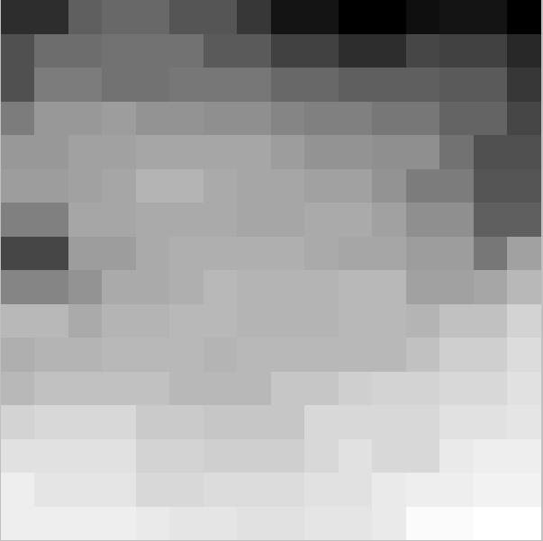
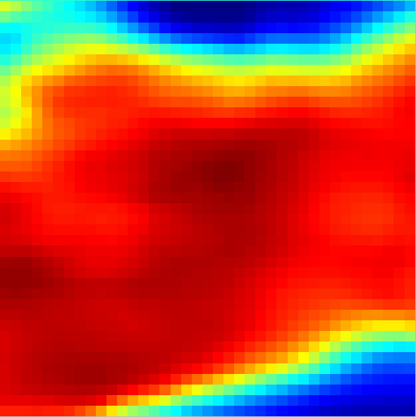
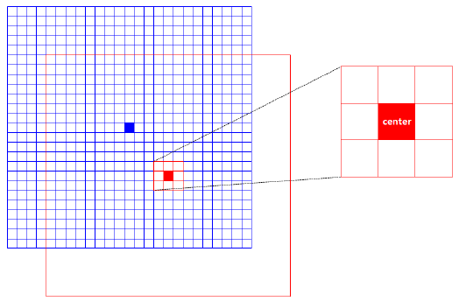
01. Introduction
Target based
(A) (B) (C)
(A)
202108180010
202108180020
(A) Target: Brightness temperature of target (time t)
(B)
(B) Tracing Area with target (red box)
: Brightness temperature of tracing area (time t+1)
The targets were divided in to 3X3 boxes and standard deviation of the nine pixels within these boxes.
Move the center of the target to the center of the box with the largest standard deviation.
If the target at time t has the highest correlation coefficient with the tracing area at time t+1, it is calculated that it has moved to that position.
(C) Correlation coefficient of target and tracing area
CCC: ${CC}_{m,n}=\frac{1}{MN}\sum_{j=1}^{N}{\sum_{i=1}^{M}{{CC}_{i,j}} }$
$=\frac{1}{MN}\sum_{j=1}^{N}{\sum_{i=1}^{M}{(\frac{a_{i,j}−\overline{a}}{σ_{a}}\frac{b_{m+i,n+i}−\overline{b_{m,n}}}{{\left(σ_{b}\right)}_{m,n}})}}$
M and N are the size of the target,
a is a variable for tracking and b is a variable for target.

Slide 4
01. Introduction
Limitations
Limitation #1
Limitation of CCC Method
If there is more than one max correlation positions,
it is not clear to choose the moved position.
It is difficult to track water vapor that has little or no change in shape when the amount of water vapor is small or water vapor that disappears or greatly changes shape over time.
Limitation #2
Impossible to Forecast
Traditional method requires time t+1 data to obtain the wind vector at time t, making forecasting impossible.

Slide 5
01. Introduction
To solve the
There are previous studies that applied
the optical flow estimation method.
Limitation #1
What is Optical Flow?
The pattern of apparent motion of objects, surfaces, and edges in a visual scene caused by the relative motion between an observer and a scene. Optical flow can also be defined as the distribution of apparent velocities of movement of brightness pattern in an image (Horn & Schunck (1981)).
Source: https://www.youtube.com/watch?v=VTQTBnXBvmw

Slide 6
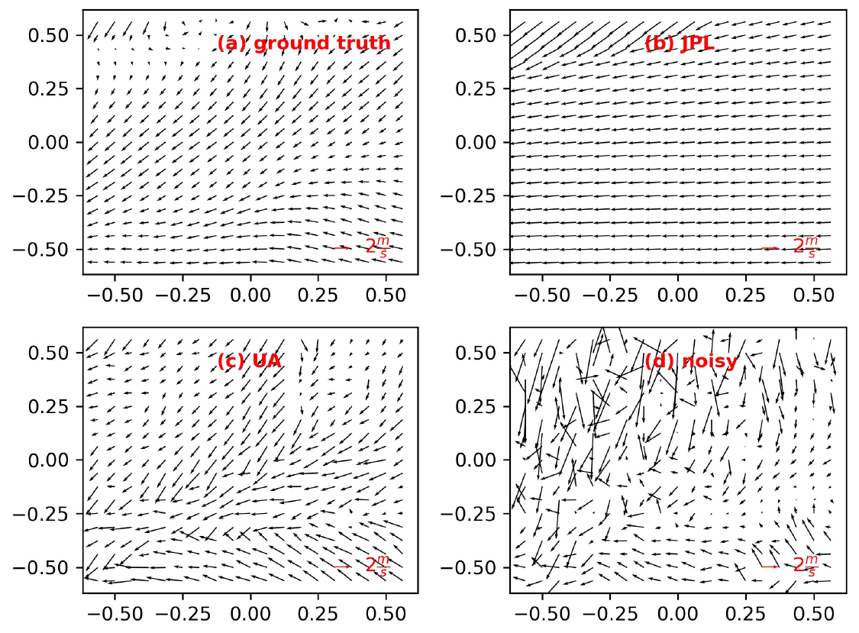
01. Introduction
Application Example
Estimates the AMV field V* at time t, used “deepflow” implementation of OpenCV
* q is water vapor fields and $∆$t is the time-step size
(Ouyed et al. 2021)
The horizontal wind was obtained using the optical flow method rather than the correlation tracking method.
Optical Flow method ((c) UA) has a higher resolution since it outputs an AMV per pixel.
The RMSVD(Root-Mean-Squared Vector Difference) of optical flow method (c) is about 4-8 m/s lower than the traditional method (b) (in the 60°N region), so the tracking performance is improved.

Slide 7
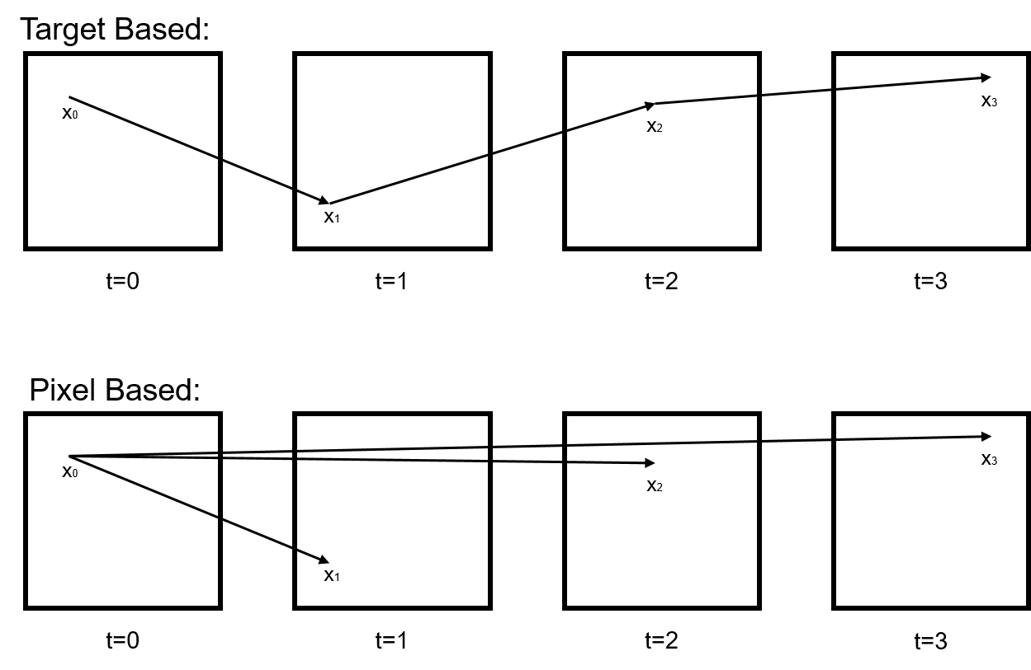
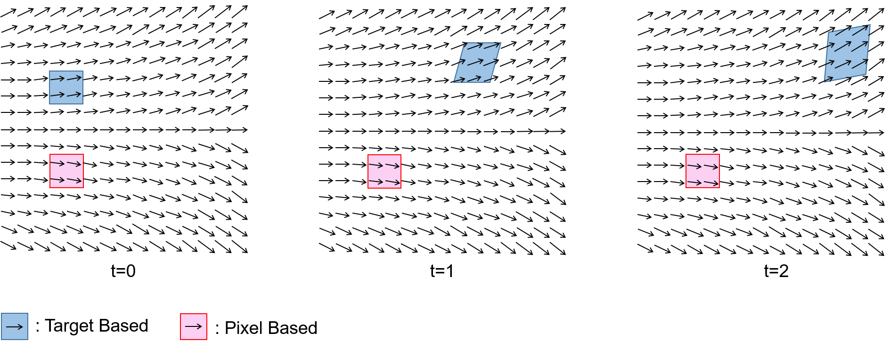
01. Introduction
Pixel based
→ Wind vectors are calculated at every pixel in the input image.
→ However, the methods of previous studies are still impossible to Forecast! (Limitation #2).
Also, previous studies did not use CNNs with better optical flow computational performance.

Slide 8
01. Introduction
Research Goal
Limitation #1
#1 CNN
Application
Limitation of CCC Method
Wind calculation with CNN model for high accuracy and high resolution by supplementing the limitations of the
CCC method
Limitation #2
# 2
Forecasting
Impossible to Forecast
Attempt Forecasting by applying linear regression
to pixel-based wind

Slide 9
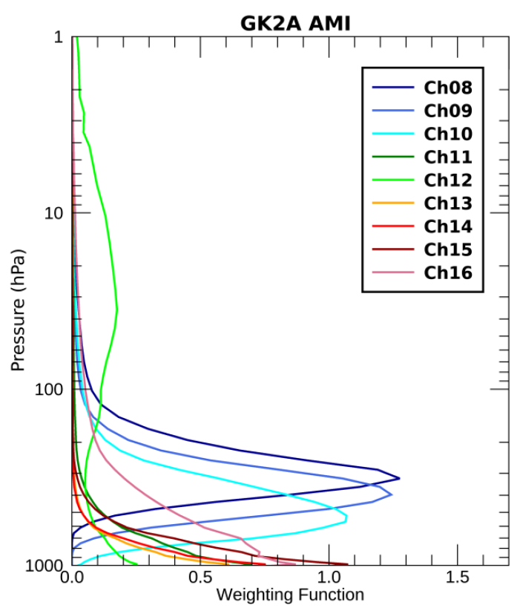
02. Data and Method
Data: selected and calculated based on the Korean peninsula, 1st day of every month in 2022
 | Level | Details | Resolution | Time [UTC] | Usage
GK2A | Level 1B | Vapor - Ch08(6.3 ㎛), Ch09(6.9 ㎛), Ch10(7.3 ㎛) | 2 km | Every 10min from 06:00 to 08:00 | Calculation
 | Level 2 | Atmospheric Motion Vector-Vapor - 6.3 ㎛, 6.9 ㎛, 7.3 ㎛ - Clear Sky target / Cloud target | unknown/ mixed | 07:00, 08:00 | Validation
ERA5 | - | hourly data on pressure levels from 1940 to present - U-component of wind, V-component of wind - 350 hPa, 450 hPa, 600 hPa | 0.25° x 0.25° | 07:00, 08:00 | Validation (Ground Truth)
* GK2A(GEO-KOMPSAT-2A): A geostationary meteorological satellite operated by KMA(Korea Meteorological Administration).
** ERA5: ECMWF (European Center for Medium-Range Weather Forecasts) reanalysis data
Based on the weight function of the GK2A output, the representative altitude of each channel is assumed.
Ch08: 350 hPa, Ch09: 450 hPa, and Ch10: 600 hPa
(Lee and Ahn. (2023))

Slide 10
02. Data and Method
Method
→ PWC-Net Algorithm
2) → Linear Regression
3) Error Analysis → Mean Vector difference (MVD)
,
→ Root-Mean-square vector difference (RMSVD) where V = (u, v), Φ is latitude field
#1 CNN
Application
# 2
Forecasting

Slide 11
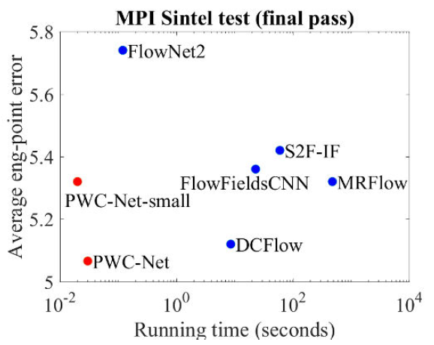
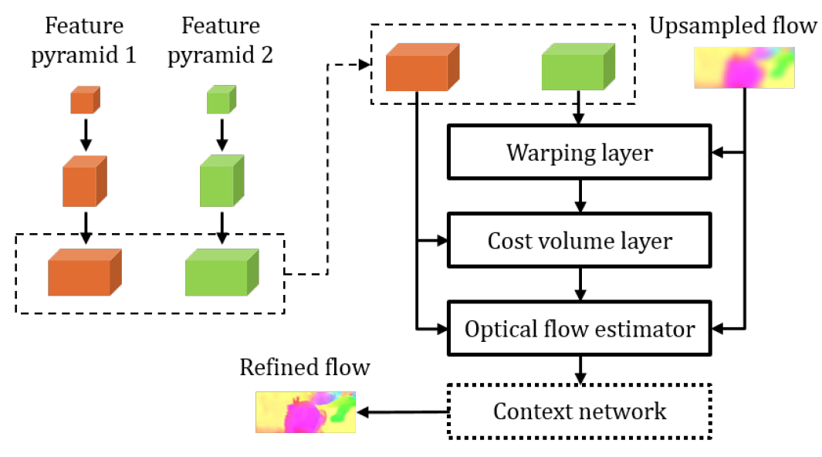
02. Data and Method
CNN Model: PWC-Net
"PWC-net: CNNs for optical flow using pyramid, warping, and cost volume."
→ FAST and ACCURATE State-of-the-Art model
PWC-Net has been designed according to simple and well-established principles:
Pyramidal processing
Warping layer
The use of a cost volume
Cast in a learnable feature pyramid, PWC-Net uses the current optical flow estimate to warp the CNN features of the second image.
* MPI Sintel test: A test with data set for the evaluation of optical flow derived from the open source 3D animated short film, Sintel.
(Sun et. al (2018))

Slide 12
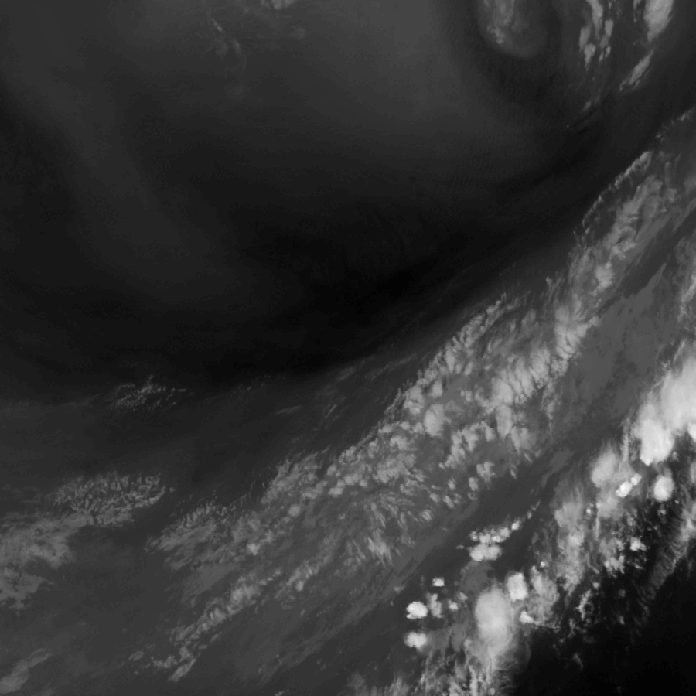
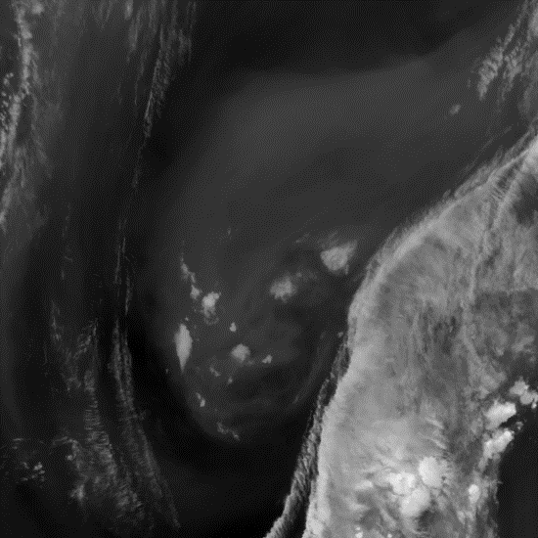
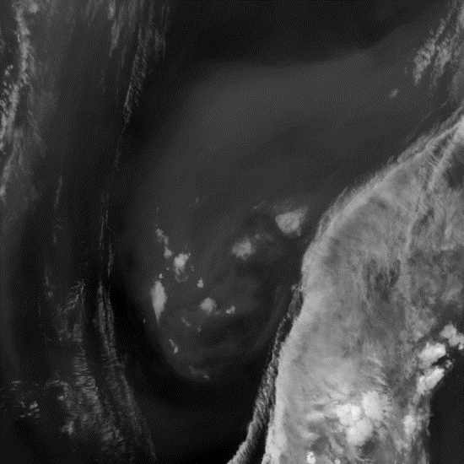
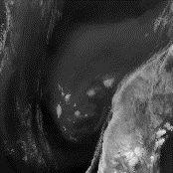
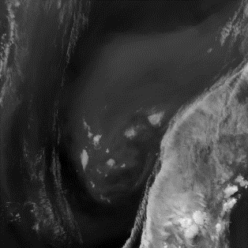
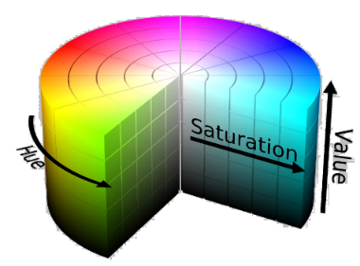
02. Data and Method
CNN Model: PWC-Net
Image
Pyramid 1
Image
Pyramid 2
Upsampled flow
Warping
Cost volume layer
Optical flow estimator
Context network
Refined flow

Slide 13
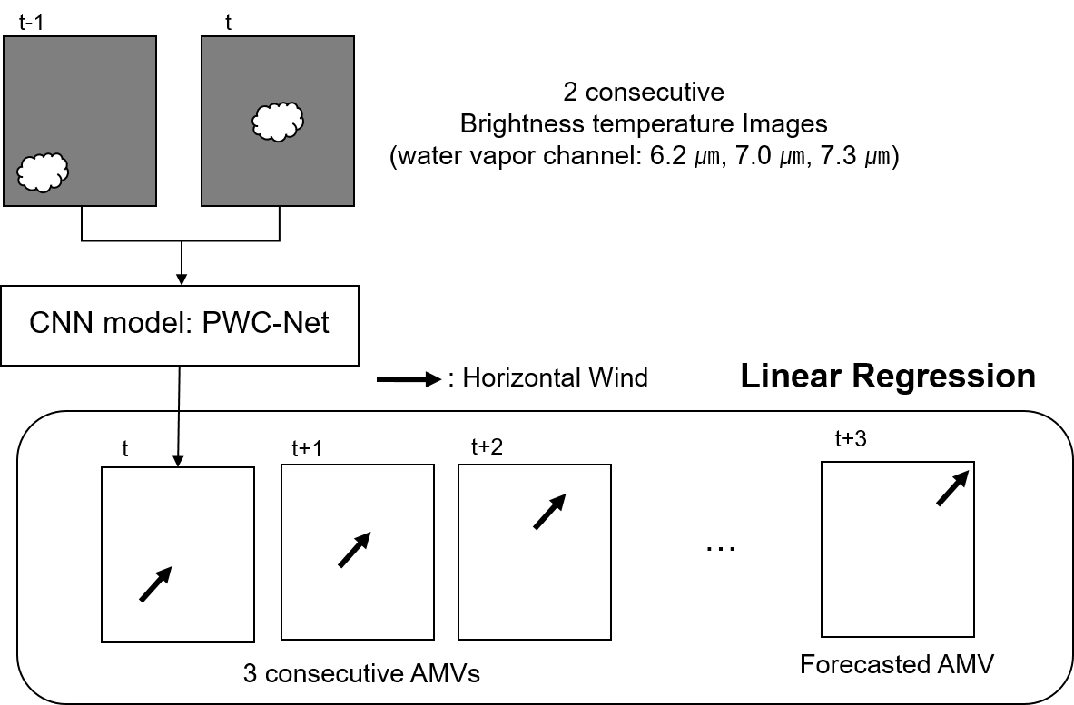
02. Data and Method
Flow Chart
#1 CNN
Application
CNN makes High resolution pixel-based AMV.
# 2
Forecasting
Linear regression for every pixel makes forecasting possible.

Slide 14
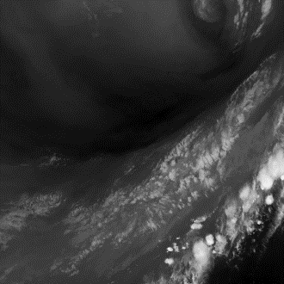
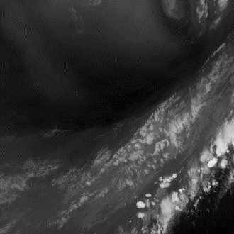
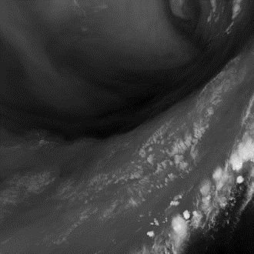
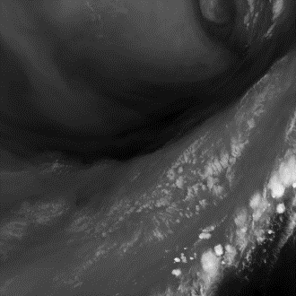
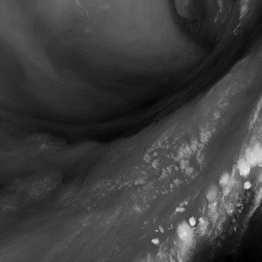
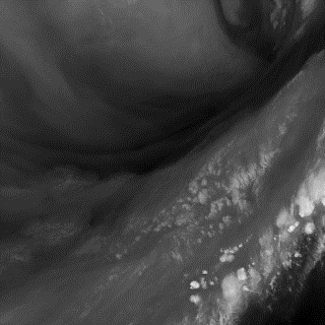
02. Data and Method
Δt=10min
Flow Chart
Ch08 (6.3 ㎛)
Ch09 (6.9 ㎛)
Ch10 (7.3 ㎛)
t-2Δt t- Δt t
Forecasted AMV
t-2Δt t- Δt t t+ Δt

Slide 15
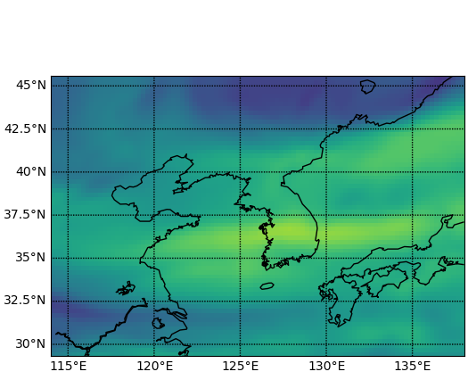
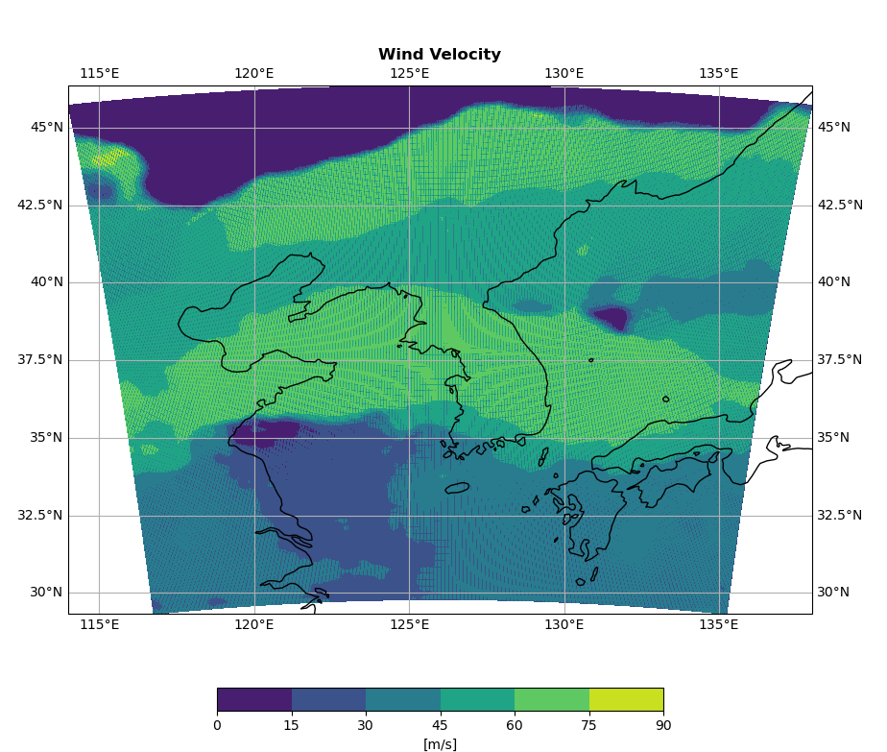
#1 CNN
Application
03. Results
ERA5 Wind velocity
GK2A AMV velocity
CNN Wind velocity
97 $×$ 66 data (0.25°$×$ 0.25°)
1,036 data
900 $×$ 900 [Pixels] (2km $×$2km)
✔ CNN wind clearly shows better resolution than ERA5 wind field data and GK2A AMV.

Slide 16
#1 CNN
Application
03. Results
: High-accuracy case (Month: 4, 5, 10)
: Low-accuracy case (Month: 2, 3, 12)
✔ CNN wind shows similar or higher tracking performance compared to the traditional GK2A AMVs.
✔ This is especially evident in the case of 600 hPa.

Slide 17
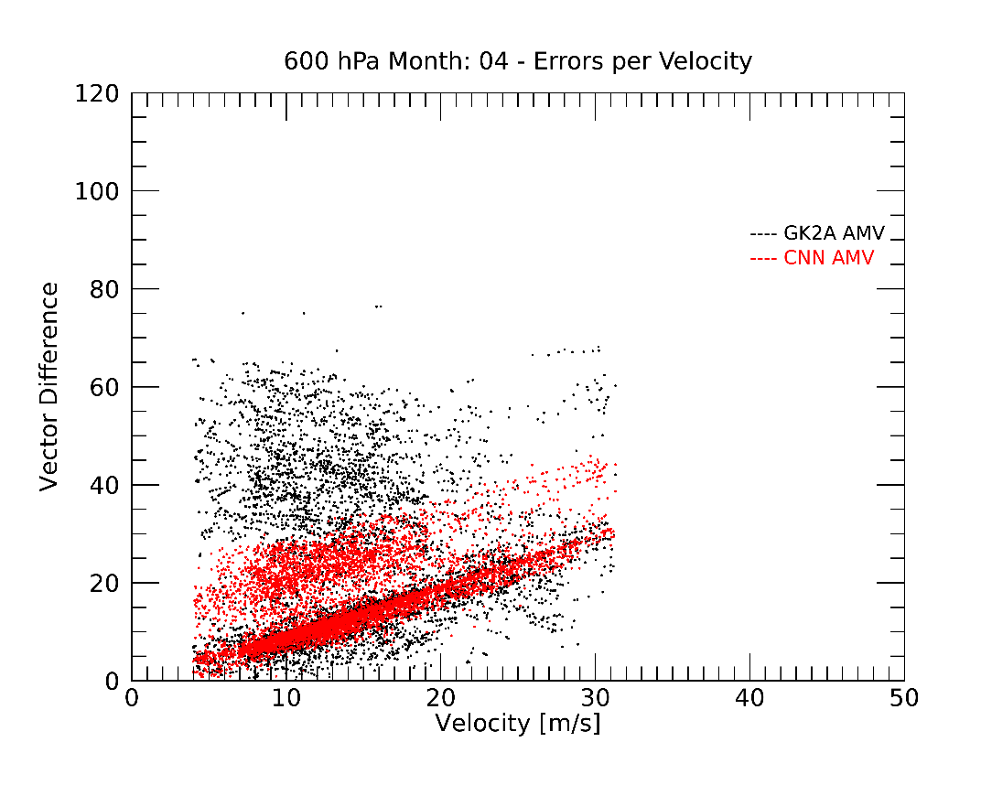
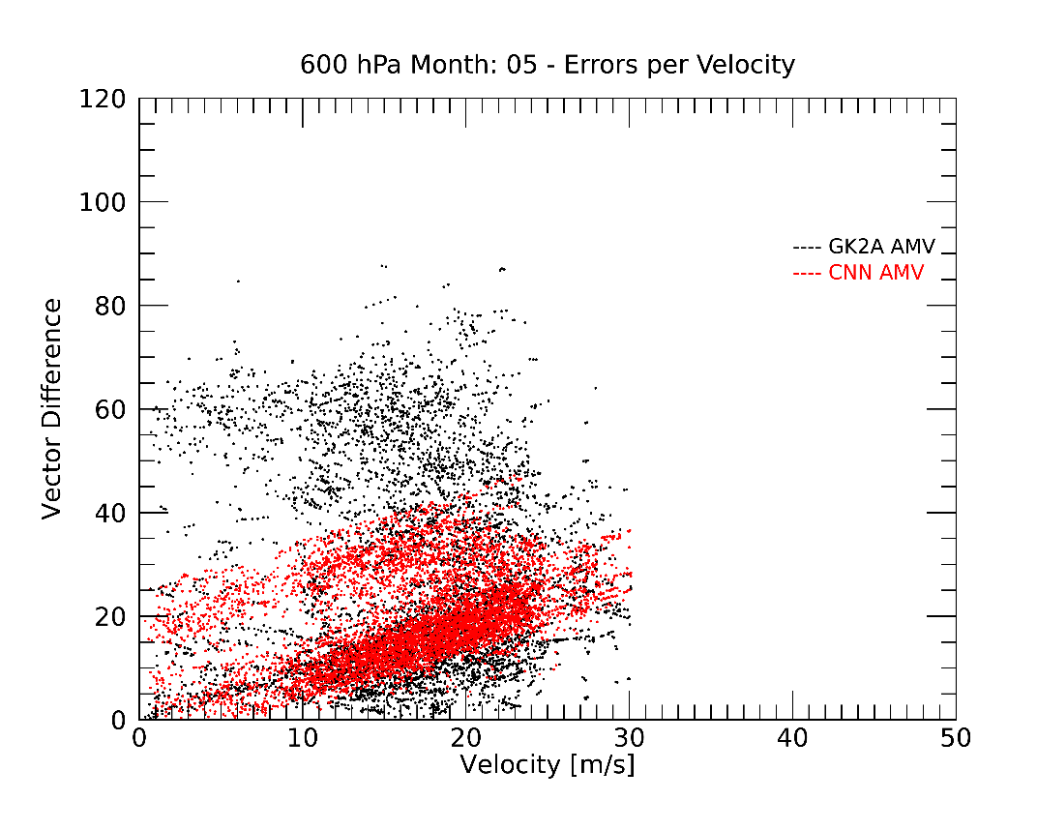
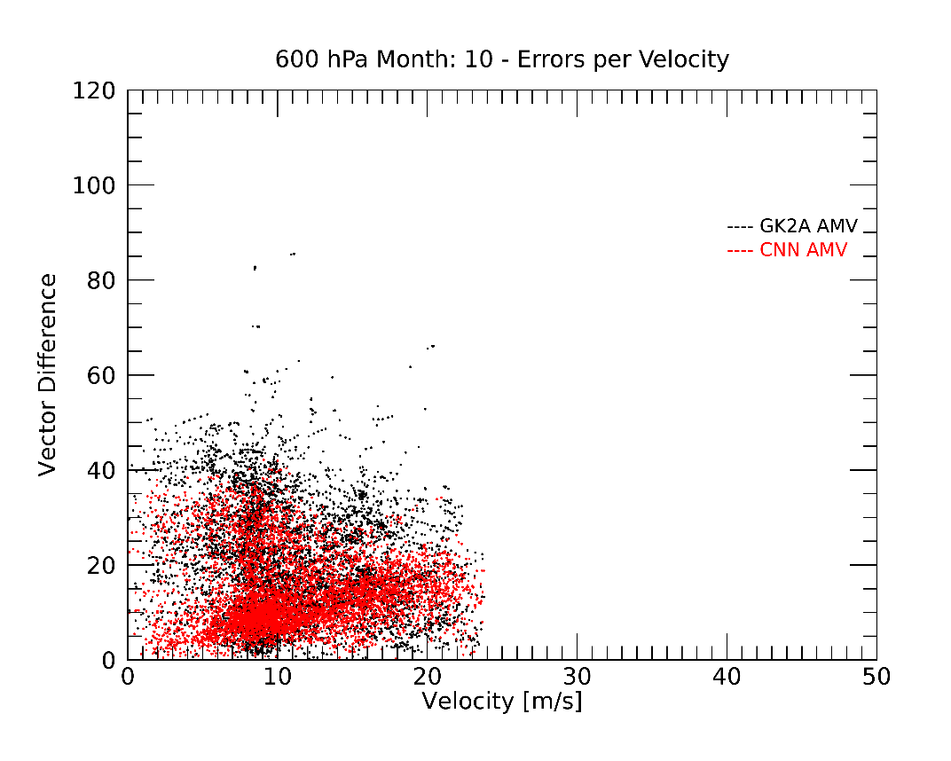
#1 CNN
Application
03. Results
Closer look for the case of 600 hPa
High-accuracy case (Month: 4, 5, 10)
A
C
B
Accuracy
A: GK2A < CNN
B: GK2A > CNN
C: GK2A ≒ CNN
✔ “A” area is large! → CNN wind performs well when the velocity is small.

Slide 18
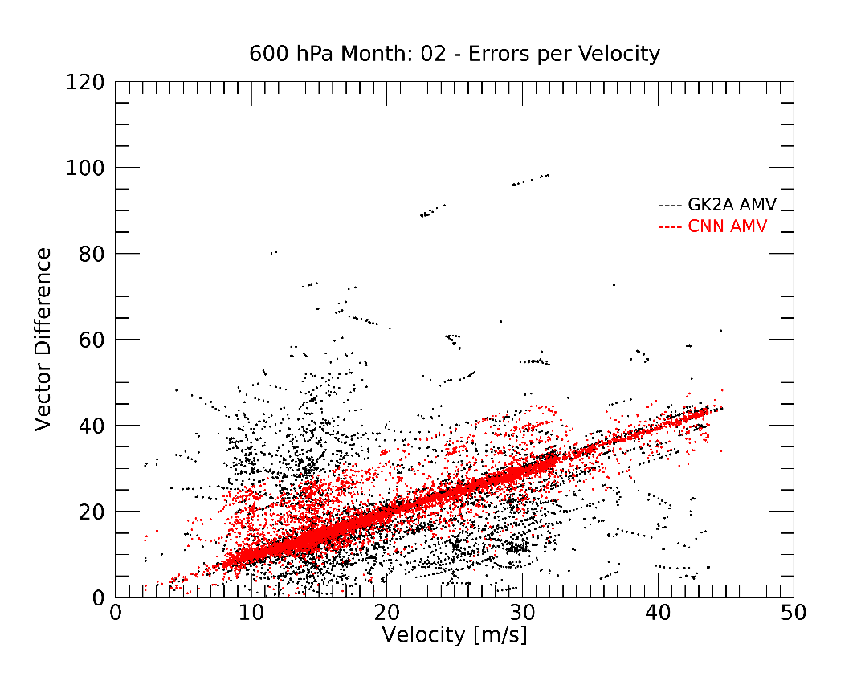
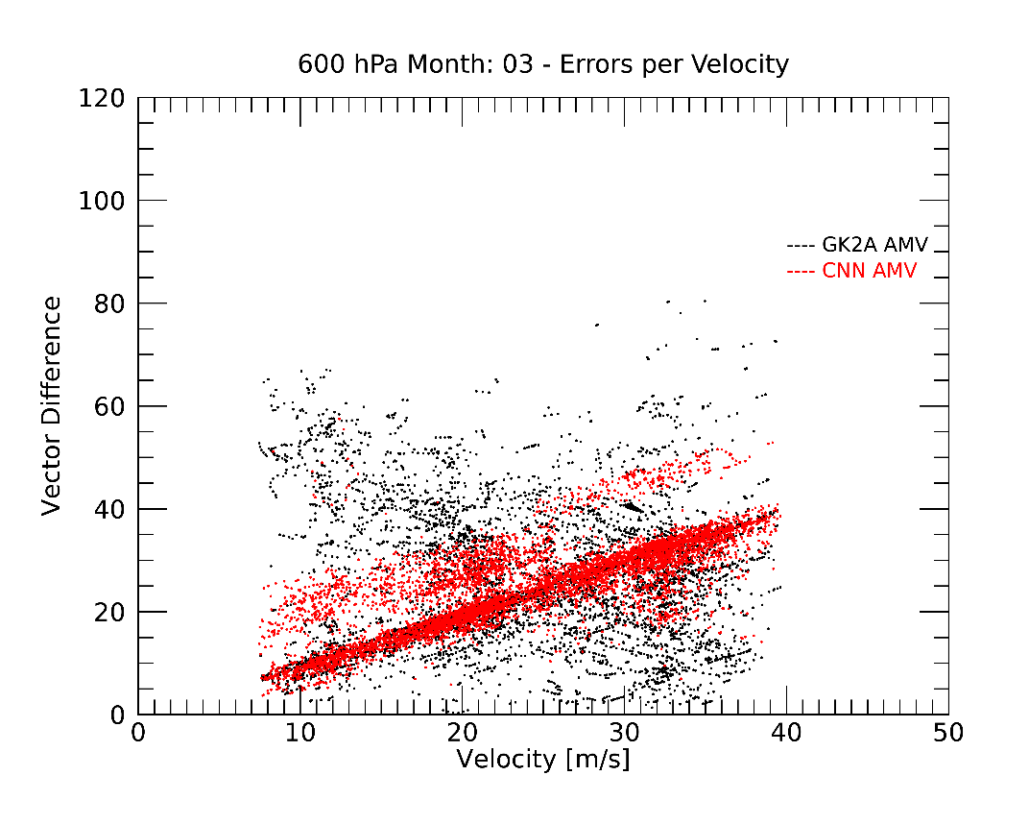
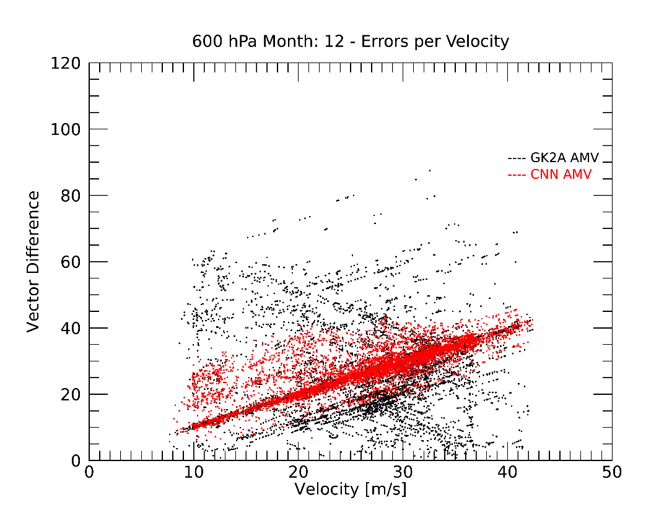
#1 CNN
Application
03. Results
Closer look for the case of 600 hPa
Low-accuracy case (Month: 2, 3, 12)
A
C
B
Accuracy
A: GK2A < CNN
B: GK2A > CNN
C: GK2A ≒ CNN
✔ The larger the velocity, the larger the error in CNN wind.

Slide 19
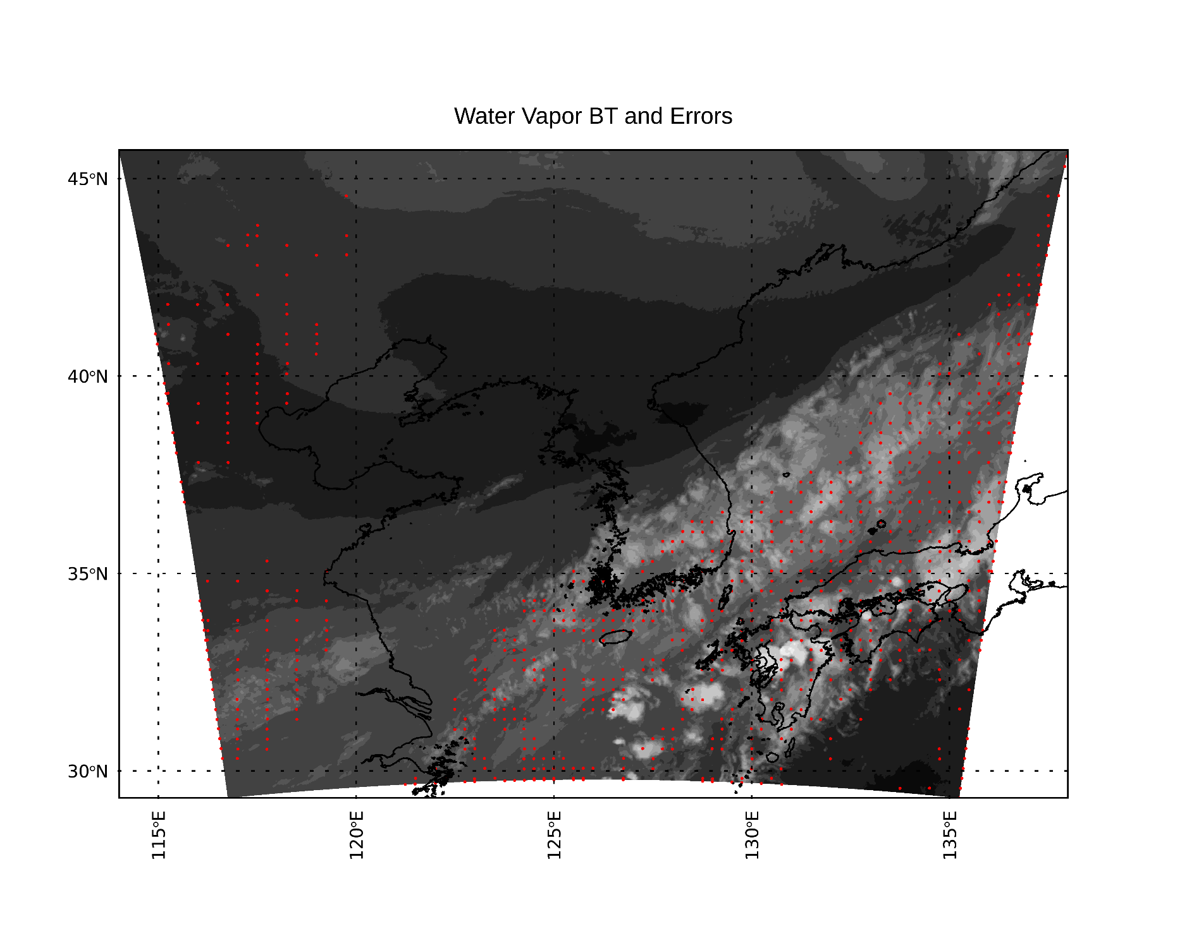
#1 CNN
Application
03. Results
Check where the large error occurred in water vapor field
✔ High error occurs
at the edge of the image
in areas with thick water vapor layer
Error correction is necessary in areas
with many clouds.
: Where errors greater than mean occur

Slide 20
#2
Forecasting
03. Results
Δt=10min
Ch08 (6.3 ㎛, 350 hPa)
Ch09 (6.9 ㎛, 450 hPa)
Ch10 (7.3 ㎛, 600 hPa)
t-2Δt t- Δt t
Forecasted AMV
✔ Ch10 with the lowest RMSVD has the highest
forecasting accuracy.
✔ When the lead time is 1hr, the error is about
4 times larger than the 10min forecasting.
t-2Δt t- Δt t t+ Δt

Slide 21
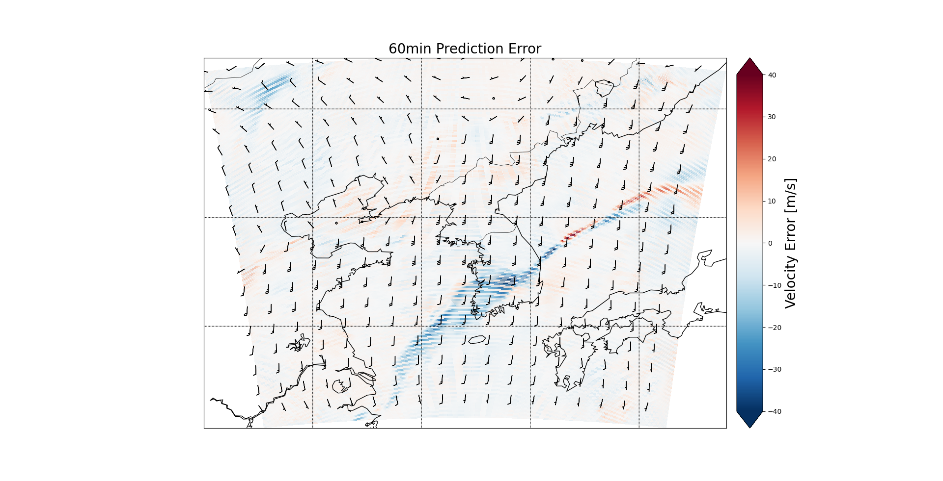
#2
Forecasting
03. Results
(A) Brightness temperature of Water vapor data
(B) Reference CNN Wind
✔ CNN wind Forecasting shows high errors in areas with thick water vapor layer.
(C) 10min Prediction and Error
(D) 60min Prediction and Error

Slide 22
04. Conclusions
#1 CNN
Application
✔ Applying CNN to calculate wind vectors from satellite data shows many advantages.
CNN wind shows better resolution than any other wind data.
Compared to the traditional GK2A AMV algorithm, it shows particularly high accuracy tracking performance in the lower latitude.
The tracking performance is more accurate when the wind velocity is small.
#2
Forecasting
✔ Forecasting the wind vectors has been attempted with pixel based wind, which
was impossible with traditional satellite target based algorithms.
✔ Since the forecasting accuracy was also low at the point where the accuracy of the
wind calculated by CNN was low, it is expected that the forecasting accuracy will
spontaneously increase if the calculation accuracy can be increased.

Slide 23
05. Reference
[1] Bresky, W., & Daniels, J. (2006, April). The feasibility of an optical flow algorithm for estimating atmospheric motion. In Proceedings of the Eighth Int. Winds Workshop, Beijing, China (pp. 24-28).
[2]Horn, B. K., & Schunck, B. G. (1981). Determining optical flow. Artificial intelligence, 17(1-3), 185-203.
[3] Lee, S. J., & Ahn, M. H. (2023). Study on the Slant Path Effect in the simulation of clear sky thermal radiance for the GK2A AMI. Monthly Weather Review.
[4] Oh, Soo Min, et al. "Development and intercomparison study of an atmospheric motion vector retrieval algorithm for GEO-KOMPSAT-2A." Remote Sensing 11.17 (2019): 2054.
[5] Oh, Y., Park, H., Kim, J. H., & Kim, S. (2020). Improvements for Atmospheric Motion Vectors Algorithm Using First Guess by Optical Flow Method. Korean Journal of Remote Sensing, 36(5_1), 763-774.
[6] Ouyed, A., Zeng, X., Wu, L., Posselt, D., & Su, H. (2021). Two-Stage Artificial Intelligence Algorithm for Calculating Moisture-Tracking Atmospheric Motion Vectors. Journal of Applied Meteorology and Climatology, 60(12), 1671-1684.
[7] Sun, Deqing, et al. "Pwc-net: Cnns for optical flow using pyramid, warping, and cost volume." Proceedings of the IEEE conference on computer vision and pattern recognition. 2018.
[8] Wu, Q., Wang, H. Q., Lin, Y. J., Zhuang, Y. Z., & Zhang, Y. (2016). Deriving AMVs from geostationary satellite images using optical flow algorithm based on polynomial expansion. Journal of Atmospheric and Oceanic Technology, 33(8), 1727-1747.

