Slide 1
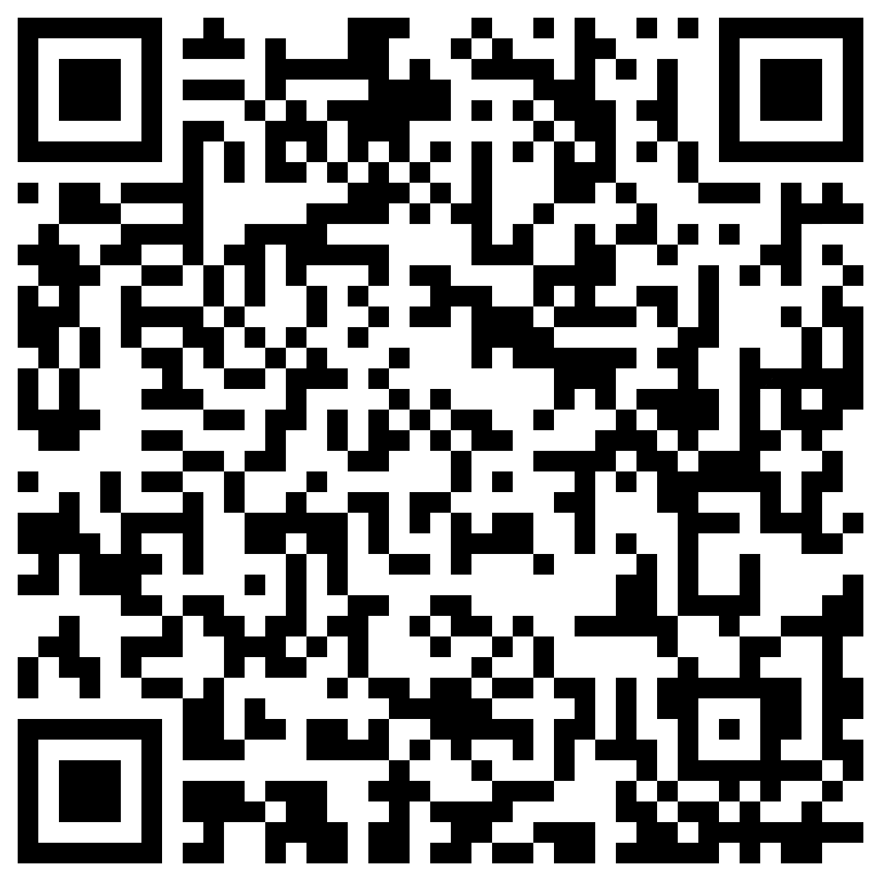
GEB: A large-scale agent-based socio-hydrological model
Jens de Bruijn, Mikhail Smilovic, Peter Burek, Luca Guillaumot, Yoshide Wada, Jeroen Aerts
jens.de.bruijn@vu.nl

Slide 2
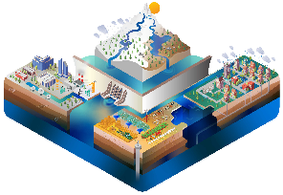
Adaption behaviour
Irrigation
Crop types
Groundwater wells
Giving trainings
Providing subsidies
Setting prices
Reservoir management
Networks
Etc.
Climate
Biodiversity
Soil water balance
Evaporation
Groundwater
Streamflow
Floods
Etc.

Slide 3
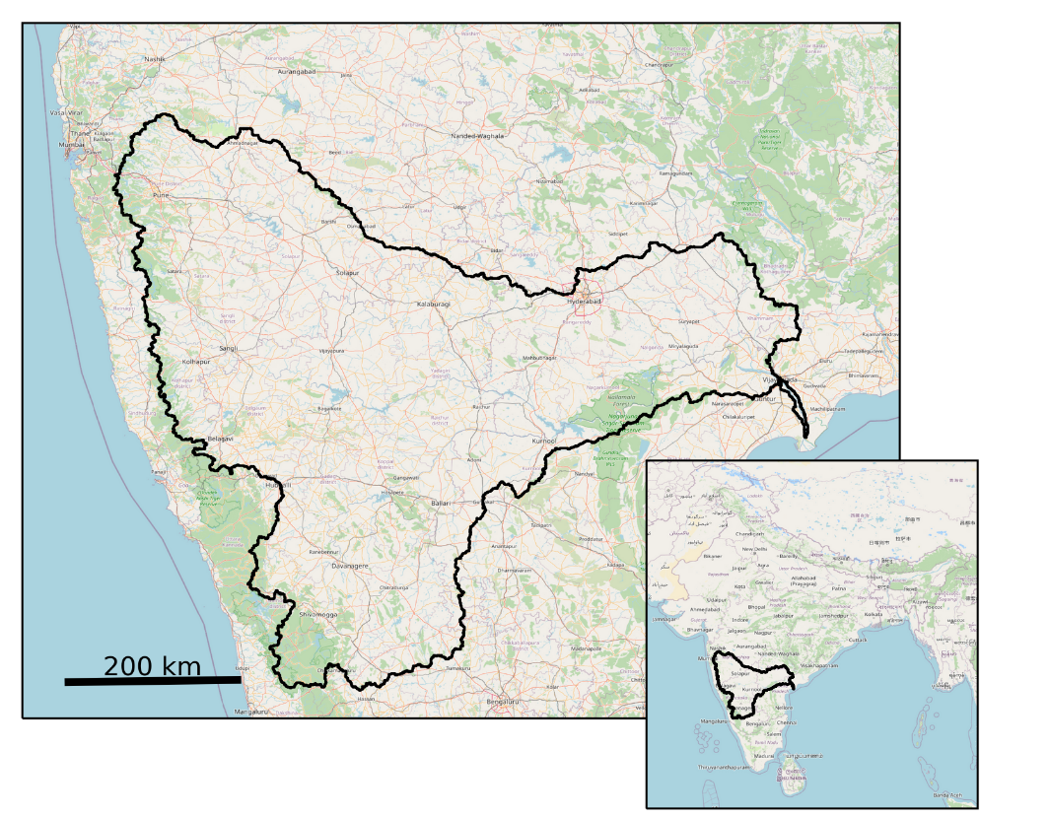

Slide 4
1
2
3

Slide 5
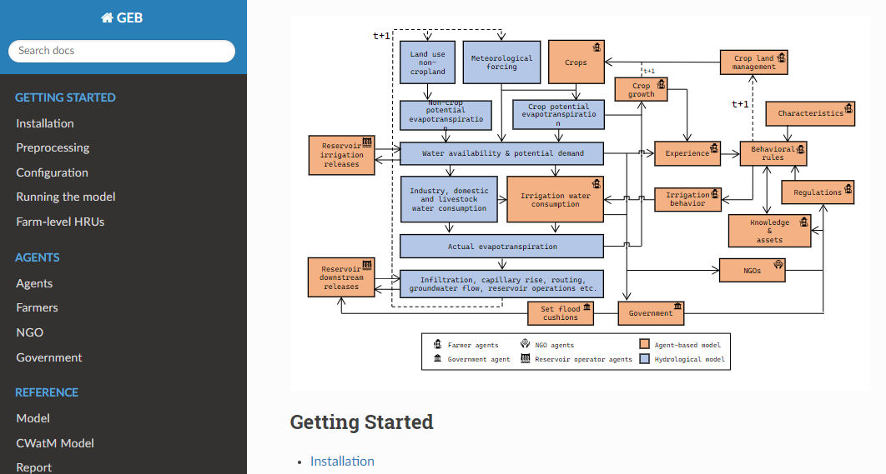
Thank you for listening!
OPEN SOURCE model + documentation
The paper

Slide 6
Supplementary material

Slide 7
GEB in short
GEB aims to simulates the hydrological system, the individual behaviour of people and their interactions at large scale. The model does so by coupling an agent-based model and hydrological model (CWatM) at high resolution. The ABM simulates millions of individual people and households one-to-one.
How flood and drought risk evolve over time
How downstream farmers are affected by upstream farmers
How different groups of people (e.g., farmers) behave, and how they are affected differently depending on their individual characteristics, location and environment
Etc.

Slide 8
Using scenarios to drive GEB
The ABM can be driven by scenarios, which are, for example, developed by stakeholders as well as climatological projections to evaluate how the system may behave under future conditions

Slide 9
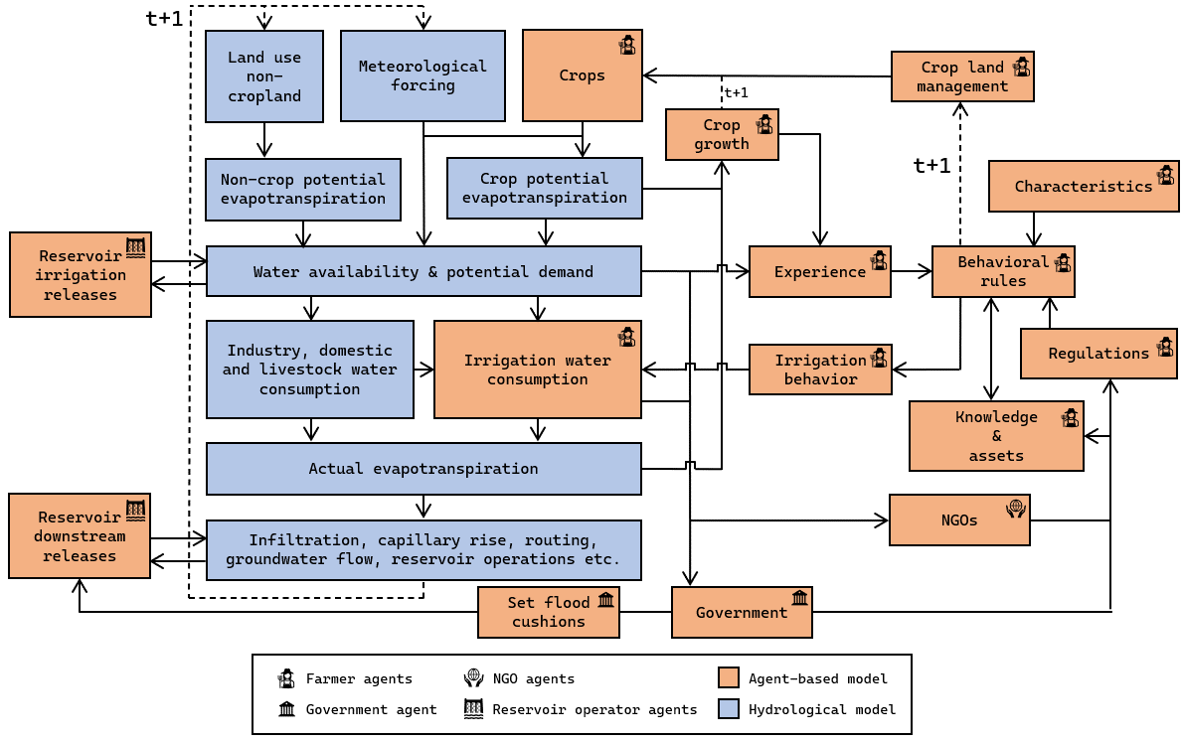
Flowchart of the model
The hydrological system affects the people (orange), and the people affect the hydrological system (blue)

Slide 10
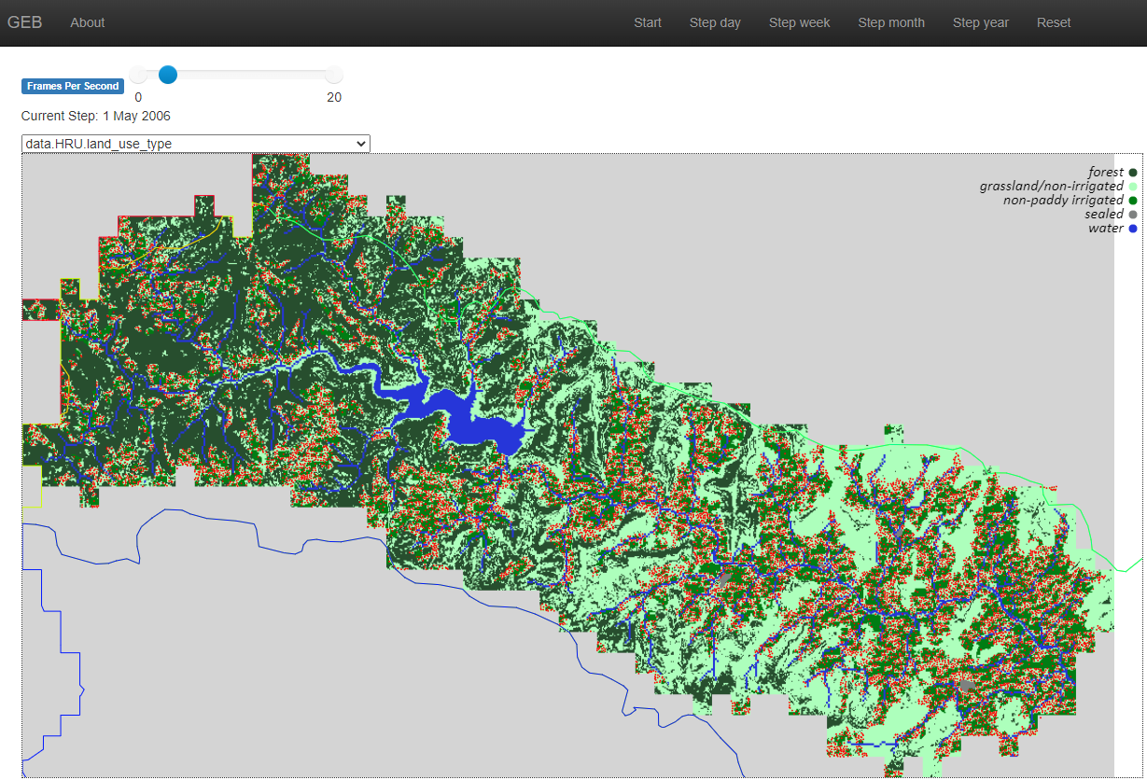
An optional web interface
The model runs on a normal laptop and has an (optional) web interface, shown here for a small part of the Krishna basin

Slide 11
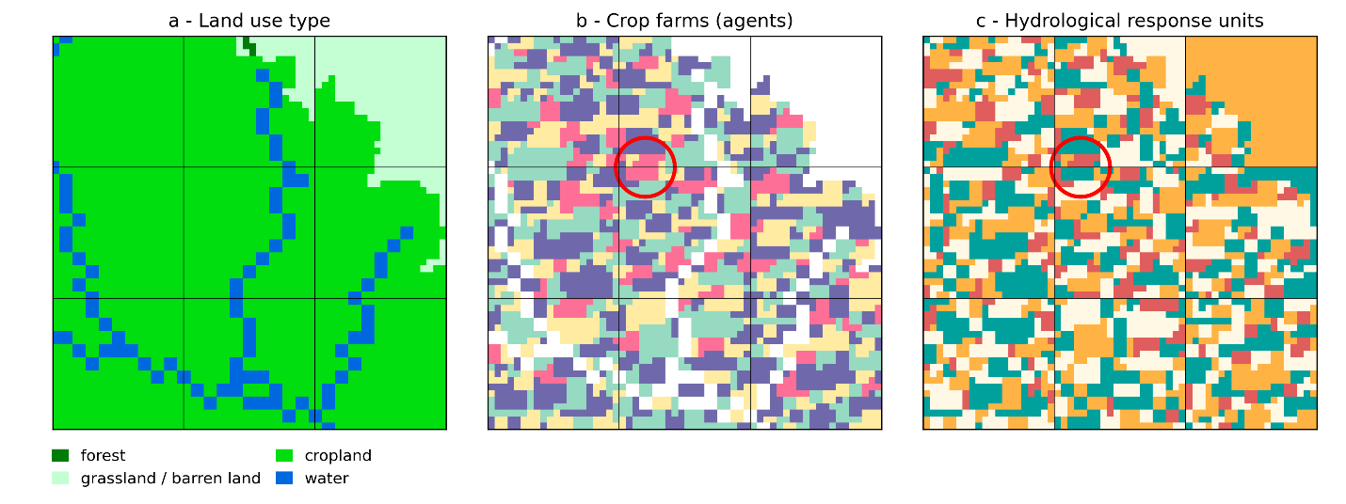
Hydrological response units
By integrating hydrological response units (HRUs) at sub-grid level each agents has their individually operated hydrological environment (e.g., a farm)

Slide 12
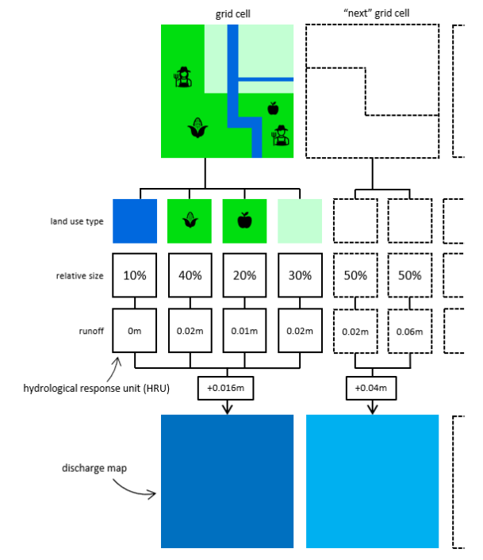
Hydrological response units (2)
By aggregating the runoff from sub-grid cells within a 1x1 km grid cell, runoff discharge and groundwater are computed for the entire grid cell

Slide 13
The Krishna basin
The Krishna basin encompasses 8% of India’s land area and has more than 10 million farmers. All famers are simulated individually

Slide 14
Generating farmer characteristics
By resampling survey data with census data at sub-district level we generated a realistic synthetic population with heterogeneous characteristics

Slide 15
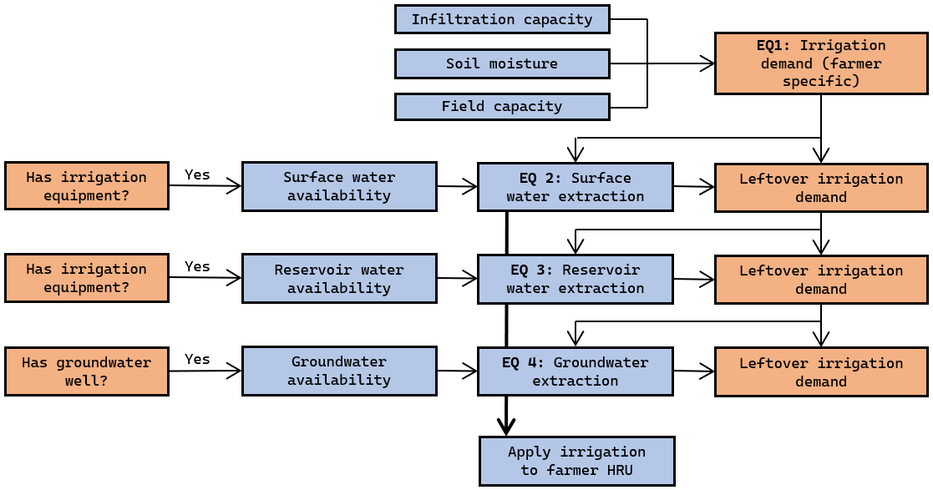
Agent decision making
Farmers can make decisions at a daily time scale. Here the logic for irrigation is shown

Slide 16
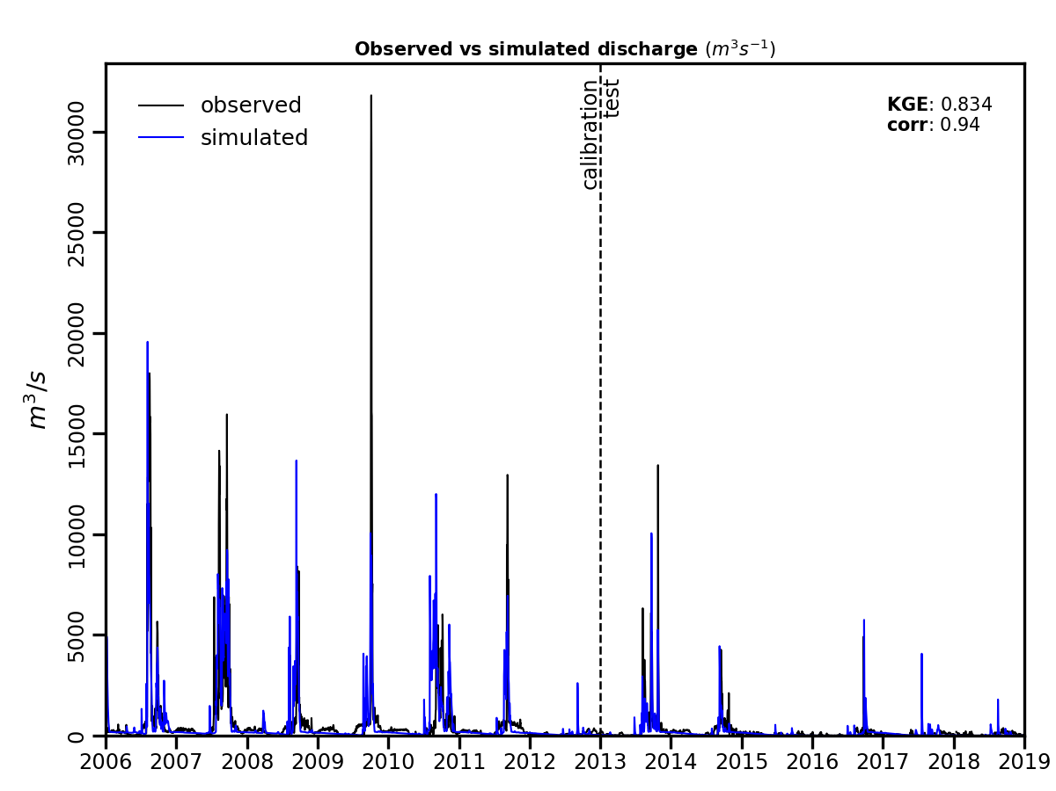
Model performance
The model is calibrated and manages to match observed streamflow well (KGE=0.834)

Slide 17
Spatial patterns
We can see how much individual farmers, but also see how patterns change throughout the basin. Note that the population is synthetic yet statistically representative.

Slide 18
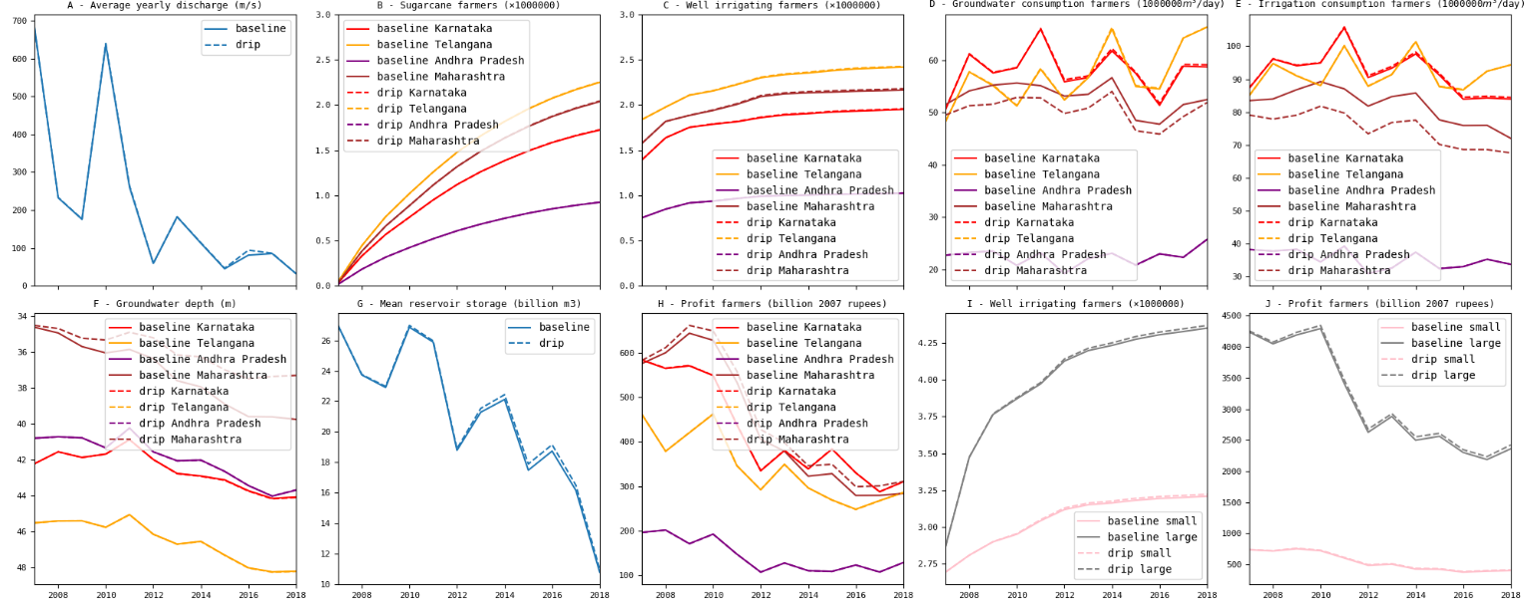
Time series
We can see how hydrological stores/fluxes, such as discharge, reservoir volume, and groundwater change over time. We can also see how different types of farmers are affected differently.

Slide 19
Thank you!
OPEN SOURCE model + documentation
The paper

