Slide 1
The Exploration of 2015-2019 Surface Background Ozone over China: A Model Study by GEOS-Chem High Performance (GCHP)
Xingpei Ye¹, Xiaolin Wang¹, Zhongjing Jiang², Jiayu Xu¹, Danyang Li¹, Ni Lu¹, Xiao Lu³ and Lin Zhang¹
Abstract QR code:
(1) Department of Atmospheric and Oceanic Sciences, Peking University
(2) Environmental and Climate Sciences Department, Brookhaven National Laboratory
(3) School of Atmospheric Sciences, Sun Yat-sen University
Screen 5-12, Session AS3.18, Trends and impacts of tropospheric ozone

Slide 2
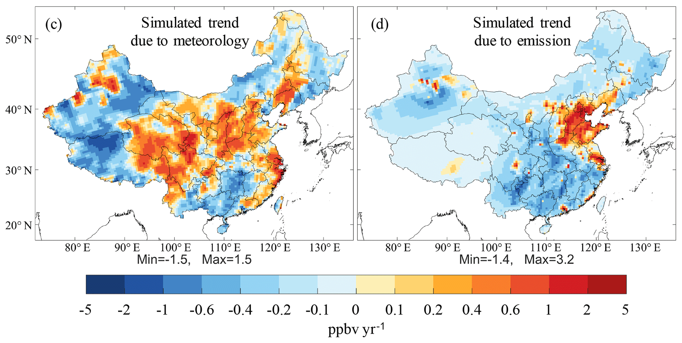
Chinese surface ozone levels are on the rise
Li et al., 2020
Many studies on the role of meteo. and emis.
The share of background ozone
the ozone w/o domestic anthro. emissions
High Performance
Liu et al., 2020

Slide 3
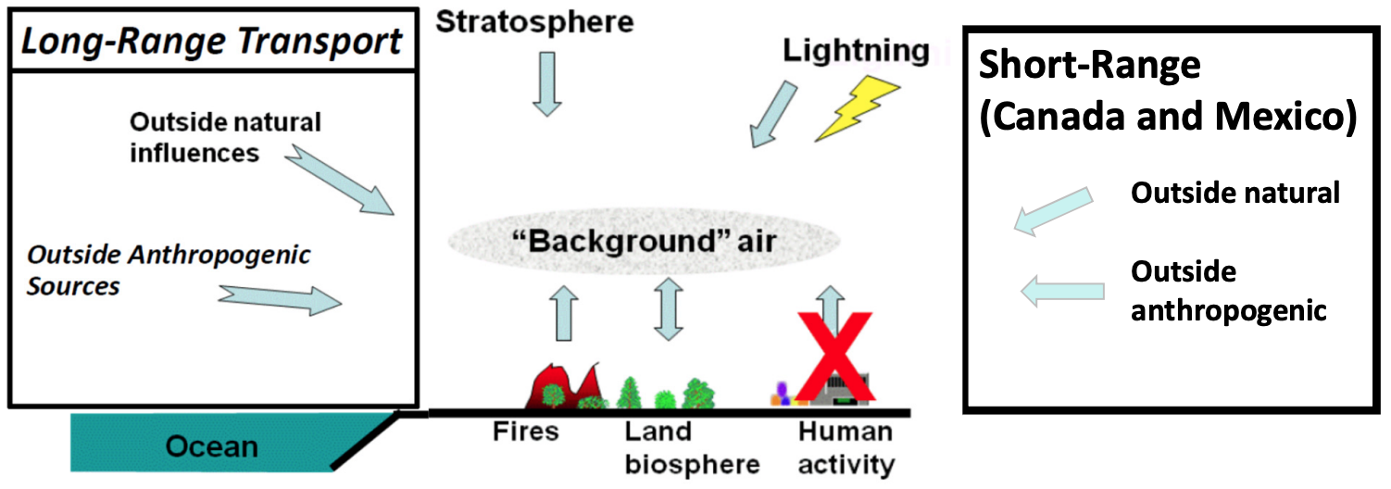
The spatial origin and natural precursor sources of background ozone?
(Adjacent regions)
US, EPA
Modelers like doing this：Base run➖ Background run (w/o anthro. emis.)
previous studies cared more about this, but we go further based on this
Tagged ozone technique for spatial origin: Domestic, foreign, stratosphere, …
Sensitivity experiments for natural precursor contribution: Lightning NOx, soil NOx, biogenic VOCs, …

Slide 4
The interannual variability of CNB ozone and its driving factors?
Previous studies on Chinese background ozone are limited at one or two selected years
Reference | Time studied
Wang et al. | 2008
Sahu et al. | 2015
Lu et al. | 2016-2017 warm seasons
Here we did a 5-year consecutive simulation from 2015 to 2019
to consider year-to-year changes in …
Meteorology
Natural emissions
Transport
ENSO …

Slide 5
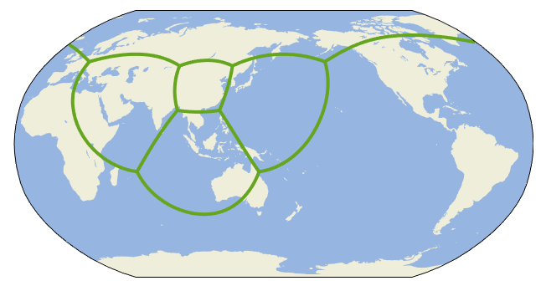
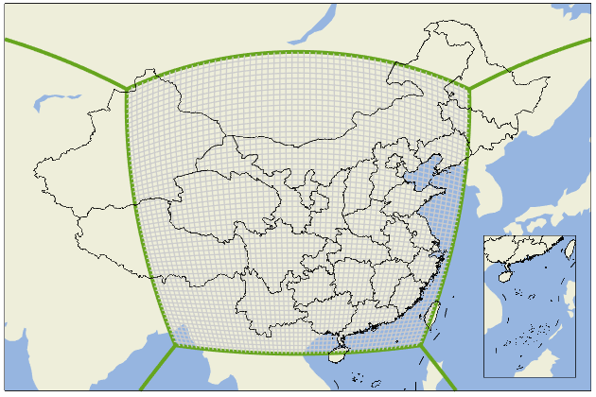
GCHP stretched-grid simulation
Highest resolution in China ~0.5°
60x60 grids on 6 faces
Lowest resolution
in South America ~4.5°
GEOS-Chem Classic | GEOS-Chem High Performance (GCHP)
Can only be ran on 1 node | Can be ran on multiple nodes
Require additional global simulation to provide lateral boundary conditions for nested-grid simulation | Simulation in one step and inherently two-way coupling
Save ~70% wall time using 3 nodes

Slide 6
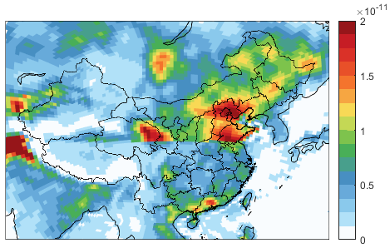
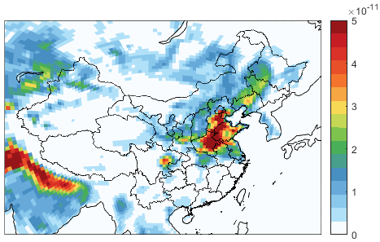
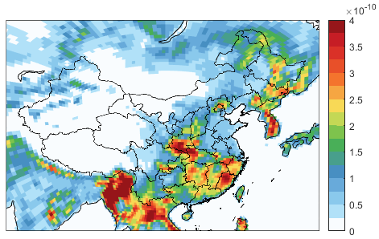
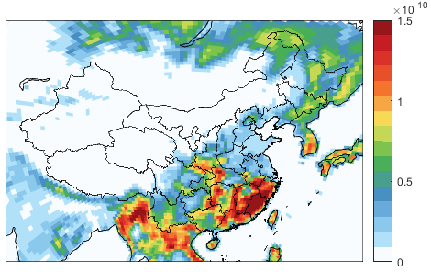
Other model setup
Natural precursor emissions in summer
Version | GCHP 13.2.1
Time | 2015.01.01-2020.01.01
Anthropogenic emissions | MEIC (China) +CEDS (Other)
Soil NOx | Hudman et al., 2010, 2012
Biogenic VOCs | MEGAN v2.1
Lightning NOx | Price and Rind, 1992; Murray et al., 2012; Ott et al., 2010
Biomass burning | GFED4
Methane | Prescribed based on NOAA observations
Lightning NOx
Soil NOx
Biogenic isoprene
Biogenic monoterpene

Slide 7
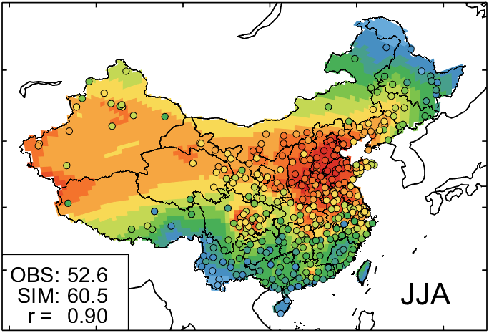
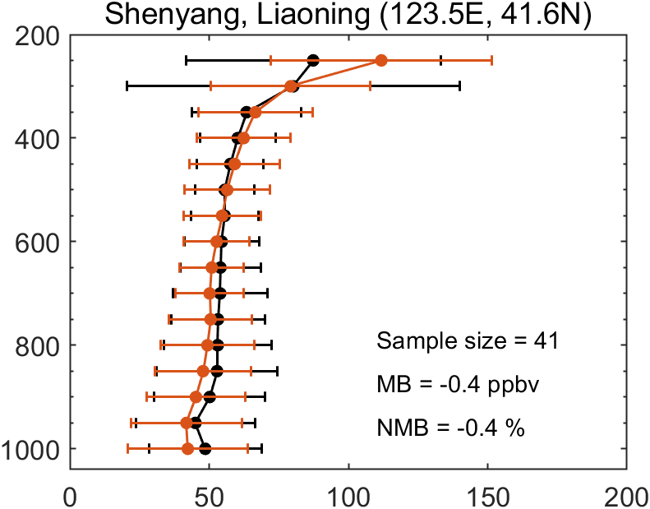
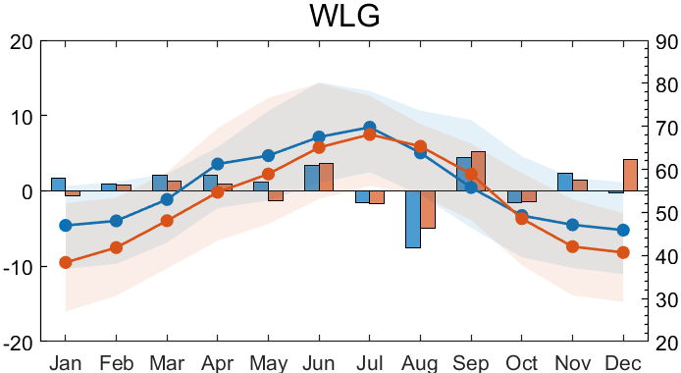
Model evaluation - Overall good ozone simulation performance
Surface non-rural sites
Aircraft observations
Pressure [hPa]
[ppbv]
Ozone [ppbv]
Surface background sites
Waliguan
MDA8 ozone difference
between 2016 and 2015 [ppbv]
Monthly MDA8 ozone [ppbv]

Slide 8
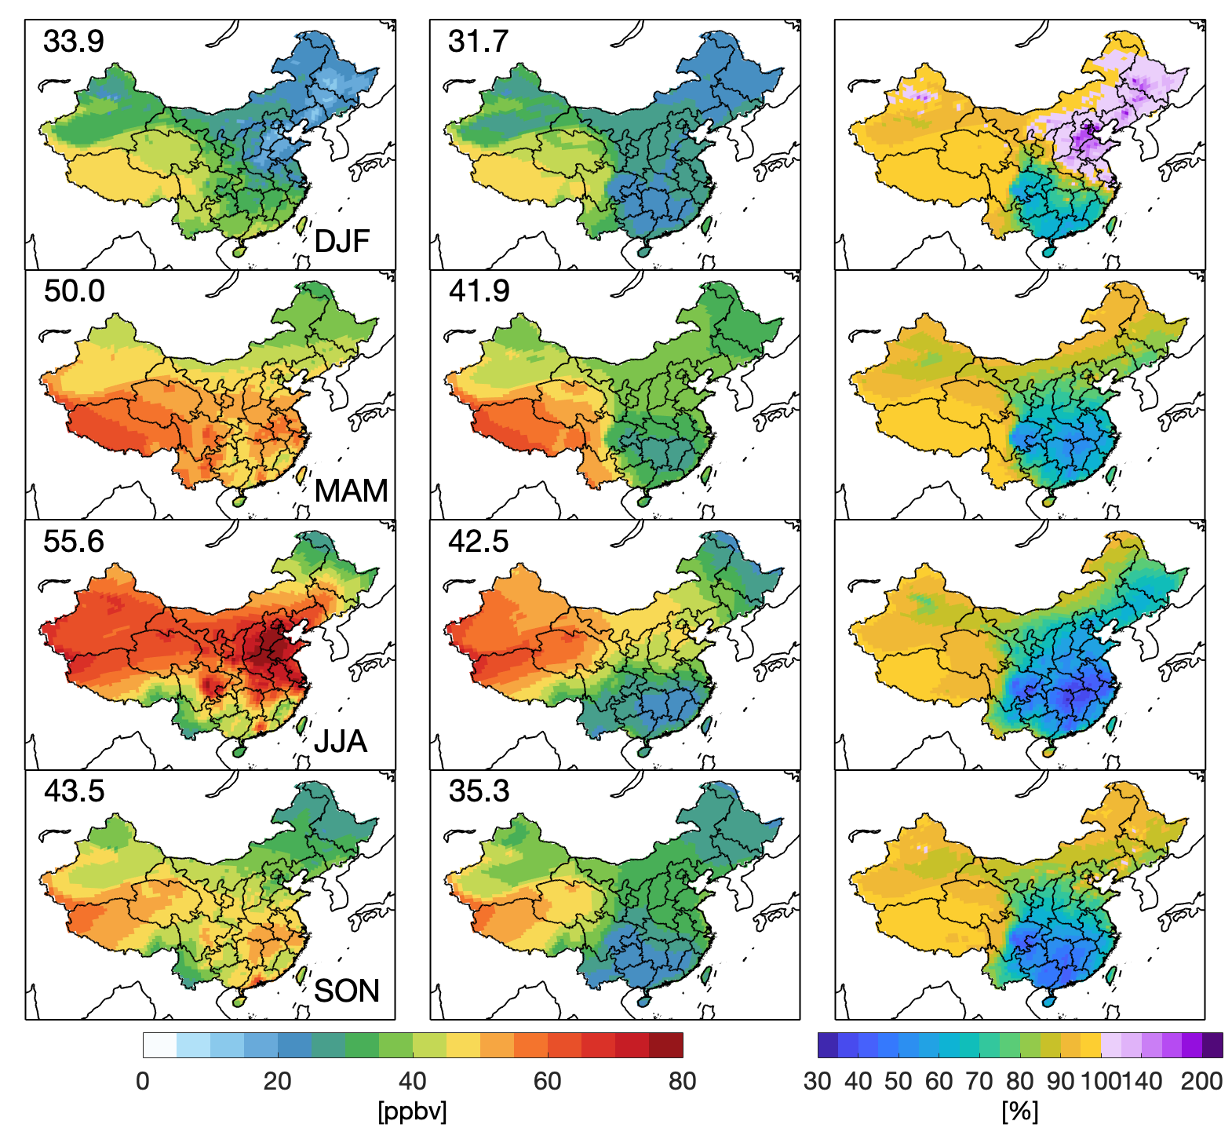
Chinese background (CNB) ozone vs. total ozone
Total
Background
Background/Total
5-year-mean CNB ozone: 37.8 ppbv
CNB ozone is high in the west and low in the east
high in summer and low in winter
High CNB over North China Plain in summer
The share of CNB ozone is lowest in Eastern and Central China
Large NOx titration over North China in winter

Slide 9
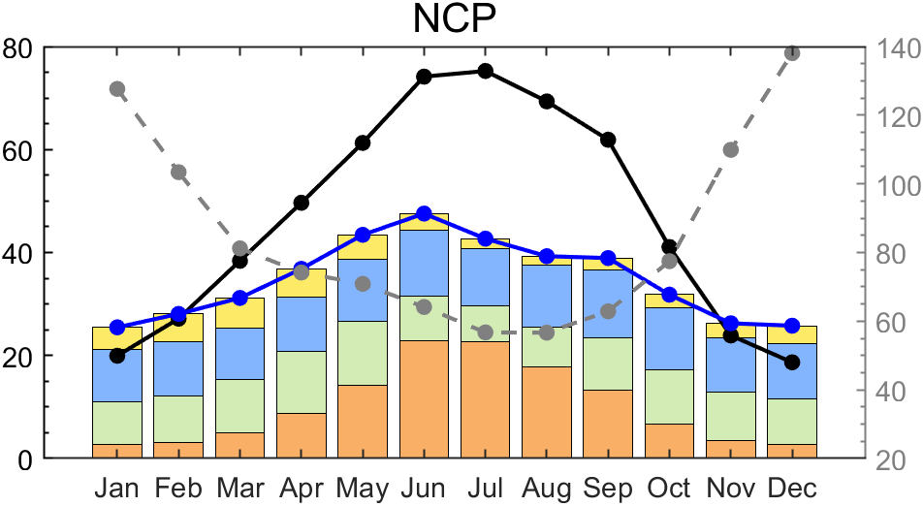
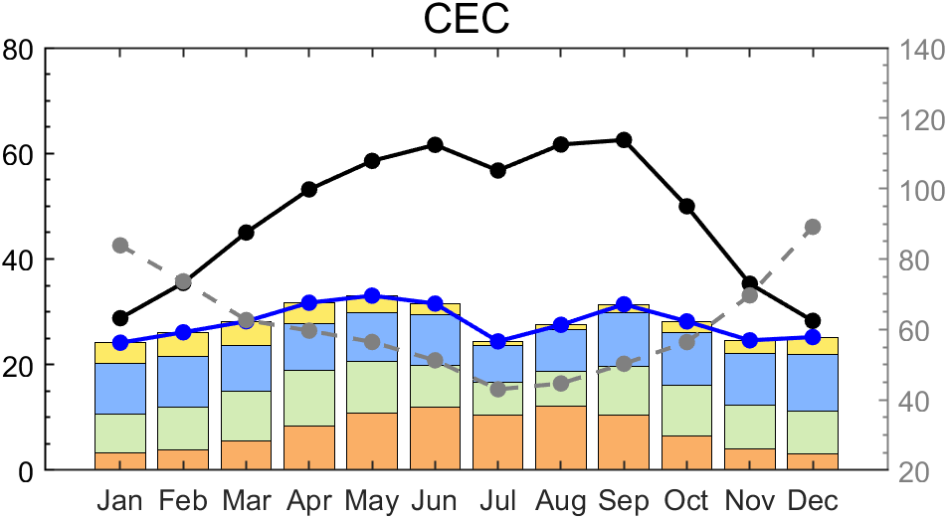
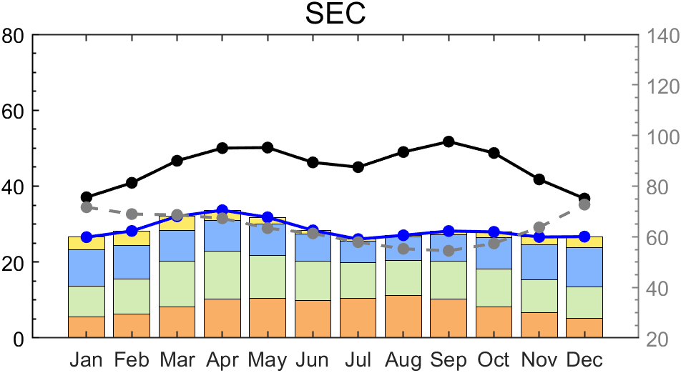
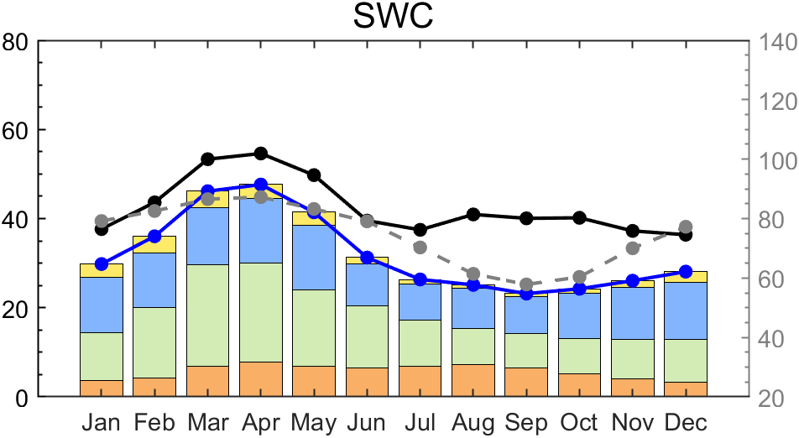
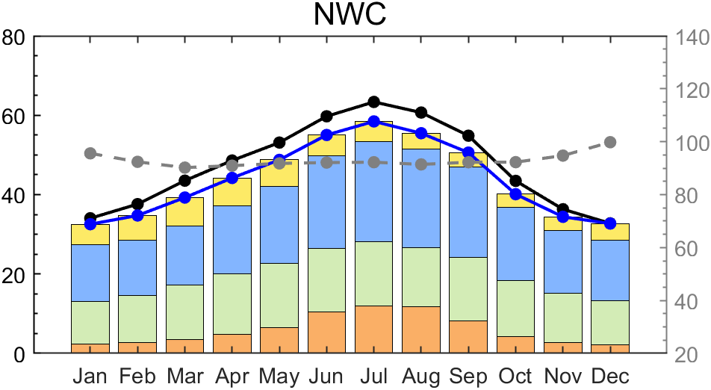
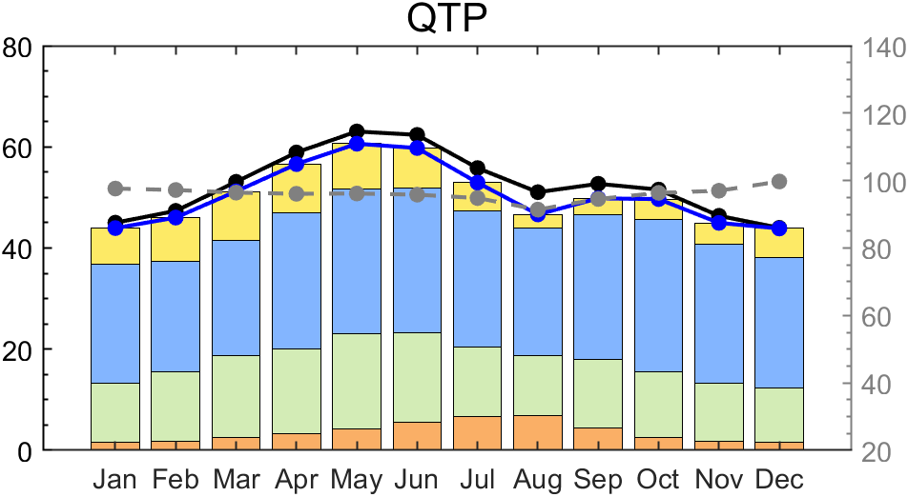
Spatial origin of Chinese background ozone
North China Plain
East China
Southeast China
MDA8 ozone [ppbv]
Southwest China
Southwest China
Qinghai-Tibet Plateau
Background/total [%]
Total ozone
Background
China PBL
Foreign PBL
Free troposphere
Stratosphere
Background / total
only applied in source grids
Tagged ozone technique
$${[O_{3}]}_{t+1}{=[O_{3}]}_{t}+Prod−Loss$$
applied in every grid

Slide 10
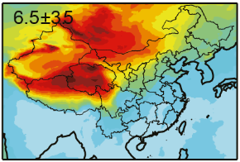
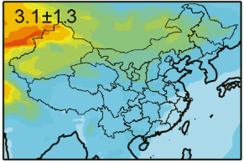
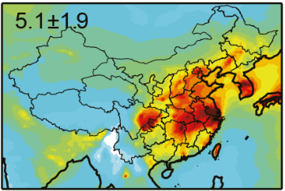
The larger importance of biogenic VOCs over soil NO_{x} to ozone
will be reversed in a “clean” and NOx-sensitive atmosphere
Contribution of natural sources to ozone in summer
Lightning NOx
Soil NOx
Biogenic VOCs
w/o anthro. emissions
(i.e., background ozone)
[ppbv]
w/ anthro. emissions
(i.e., current total ozone)
Lu et al., 2019

Slide 11
Interannual variability (IAV) is largest in summer and over southern China in spring
$$STD=\sqrt{\frac{1}{N}\sum_{i=1}^{N}{{\left|C_{i}−\frac{1}{N}\sum_{i=1}^{N}{C_{i}}\right|}^{2}}}$$
IAV of background ozone in 2015-2019, measured by STD
Spatial sources with the largest IAV
Free
troposphere

Slide 12
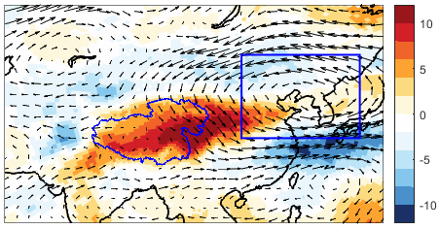
Changes in IAV when
Circulation controls background ozone in the west
Subtracting ozone from
free troposphere and stratosphere
Ozone and wind anomaly at 500 hPa
Between 2018 and 2015
L
Turning off soil NOx emissions
Soil NOx dominates background ozone in the east
Monthly background ozone and soil NOx emissions over North China Plain
[ppbv]

Slide 13
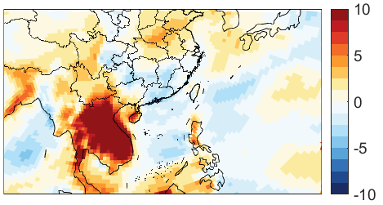
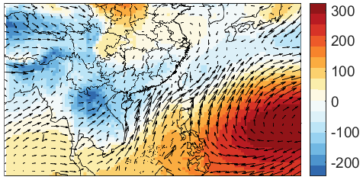
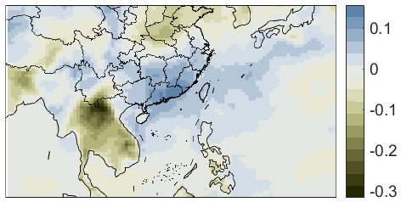
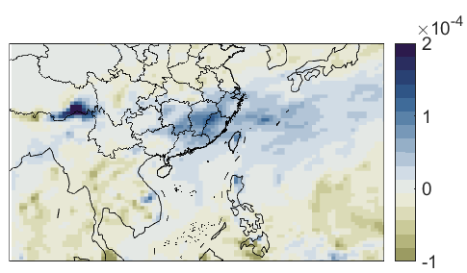
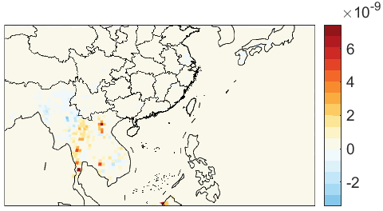
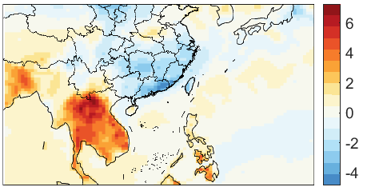
In spring, compared to La Nina, El Nino will …
↓ background ozone in Southeast China through ↑ precipitation/RH
↑ background ozone in Southwest China through ↑ wildfires/temperature in Southeast Asia
Differences between 2016 (El Nino) and 2018 (La Nina) in spring
Ozone
Slp and 10-m wind
RH
Precipitation
Daily-max 2-m temperature
Biomass burning CO

Slide 14
Background ozone appears to contribute little to the upward trend in total ozone… but itself shows large inter-annual variations.
Controlled by the upper air circulation
Controlled by soil NOx emissions
Interannual variations of background ozone
[ppbv]
Controlled by ENSO-related foreign transport and weather anomaly
(wildfires in Southeast Asia, precipitation, etc.)

Slide 15
Take-home messages
The GCHP stretched-grid simulation can significantly save wall time.
Background ozone averages 37.8 ppbv but shows large spatial and temporal complexity.
The contribution of soil NOx to ozone will overtake that of biogenic VOCs as we continue to reduce anthropogenic emissions.
The interannual variability of background ozone can be dominated by the large-scale circulation, soil NOx or ENSO.
Group website:
http://scholar.pku.edu.cn/acaq/
Personal website:
http://xpye.net/
Email:
xpye@stu.pku.edu.cn
Abstract QR code:

