Slide 1
Unreported VOC emissions from road transport including from electric vehicles
Samuel J. Cliff, Alastair C. Lewis, Marvin D. Shaw, James D. Lee, Michael Flynn, Stephen J. Andrews, James R. Hopkins, Ruth M. Purvis and Amber M. Yeoman
sjc613@york.ac.uk
Exhaust
Fuel-tank evaporation
31 mg veh⁻¹ km⁻¹
24 mg veh⁻¹ km⁻¹
Missing screenwash source
58 mg veh⁻¹ km⁻¹
Motivation
Methodology
Measurement results
Inventory comparison
Future implications
Brake and tire wear

Slide 2
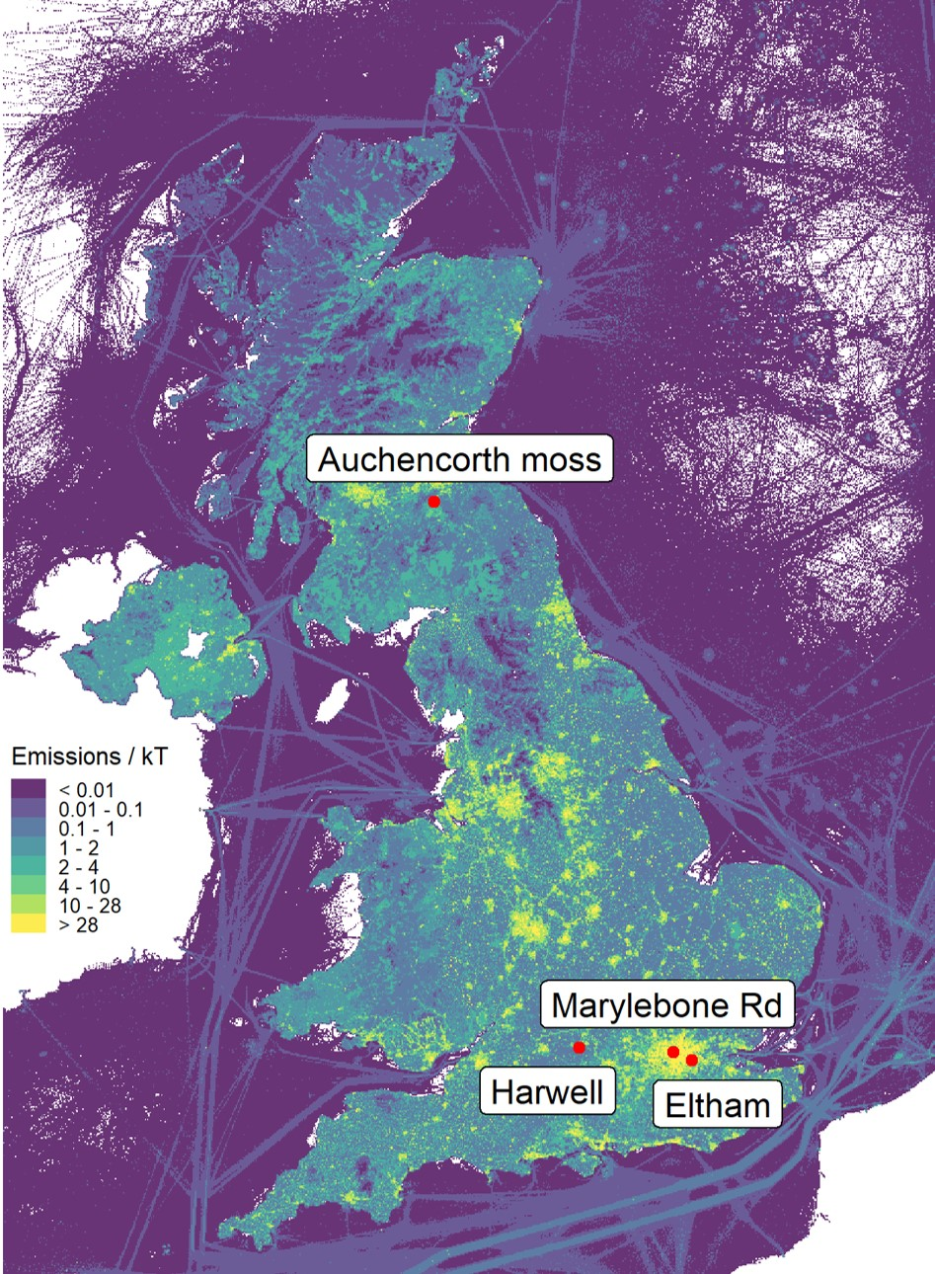
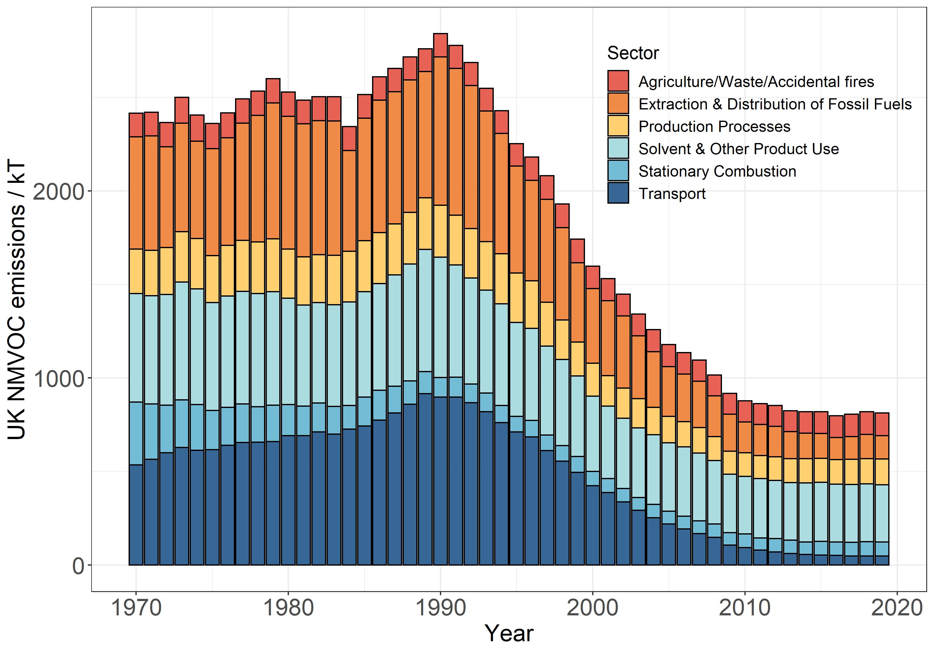
Motivation
Home
In the UK there is:
Poor monitoring coverage.
No oxygenated VOC measurements.
1
¹Department for Business, Energy and Industrial Strategy, National Atmospheric Emissions Inventory (NAEI), 2019, https://naei.beis.gov.uk/data/.

Slide 3
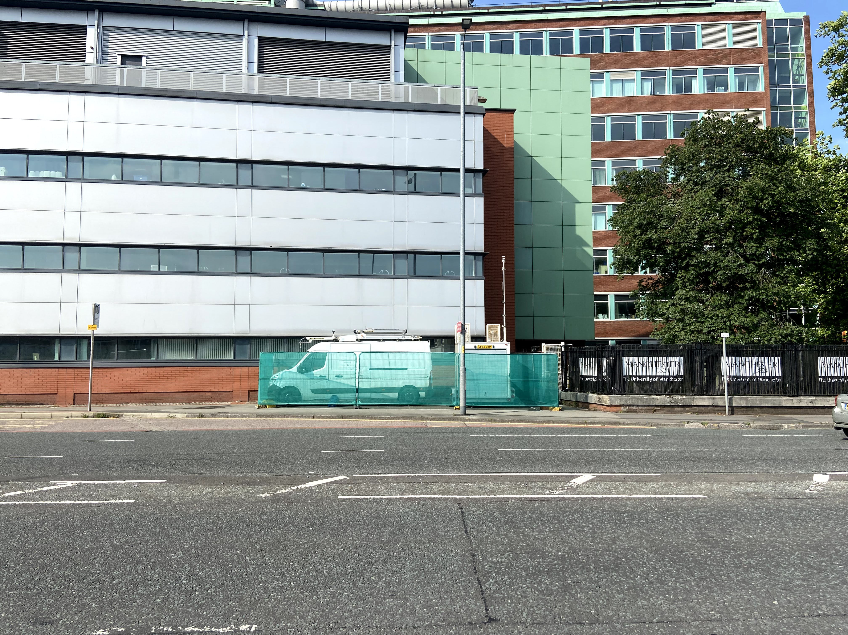
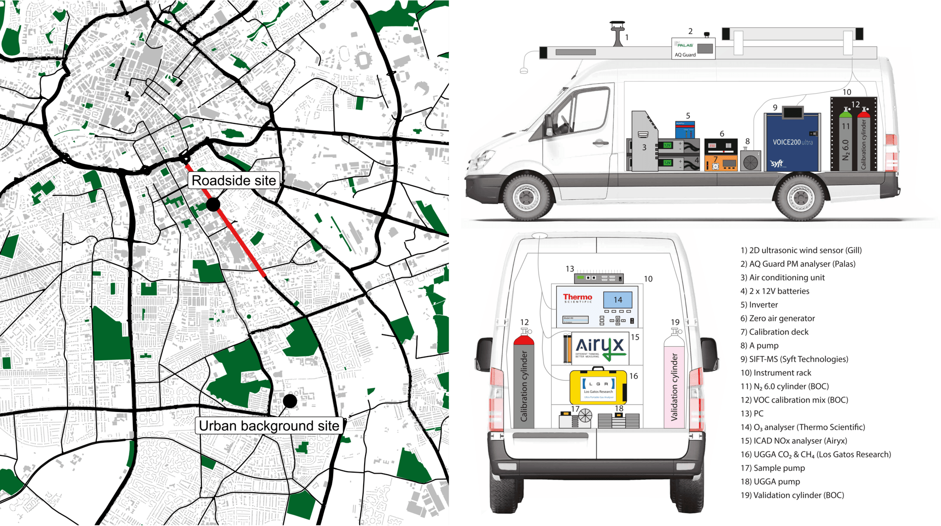
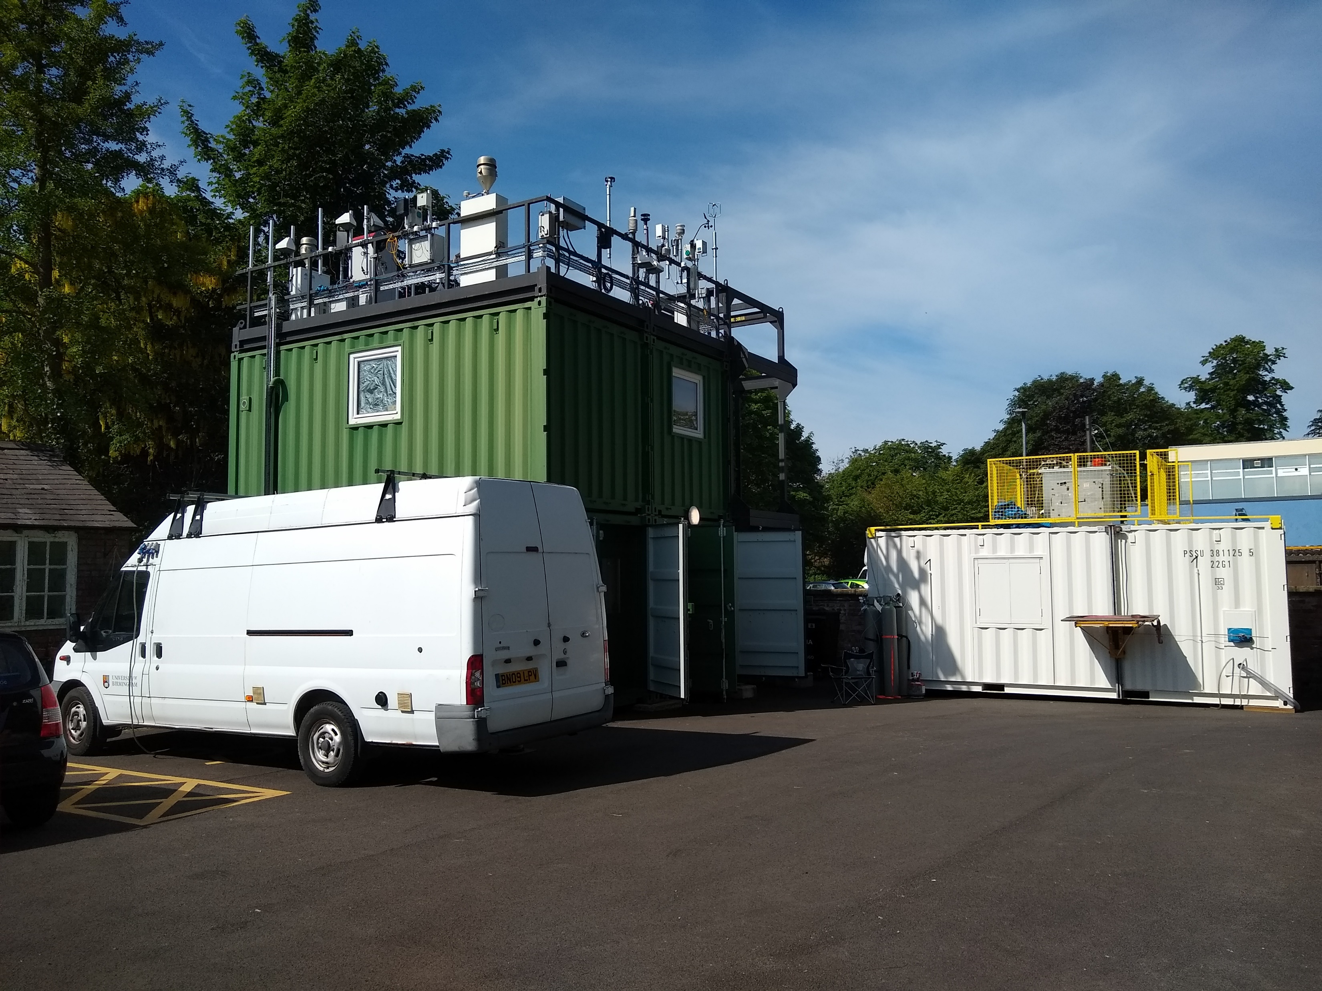
Measurement sites
Home
3 x weeks of measurements in summer 2021 & winter 2022 in Manchester, UK.

Slide 4
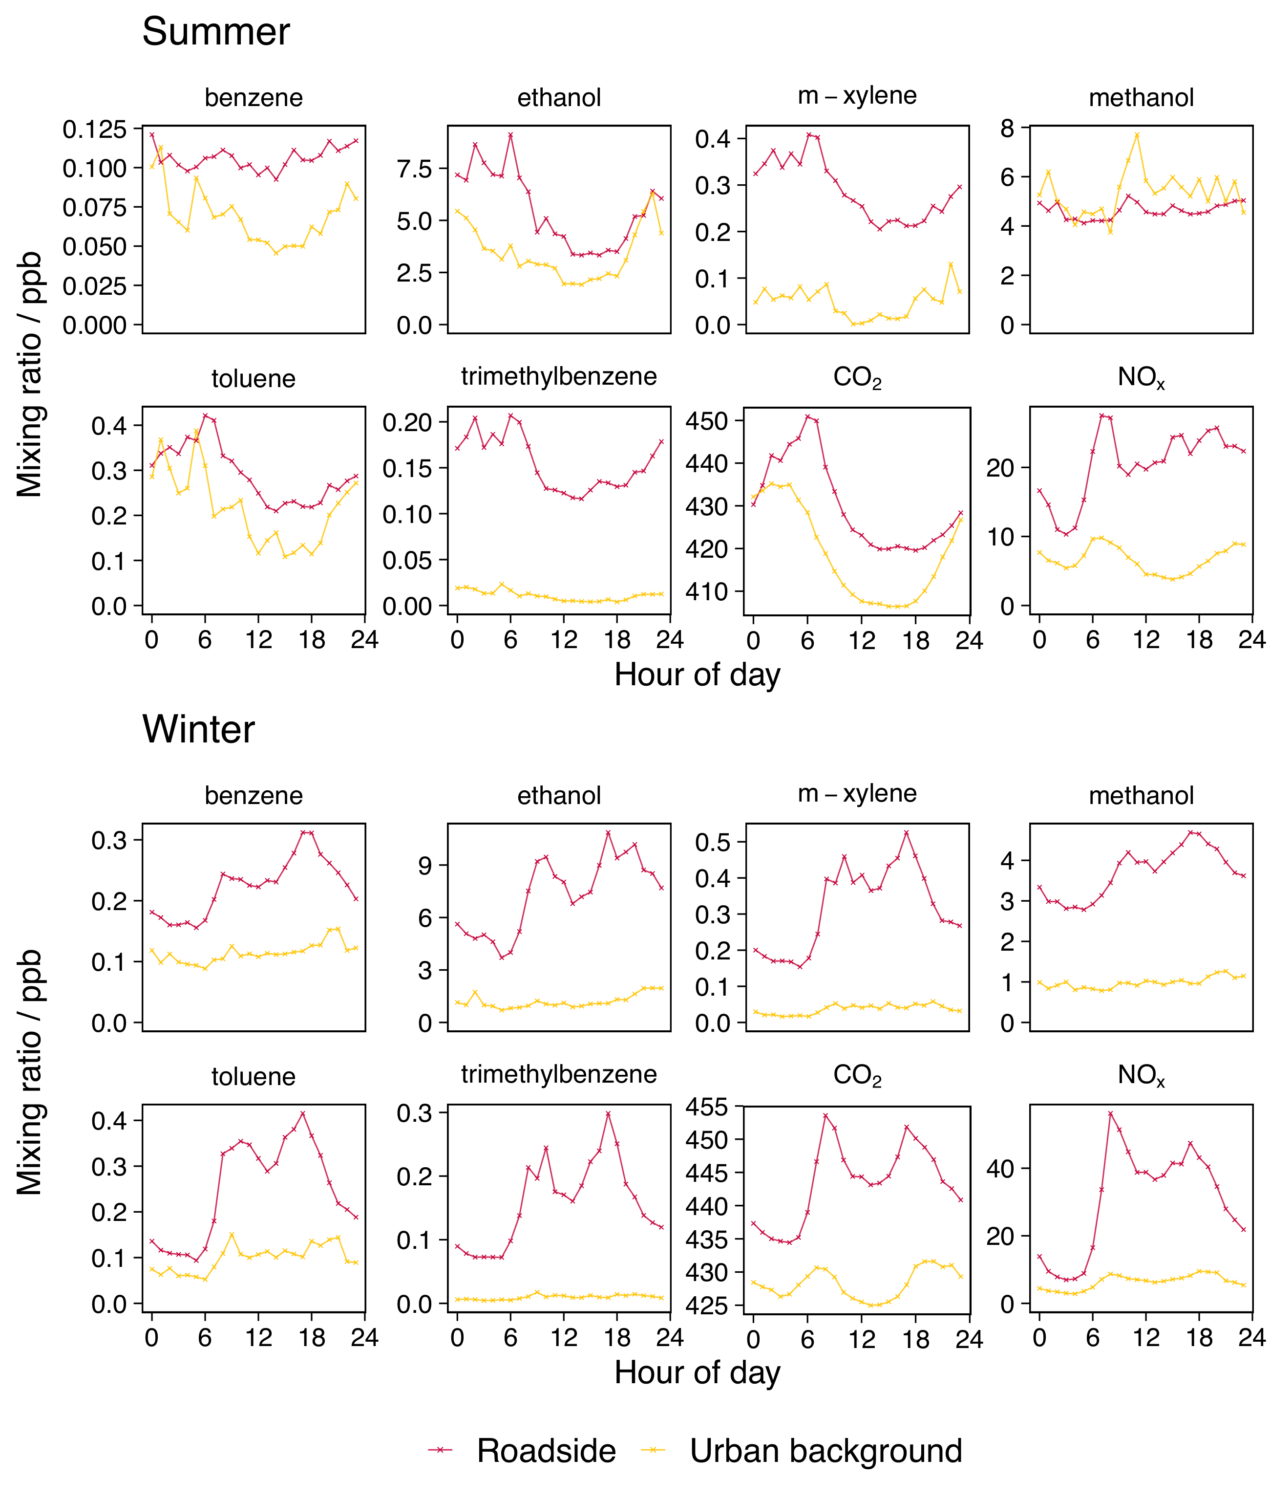
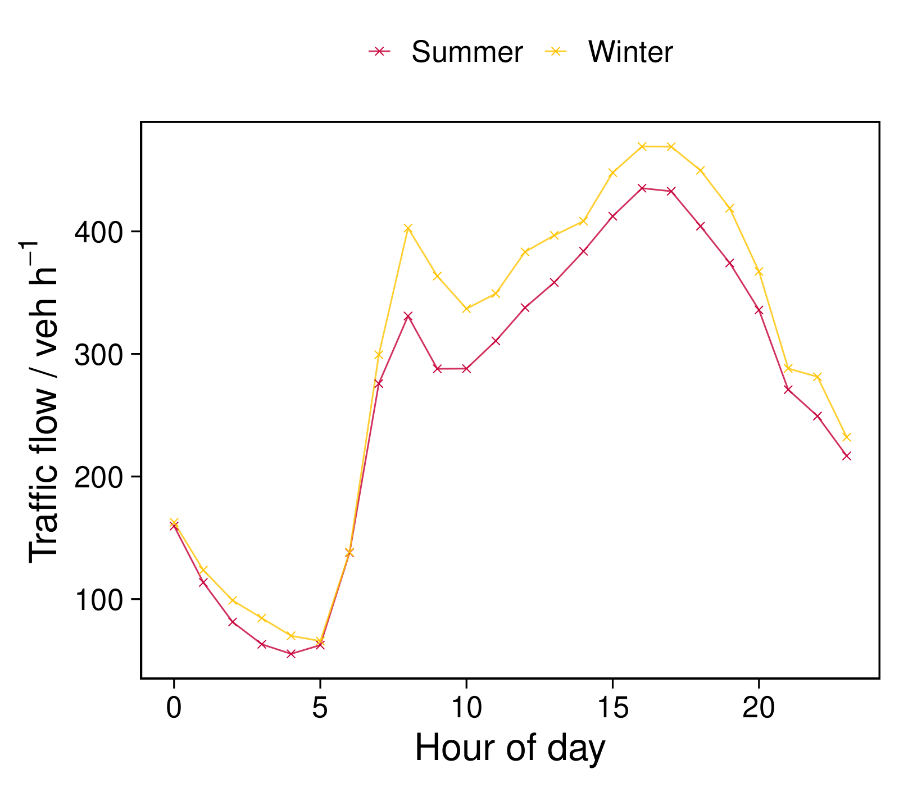
Measured data
Home
Positive roadside increment observed for summer and winter measurements.
Winter tracks traffic flow diel.
Summer is influenced by meteorology and boundary layer height.

Slide 5
Emission factor calculation methodology
Home
$$∆C_{T}=C_{T, roadside}−C_{T, background}$$
Where:
$C$ = concentration
$T$ = tracer species (CO₂ or NO_{x})
$d$ = dilution factor
$EF$ = emission factor
$i$ = vehicle type
$n$ = number of vehicles
$x$ = VOC species
$$dT=\frac{\sum_{i}{{EF}_{T, i}×n_{i}}}{∆C_{T}}$$
Expand
$$dT=\frac{\left({EF}_{T,car}×n_{cars}\right)+\left({EF}_{T,bus}×n_{buses}\right)+…\left({EF}_{T,HGV}×n_{HGVs}\right)}{∆C_{T}}$$
$${EF}_{fleet, x}=\frac{∆C_{x}×dC_{T}}{n_{tot}}$$

Slide 6
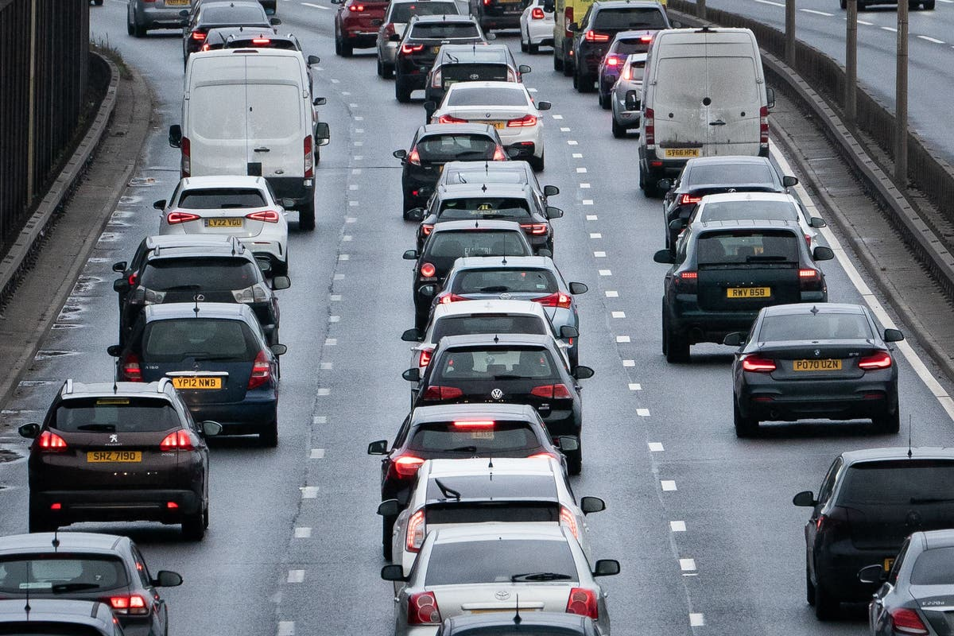
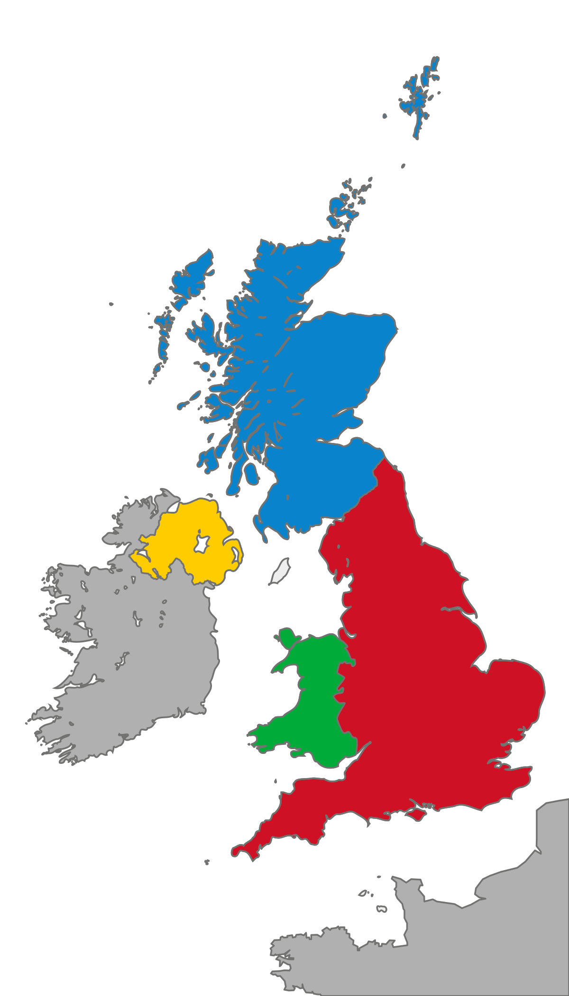
Generating inventory estimations
Home
Traffic data breakdown at roadside site.
Inventory estimated annual emissions for different VOCs.
Meteorological conditions e.g. Temperature, RH.
Convert into mg veh⁻¹ hr⁻¹ emission factor.
UK specific characteristics e.g. average trip length.

Slide 7
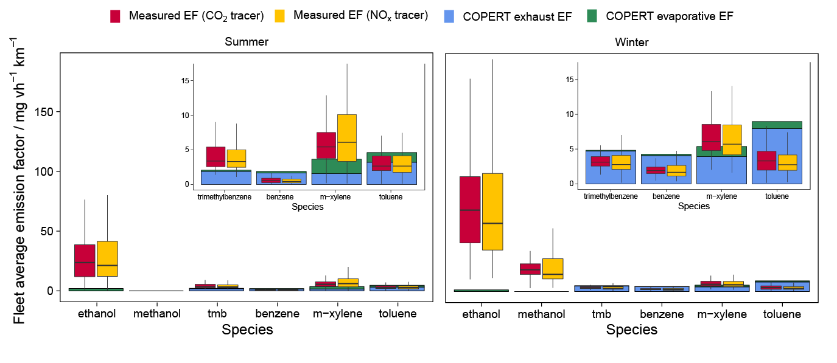
Emission factors
Home
A factor of 45 underestimation in ethanol and methanol!

Slide 8
Discrepancy between measured and COPERT for ethanol and methanol agrees very well with scaled industry sales statistics for screenwash
Comparison with industry sales statistics
Home
Table 1: Headspace analysis results of different screen wash brands on the UK market.
35 kT of screenwash VOC emissions in 2018 for 537 billion vehicle km.
64 mg veh⁻¹ km⁻¹.
Inventory estimates 92 % (32 kT) is from ethanol and methanol.
Discrepancy of seasonal average measured ethanol and methanol emission factors.
58 ± 39 mg veh⁻¹ km⁻¹ : Excellent agreement!
Speciation agrees well with headspace analysis of different screen wash brands on the UK market.
Screen wash emissions are 2x greater than exhaust emissions (31 mg veh⁻¹ km⁻¹) and not in road transport emissions inventories.
Product | Methanol % | Ethanol %
1 | 25.1 | 3.41
2 | 4.95 | 17.5
3 | 4.54 | 7.75
4 | 4.53 | 0.00
5 | 4.50 | 8.12
6 | 4.11 | 18.3
7 | 0.00 | 0.00
8 | 1.95 | 7.29
9 | 4.58 | 22.8
10 | 0.00 | 22.5
Average | 5.42 | 10.8

Slide 9
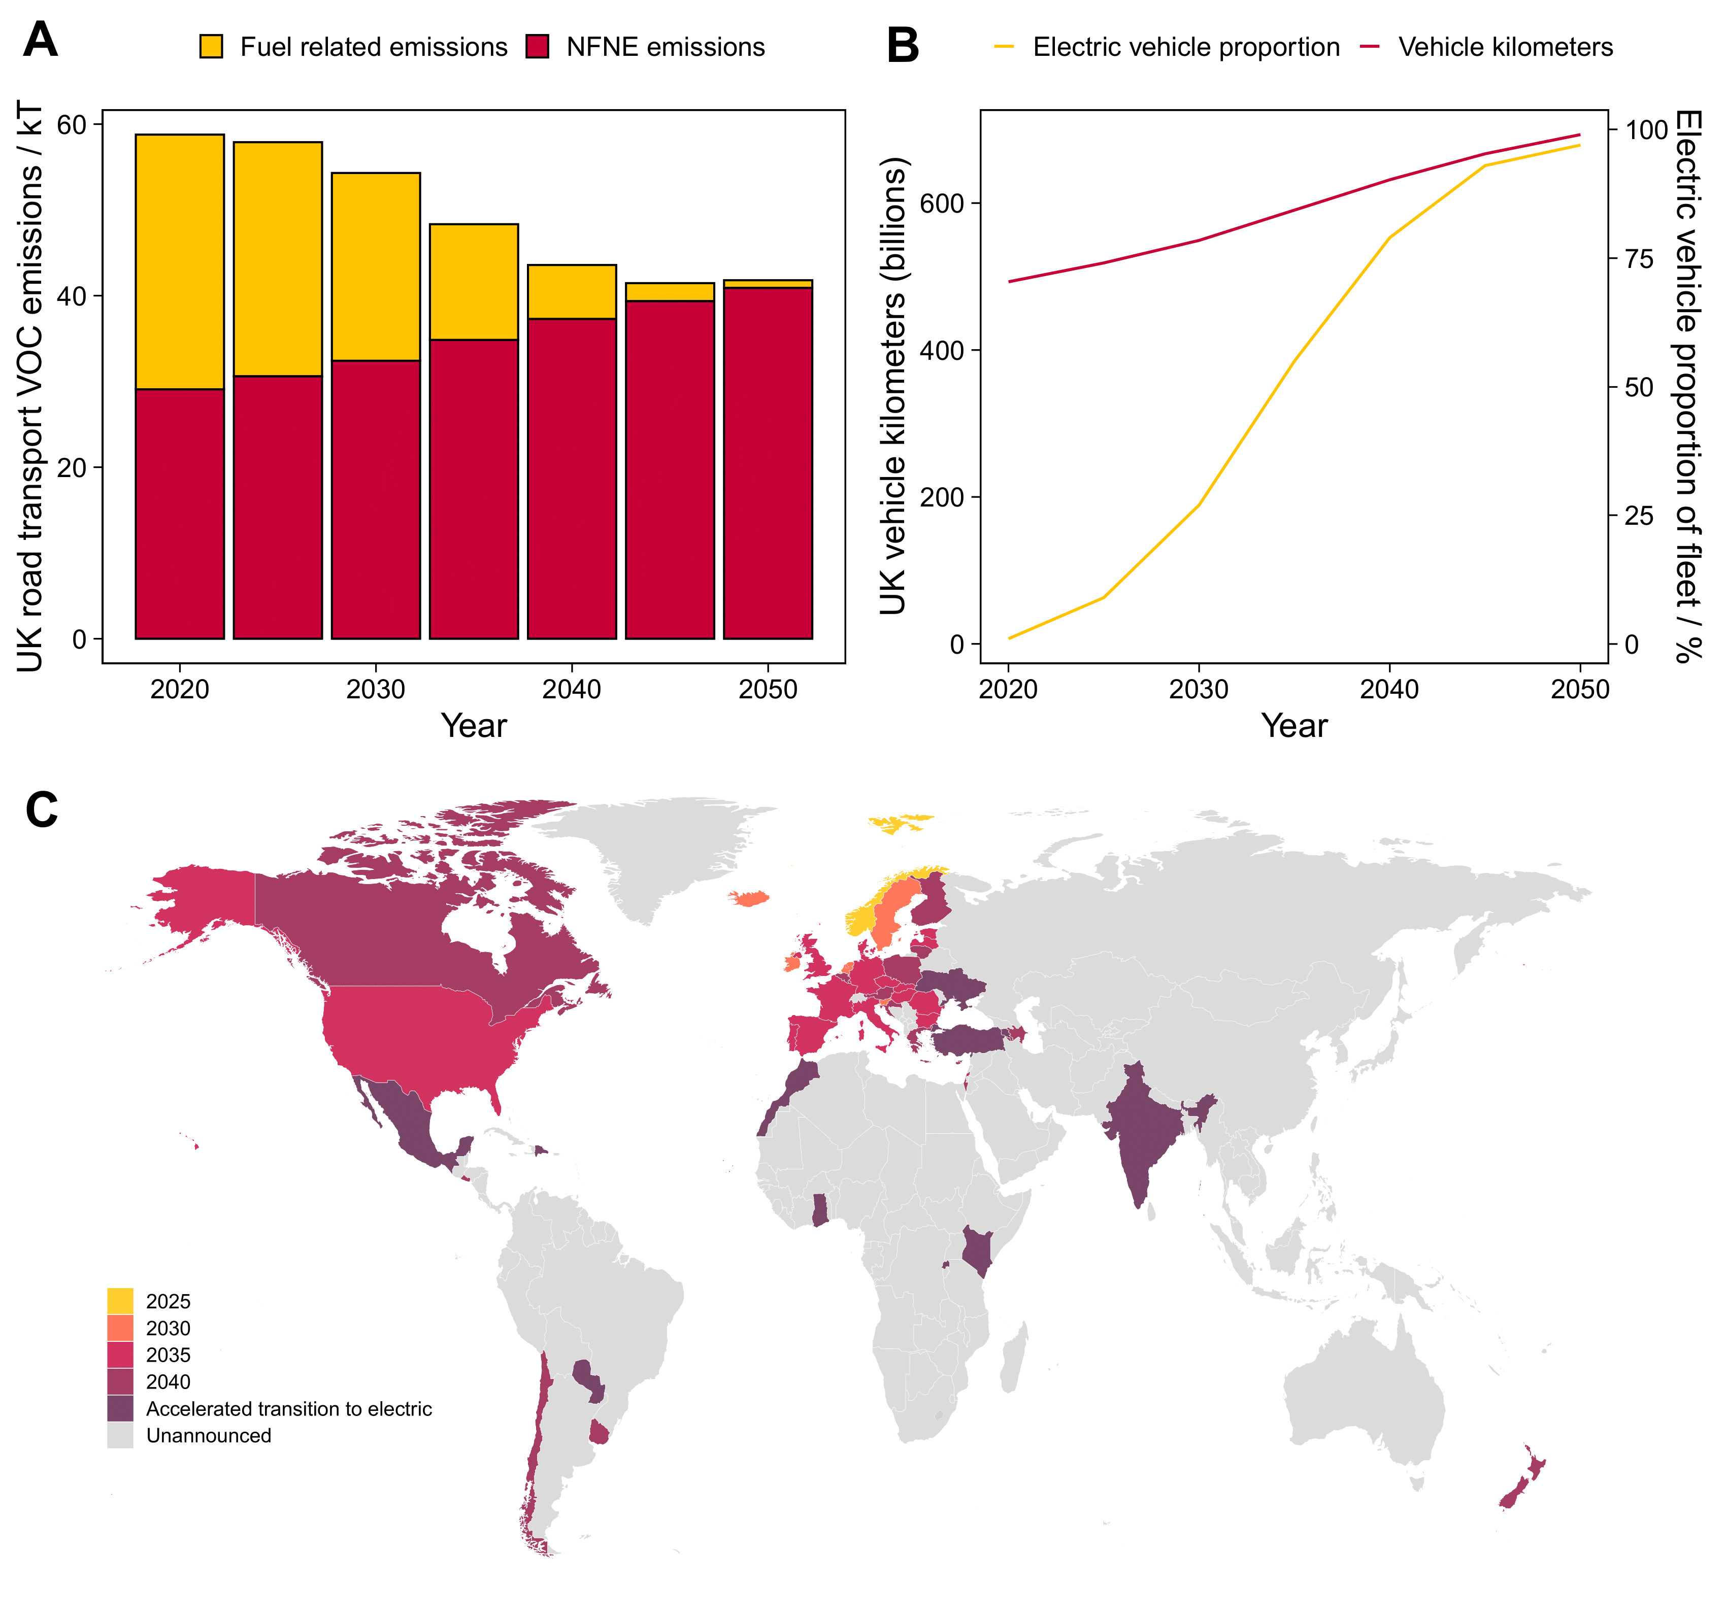
Future predictions
Future emissions
Home
Use predictions of vehicle mileage and electric vehicle uptake to estimate future emissions.
Increase in vehicle kilometers expected due to increased population and reduced running costs of electric vehicles.
Transition from fuel to non-fuel-related emissions.
Globally important transition due to planned bans on sales of new petrol and diesel-powered vehicles.

Slide 10
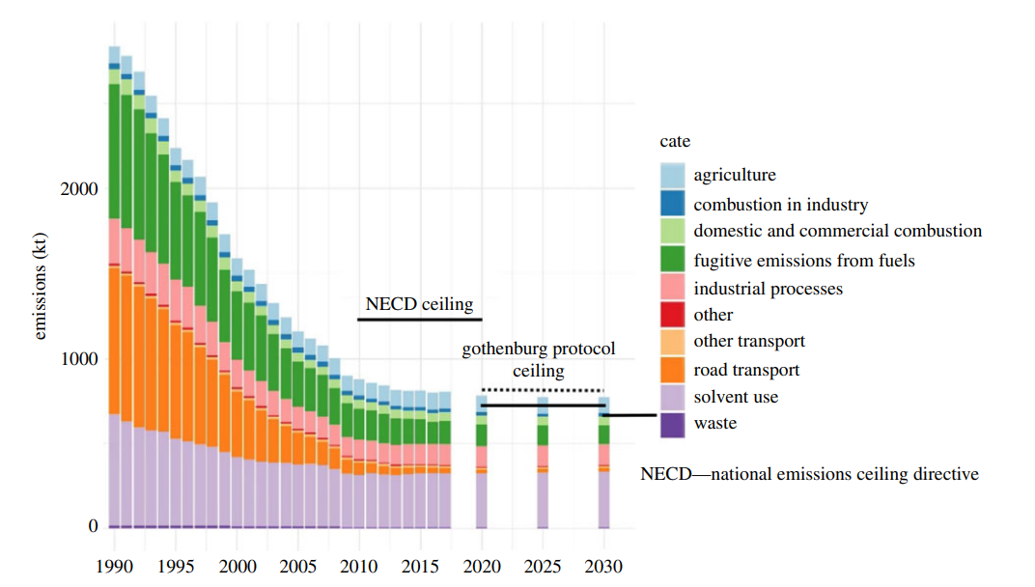
Implications
Home
2
6 % of the UK’s VOC National Emission Ceilings Directive (NECD) ceiling.
Relatively simple source for policy consideration to reduce a country’s VOC emissions.
Complete respeciation of road transport VOCs over the coming decade.
Models which do not include NFNE emissions may underestimate future ozone concentrations.
Increased production of PAN.
Peroxyacetyl nitrate (PAN)
Acetaldehyde/formaldehyde
Ozone (O₃)
²Lewis, A. C. et al. An increasing role for solvent emissions and implications for future measurements of volatile organic compounds, Phil. Trans. A. 378, 20190328, 2020.

