Slide 1
Equatorial waves atop the Earth’s core and potential mechanism
Pengshuo Duan, Chengli Huang & Cancan Xu
CAS Key Laboratory of Planetary Sciences, Shanghai Astronomical Observatory, Chinese
Academy of Sciences, Shanghai 200030, China
E-mail: duanps@shao.ac.cn; clhuang@shao.ac.cn
2023-04-27

Slide 2
Outline
1. Background
2. Potential mechanisms for the subdecadal equatorial core waves
(the equatorially trapped Magnetic-Archimedes-Coriolis waves)
3. Summary

Slide 3
1. Background

Slide 4
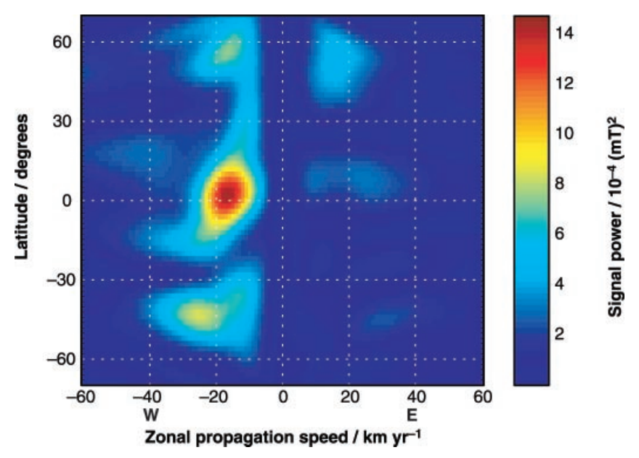
Localised, alternating interannual core flow motions and geomagnetic acceleration pluses at the equatorial regions
Finlay & Jackson, 2003. Science
$$±\sim 15°$$
Fast subdecadal equatorial waves
Chulliat et al, 2015, GRL
Kloss & Finlay, 2019. GJI

Slide 5
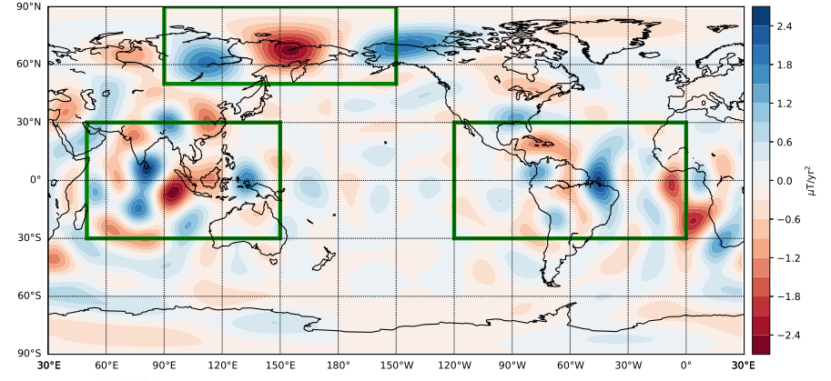
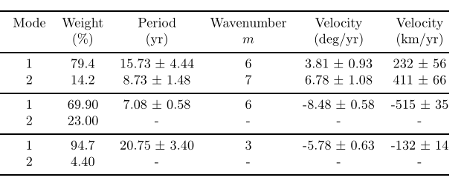
Different periodic core waves inferred from the geomagnetic accelerations
[Chi-Durán et al, 2020, GRL]

Slide 6
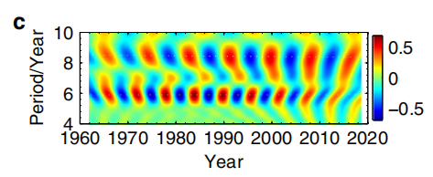
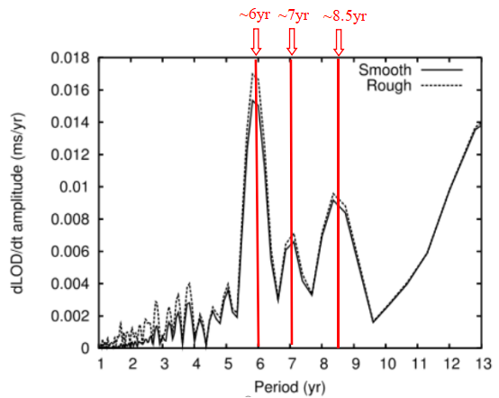
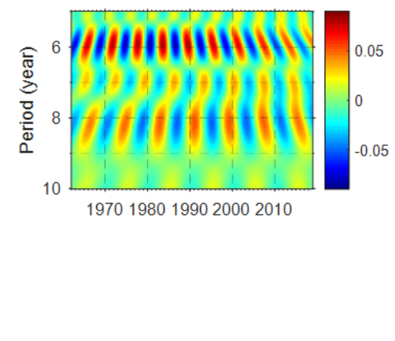
Subdecadal variations in length-of-day (LOD)
Subdecadal (5~10yr) variations in LOD present three periodic oscillations.
7
7
FFT spectrum
Silva et al, 2012. JGR
LOD variations
NMWT spectrum
(1) The 6yr LOD signal ~0.124ms (reflecting the signatures of inner core gravitational oscillation and the torsional waves within the fluid core) (e.g., Duan et al, 2015, EPS; 2019, PEPI; 2018, EPSL; 2020, JGR)
(2) The 8.6yr LOD signal ~0.08ms
(3) The 7yr LOD signal ~0.04ms(weakest)
(Duan and Huang, 2020 Nat. Commun; Hsu et al, 2021, J.Geod)

Slide 7
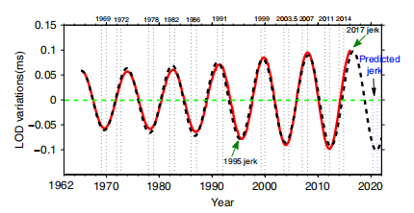
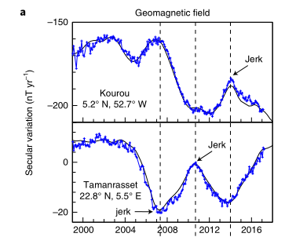
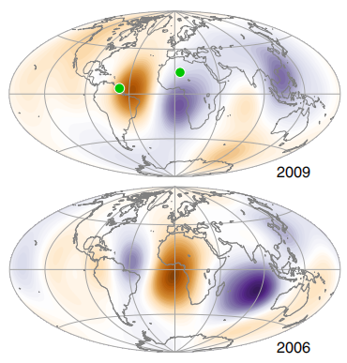
The 8.6yr signal in LOD closely correlates with geomagnetic jerks
Geomagnetic jerks: related to the fluid core motions atop the Earth core (Aubert and Finlay, 2019, Nat.Geosci)
[Duan P.S & Huang C.L., Nature Commun, 2020]
Providing the new ideas for solving the issues
The same physical source: The equatorial hydromagnetic waves
1）The nature of the 8.6yr signal origin
2）The nature of the jerk origin and the jerk prediction
Notes:
我们的工作很可能为这一国际难题的解决带来新的突破口！

Slide 8
2. Potential mechanisms responsible for the subdecadal equatorial core waves

Slide 9
1) Fast quasi-geostrophic Magneto-Coriolis modes
The potential mechanisms
2) Equatorially trapped magnetic-Archimedes-Coriolis waves

Slide 10
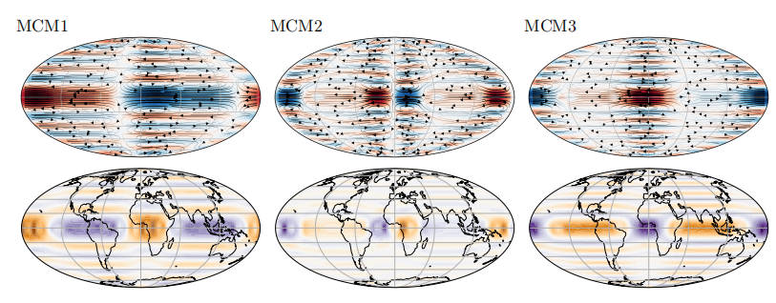
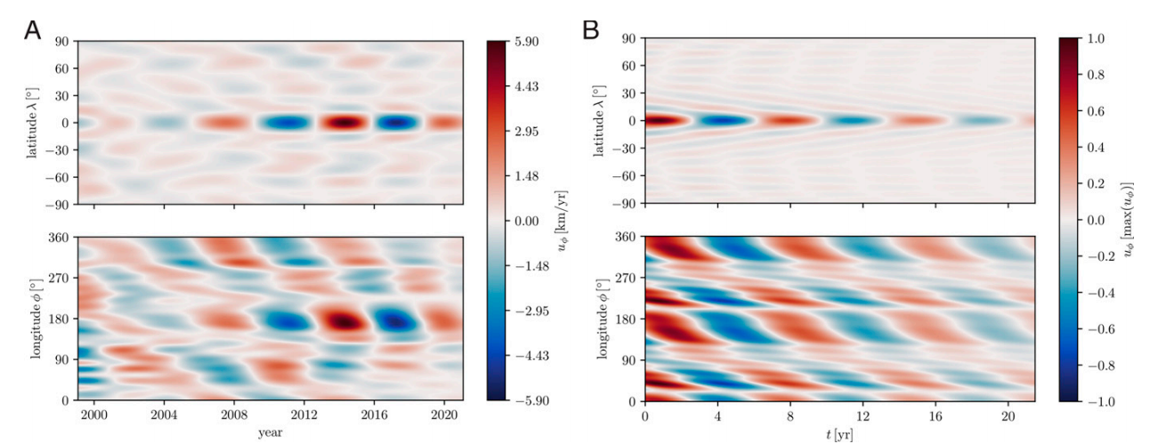
1) Fast quasi-geostrophic Magneto-Coriolis (MC) modes
(Gerick et al, 2020, GRL)
The 7.16yr period magnetic waves propagating weastward (Latitude within $±10°$) were interpreted as the signatures of MC modes
(Gillet et al, 2022, PNAS)

Slide 11
2) Equatorially trapped magnetic-Archimedes-Coriolis (eMAC) waves
The eMAC wave meschanism (Buffett and Matsui, 2019, GJI) may explain the origin of the ~8.6yr magnetic waves propagating eastward (Chi-Durán et al, 2020, GRL )
The current eMAC wave theory has some issues need to be clarified
1. The specific latitude range where the eMAC wave model can own the enough accuracy to describe the low-latitude waves is unclear
2. What are the detailed physical factors which can determine the related physical properties (e.g., the equatorial confinement and latitudinal distribution law, damping rate, eigen-period T, propagating speed, perturbed magnetic field) ? The systematically analytical expressions have not been given.
Duan, P. S., Huang, C. L., & Xu, C.C., 2023. On the model of equatorial Magnetic-Archimedes-Coriolis waves propagating at Earth’s core surface and the potential implications. J. Geophys. Res: Solid Earth. https://doi.org/10.1029/2022JB025199

Slide 12
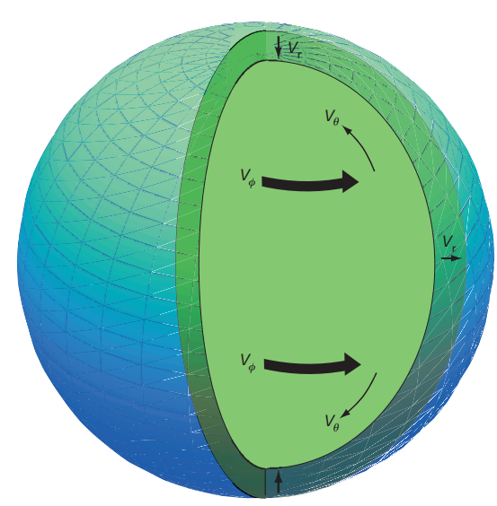
On the equatorial trapped MAC waves
$(∇∙\vec{v}$=0)
Stable stratification at the core surface(Schematic illustration)
Wave equation
( is co-latitude)
$$x=cosθ$$
$$θ$$

Slide 13
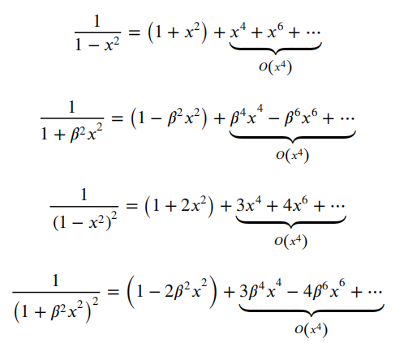
Derivation of the ‘Weber equation’
Series expansion
[the quadratic terms+o(x⁴)]

Slide 14
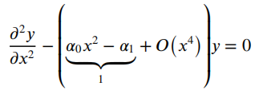
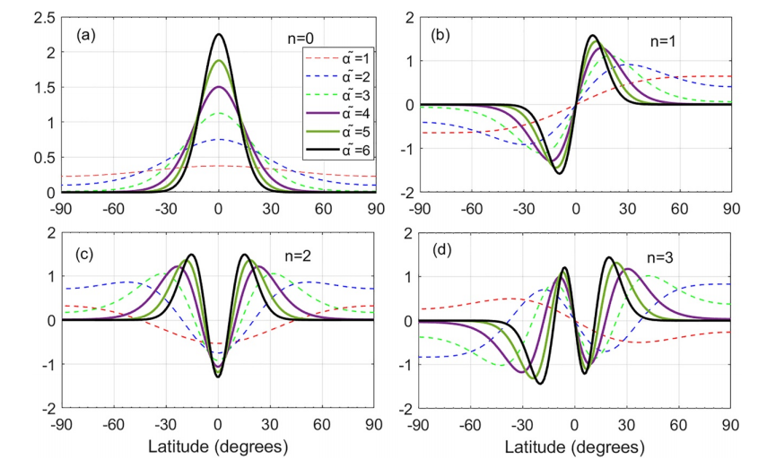
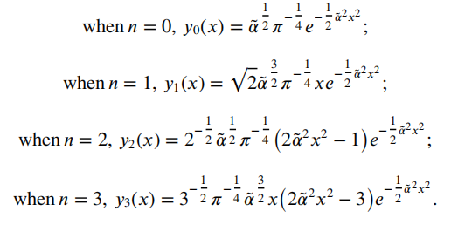
‘Weber equation’
Simplified as
The energy eigen-equation of one-dimensional harmonic oscillator in quantum mechanics
Specific solution
Sufficient and Necessary Condition
Synthetic numerical simulation

Slide 15
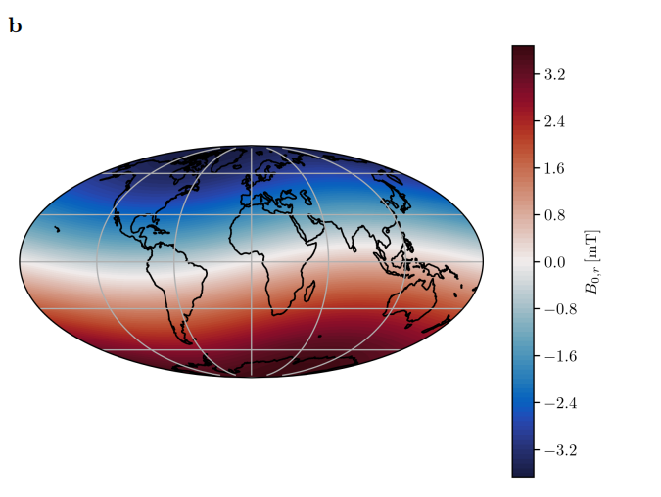
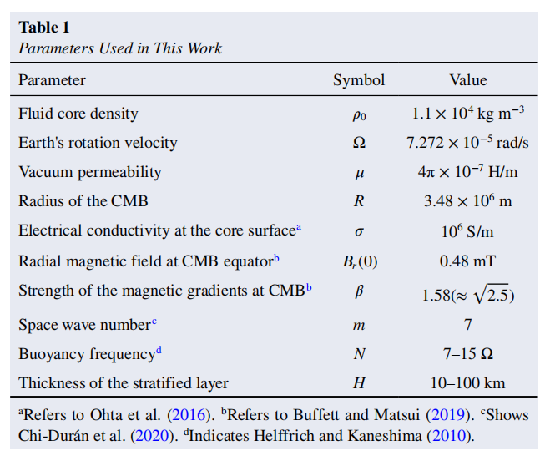
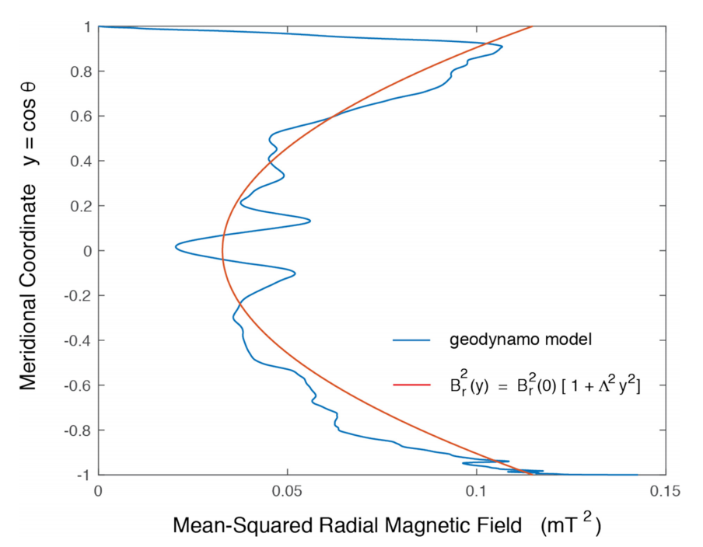
Physical parameters used in our work
Radial background magnetic field is not constant over the core surface
(e.g., Gillet et al, 2022 PNAS)
Two parameters are involved
$$(B_{r}(0), β)$$

Slide 16
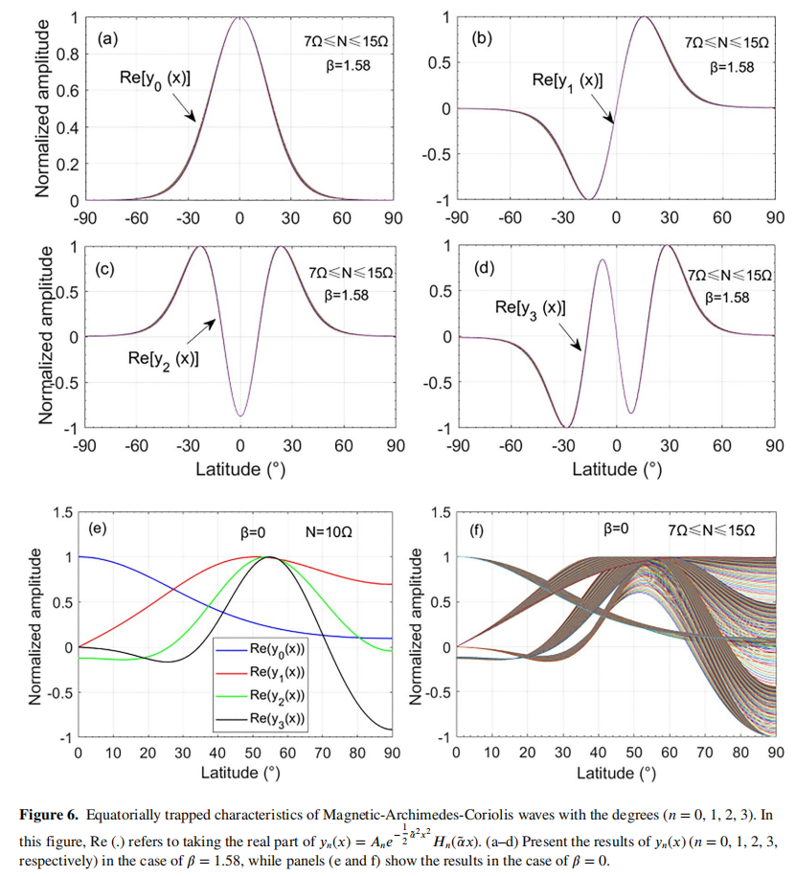
Equatorially trapped features of MAC waves (degrees n=0,1,2,3)
Using the real (or close to real) physical parameters listed in the Table mentioned above
$$\tilde{α} =3.5\sim 4.5$$

Slide 17
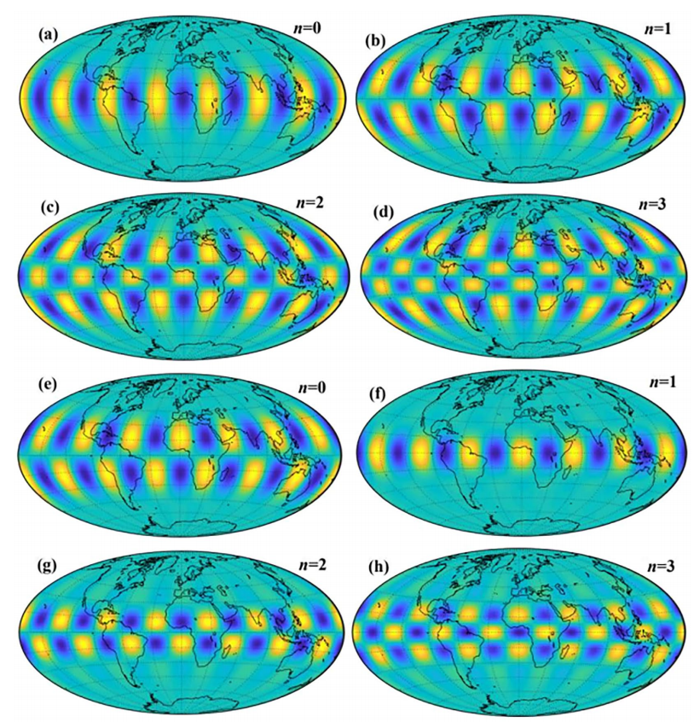
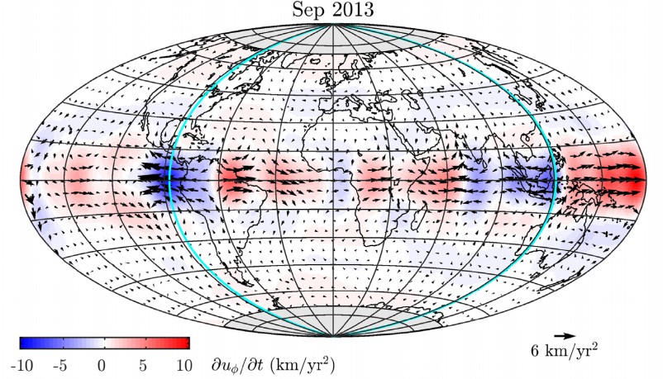
The perturbed magnetic field model
(Latitudinal)
(azimuthal)
(Latitudinal)
(azimuthal)

Slide 18
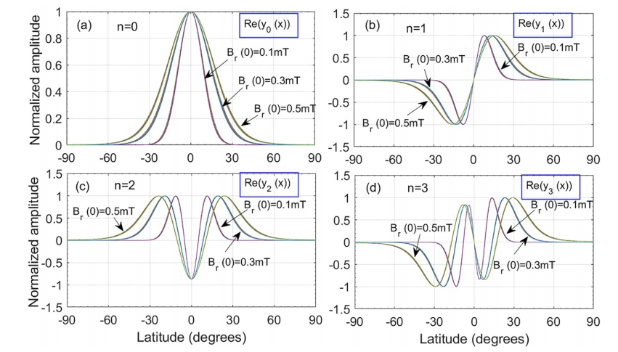
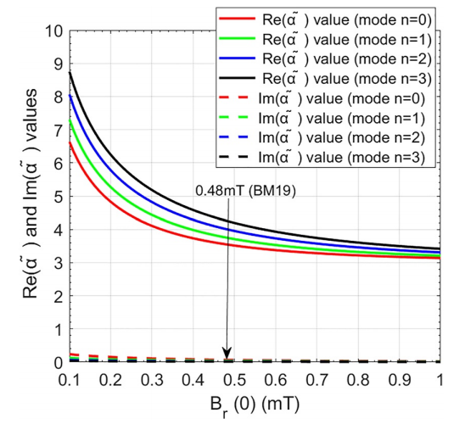
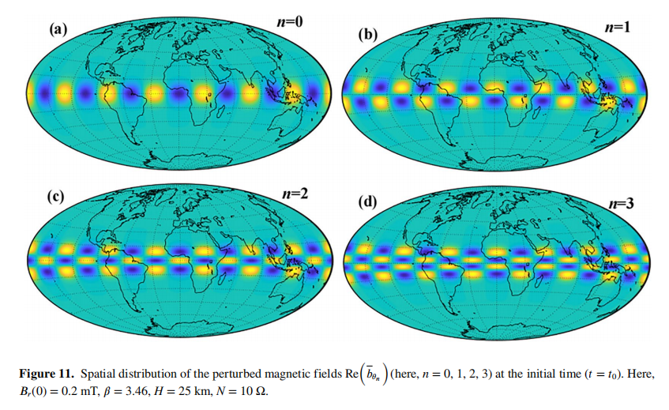
Influence on the equatorial confinement degree from the radial geomagnetic field at the CMB equator
$$M(0)=\frac{B_{r}^{2}(0)k^{4}R^{2}}{χρ_{0}μN^{2}}$$

Slide 19
The other physical properties of the eMAC waves
1) the damping rate
2) the eigen-period
3) propagation speed and direction

Slide 20
Formulas of the damping rate and eigenperiods for the eMAC waves
$$Imaginary part=0$$
$$Real part=0$$

Slide 21
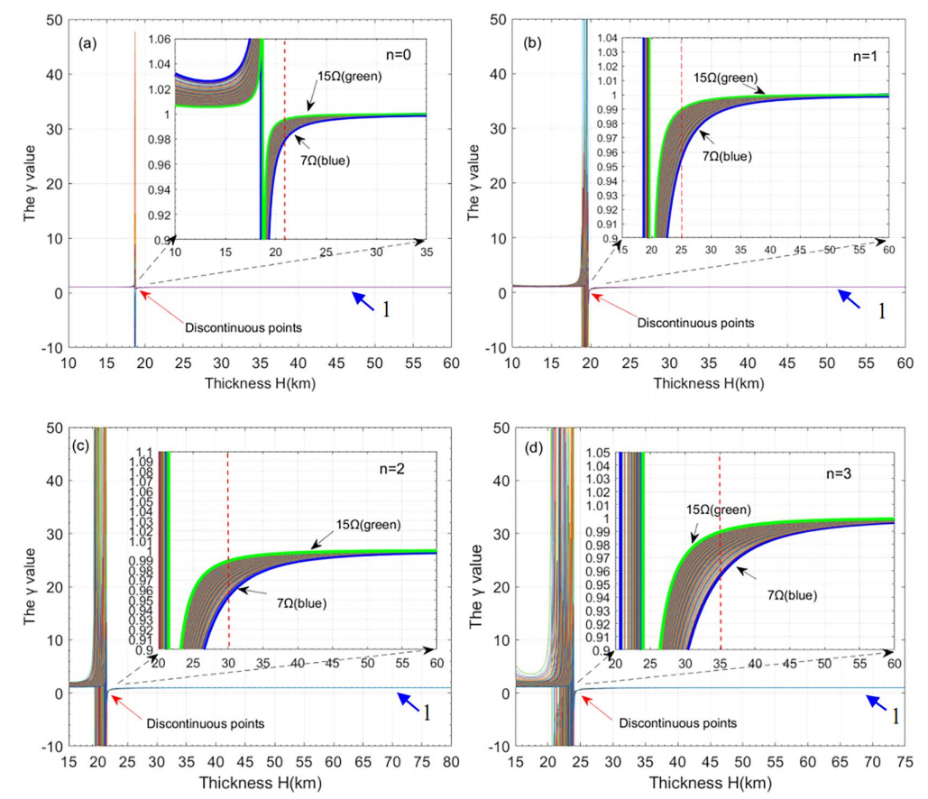
Damping rate can be estimated by a simple formula
$$σ$$
electrical conductivity at the core surface
$$H$$
the thickness of the stratified layer atop the Earth’s core

Slide 22
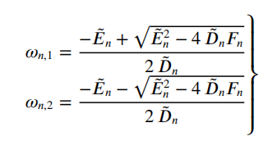
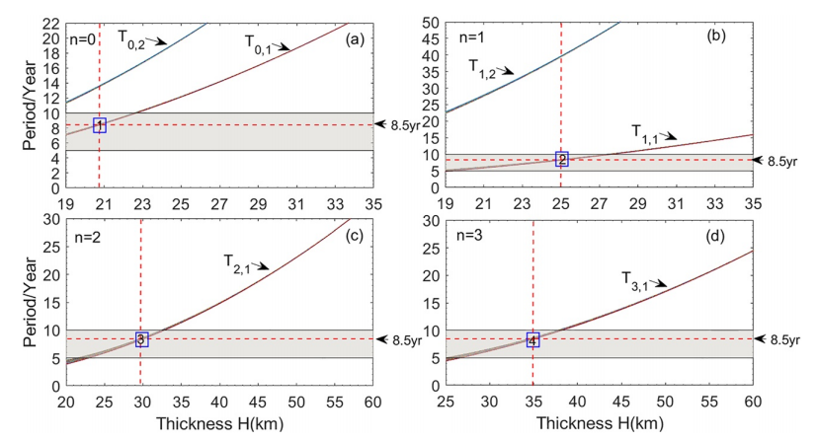
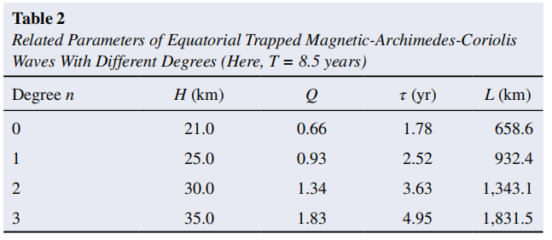
Eigenperiod
Only one root can match the target 8.5yr period
Quality factor formula is also given

Slide 23
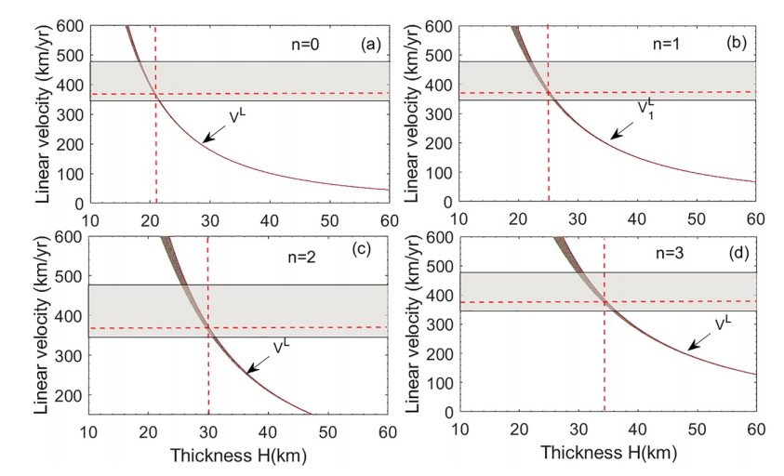
The predicted propagation speed and direction of the waves
Formula of the propagation speed
<0
(Eastward propagation)
Predicted propagation velocity of the eMAC waves

Slide 24
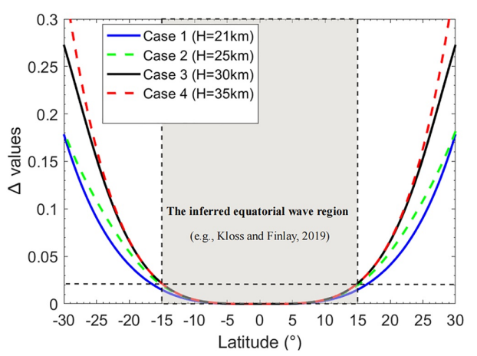
On the perturbation analysis
$$A(x)=α_{0}x^{2}−α_{1}$$
‘Importance’ of the higher order term B(x) with respect to the ‘remaining’ term A(x)

Slide 25
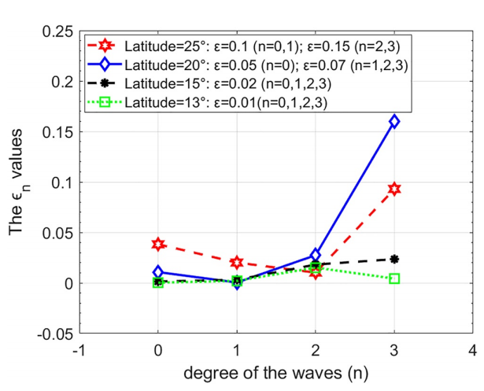
Relative errors for the latitude distribution function
The developed eMAC wave model is significant to understand the origin of the equatorial core waves

Slide 26
Summary
1) The latitudinal distribution law of the MAC waves is essentially determined by y_{n} (x)=A_{n} e^(-1/2 α ̃^2 x^2 ) H_{n} (α ̃x), where, H_{n} (α ̃x) being the Hermite polynomial term of the degree n, impling that the MAC waves have the equatorially symmetric and antisymmetric characteristics, while the equatorial confinement degree is determined by α ̃, which depends on the joint effects from the (not well-known) physical parameters, i.e., β and B_{r}(0). Besides the parameter β, the weaker B_{r}(0) (<0.5mT) also can obviously increase the confinement degree.
2) The damping rate α of the eMAC waves can be estimated by α≈-π²/(μσH² ). Therefore, detection of the damping effects of the eMAC waves will be helpful to infer the information of the electrical conductivity and the stratification atop the Earth’s core. The H value is predicted to be larger than 20km, when the eigen-periods of the eMAC waves with the degrees (e.g., n= 0,1,2,3) match the 8.5yr period.
3) The azimuthal perturbed magnetic field model b_{φ} with degree n=1 is shown to be mainly confined to the equatorial regions with latitude below 15 degrees, the profile of which is generally consistent with that of the time-varying, non-zonal azimuthal core flows inferred from the geomagnetic observations.
4) Relative errors of the developed analytical eMAC wave model in describing the hydromagnetic waves with the latitude below 25 degrees are less than 5%, the developed model is significant to deeply understand the origin of the equatorial waves.

Slide 27
Thanks for your attention!

