Slide 1
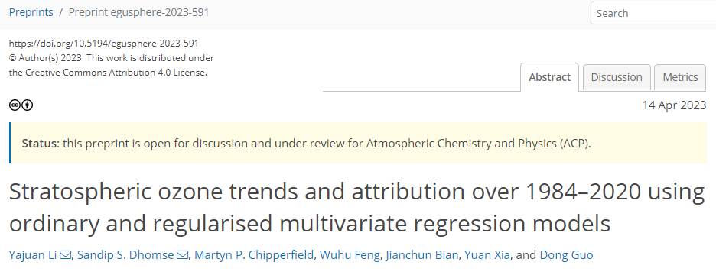
Stratospheric Ozone Trends & Attribution over 1984–2020 using Ordinary and Regularised Multivariate Regression Models
Yajuan Li^{1,2}, Sandip Dhomse³, Martyn Chipperfield³, Wuhu Feng³, Jianchun Bian², Yuan Xia¹ and Dong Guo⁴
1 Nanjing Xiaozhuang University, Nanjing, China. 2 Institute of Atmospheric Physics, Chinese Academy of Sciences, Beijing, China.
3 School of Earth and Environment, University of Leeds, Leeds, UK. 4 Nanjing University of Information Science & Technology, Nanjing, China.
Key points
For the first time a regularised multi-variate regression model is used to estimate strat. ozone trends.
Regularised regression avoids the over-fitting issue due to correlation among explanatory variables.
Considerable differences in satellite and chemical model-based ozone trends highlight large uncertainties in our understanding about ozone variability.
Caution is needed while interpreting results with different methods and data sets.
Under review
Contact: yajuanli@njxzc.edu.cn; S.S.Dhomse@leeds.ac.uk

Slide 2
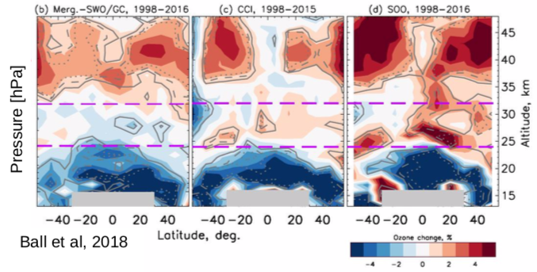
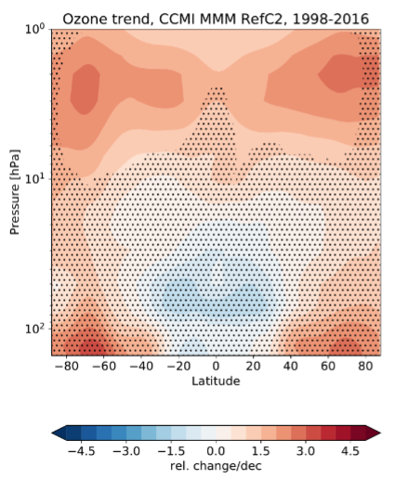
Ozone evolution in the stratosphere
WMO, 2022: Column ozone does not show statistically significant increase since 1998.
– Upp. strat. (US) ozone is recovering.
– Lower strat. (LS) ozone is likely decreasing, offsetting recovery.
Observed LS ozone decrease:
– Tropics: increasing GHGs -> enhanced upwelling
– Mid-lat: stronger negative trends at NH mid-lat (BDC…)
Model simulations do not reproduce the observed LS ozone decrease.
Dietmüller et al., 2021

Slide 3
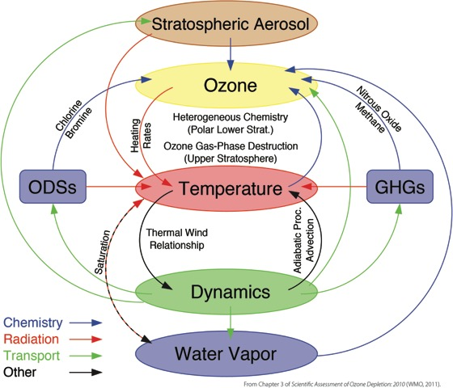
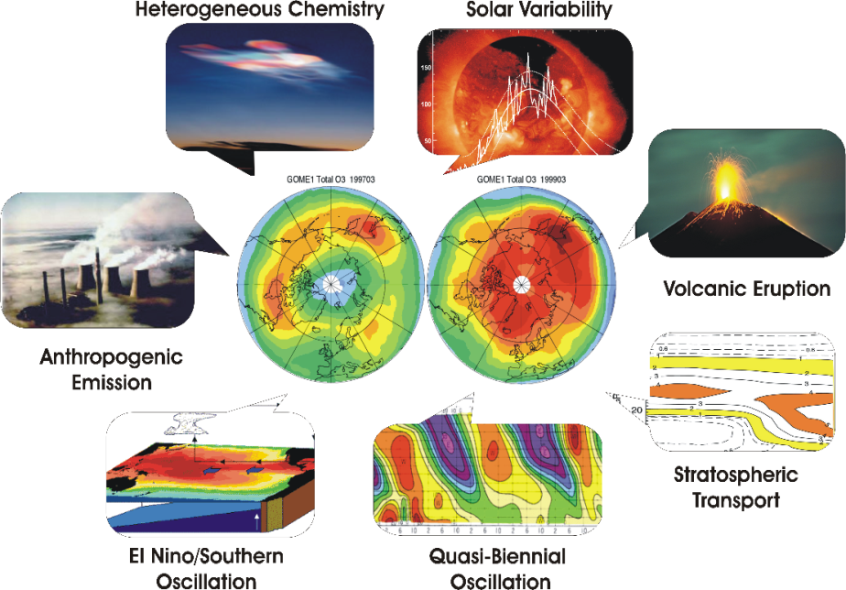
Accurate quantification of stratospheric ozone trends and attribution remains an unresolved challenge
Sensitivity to natural variability
Non-linear changes in forcing processes
Quality of the observational datasets
Different statistical methodologies …
Notes:
Accurate quantification of long-term trends in stratospheric ozone can be challenging due to their sensitivity to natural variability, the quality of the observational datasets, non-linear changes in forcing processes as well as the statistical methodologies.

Slide 4
Historically multi-variate regression models with ordinary least square (OLS) fit method are used to estimate ozone trends
Multivariate regression models are widely used to quantify the long-term ozone trends and variability.
In the stratosphere (~10-50 km) ozone concentrations are controlled by different processes at different altitudes/latitudes, but almost all previous studies used same regression model for all locations.
Explanatory variables are generally correlated and finding optimum/suitable variables is tricky.
Hence, here we use a regularised multi-variate regression model (Ridge) for ozone trend analysis.
Notes:
Multivariate regression models are widely used to quantify the influence of a particular process.
In the stratosphere (~10-50 km) ozone concentrations are controlled by different processes at different altitudes/latitudes, but almost all previous studies used same regression model for all locations.
Explanatory variables are generally correlated and finding optimum/suitable variables is tricky.
Hence, here we use a regularised multi-variate regression model (Ridge) for ozone trend analysis.

Slide 5
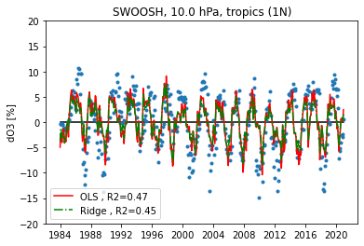
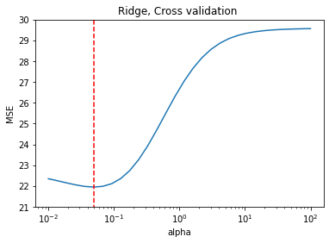
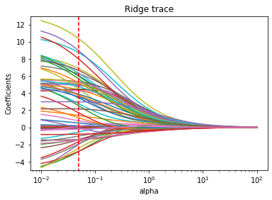
Regularised regression avoids the over-fitting issue due to correlation among explanatory variables
OLS regression: minimum residuals but high variance
Ridge regression: minimum residuals + L2 penalty
optimal alpha
OLS regression with unbiased estimators performs well only when all key assumptions are satisfied, e.g. linear relationship, no or little multi-collinearity among the explanatory variables ...
Most atmospheric processes are correlated. Hence if we use different combinations of data points, regression coefficients will not be unbiased.
Ridge regression gives a penalty (L2) to constrain the magnitudes and fluctuations of the coefficient estimates and reduce the variance of the model at the expense of no longer being unbiased.
Notes:
OLS with unbiased estimators performs well only when all key regression assumptions are satisfied, e.g. linear relationship, more observations (n) than features (p), no or little multi-collinearity among the explanatory variables.
OLS: minimise the residual errors but with relatively high variance
Most atmospheric processes are correlated. Hence if we use different combinations of data points, regression coefficients will not be unbiased
Ridge regression is a type of regularized regression which gives a penalty (called an L2 penalty) to constrain the magnitudes and fluctuations of the coefficient estimates. This constraint helps to reduce the variance of the model at the expense of no longer being unbiased.

Slide 6
Data and Methodology
SWOOSH: Stratospheric Water and OzOne Satellite Homogenized dataset
Monthly mean zonal-mean data from 1984 to present (v2.7)
at grids of 2.5° from 316 to 1 hPa (31 levels)
Merged record of Aura MLS, UARS MLS, UARS HALOE, SAGE II and SAGE III
TOMCAT/SLIMCAT: a global 3-D Off-line chemical transport model (CTM)
A_ERAI: simulation forced by ECMWF ERA-Interim (1979 - 2019.08)
B_ERA5: simulation forced by ERA5 (1979 - present)
2.8°× 2.8°grids (T42), 32 hybrid sigma-pressure levels (surface to ~60km)
ML-TOMCAT: Machine-learning-based satellite-corrected global stratospheric ozone profile dataset from a CTM
ML-TOMCAT is gap-free ozone profile dataset.
Satellite-model differences are used to train ML algorithms.
Seamlessly combines up-to–date knowledge about the chemistry, meteorology (reanalysis data) and satellite datasets.
Multivariate regression model (MLR): modified version of that used in Dhomse et al., (2022)
QBO, ENSO, AO and AAO from Climate Prediction Center, Solar (Mg ii index) from IUP Bremen, Fz50 from TOMCAT.
Davis et al. (2016)
Li et al. (2022)
Dhomse et al. (2021)
dOzone = Independent linear trends (ILTs, pre-1998 and post-1998) + QBO terms (Q30 and Q50)
+ Solar + ENSO + AO + AAO + EP flux (Fz50)

Slide 7
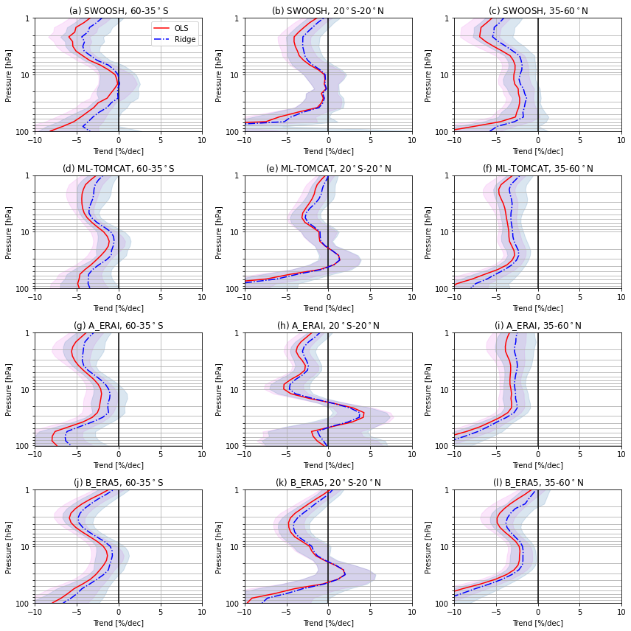
Ozone profile trends with OLS and Ridge regression
Pre-1998 trends
Ozone declines during 1984-1997 are smaller in Ridge regression.
OLS-Ridge differences appear in the upper stratosphere (~2 hPa) & the lowermost stratosphere (~100 hPa).
ML-TOMCAT and two model simulations show good agreement with those from SWOOSH data at NH/SH mid-latitudes.
Large differences in the tropical middle-lower stratosphere for A_ERAI.
Large uncertainties in the lower stratosphere for both satellite data and model simulations.
SWOOSH
ML-TOMCAT
A_ERAI
B_ERA5

Slide 8
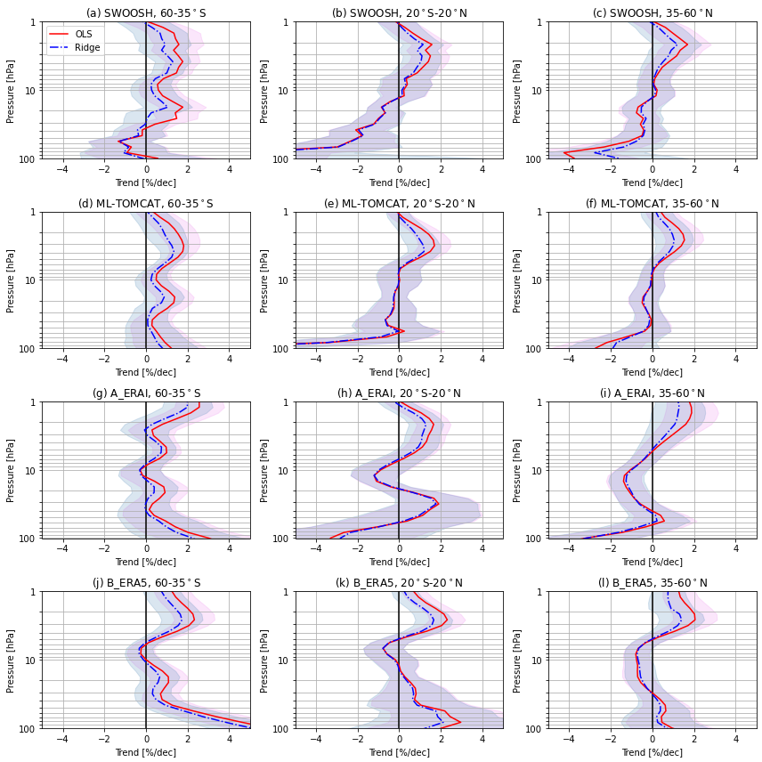
Ozone profile trends with OLS and Ridge regression
Post-1998 trends
Since 1998, upper stratospheric ozone has recovered and the increase based on Ridge regression is relatively smaller.
Negative trends with large uncertainties are observed in the lower stratosphere with the most pronounced in the tropics.
The largest OLS-Ridge differences in post-1998 trend estimates appear in the tropical lower stratosphere (with ~7 %/dec difference at 100 hPa).
ML-TOMCAT trends are consistent with those using SWOOSH data.
Model simulations show largest inconsistencies w.r.t. SWOOSH-based trends in the lower stratosphere.
SWOOSH
ML-TOMCAT
A_ERAI
B_ERA5

Slide 9
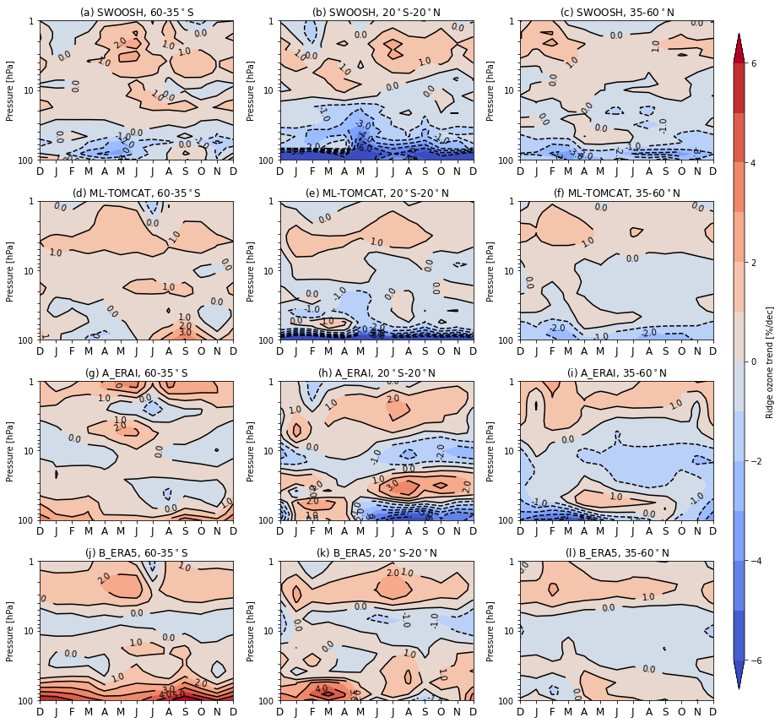
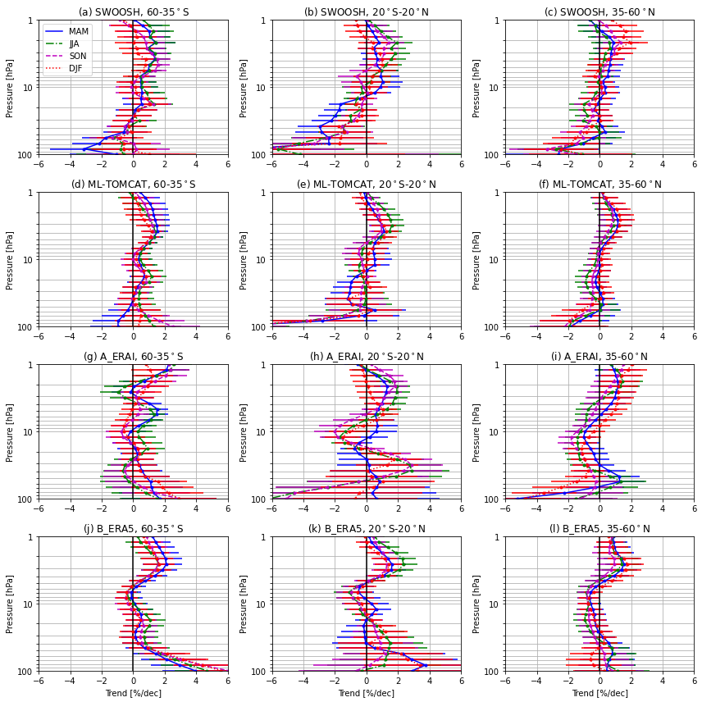
Seasonal ozone trends based on Ridge regression
（Post-1998）
SWOOSH
ML-TOMCAT
A_ERAI
B_ERA5
Strong seasonal dependence in stratospheric ozone trends
Ridge-based trends are constrained with smaller coefficients
ML-TOMCAT shows similar seasonal trends to those using SWOOSH data; model simulations show larger inconsistencies especially in the lower stratosphere.

Slide 10
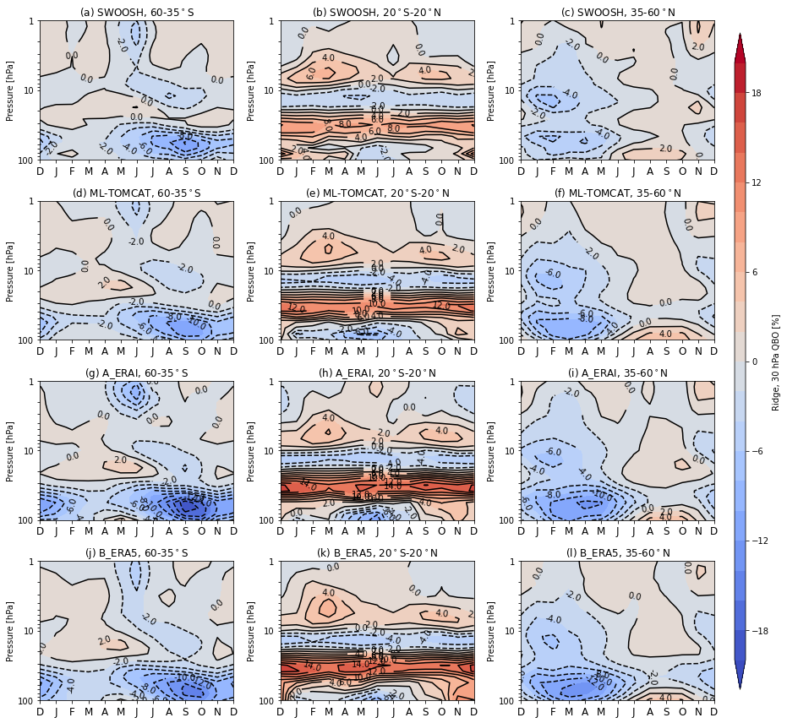
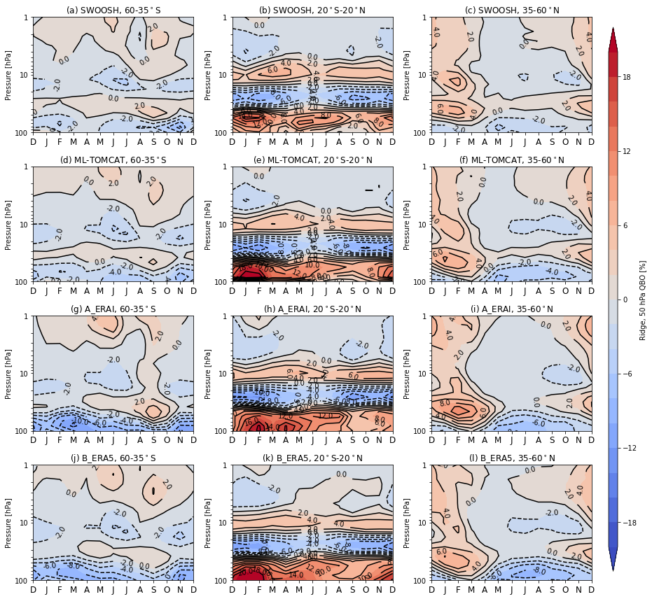
Ozone variations associated with natural processes
seasonal ozone response to 30 hPa QBO (Ridge)
seasonal ozone response to 50 hPa QBO (Ridge)
The positive QBO influences on the tropical lower stratospheric ozone and negative influences in the subtropical region:
- Model simulations show more negative ozone anomalies compared to SWOOSH and ML-TOMCAT (mid-lats)
- Tropics: more positive ozone anomalies from model simulations near 30 hPa and the lower stratosphere (DJF)

Slide 11
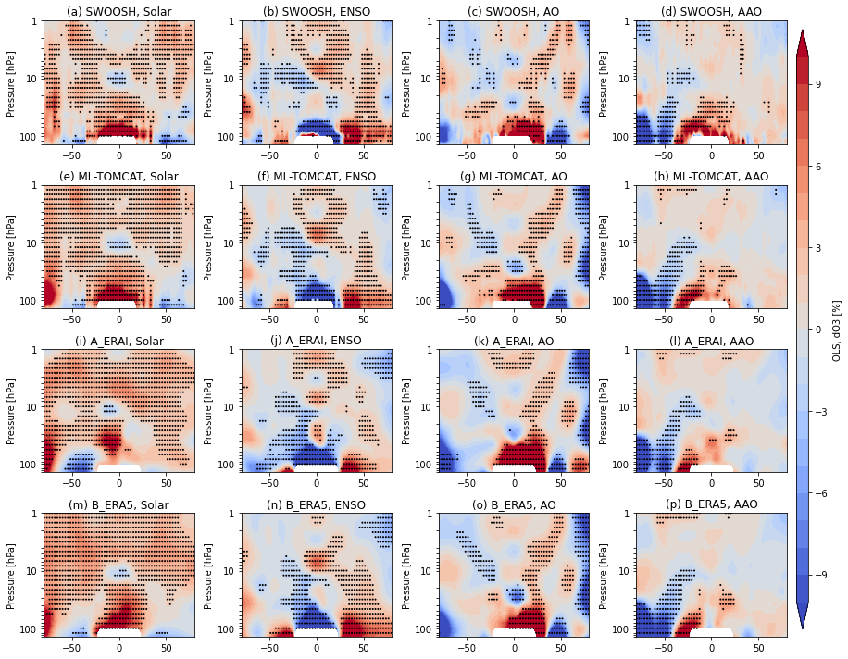
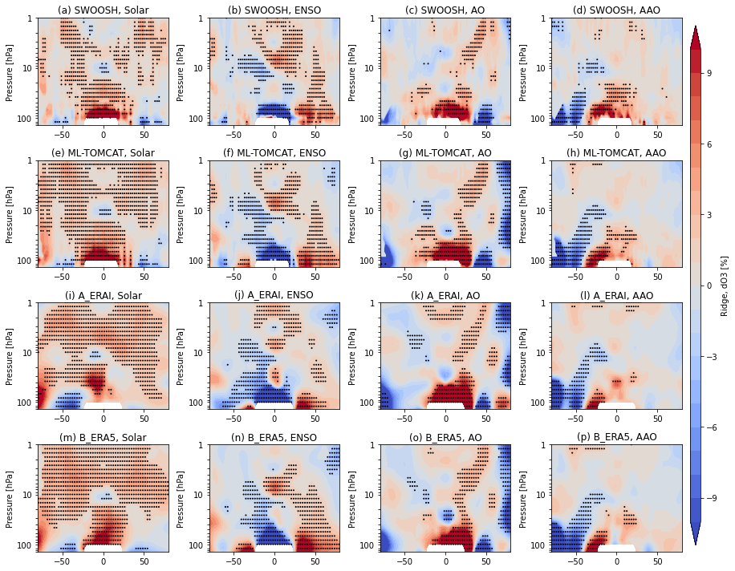
Ozone variations associated with natural processes
ozone response to solar, ENSO, AO, AAO (OLS)
ozone response to solar, ENSO, AO, AAO (Ridge)
1) Ridge regression constrains the coefficients compared to the OLS-based estimates; 2) Very similar characteristics in natural ozone variations for both regression methods; 3) Still, ML-TOMCAT shows similar results to those using SWOOSH data, while model simulations show larger inconsistencies especially in the lower stratosphere.

Slide 12
Summary & Outlook
Ridge regression method is used to overcome the over-fitting (multi-collinearity) issue due to the complex coupling in most atmospheric processes.
The coefficients of trend estimates at different altitudes and seasons are constrained by Ridge regression in magnitudes and fluctuations.
The largest difference between OLS and Ridge regression methods appears in the tropical lower stratosphere.
ML-TOMCAT shows similar results to SWOOSH data while model simulations show larger inconsistencies especially in the lower stratosphere.
Still large uncertainty about the lowermost stratospheric signal.
Caution is needed while interpreting results with different methodologies & data set sources.
Detailed information—https://meetingorganizer.copernicus.org/EGU23/session/46914
https://egusphere.copernicus.org/preprints/2023/egusphere-2023-591/

Slide 13
REFERENCES
Ball et al.: Evidence for a continuous decline in lower stratospheric ozone offsetting ozone layer recovery, Atmos. Chem. Phys., 18, 1379–1394, https://doi.org/10.5194/acp-18-1379-2018, 2018.
Davis et al.: The Stratospheric Water and Ozone Satellite Homogenized (SWOOSH) database: a long-term database for climate studies, Earth Syst. Sci. Data, 8, 461–490, https://doi.org/10.5194/essd-8-461-2016, 2016.
Dietmüller et al.: Analysis of recent lower-stratospheric ozone trends in chemistry climate models, Atmos. Chem. Phys., 21, 6811–6837, https://doi.org/10.5194/acp-21-6811-2021, 2021.
Dhomse et al.: ML-TOMCAT: machine-learning-based satellite-corrected global stratospheric ozone profile data set from a chemical transport model, Earth Syst. Sci. Data, 13, 5711–5729, https://doi.org/10.5194/essd-13-5711-2021, 2021.
Dhomse et al.: A single-peak-structured solar cycle signal in stratospheric ozone based on Microwave Limb Sounder observations and model simulations, Atmos. Chem. Phys., 22, 903–916, https://doi.org/10.5194/acp-22-903-2022, 2022.
Li et al.: Effects of reanalysis forcing fields on ozone trends and age of air from a chemical transport model, Atmos. Chem. Phys., 22, 10635–10656, https://doi.org/10.5194/acp-22-10635-2022, 2022.
WMO: Scientific Assessment of Ozone Depletion: 2022, GAW Report No. 278, ISBN 978-9914-733-97-6, https://csl.noaa.gov/assessments/ozone/2022/, 2022.

