Slide 1
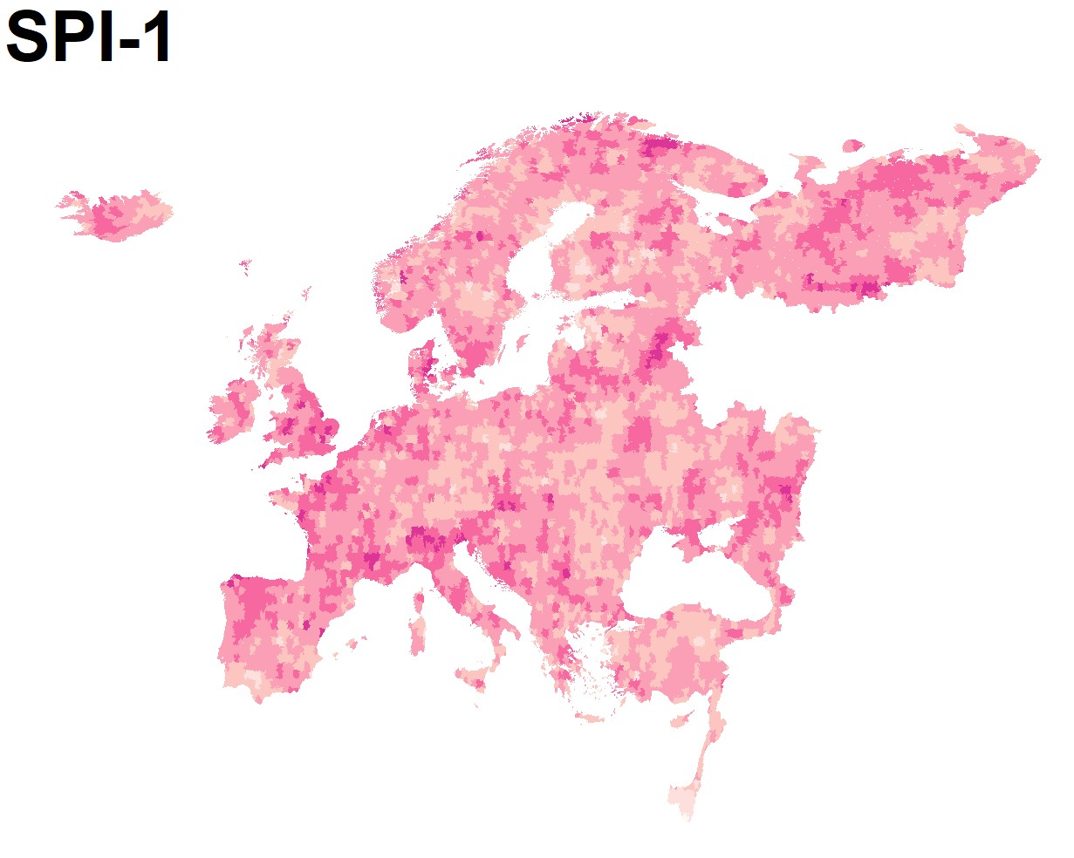
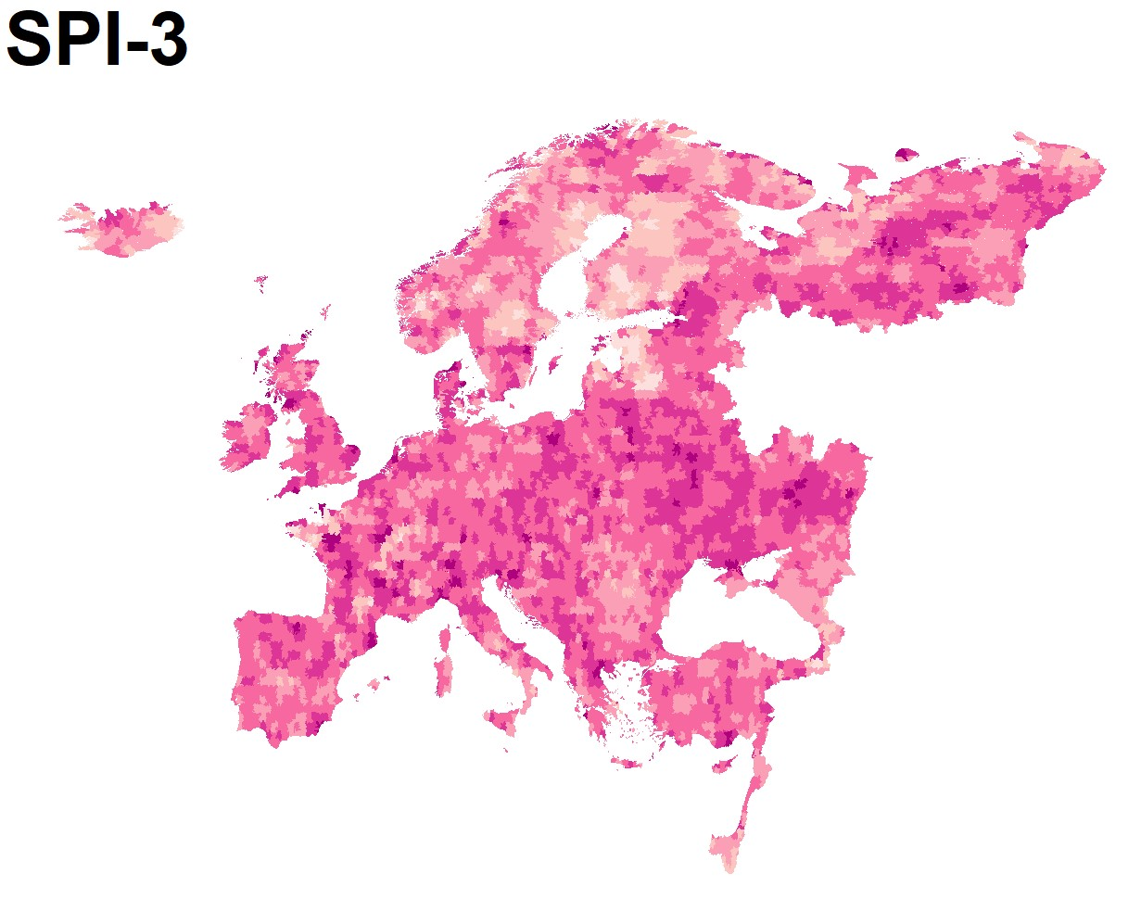
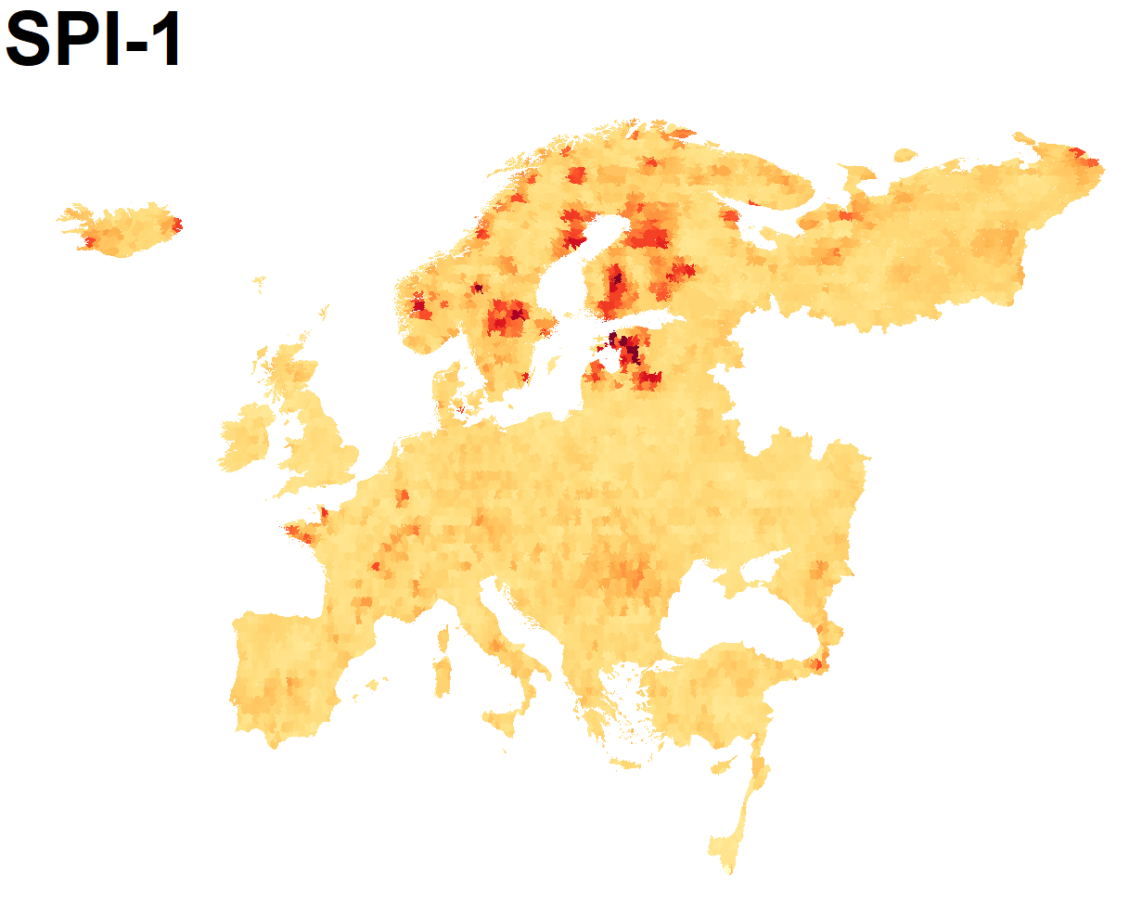
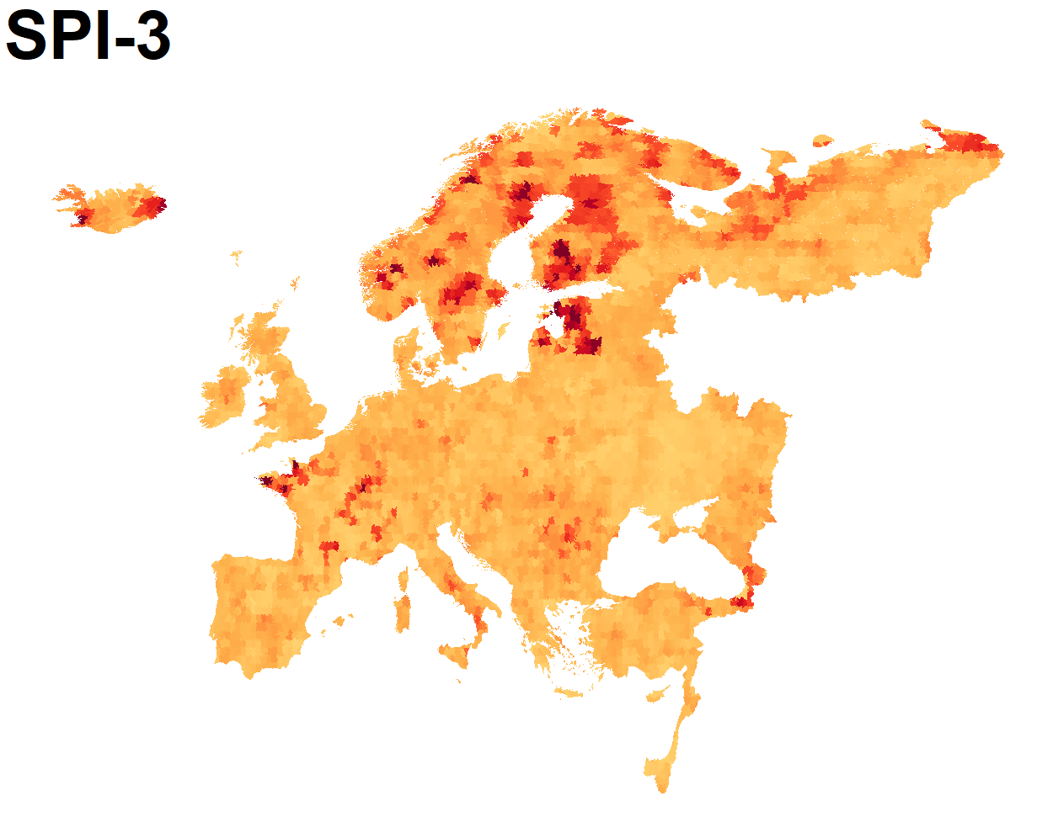
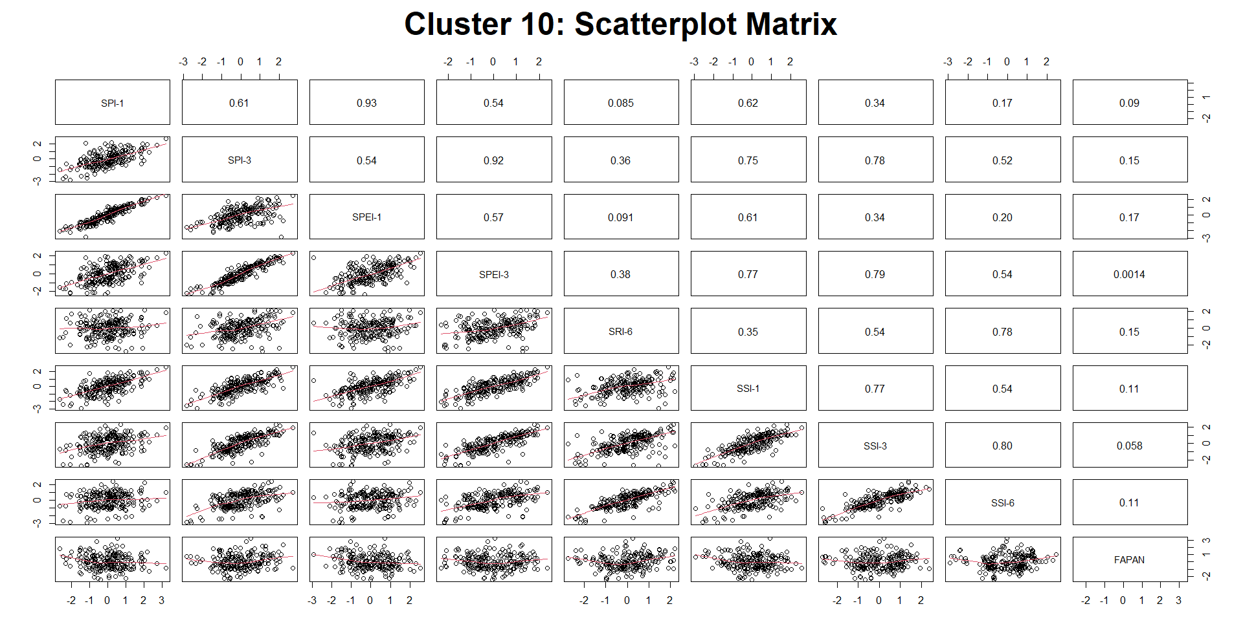
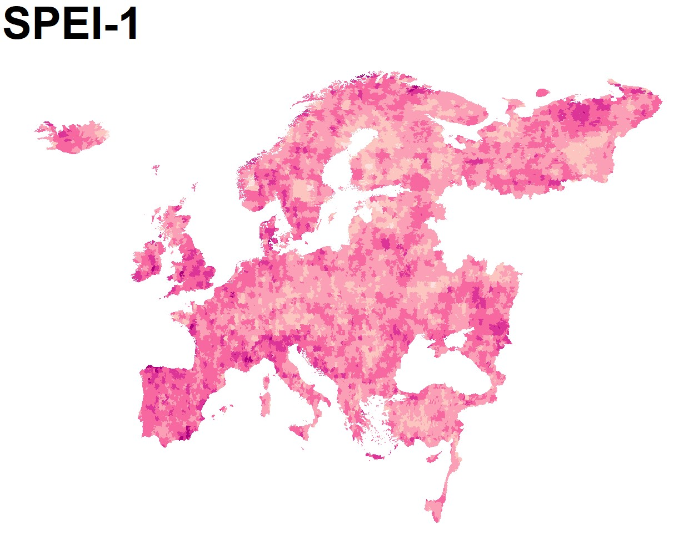
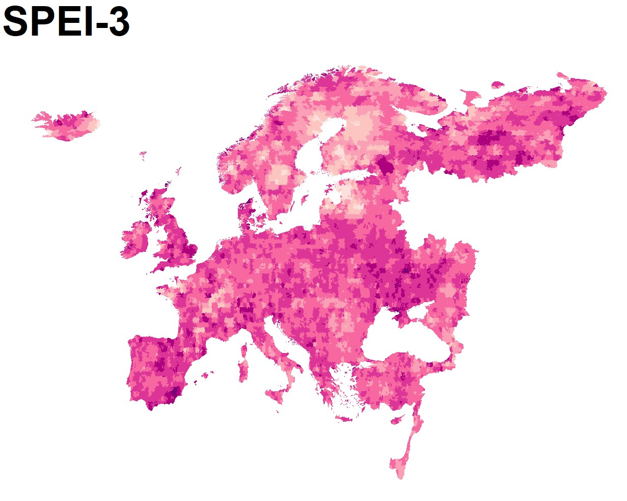
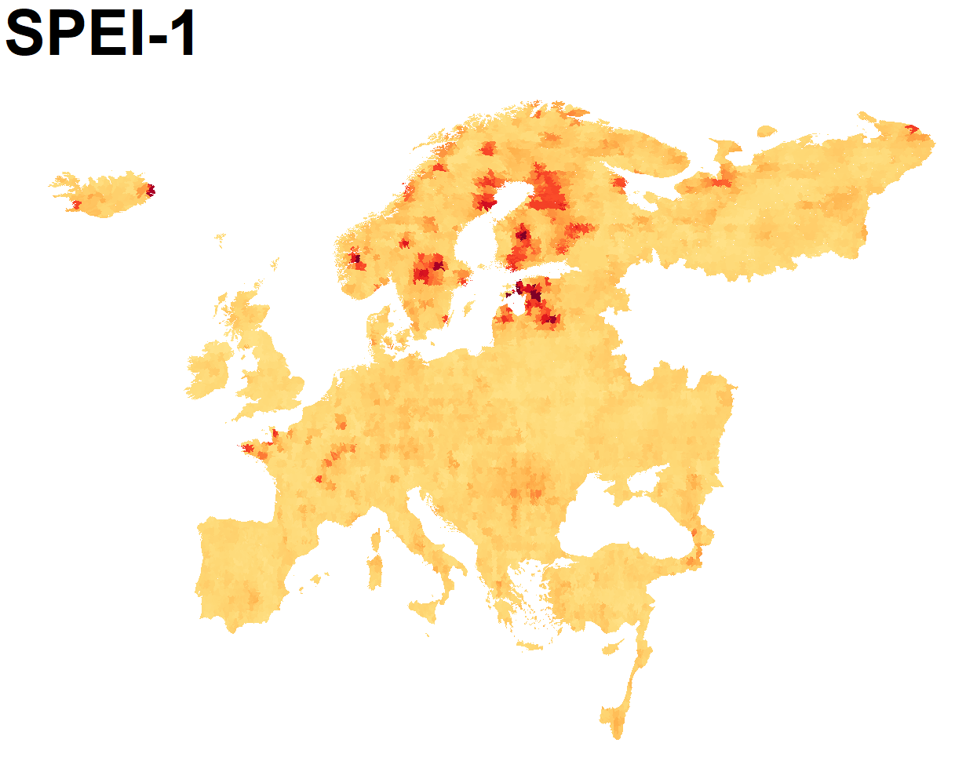
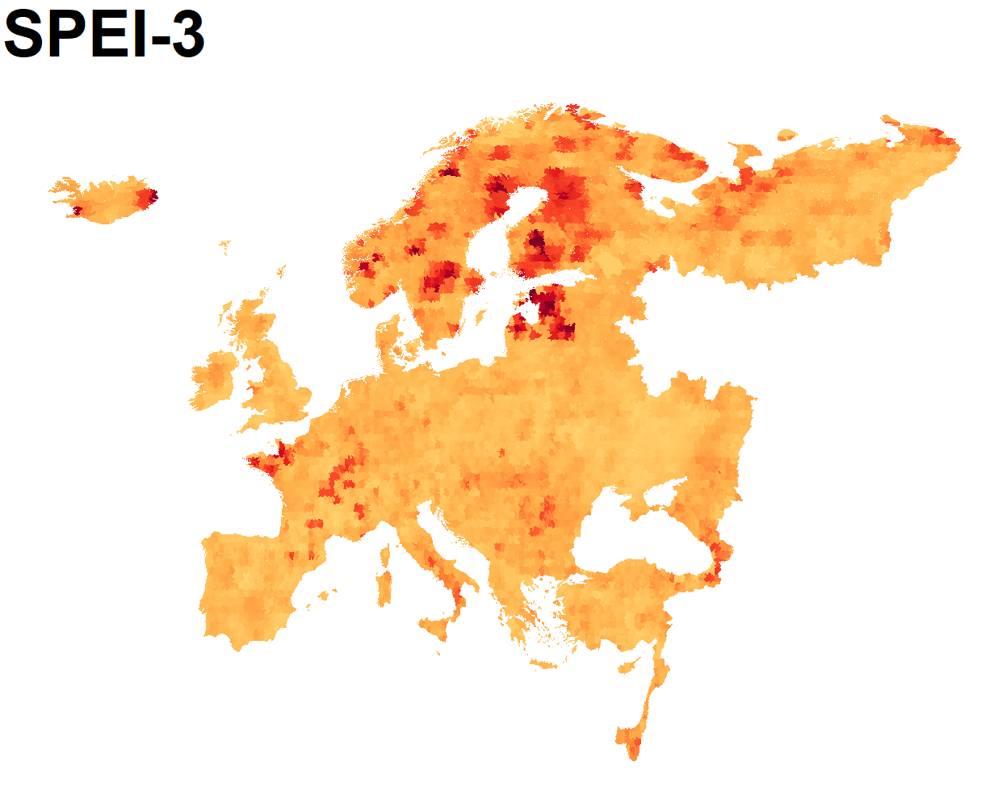
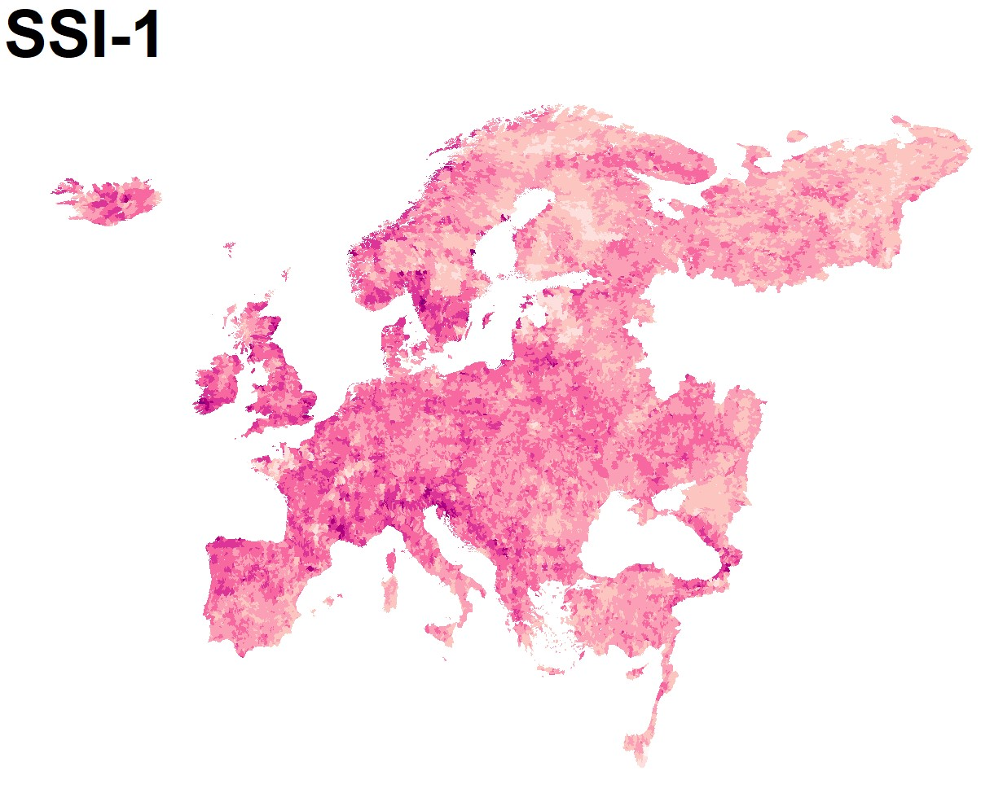
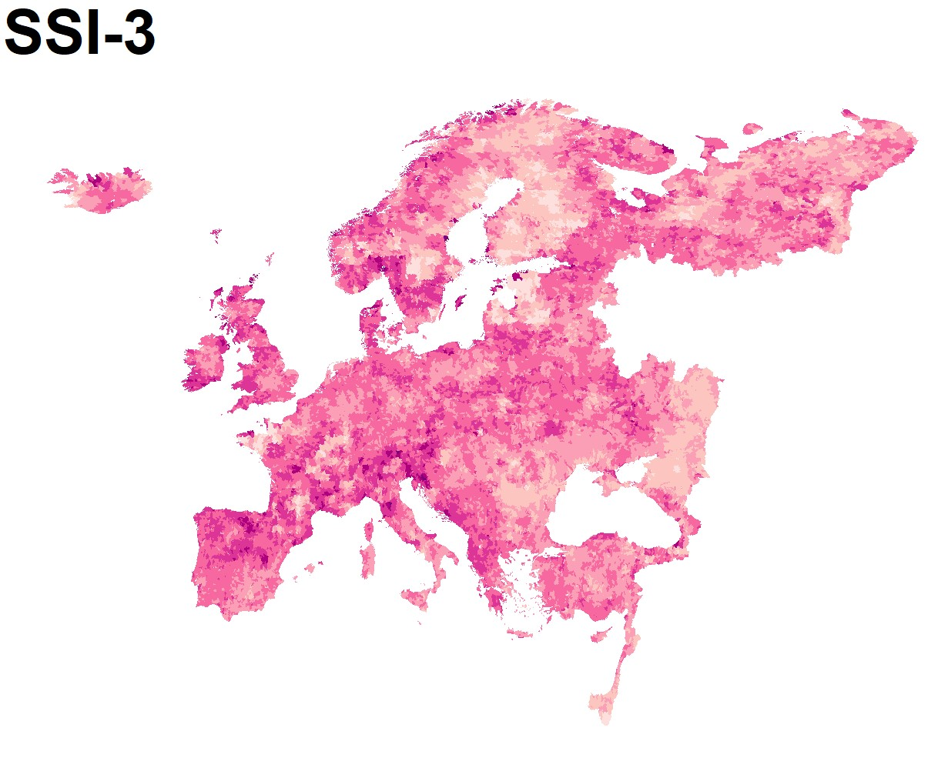
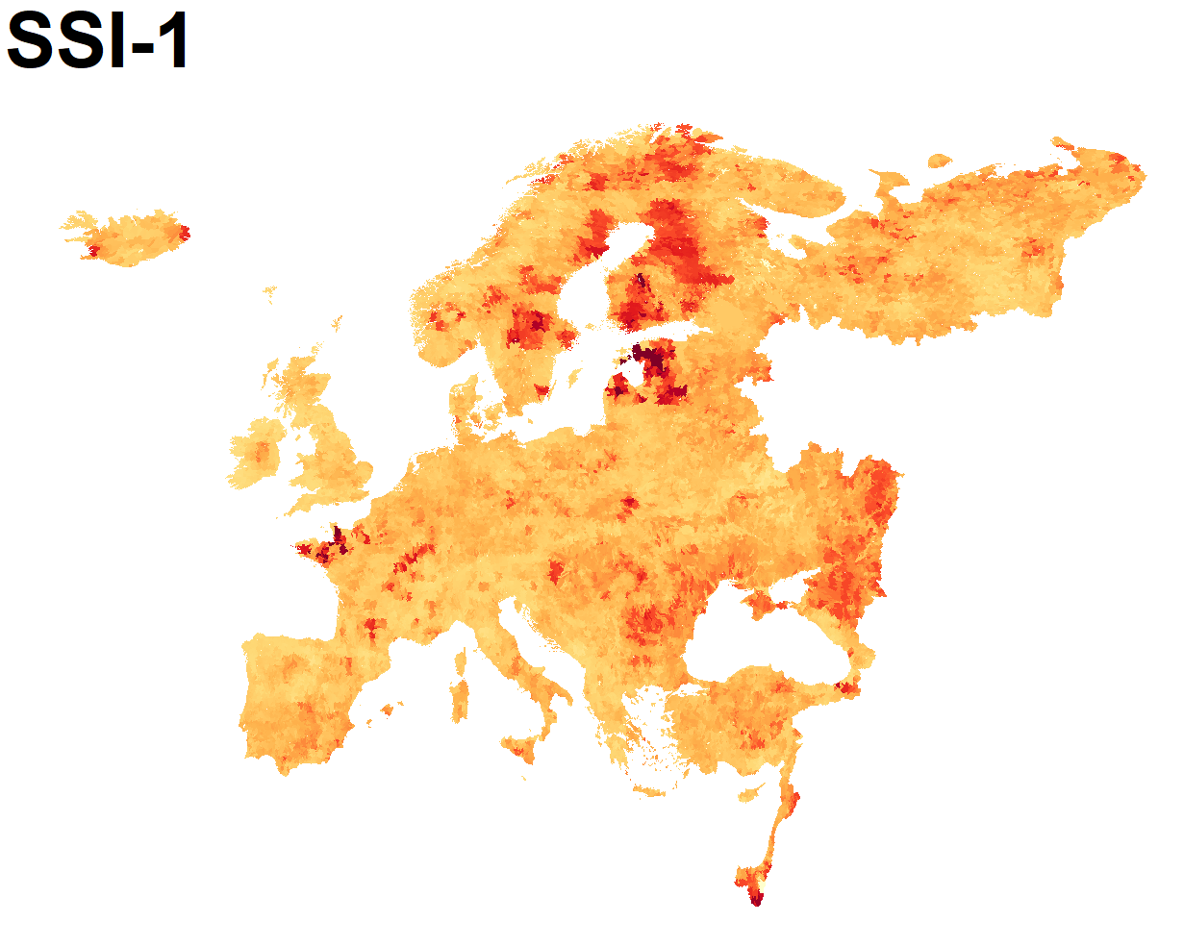
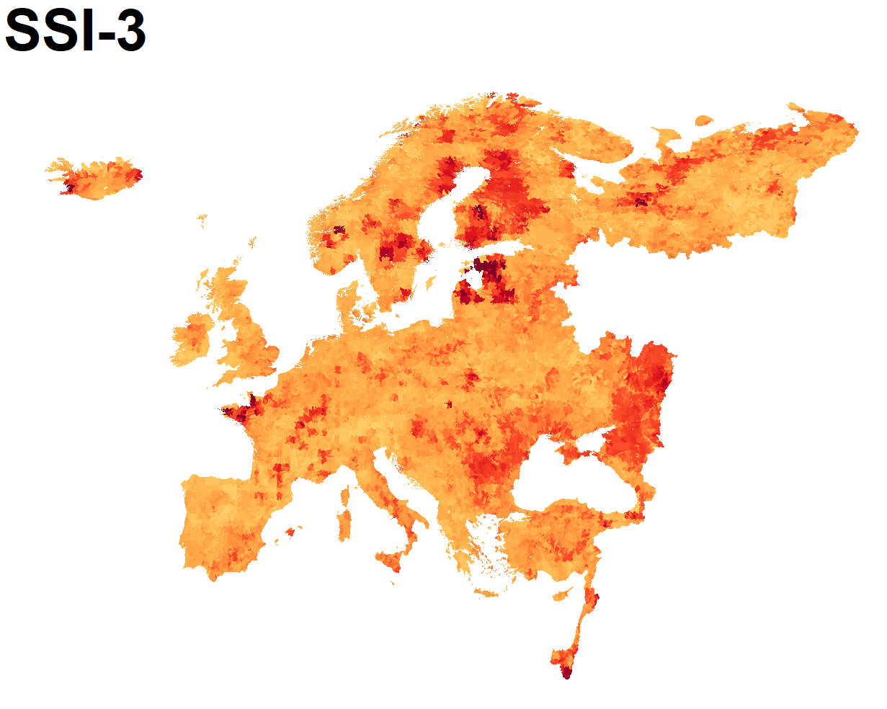
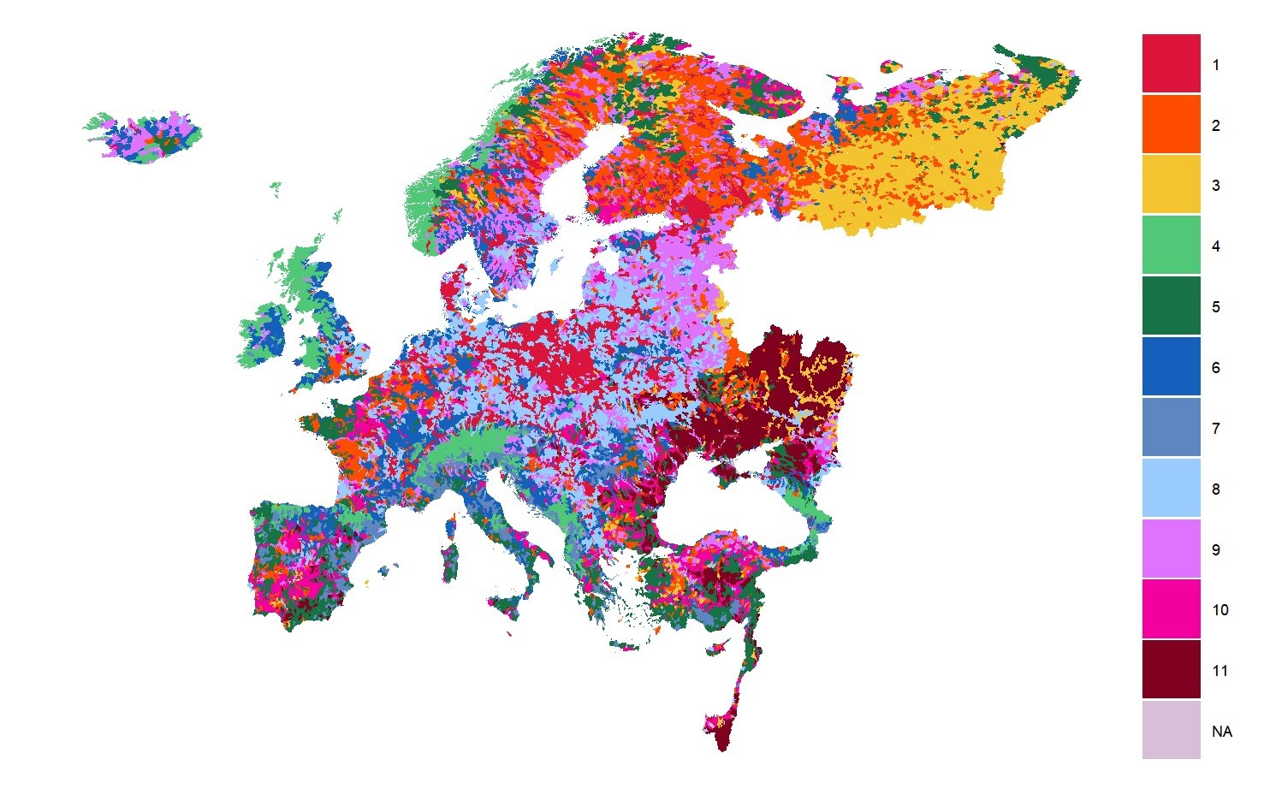
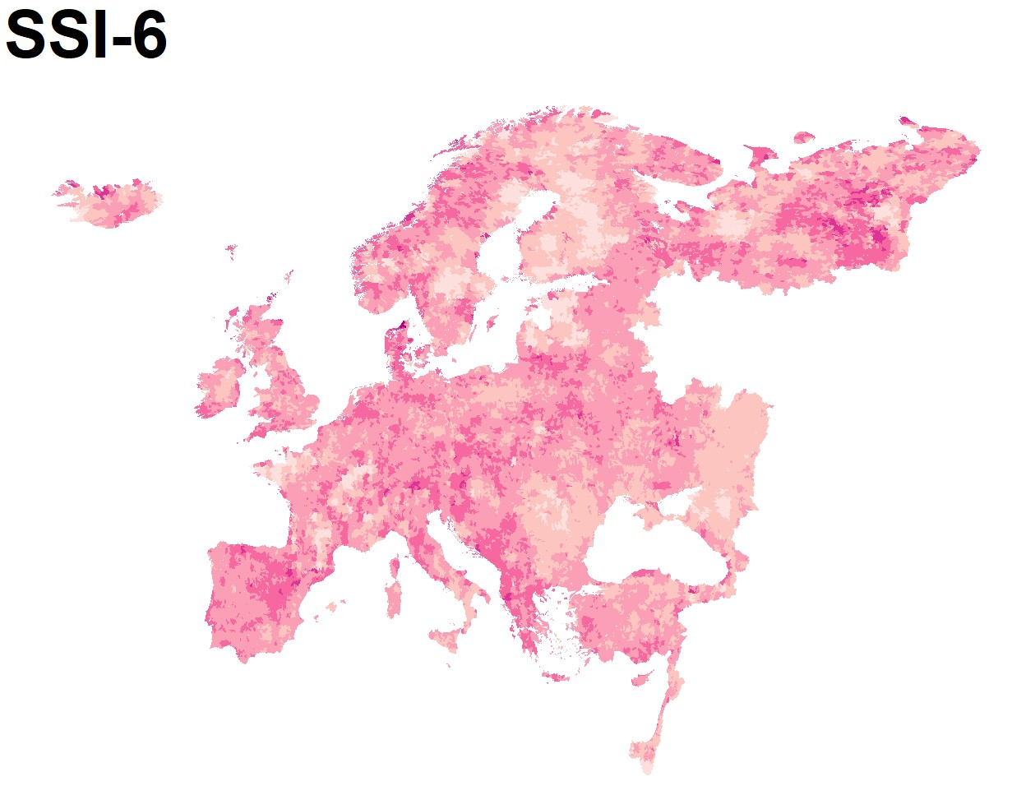
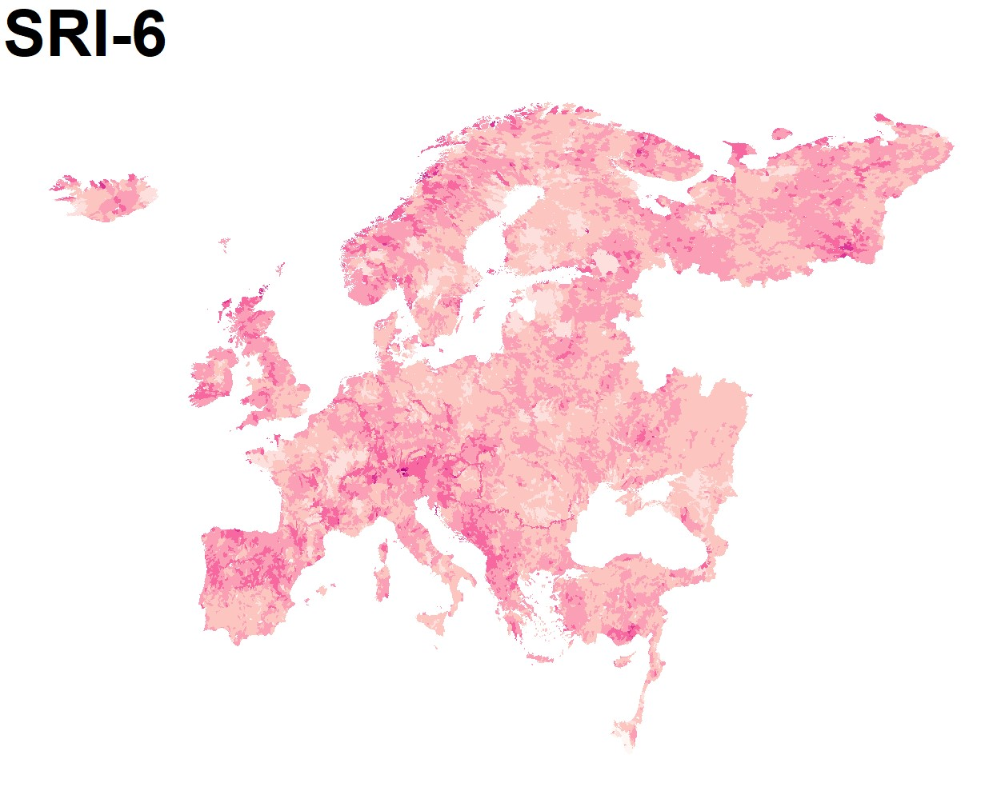
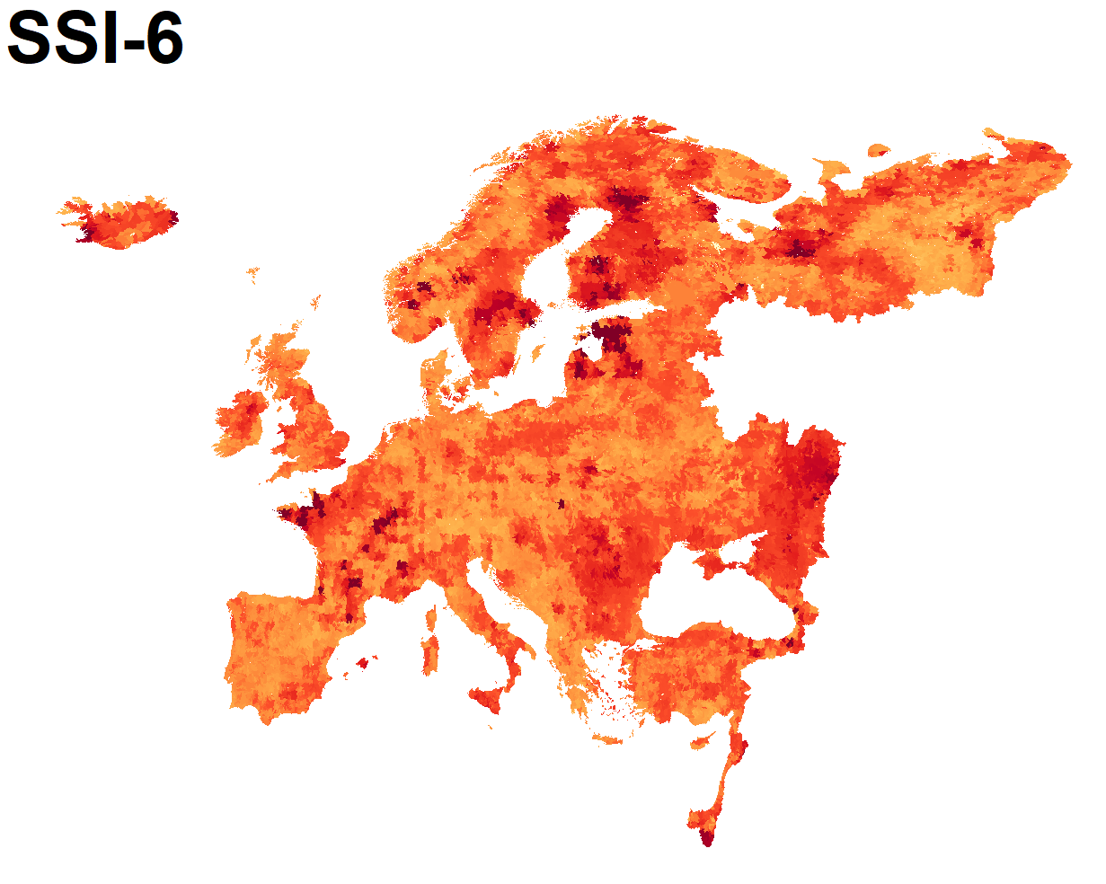
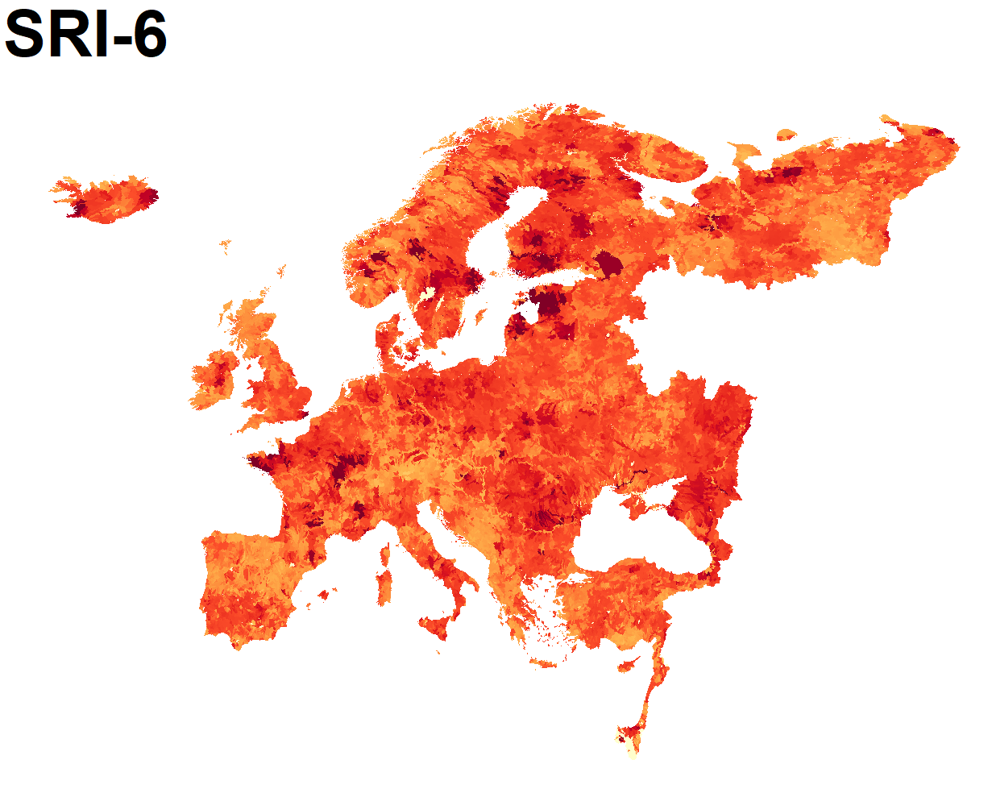
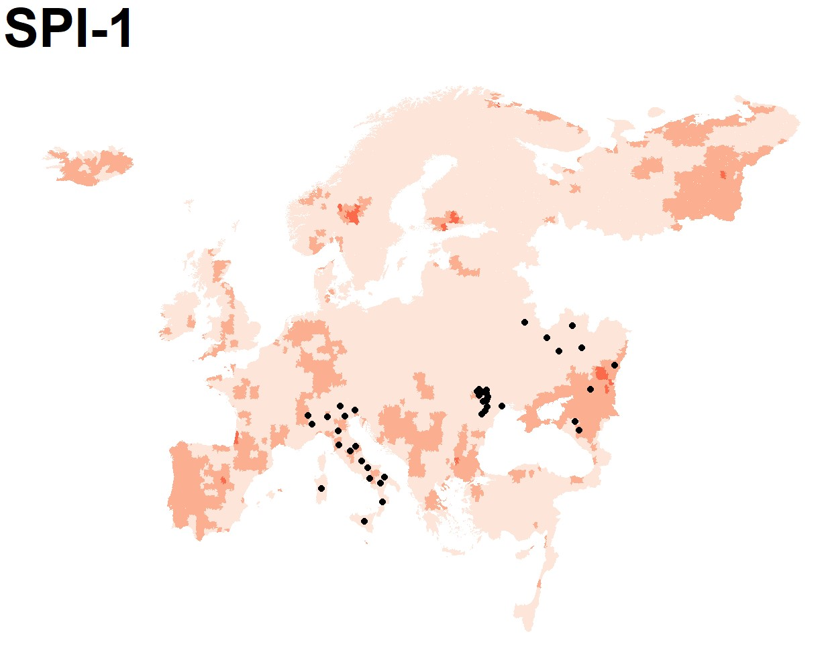
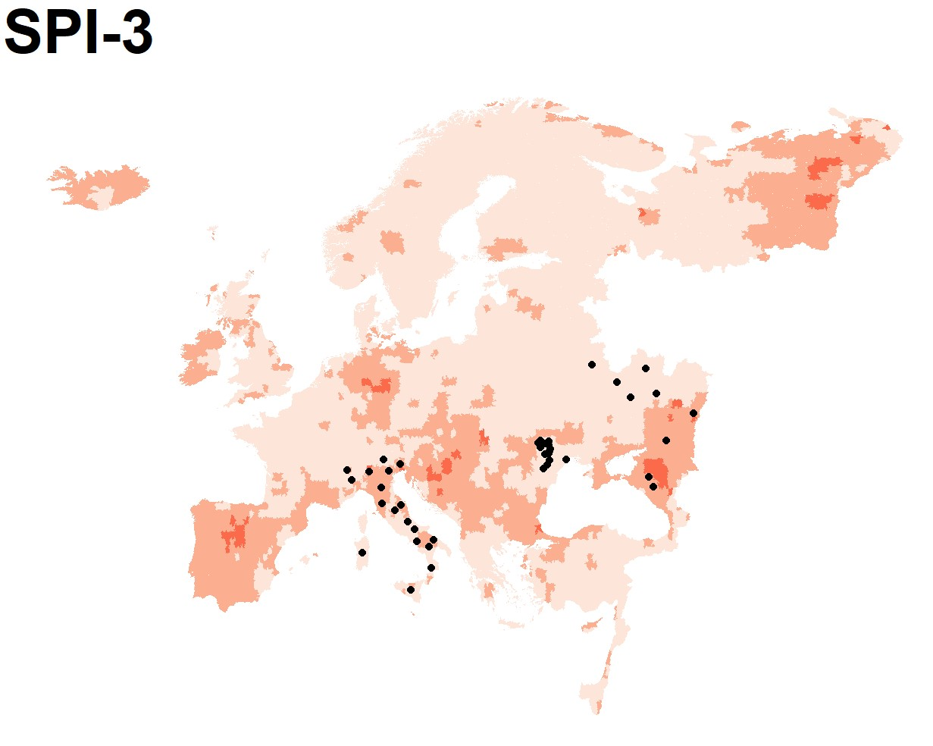
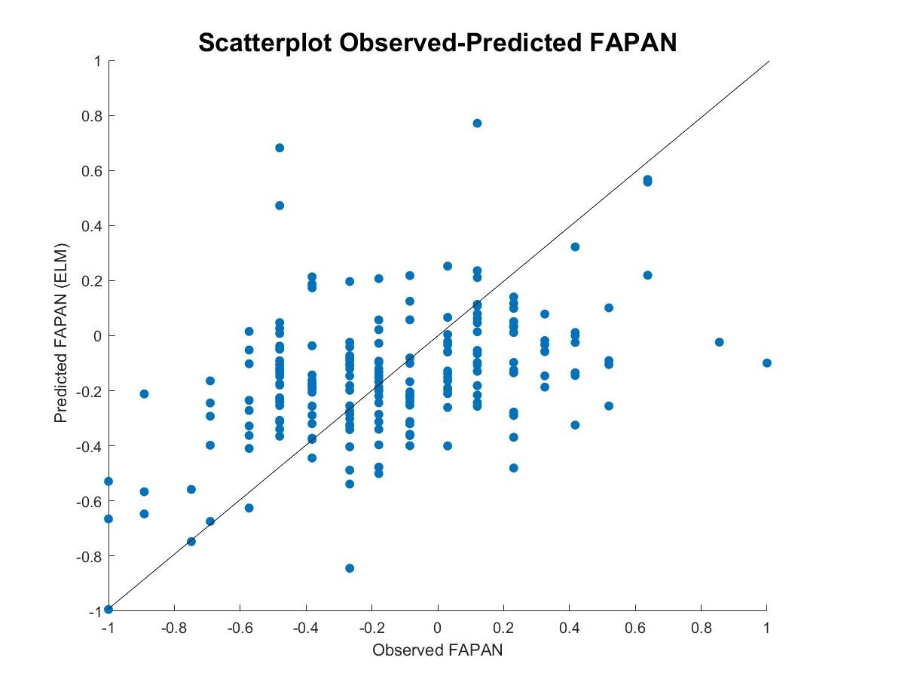
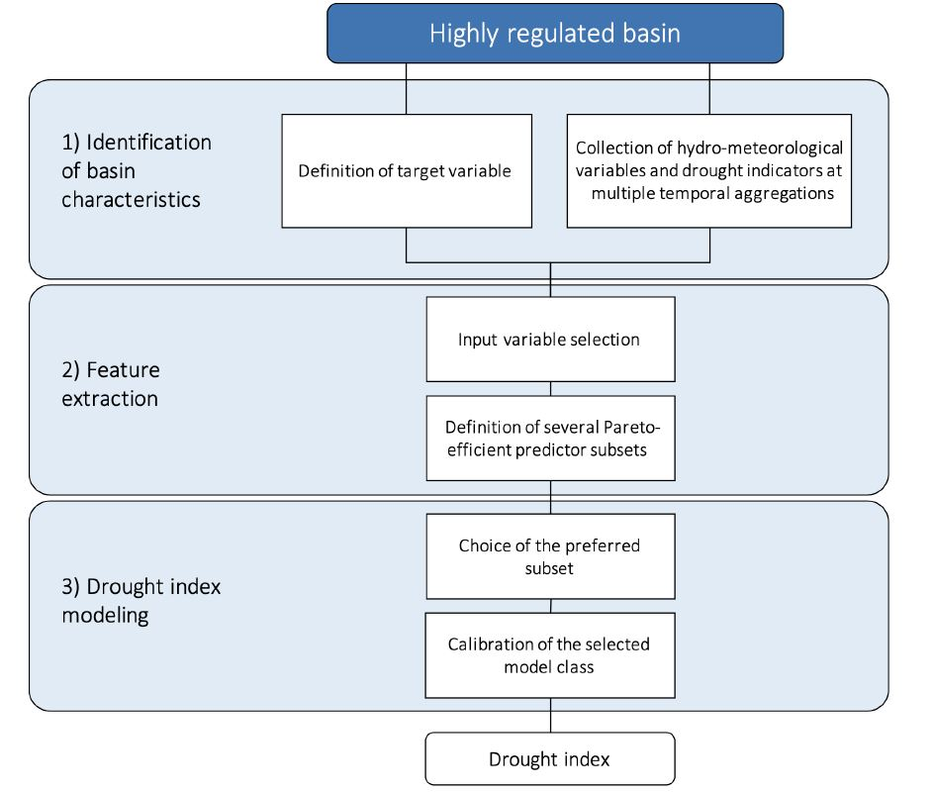
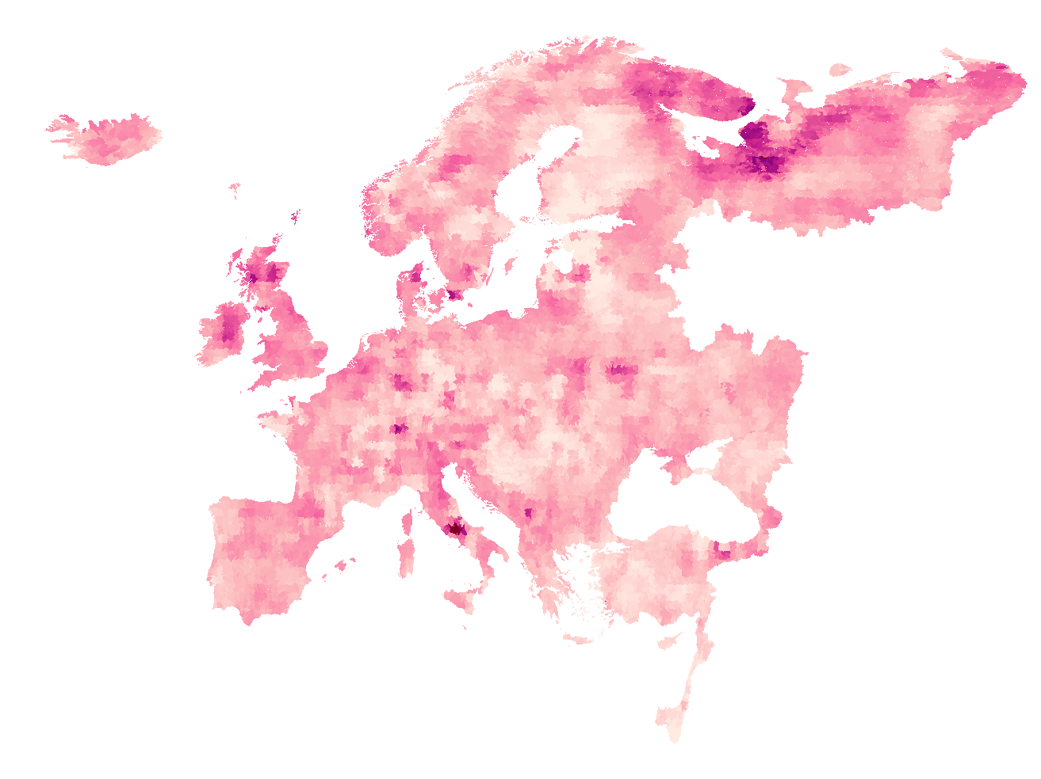
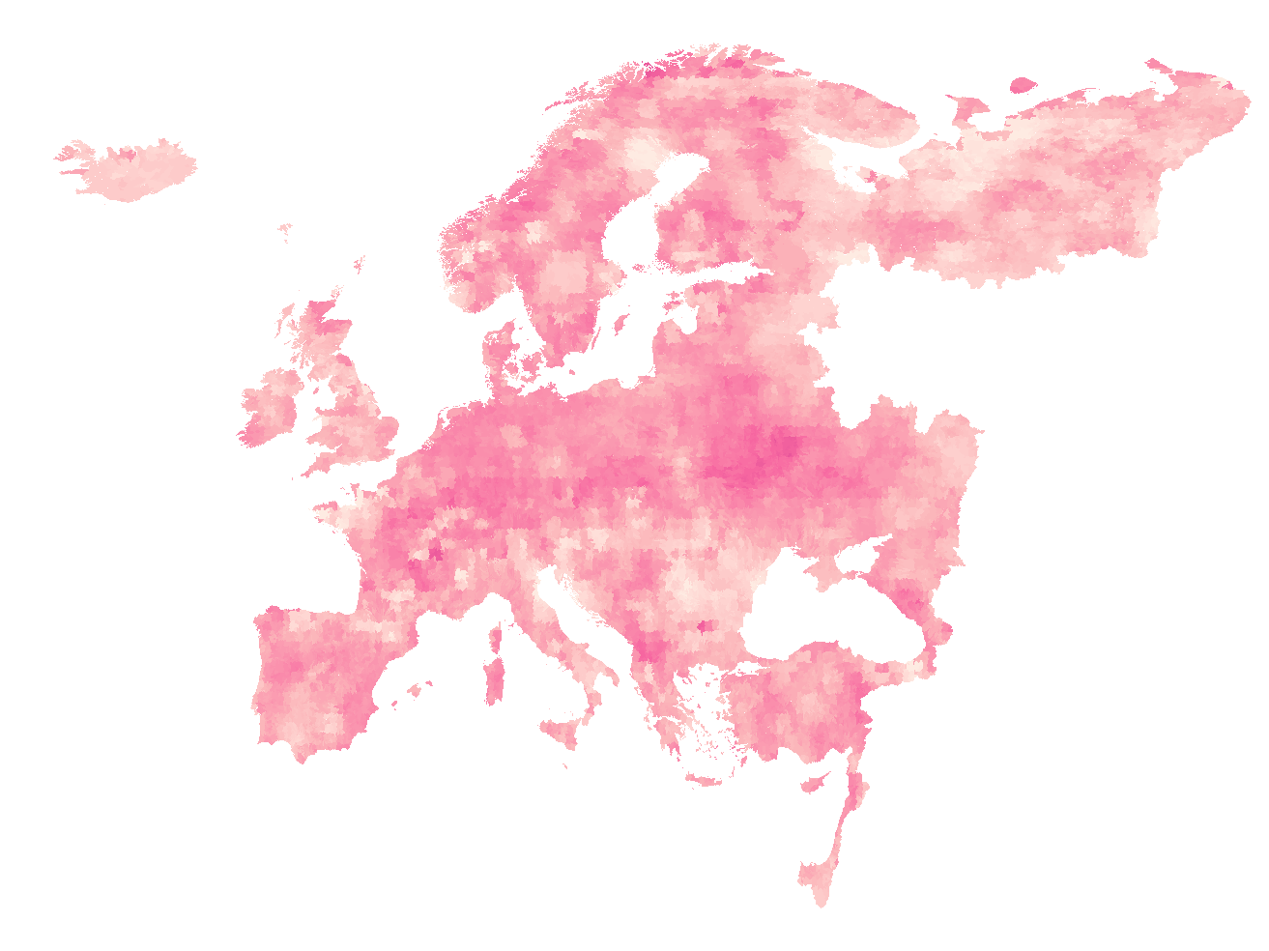
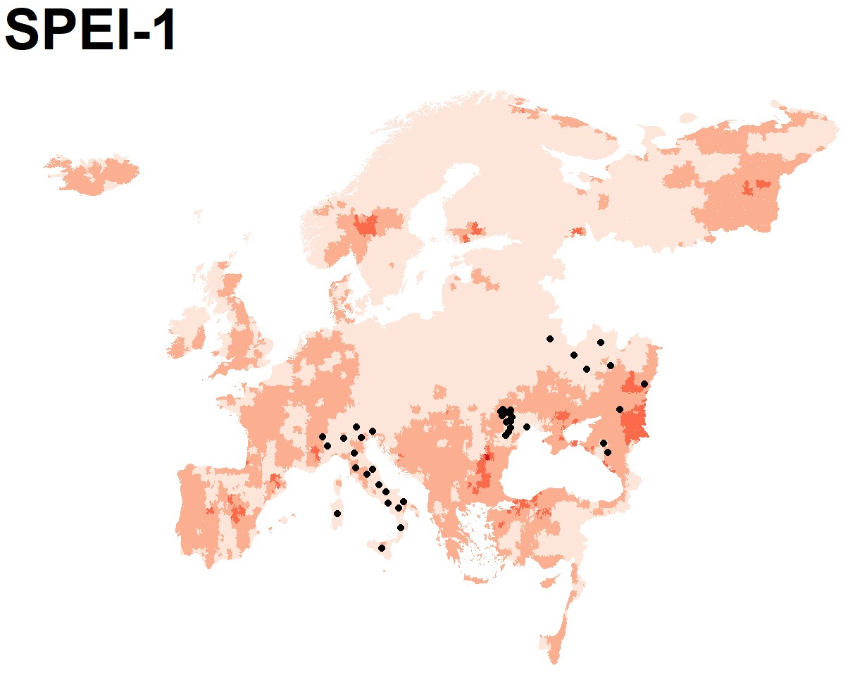
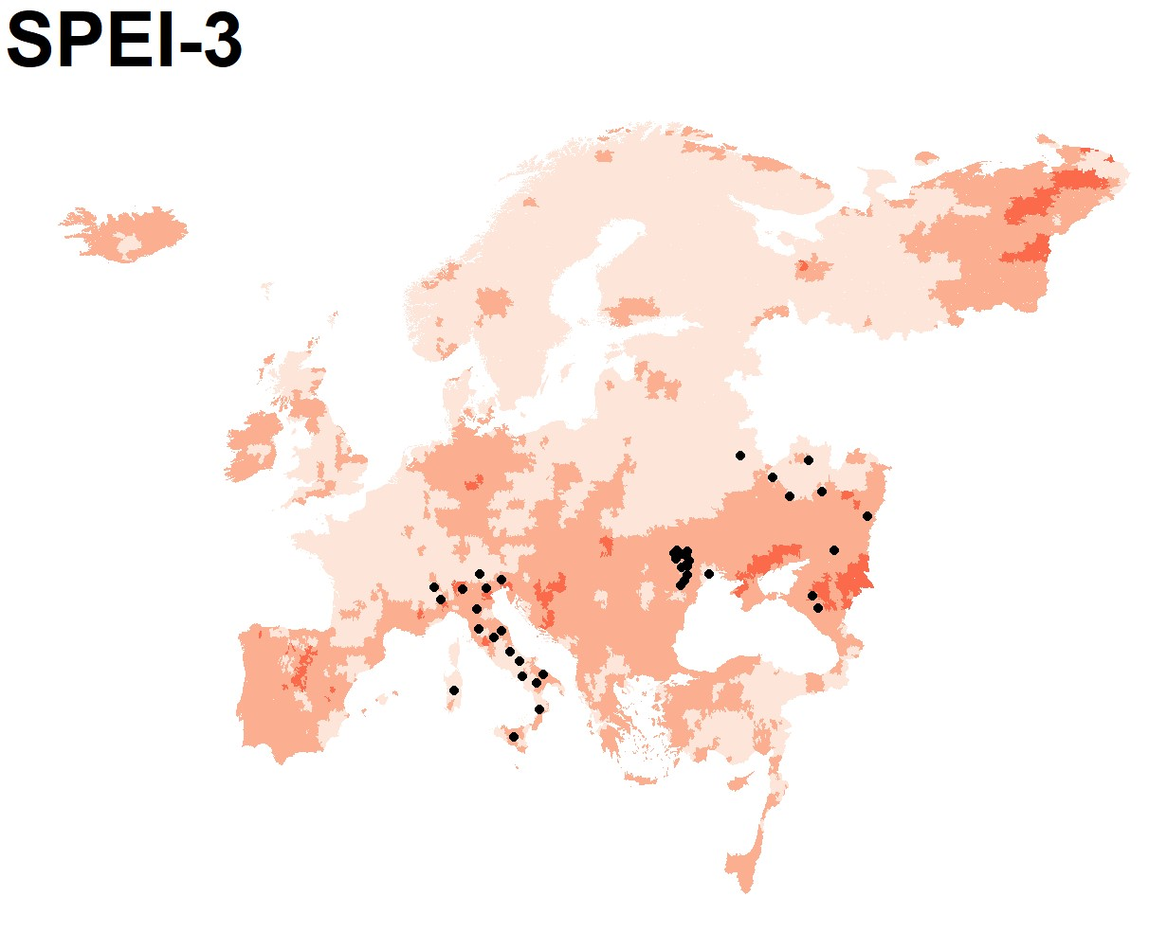
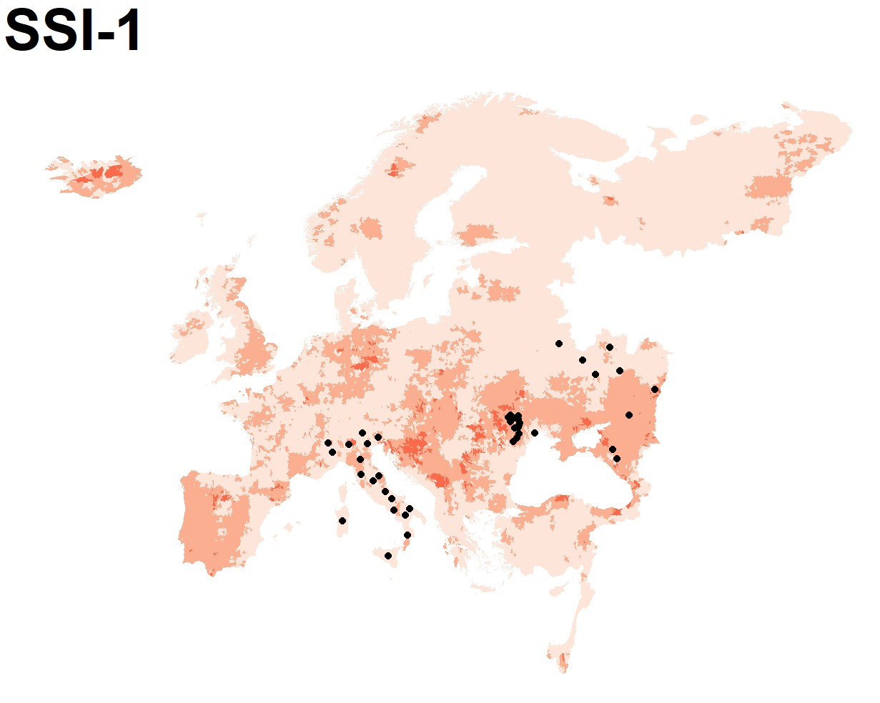
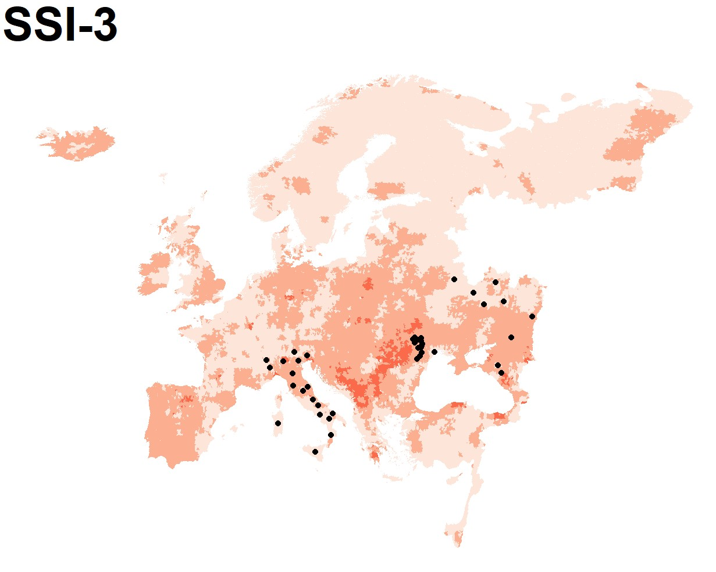
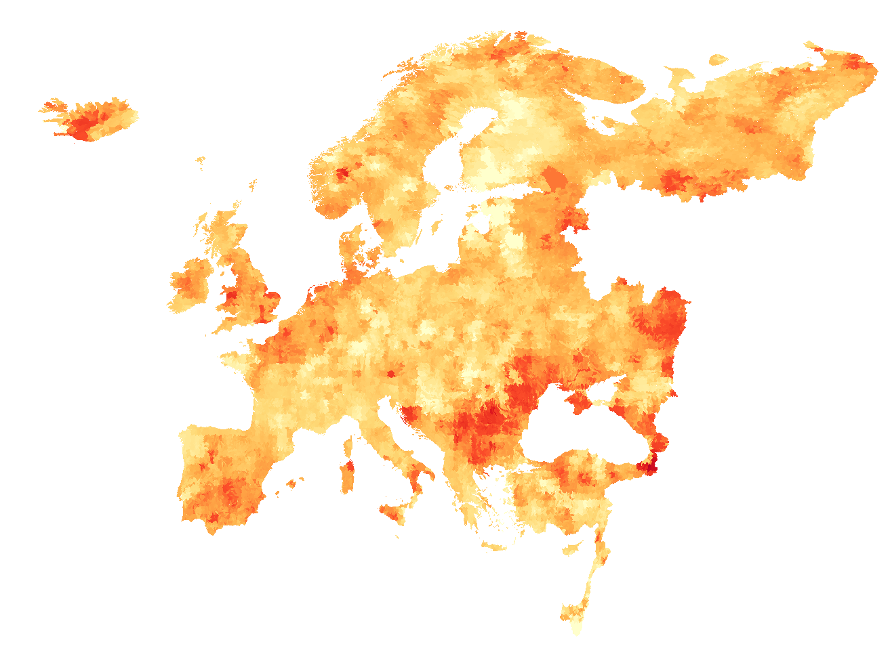
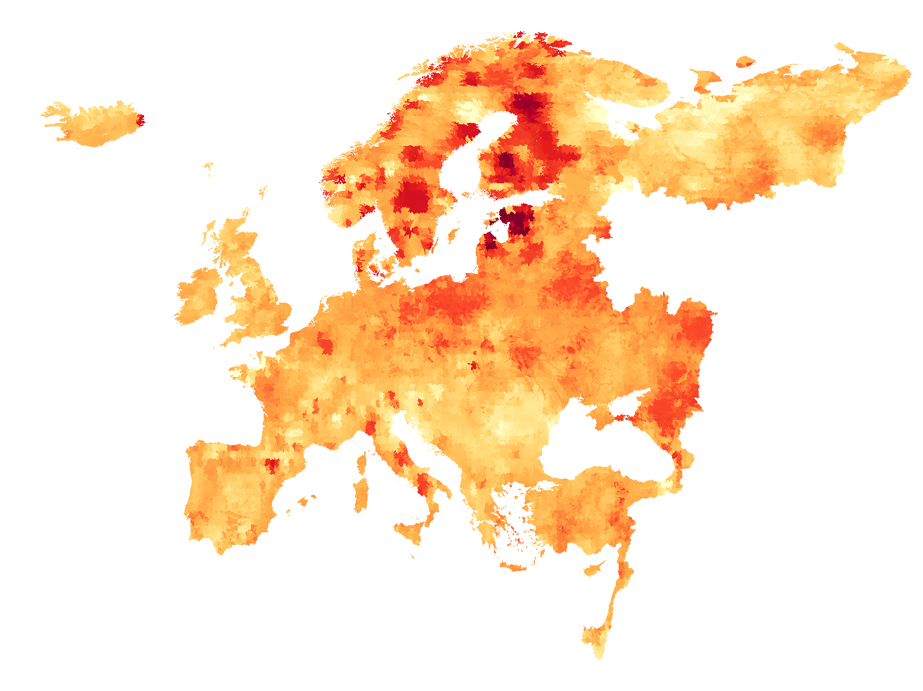
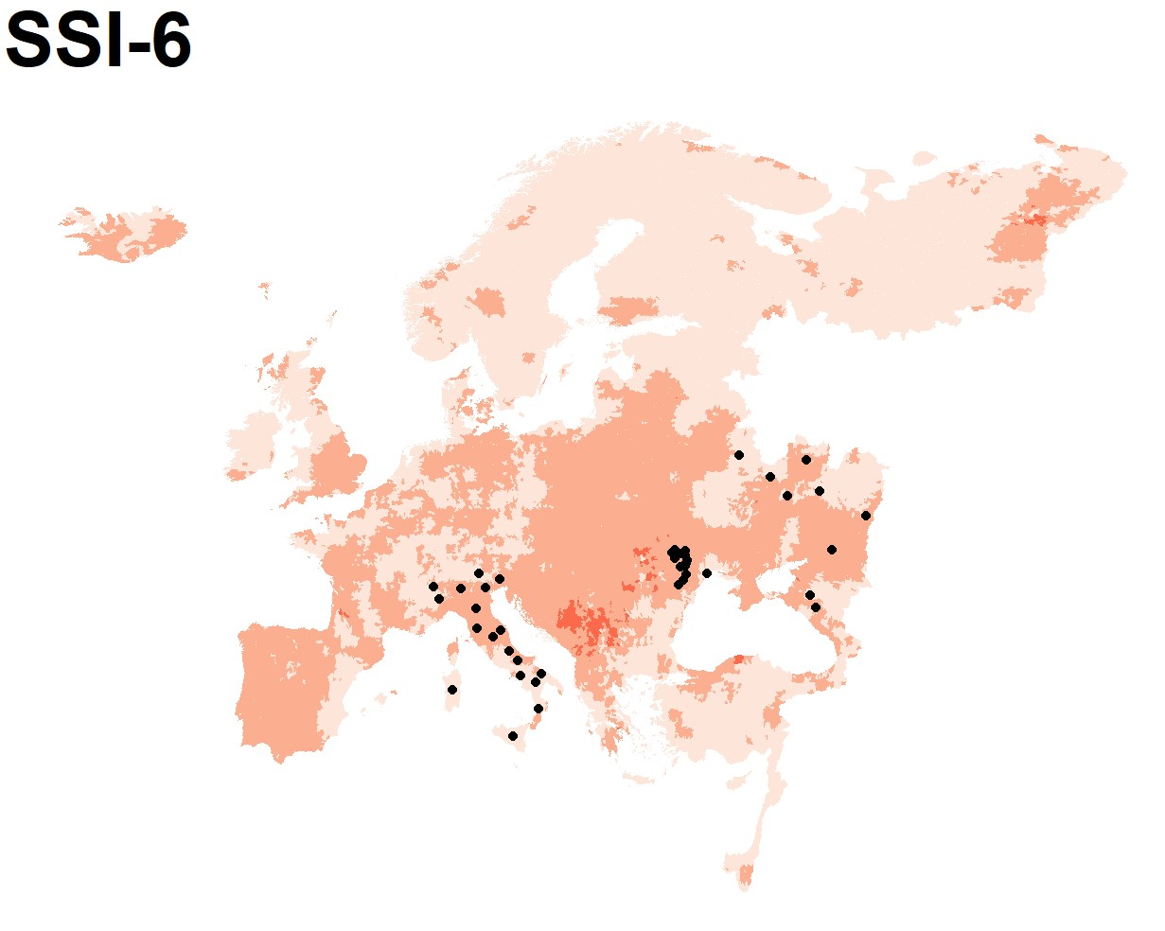
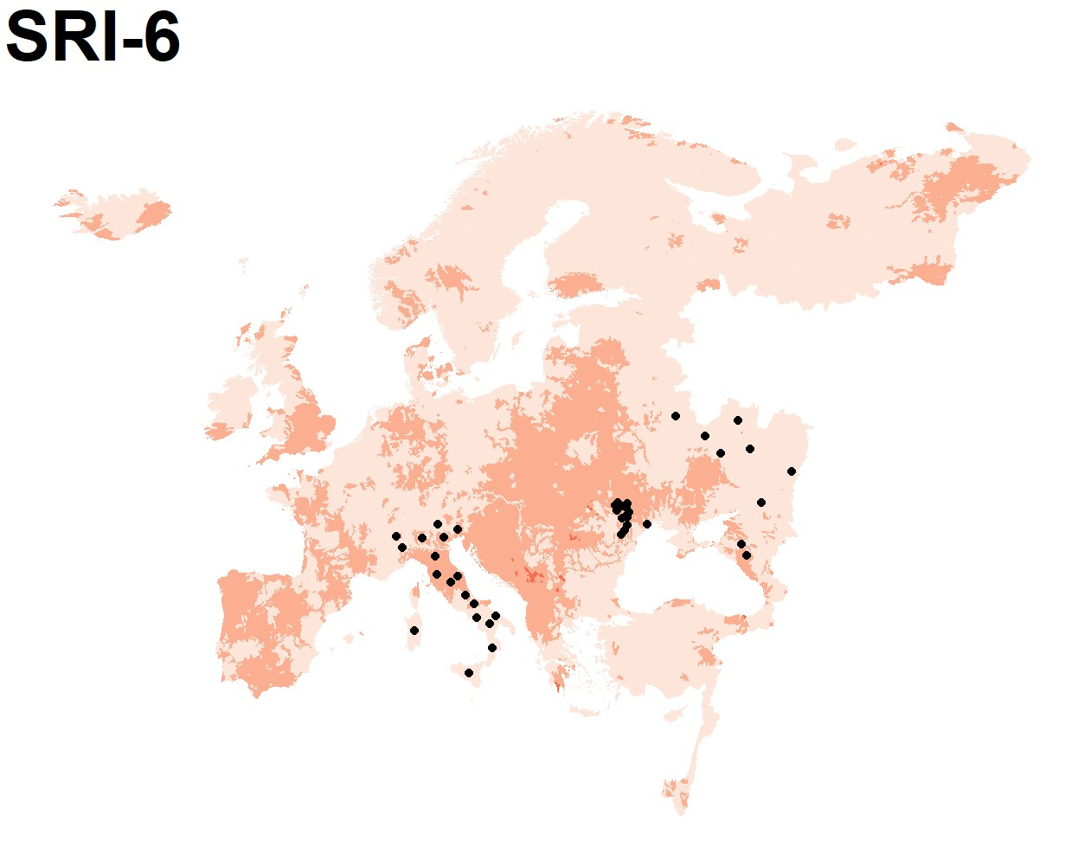
(1) Dept. Electronics, Information, and Bioengineering, Politecnico di Milano, Italy
A pan-European analysis of drought events and impacts
Martina Merlo¹, Matteo Giuliani^{1*}, Yiheng Du², Ilias Pechlivanidis², and Andrea Castelletti¹
¹ Politecnico di Milano, University, Electronics, Information and Bioengineering, Italy (*corresponding to: matteo.giuliani@polimi.it)
² Swedish Meteorological and Hydrological Institute (SMHI), Hydrology Research Unit, Norrköping, Sweden
(1) ABSTRACT
Today drought detection is becoming more and more important for supporting water management strategies, especially in a changing climate.
Here we assess the ability of traditional standardized drought indexes (the most common tools used in the literature) in detecting drought events and their impacts at the pan-European scale, using data from HydroGFD2.0 reanalysis and E-HYPE hydrological model simulations over the time period 1993-2018.
HIGHLIGHTS:
Beside some inconsistencies across the drought indexes, substantial disagreements emerge between observed impacts and detected droughts. Such asymmetry suggests that traditional drought indexes are not always consistent in detecting droughts impacts, especially in highly regulated contexts.
An evolution of the FRIDA framework for index-based drought analysis succeeds in constructing a new composite drought index that better capture the underlying drought impacts.
(5) COMPARISON OF STATISTICAL DROUGHT INDEXES
(7) IMPACTS USING THE FAPAN INDEX
(2) HYDROLOGICAL SIMILARITY OVER THE PAN-EUROPEAN DOMAIN
Based on the E-HYPE hydrological model, the pan-European domain consists of 35,408 sub-basins that can be grouped into 11 clusters (Pechlivanidis et al., 2020).
For every sub-basin eight statistical indexes have been computed on a monthly basis over the period 1993-2018: SPI-1, SPI-3, SPEI-1, SPEI-3, SSI-1, SSI-3, SSI-6, and SRI-6.
Figure 6.
Correlation between drought indexes and FAPAN for sub-basins in cluster 10.
One limit characterizing any kind of disaster dataset is related to its eventual incomplete spatial and temporal coverage. In order to overcome these drawbacks, the GDIS is here replaced with a proxy of drought impacts on vegetation stress as represented by the Fraction of Absorbed Photosynthetically Active Radiation Anomaly (FAPAN) index.
The maximum correlation between drought indexes and FAPAN (last column) is equal to 0.17. These low values suggest that traditional drought indexes are not always consistent in detecting droughts impacts.
Figure 4.
Occurrence of droughts (left) and mean duration of droughts measured in months (right) in 1993-2018, according to the different statistical drought indexes.
Figure 1.
Spatial distribution of hydrological clusters. The sub-basins are grouped according to their hydrological similarity: 15 streamflow signatures from the E-HYPE hydrological model setup were analyzed, resulting in 11 clusters of different sizes and variable distributions in the signatures (Pechlivanidis et al., 2020).
(6) GDIS IMPACTS
(8) IMPACT-BASED DROUGHT INDEX FORMULATION
Figure 5.
Comparison between GDIS droughts (black points) and Index-detected droughts in 2012.
The Geocoded Disasters dataset (GDIS) is an extension of the Emergency Events Database (EM-DAT). It contains location information and geographic information system (GIS) polygons of any administrative units affected by any kind of dominant geophysical, meteorological, hydrological, and
climatological disaster types: floods, storms, earthquakes, volcanic activity, extreme temperatures, landslides, droughts, and (dry) mass movements. However, one significant limit that characterizes the GDIS is related to the temporal information provided: each disaster is associated only with the year in which it happened, neither the month nor the day.
(3) The FRIDA framework
(4) TEMPORAL TRENDS OF EUROPEAN DROUGHTS
(a)
Figure 2.
FRIDA framework: 1) Identification of basin characteristics; 2) feature extraction, and 3. drought index modeling (Zaniolo et al., 2018).
The FRamework for Index-based Drought Analysis was developed to support the construction of new composite drought indexes that can be tailored to the unique hydrological and meteorological conditions of a particular region, being able to better capture the impacts of a drought event. In particular, FRIDA is a Machine Learning framework that builds an index representing a surrogate of the drought conditions of the basin, computed by combining all the relevant available information about the water circulating in the system identified by means of a feature extraction algorithm.
(b)
Figure 7.
Scatterplot observed-predicted FAPAN for sub-basins in cluster 10.
The predicted FAPAN was designed using FRIDA, considering as surrogate of the drought conditions of the basin the FAPAN itself.
Their correlation is equal to 0.45. This result is substantially better than all correlation values between FAPAN and statistical indexes for this cluster.
Figure 3.
(a) Number of droughts during 1993-1997 (left) and 2014-2018 (right). (b) Mean duration of droughts during 1993-1997 (left) and 2014-2018 (right).
Although the occurrence of the events seems to decrease in areas that experience a large number of droughts, the mean duration is substantially growing, with high risk for severe impacts for different socio-economic sectors.
REFERENCES
Pechlivanidis I.G., Crochemore L., Rosberg J., Bosshard T. (2020) What are the key drivers controlling the forecasts of seasonal streamflow volumes?, Water Resources Research, doi: 10.1029/2019WR026987
Zaniolo, M., Giuliani, M., Castelletti, A. F., Pulido-Velazquez, M. (2019) Automatic design of basin-specific drought indexes for highly regulated water systems, Hydrol. Earth Syst. Sci., 22, 2409–2424, https://doi.org/10.5194/hess-22-2409-2018

