Slide 1
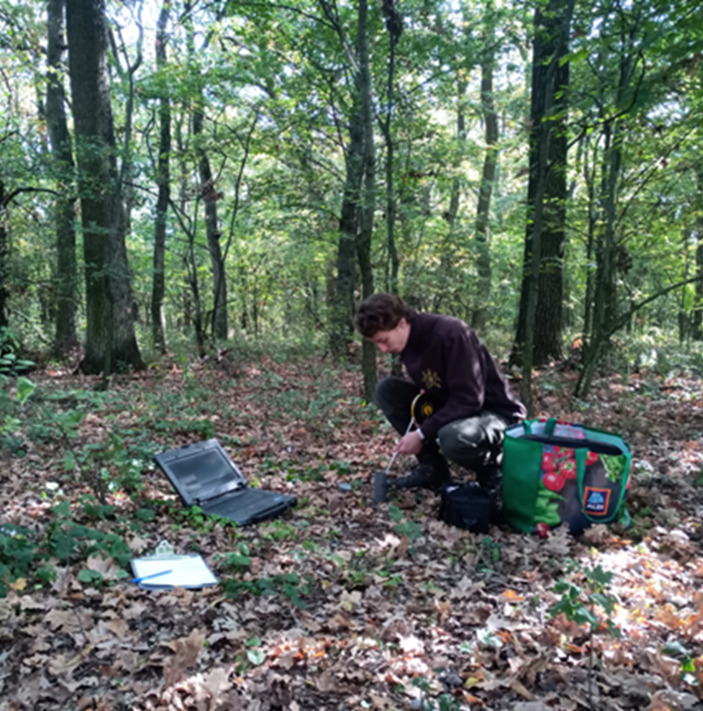
Groundwater transpiration of a salt steppic oak forest in the extreme dryness of 2022
Zsombor Kele
A kedvezményezett logója

Slide 3
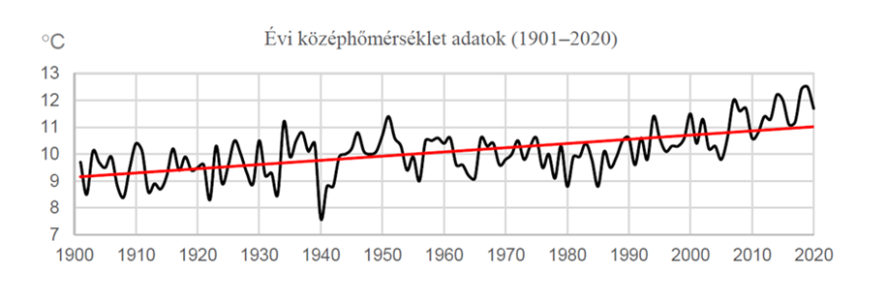
Results (Precipitation and temperature )
Much more drought than in the past, and in the growing season
Continuous warming and drying over the last 120 years based on Debrecen time series

Slide 4
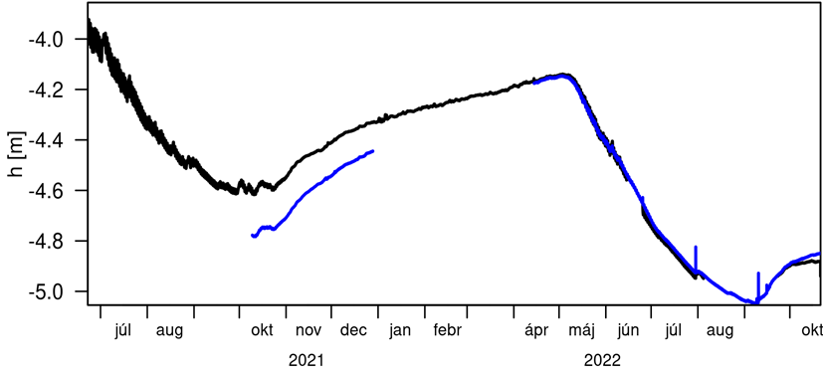
Groundwater time series (two wells)
There is a strong correlation between water table decline, temperature and precipitation deficits.

Slide 5
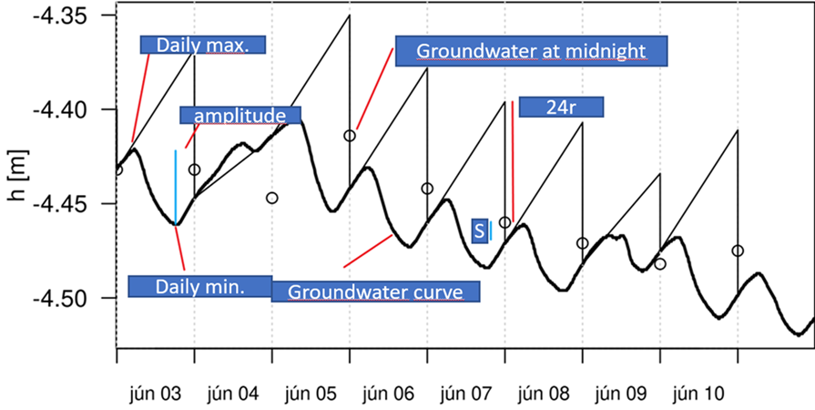
White-method
White (1932) method (Escalante Valley, Utah)
between 0 and 4 h ET=0, so that ET_GW=S_y (24r±s) Based on the recharge, and daily GW change

Slide 6
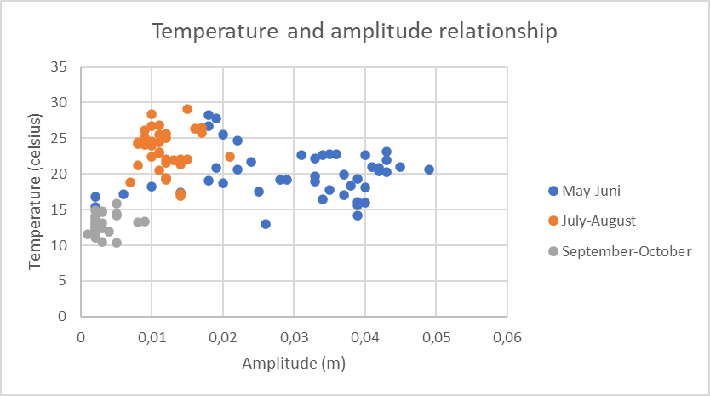
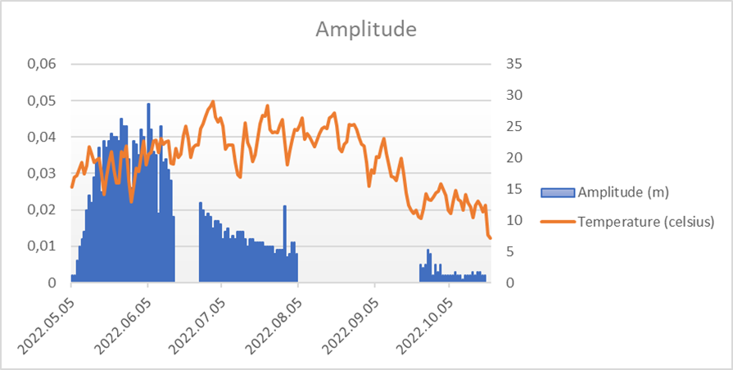
Analysis of the daily amplitude
Amplitude (closely related to ET) is largely independent of temperature
The amplitude decreases in spite of the warming and thus the increase in PET

Slide 7
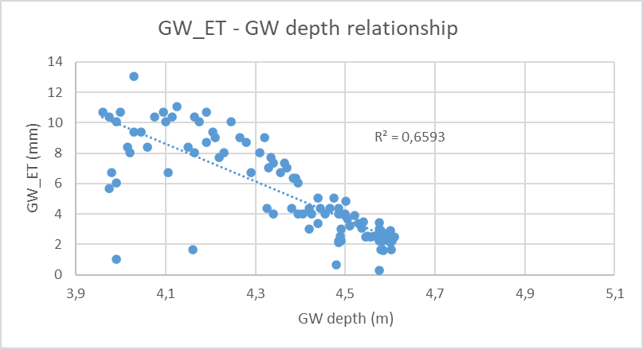
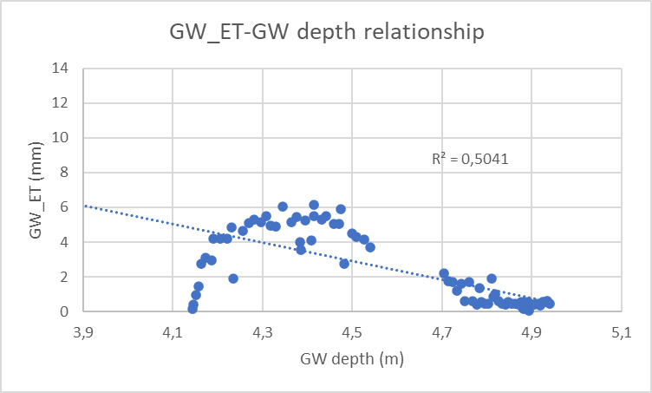
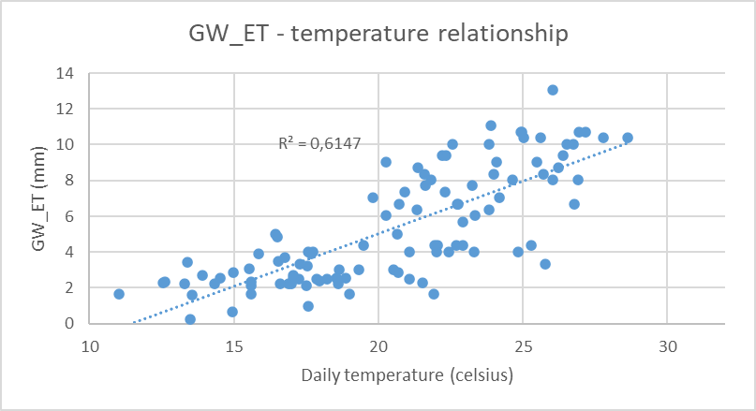
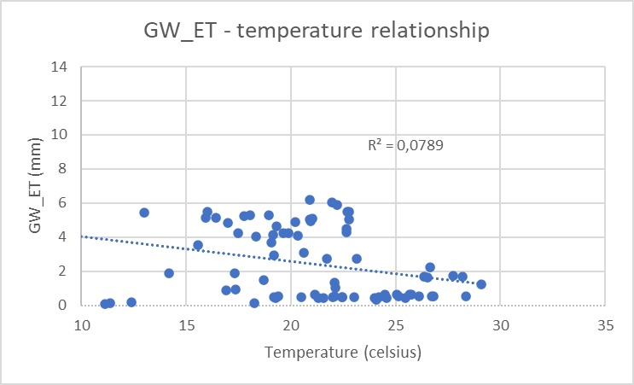
Comparison with previous year's results
Results of 2021
Results of 2022

Slide 8
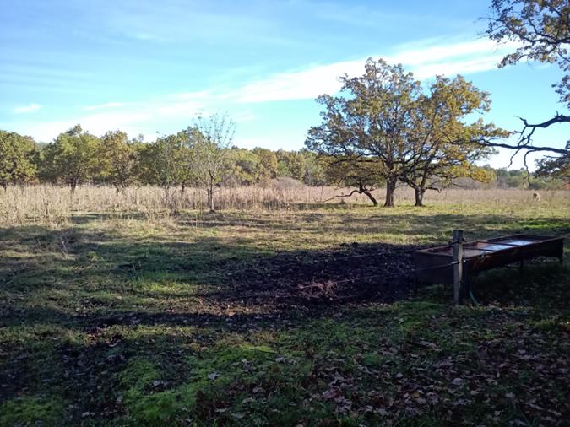
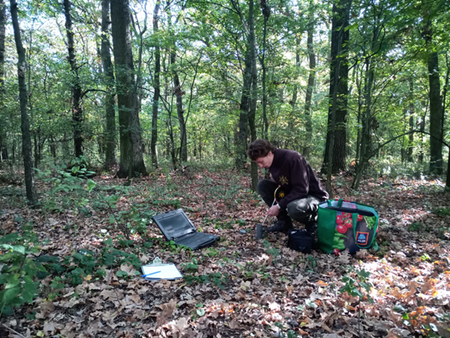
Summary
Clear groundwater abstraction from 4-5 metres
Continuous drying out is evident, oak may be threatened

Slide 9
Acknowledgements
I would like to thank my fellow students for all the little help, listening and comments.
This research was funded by the NRDI Fund under grant FK 20. 134547 and TKP2021-NKTA-43 project at the University of Sopron, and the National Research, Development and Innovation Office -NKFIH, grant 143972SNN.

Slide 10
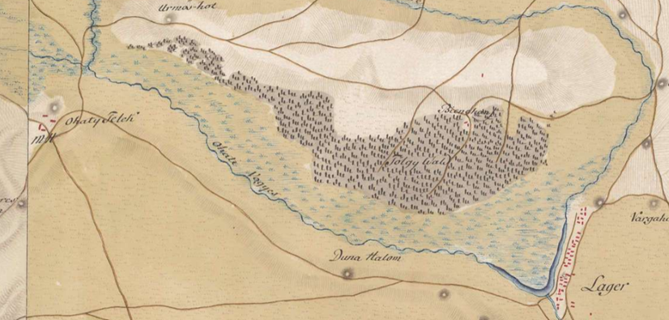
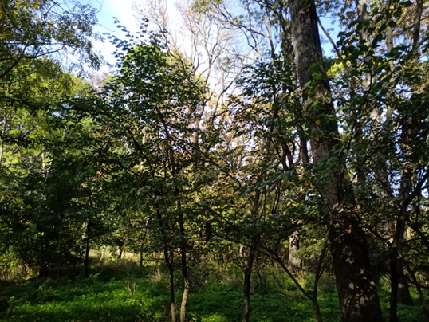
History of the Ohat forest
The forest is a remnant of a Sicilian oak forest, a hardwood grove that formerly dominated the Tisza area
For centuries it was owned by the city of Debrecen and was a great treasure
In general, deforestation, forest resting, forest grazing
Since 1973 under the management of the Hortobágy National Park

Slide 11
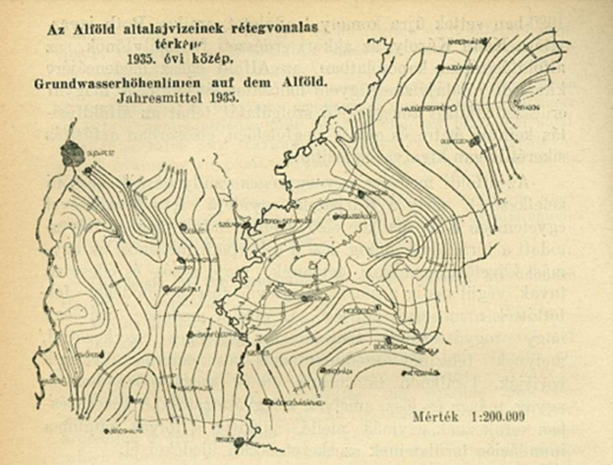
Groundwater-forest relationship in the Great Hungarian Plain
Gyula Roth (1935): ...the forestry of our country is mainly a question of water, of water management.
1908: first initiatives by Gyula Roth
1920: Groundwater monitoring network in the Great Plain
1936: Ervin IjjászThe work of Pál Magyar
VITUKI studies-forests investigating the relationship between vineyards and water resources (Komlósi-telep)

Slide 12
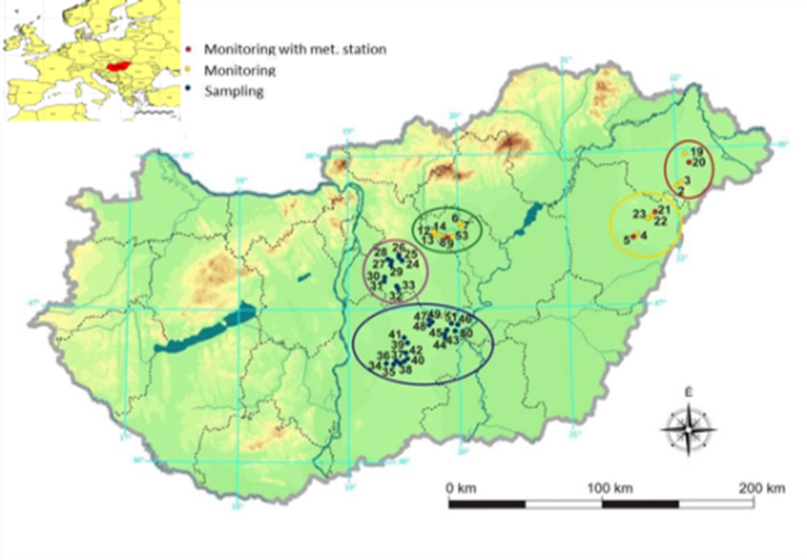
2000: New researches
2000s: Zsolt Gácsi Groundwater flow modelling
Tóth Tibor-Szabó A.: Groundwater well network -now managed by ERTI - with Bolla Bence.

Slide 13
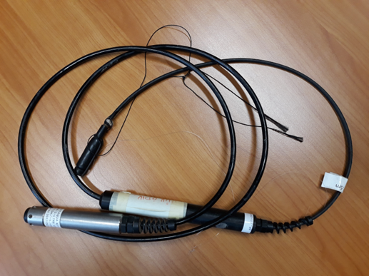
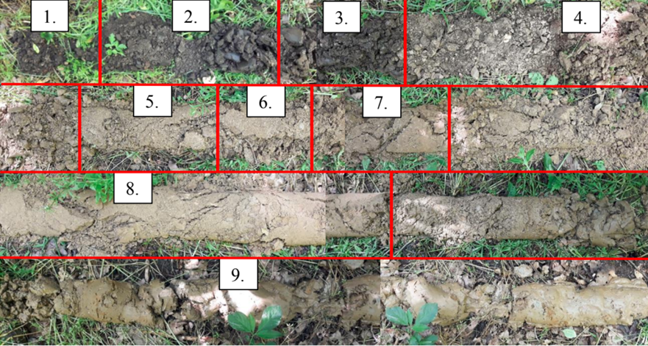
Drilling, stock survey
Well drilling: drillable, with hand-held auger
The first well is 6.3 m deep, the second 5.3 m deep, the walls of the wells are PVC pipes
Groundwater level detection: Dataqua DA-S-LTRB 122- every 10 minutes
Marking and measuring at 130 cm to measure the circumference increase

Slide 14
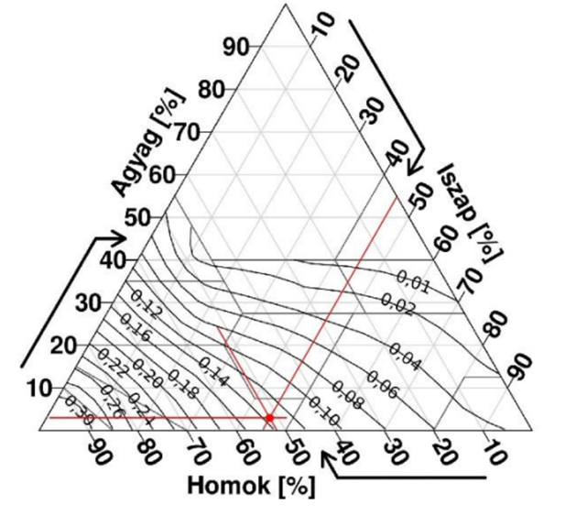
Laboratory tests
Eye distribution analysis: sieving (with shaking machine): soil particles larger than 0,063 mm
Hydrometry: soil particles smaller than 0,063 mm
Use: Sy (rapidly draining gravity pore space) to determine the Loheide diagram (Loheide 2005), Meyboom correction (Meyboom 1965)

Slide 15
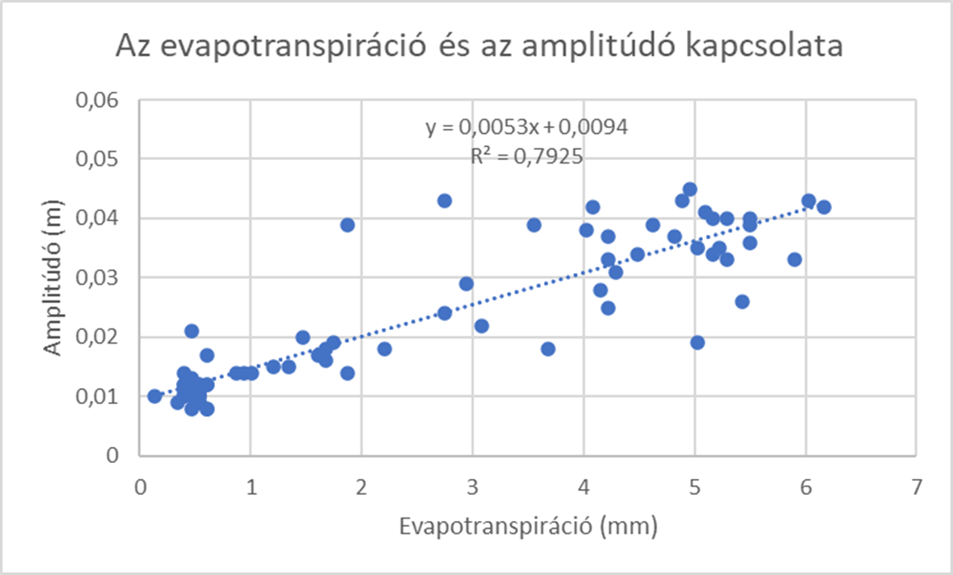
Relationship between evapotranspiration and amplitude
Close relationship between evapotranspiration and amplitude
Correlation: 0,9

Slide 16
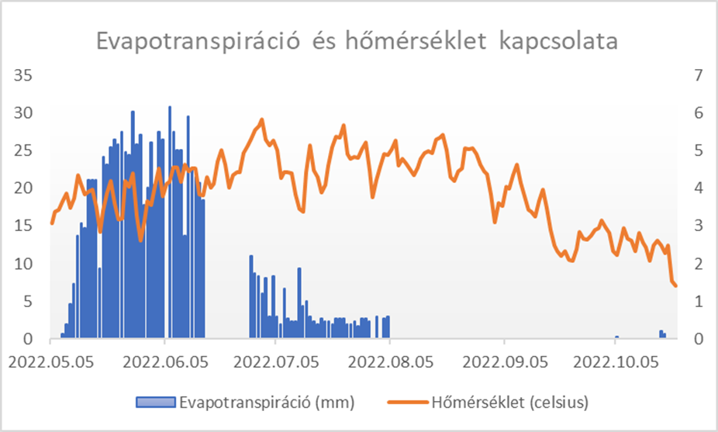
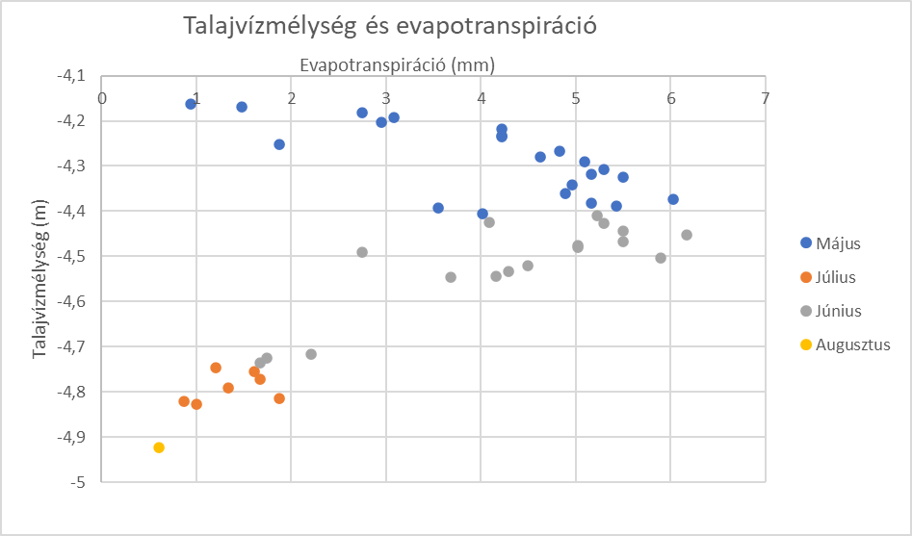
The ET
The processes mentioned for amplitude can also be observed here, but there is no strong relationship between temperature and ET

Slide 17
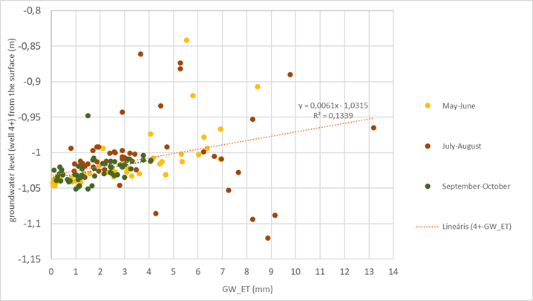
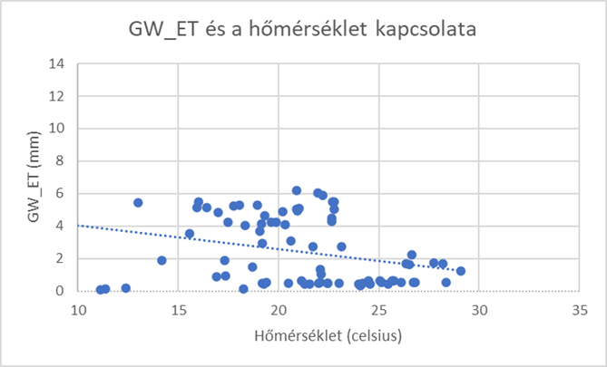
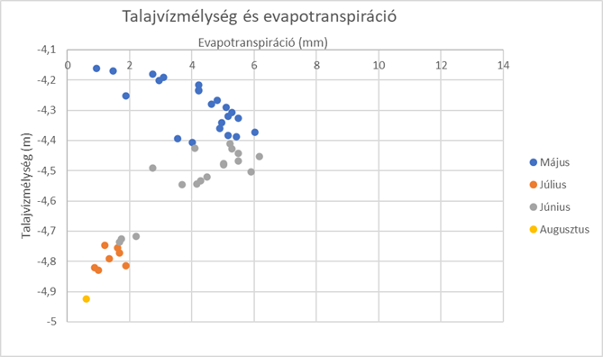
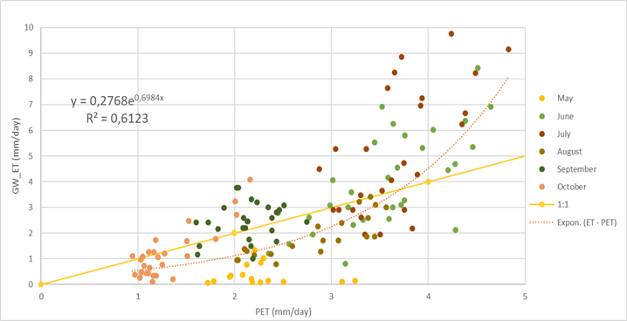
Comparison with alder data in the Hidegvíz Valley
Not strictly related to the topic, but it is instructive to compare the groundwater evapotranspiration data of a Siki-oak and an alder with good water supply.

Slide 18
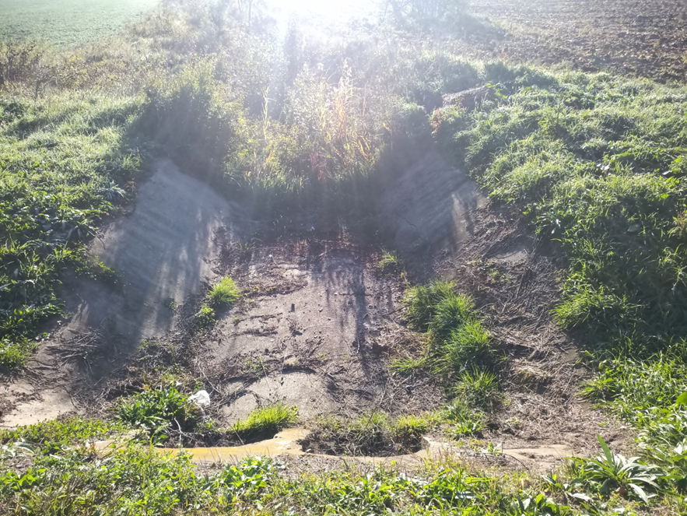
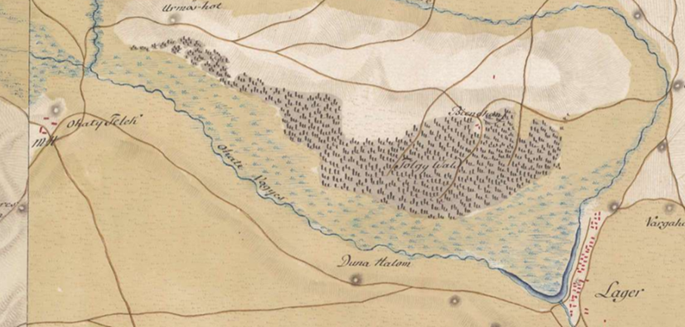
Outlook - how can the situation of oak be improved?
Filling of the Völgyes-ér
In times of flooding and major floods, significant amounts of water could be diverted into the former Völgyes-ér riverbed

Slide 19
www.uni-sopron.hu

