Slide 1
Miocene Depocenters and Sediment Supply in the Roer Valley Rift System of the southern Netherlands
Alexandra Siebels^{1,2}, Johan ten Veen², Dirk MUNSTERMAN², Jef Deckers³, Cornelis Kasse¹, Ronald van Balen^{1,2}
¹Vrije Universiteit Amsterdam, ²TNO (Geological Survey of the Netherlands), ³VITO (Flemish Institute for Technological Research)
Link to abstract

Slide 2
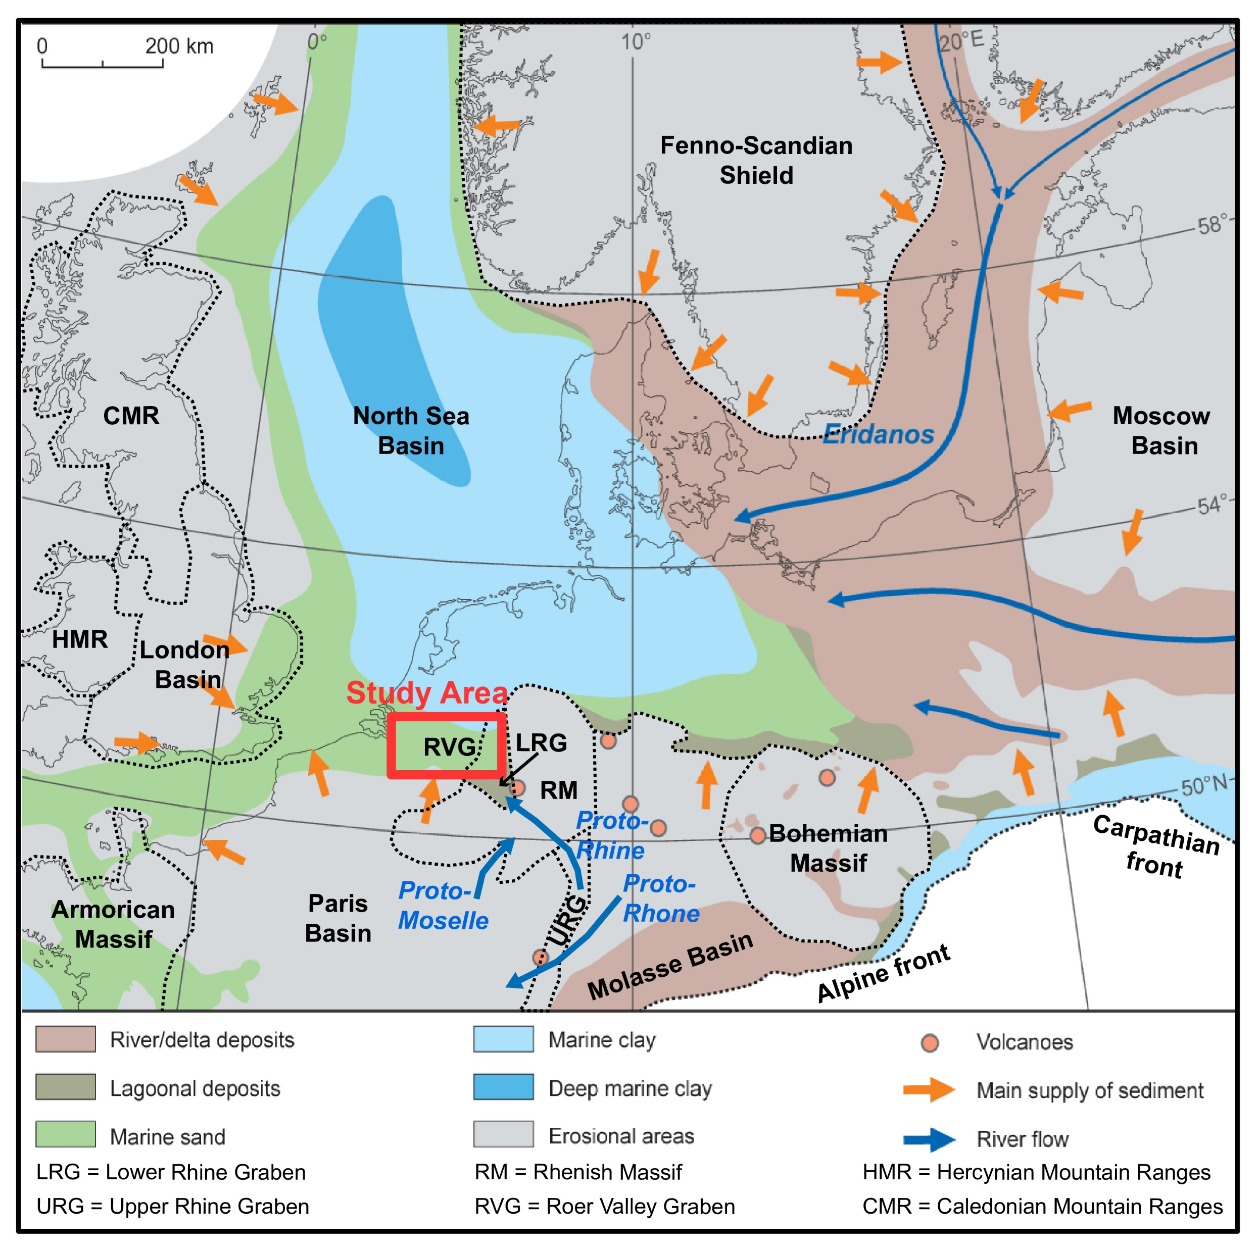
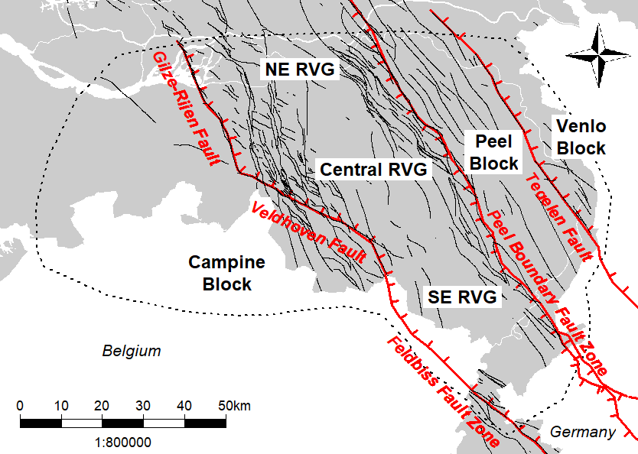
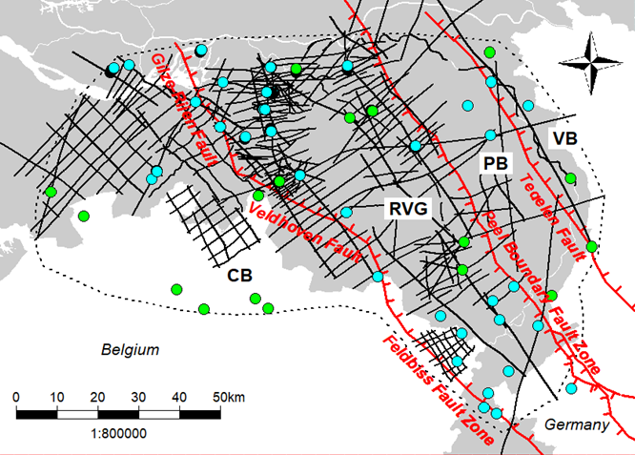
Introduction Roer Valley Rift System
Miocene Paleogeography
Tectonic Setting
Dataset
Fennoscandian
Shield
Relatively warm climate
Mainly marine environment
Proto-Rhine and Eridanos
Extension during the Miocene
Half-graben geometry along the Peel Boundary Fault Zone
310x 2-D seismic lines
52x wells
18x dinocyst palynology records
Link to abstract

Slide 3
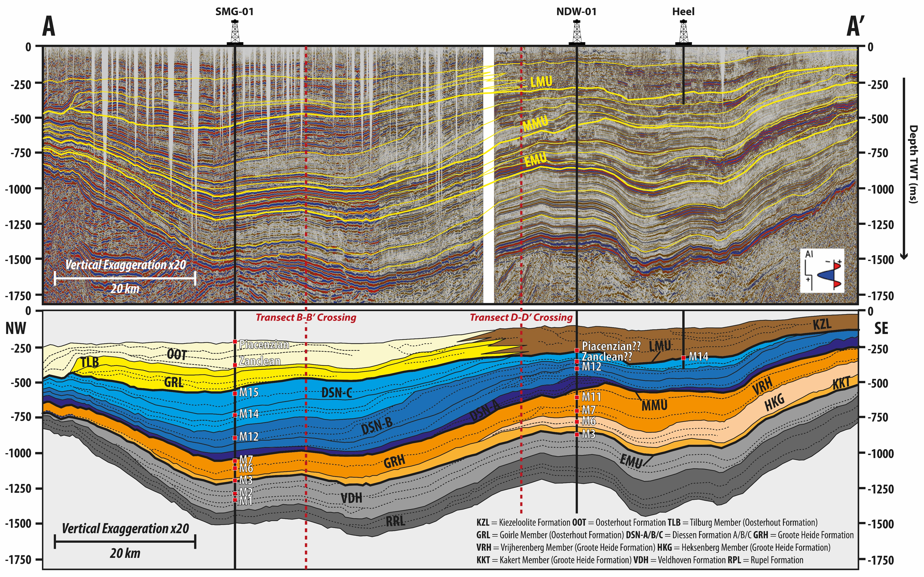
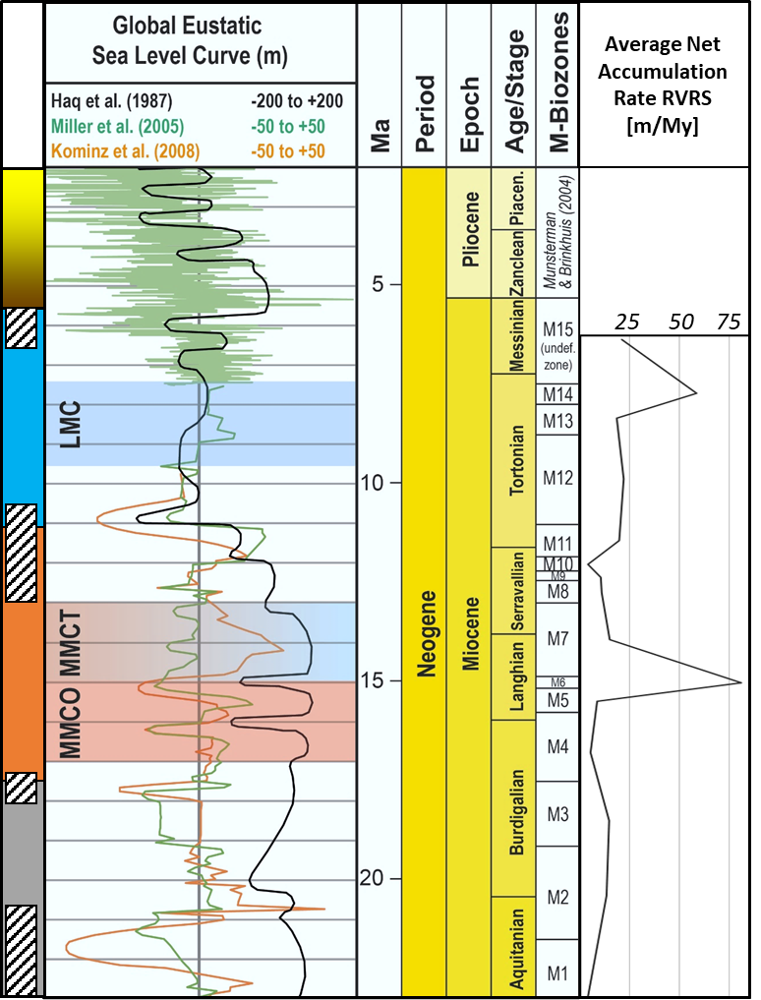
Miocene Sediment Distribution Mechanisms
Differentiating between
Eustacy, Tectonics and Sediment Supply
Detailed seismic interpretations using well logs and palynological analyses
Link to abstract

Slide 4
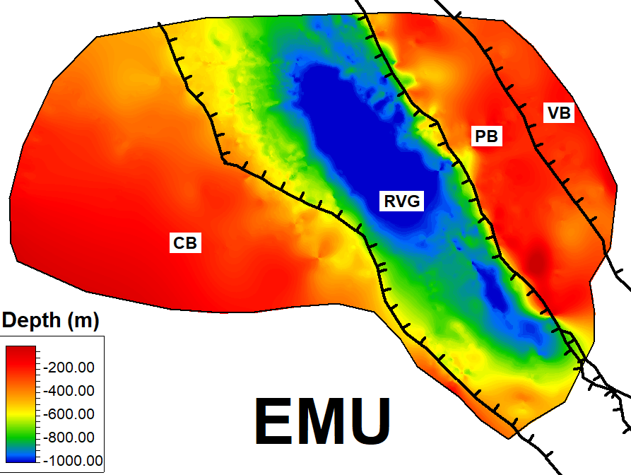
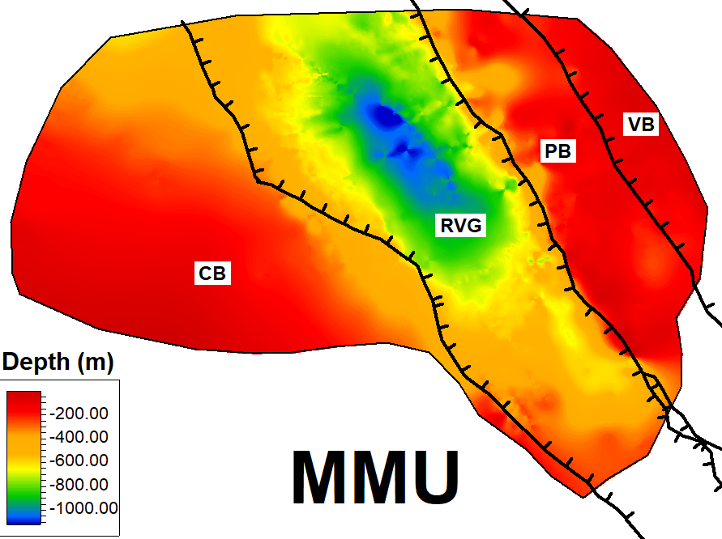
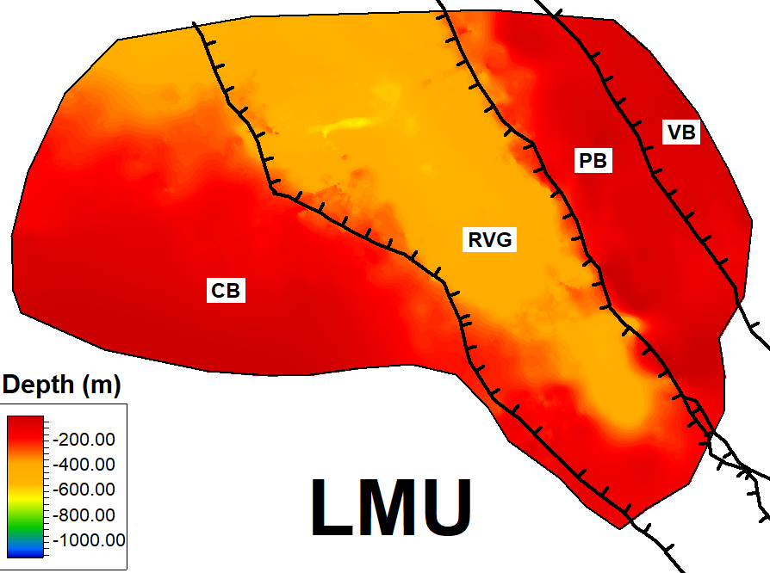
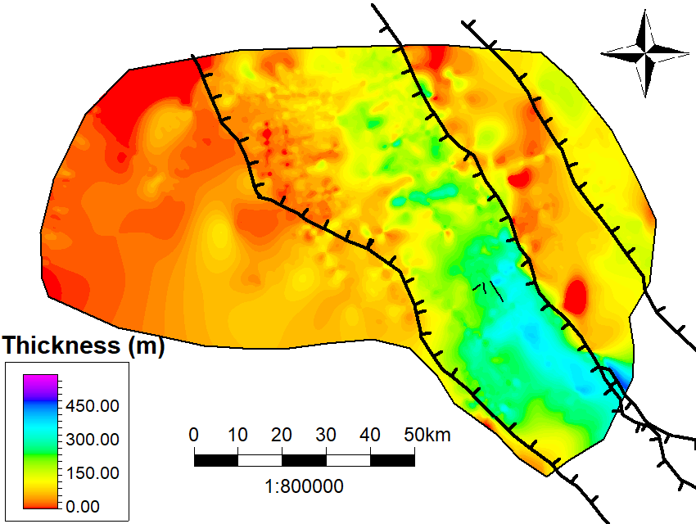
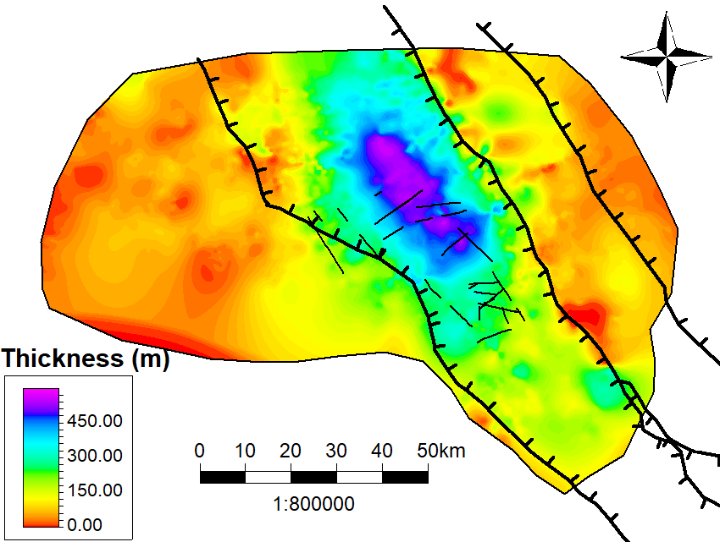
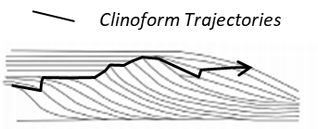
Miocene Depocenters Roer Valley Rift System
Unconformities
E. - M. Miocene Depocenter
Late Miocene Depocenter
Thickness Maps
NW
Shift
Link to abstract

Slide 5
Outlook: Miocene of the RVRS
Chronostratigraphic framework → Seismics, well logs and dinocyst palynology
Transport mechanisms and permeability → End-member modelling on grain sizes
Depositional age and reworking factor → Rb/Sr dating on glauconite and REE analysis
Sediment provenance → Ar39/Ar40 dating on muscovite and HMA
Forward stratigraphic modelling → DionisosFlow
Link to abstract

