Slide 1
A Climate Data Record of Global Sea-Ice Drift from the EUMETSAT OSI SAF
Emily Down, Thomas Lavergne
MET Norway

Slide 2
OSI SAF Sea-Ice Drift CDR Summary
Sea ice moves up to 10s of km per day, pushed by winds and currents
Transports ice to lower latitudes where it melts, redistributing fresh water
Motion of sea-ice can lead to aging and thickening of the ice pack in certain areas
Climate change is resulting in faster sea-ice drift
ID | OSI-455 (CDR)
Spatial coverage | Global (a NH and a SH product file)
Temporal coverage | Jan 1991 - Dec 2020
Product resolution | EASE2 75 x 75 km (~120 km “true” resolution)
Drift period | ~ 24 h (actual drift period of each vector)
Product dependency | Year-round, but reduced accuracy during summer months
Method | Continuous Maximum Cross Correlation (Lavergne et al., 2010) & free-drift model
Input data | Daily average maps of : SSM/I (>= F10) and SSMIS (CMSAF FCDR) AMSR-E (NSIDC) AMSR2 (JAXA) ECMWF/C3S ERA5 10m winds
Sea ice drift is an Essential Climate Variable (ECV) product for the Global Climate Observing System (GCOS)

Slide 3
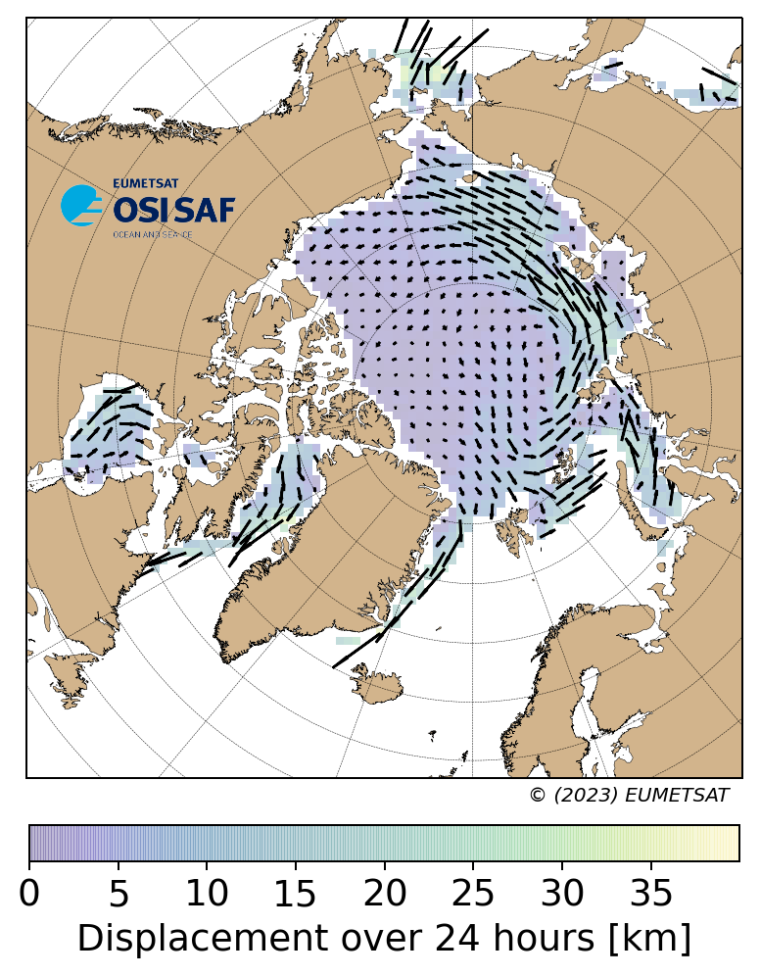
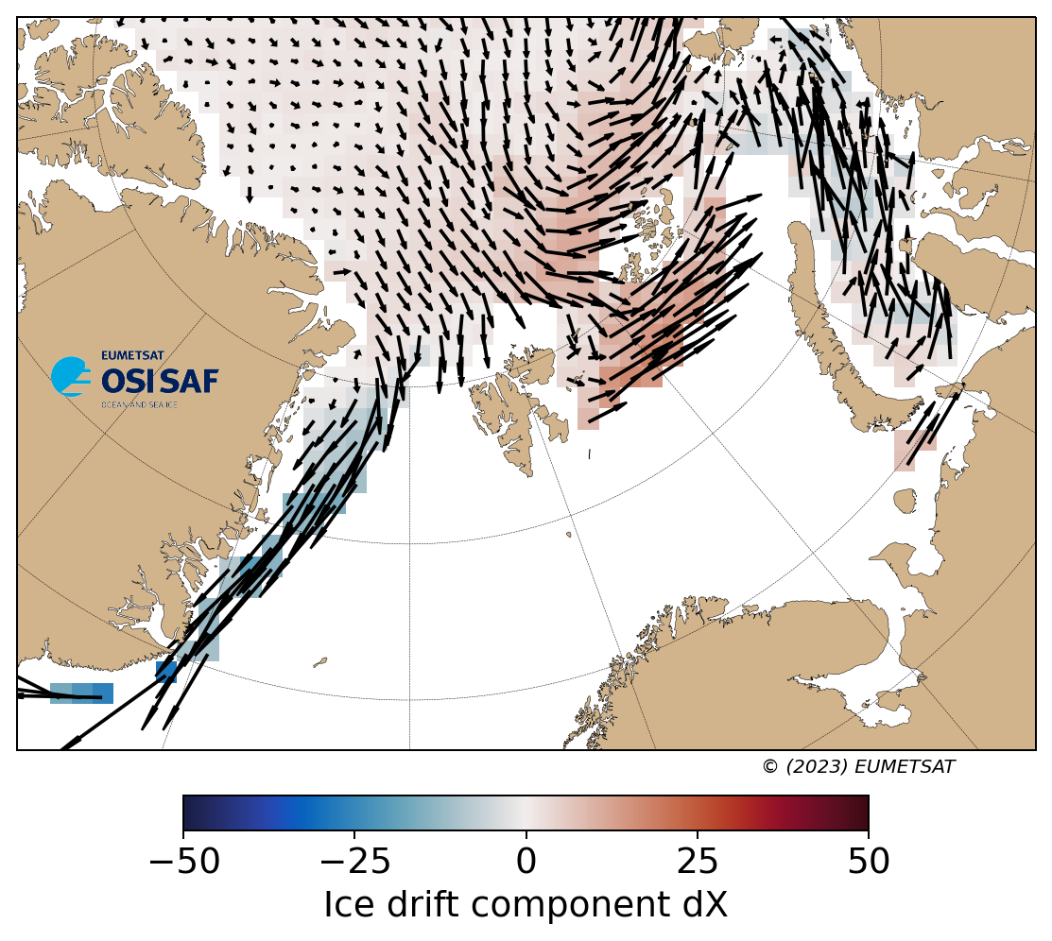
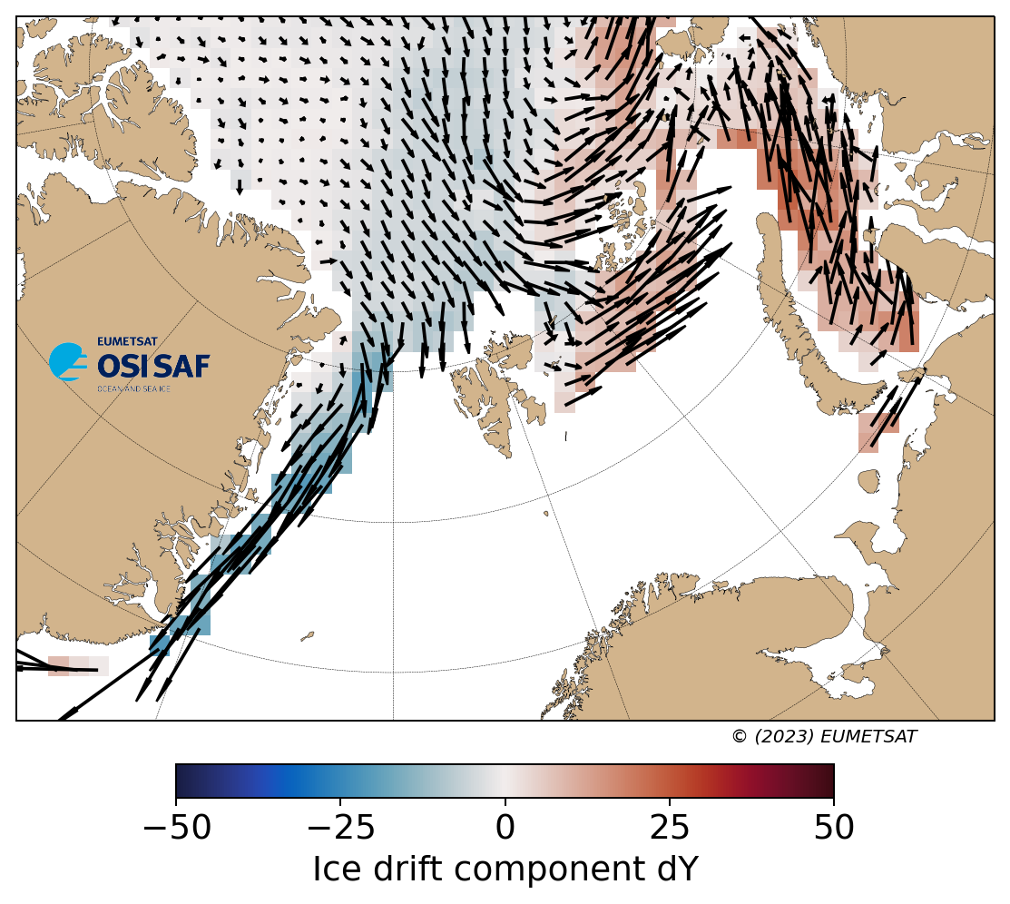
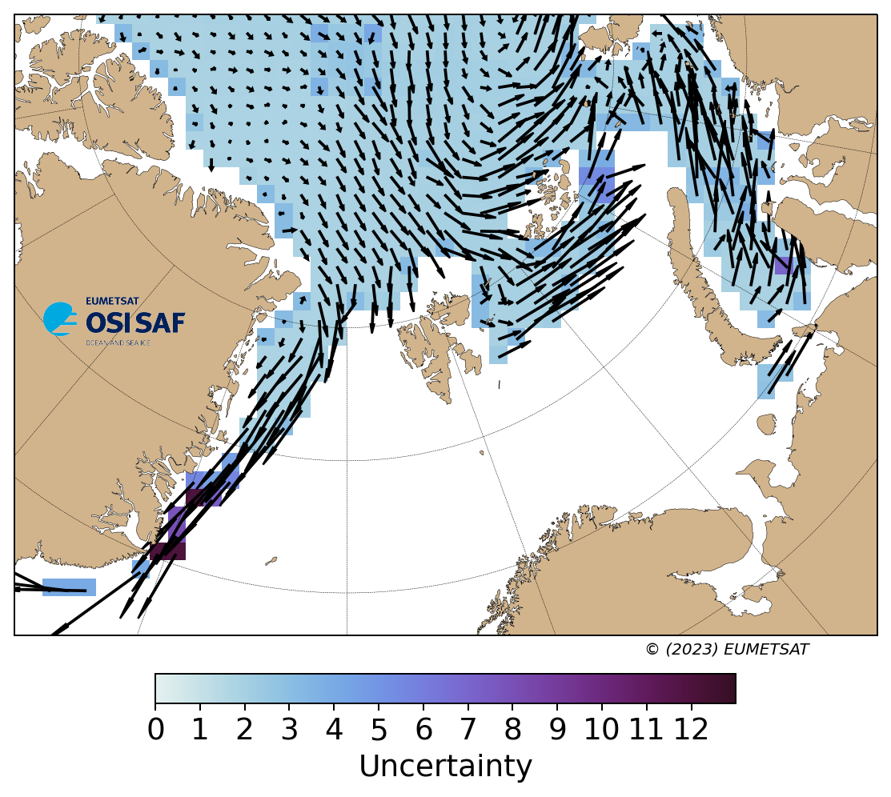
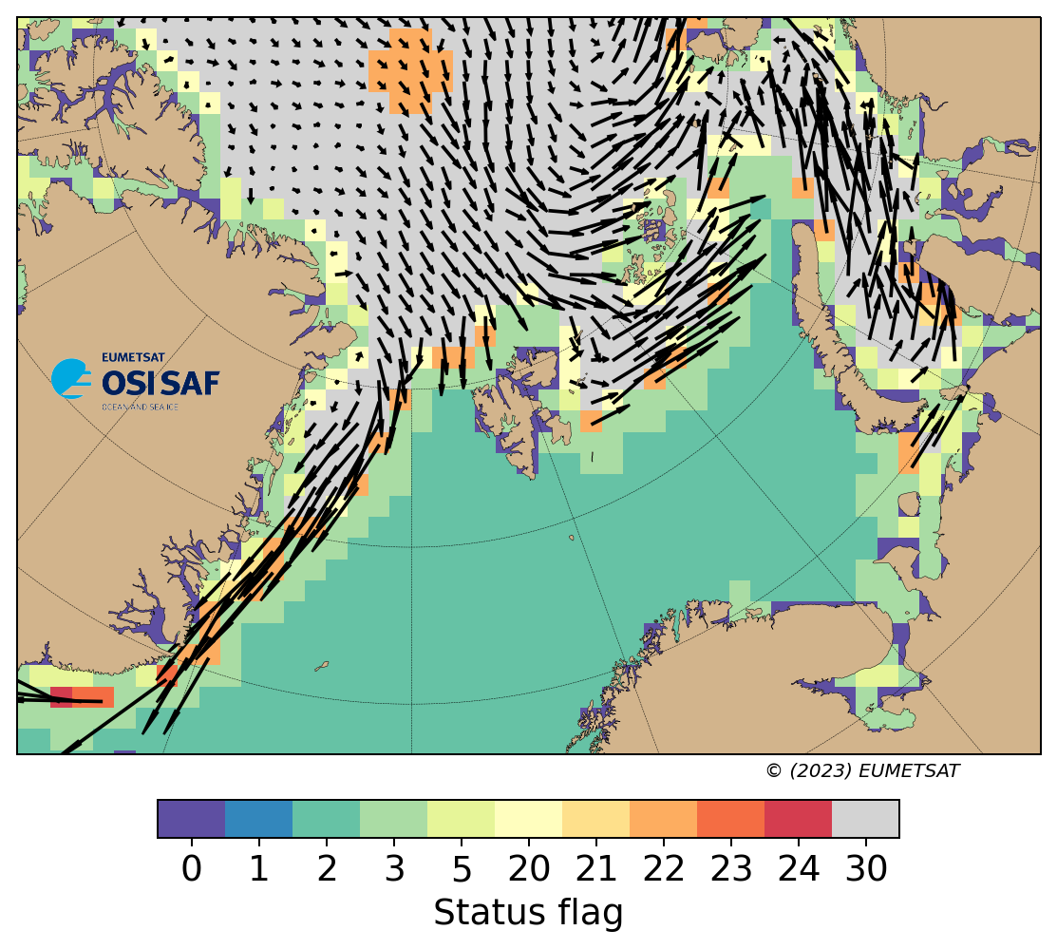
Example: NH 16-17 January 2010

Slide 4
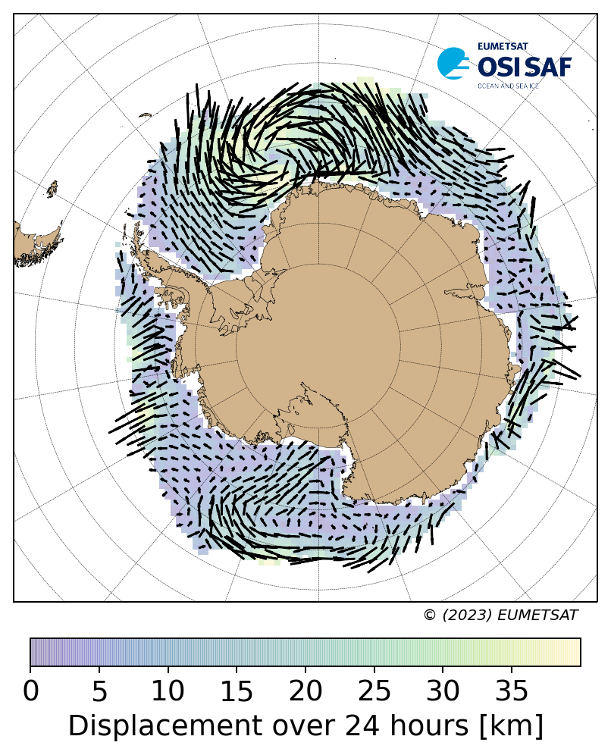
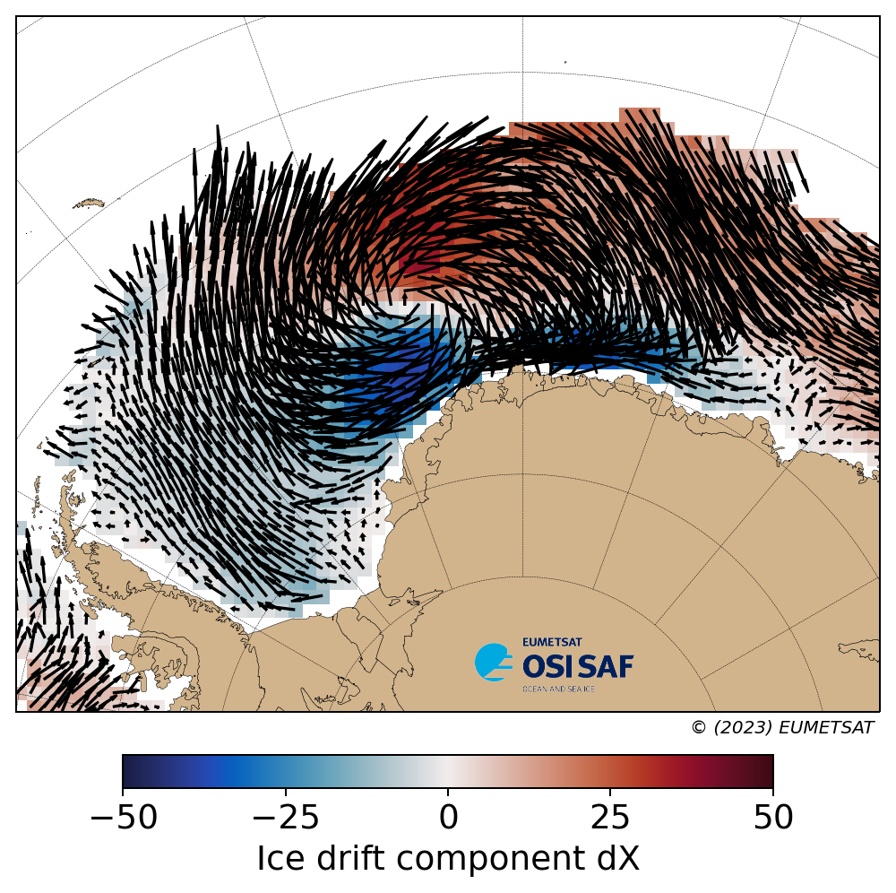
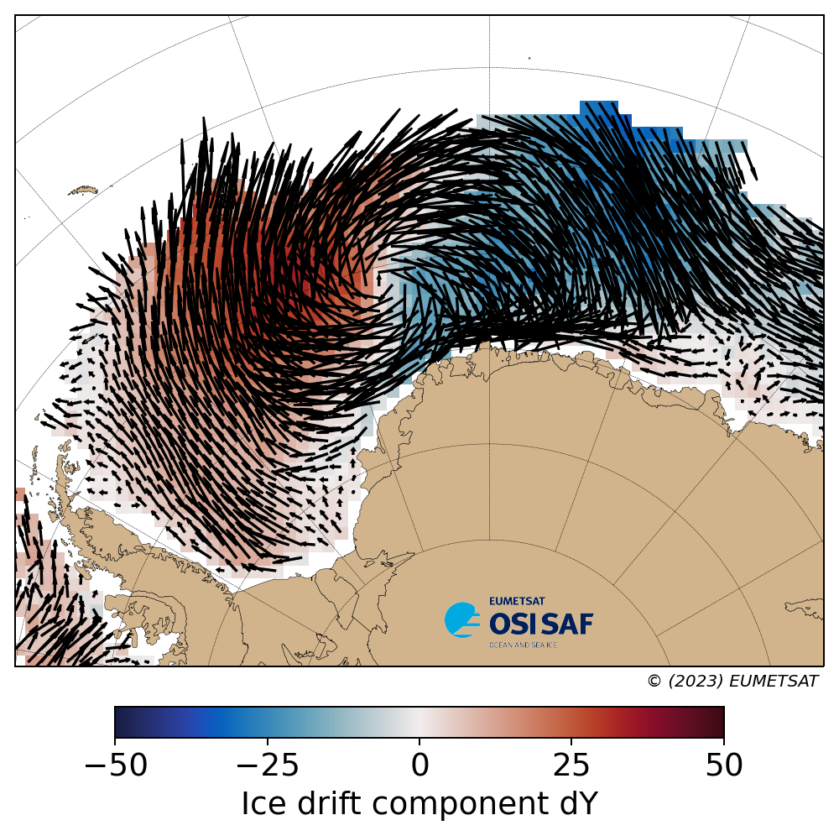
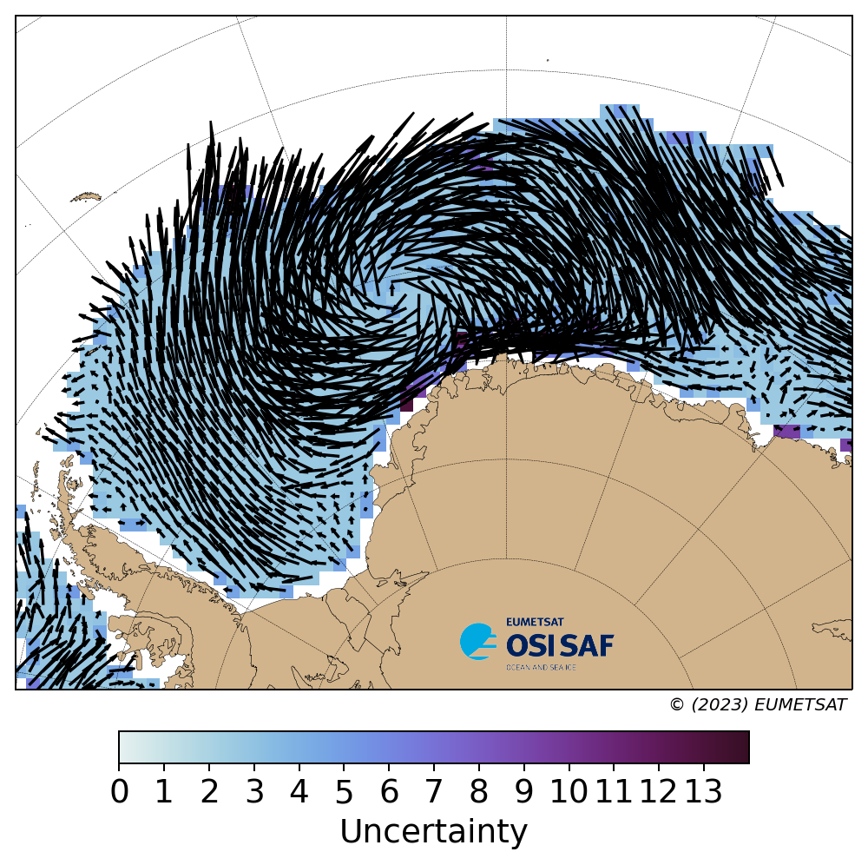
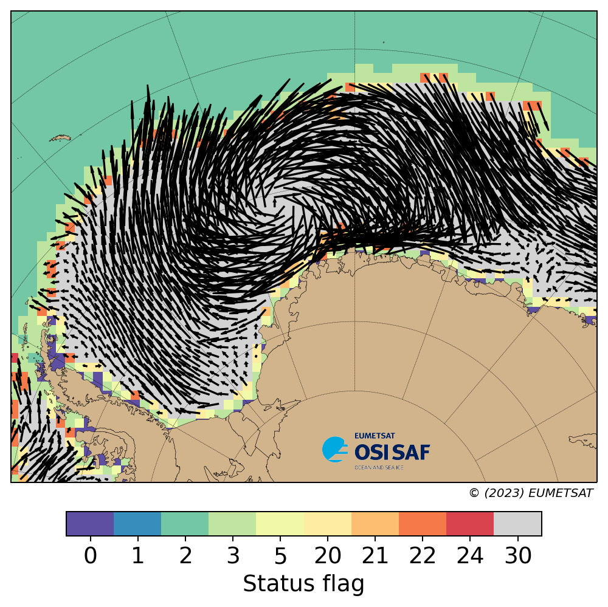
Example: SH 13-14 August 2010

Slide 5
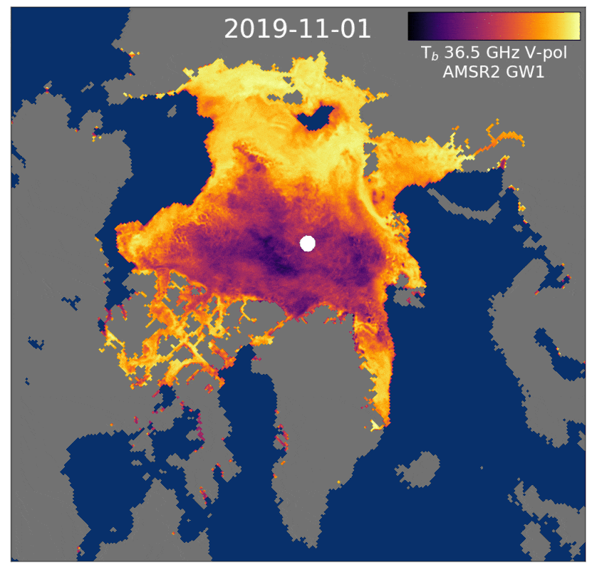
Motion tracking methodology
Passive microwave satellite data offers great coverage and consistency, and captures the movement of the sea ice
Daily average maps of satellite signal:
SSM/I, SSMIS - near 90GHz
AMSR-E, AMSR2 - 37GHz
Laplacian filter applied to enhance the features in the images
Continuous Maximum Cross-Correlation (Lavergne et al. 2010) to pattern match the ice features in a consecutive pair of images - fractional pixel solution
Correction of erroneous vectors using neighbouring vectors
Image credit: Thomas Lavergne

Slide 6
Summer gap-filling: Ice drift from winds
In the summer, the CMCC algorithm is less reliable due to meltwater and increased atmospheric water content
Hence, we gap-fill temporally with ice drift from a free drift model
ERA5 wind reanalysis as input
AMSR-E and AMSR2 37GHz ice drift vectors used as training data
Inverse wind model computes per-month parameter fields
Parameter fields and ERA5 wind used to calculate summer drift in the forward model
Notes:
Wind forcing transfer coefficient
Turning angle
x- and y-components of geostrophic currents

Slide 7
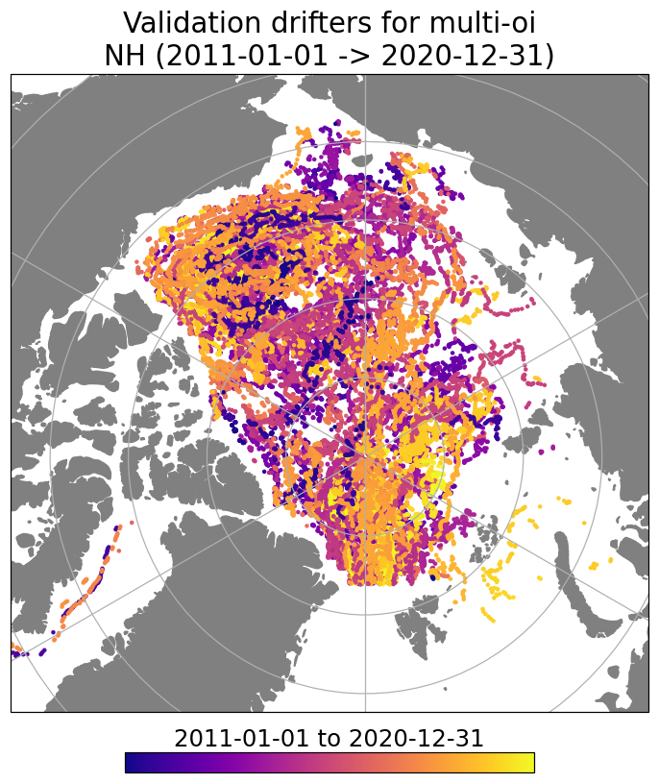
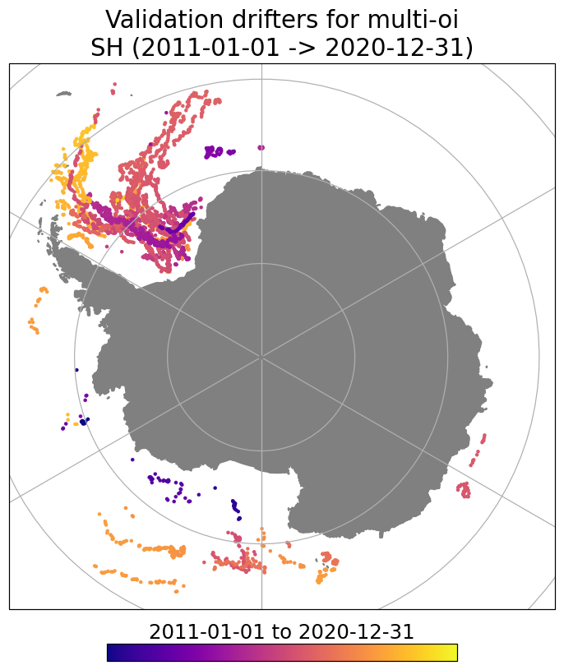
Validation, Uncertainties and Merging
Validation against on-ice drifters
Merging
On-ice buoy coverage is limited
Sparse coverage in Southern Hemisphere
Vectors collocated in time and position
dX, dY values are compared between buoy and product to retrieve RMSE errors and bias
Selection of which data contribute to the final product
Optimal merging based on uncertainties
Interpolation for spatial gap-filling
In transition seasons, satellite drift is blended with wind drift
On-ice buoy coverage for 10-year period 2011-2020

Slide 8
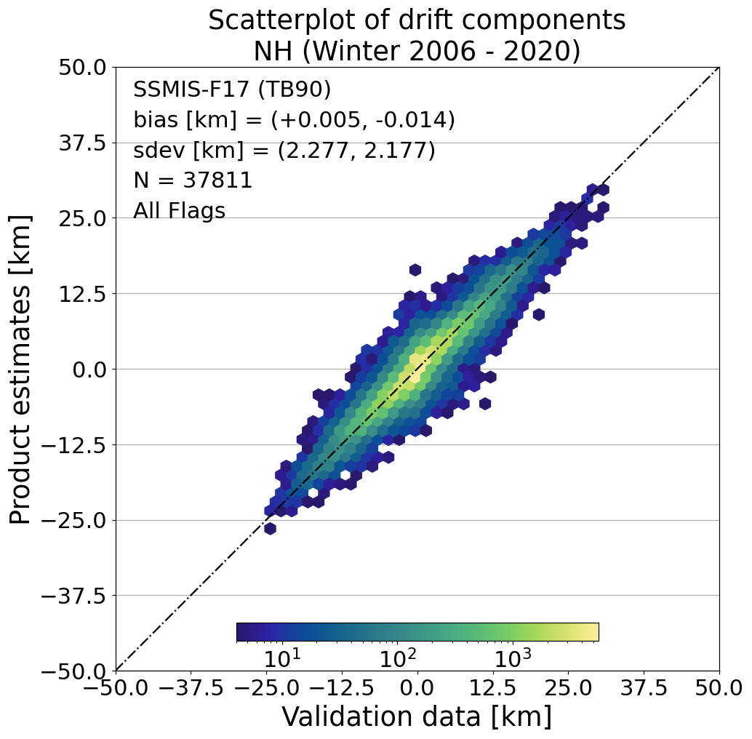
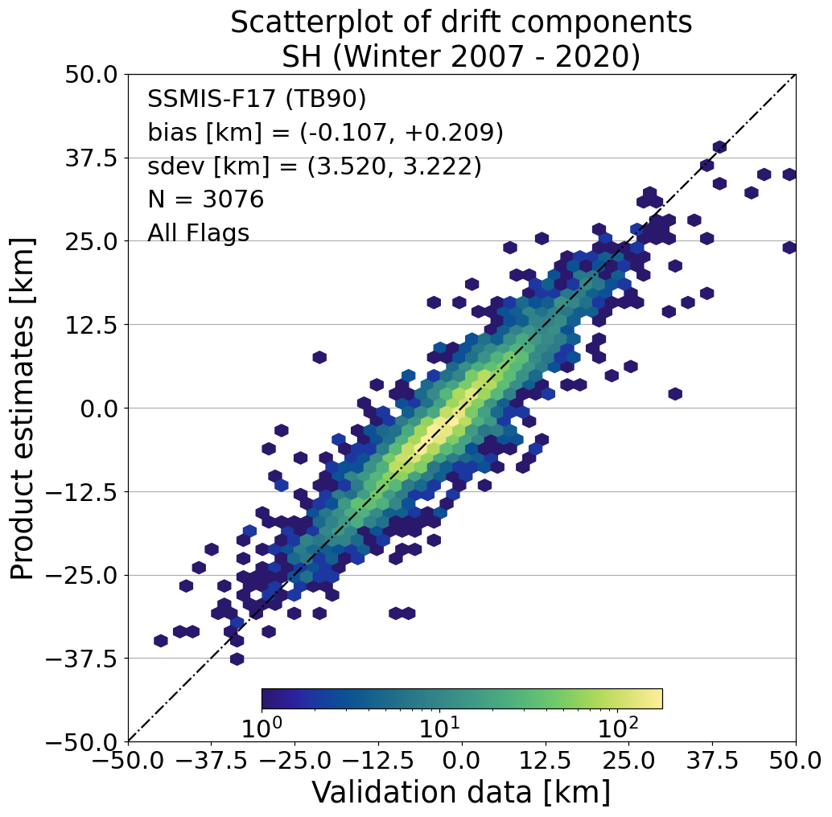
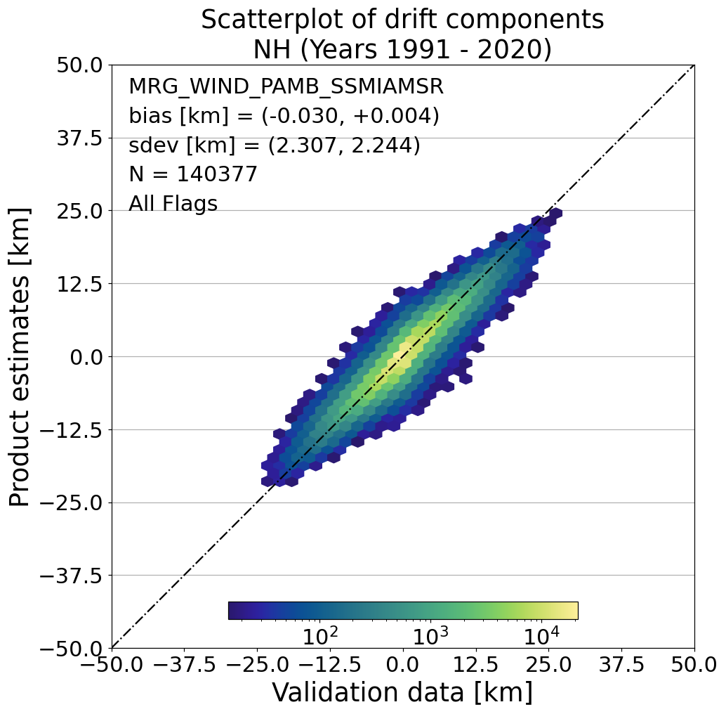
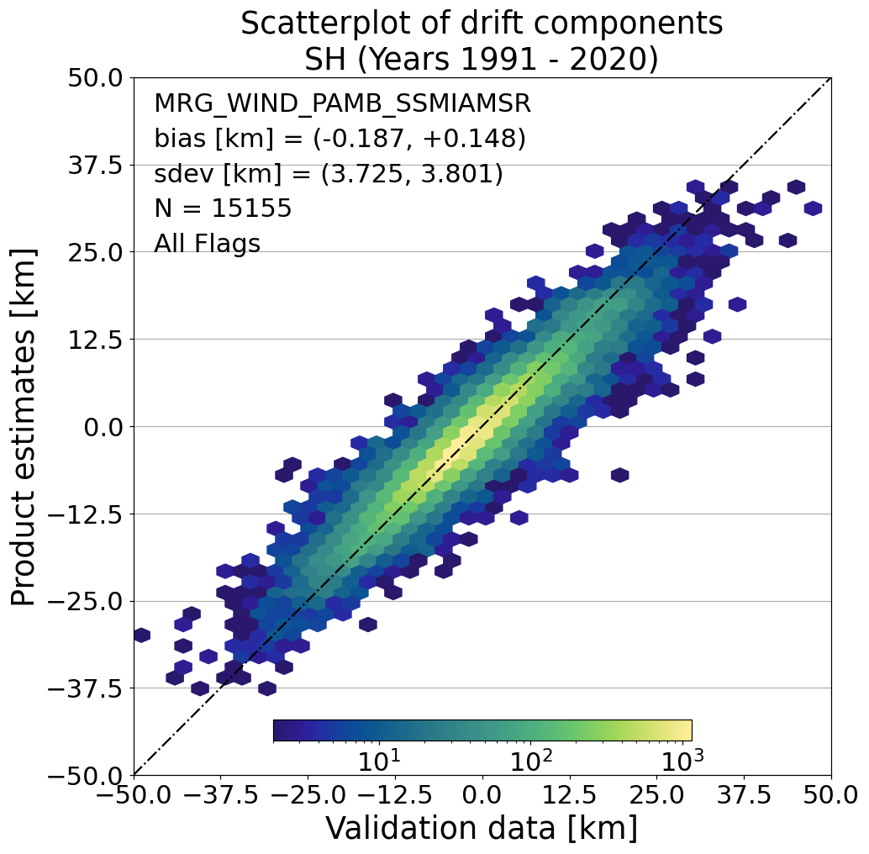
Validation results
Excellent agreement between drift products and buoy trajectories
Multi-sensor RMSE exceeds target requirement of 5km for all seasons and both hemispheres (approaches optimal requirement of 2km in NH winter)
NH bias close to zero
SH has small bias where product has lower drift than buoys:
Far fewer buoys in SH
More dynamic ice conditions
SSMIS-F17
NH
SH
PRODUCT
MULTI-SENSOR
NH
SH
BUOY

Slide 9
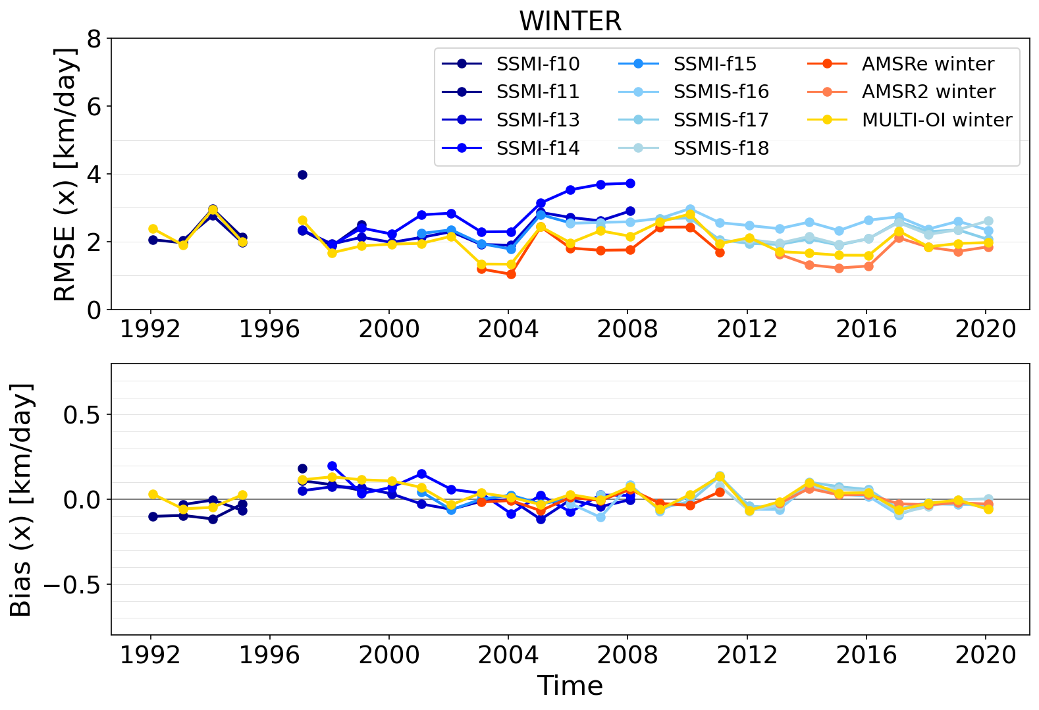
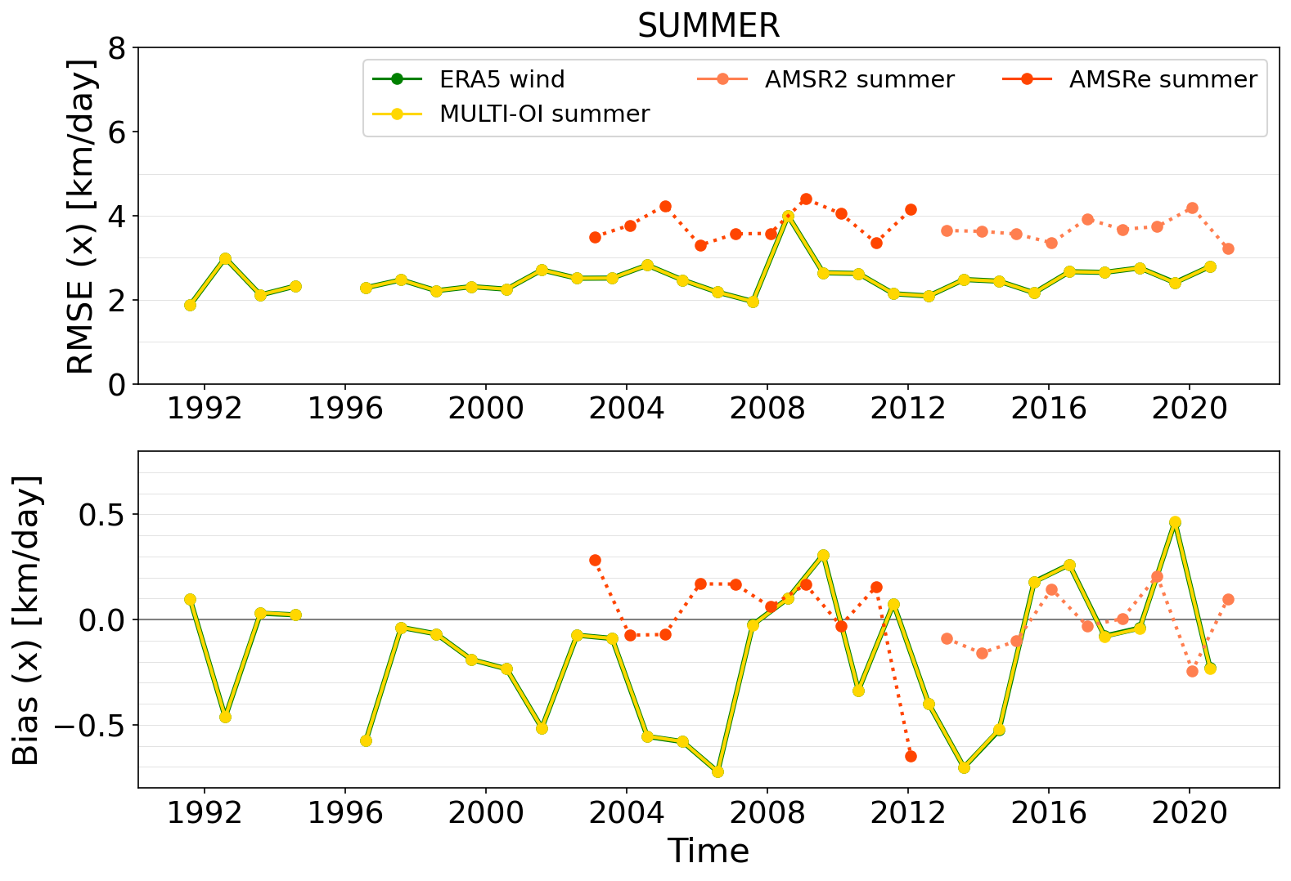
Validation Timeseries (NH)
Winter bias close to zero over the 30 years
Summer bias could be affected by using training data from only 2002-2020
Training data has larger RMSE but smaller bias than the wind drift

Slide 10
Future Work
Extension back to earlier passive microwave missions (1978)
Extension to an ICDR
Investigate if finer spatial resolution can be attained
Investigate the bias in the SH drift for the winter period
Improve the tuning of the free drift model for summer ice drift
Improve the uncertainty model
Notes:
Extension back to earlier passive microwave missions (1978)
SMMR Oct 1978 - Aug 1987 37GHz channel with lower spatial resolution
SSM/I F08 Jun 1987 - Dec 1991, but 85GHz channel defective after Apr 1988
Extension to an ICDR
Investigate if finer spatial resolution can be attained
Currently on 75km grid with 100km sub-images used, so slight over-sampling
Can investigate a 2-step process, where the initial coarse drift is refined on a finer grid
Investigate the bias in the SH drift for the winter period
Since SH is highly dynamic, the filter to remove drifts over 25km in 1 day may be too strict
Improve the tuning of the free drift model for summer ice drift
Lose the temporal trends in sea ice by using all AMSR data together
Can try tuning on buoy drift as well as satellite drift
Can look into using ocean current data as an input instead of creating a parameter field
Improve the uncertainty model

Slide 11
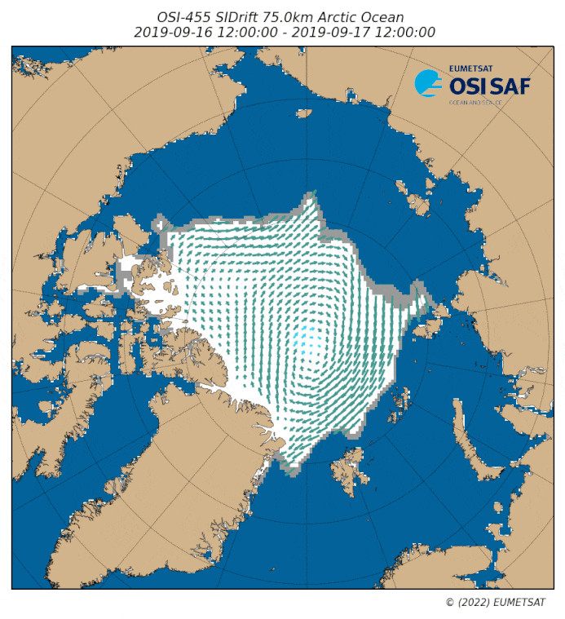
Thank you for your attention
Questions/comments to emilyjd@met.no
Data at
https://osi-saf.eumetsat.int/products/sea-ice-products
Paper preprint
EGU Abstract

