Slide 1
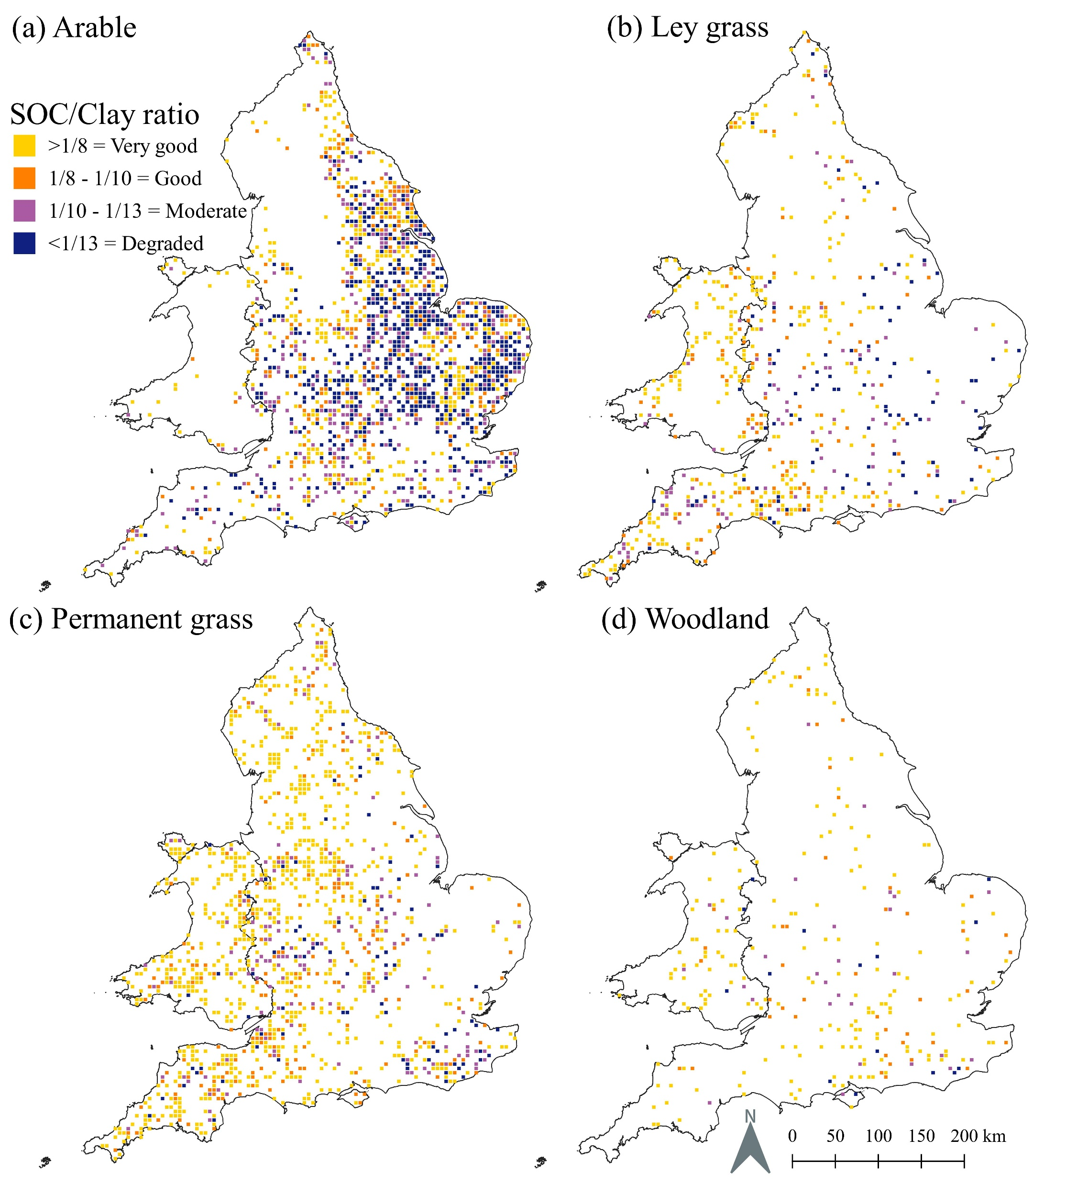
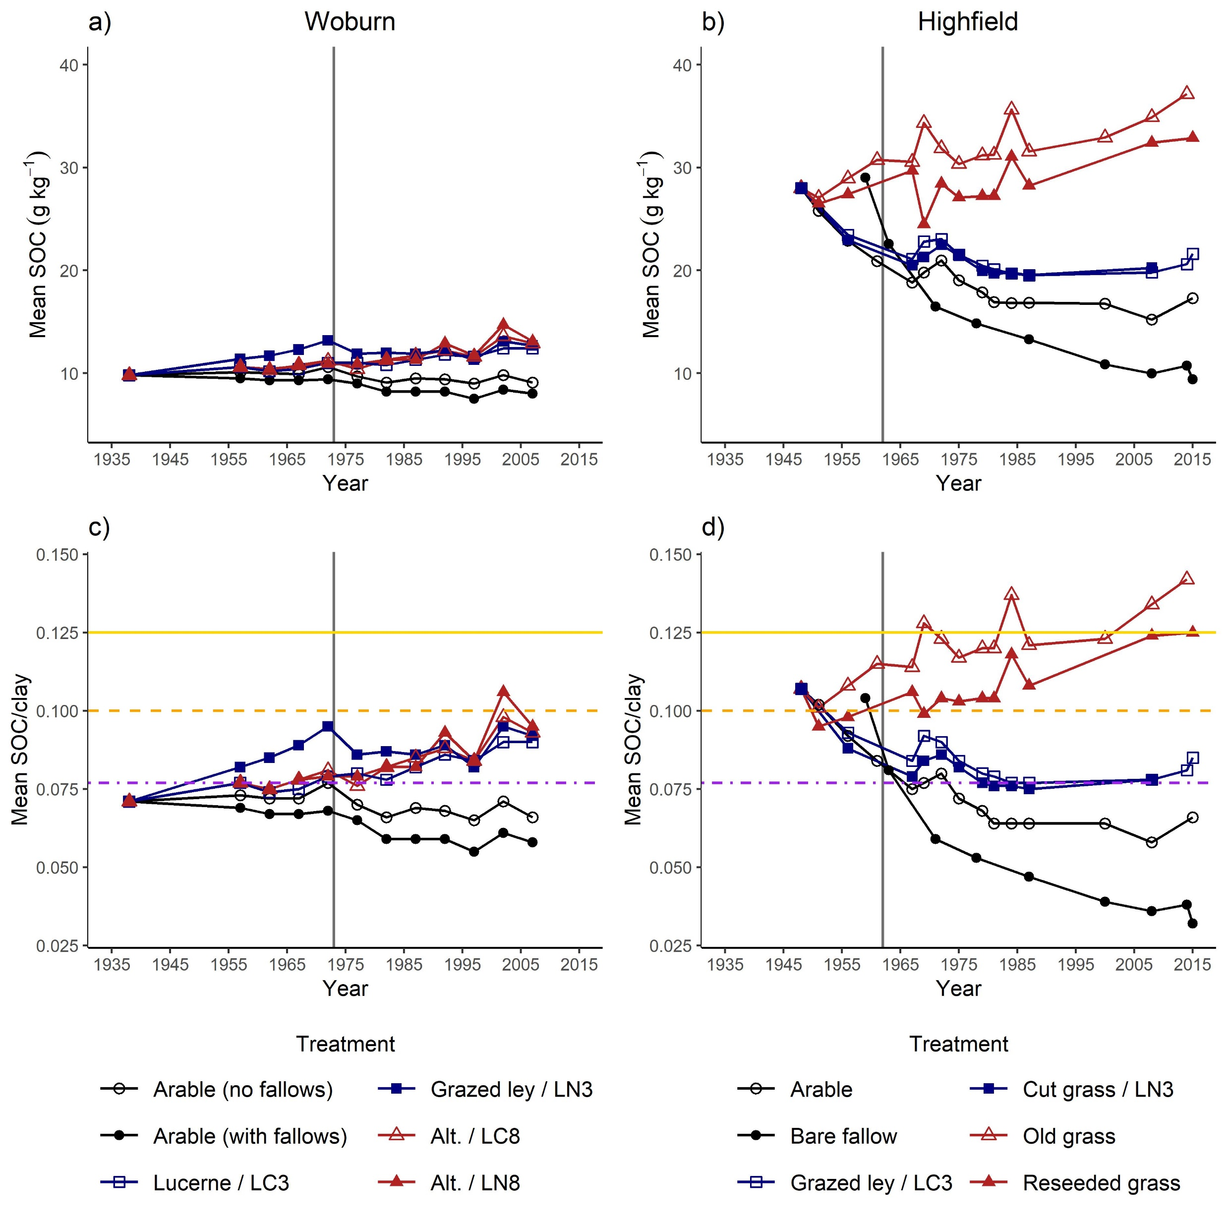
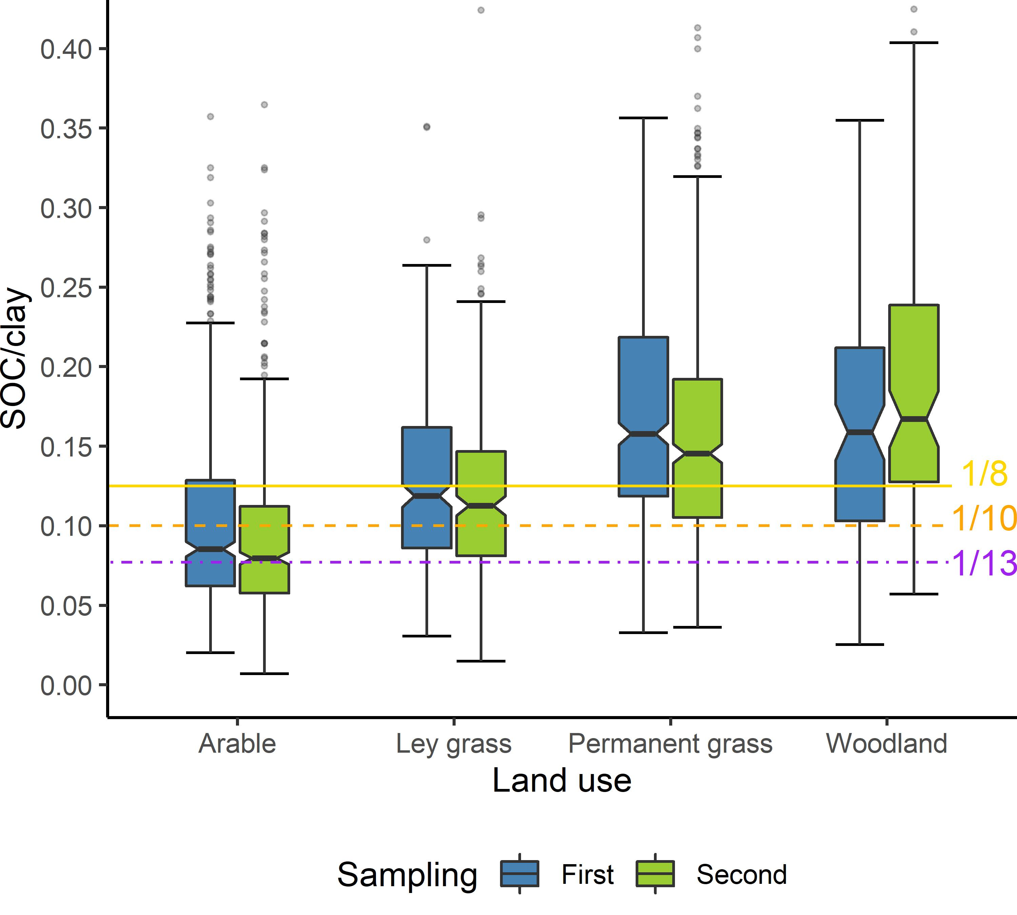
How do you tell if your soil has enough soil organic carbon (SOC)?
An index for assessing soil carbon status
AUTHORS: Jonah Prout, Keith Shepherd, Kirsty Hassall, Guy Kirk, Steve McGrath, Stephan Haefele
First sampling of the National Soil Inventory of England and Wales: 1978 - 1983
SOC/clay targets
Arable | 1/13
Ley | 1/10
Grass | 1/8
Analysis of the National Soil Inventory of England and Wales showed that: 40% of arable soils are likely to be degraded compared with just 5-7% of grassland and woodland soils.
A second sampling of 40% of sites suggested net decreases in SOC/clay for arable and grassland soils.
Normalising for soil texture (clay) can help to better assess soil carbon status across soil types and inform management decisions.
 | % of sites
Land use | Very Good | Degraded
Arable | 28.8 | 38.2
Ley grass | 50.2 | 15.0
Perm. grass | 66.9 | 6.6
Woodland | 67.7 | 5.6
SOC / clay
Long-term experiments
≥ 1/8
Very Good
Historic land use Arable Grass
Clay concentration 13% 28%
$$\text{Index} \text{value}\text{ =}\frac{\text{SOC}}{\text{clay}}$$
≥ 1/10 – 1/8
SOC
Good
≥ 1/13 – 1/10
Moderate
< 1/13
Resampling of the National Soil Inventory
Degraded
1978-1983
1994-2003
Tips for using the index
Applies to topsoils (to 25 cm).
Loss-on-ignition is not accurate enough for monitoring SOC in mineral soils, employ dry combustion methods (with inorganic C subtracted) instead.
Clay concentration need not be measured at every sampling if sampling locations are consistent and areas of soil variation are accounted for.
Consider land use history and sampling locations to help understand index value and changes over time.
Regenerative activities are likely to improve carbon status. The index helps you to track progress and the effects of management, across different soils, better than SOC alone.
SOC/clay
Very good
Good
Grass
Moderate
Ley
Degraded
Arable
Bare
fallow
Decreases in SOC/clay for arable, ley, and permanent grass over time
Corresponding research papers:
Prout, J.M. et al. Eur J Soil Sci. 72, pp.2493 – 2503 (2021). https://doi.org/10.1111/ejss.13012
Prout, J.M. et al. Sci Rep 12, 5162 (2022). https://doi.org/10.1038/s41598-022-09101-3
Mapping derived from soils data
© Cranfield University (NSRI) and for the Controller of HMSO [2022]

