Slide 1
Atmospheric trends of long-lived halocarbons derived from 15 years of IASI/Metop measurements
Hélène De Longueville¹, L. Clarisse¹, S. Whitburn¹, C. Clerbaux^{1,2} and P. Coheur¹
Spectroscopy, Quantum Chemistry and Atmospheric Remote Sensing (SQUARES), Université libre de Bruxelles (ULB), Brussels, Belgium
LATMOS/IPSL, Sorbonne Université, UVSQ, CNRS, Paris, France

Slide 2
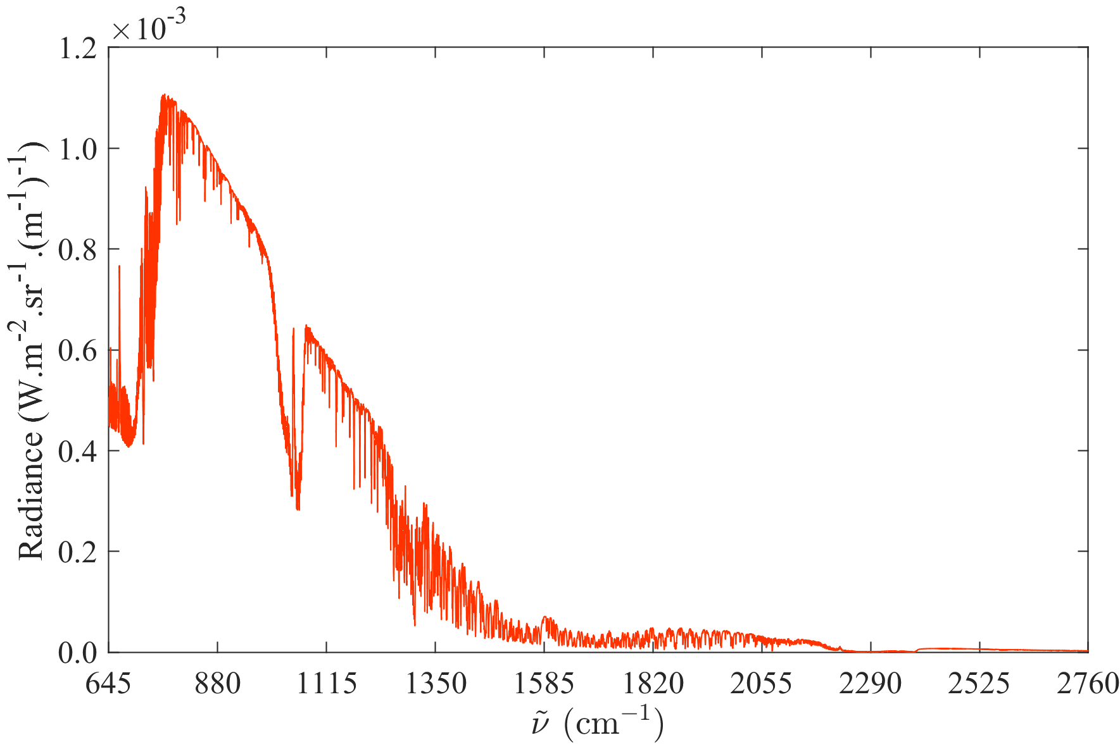
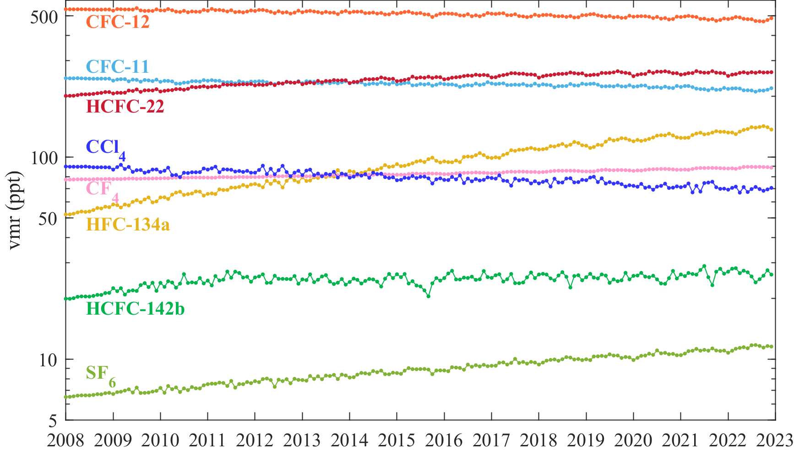
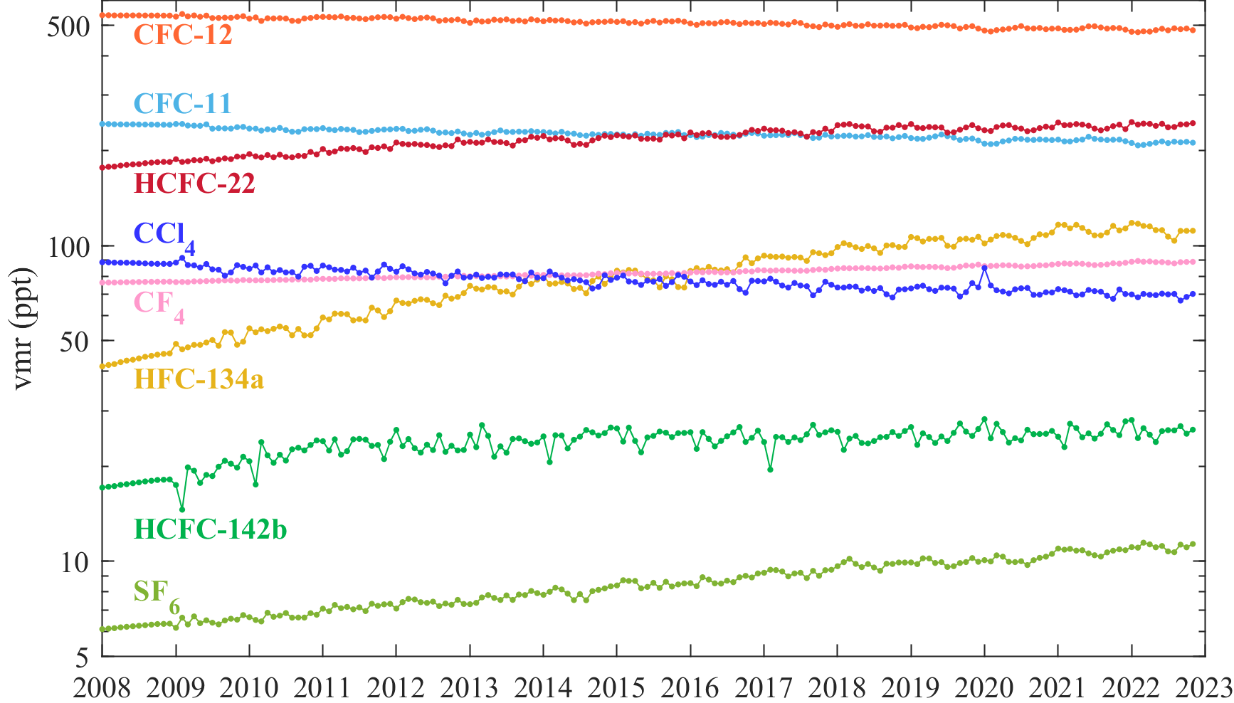
Home page
Instrument
Can nadir-pointing IR satellite sounders contribute to monitoring atmospheric concentrations of halocarbons ?
Click to learn more…
remote sensing
Long-lived
halogenated
gases
$$O_{3}$$
Spectral detection
Time series
Northern midlatitudes
CFCs
HCFCs
HFCs
CCl₄
SF₆
CF₄
Retrieval methodology
generalized least squares estimation
$$\hat{x}=x_{0}+{\left(K^{T}S^{−1}K\right)}^{−1}K^{T}S^{−1}(y−\overline{y})$$
Time series
Southern midlatitudes

Slide 3
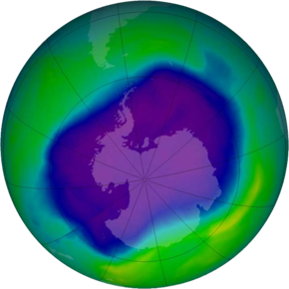
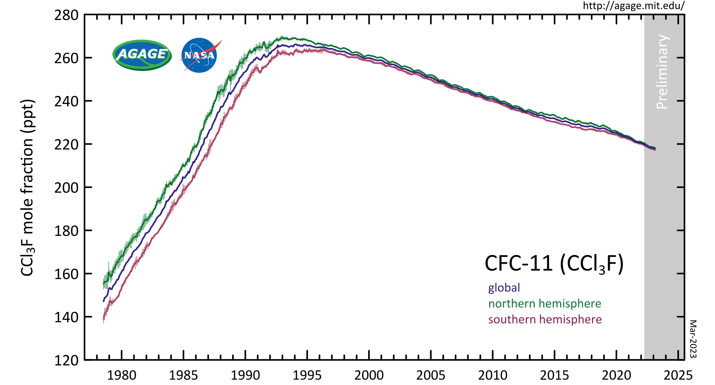
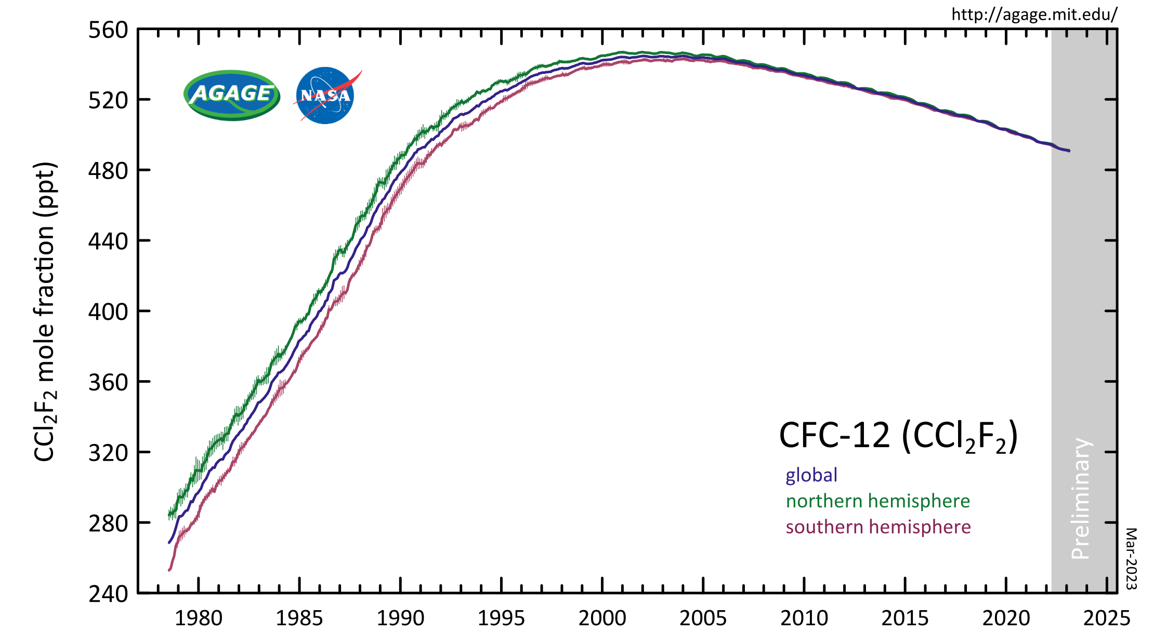
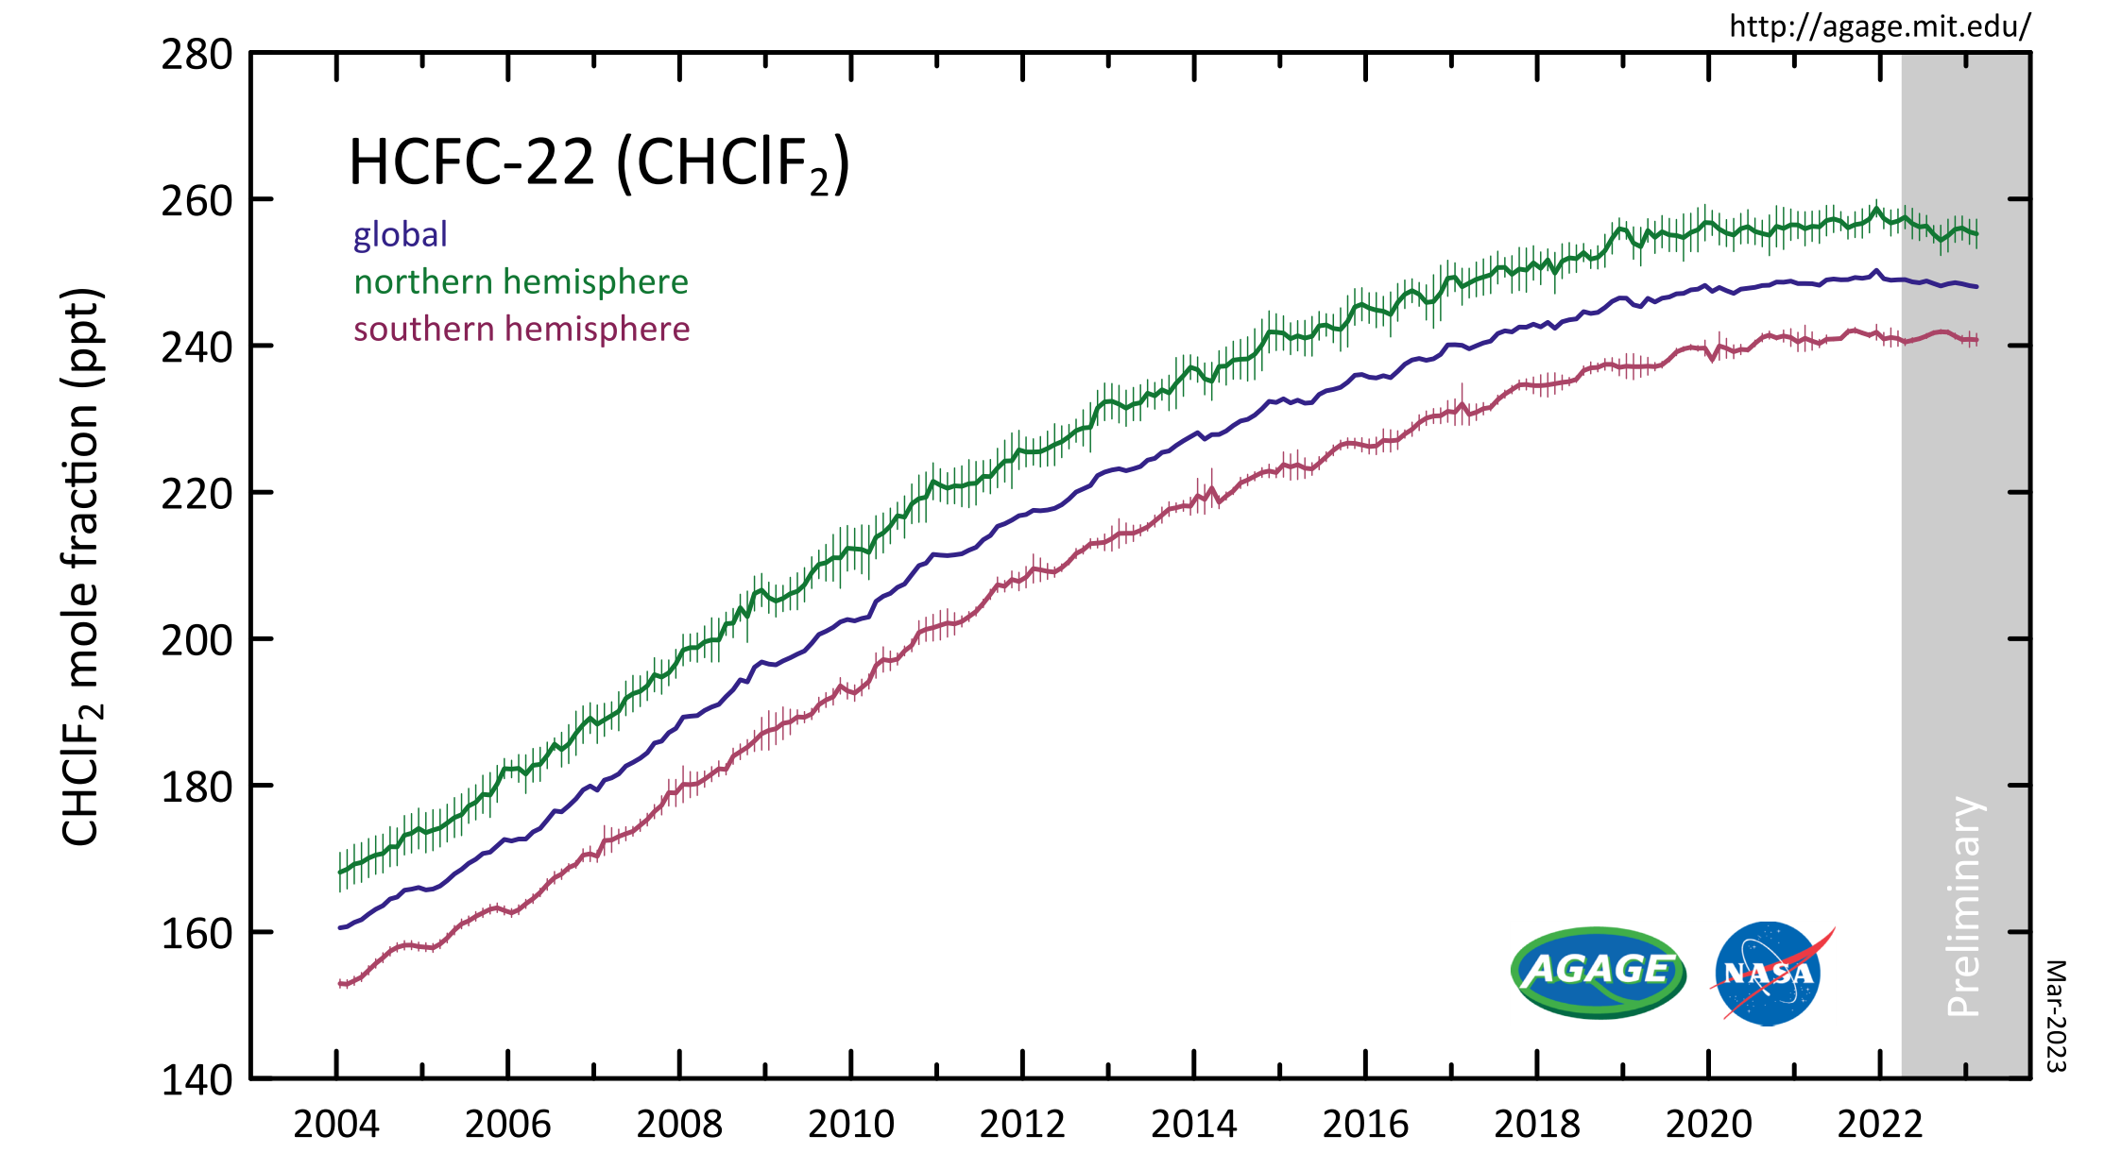
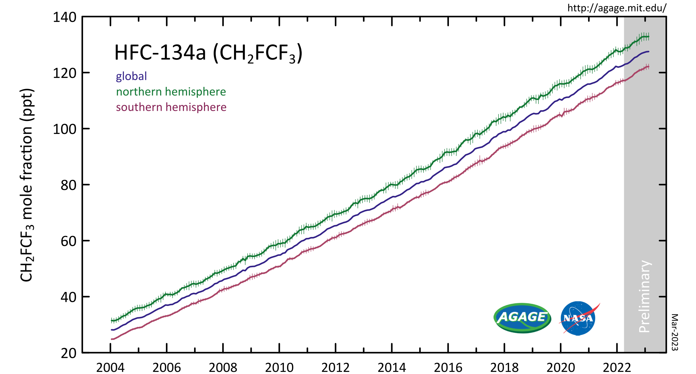
Long-lived halogenated gases
The emissions of chlorofluorocarbons (CFCs) and its substitutes have profoundly affected the chemical and radiative equilibrium of the atmosphere. The CFCs play a key role in the depletion of stratospheric ozone and are, just as their hydrogenated substitutes, powerful greenhouse gases. The emissions of most of these species are presently controlled by international regulations. Following the Montreal protocol and its amendments, the concentrations of the CFCs have started to decline in the early-2000. In parallel, the concentrations of the hydrogenated substitutes have increased. The exploitation of the measurements from the IASI sounder could play a key role in the monitoring of these species and thereby complement existing surface measurement networks.
1930
CFCs = chlorofluorocarbons
e.g. CFC-11 (CFCl₃), CFC-12 (CF₂Cl₂)
1985
Ozone Hole
Montreal Protocol: 1987
CFCs
HCFCs = Hydrochlorofluorocarbons
e.g. HCFC-22 (CHF₂Cl)
1992
HCFCs
HFCs = Hydrofluorocarbons
e.g. HFC-134a (CH₂FCF₃)
Kigali Amendment: 2016
HFCs
Click to go back to home page

Slide 4
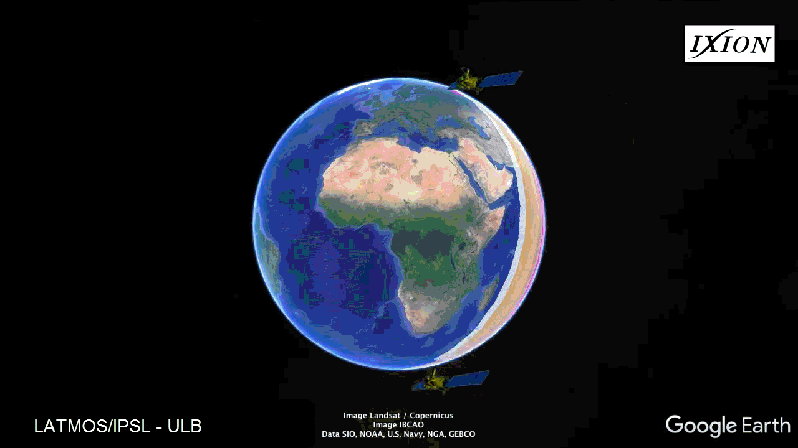
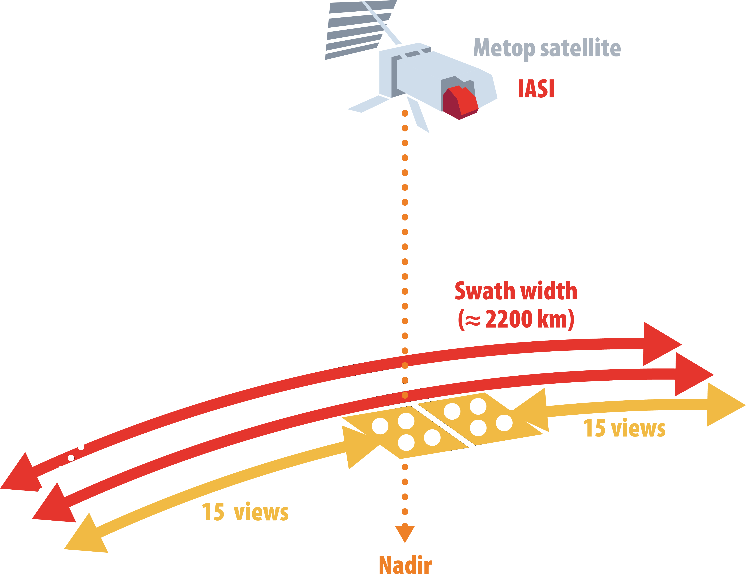
Infrared Atmospheric Sounding Interferometer
© ESA
© ESA
Metop: Polar orbiting satellite
IASI: Thermal IR nadir sounder
The spatial instrument IASI is an operational hyperspectral sounder flying on-board Metop, the European meteorological satellites on polar orbit. It offers quasi-global coverage bi-daily with high horizontal resolution (~12 km at nadir). IASI measures a large continuous part of the thermal infrared (645-2760 cm⁻¹) with high radiometric performances.

Slide 5
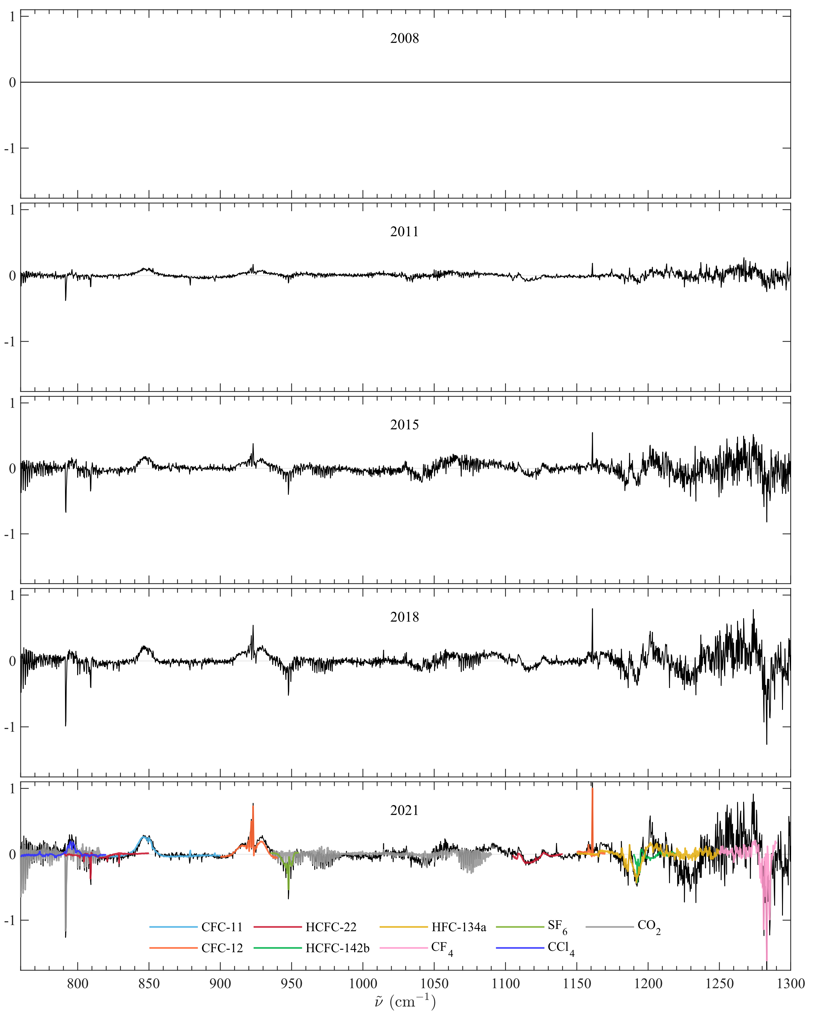
Spectral detection
Long-lived halogenated species have a weak spectral signature in the Earth’s outgoing longwave radiation, which makes their detection in individual spectra challenging. Using a particular type of spectral transformation, called whitening, allows for the identification of eight halogen-containing species in IASI mean spectra, i.e., CFC-11, CFC-12, HCFC-22, HCFC-142b, HFC-134a, CF₄, SF₆ and CCl₄, by remove the largest and most variable spectral features due to e.g., O₃, N₂O, CH₄ and H₂O that are seen in each spectrum.
Whitening a spectrum $y$produces another spectrum $\tilde{y}$in which most of the background signal is removed and all spectral aberrations are exposed. It relies on a dataset of reference spectra from 2008, characterized by a mean spectrum $\overline{y}$ and a covariance matrix $S$.
$$\tilde{y}=S^{− \frac{1}{2}} (y−\overline{y})$$
A positive (negative) whitened signal indicates a decrease (increase) over times.
CFC-11, CFC-12, and CCl₄ are detected with a positive signal, indicating that their atmospheric abundance was smaller in 2021 than in 2008.
HCFC-22, HCFC-142b, HFC-134a, CF₄ and SF₆ are detected with a negative signal, indicating an increase in their atmospheric abundance between 2008 and 2021.
De Longueville et al., 2021. Identification of Short and Long-Lived Atmospheric Trace Gases From IASI Space Observations. GRL 48. doi:10.1029/2020gl091742
N₂O
H₂O
CO₂
whitening
CO₂
H₂O
O₃
CH₄

Slide 6
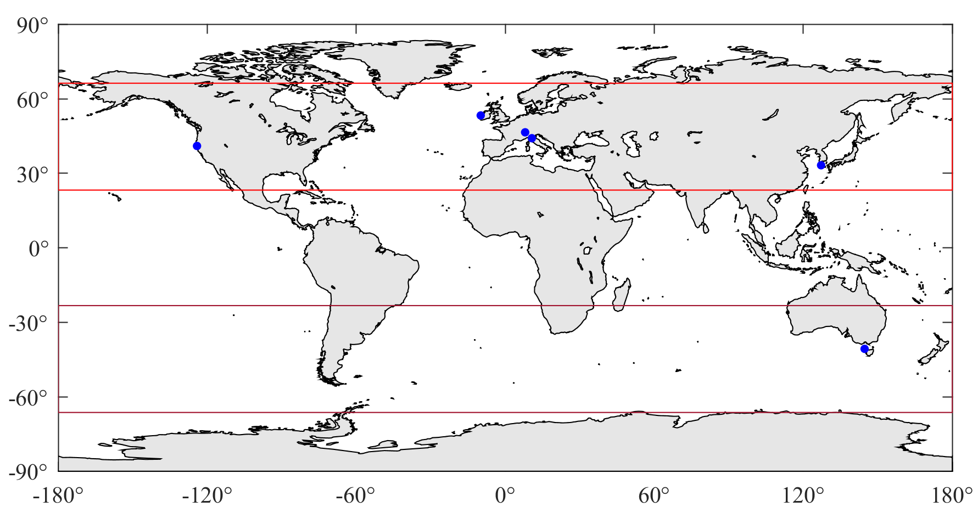
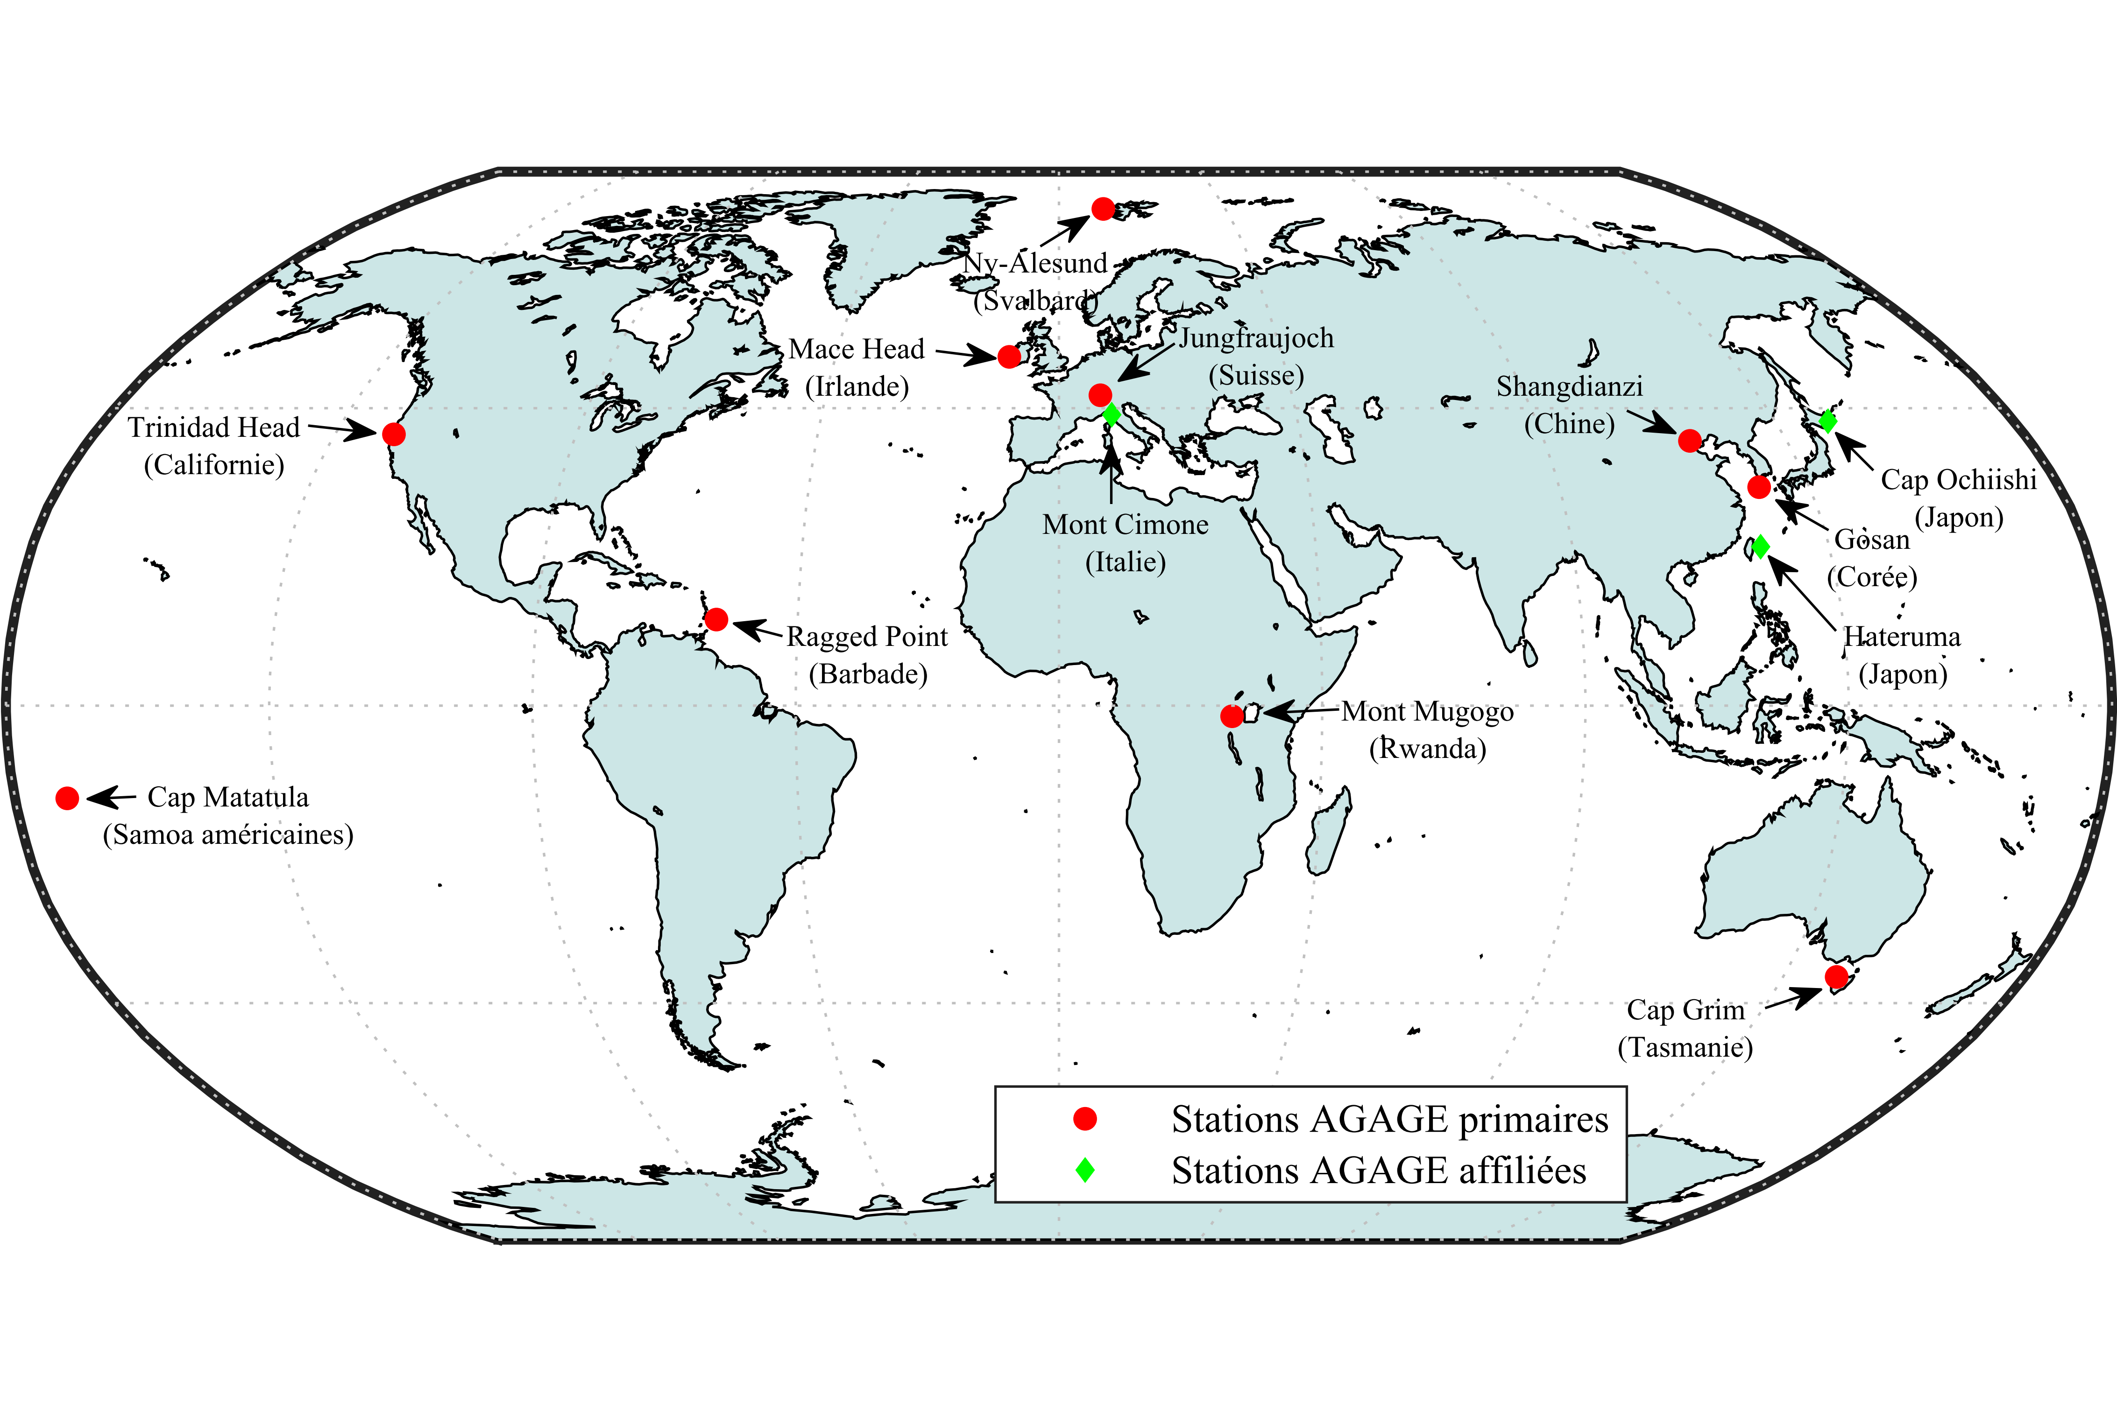
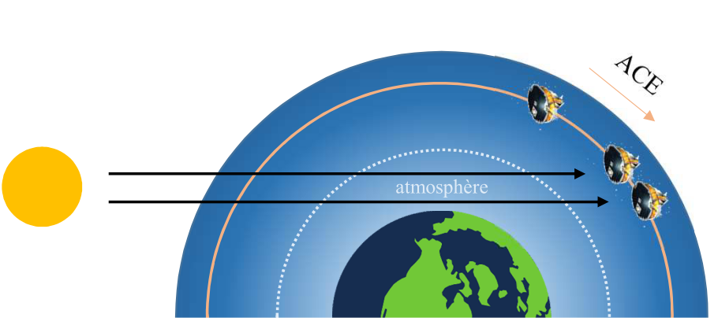
Restitution of atmospheric concentration
To retrieve monthly atmospheric concentrations, the generalized least squares estimation is applied on IASI monthly averaged spectra:
$$\hat{x}=x_{0}+{\left(K^{T}S^{−1}K\right)}^{−1}K^{T}S^{−1}(y−\overline{y})$$
with $\hat{x}$ and $x_{0}$ the retrieved and reference concentrations of the target species, and $K$ the Jacobians. This operation separates the contribution of the target, in a specific spectral range, from the atmospheric background which has a bigger impact on the signal.
Annual trends were derived from the retrieved time series using ordinary least squares, for the period 2008—2021.
The retrieved concentrations and trends are intercompared with observations from the in situ measurements network AGAGE and the solar occultation sounder ACE-FTS.
This work focuses on clear-sky IASI spectra observed over ocean at northern and southern mid-latitudes for the period 2008—2022.
$S$: 2008
(~430,000 spectra)
$\overline{y}$: 2008 monthly
(~35,500 spectra)
Background conditions:
T
ϵ
H₂O, CO₂, O₃, CH₄, N₂O
$y$: 2008 → 2022 monthly
(~35,500 spectra)
• AGAGE stations
Ground-based observations (AGAGE)
Limb satellite observations (ACE-FTS)
$S$: 2008 (~360,000 spectra)
$\overline{y}$: 2008 monthly (~30,000 spectra)
$y$: 2008 → 2022 monthly (~31,000 spectra)

Slide 7
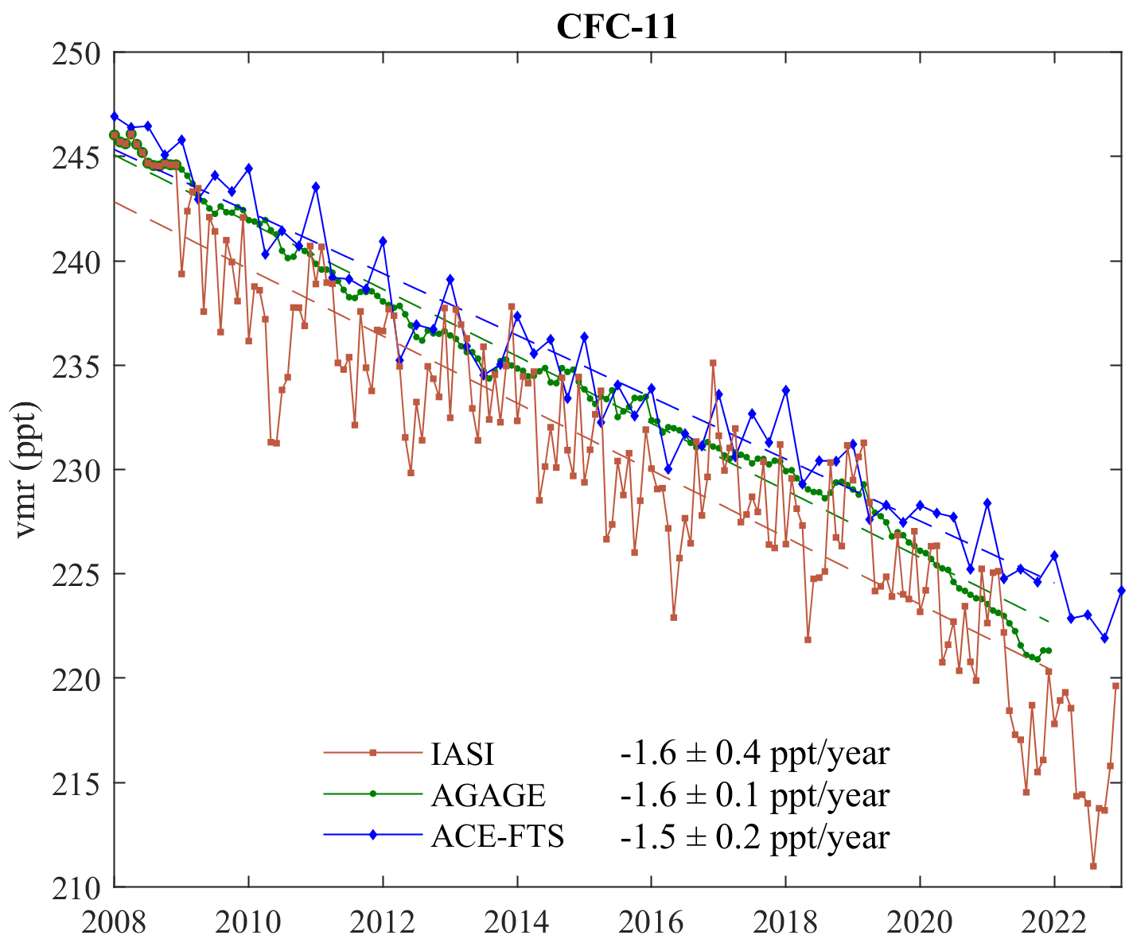
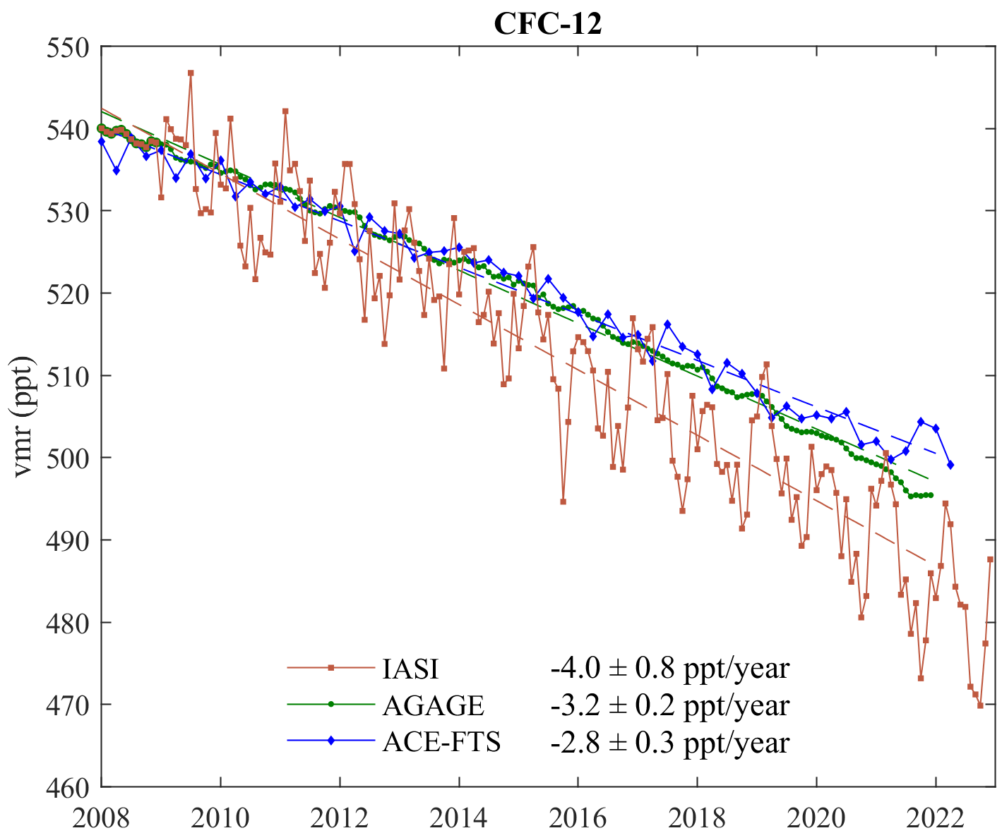
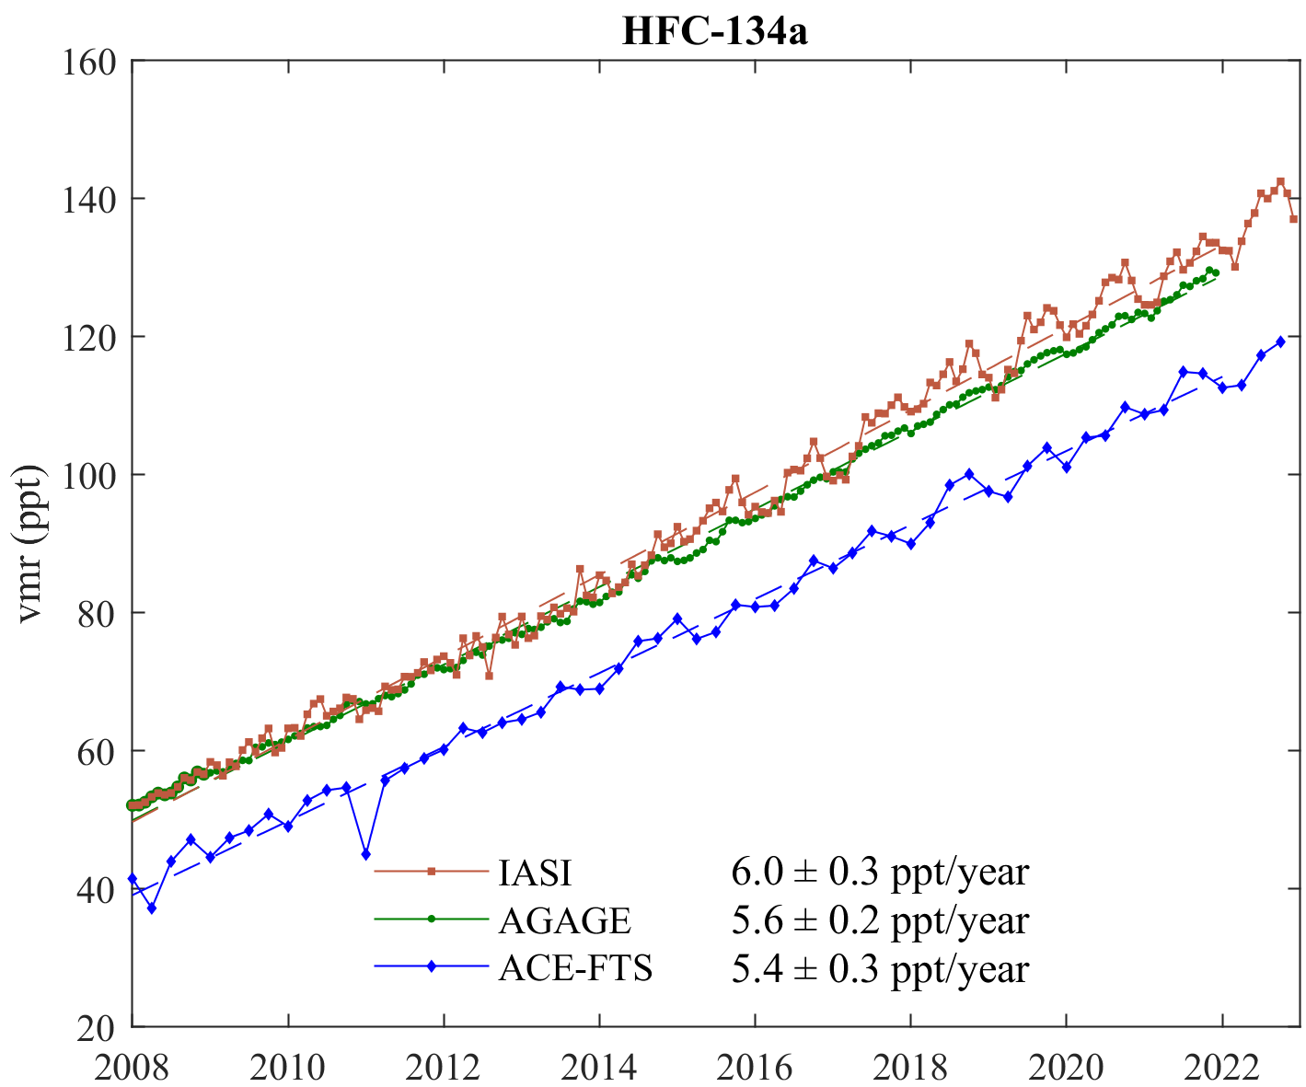
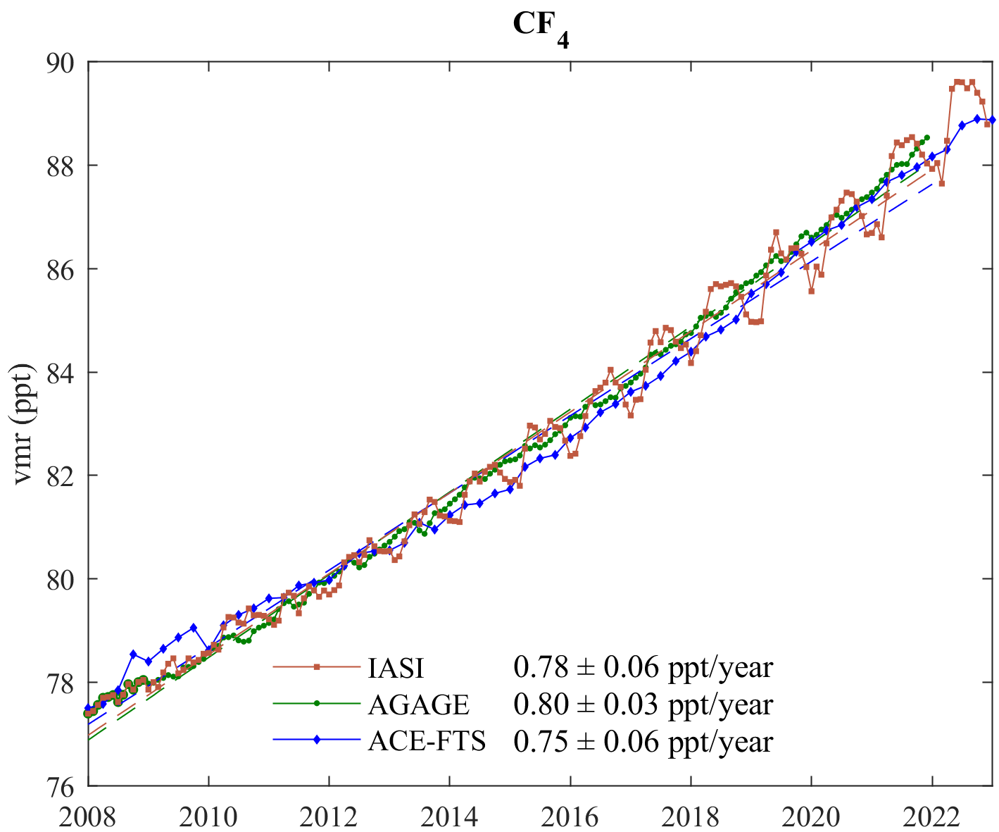
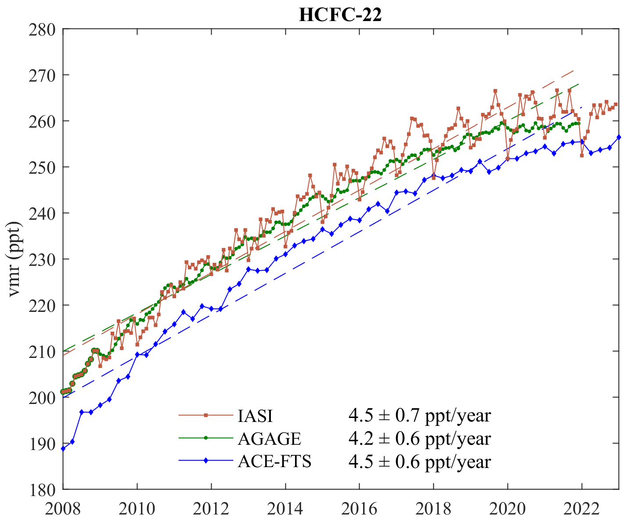
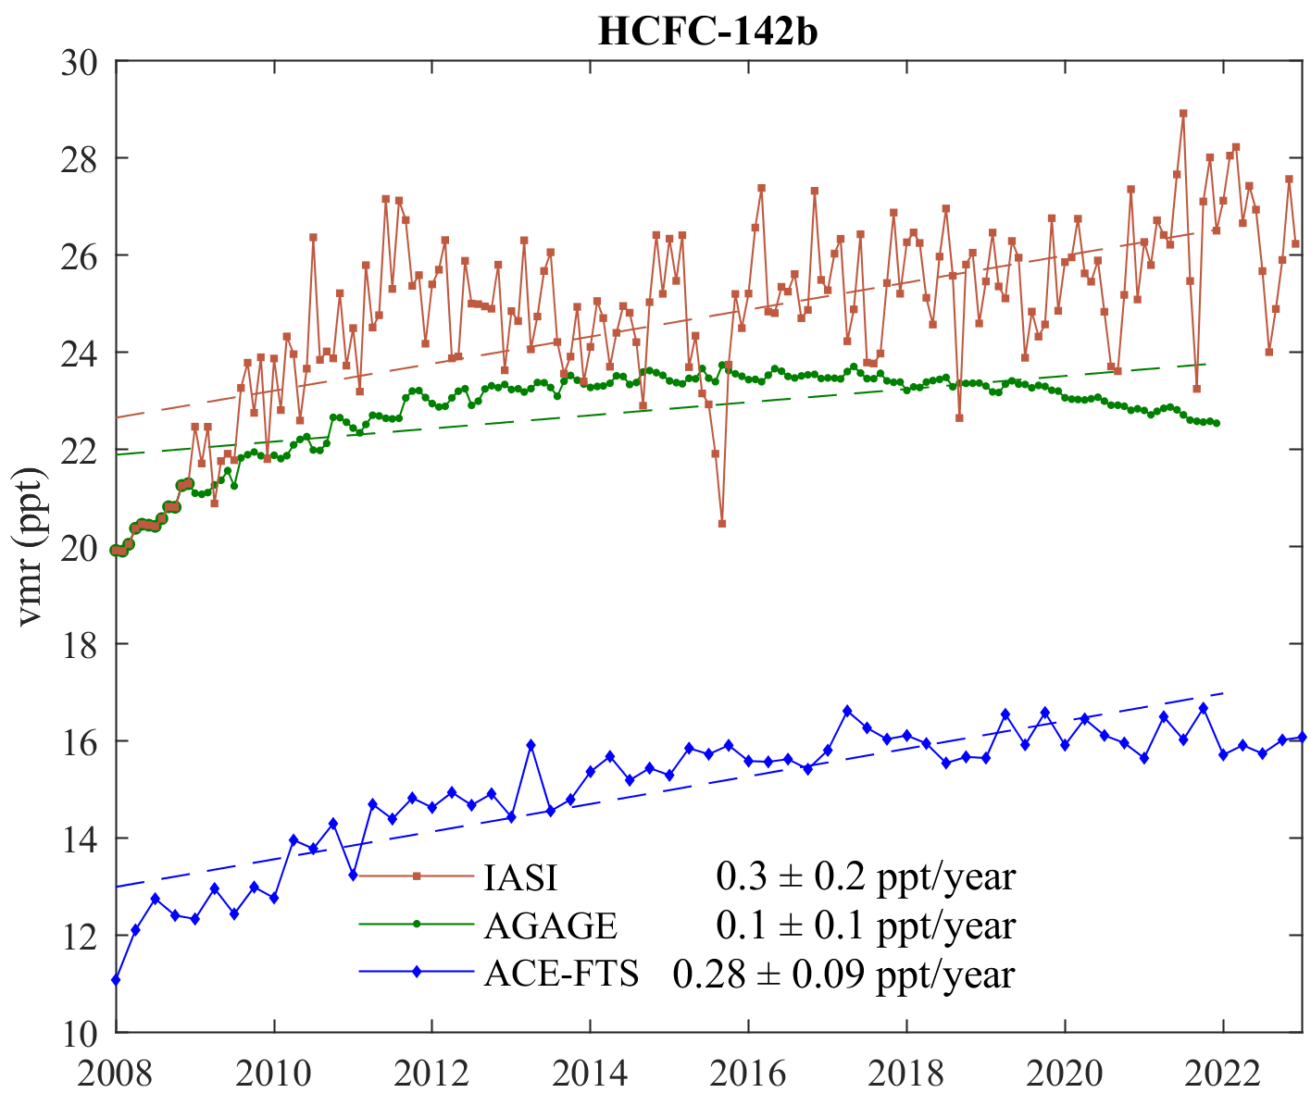
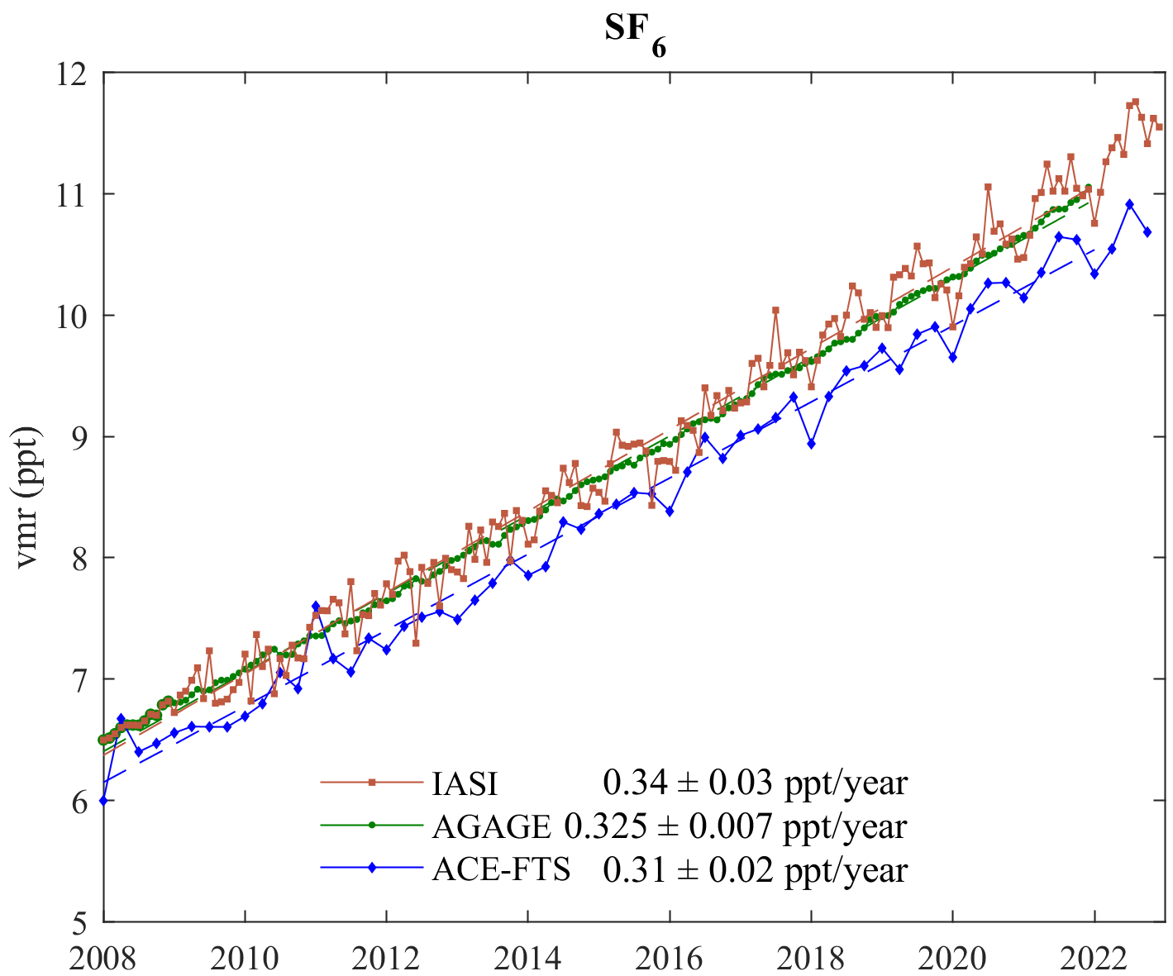
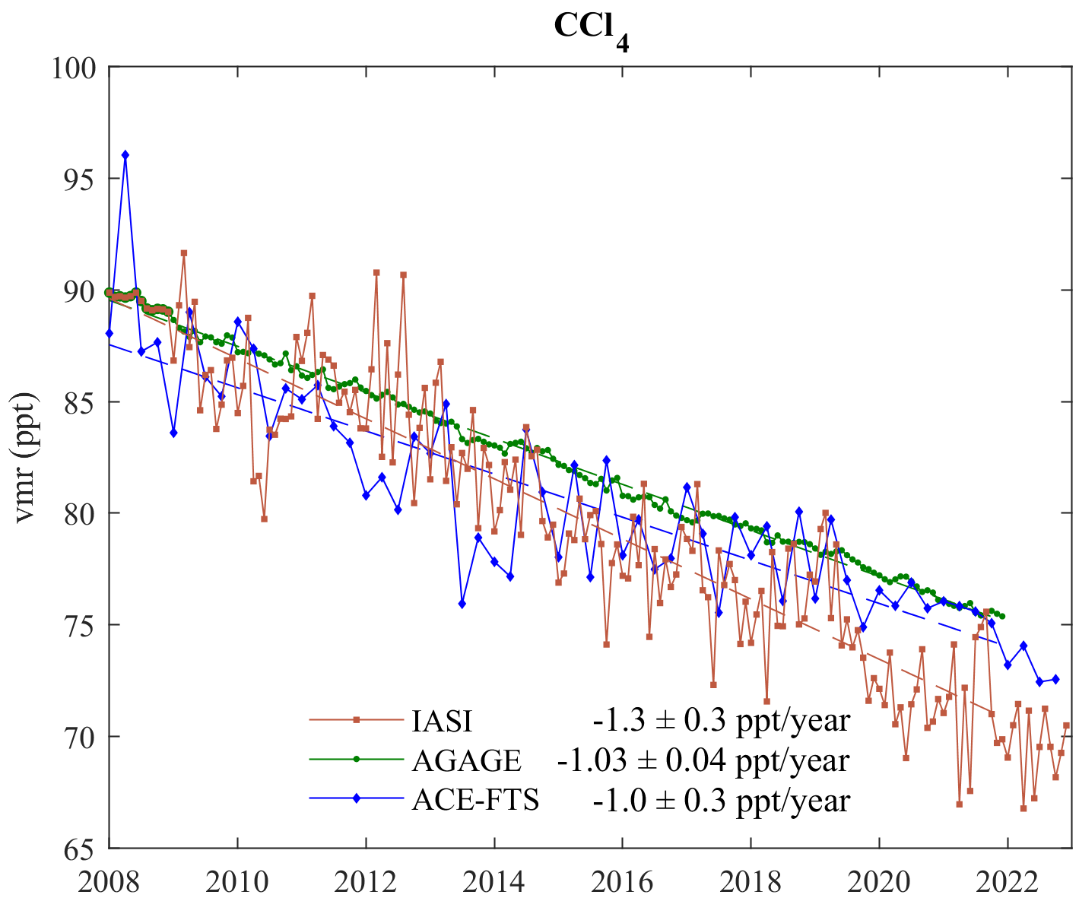
Time series – Northern mid-latitudes
Click to zoom +

Slide 8
Time series – CFC-11
Click to zoom -
CFC-11 is the second most abundant CFC in the atmosphere after CFC-12. In response to the Montreal Protocol, its atmospheric abundance is decreasing since 2000. The trend derived from IASI shows a rate of decrease amounting -1.6 $±$ 0.4 ppt/year during 2008—2021, which is in excellent agreement with the one from AGAGE (-1.6 $±$ 0.1 ppt/year) for the same period. It is also matching within the uncertainty the -1.5 $±$ 0.2 ppt/year trend from the ACE-FTS. The case of CFC-11 is of particular interest in view of the reported slowdown of the decrease between 2012 and 2019, possibly due to illegal emissions. To see if these two breakpoints in the time evolution could be seen with IASI we have compared the trends for three separate periods: 2008—2011, 2012—2018 and 2019—2022 and found values of respectively -3 $±$ 1 ppt/year, -1.3 $±$ 0.6 ppt/year and -4 $±$ 1 ppt/year. We observe clearly a slowdown in the decline after 2012 followed by a return to normal in 2019 with an even higher rate of decrease than before 2012. While this acceleration compared to pre-2012 will have to be confirmed in the future by extending the time series, the fact that the breakpoints are well identified demonstrates the ability of IASI to capture the changes in the rate of decrease.
Retrieval parameters
Target | Spectral range (cm⁻¹) | Interfering species
CFC-11 | 800—900 | CO₂, HNO₃, HCFC-22, CCl₄

Slide 9
Time series – CFC-12
CFC-12 is the most abundant CFC in the atmosphere. In response to the Montreal Protocol, its atmospheric abundance is decreasing since 2000, like CFC-11. For CFC-12, we calculate from the IASI time series a rate of -4.0 $±$ 0.8 ppt/year between 2008 and 2021, which is larger than that inferred from AGAGE (-3.2 $±$ 0.2 ppt/year) and even more from the ACE-FTS (-2.8 $±$ 0.3 ppt/year). The reason for this discrepancy is not known at present but we suspect that it could be due to spectral interferences with another long-lived tracer absorbing in the same spectral region (900—940 cm⁻¹). It is clear that more work will be needed to identify the cause of outliers in the CFC-12 time series from IASI and to improve its trend determination.
To conclude for CFC-12, we find with IASI, consistent with AGAGE and ACE-FTS, an acceleration of the rate of decrease with time with trend of -3 $±$ 2 ppt/year and -4 $±$ 1 ppt/year for the two sub-periods 2008—2011 and 2012—2021 considered.
Retrieval parameters
Target | Spectral range (cm⁻¹) | Interfering species
CFC-12 | 900—940 | CO₂, HNO₃, CFC-11, HCFC-142b, SF₆

Slide 10
Time series – HCFC-22
As a consequence of the regulations put on the production of CFCs, transitional HCFCs, such as HCFC-22 and HCFC-142b, have been widely used, leading to an increase of their atmospheric abundance. Starting from values of about 205 ppt in 2008 we find from IASI vmrs reaching maxima at the end of the time period, of around 262 ppt after 2021. Having been regulated themselves by the Montreal Protocol, the rate of increase is progressively slowing down. The linear regression applied over the entire 2008—2021 time period gives for HCFC-22 a growth rate of 4.5 $±$ 0.7 ppt/year, broadly consistent with AGAGE (4.2 $±$ 0.6 ppt/year) and ACE-FTS (4.5 $±$ 0.6 ppt/year). The rate of decrease has halved between 2008—2011 (7 $±$1 ppt/year) and 2012—2021 (3.5 $±$ 0.8 ppt/year).
Retrieval parameters
Target | Spectral range (cm⁻¹) | Interfering species
HCFC-22 | 790—850 | CO₂, CFC-11, CCl₄

Slide 11
Time series – HCFC-142b
HCFC-142b shows a much smaller positive trend of 0.3 $±$ 0.2 ppt/year than HCFC-22, which is furthermore not representative in view of the plateau appearing just after 2011 (the trend is close to zero after 2012). In that respect, the comparison with the trends obtained from the AGAGE (0.1 $±$ 0.1 ppt/year) and ACE-FTS (0.28 $±$ 0.09) datasets is also not relevant. Among the eight investigated species, HCFC-142b is the least well represented by linear regression.
Retrieval parameters
Target | Spectral range (cm⁻¹) | Interfering species
HCFC-142b | 1190—1220 | HFC-134a

Slide 12
Time series – HFC-134a
The abundance of HFC-134a is increasing rapidly as a result of its intensive use in refrigeration and air conditioning systems, as a blowing agent for polyurethane foams, and as a propellant for medical aerosols. We find from IASI a vmr of 130 ppt in 2021, more than 2.4 times its 2008 value (54 ppt). The linear trend value for the 2008—2021 IASI period is 6.0 $±$ 0.3 ppt/year, surpassing that of HCFC-22. This trend is, taking into account the respective uncertainties, in good agreement with those from AGAGE (5.6 $±$ 0.2 ppt/year) and ACE-FTS (5.4 $±$ 0.3 ppt/year).
Retrieval parameters
Target | Spectral range (cm⁻¹) | Interfering species
HFC-134a | 1150—1250 | CFC-12, HCFC-142b

Slide 13
Time series – CF₄
CF₄, also named PFC-14, is one of the major PFCs and is emitted mostly from the industrial sector, following its use in aluminium and semiconductor production. Because of its extremely long lifetime (50,000 years), this gas reaches the mesosphere where it is photolyzed by UV radiation. Its abundance is also increasing steadily, although at a slower pace than HFC-134a. We find from IASI maximum vmrs around 88 ppt, resulting from a linear growth rate of 0.78 $±$ 0.06 ppt/year. We find a remarkable agreement with the trends determined from AGAGE (0.80 $±$ 0.03 ppt/year) and ACE-FTS (0.75 $±$ 0.06 ppt/year).
Retrieval parameters
Target | Spectral range (cm⁻¹) | Interfering species
CF₄ | 1250—1290 | HCFC-142b, HFC-134a

Slide 14
Time series – SF₆
SF₆ is primarily used for electrical insulation and semiconductors. Like CF₄, because of its extremely long lifetime (3,200 years), it reaches the mesosphere where it is photolyzed by UV radiation or, degraded after electron attachment. Its atmospheric abundance is also increasing over time, with a linear growth rate of 0.34 $±$ 0.03 ppt/year between 2008 and 2021. This trend value is in good agreement with AGAGE (0.325 $±$ 0.007 ppt/year) and ACE-FTS (0.31 $±$ 0.02 ppt/year).
Retrieval parameters
Target | Spectral range (cm⁻¹) | Interfering species
SF₆ | 935—955 | CO₂, CFC-12

Slide 15
Time series – CCl₄
CCl₄ has been regulated by the Montreal Protocol for as long as CFCs, leading to a decrease in its atmospheric vmrs after a peak at around 105 ppt in the early 1990s. Starting from a vmr value of around 89 ppt in 2008, we find a minimum vmr in 2021 of about 72 ppt, corresponding to a linear rate of decline of -1.3 $±$ 0.3 ppt/year over the 2008—2021 time period. While it comes with a small error, this negative trend is significantly larger than that inferred from the in situ measurements (-1.03 $±$ 0.04 ppt/year) and even more so from ACE-FTS (-1.0 $±$ 0.3 ppt/year). This might be due to the overlap with CO₂ in the region where CCl₄ is retrieved (760—820 cm⁻¹).
Retrieval parameters
Target | Spectral range (cm⁻¹) | Interfering species
CCl₄ | 760—820 | CO₂, HNO₃, HCFC-22

Slide 16
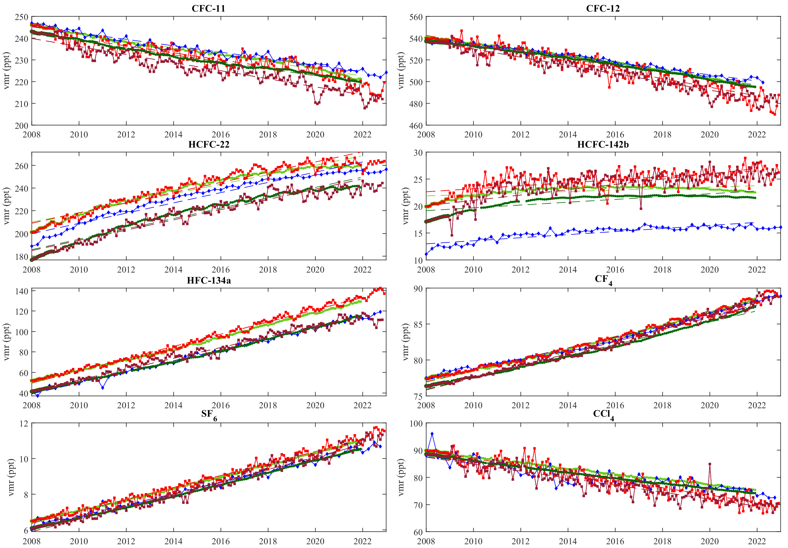
Time series – Southern mid-latitudes
 | Annual trend (ppt/year)
 | IASI | AGAGE | ACE-FTS
CFC-11 | -1.6 $±$ 0.4 | -1.6 $±$ 0.1 | -1.5 $±$ 0.2
 | -1.9 $±$ 0.4 | -1.6 $±$ 0.1
CFC-12 | -4.0 $±$ 0.8 | -3.2 $±$ 0.2 | -2.8 $±$ 0.3
 | -3.8 $±$ 0.7 | -3.1 $±$ 0.1
HCFC-22 | 4.5 $±$ 0.7 | 4.2 $±$ 0.6 | 4.5 $±$ 0.6
 | 4.5 $±$ 0.8 | 4.6 $±$ 0.6
HCFC-142b | 0.3 $±$ 0.2 | 0.1 $±$ 0.1 | 0.28 $±$ 0.09
 | 0.5 $±$ 0.3 | 0.3 $±$ 0.1
HFC-134a | 6.0 $±$ 0.3 | 5.6 $±$ 0.2 | 5.4 $±$ 0.3
 | 5.3 $±$ 0.4 | 5.3 $±$ 0.2
CF₄ | 0.78 $±$ 0.06 | 0.80 $±$ 0.03 | 0.75 $±$ 0.06
 | 0.84 $±$ 0.06 | 0.78 $±$ 0.04
SF₆ | 0.34 $±$ 0.03 | 0.325 $±$ 0.07 | 0.31 $±$ 0.02
 | 0.35 $±$ 0.03 | 0.323 $±$ 0.07
CCl₄ | -1.3 $±$ 0.3 | -1.03 $±$ 0.04 | -1.0 $±$ 0.3
 | -1.3 $±$ 0.3 | -1.03 $±$ 0.04
IASI | Northern mid-latitudes
IASI | Southern mid-latitudes
AGAGE | Northern mid-latitudes
AGAGE | Southern mid-latitudes
ACE-FTS | Global

Slide 17
Conclusion and perspectives
The temporal evolution of the atmospheric abundance of eight long-lived halogenated gases has been determined for the period 2008—2022 currently covered by IASI; a reasonable agreement was obtained with the in situ measurements from AGAGE stations and with the measurements from the ACE-FTS solar occultation sounder. However, too large discrepancies were found in the trends of CFC-12 and CCl₄, for reasons which are not entirely clear at the moment.
These results are very promising in that they suggest an important role of IASI for monitoring long-lived halogenated species over time.
Future research will include the investigation of spatial variability in their trends over the globe, with a particular interest in regions suspected of fugitive emissions or regions lacking in situ measurements (e.g., India, Arabian peninsula, South America).
Global and long-term monitoring of halocarbons atmospheric abundances
Monitoring of the global evolution of the atmosphere system
Verification of the effectiveness of international protocols
Helene.De.Longueville@ulb.be

