Slide 1
SUPPLEMENTARY MATERIAL Advanced processing strategies for a future GFZ GRACE/GRACE-FO Level-2 data release
Murböck M.¹, Dahle C.², Panafidina N.², Hauk M.^{2,3,4}, Wilms J.², Neumayer K.-H.², Flechtner F.^{1,2}
1 | TU Berlin, Physical Geodesy, murboeck@gfz-potsdam.de
2 | Helmholtz Centre Potsdam, GFZ, Section 1.2: Global Geomonitoring and Gravity Field
3 | Max-Planck-Institute for Gravitational Physics (AEI), Leibnitz University Hannover
4 | German Aerospace Center (DLR), Institute for Satellite Geodesy and Inertial Sensing

Slide 2
Improving and better understanding
Background models
Stochastic modeling of ocean tide (OT) models
Stochastic modeling of non-tidal atmospheric and oceanic de-aliasing (AOD) models

Slide 3
Improving and better understanding
Background models
Stochastic modeling of ocean tide (OT) models (Wilms et al., poster presentation)
Stochastic modeling of non-tidal atmospheric and oceanic de-aliasing (AOD) models
Sensor data
Stochastic modeling of ACC and MWI data
Murböck, M.; Abrykosov, P.; Dahle, C.; Hauk, M.; Pail, R.; Flechtner, F. In-Orbit Performance of the GRACE Accelerometers and Microwave Ranging Instrument. Remote Sens. 2023, 15, 563. https://doi.org/10.3390/rs15030563
Murböck, M.; Flechtner, F.; Abrykosov, P.; Pail, R. Stochastic models for GRACE/GRACE-FO accelerometers and inter-satellite ranging instruments. GFZ Data Services. 2023. https://doi.org/10.5880/nerograv.2023.001
Stochastic modeling of GPS data

Slide 4
Improving and better understanding
Background models
Stochastic modeling of ocean tide (OT) models (Wilms et al., poster presentation)
Stochastic modeling of non-tidal atmospheric and oceanic de-aliasing (AOD) models
Sensor data
Stochastic modeling of ACC and MWI data (Murböck et al., 2023)
Stochastic modeling of GPS data
Processing strategies
Reduction of empirical parameters
Optimization of relative weighting
Increasing the resolution, accuracy, and long-term consistency of mass transport series from satellite gravimetry
Details in this presentation
(more results in supplementary material)

Slide 5
Stochastic modeling of GPS data
Analysis of GRACE/GRACE-FO GPS code/phase pre-fit residuals
A priori analytical models in $m/{\sqrt{Hz}}$
Corresponding normalized filter matrix (length 20 minutes) applied to design matrix and observations
${ASD}_{phase}=0.008×\sqrt{1+{\left({3 mHz}/f\right)}^{4}}$
${ASD}_{code}=0.9×\sqrt{1+{\left({2 mHz}/f\right)}^{4}}$
Aug. 2008
Dez. 2018

Slide 6
Advanced processing scheme
daily
daily
monthly
Filter
Σ
VCE
GPS
GPS
GPS
$${σ_{GPS}^{}}^{2}$$
GPS
Filter
KRR
KRR
KRR
$${σ_{KRR}^{}}^{2}$$
KRR
OT
$${σ_{OT}^{}}^{2}$$
OT

Slide 7
First results
Test months 2007-01 (GRACE) and 2019-01 (GRACE-FO)
Fixed a priori filters for KRR and GPS based on analytical ASDs
Residuals wrt. COST-G climatology in terms of SH degree/order amplitudes and ocean RMS of filtered residuals
Comparison of
RL06 (GRACE) and RL06.1 (GRACE-FO)
“Best” solution with empirically derived VCs
Final solution without OT-VCM after 2 VCE iterations
Final solution with OT-VCM after 5 VCE iterations

Slide 8
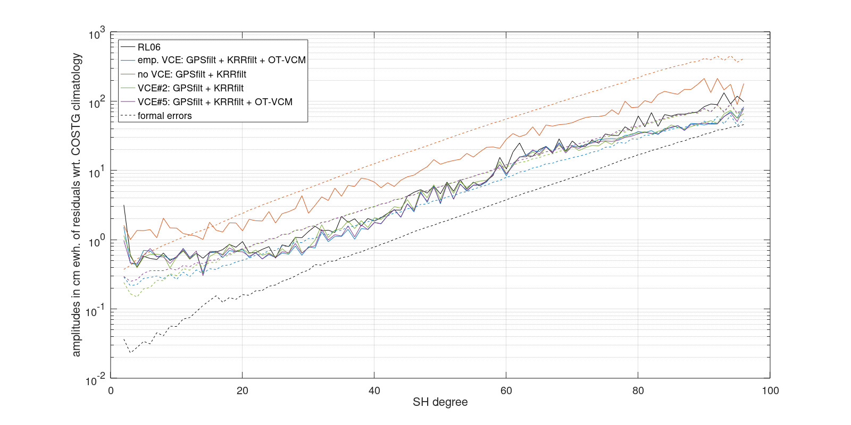
Degree amplitudes for 2007-01
4.9 cm ewh.
3.9 cm ewh.
ocean RMS
300 km gauss. filter C₂₀ neglected
13 cm ewh.
4.1 cm ewh.
3.9 cm ewh.

Slide 9
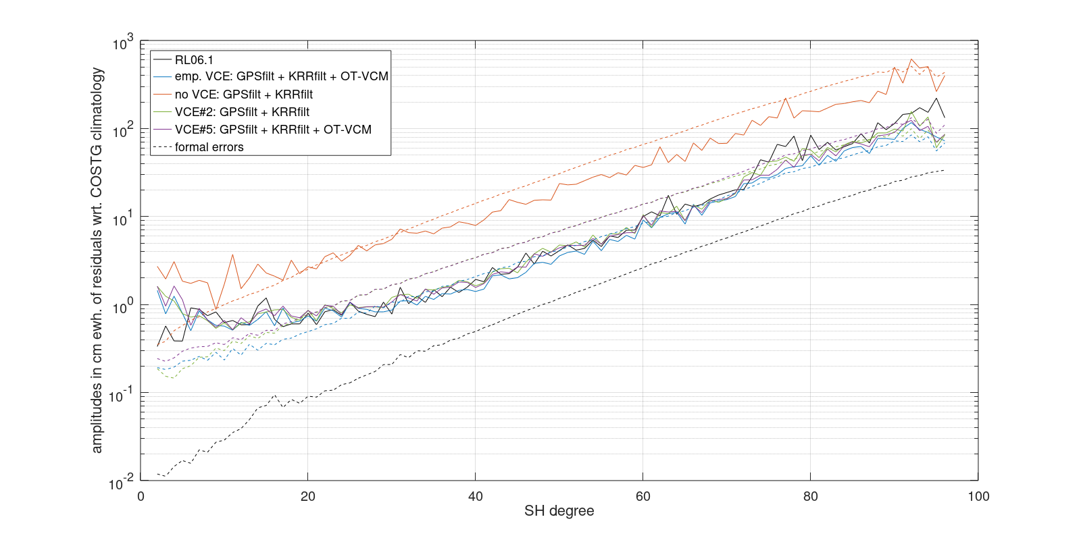
Degree amplitudes for 2019-01
4.2 cm ewh.
3.8 cm ewh.
ocean RMS
300 km gauss. filter C₂₀ neglected
19 cm ewh.
Degradation of low degrees due to non optimal KRR filtering
4.5 cm ewh.
4.6 cm ewh.

Slide 10
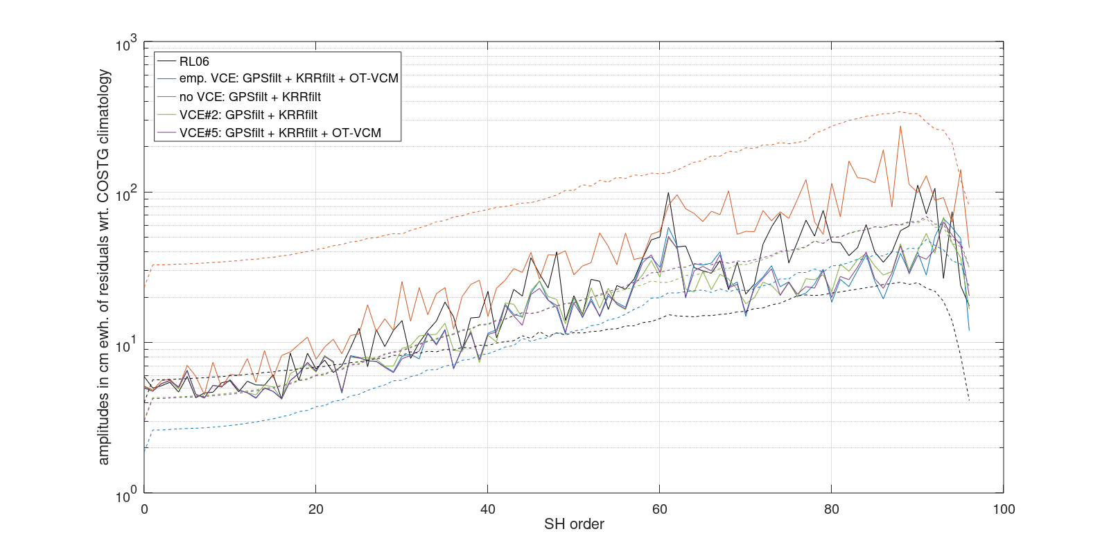
Order amplitudes for 2007-01

Slide 11
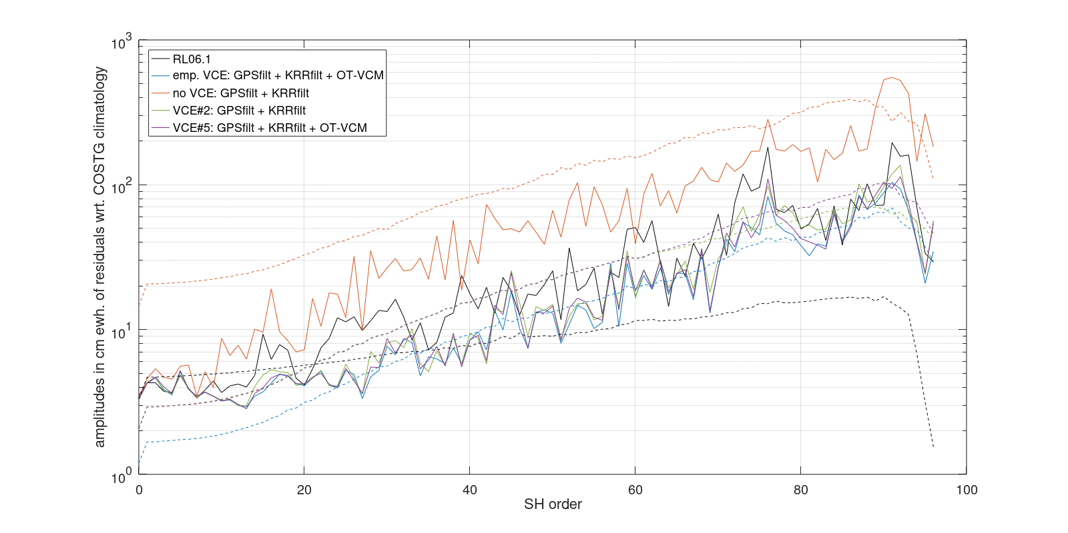
Order amplitudes for 2019-01

Slide 12
Conclusions
Stochastic modeling for OT background models
Stochastic modeling for KRR (ACC+MWI), and GPS (code and phase)
No empirical parameters
Variance component estimation for KRR, GPS, and OT
More realistic formal errors
Improved medium and high degrees
Iterative KRR filtering derived from post-fit residuals
Stochastic modeling for non-tidal AOD models
Outlook

