Slide 1
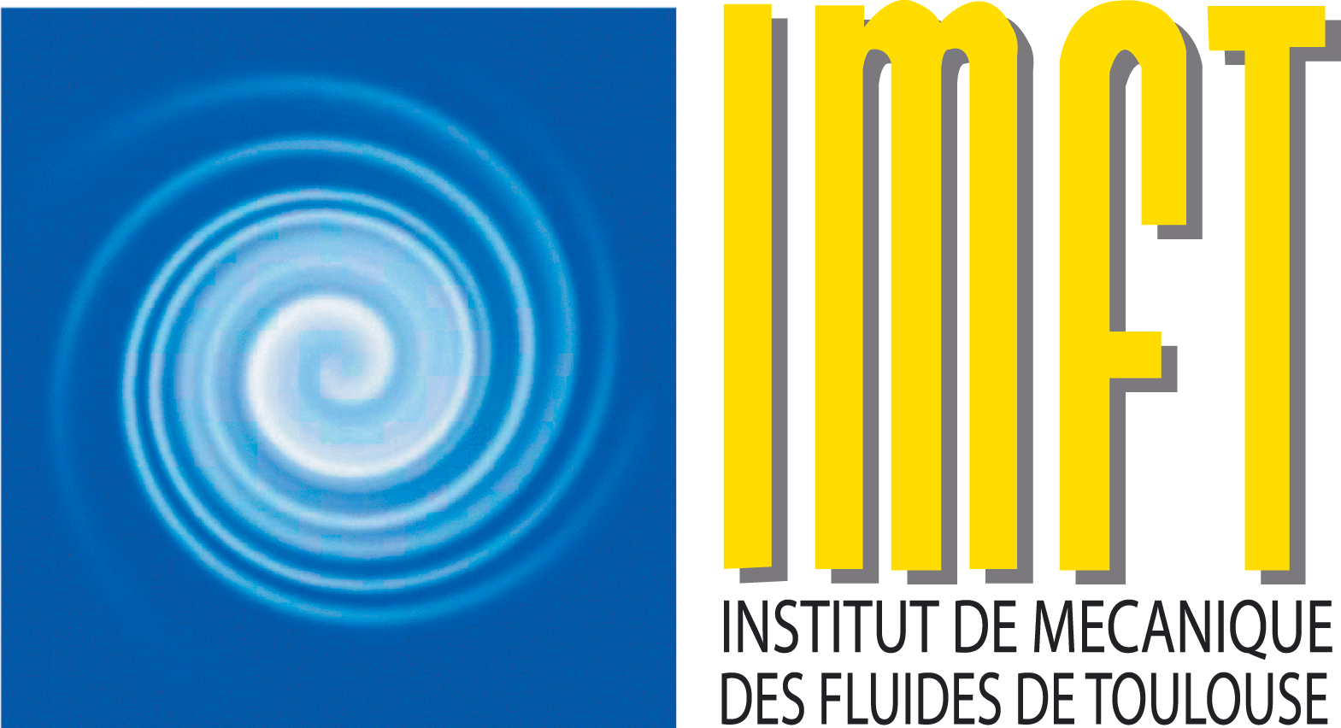
Adaptive Mesh Refinement of 3D saturated - unsaturated transport and hydrological models
Gillien Latour¹, Gérald Debenest¹, Pierre Horgue^{1,} Romain Guibert & François Renard²
1 : IMFT, CNRS-INPT-UPS, Toulouse FRANCE
2 : CEA, DAM, DIF, Arpajon FRANCE
Notes:
Hello everyone,
I’m
working at
in collaboration with the CEA, the French Alternative Energies and Atomic Energy Commission
Today I’ll take about the use of Adaptive Mesh Refinement of 3D saturated - unsaturated transport and hydrological models
CEA has interest in transport of pollutant at the watershed scale
30s~

Slide 2
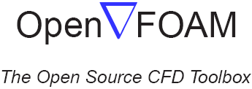
Equation and tools
Richardson-Richards Equation
Advection-Dispersion Equation
Recent reviews ^{1,2} suggested that Adaptive Mesh Refinement (AMR) was to be developed and more widely applied on 3D saturated-unsaturated flow and transport models
porousMultiphaseFoam toolbox ^{3,4}
Dedicated 3D optimization has been done, but was very expensive computational resource wise
1 : Farthing & Ogden 2017, Soil Science Society of America Journal
3 : Horgue et al. 2015, Computer Physics Communications
2 : Zha et al. 2019, WIREs Water
4 : Horgue et al. 2022, Computer Physics Communications
Notes:
In porous media, at the watershed scale, the flow is governed by the Richardson-Richards Equation (aka RRE) which is a simplification of the 2 phase generalized Darcy’s equation and is highly non-linear, due to permeability models. This equation can be coupled to the advection-dispersion equation, which uses dispersion models to model transport in porous media.
Text
The solver used in this study is part of a 3D toolbox solving the RRE and the transport equation, porousMultiphaseFoam which has been developed at the IMFT
it relies on OpenFOAM, an open source CFD toolbox able to efficiently solve differential equations using the finite volume method. AMR is already implemented in numerous OpenFOAM solvers, but not the ones of the porousMultiPhaseFoam toolbox.
Using this toolbox, a dedicated 3D calibration of hydraulics parameters has been conducted, highlighting the expensive use of 3D models over 2D.

Slide 3
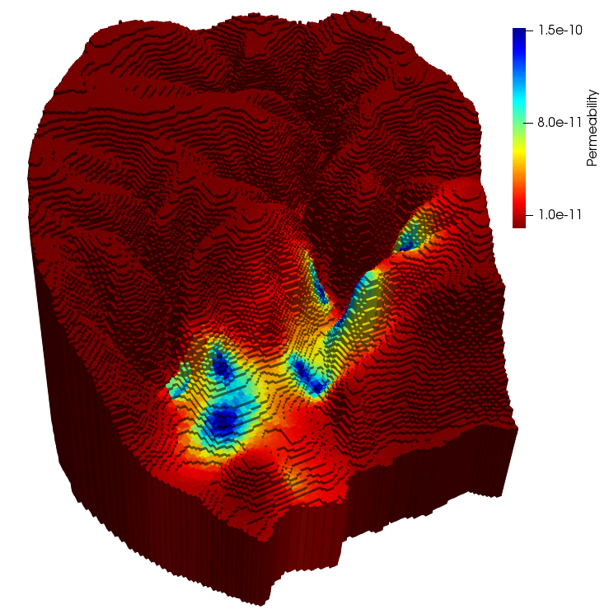
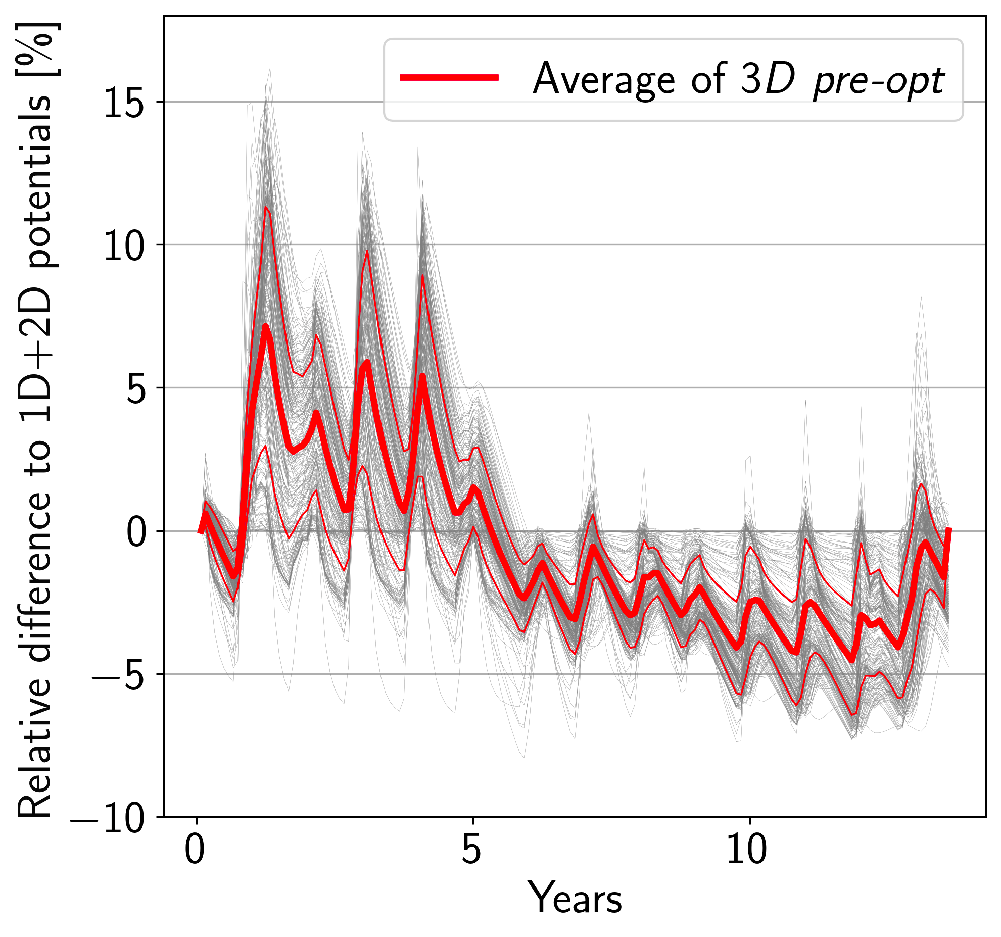
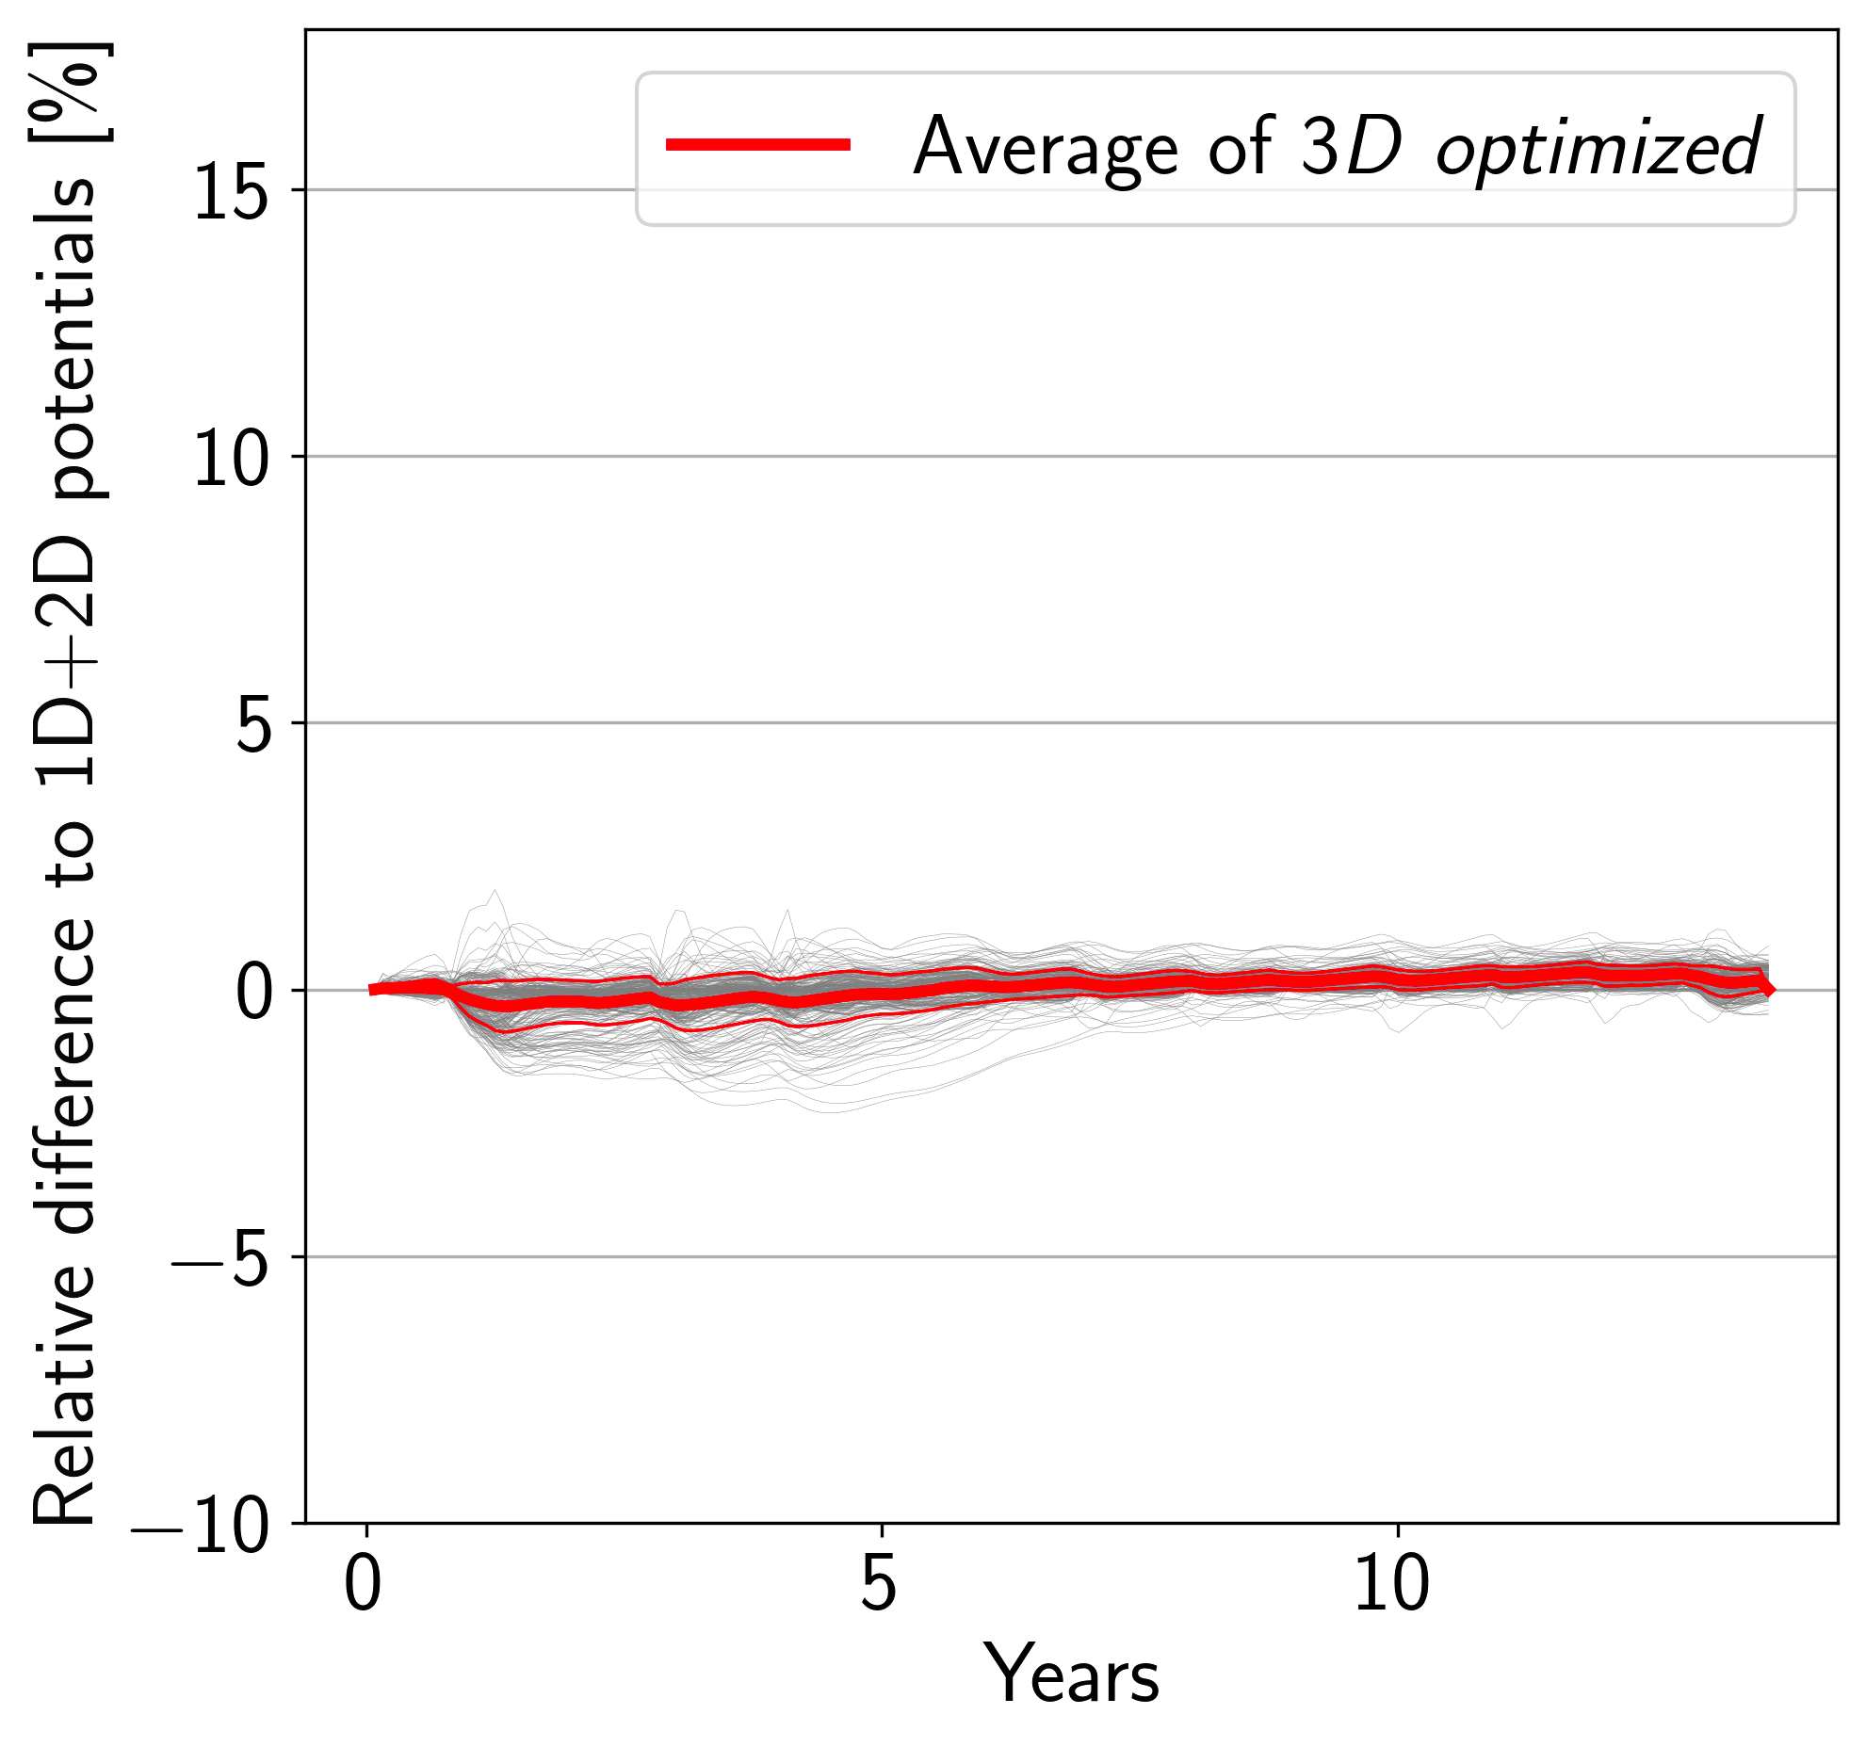
Reminder : 3D calibration of the model⁵
Steady optimization of the permeability & transient optimization of the van Genuchten model parameters
3D models cost up to 70 000 times more computational time than 2D models
scaled up 20x vertically to improve clarity
5 : Latour et al. 2023, submitted to Computer Physics Communications
Notes:
Just to remind you, this calibration has been presented last year and is the subject of an article that has been submitted earlier this year.
The calibration works in two steps, calibration of the permeability in a steady state. Here I’m showing you the results with the permeability field. We can see zones of high permeability in blue, and low in red
Second step consists in a calibration of the van Genuchten model parameters in a transient simulation, and I’m showing you here the hydraulic potential difference to a reference before and after optimization.
The calibration process highlighted the cost of 3D simulation, with the 3D calibration costing up to 70 000 times more than the 2D one.
So to reduce the cost, we want to apply adaptive Mesh Refinement. But what is it and how does it work ?

Slide 4
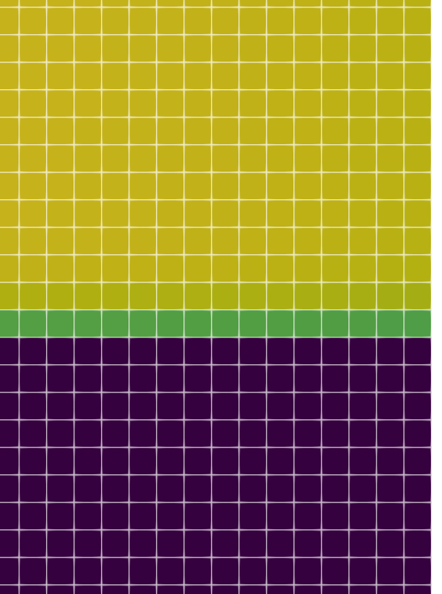
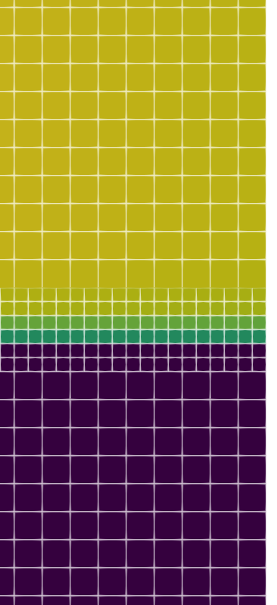
AMR⁶ : How it works
Cell cutting and field adjustment
Main numerical parameter of the AMR
Criteria : saturation, concentration or relative concentration, gradient
Frequency of application
-> Seek accuracy/efficiency compromise
Before
After
6 : Berger & Colella 1989, Journal of Computational Physics
Notes:
AMR, consists in locally refining/coarsening the mesh on the fly in order to better compute gradients in zones of interest.
Theses zones are defined using a criteria, and here in the example I’m showing you, we refine the interface between the saturated and unsaturated zones, which correspond to a saturation theta between 0.12 and 0.23. We divide the cells satisfying the criteria in 8 smaller cells, so that gradients can be better solved.
there are 2 main parameter to the AMR, the criteria use to select cells to refine/unrefine and the frequency of application of the AMR, being every iteration or less often.
Ultimate goal of AMR is to reach the accuracy of a very fine mesh without its cost, using these parameters.
I’ll now present you the results of AMR on our transport solver.

Slide 5
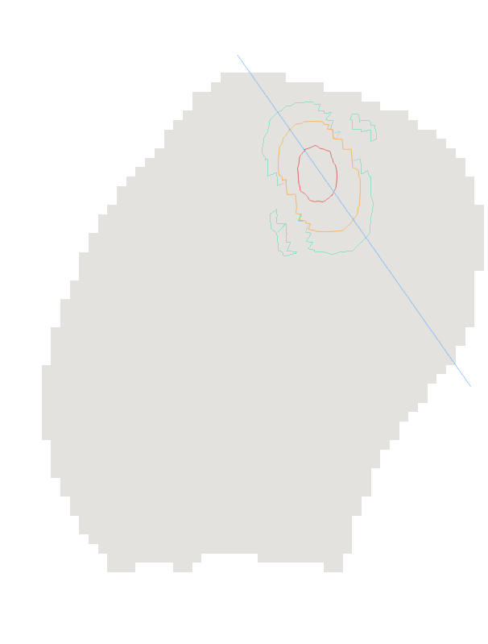
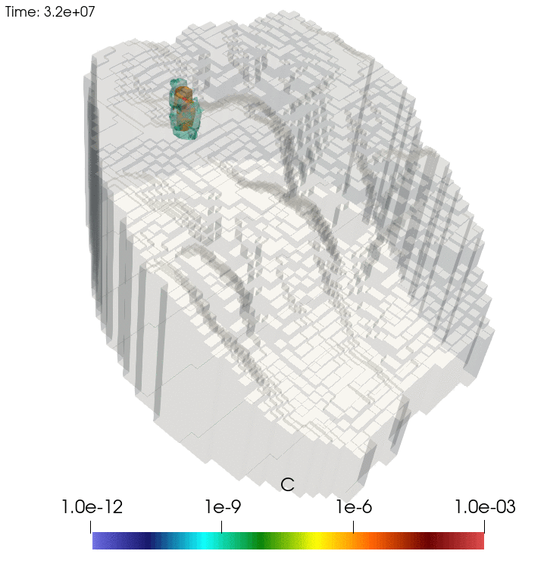
Applicative case - Transport
Injection
watershed spanning over 20 km²
set up with measured infiltrations and pollutants
reference solutions on coarse and fine static meshes
cells of 100m x 100m x 1m to 50m x 50m x 0.5m
Notes:
The case studied is the same as the one we did the calibration on.
watershed spanning over 20 km²
has been set up with measured infiltrations and pollutants
reference solutions for the transport are made on coarse and fine static meshes
On the right you can see a slice of the plume, with the line along which we will compare the concentration

Slide 6
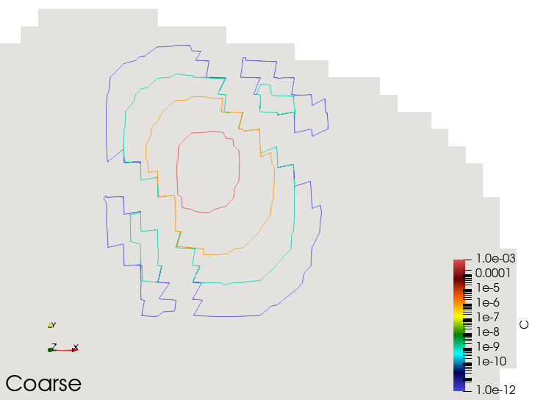
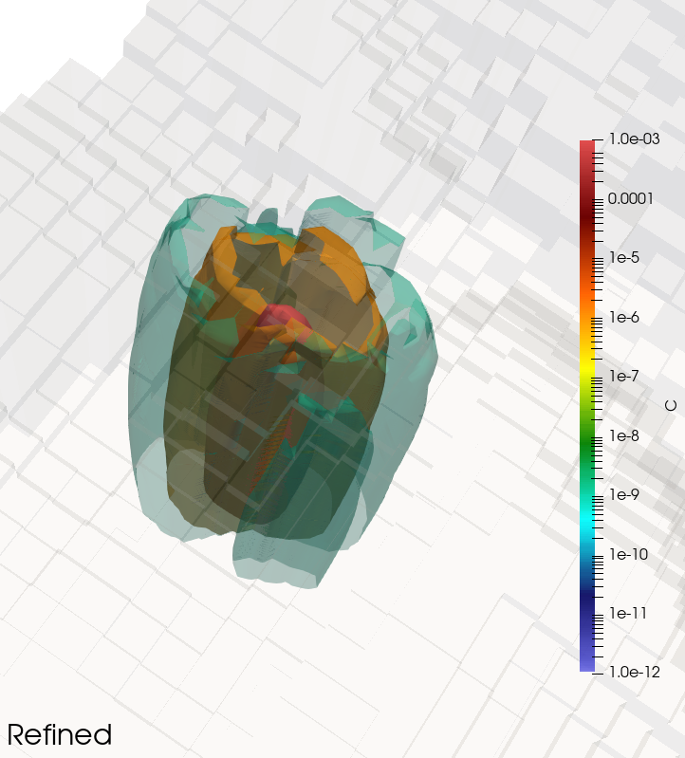
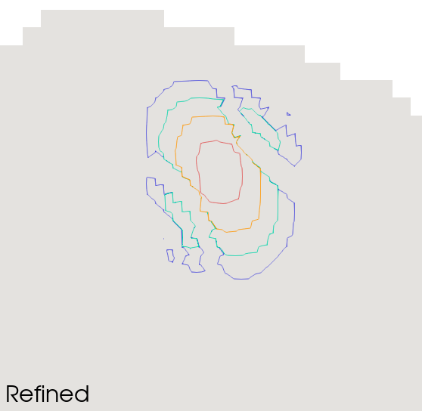
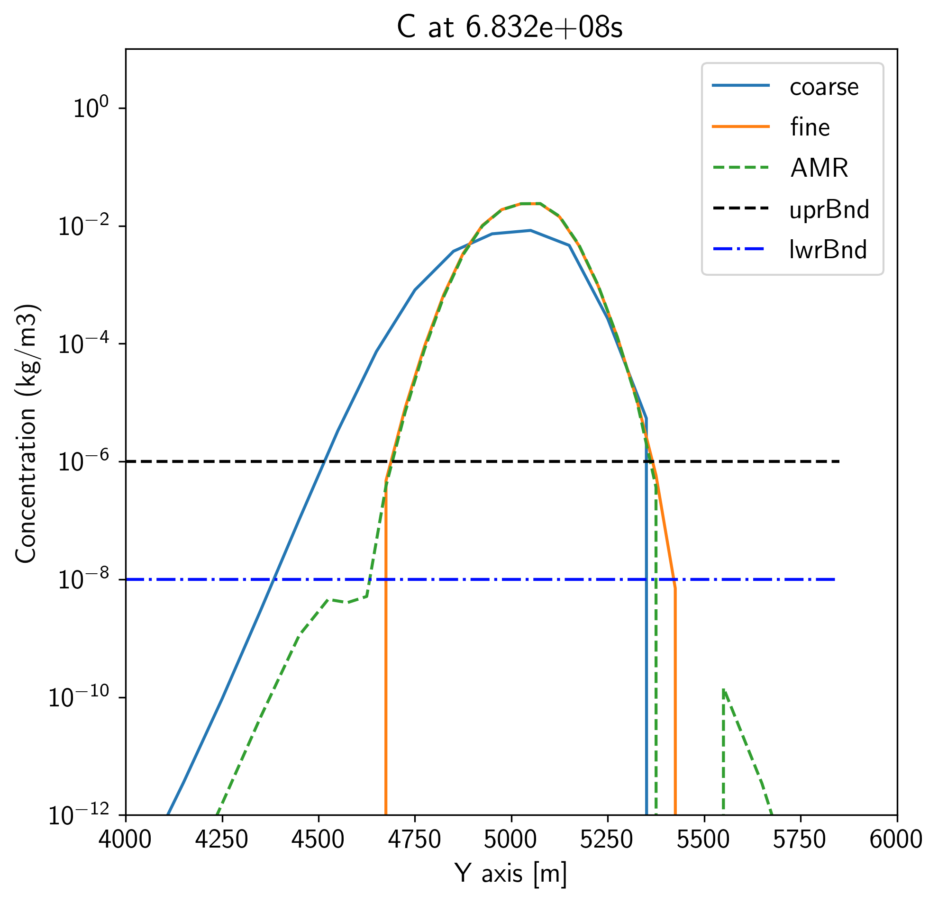
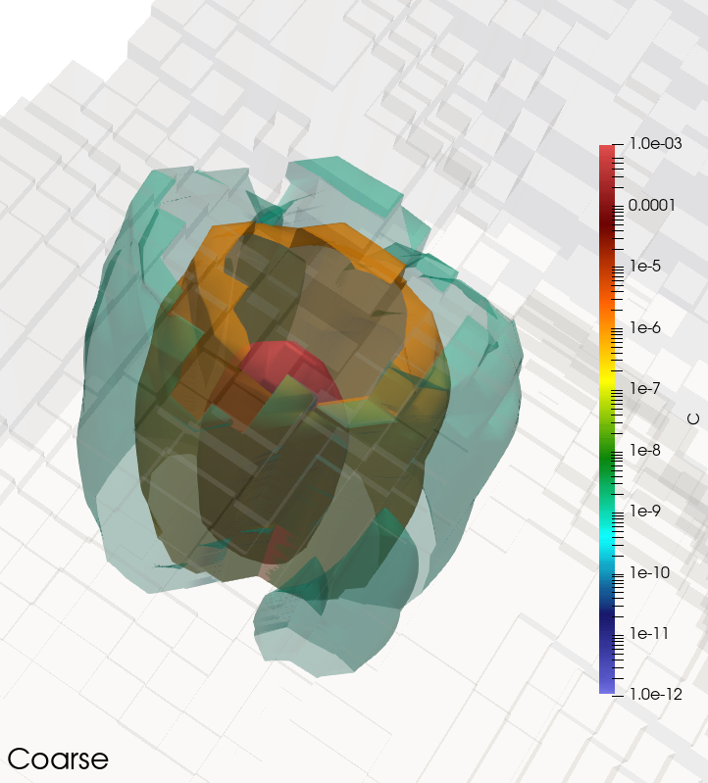
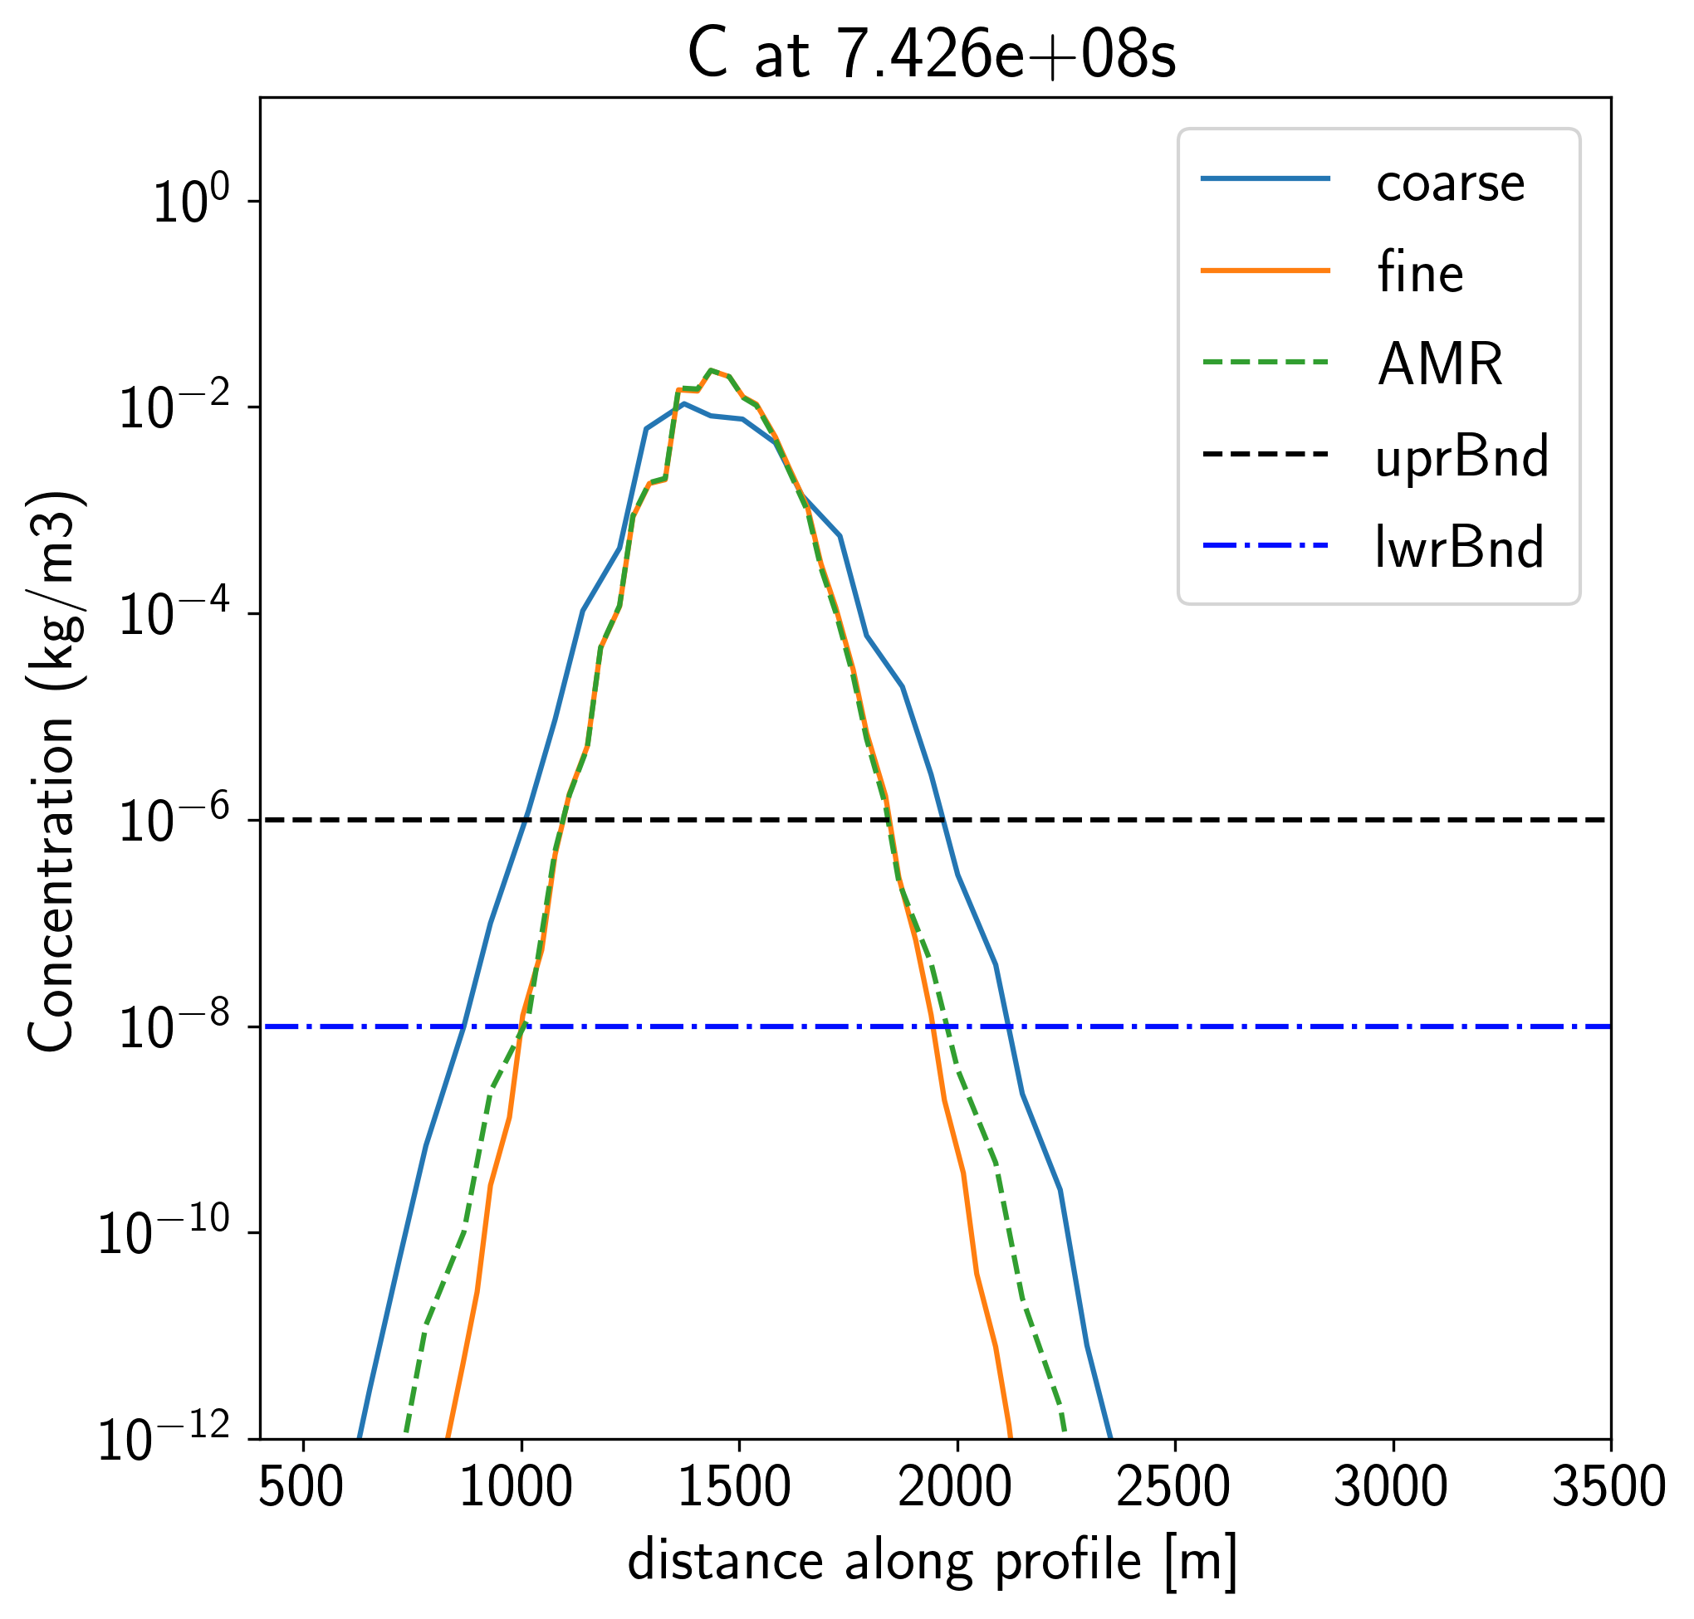
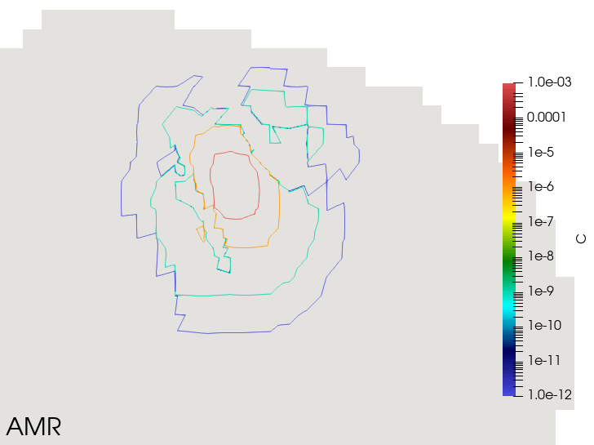
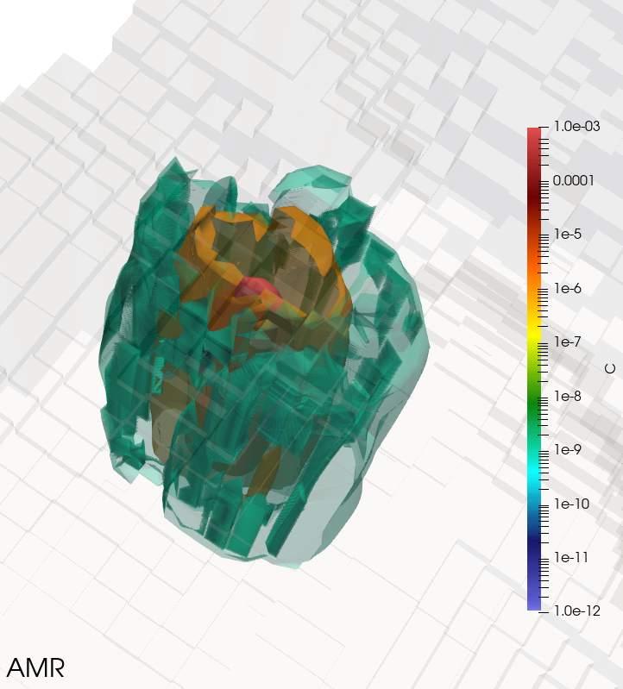
Validity of AMR simulations
progression of the plume
contours 1e-3 kg/m³
Refining for concentration above 1e-6 kg/m³ and coarsening below 1e-8 kg/m³
Notes:
In this case, I use a criteria based on the concentration, where every cells with a concentration above 10-6 Kg/cubic meters is refined, and cells with less than 10-8 Kg/m3 are unrefined.
For a illustrative representation of the AMR, we can look at the slices on the left, we can see that the concentration contours for the 10-3 and 10-6 are very similar between AMR and fine simulations, this can be seen in 3D representation as well.
For a quantitative representation, I’m presenting on the right a profile of concentration along the line shown earlier, and we can see that the profiles of the AMR and fine simulations are similar above the 1e-6 Kg/cubic meter mark, which is our refining threshold.
Overall, AMR simulations matches the results of fine simulations for the concentrations we are interested in.

Slide 7
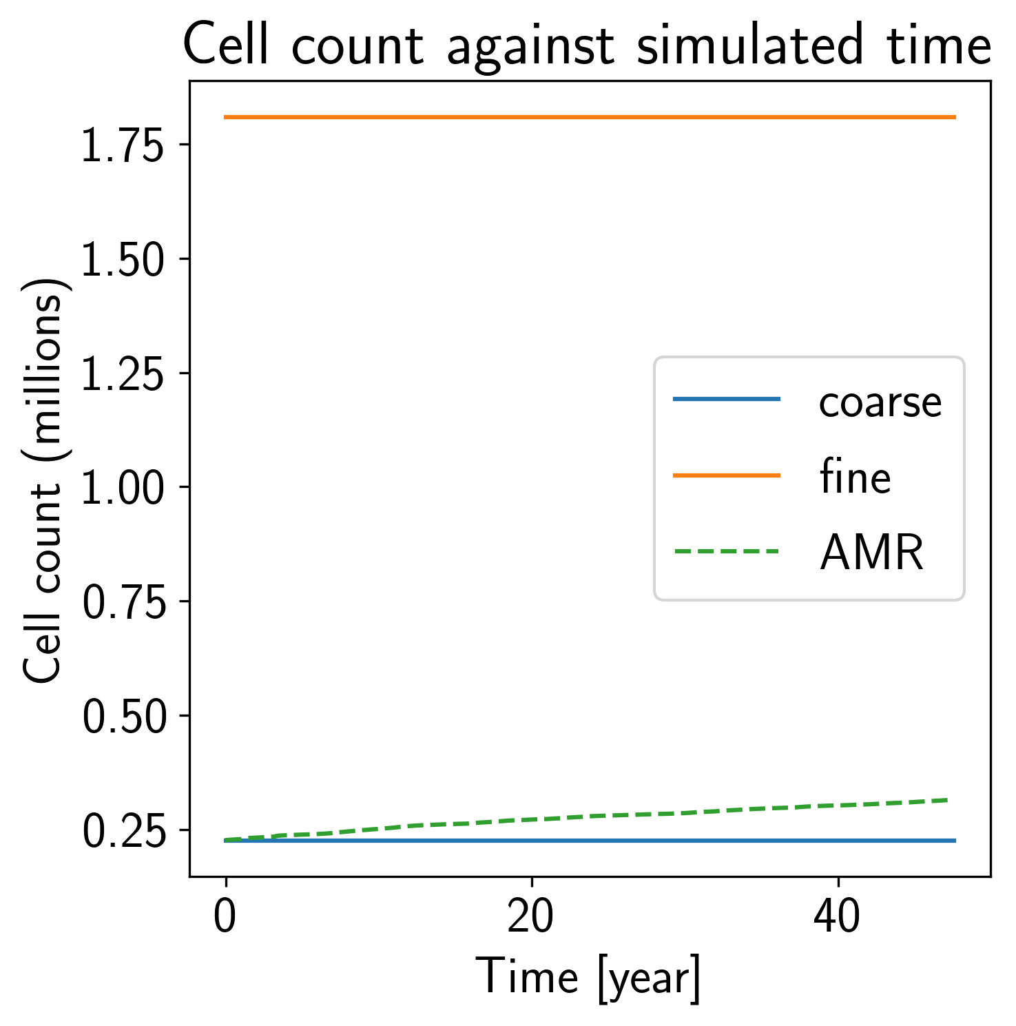
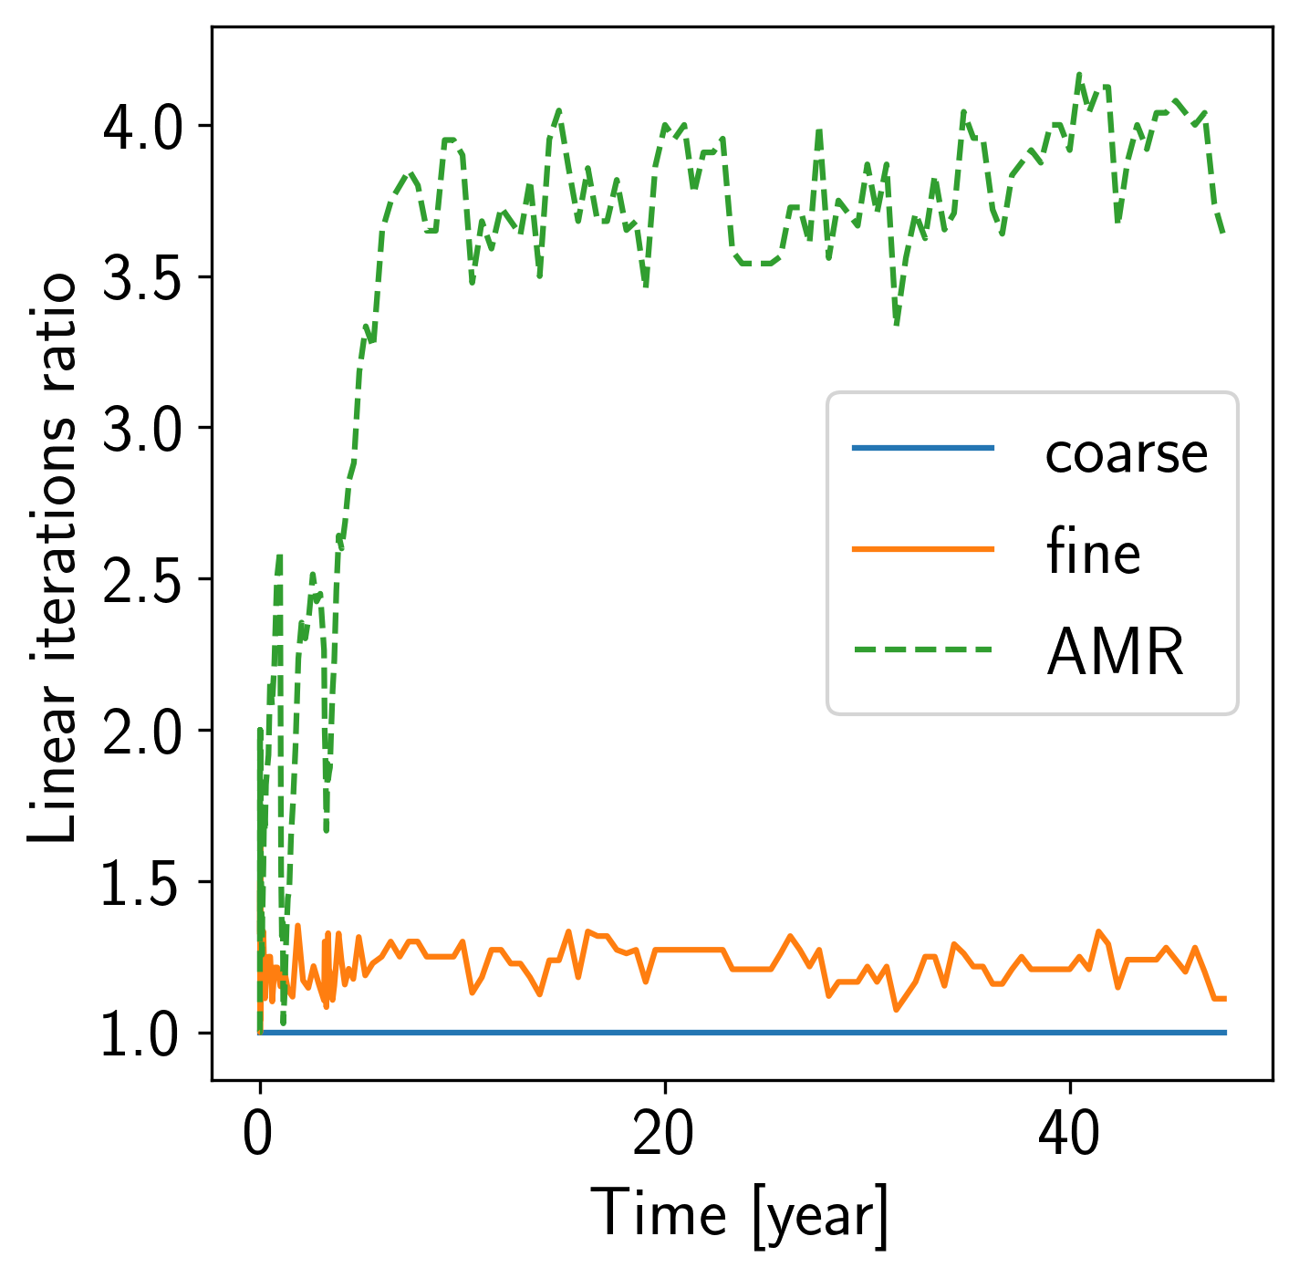
AMR : how it performs
x5
 | AMR standard | AMR every 5 | AMR on multi level
efficiency | 1.3 | 2.6 | >4 !
 | coarse | fine | AMR
eq CPU Time | 96s | 1388s | 1040s
Notes:
Knowing that the method is accurate, we need to evaluate its efficiency.
The AMR method has an obvious advantage over a completely refined simulation : the mesh size is way smaller.
However, when we look at the computational time of both simulation, we observe that the difference is not as huge as we could have expected from the mesh sizes.
Considering the efficiency, that is how faster is the AMR compared to the fine simulation, we had a efficiency of 1.3 for the standard method.
The reason for this mediocre performance is that even if the numerical problem is smaller, it is in fact more complex and requires more linear iterations than the fine problem to be solved.
To improve this efficiency, we reduced the frequency of application of the AMR, that is to use it only one every five time step. We had similar results in terms of accuracy but the efficiency doubled.
Finally, when using multi-level AMR, that is to say that we refine cells more than once, we increase the efficiency significantly.
The conclusion here is that the AMR is an efficient tool to reduce computational cost, but we can not simply look at the mesh size to evaluate its performances.

Slide 8
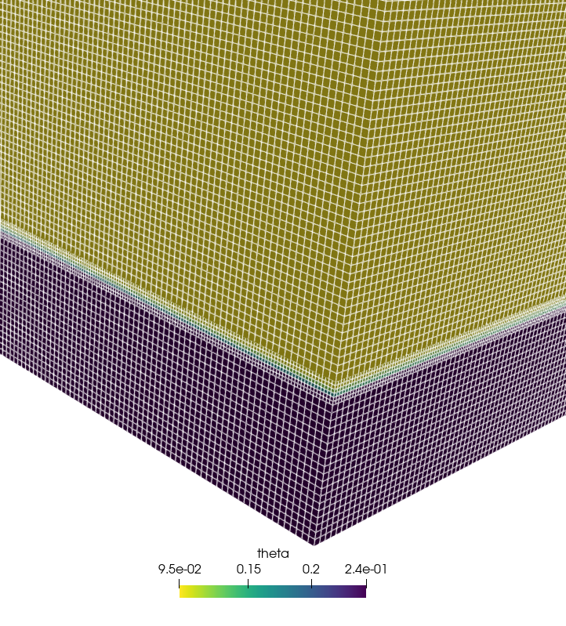
On-going works
AMR on RRE solvers
AMR on for both flow and transport
Notes:
We showed that we had efficient AMR on transport models, and we are currently working on adding AMR to the hydrological models to refine saturated/unsaturated interface.
the final objective of the project is to have AMR on both flow and transport in coupled models.

Slide 9
Thank you for your attention
Contact :
gillien.latour@toulouse-inp.fr

