Slide 1


Improving global water quality information by combining in-situ data, remote sensing and modeling
GlobeWQ Team

Slide 2
The main workhorse
„Unlimited“ parameters
Ground truthing
Long- time series
Near-realtime information
Spatially unconstrained
Limited parameters
Predictions and Scenarios
Spatially and temporally continuous

Slide 3
In situ data and SDG 6.3.2
Certainty pays off* (in decisions about hydropower management) : „uncertainty significantly reduced utility levels and willingness to pay, which indicates that the public positively values monitoring.”
*Venus and Sauer (2022), doi.org/10.1016/j.ecolecon.2021.107220

Slide 4
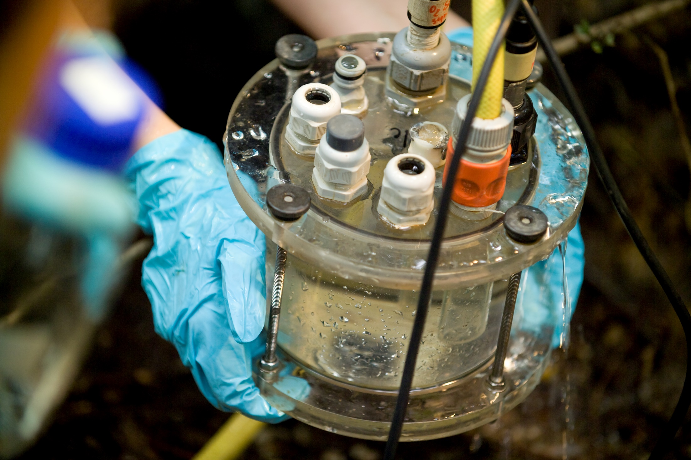
In situ data
Notes:
In situ data is considered „reliable“, high flexibility ,
Samples and sensor

Slide 5
The main workhorse
„Unlimited“ parameters
Ground truthing
Long- time series
Near-realtime information
Spatially unconstrained
Limited parameters
Predictions and Scenarios
Spatially and temporally continuous

Slide 6
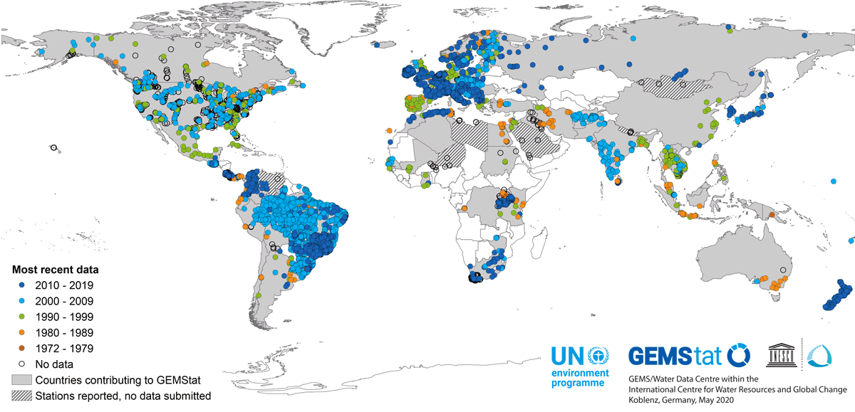
GEMStat in-situ data

Slide 7
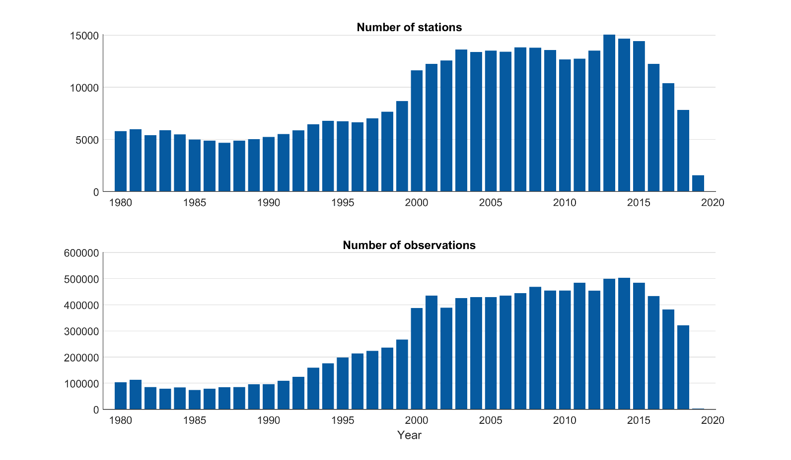
In situ data set Thorslund and van Vliet, 2020

Slide 8
In situ data set Thorslund and van Vliet, 2020

Slide 9
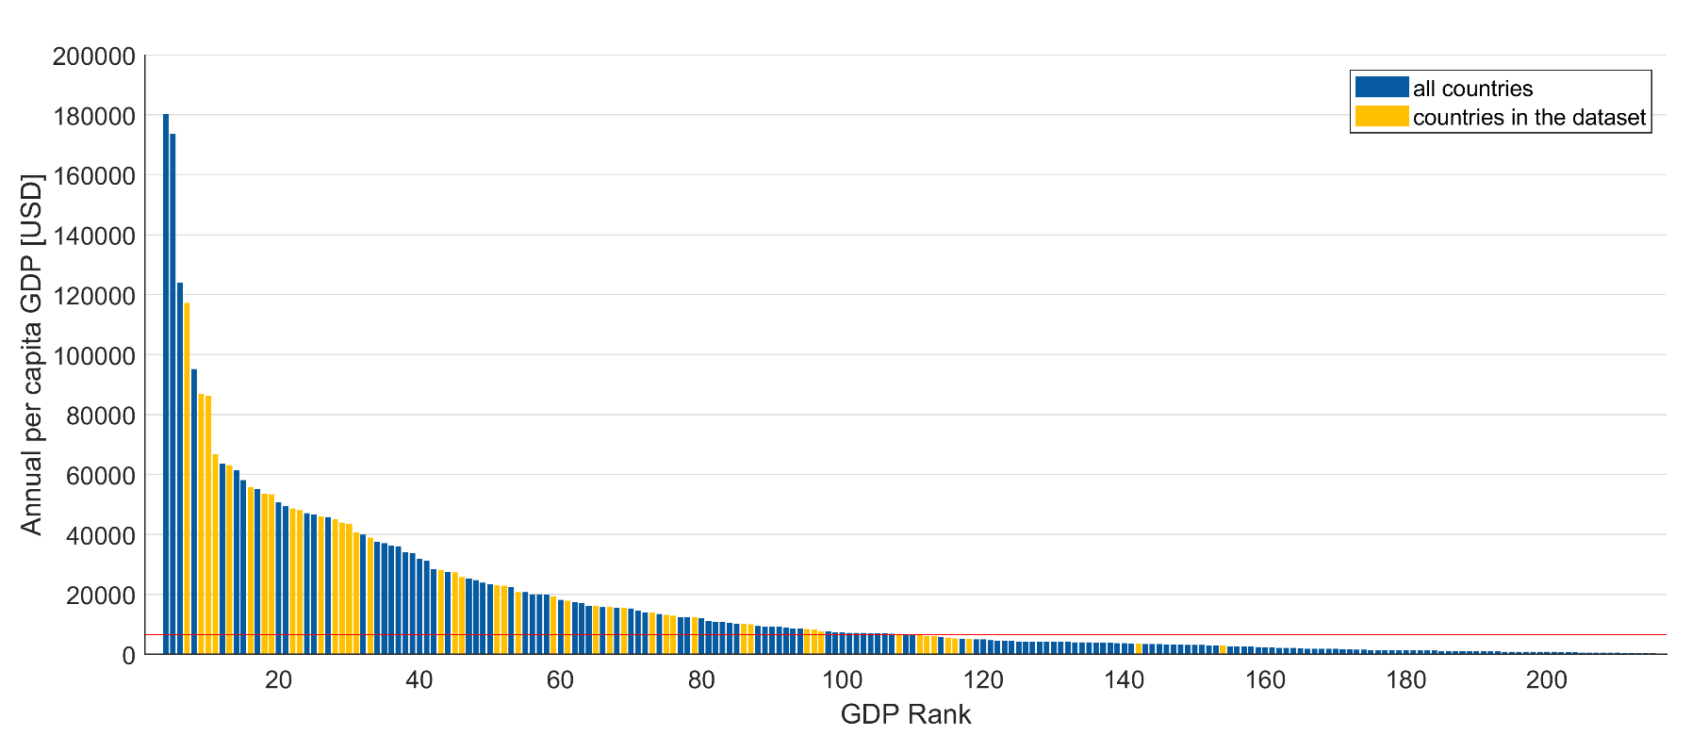
Water Quality Information vs. GDP

Slide 10

In situ data- Ways forward
More rigorous mining of available data→ Comes with huge efforts for collection (manual, via API, webscraping) and preprocessing
Application of automated sensors could ensure timely availability
„Standardisation“ of lead times also for samples

Slide 11
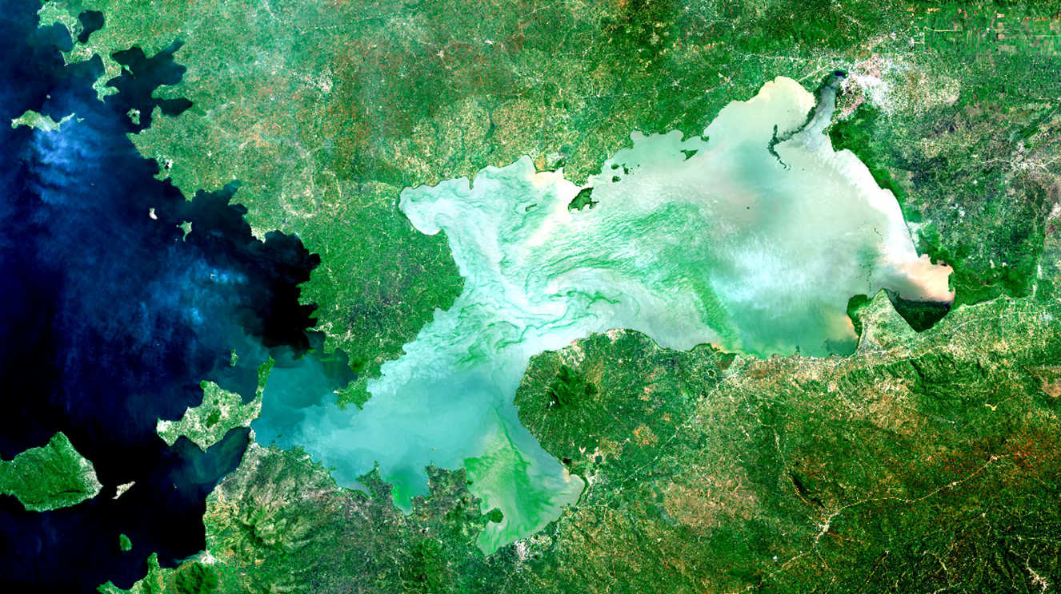
Remote sensing

Slide 12
The main workhorse
„Unlimited“ parameters
Ground truthing
Long- time series
Near-realtime information
Spatially unconstrained
Limited parameters
Predictions and Scenarios
Spatially and temporally continuous

Slide 13
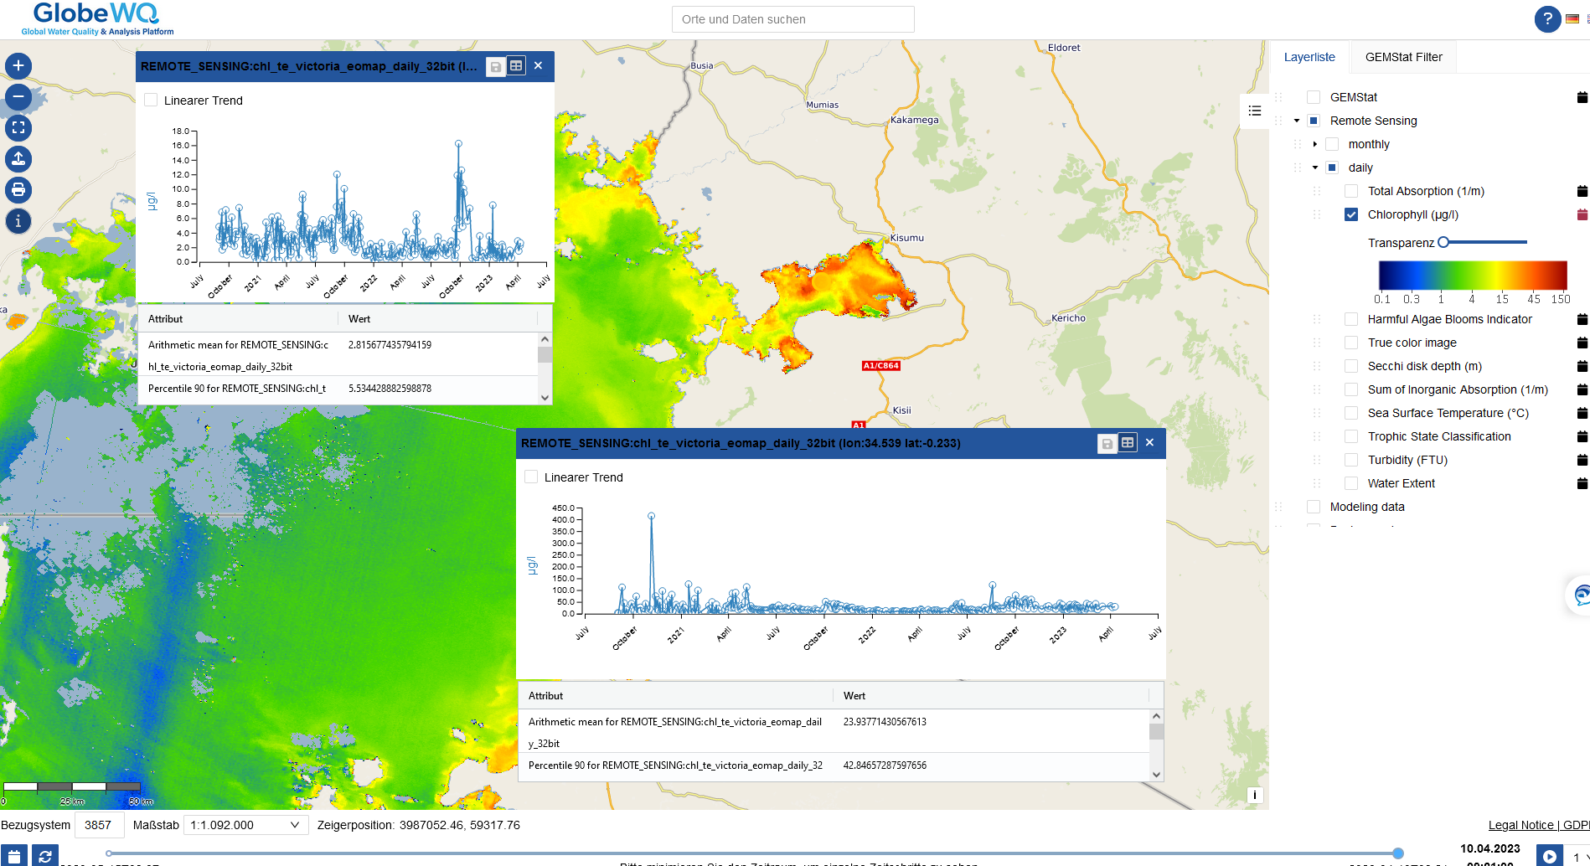
Water quality from remote sensing
www.globewq.info

Slide 14
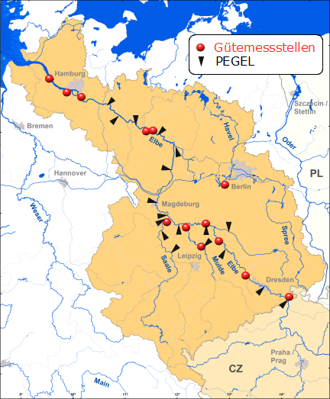

Remote sensing „water quality stations“ - Elbe
Complement spatially sparse, automated WQ stations with remote sensing data for turbidity and chlorophyll
https://undine.bafg.de/elbe/elbegebiet.html

Slide 15
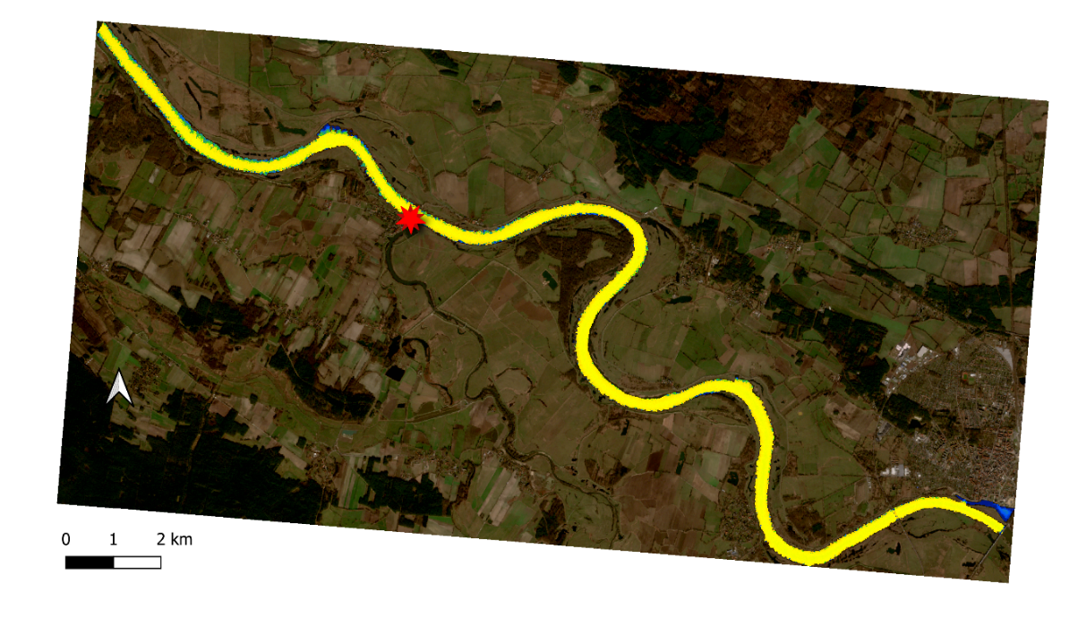
Station Schnackenburg
Turbidity, Chlorophyll 2018/2019
Remote sensing: Sentinel2
In situ: Sampling (low flow monitoring)+automated stations

Slide 16
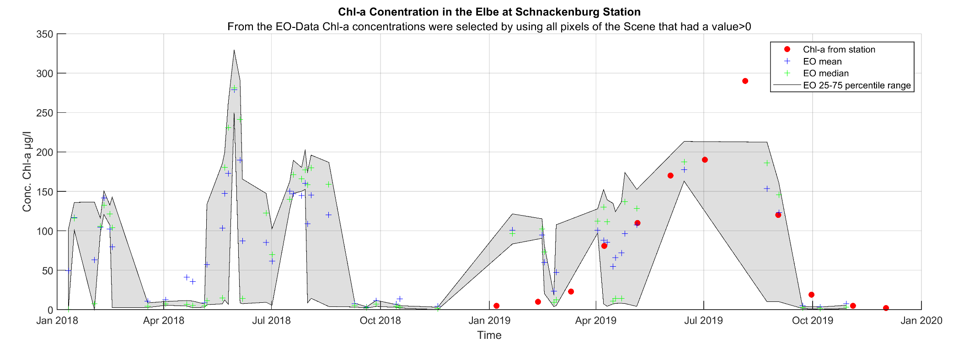
Station Schnackenburg Chlorophyll

Slide 17
Remote sensing data - ways forward
Improve integration with in situ data
Remote sensing data is currently hardly used to inform water quality models (for water quality itself and for drivers)
Scope applications for routine monitoring
Development of more automated image processing workflows
Notes:
- Bigfe Erfassung der Wasserqualität und Wasserflächenausdehnung von Binnengewässern durch Fernerkundung
- Some data sets that may feed into models make , e.g. GDP estimation

Slide 18
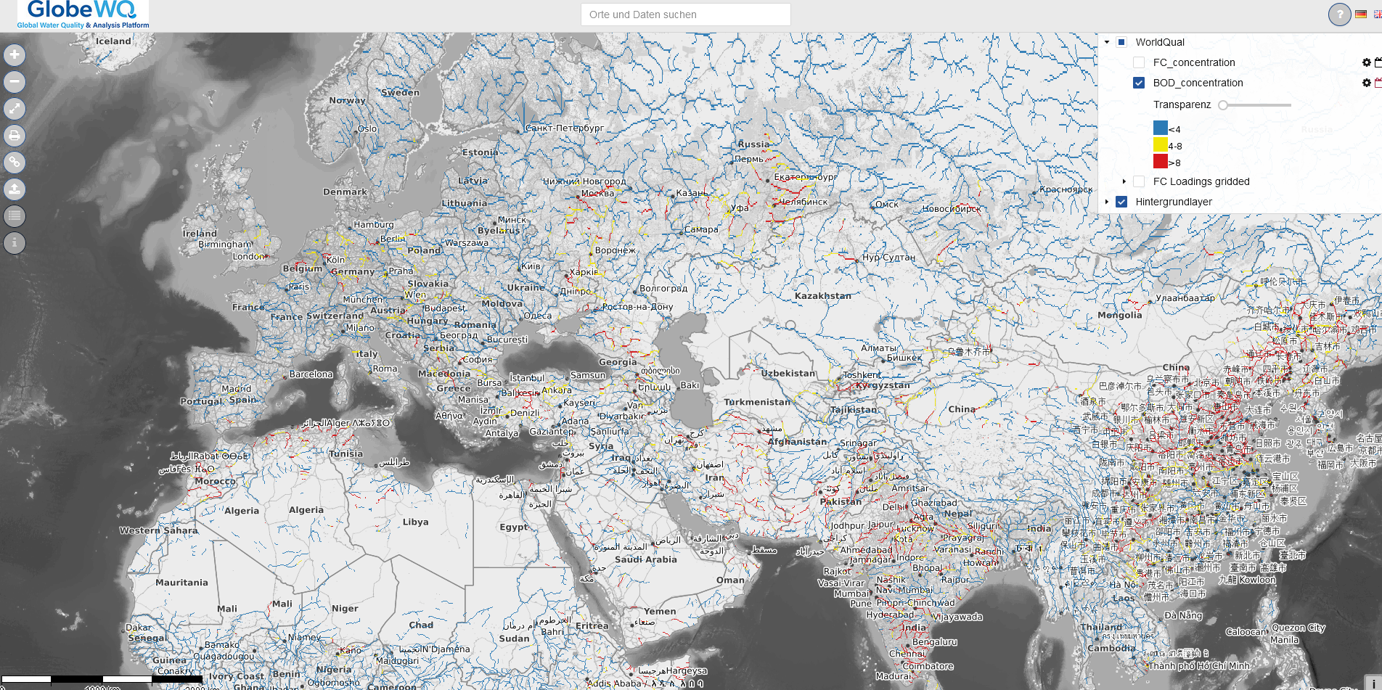
Water Quality Modelling

Slide 19
The main workhorse
„Unlimited“ parameters
Ground truthing
Long- time series
Near-realtime information
Spatially unconstrained
Limited parameters
Predictions and Scenarios
Spatially and temporally continuous

Slide 20
Water quality models

Slide 21
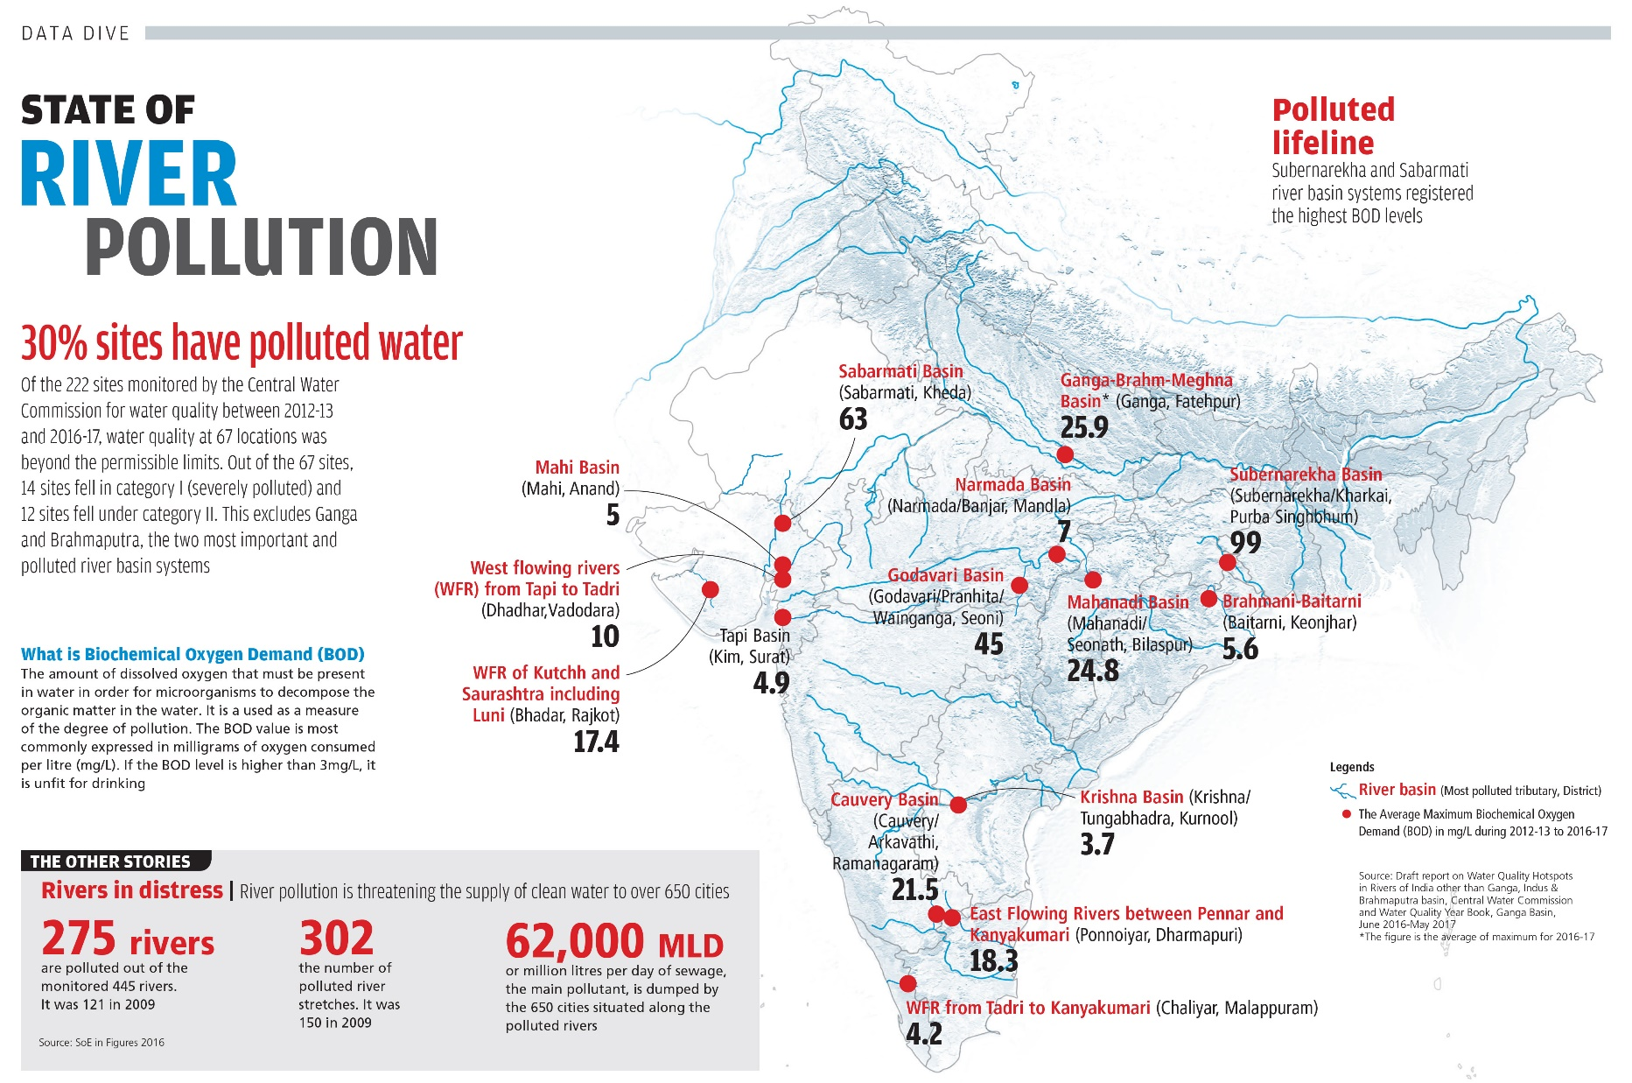
http://cdn.downtoearth.org.in/library/original/2018-03-14/0.95391200_1521004025_56-57.jpg

Slide 22
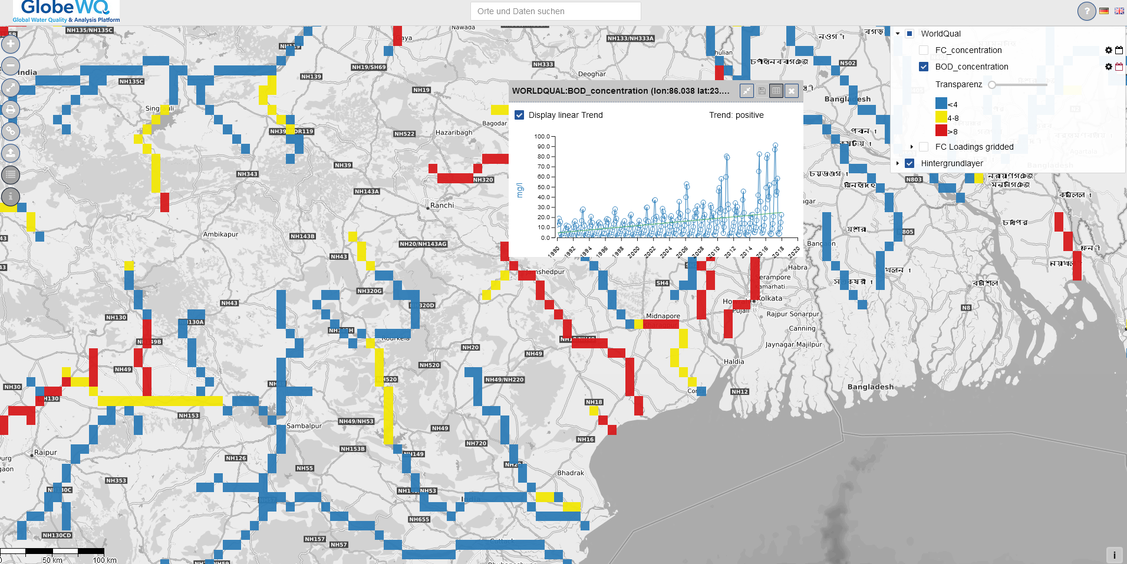

Slide 23
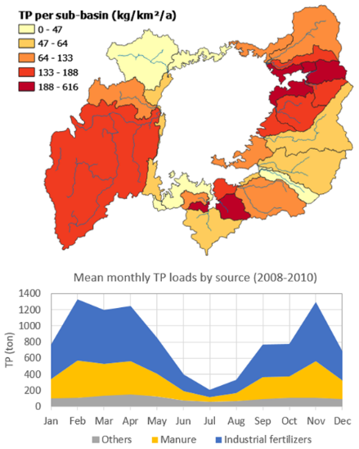
Water quality models
Models are data integrators
  Point data to aerial information
  „Temporal inter-and extrapolation“
Learning from models on the drivers of water quality
Models are wrong but consistent
Source: Chair of Engineering Hydrology and Water Resources Management at Ruhr University Bochum

Slide 24
Data driven models- Example Nitrate
Virro et al., 2021: Global River Water Quality Archive (GRQA
Monthly NO3N
Stations: 45255
Time span: 1990-2015
Gridded to 0.0833 degree (~10km)
Temporal availability of observations
Notes:
The underlying data set of Virro is an ensemble data but not updated → archive

Slide 25
Data driven models- Example Nitrate
Overall 24 explanatory variables tested

Slide 26
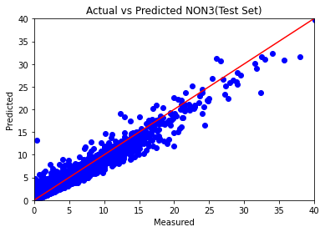
Data driven models- Example Nitrate

Slide 27
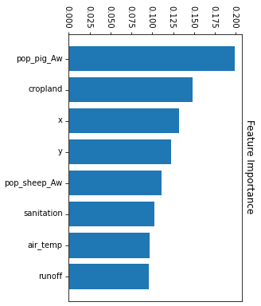
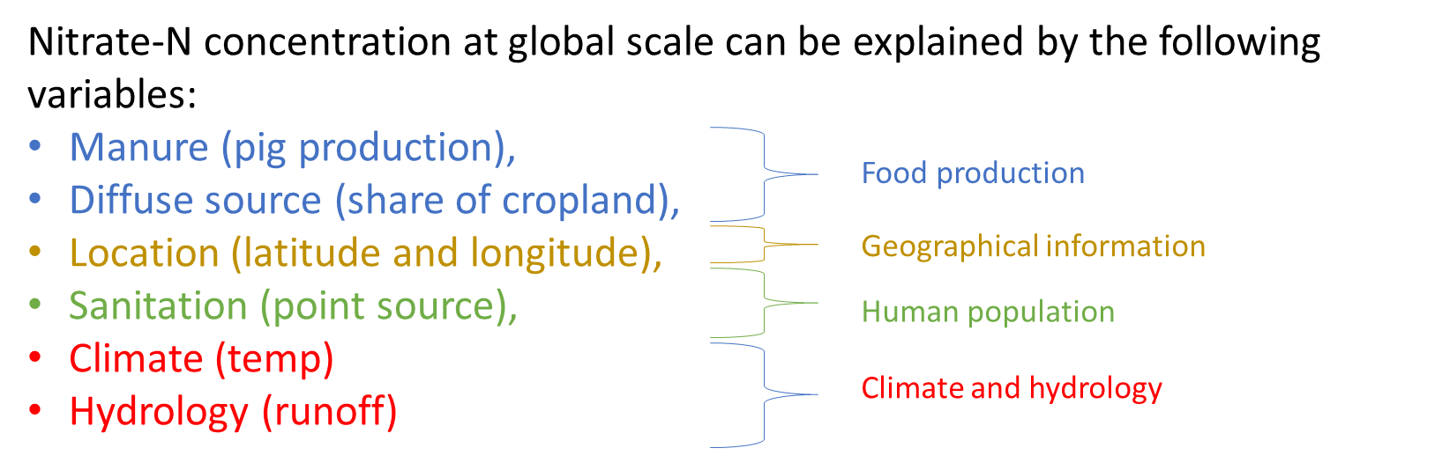
Data driven models- Example Nitrate
But: Training data set biased towards Europa and the US

Slide 28
Water Quality Models - Ways forward
Flexible model concepts that can ingest diverse data (e.g. from remote sensing)
Utilize data driven and emerging ML approaches or hybrid (physics-informed ML) concepts, e.g. for short term forecasts
Ensemble model approaches can increase the robustness of results

Slide 29
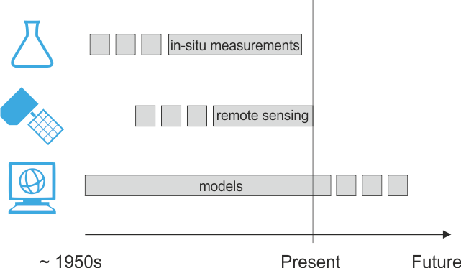
Summary
Predictions/Scenarios

Slide 30

Summary
Combine different situ data sources
Reduce lead time between measurement and availability
Complement sparse in situ data
Insight into spatial patterns
Automatization and up-scaling needed
Flexible model concepts that allow the ingestion of diverse data

Slide 31


Thank you for your attention

Slide 32
Image sources, www.pixabay.com, UFZ Bilddatenbank

Slide 33
Some back-up slides

Slide 34
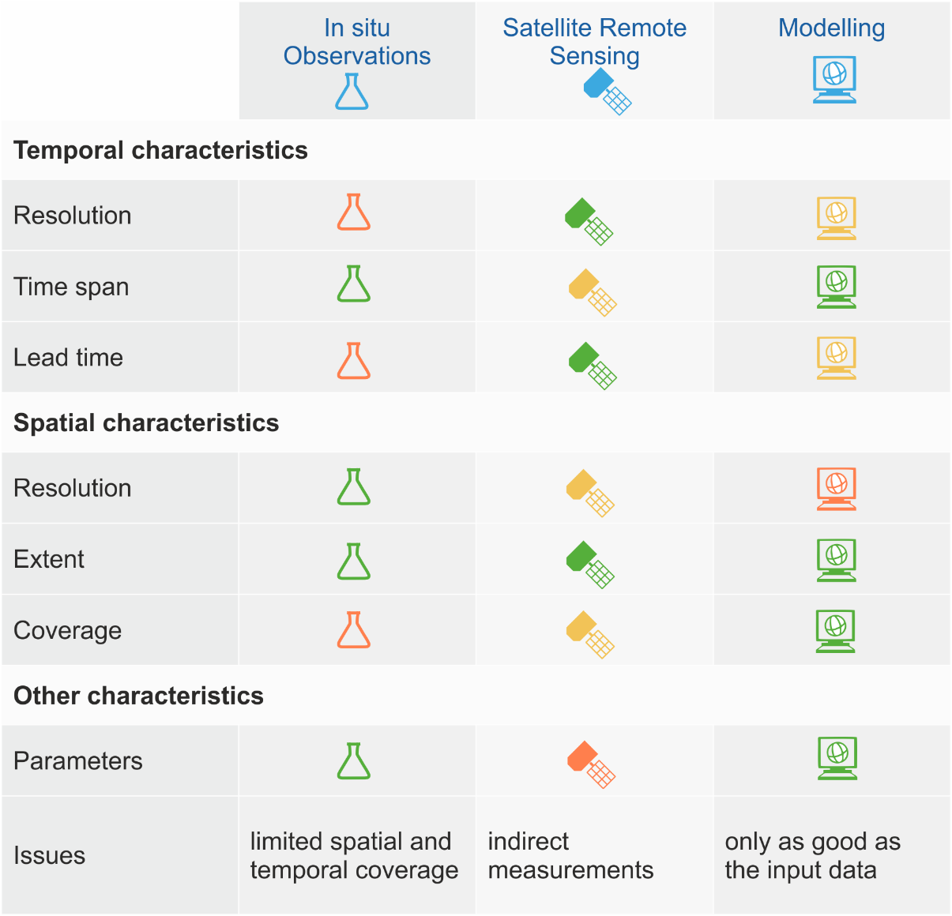

Slide 35

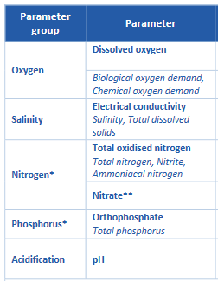
Water quality
EU WRRL: 33 Priority Substances+Nitrate
SDG Indicator 6.3.2
https://communities.unep.org/display/sdg632/Documents+and+Materials?preview=/32407814/38306240/CDC_GEMI2_TechDoc1_MonProgDes_20200413.pdf#DocumentsandMaterials-Technical
Notes:
What is water quality?
focus on chemical water quality --> concentrations of solutes-
Parameters and substances of concern differ.

Slide 36
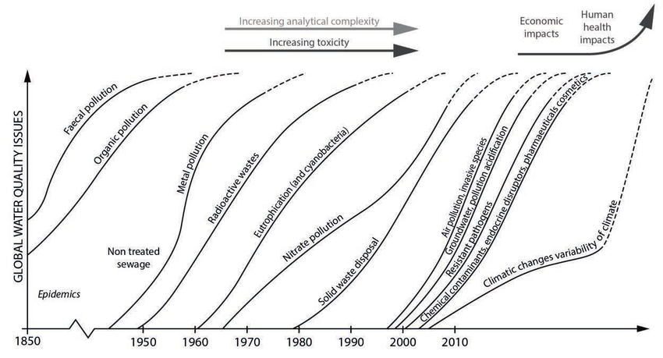
Emerging threats to water quality
Tundisi et al. (2015). 10.5194/piahs-366-75-2015.

Slide 37
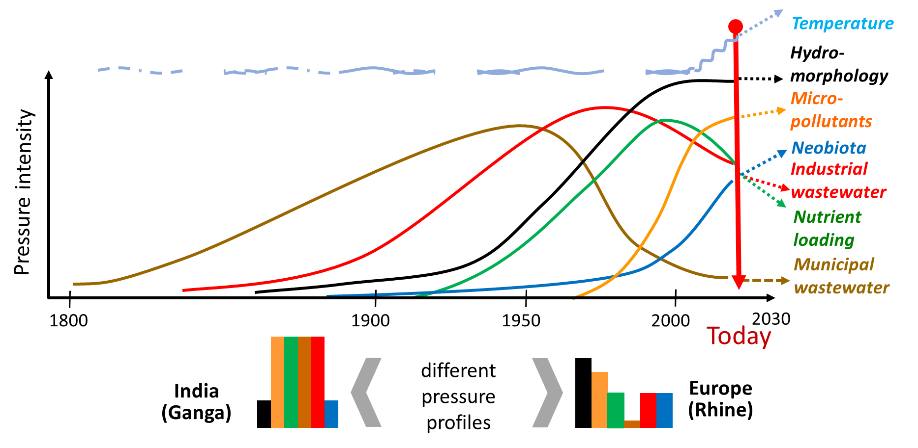
Trajectories of water quality

