Slide 1
ESA CCI and C3S Soil Moisture
New Developments and Recent Applications
W. Preimesberger, P. Stradiotti, R. Madelon, R. van der Schalie, N. Rodriguez-Fernandez, M. Hirschi, A. Pasik, A. Gruber, W. Dorigo, R. de Jeu, R. Kidd, and C. Albergel

Slide 2
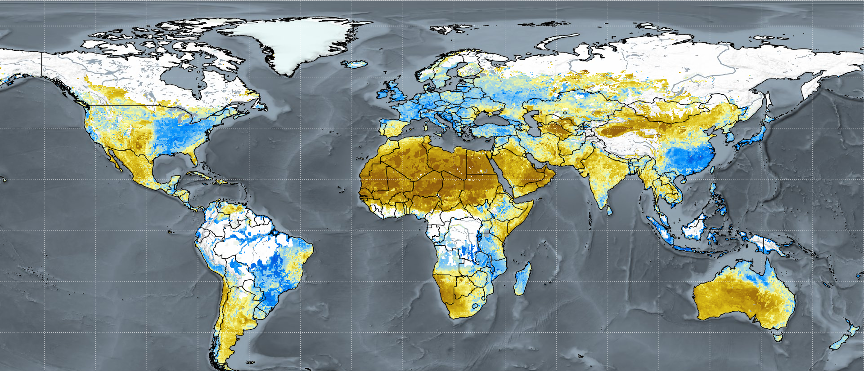
ESA CCI and C3S Soil Moisture
ESA CCI SM
Long-term soil moisture data records
> 40 years of soil moisture
Data from 19 different satellites
0.25 degree resolution (~daily)
Scientific dataset, annual release
C3S Soil Moisture
Operational product based on ESA CCI SM
Implements NRT data streams
AMSR2, SMOS, SMAP, ASCAT-B / C
Monthly and 10-daily averages are provided
Updated every 10 days (10-20 days delay)
March 2023
https://dataviewer.geo.tuwien.ac.at/
Soil Moisture [m³/m³] * 100
0 0.125 0.25 0.375 0.5
wolfgang.preimesberger@geo.tuwien.ac.at
EGU23-13224 - HS 6.1 - ESA CCI and C3S Soil Moisture New Developments and Recent Applications

Slide 3
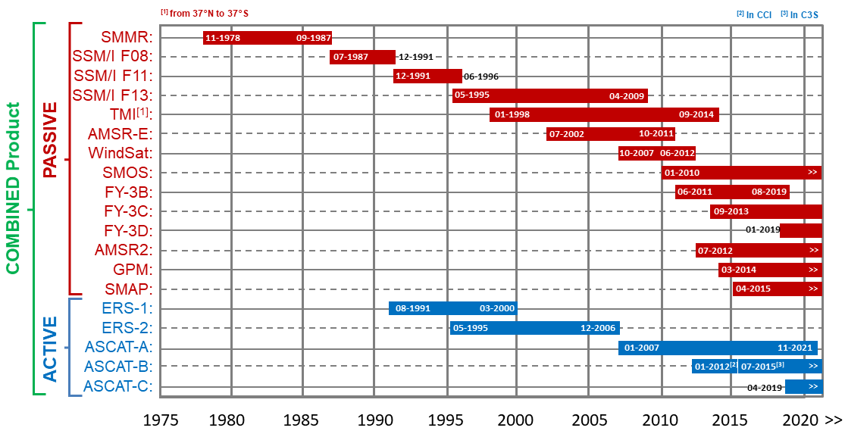
ESA CCI / C3S SM Data and Methods
Scatterometer Products (active)
L3 ASCAT SSM is provided by H SAF
ERS and ASCAT SSM are based on TU Wien Change Detection method
Radiometer Products (passive)
Land Parameter Retrieval Model (LPRM) for SM retrieval from all passive sensors (van der Schalie et al., 2021)
CDF-matching to harmonize observations
Triple collocation analysis based merging (Gruber et al., 2019)
Break correction applied at sensor transitions (Preimesberger et al., 2021)
Sensor A
Sensor B
Scaling
Scaling
Reference
Error Estimation
Error Estimation
Merging
wolfgang.preimesberger@geo.tuwien.ac.at
EGU23-13224 - HS 6.1 - ESA CCI and C3S Soil Moisture New Developments and Recent Applications

Slide 4
ESA CCI & C3S SM Version Overview
v06.1
v07.1
v08.1
Flagging consistency has been improved
Temporal break correction introduced
3 additional satellites
Daytime passive observations are used
Intra-annual CDF matching introduced
EGU23-13940 (Oral)
Accounting for Seasonal Soil Moisture Retrieval Errors in the Generation of Climate Data Records
P. Stradiotti (17:37)
Intra-annual uncertainty estimates
Experimental gap-filled COMBINED product
Experimental model-free COMBINED product
v202012
v202212
2021
2022
2023
wolfgang.preimesberger@geo.tuwien.ac.at
EGU23-13224 - HS 6.1 - ESA CCI and C3S Soil Moisture New Developments and Recent Applications

Slide 5
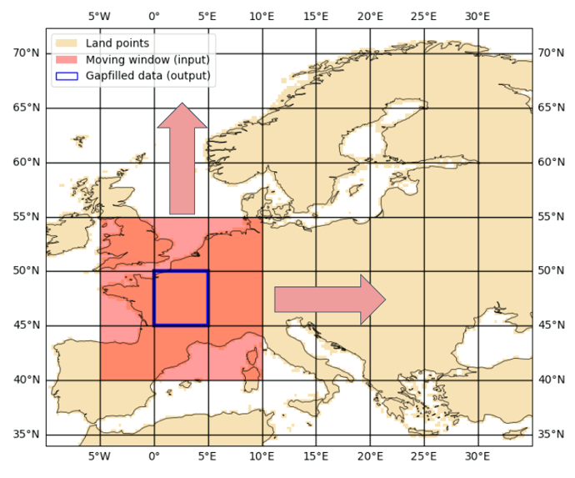
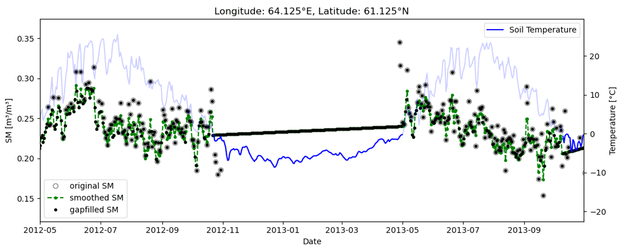
Gap-filled COMBINED Product
Using extra satellite observations in densely vegetated areas (L / C-band)​
Apply gap-filling algorithm: Discrete Cosine Transform (Garcia, 2010)​
Via moving window (15x15 deg, increased if necessary)​
Linear interpolation when soil temperature < 0° C​
Fill gaps in original data set​, keep observations
wolfgang.preimesberger@geo.tuwien.ac.at
EGU23-13224 - HS 6.1 - ESA CCI and C3S Soil Moisture New Developments and Recent Applications

Slide 6
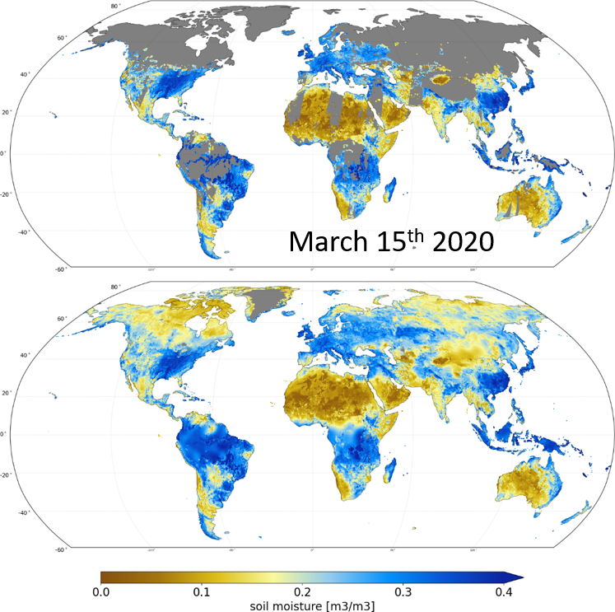
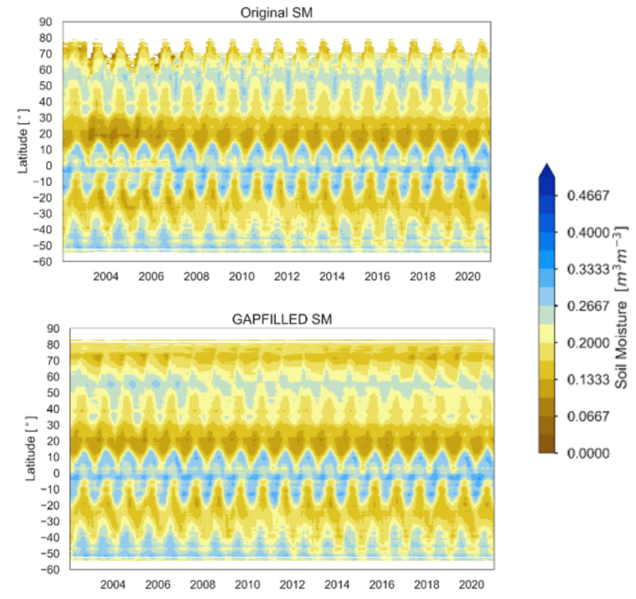
Gap-filled COMBINED Product
before
after
Smooth transition between original and gap-filled values over the whole period ✔
Validation of gap-filled product w.r.t. ERA5 and in situ reference soil moisture data ✔
wolfgang.preimesberger@geo.tuwien.ac.at
EGU23-13224 - HS 6.1 - ESA CCI and C3S Soil Moisture New Developments and Recent Applications

Slide 7
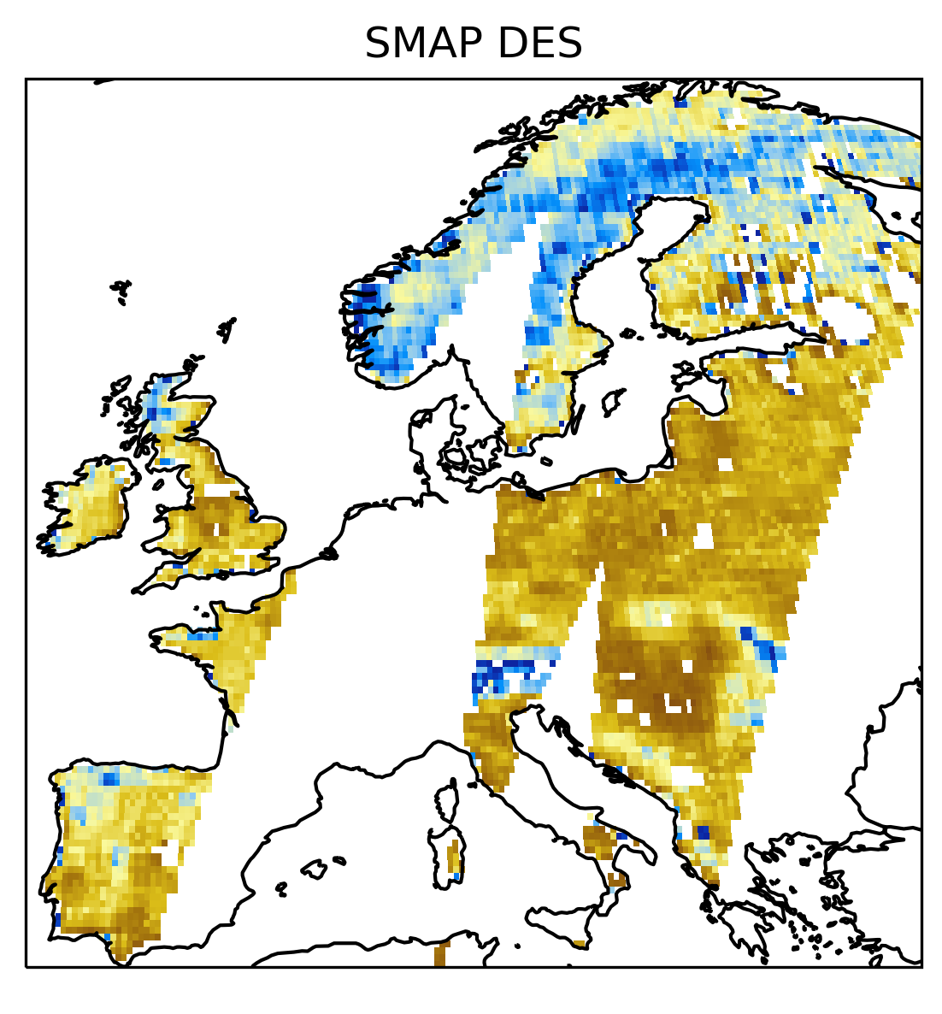
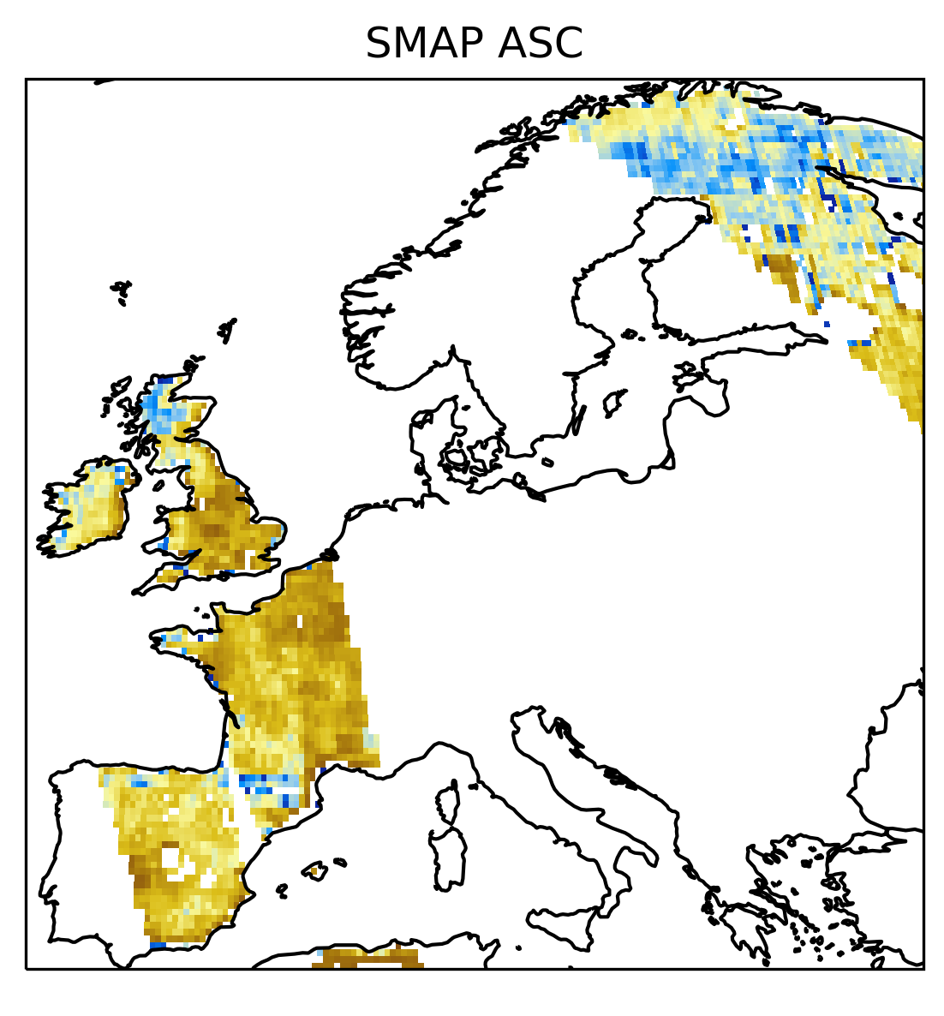
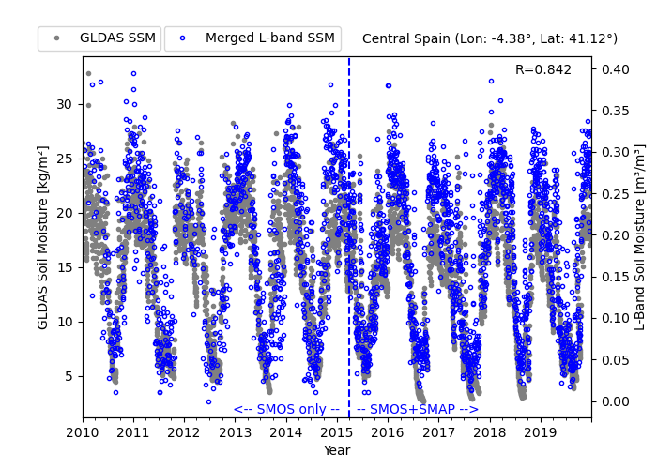
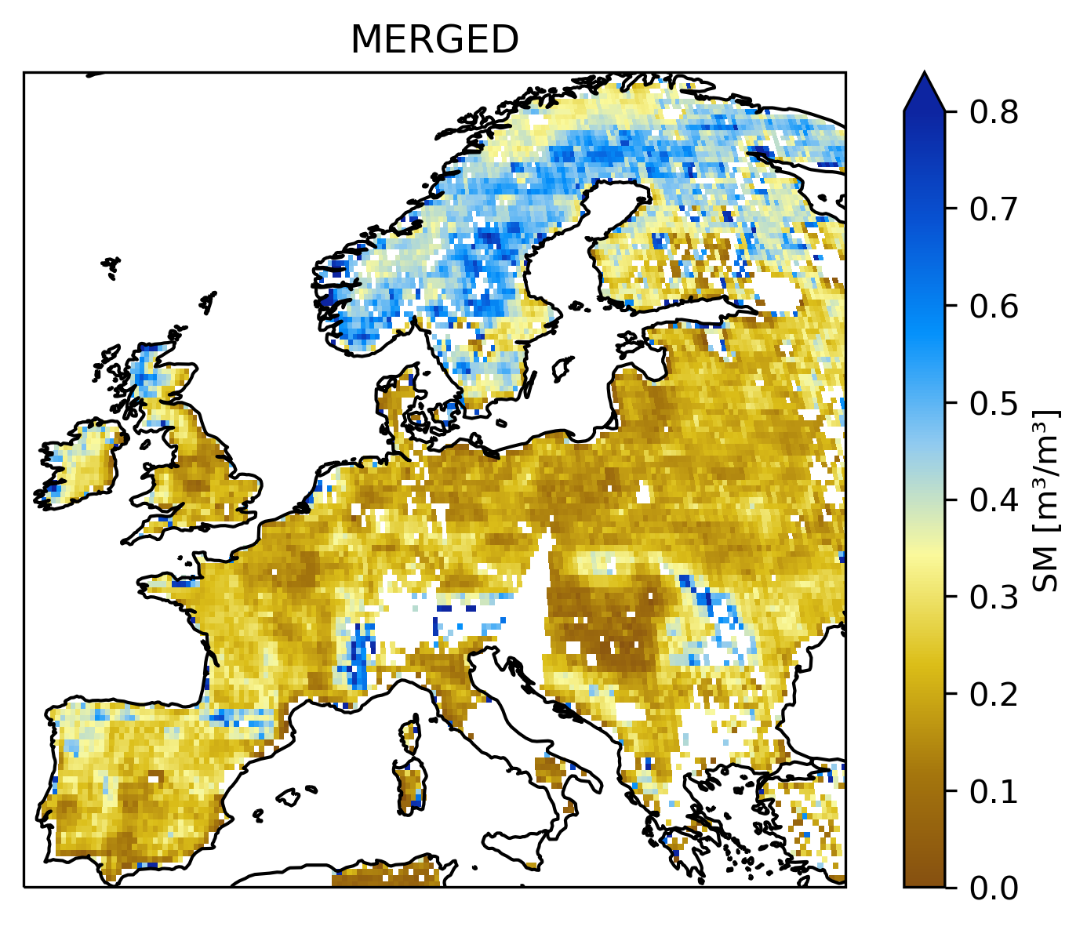
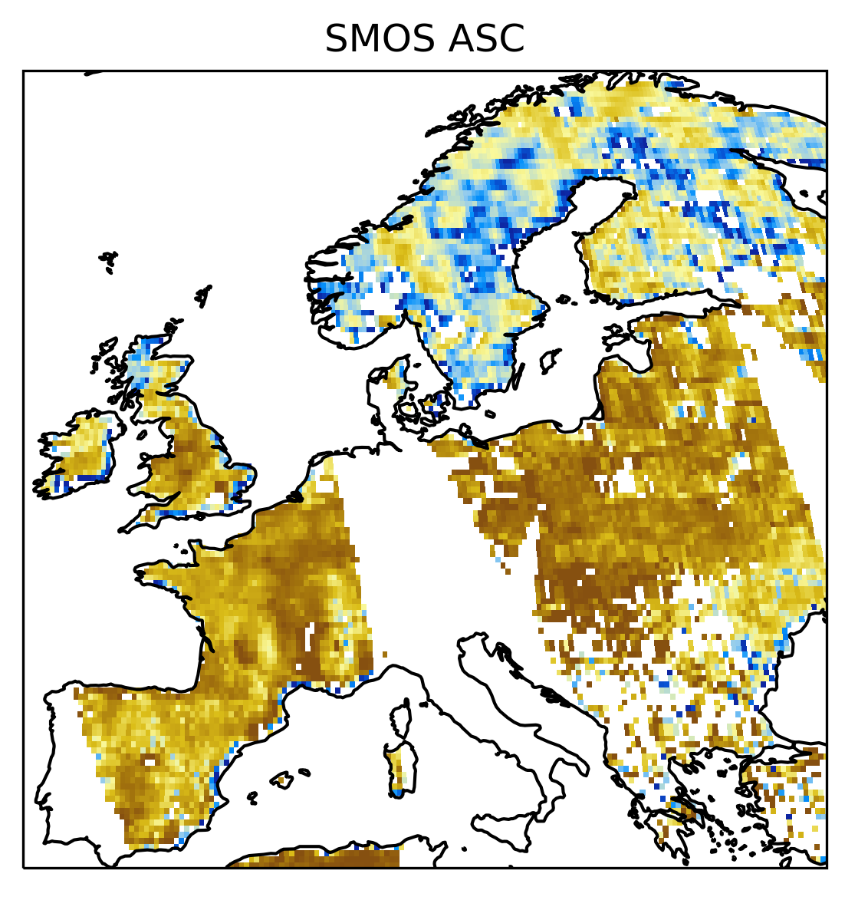
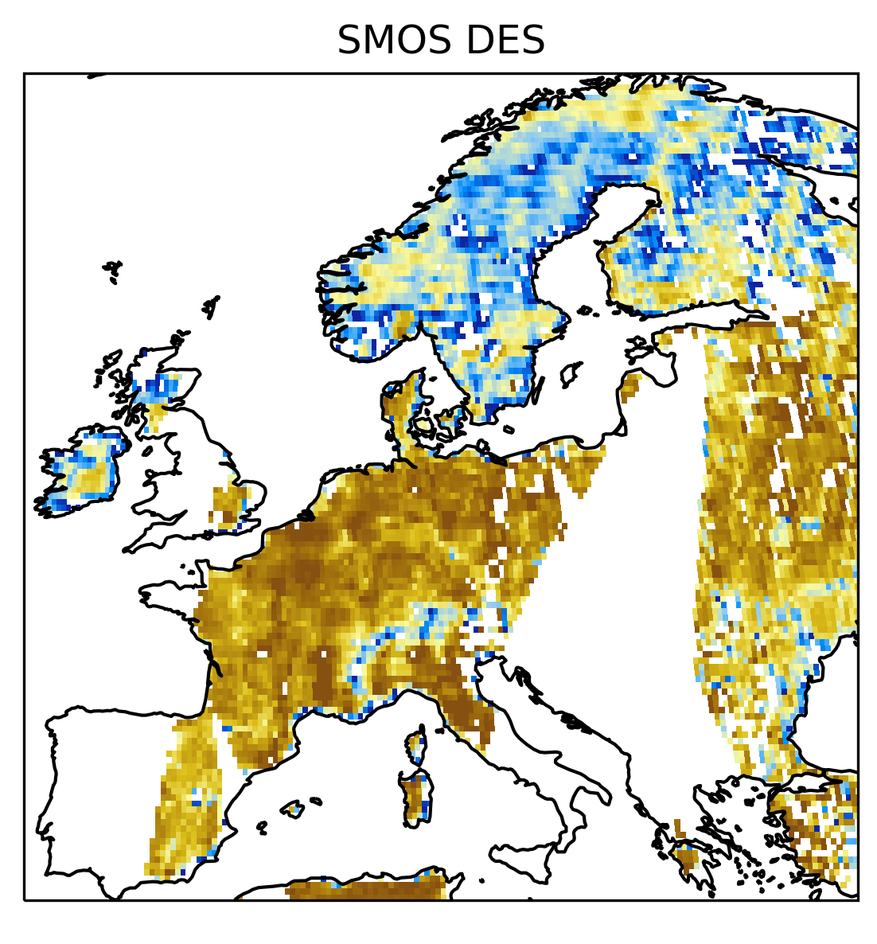
Model-free COMBINED product
GLDAS Noah SM is currently used as scaling reference in CCI COMBINED
Merged SMAP + SMOS L-band SM to replace GLDAS Noah (Madelon et al., 2022)
In CCI v8, a first experimental product is available from 2010-2022
Merging L3 SM in v8.1; in the future merging on brightness temperature level
2021-06-18
wolfgang.preimesberger@geo.tuwien.ac.at
EGU23-13224 - HS 6.1 - ESA CCI and C3S Soil Moisture New Developments and Recent Applications

Slide 8
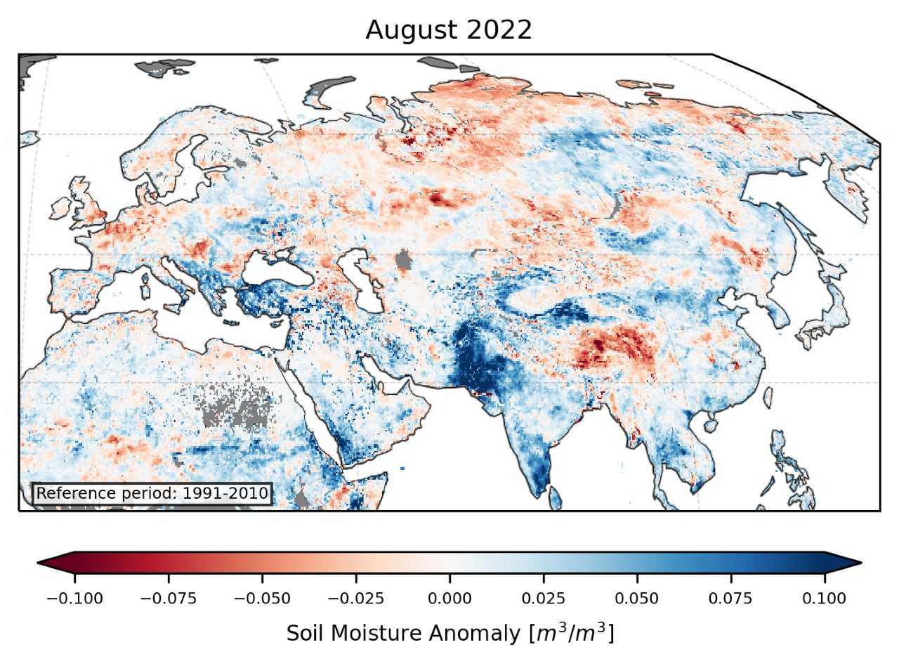
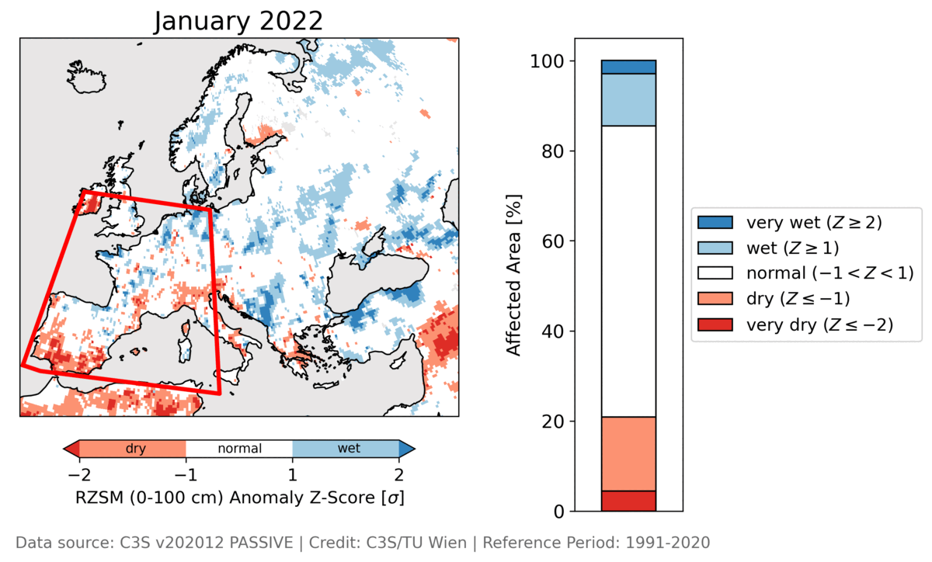
Example Applications
ESA CCI and C3S SM are widely used data sets (>100 peer reviewed publications / year) and contribute to e.g. BAMS and European State of the Climate reports, Global Water Monitor, … and many more
Pakistan flooding (August 2022) related soil moisture anomalies
Soil Moisture Z-score drought classification
(from European State of the Climate in 2022)
wolfgang.preimesberger@geo.tuwien.ac.at
EGU23-13224 - HS 6.1 - ESA CCI and C3S Soil Moisture New Developments and Recent Applications

Slide 9
Data Availability
ESA CCI SM
v8.1 products will be released in May
ACTIVE, PASSIVE, COMBINED, GAP-FILLED COMBINED, MODEL-FREE COMBINED
Visit the website for more details https://climate.esa.int/en/projects/soil-moisture/
Past versions are archived at https://archive.ceda.ac.uk/
C3S SM
v202212 will be released soon. User help materials are provided with the data.
Temporal extensions (ICDRs) will be provided after release of the TCDR
Available at Copernicus Climate Data Store https://cds.climate.copernicus.eu
Data from the International Soil Moisture Network (ISMN) is available for free at https://ismn.earth
The QA4SM validation service can be freely accessed at https://qa4sm.eu/
The Global Water Monitor report is published at https://wenfo.org/globalwater/
A. Gruber et al., "Evolution of the ESA CCI Soil Moisture climate data records and their underlying merging methodology," Earth Syst. Sci. Data, vol. 11, pp. 717-739, 2019. [Online]. Available: https://doi.org/10.5194/essd-11-717-2019.
R. van der Schalie et al., “L-Band Soil Moisture Retrievals Using Microwave Based Temperature and Filtering. Towards Model-Independent Climate Data Records,” Remote Sensing, vol. 13, no. 13, p. 2480, Jun. 2021, doi: 10.3390/rs13132480.
W. Preimesberger, T. Scanlon, C. -H. Su, A. Gruber and W. Dorigo, "Homogenization of Structural Breaks in the Global ESA CCI Soil Moisture Multisatellite Climate Data Record," in IEEE Transactions on Geoscience and Remote Sensing, vol. 59, no. 4, pp. 2845-2862, April 2021, doi: 10.1109/TGRS.2020.3012896.
D. Garcia, "Robust smoothing of gridded data in one and higher dimensions with missing values," Comput. Stat. Data Anal., vol. 54, no. 4, pp. 1167-1178, Apr. 2010. doi: 10.1016/j.csda.2009.09.020.
R. Madelon et al., "Toward the Removal of Model Dependency in Soil Moisture Climate Data Records by Using an L-Band Scaling Reference," in IEEE Journal of Selected Topics in Applied Earth Observations and Remote Sensing, vol. 15, pp. 831-848, 2022, doi: 10.1109/JSTARS.2021.3137008.
wolfgang.preimesberger@geo.tuwien.ac.at
EGU23-13224 - HS 6.1 - ESA CCI and C3S Soil Moisture New Developments and Recent Applications

