Slide 1
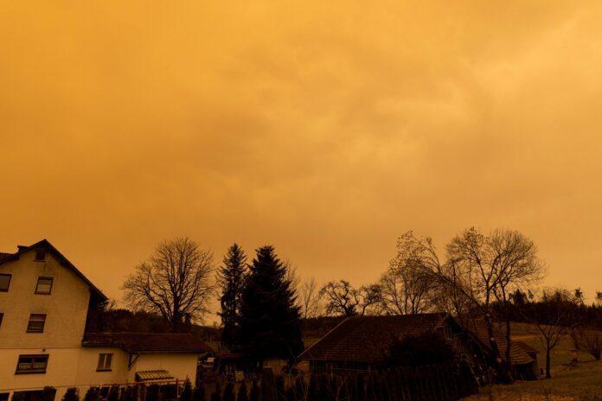
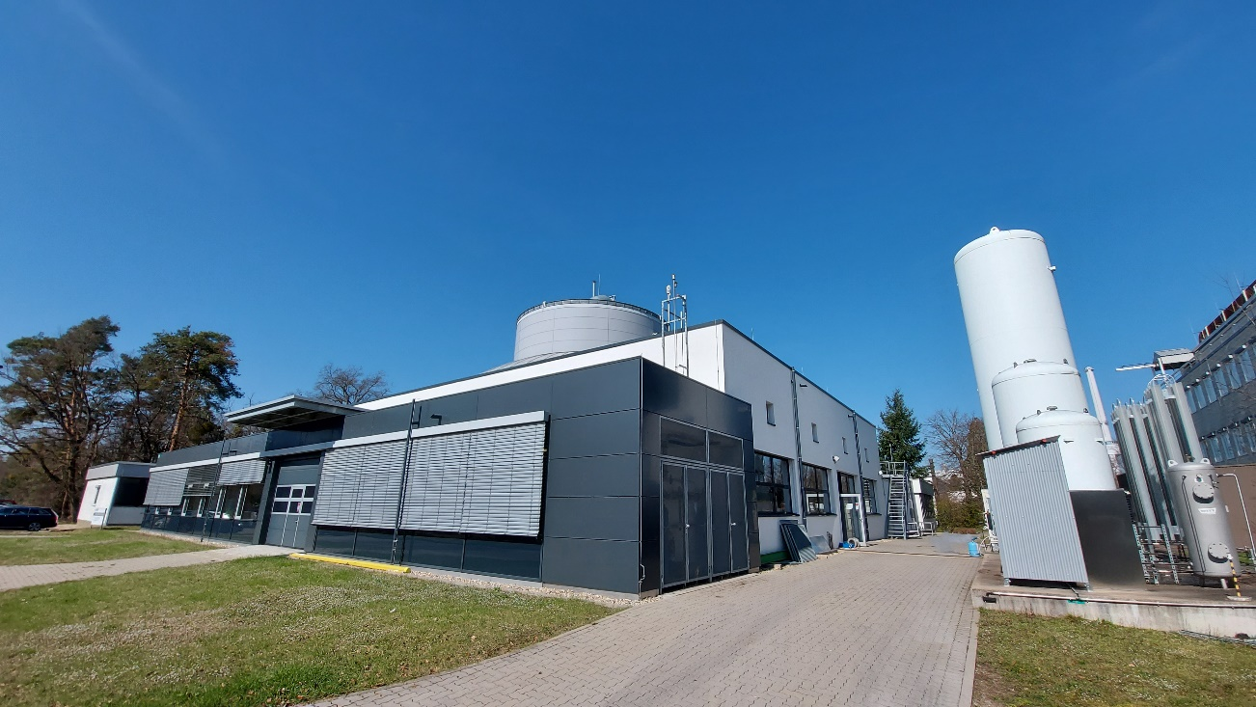
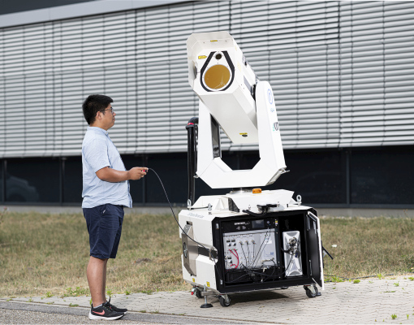
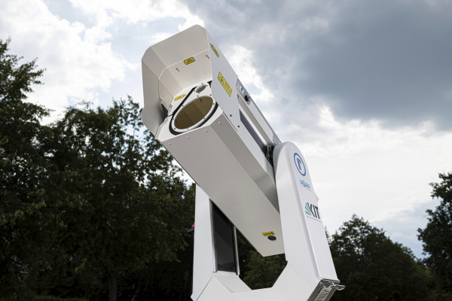
Investigation of Saharan dust plumes in Western Europe by remote sensing, in situ measurements, and transport modelling
Hengheng Zhang, Frank Wagner, Gholam Ali Hoshyaripour, Heike Vogel, and Harald Saathoff
2023.04.24

Slide 2
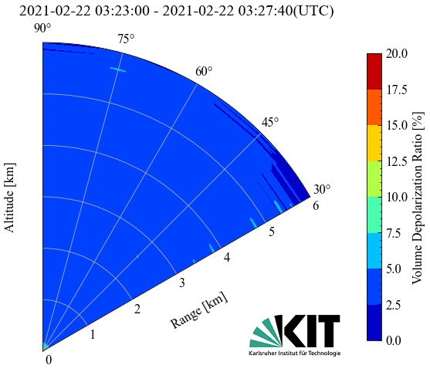
Research objective and experiment
Objective: Combining Lidar measurements with in situ measurements and the
ICON-ART model to study the transport and properties of Saharan dust plumes.
Time and place:
April, 2018 (Karlsruhe)
February, 2021 (Karlsruhe)
June, 2021(Rottenburg)
March, 2022 (Karlsruhe)
June, 2022 (Karlsruhe)
February, 2021 (KIT-CN)

Slide 3
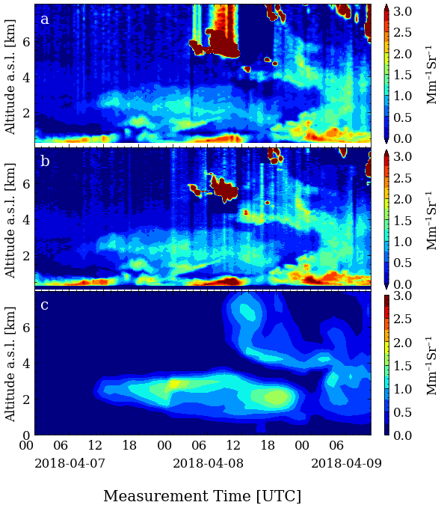
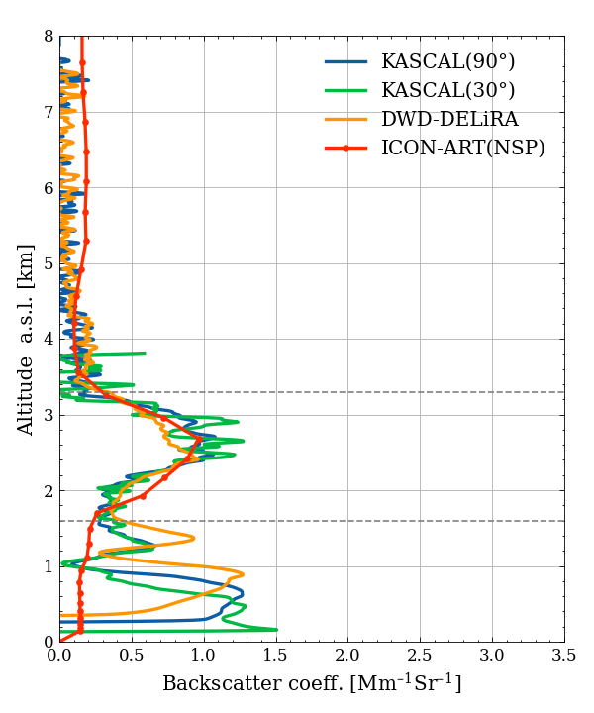
Saharan Dust plume in April, 2018, at KIT near Karlsruhe
Clouds
Scanning lidar (KASCAL)
Dust layer
Boundary layer
Vertical lidar (DWD-DELiRA)
Dust
ICON-ART Transport model
Boundary layer
aerosol

Slide 4
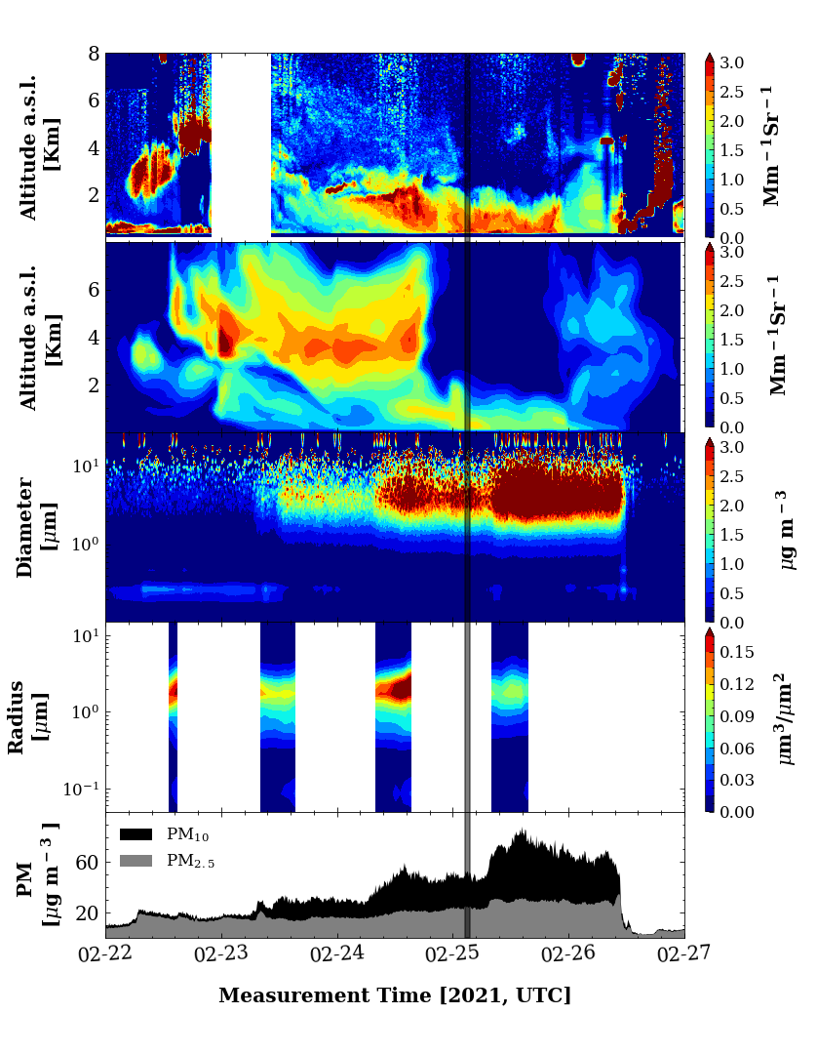
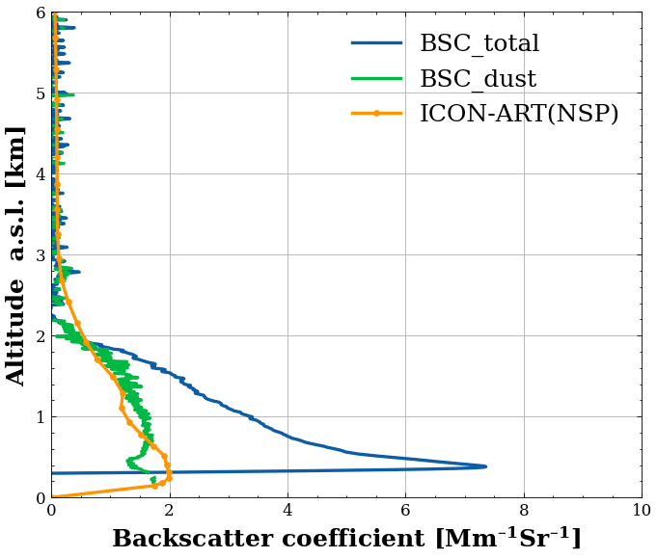
Saharan Dust plume in February, 2021, at KIT near Karlsruhe
Scanning lidar
ICON-ART model
OPC
(Fidas 200)
Sun
photometer
The ICON-ART model predicts dust backscatter coefficients. Total particles and Saharan dust can be distinguished.
The size distribution from sun photometer agrees with OPC(Fidas200) measurement
OPC
(Fidas 200)

Slide 5
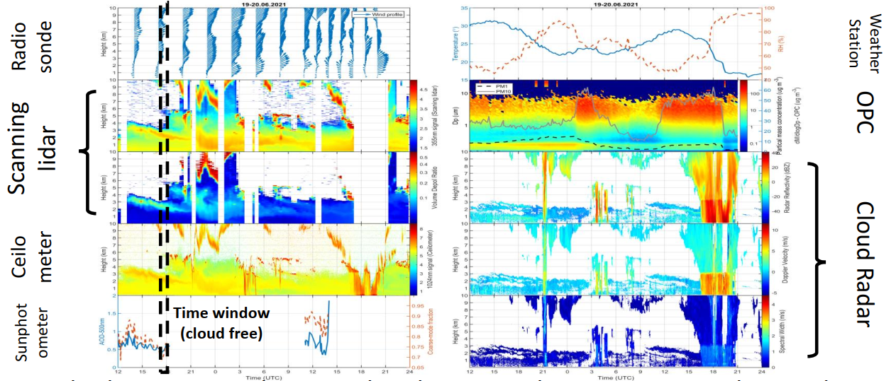
Saharan Dust plume in June, 2021, Rottenburg am Neckar
Wind profile
Wind
Relative humidity
Lidar backscatter
Particle size
Mass concentration
Depolarization
Radar reflectivity
Doppler velocity
ceilometer backscatter
AOD
Spectral width
Outlook: retrieving dust size distributions from remote sensing data in the cloud free time window to inform/improve the ICON-ART model simulation.

Slide 6
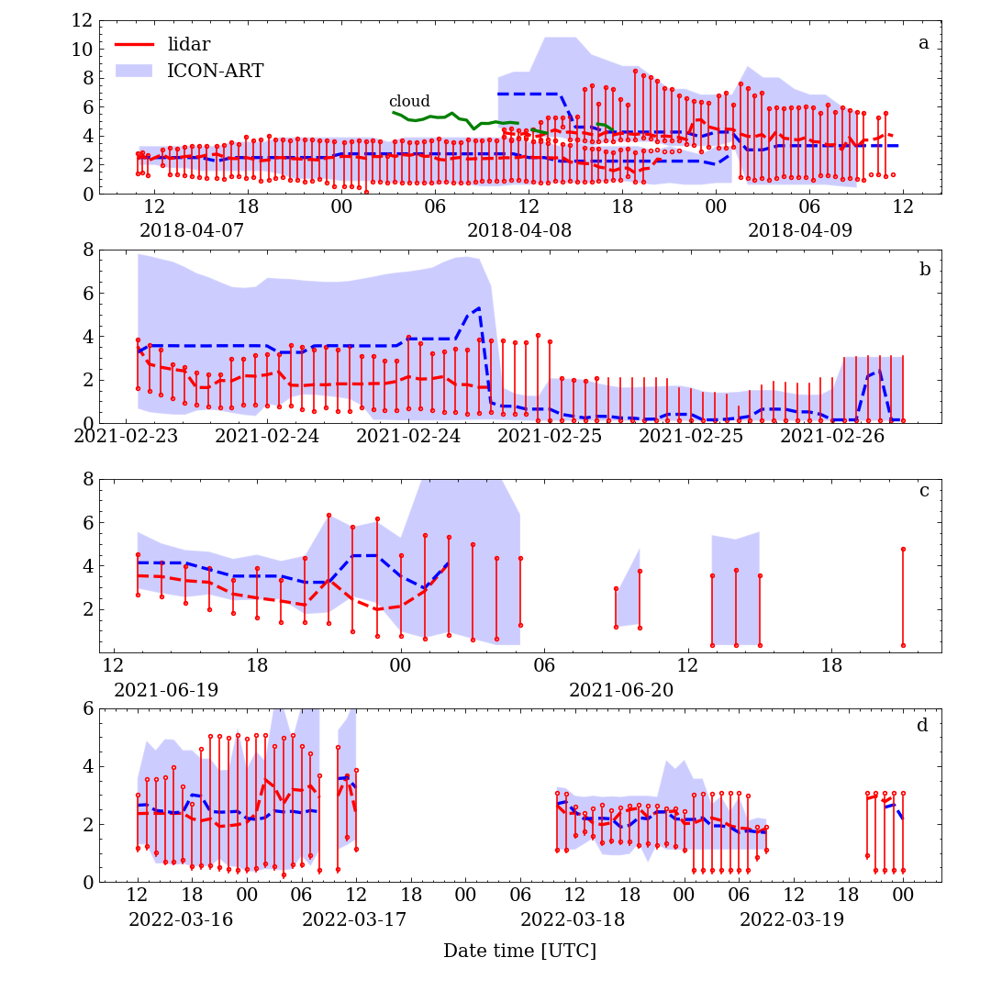
Comparison of between lidar observation and ICON-ART results
Dust layer heights
Case1
Case2
Case3
Case4
ICON-ART predicts dust layer heights generally well. Some deviations still need to be discussed.

Slide 7
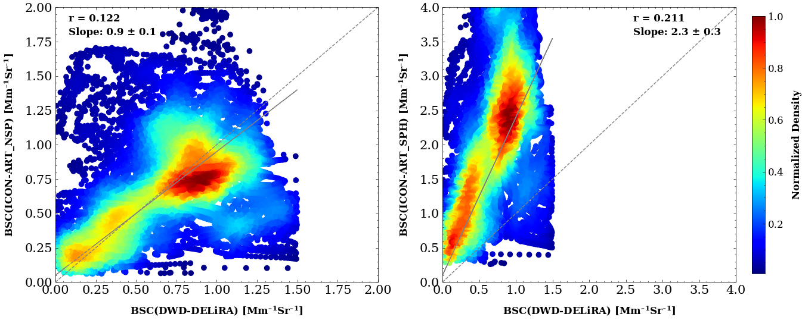
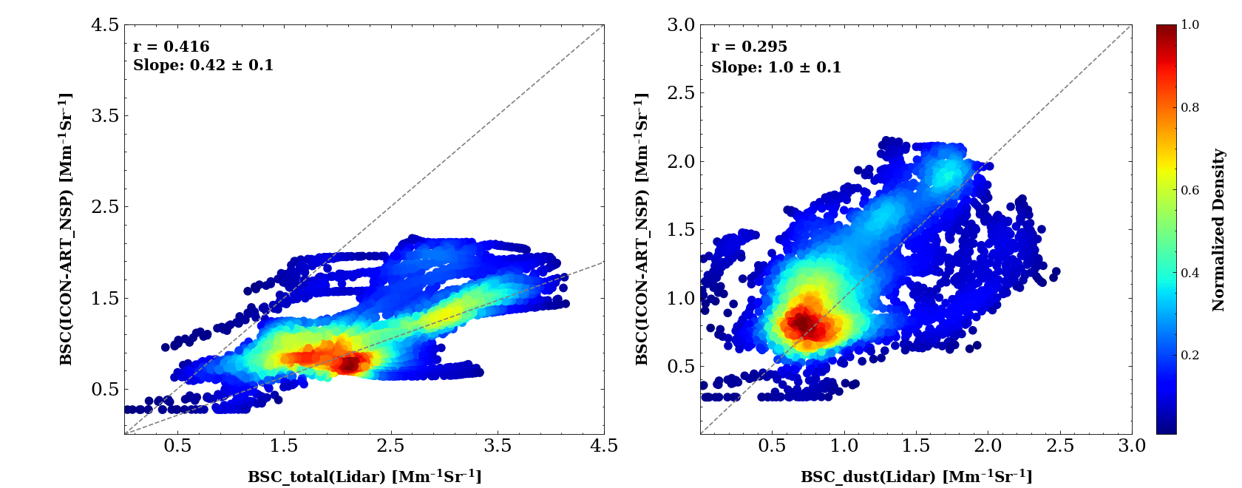
Comparison of between lidar observation and ICON-ART results
Backscatter coefficients
Case 1:
ICON-ART predicts dust BSC well. Correlation with lidar is 0.9 ± 0.1 for non-spherical particles while is 2.3 ±0.3 for spherical particles.
non-spherical
spherical
Case 2:
ICON-ART predicts dust BSC well. Correlation with lidar is 0.96 ±0.21 for pure dust only while it is 1.94 ± 0.65 if total backscatter is used.
all particles
dust only
BSC: backscatter coefficient

Slide 8
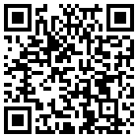
Summary
The properties and the transport of Saharan dust plumes was studies for 5 Saharan dust events combing remote sensing, in-situ measurements, and ICON-ART model results. The agreement between the measurements, model results, and typical literature data is good.
The ICON-ART model predicts dust layer height (± 50 m), and arrival time (± 20 min) generally well when compared with lidar measurements but still shows some deviations for certain events that need to be discussed in terms of meteorological conditions.
ICON-ART predicts dust backscatter coefficients well. The correlation with lidar values is 0.9 ± 0.1 for non-spherical particles. This validates the parameterization of the particle optics in the model.

