Slide 1
Supplementary material
Sensitivity of micro-scale atmospheric processes in a city quarter of Berlin, Germany on elevated meso-scale temperature forcing
Dieter Scherer, Katharina Scherber (katharina.scherber@tu-berlin.de), Ute Fehrenbach, Fred Meier, Marco Otto, Benjamin Schmidt, Ralf Steikert, Achim Holtmann
EGU 2023; April 25th
Session: CL2 EDI: Urban climate, urban biometeorology, and science tools for cities

Slide 2
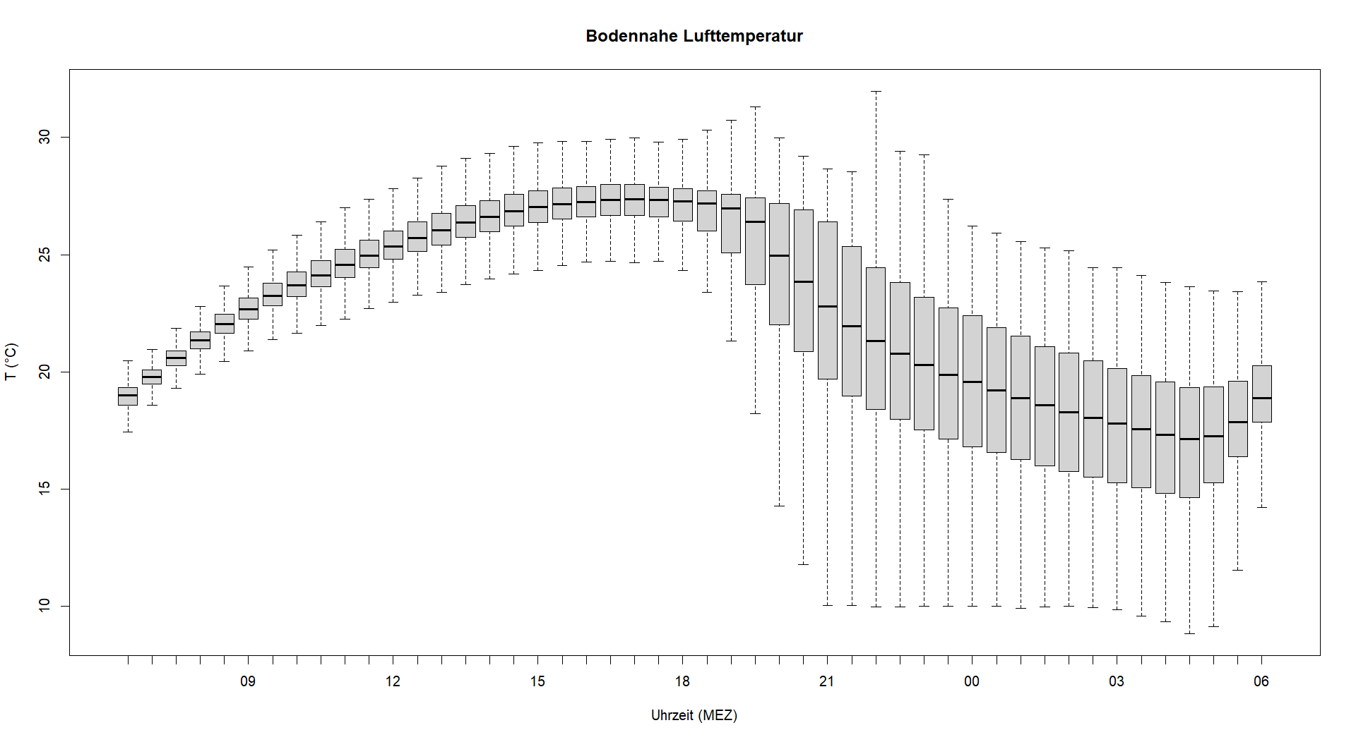
Results
Near-surface air temperature (T in 1 m)
For further considerations, we distinguish between day and night
Day
Night
Control simulation – 30 min-mean values - 16.07.2018 06:00 CET - 17.07.2018 06:00 CET

Slide 3
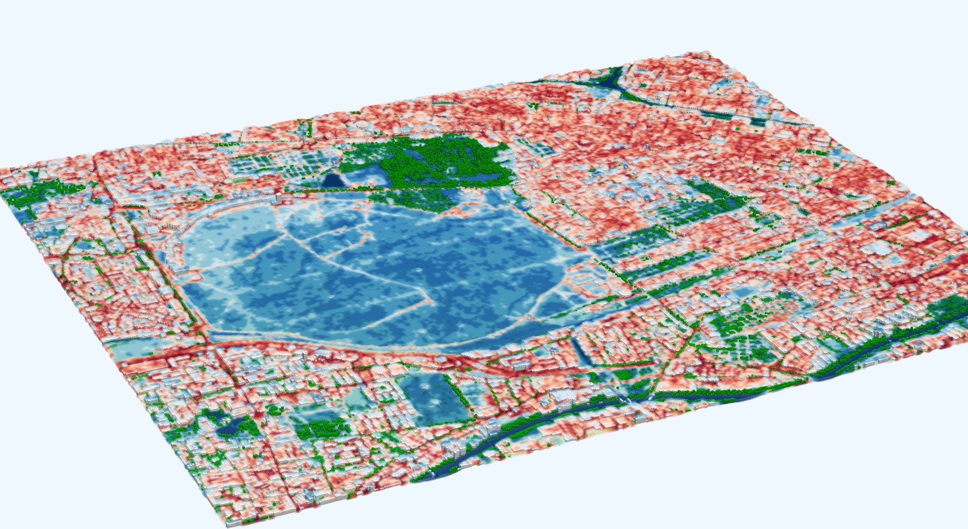
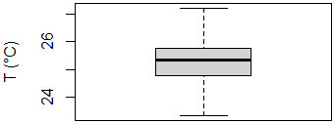
Results
Near-surface air temperature (T in 1 m)
Green spaces are generally cooler, but thermal turbulence reduces variability of T
T (°C)
Control simulation – day-time-mean values - 16.07.2018 08:00 CET - 17.07.2018 16:00 CET
Notes:
Additional info:
The box plot illustrates that spatial variations of T are rather small (interquartile range of about 1 K)

Slide 4
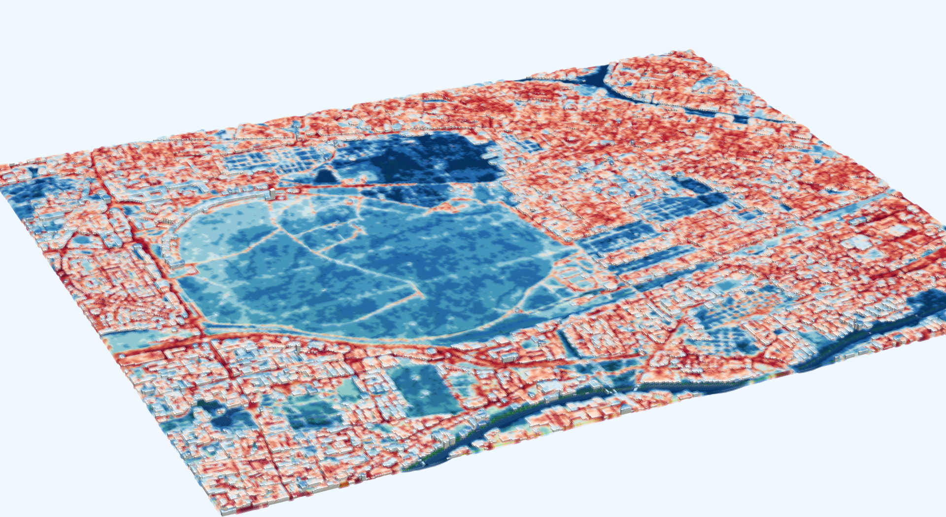
Results
Near-surface air temperature (T in 1 m) – without trees
In tree populations, T is cooler during the day due to shading and transpiration
T (°C)
Control simulation – day-time-mean values - 16.07.2018 08:00 CET - 17.07.2018 16:00 CET

Slide 5
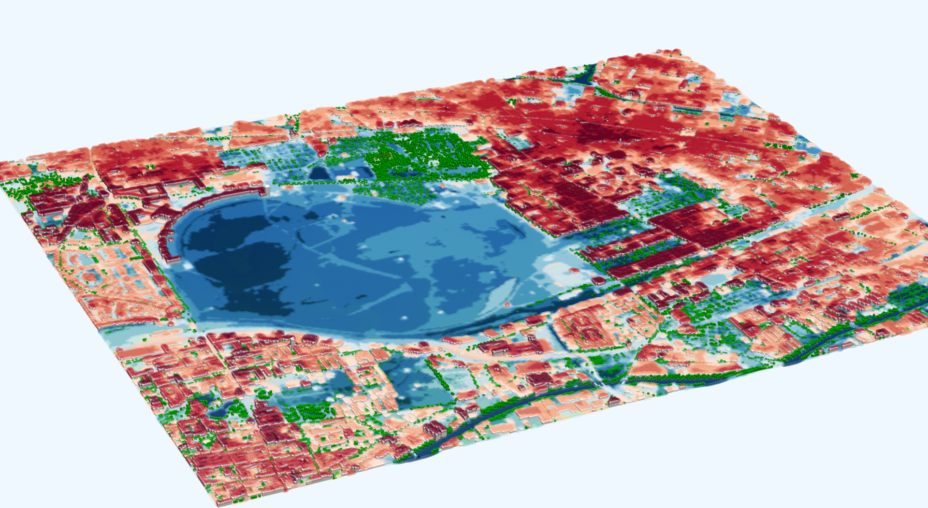
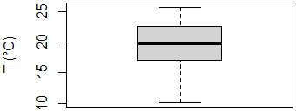
Results
Near-surface air temperature (T in 1 m)
Vegetation produces cold air at night, even in inner yards of building blocks
T (°C)
Control simulation – night-time-mean values - 16.07.2018 20:00 CET - 17.07.2018 04:00 CET

Slide 6
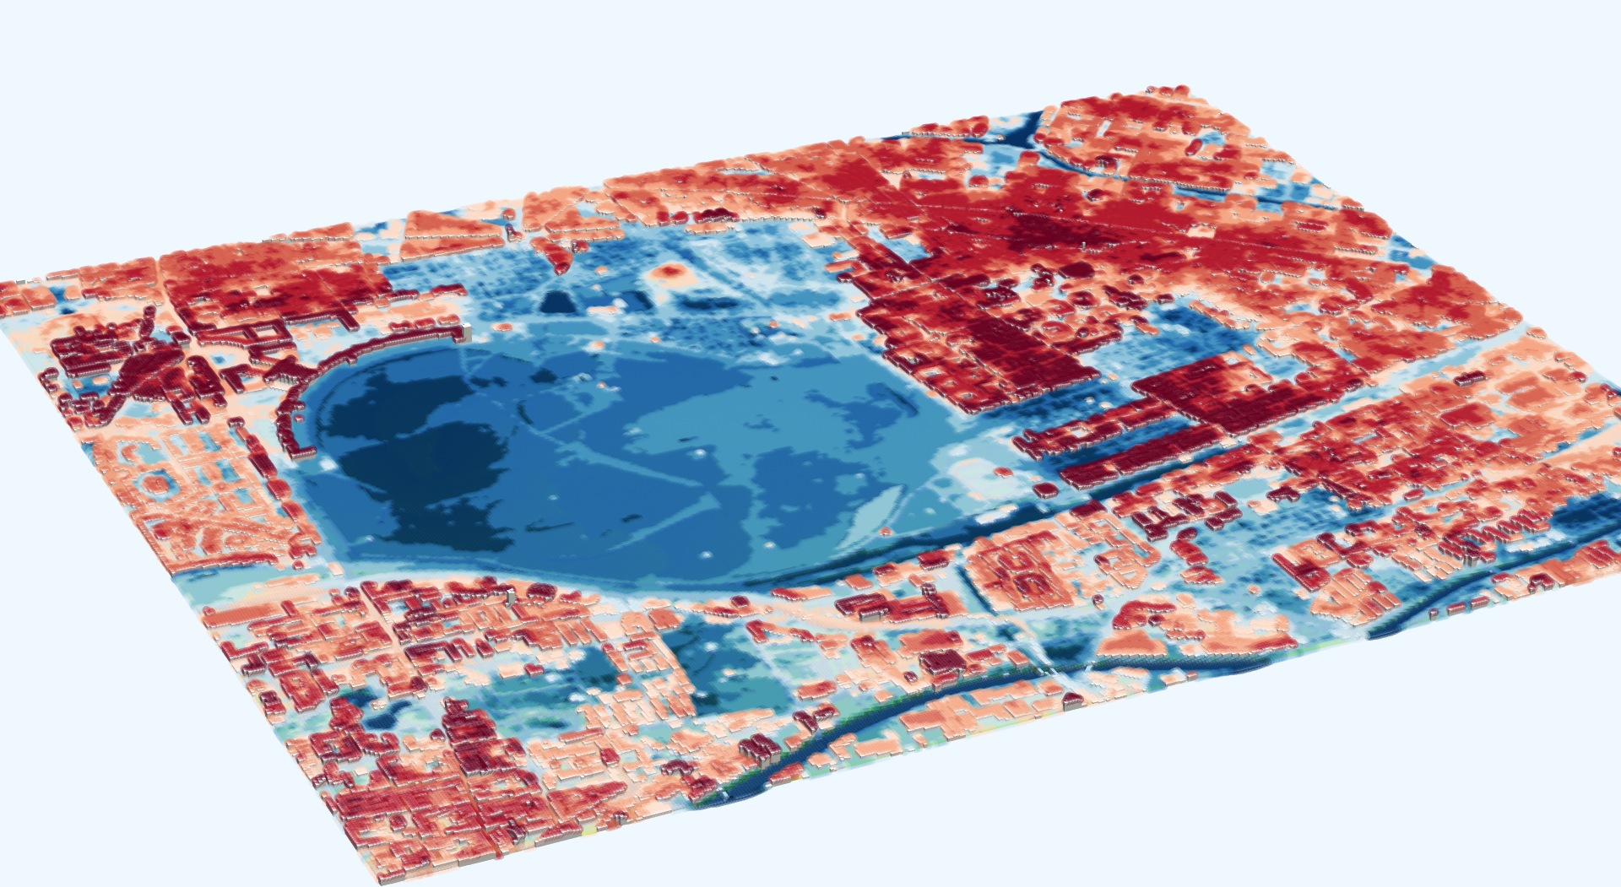
Results
Near-surface air temperature (T in 1 m)
Cold air production is most pronounced above unsealed open spaces
T (°C)
Control simulation – night-time-mean values - 16.07.2018 20:00 CET - 17.07.2018 04:00 CET
Notes:
Additional info:
Tree crowns reduce surface energy losses by upwelling long-wave radiation, thus net radiation is less negative at the surfaces in tree canopies

Slide 7
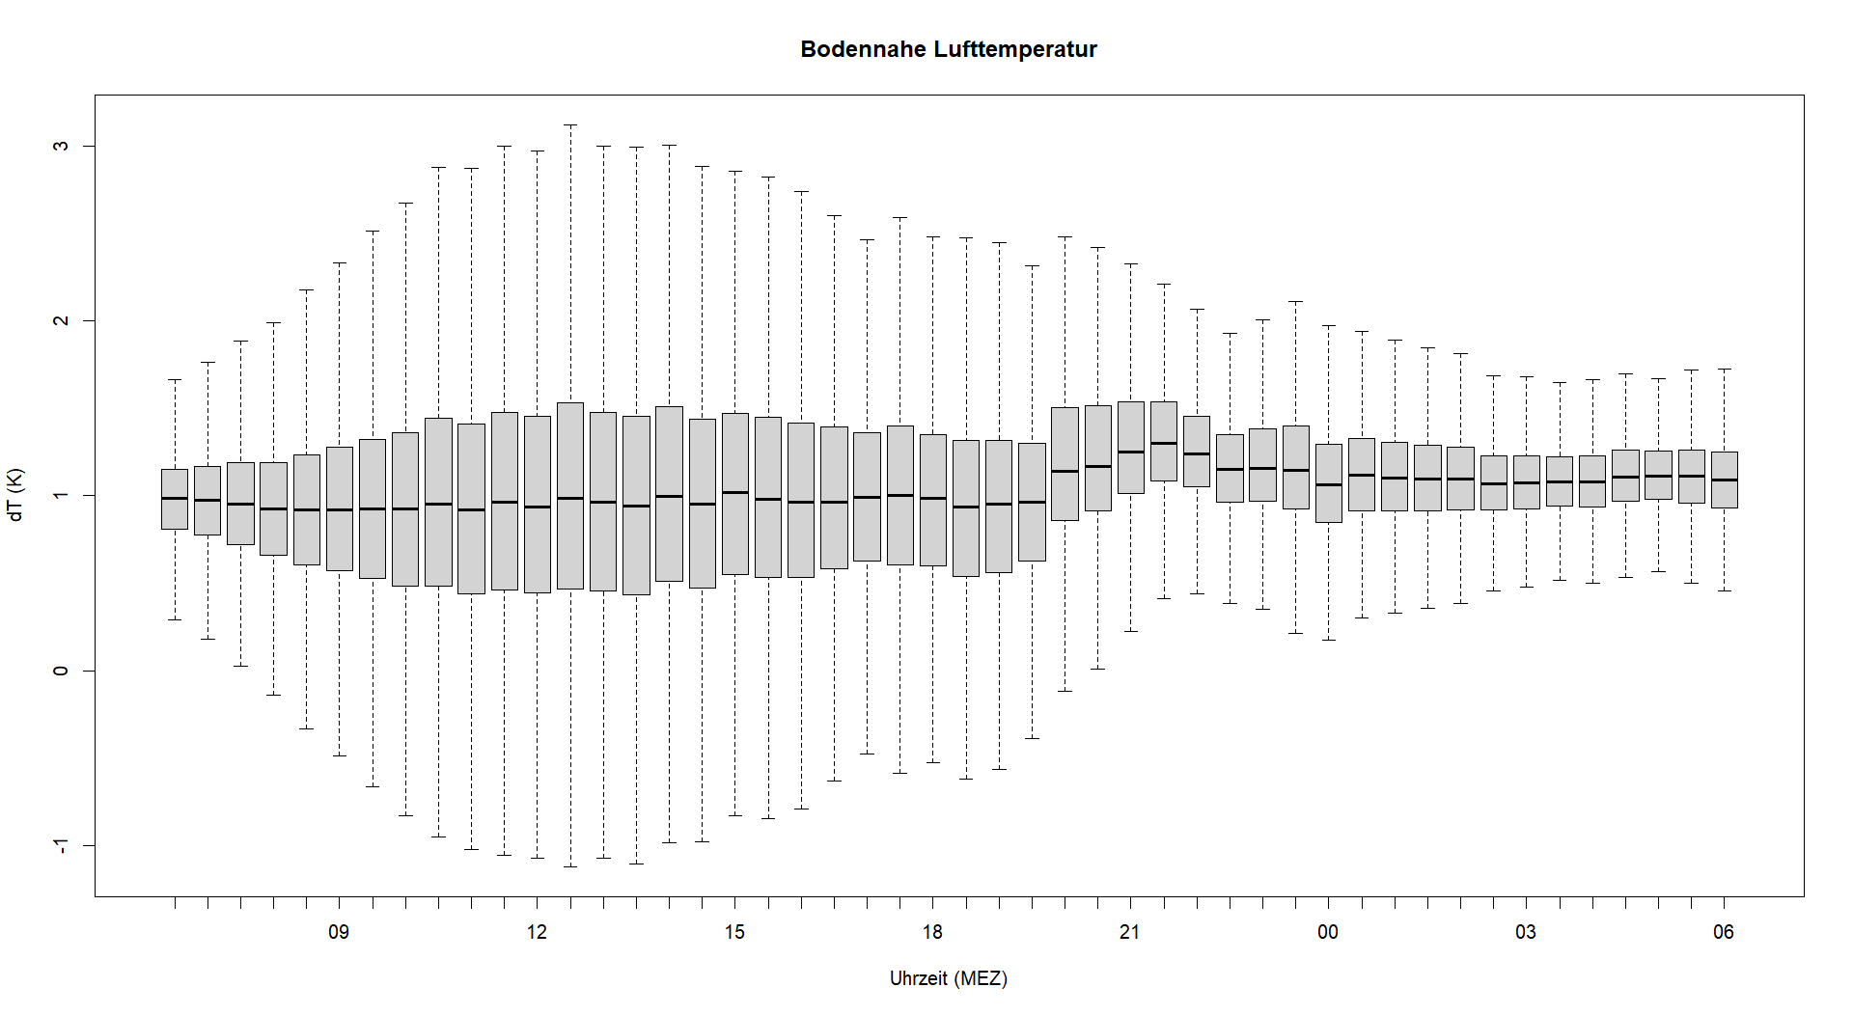
Results
Change in near-surface air temperature (T in 1 m)
Lower values during day-time
Day
1 K
Scenario minus control simulation – 30 min-mean values - 16.07.2018 08:00 CET - 17.07.2018 16:00 CET

Slide 8
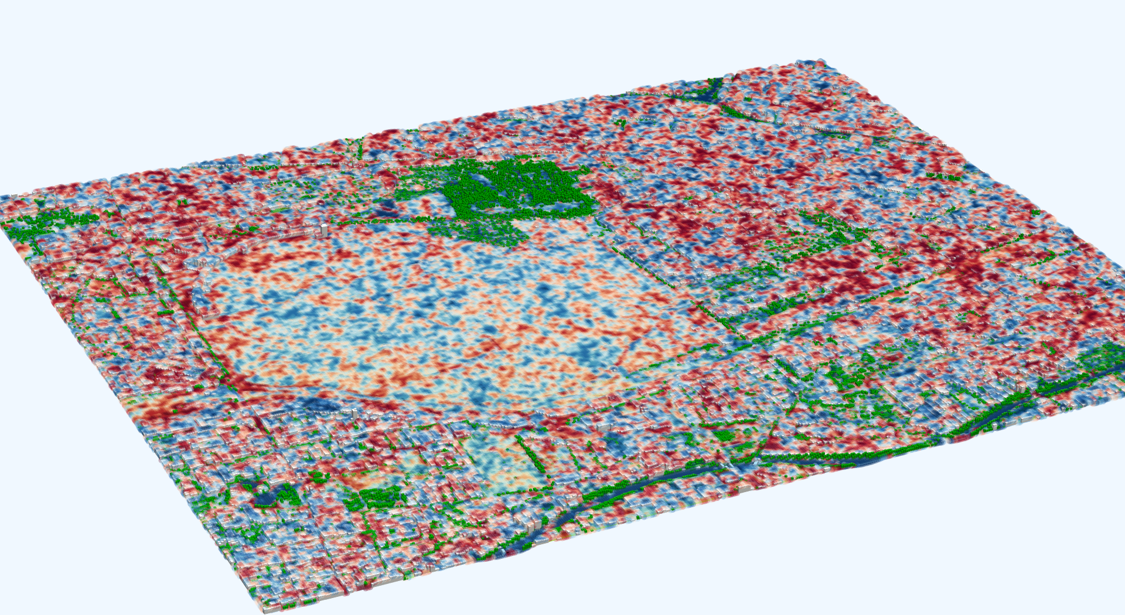
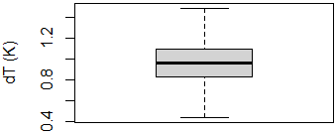
Results
Change in near-surface air temperature (T in 1 m)
Strong influence of thermal turbulence during day-time
∆T (°C)
Scenario minus control simulation – day-time-mean values - 16.07.2018 08:00 CET - 17.07.2018 16:00 CET

Slide 9
Results
Change in near-surface air temperature (T in 1 m)
Higher values during night-time, particularly in the early evening
Night
1 K
Scenario minus control simulation – 30 min-mean values - 16.07.2018 20:00 CET - 17.07.2018 04:00 CET

Slide 10
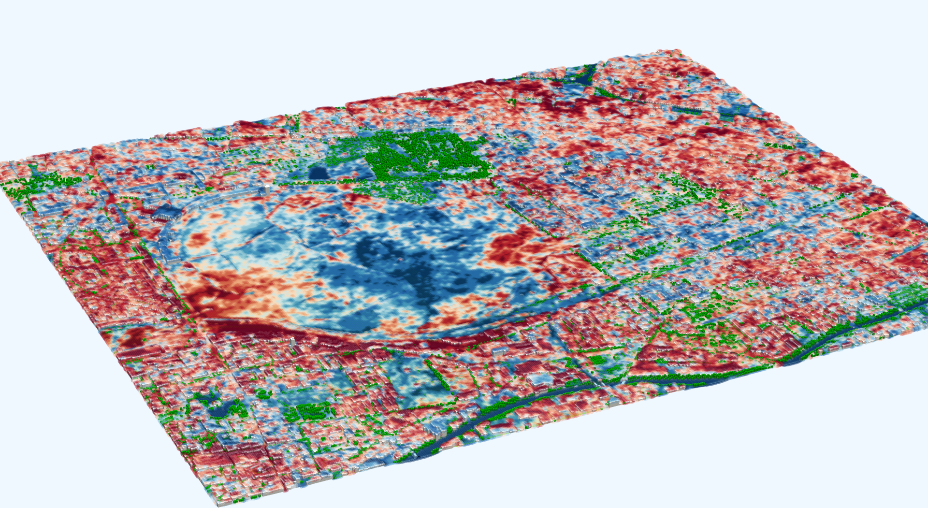
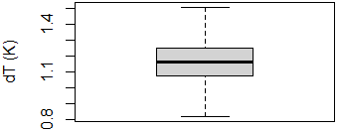
Results
Change in near-surface air temperature (T in 1 m)
At night, the change in T is dominated by land cover
∆T (°C)
Scenario minus control simulation – night-time-mean values - 16.07.2018 20:00 CET - 17.07.2018 04:00 CET

Slide 11
Thank you!
For further information visit our project website:
www.uc2-program.org

