Slide 1
Run analysis of potential evapotranspiration and soil moisture for investigating flash droughts in Sicily
Tagele Mossie Aschale¹, David J. Peres¹ , Nunziarita Palazzolo¹, Guido Scuito², Antonino Cancelliere¹
University of Catania, Department of Civil Engineering and Architecture, Catania, Italy (tagele.aschale@phd.unict.it)
Ambiens Srl, Via Roma, 44, 94019 Valguarnera Caropepe, Italy
Programme group: NH
Session: NH9.16
Tue, 25 Apr, 09:07–09:09 –
Room: PICO spot 3b | PICO3b.13

Slide 2
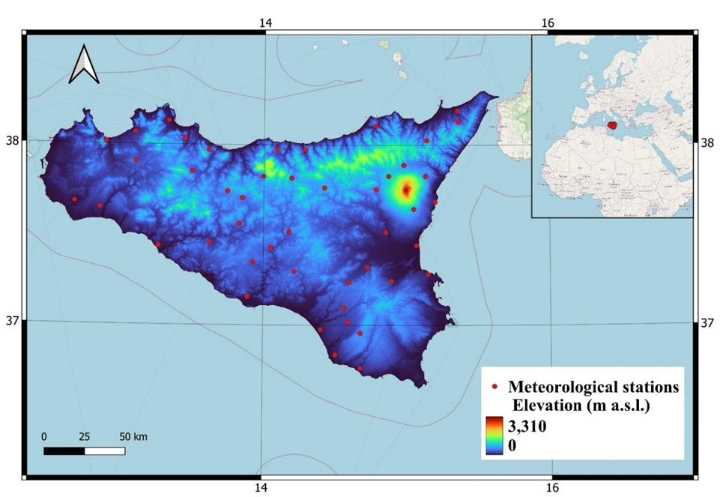
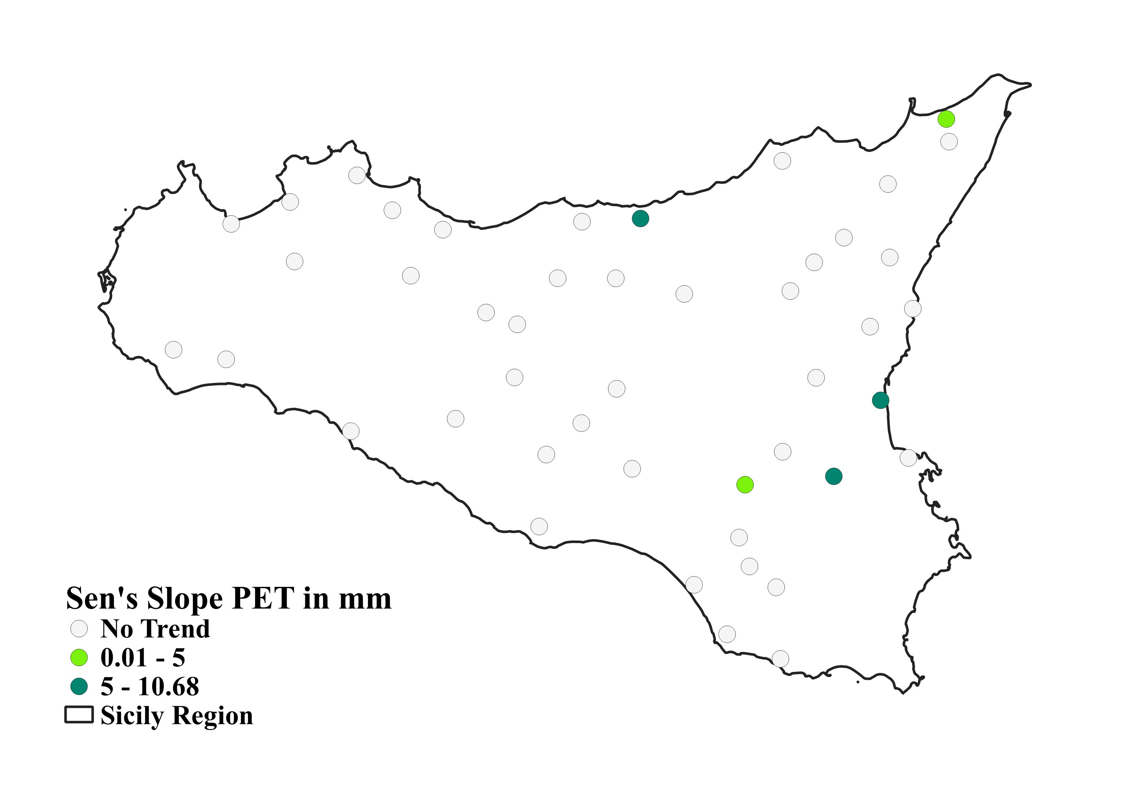
Aim of the study
The identification of a rapid and exceptional increase of evapotranspiration and decrease of soil moisture is considered as key for identifying flash drought onset.
A preliminary investigation on the possible recent occurrence of flash droughts in Sicily has been carried out
Data
Soil moisture from ERA5 Land (daily average)
ET0 computed by Penman-Monteith in 46 meteorological stations in Sicily island for the last 22 years
Analysis
Anomalies of soil moisture and ET0 respect to daily long-term means have been considered (runs) in order to spot possible past flash droughts
The trend of ET0 has been analysed. In 5 locations a significant annual trend has been observed.
The Evaporative Demand Drought Index (EDDI) for these 5 stations has been computed at various aggregations
Results show possible flash drought occurrence in eastern Sicily within year 2002

Slide 3
SOIL MOISTURE AND ET0
ANOMALIES

Slide 12
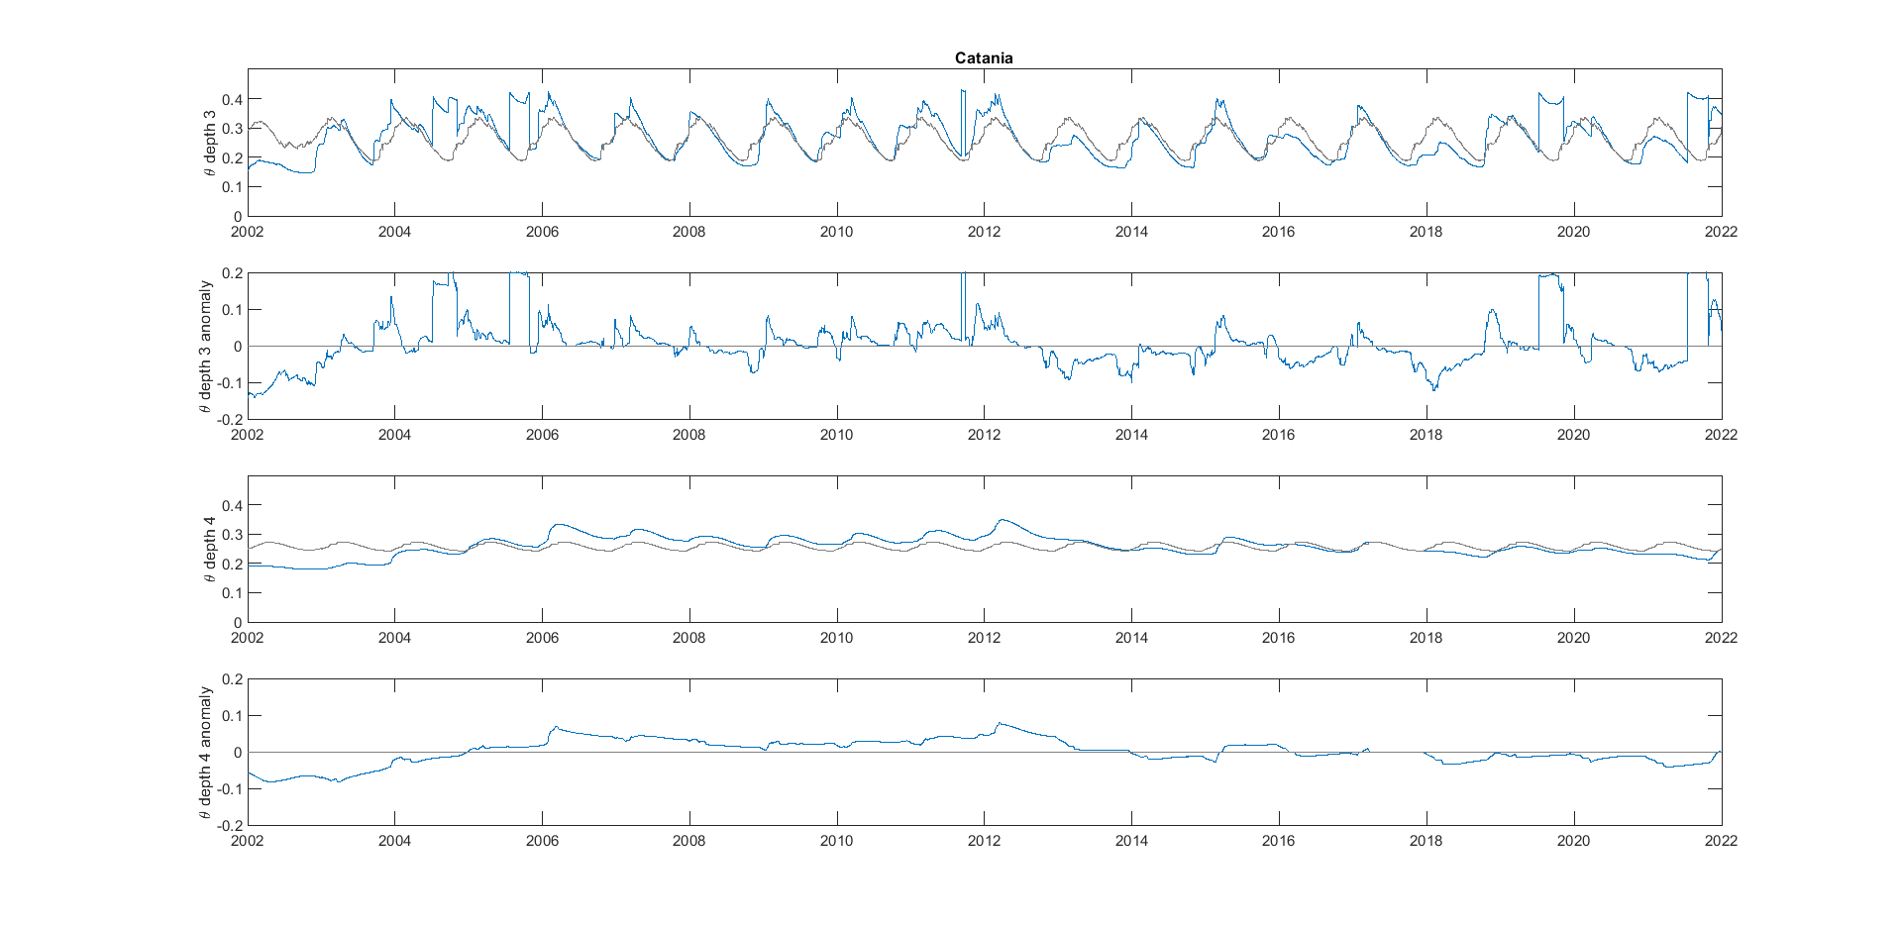
Soil moisture anomaly – Catania
0.72 m depth
drougth
1.89 m depth
drougth

Slide 13
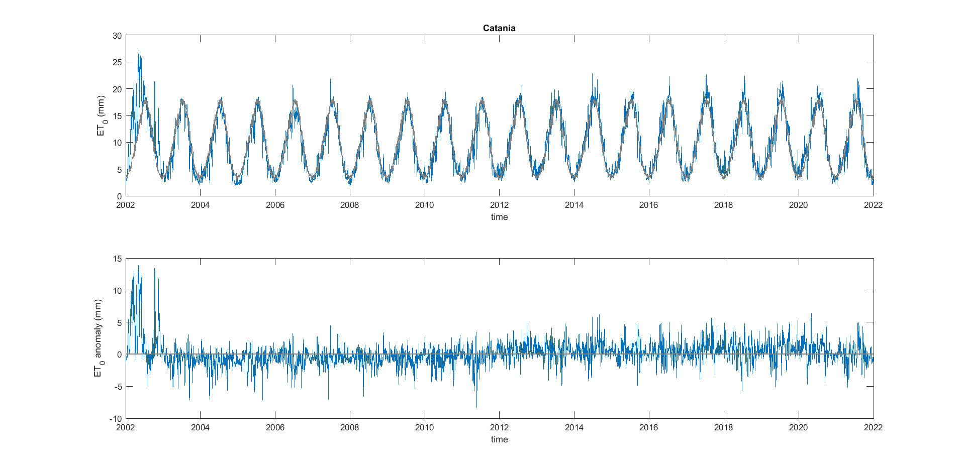
ET0 anomaly – Catania
Very high ET0 anomaly

Slide 14
ET0 TREND ANALYSIS

Slide 15
Results
The MK of the PET trend for each meteorological station at different temporal scales.
Yellow shading represents the Z value decreasing PET trend, whereas the reddish shading is the Z value increasing PET trend.

Slide 16
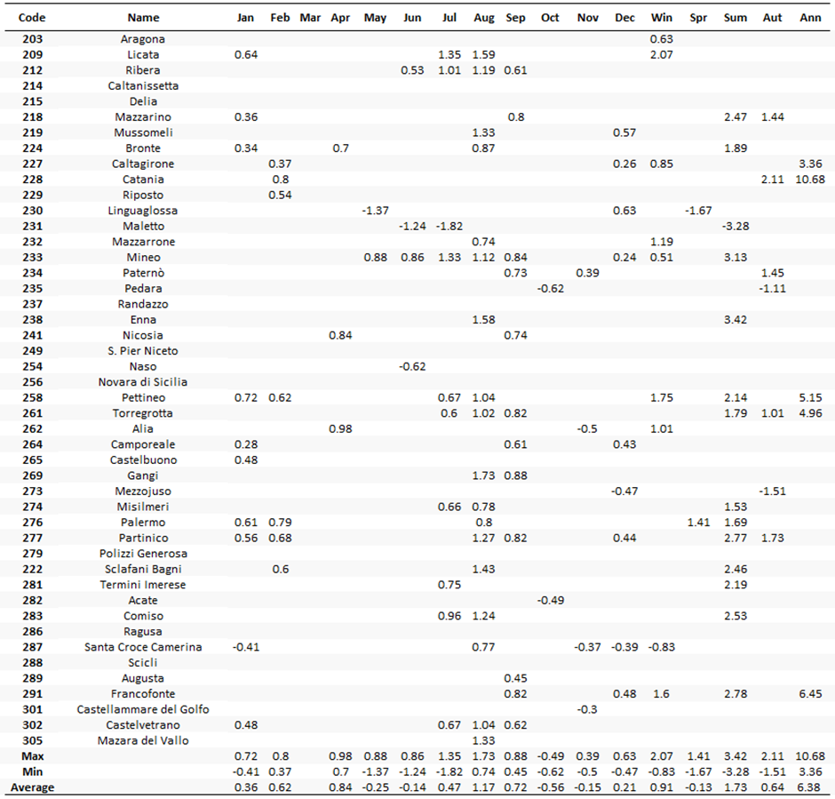
Sen’s Slope (the PET Trend Magnitude) in mm for monthly, seasonally and annually scales.
Five metrological stations showed a positive trend in annual scale.
The highest decreasing trend of PET was detected at Maletto in July & Summer trend of the PET.

Slide 17
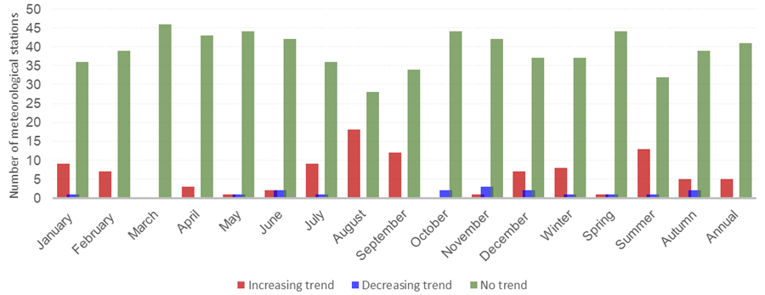
The five meteorological stations which showed positive annul PET trend.

Slide 18
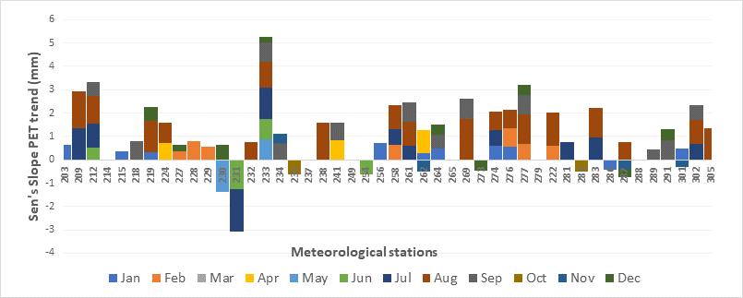
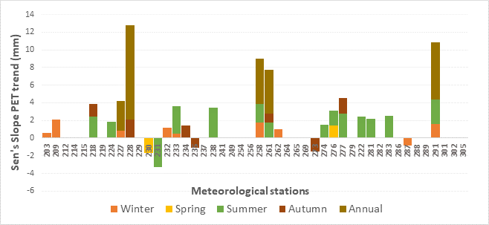
Different temporal scale trend

Slide 19
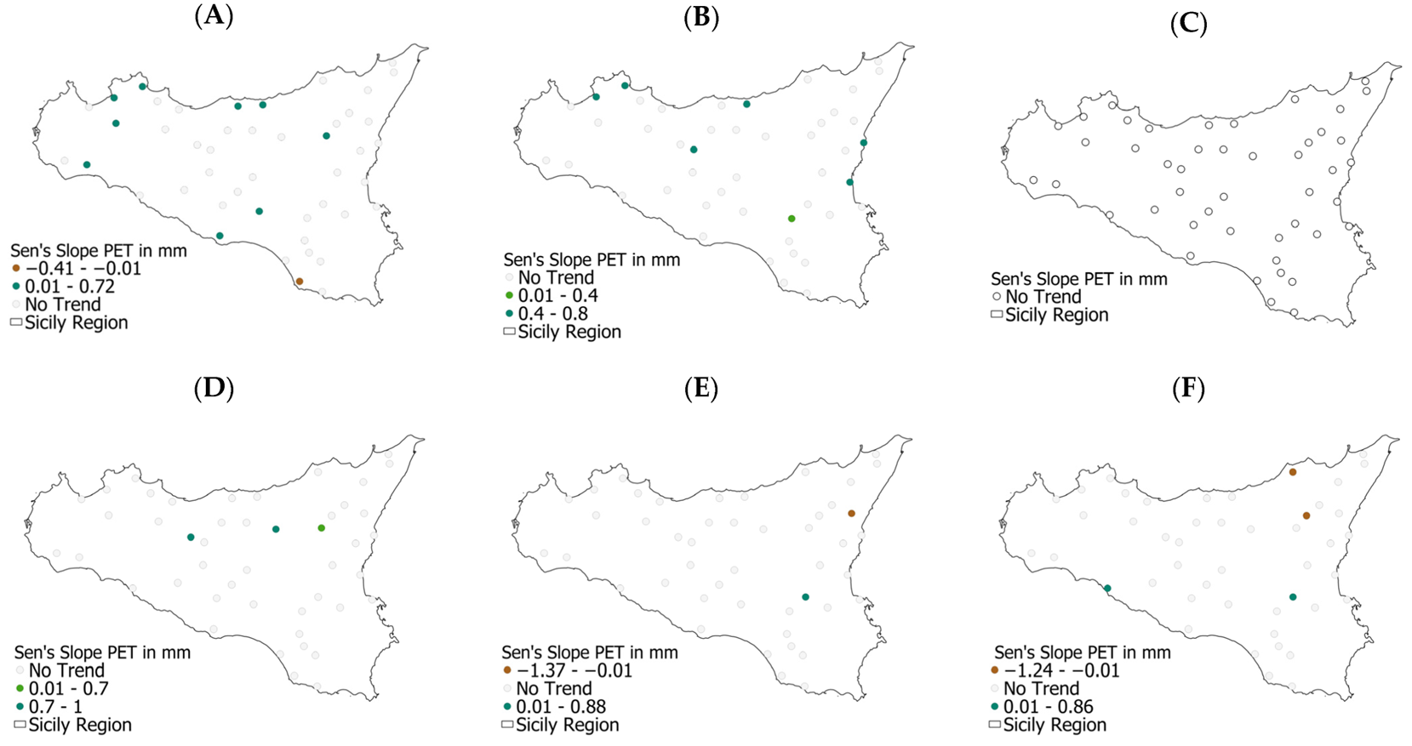
Spatial PET trend over Sicily
JAN
FEB
MAR
APR
MAY
JUN

Slide 20
JUL
AUG
SEP
OCT
NOV
DEC

Slide 21
Winter
Spring
Summer
Autumn
Annual

Slide 22
EDDI

Slide 28
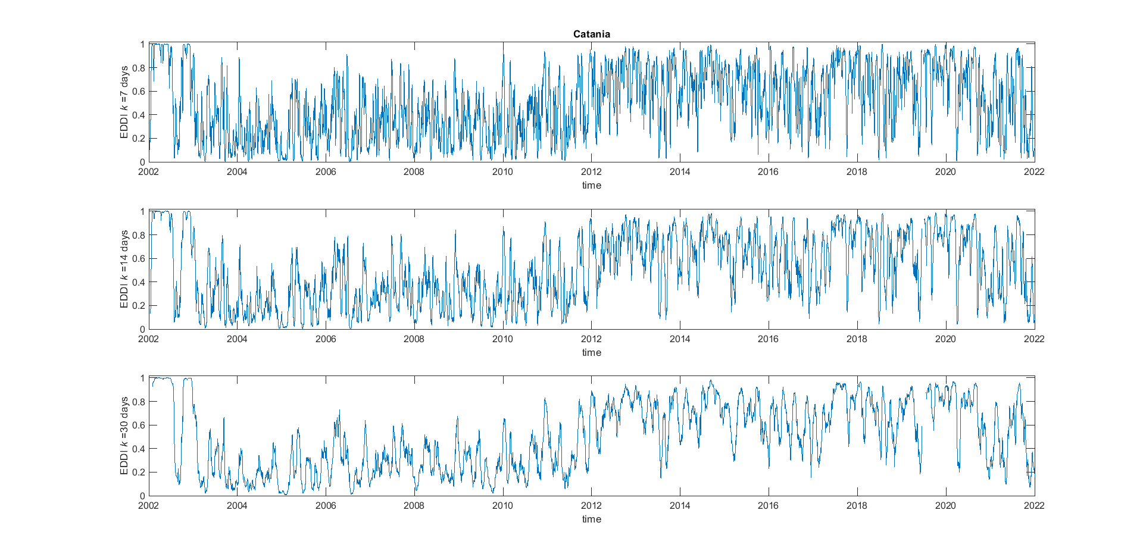
EDDI – Catania
Very fast increase
Very high ET0

Slide 29
Th ETo spatiotemporal trend paper is:
An Assessment of Trends of Potential Evapotranspiration at Multiple Timescales and Locations in Sicily from 2002 to 2022
DOI: https://doi.org/10.3390/w15071273

