Slide 1


The General Assembly 2023 of
the European Geosciences Union
A deep learning-based bias correction method for predicting ocean surface waves in the Northwest Pacific Ocean
Author: Danyi Sun
Co-Authors: Wenyu Huang , Yong Luo , Jingjia Luo , Jonathon S. Wright,
Haohuan Fu, Bin Wang
Presentation by: Danyi Sun
Department of Earth System Science,
Tsinghua University, Beijing, China
Email: sundy19@mails.tsinghua.edu.cn
Abstract QR code
Notes:
Professor Wang, ladies and gentlemen, Good afternoon.
I am sun danyi, a PhD student from Tsinghua Unviversity in China.
%I am very honored give a presentation at the EGU general Assembly.
Today I want to talk about a deep learning-based bias correction method for predicting ocean surface waves in the Northwest Pacific Ocean.

Slide 2
PRESENTATION OUTLINE
Motivation
Data and Methods
Results
Conclusion
References
Notes:
I have broken this talk up into five parts
and I will first go with the introduction.

Slide 3
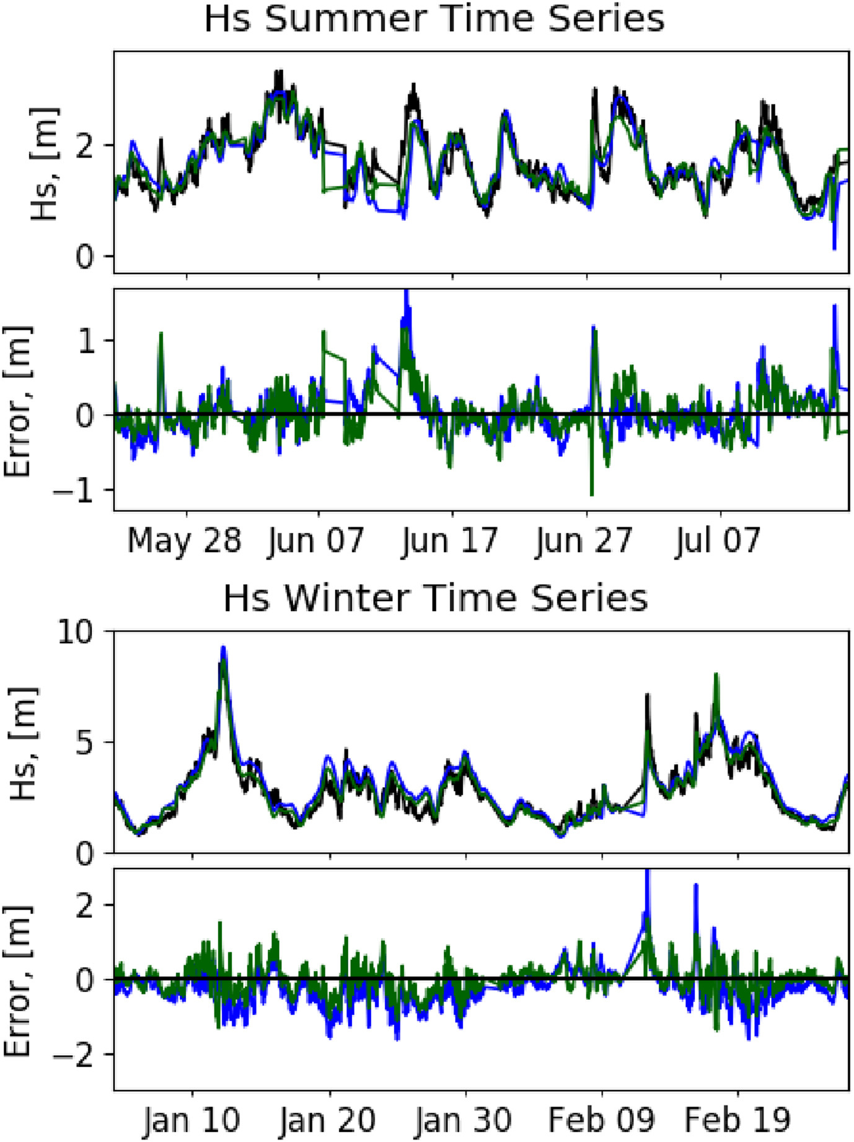
MOTIVATION
Sea surface waves alter sea surface roughness and are vital for sea-air interactions and shipping
Huge waves under extreme wind conditions usually cause severe coastal and ship disasters
Accurate wave height forecasts are important
Large biases in current wave models
Machine learning-based bias correction methods are becoming popular.
(Alves et al., 2013; Chang & Mori, 2021; Huang, 2011; Reichstein et al., 2019 )
0.33m->0.29m (summer, p=0.54)
0.58m->0.25m ( winter, p=0.0)
Ellenson et al., (2020)
Notes:
Therefore, providing accurate wave height forecasts is necessary and urgent
However, significant bias still exist in numerical wave models
machine learning has been rapidly developed in geoscience recently.
Ellenson et al. (2020) used a bagged regression tree to correct the SWH bias forecasted by WAVEWATCH3 (WW3) for five stations along the California-Oregon border in the United States. They reduced the SWH Root Mean Squared Errors (RMSEs) from 0.33 to 0.29 m in summer and from 0.58 to 0.25 m in winter.
which is also called SWH which is also referred to as
et al., and others

Slide 4

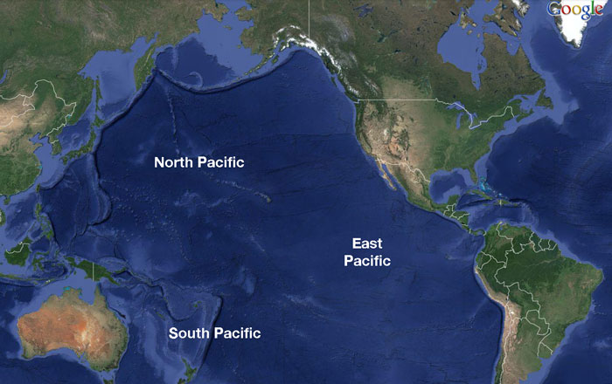
MOTIVATION
The Northwest Pacific Ocean (NWPO) is one region with frequent human activities.
Within the NWPO region, extreme winds frequently occur.
A lack of spatial bias correction for SWH forecast of NWPO from numerical wave models.
The forecast lead time includes 24, 48, and 72 h
NWP
Deep Learning
SWH in NWPO
Study Period
NWPO
2017
2018
2019
2020
2021
Training
Testing
(https://sharktourshawaii.com/blog/11-awesome-facts-pacific-ocean/)
Notes:
Northwest Pacific ocean (NWPO), which inside the yellow rectangle.
Therefore, this paper proposes a wave height forecasting model based on a combination of numerical wave models and deep learning to forecast wave heights in the northwest Pacific.
the forecast lead time we used in this research includes 24, 48 and 72h
the study period is from 2017 to 2021. the first four year serves as the training dataset, and the remaining 2021 serves as the testing period.

Slide 5
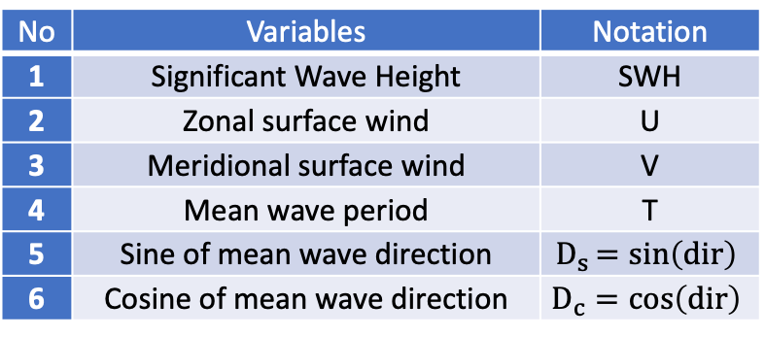
DATA AND METHODS
Input Module
BU-Net Module
Output Module
Table1 Input variables for BU-Nets
GFS UV Wind
Conv 3x3
Block
Conv 3x3
Block
Corrected Wave
No | Variables | Notation
1 | Significant Wave Height | SWH
2 | Zonal surface wind | U
3 | Meridional surface wind | V
4 | Mean wave period | T
5 | Sine of mean wave direction | $$D_{s}=sin\left(dir\right)$$
6 | Cosine of mean wave direction | $$D_{c}=\cos\left(dir\right)$$
Forcing
Conv 3x3
Block
Conv 3x3
Block
WAVEWATCH III
Metrics
Conv 3x3
Block
Conv 3x3
Block
Output
Raw Data
Conv 3x3
Block
Conv 3x3
Block
ERA5 Reanalysis
Input
Output
Differences between BU-Net and U-Net
Batch Normalization layers between convolutional layers and ReLU layers
Same padding
Notes:
then we will move on the data and methods.
The schematic diagram in the upper right corner shows the forecast model.
First of all, we use UV wind from Global forecast system (GFS) as the forcing data to run the wavewatch iii model, and we get the raw prediction of wave and some wave parameters.
and the data will be fed into the deep neural network to train, and we use the SWH from ERA5 reanalysis as the groud truth.
the input six variables include significant wave height, zonal and meridional surface winds, mean wave period, sine and cosine of mean wave direction.
The deep neural network we used is called BU-Net by adding batch normalization layers between convolutional layer and ReLU layers in each conv-block.
and We use the same padding in the convolutional layer to ensure the same size of input and output which is important to the bias correction.

Slide 6
RESULTS
Table 2 The RMSE (units: m) after correction
Forecast lead time | Training Period | after train RMSE | Testing Period | after train RMSE
 | WW3 | BU-Net | WW3 | BU-Net
24h | 0.31 | 0.19 | 0.35 | 0.21
48h | 0.36 | 0.21 | 0.39 | 0.24
72h | 0.41 | 0.29 | 0.43 | 0.30
good generalization ability
RMSEs ↓ 40%, 38%, and 30% for 24, 48, and 72 h.
BU-Net forecasts have good and stable performance
The RMSEs ↓ and the correlation ↑ for four seasons.
Summer, by 52%, 49%, and 41%
Winter, by 30%, 26%, and 26%
The PCC improved by 2% to 6% for four seasons.
The variation of RMSEs and PCC after using BU-Net
Notes:
Here is the Results part
First of all, the forecast performance on the testing dataset is comparable to that on the training dataset, indicating that BU-Net-based bias correction has good generalization ability.
The BU-Net reduces the RMSE by 40%, 38% and 30%, for the three lead times, respectively.
In particular, from panel (a), the SWH RMSEs after BU-Net-based bias correction have smaller outlier and more concentrated distributions, indicating the bias-corrected SWH forecasts have good and stable forecast performance.
The second row in the left picture shows the variation of RMSE in four seasons.
The RMSE decrease the most in the summer and the least in the winter
The last row shows the variation of PCC after the bias correction, with 2% and 6% increase percentage for four seasons.

Slide 7
RESULTS
RMSE
Correlation coefficient
24h
the east of Taiwan island:
0.4m → 0.2m
the coast of Jiangsu province: 0.74m→0.25m
48h & 72h
the east and northeast of Taiwan island: 0.6m→ 0.4m
CCs in Bohai Bay are increased by 9%
The BU-Net-based bias correction largely reduces SWH RMSEs and improves time correlations between the SWH forecasts and observations.
Notes:
So what is the horizontal forecast performance of BU-Net?
The figure on the left side shows the horizontal distribution of the RMSEs and correlation coefficients of SWH forecasts of WW3 and BU-Net.
The first and third columns is the WW3 forecasts and the second and fourth are the BU-Net forecasts.
The lighter green means smaller RMSE and darker red means higher correlations.
from the figure we can see that the BU-Net reduces the RMSEs and improves the CC of WW3.
The large RMSE in the east and northest of taiwan island and coast of Jiangsu province is well-corrected.

Slide 8
RESULTS
Forecast Performance of BU-Net During Typhoon Passages
WW3 variability: frequent typhoon passages
  24h 0.55→0.30 m (45%)
  48h 0.67→0.39 m (32%)
  72h 0.81→0.53 m (35%)
the RMSEs of six cases drop more than 15%
6m
10m
The SWH during the passage of typhoon In-fa
RMSE:
0.69,0.83,1.02 → 0.30,0.37,0.55m ( 55%, 57%, 36%)
long duration (9 days) and inner parts center are beneficial to the correction performance.
The variation of RMSEs during Typhoon passages
Notes:
The forecast performance of WW3 over NWPO has the most significant variability in summer, mainly related to the frequent typhoon passages.
therefore, we assessed the forecast performance of BU-Net during the typhoon passages.
The drop percentages of RMSE during typhoon passages are 45%, 32%, and 35%, and from the below picture we can see that the RMSEs decrease for six out of eight typhoons.
Here we take typhoon In-fa as an example, In-fa has a long duration of 9 days.
The RMSEs are reduced by 55%, 57%, and 36% percent after bias correction.
The 6m waves in 23 July was overestimated by WW3 to 10m, and BU-Net well reproduced.
so we may conclude that long duration and inner parts center are beneficial to the correction performance.

Slide 9
CONCLUSION
The BU-Net essentially improves the forecast performance of SWH over NWPO at lead times of 24, 48, and 72 h in terms of reducing the SWH RMSE and increasing the correlations with observations.
The BU-Net improves the forecast performance of SWH in all four seasons and is still valid during typhoon passages.
The BU-Net reduced the RMSEs of WW3 by about 8% compared to the U-Net, which demonstrates that adding batch normalization layers is a suitable method for correcting the bias of SWH forecast over NWPO.
In the future, BU-Net can be applied in the bias correction of other variables such as precipitation and the joint correction of winds and waves.
Notes:
At the end of the presentation, I will give a brief summary of this work.
firstly,

Slide 10
REFERENCES
Alves, J.-H. G. M., Wittmann, P., Sestak, M., Schauer, J., Stripling, S., Bernier, N. B., et al. (2013). The NCEP–FNMOC combined wave ensem- ble product: Expanding benefits of interagency probabilistic forecasts to the oceanic environment. Bulletin of the American Meteorological Society, 94(12), 1893–1905. https://doi.org/10.1175/BAMS-D-12-00032.1
Chang, C.-W., & Mori, N. (2021). Green infrastructure for the reduction of coastal disasters: A review of the protective role of coastal forests against tsunami, storm surge, and wind waves. Coastal Engineering Journal, 63(3), 370–385. https://doi.org/10.1080/21664250.2021.1929742
Ellenson, A., Pei, Y., Wilson, G., Özkan-Haller, H. T., & Fern, X. (2020). An application of a machine learning algorithm to determine and describe error patterns within wave model output. Coastal Engineering, 157, 103595. https://doi.org/10.1016/j.coastaleng.2019.103595
Han, L., Chen, M., Chen, K., Chen, H., Zhang, Y., Lu, B., et al. (2021). A deep learning method for bias correction of ECMWF 24–240 h forecasts. Advances in Atmospheric Sciences, 38(9), 1444–1459. https://doi.org/10.1007/s00376-021-0215-y
Hwang, P. A. (2011). A note on the ocean surface roughness spectrum. Journal of Atmospheric and Oceanic Technology, 28(3), 436–443. https://doi.org/10.1175/2010JTECHO812.1
Reichstein, M., Camps-Valls, G., Stevens, B., Jung, M., Denzler, J., Carvalhais, N., & Prabhat (2019). Deep learning and process understanding for data-driven Earth system science. Nature, 566(7743), 195–204. https://doi.org/10.1038/s41586-019-0912-1
Notes:
and here are the references in this presentation

Slide 11
The General Assembly 2023 of
the European Geosciences Union
Thanks for your attention!
A deep learning-based bias correction method for predicting ocean surface waves in the Northwest Pacific Ocean
Abstract QR code
Notes:
I would like to thank you for the previlige and the opportunity of talking to you about this research.
Thank you very much！

