Slide 1
Hourly characteristics and synoptic patterns of spring precipitation over the southeastern Tibetan Plateau
EGU 2023
Yin Zhao¹, Jian Li^{1,2}, Liwen Ren³, Nina Li⁴, Puxi Li^{1,2}
1 Chinese Academy of Meteorological Sciences, China Meteorological Administration
2 Research Center for Disastrous Weather over Hengduan Mountains & Low-Latitude Plateau
3 Public Meteorological Service Center, China Meteorological Administration
4 National Meteorological Center, China Meteorological Administration

Slide 2
1
Introduction
2
Data and methods
Contents
3
Results
4
Summary

Slide 3
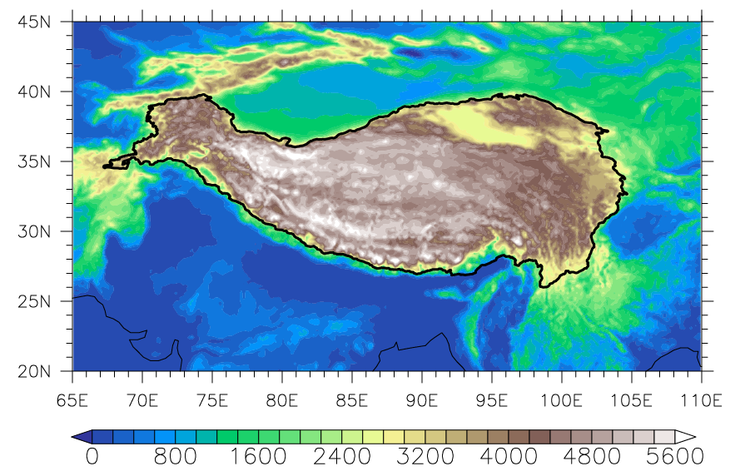
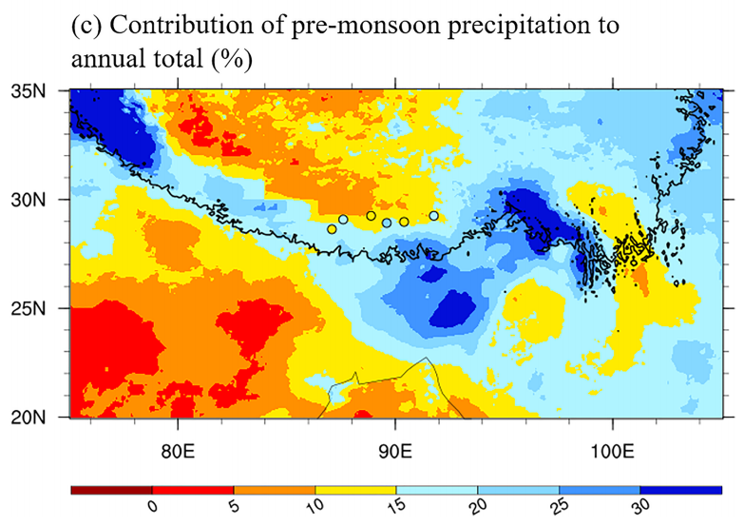
Introduction
a photo taken
at Bomi in spring
contribution of spring precipitation to annual total (%)
Topic:
spring precipitation over complex terrain of the southeastern Tibetan Plateau
(Ouyang et al. 2020)

Slide 4
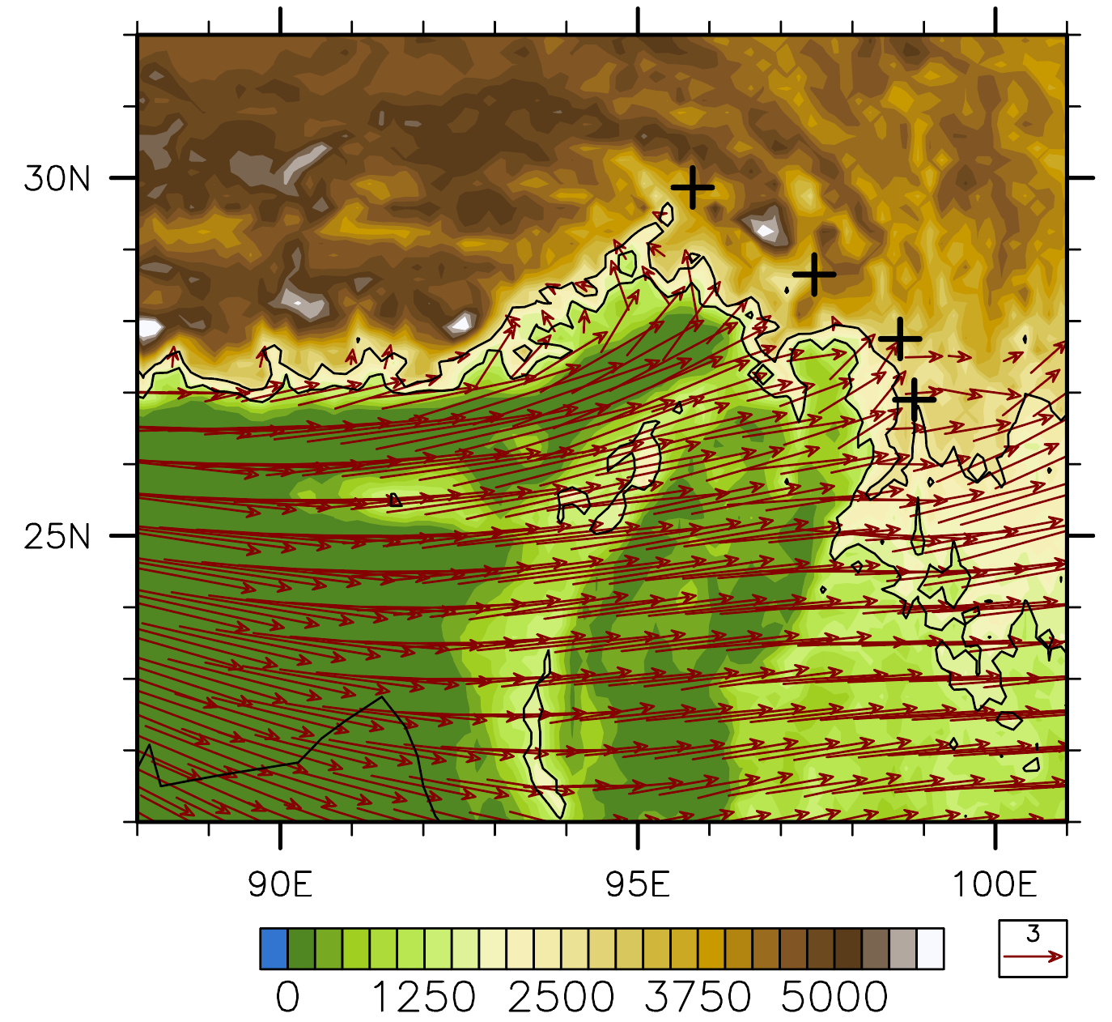
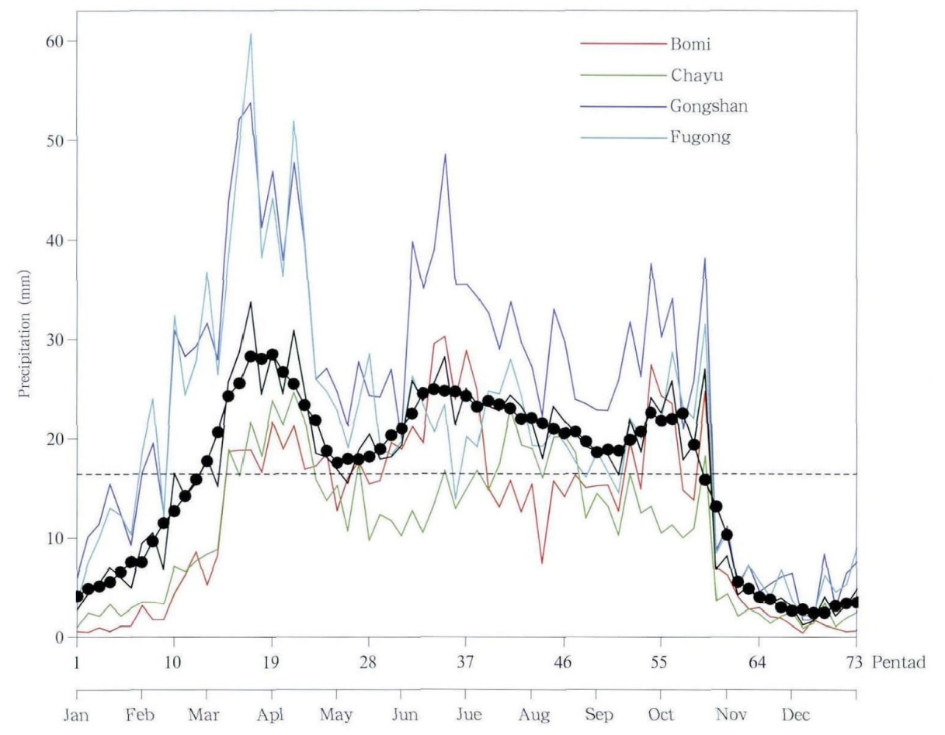
Introduction
The spring rainfall over the southeastern Tibetan Plateau (SETP) is a special phenomenon:
pre-monsoon rainfall, which is an exception for the TP influenced by the South Asia Summer Monsoon;
the area of rainfall is closely related to mega relief of the SETP, which is perpendicular to low-level westerly.
The spring rainfall over the SETP is a typical representative of orographic rainfall around the TP.
hourly characteristics and dominant synoptic patterns
contribution of pre-monsoon precipitation to annual total (%)
terrain & climatological 700-hPa winds
annual evolution of rainfall at four SETP stations
spring rainfall
（Xiao et al. 2013)
summer-monsoon rainfall
(Ouyang et al. 2020)

Slide 5
Data and methods
Precipitation data
Atmospheric variables
Hourly records from gauge stations around the southeastern TP obtained from the China Meteorological Administration with strict quality control. Integrated Multi-satellite Retrievals for GPM (IMERG) is used to reveal the spatial range of the pre-monsoon precipitation.
ERA5 is used to clarify the typical synoptic background when spring precipitation occurs over the SETP.
Definition of rainfall events
Clustering method
A case or event of precipitation is defined as continuously rainfall with interruption no more than 1-hour, to further investigate the relationship between diurnal cycle and duration of rainfall events from a climatological perspective.
The self-organizing map (SOM) method is applied to reveal the typical synoptic circulation types of the spring precipitation over the SETP. We apply SOM to the daily geopotential height at 500 hPa from 2001 to 2015 in spring, with the climatology removed in advance.

Slide 6
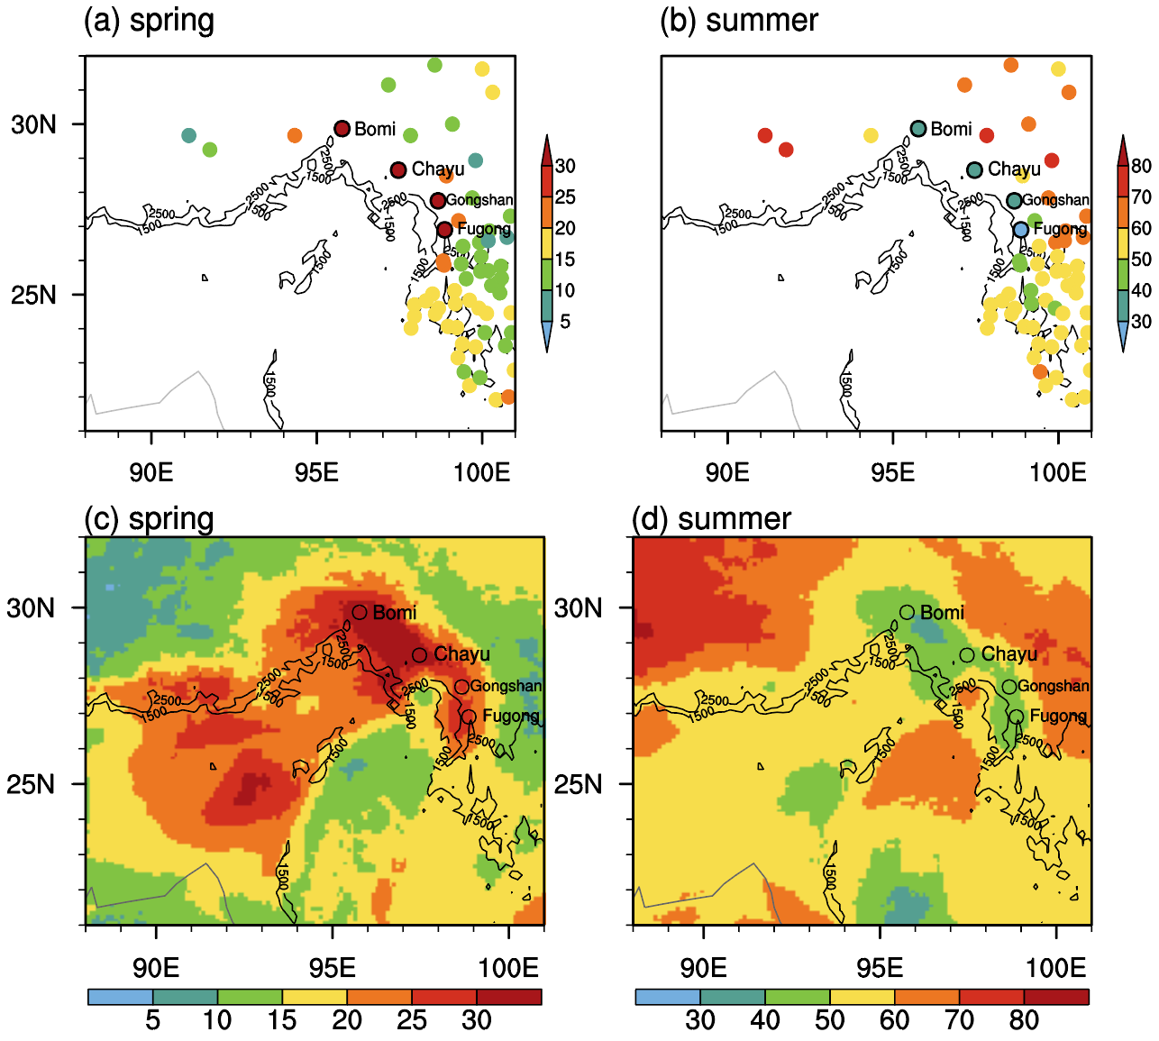
characteristics at hourly scale
ratio of spring and summer precipitation to annual accumulation (%)
hourly characteristics
mm day⁻¹
station
%
mm h⁻¹
satellite
Distinct at the windward slope of the mega relief of the SETP
Represented by stations Bomi, Chayu, Gongshan, Fugong
Mainly manifested in the high frequency rather than intensity

Slide 7
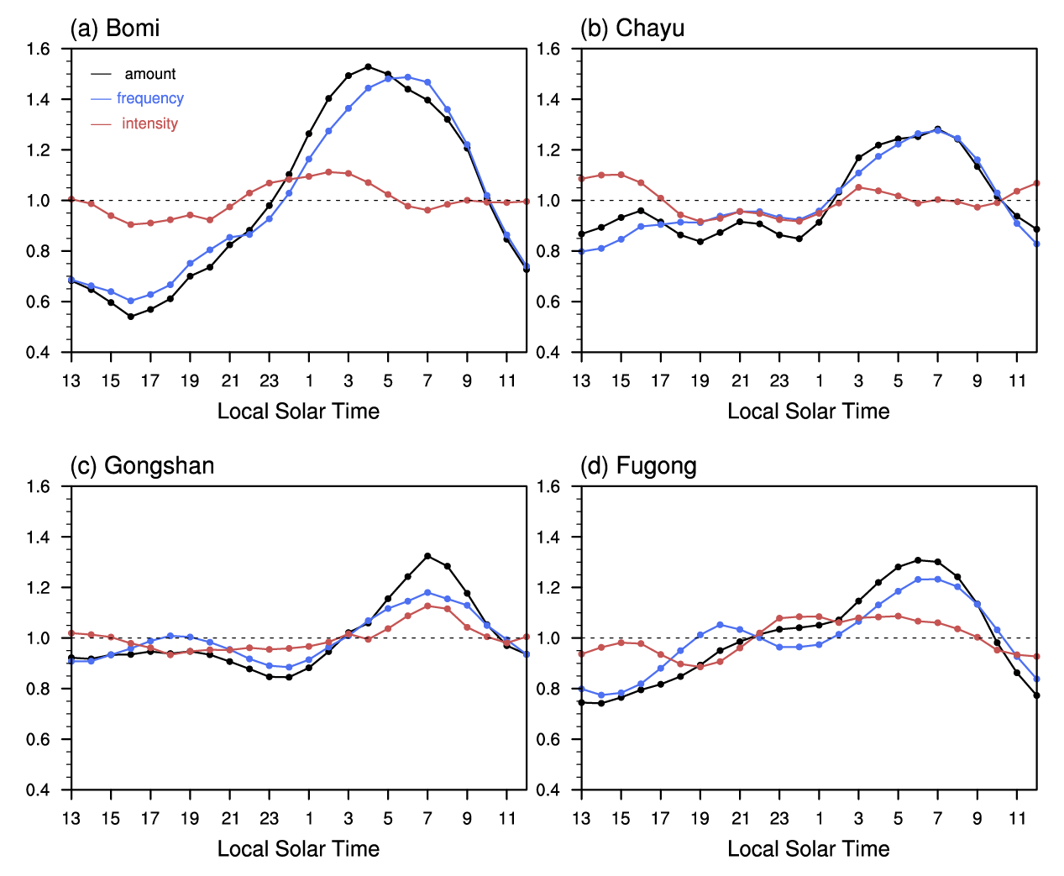
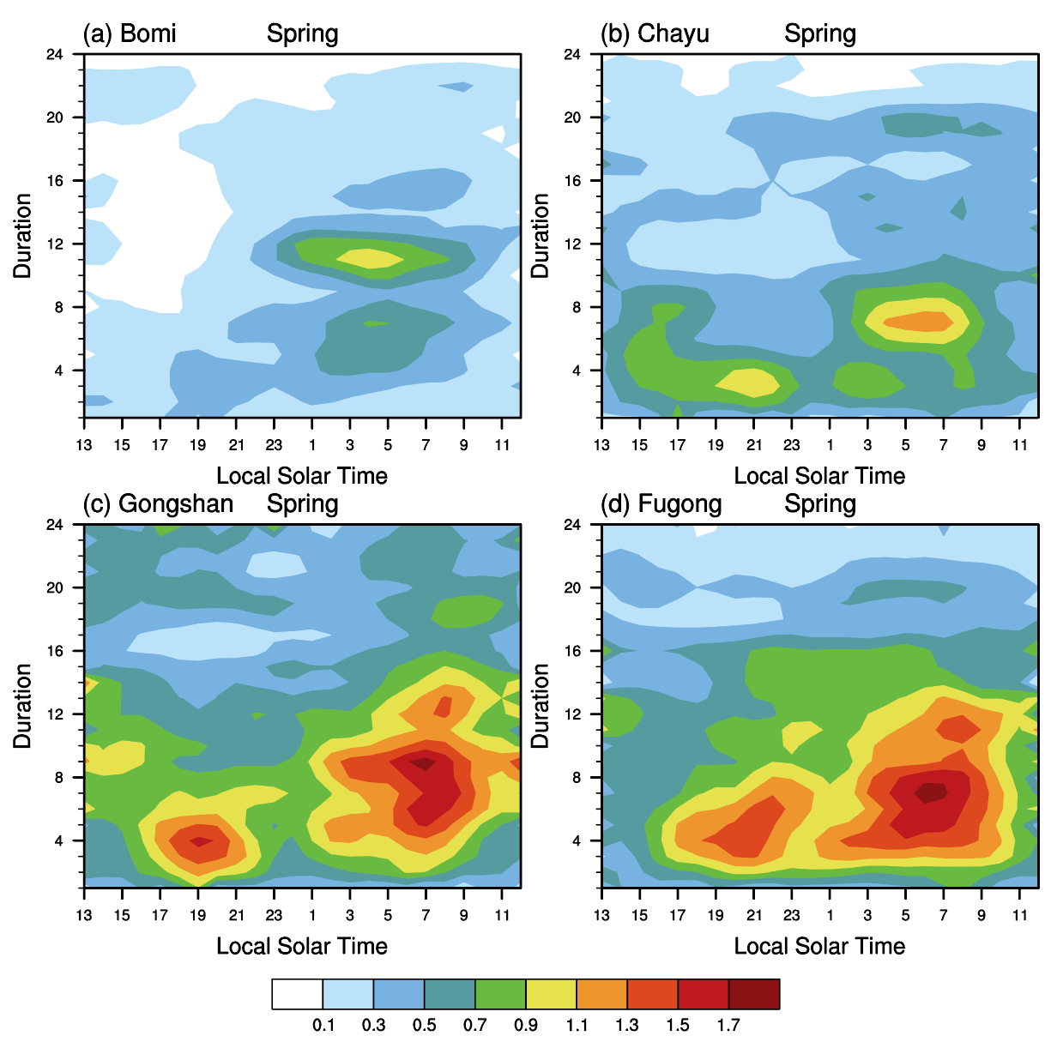
characteristics at hourly scale
diurnal cycle at four representative stations
duration-diurnal cycle relationship of rainfall events
(mm)
Featured by frequent nocturnal rainfall
Dominated by events with long duration

Slide 8
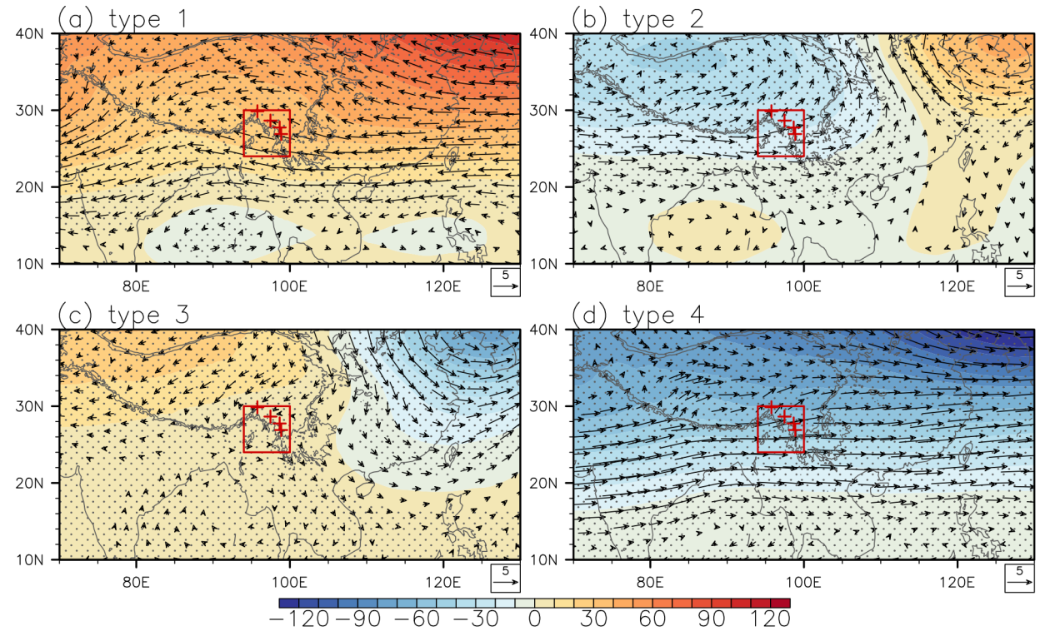
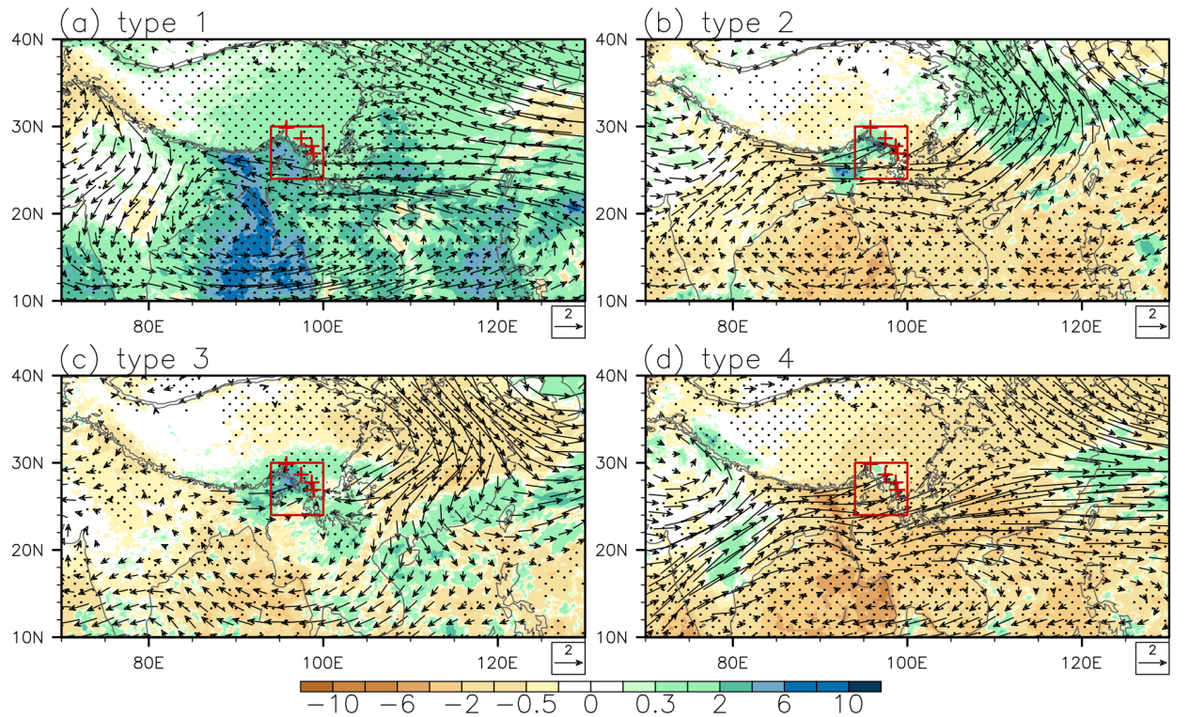
synoptic patterns clustered by SOM
anomalous 500-hPa UVZ clustered by SOM
anomalous rainfall & 700-hPa UV
Type 1: anomalous cyclone at low level of troposphere; largest area of rainfall
Type 4: anomalous anticyclone at low level of troposphere; smallest area of rainfall
Type 2&3: transitional types
Comparison of anomalous geopotential height between the TP and its south (the Bay of Bengal) and east (the East Asia)

Slide 9
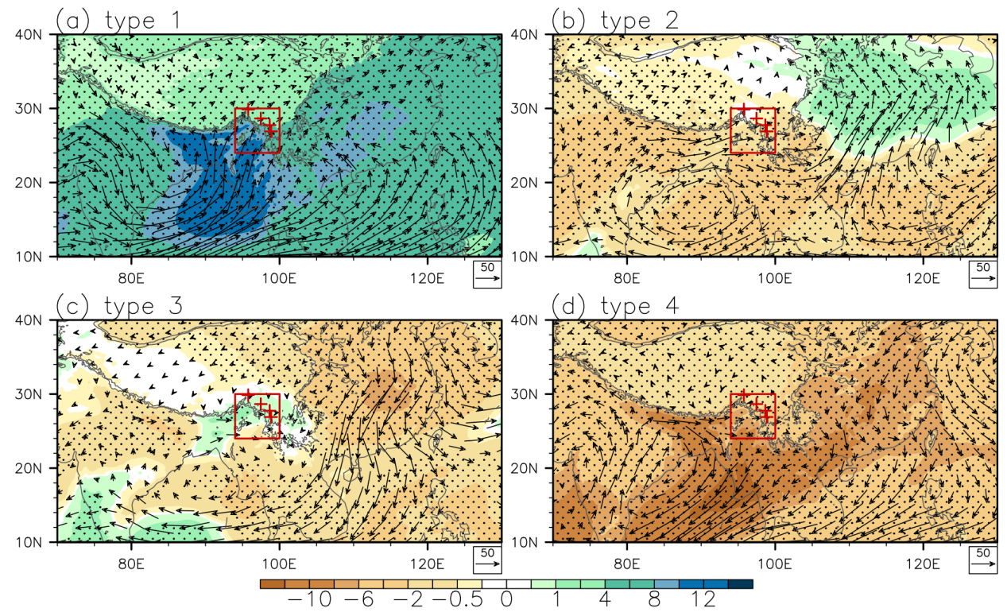
moisture-/winds-dominated types
anomalous column moisture and its transport
anomalies averaged over the red rectangle under the four synoptic types
 | Type 1 | Type 2 | Type 3 | Type 4
700-hPa u winds | -1.1 | 1.9 | 0.6 | 2.2
700-hPa v winds | 0.1 | 0.6 | 0.3 | 1.0
column water vapor | 4.8 | -0.5 | -0.01 | -3.2
largest smallest
Type 1: water vapor transported from oceans towards the TP by enhanced southerly winds; largest increase in atmospheric moisture
Type 4: water vapor transported from land to oceans; largest decrease in atmospheric moisture
Type 2&3: transitional types
Type 1: moisture-dominated type
Type 4: westerly-dominated type
Type 2&3: transitional types

Slide 10
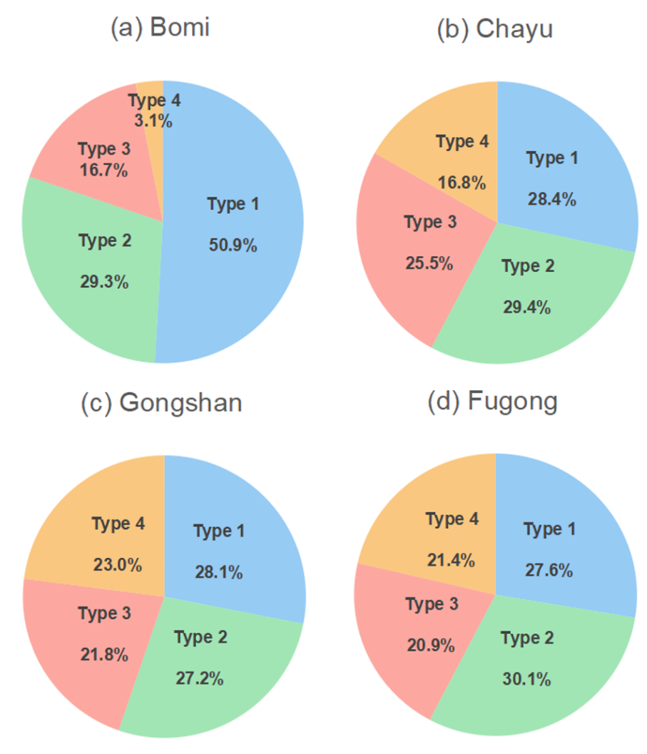
spatial heterogeneity
contribution of four synoptic types to total precipitation at four typical stations
terrain & climatological 700-hPa winds
Bomi
Gongshan
type 1
Fugong
type 4
Type 1 accounts for more than half of of the spring rainfall at Bomi. Enhanced southerly moisture transport is more likely to give rise to rainfall over Bomi with west-east-oriented terrain.
Type 4 mainly influence the precipitation at Gongshan and Fugong, which is related to the enhanced low-level westerly and the north-south-oriented terrain around these two stations.

Slide 11
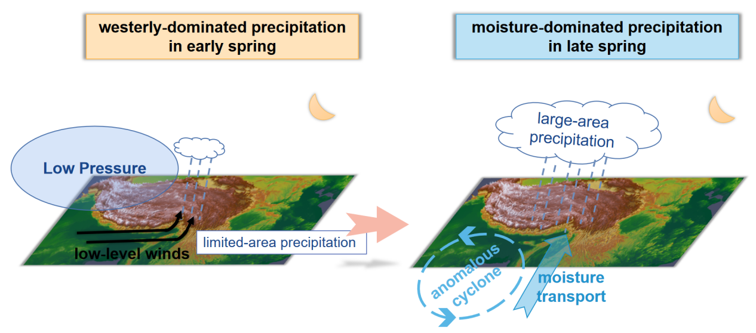
Summary
Hourly characteristics and synoptic patterns of spring precipitation over complex terrain of the southeastern Tibetan Plateau
1
Spring rainfall over the SETP is characterized by frequent nighttime events of long duration.
2
Moisture-dominated type accounts for more than half of of the spring rainfall at Bomi with west-east-oriented terrain.
3
Westerly-dominated type mainly influence the rainfall at stations with north-south-oriented terrain.

Slide 12
Discussion
The fine-scale characteristics of precipitation crucially impact the land-atmosphere interaction and hydrological cycle, since different intensity of precipitation influences the water partitioning of the land surface processes, and previous conditions of soil moisture will further influence the subsequent precipitation through the soil moisture-precipitation feedback.
1
2
Given orographic precipitation has been a long-lasting challenge for numerical modelling, the fine-scale characteristics and the relevant synoptic patterns of the spring precipitation over the SETP could provide information for model evaluation and improvement.
Yin Zhao, Jian Li, Liwen Ren, et al. 2023, Fine-scale characteristics and dominant synoptic factors of spring precipitation over complex terrain of the southeastern Tibetan Plateau. JGR-A, under 2nd review.

Slide 13
EGU 2023
Thanks for your attention
zhaoyin@lasg.iap.ac.cn

