Slide 1
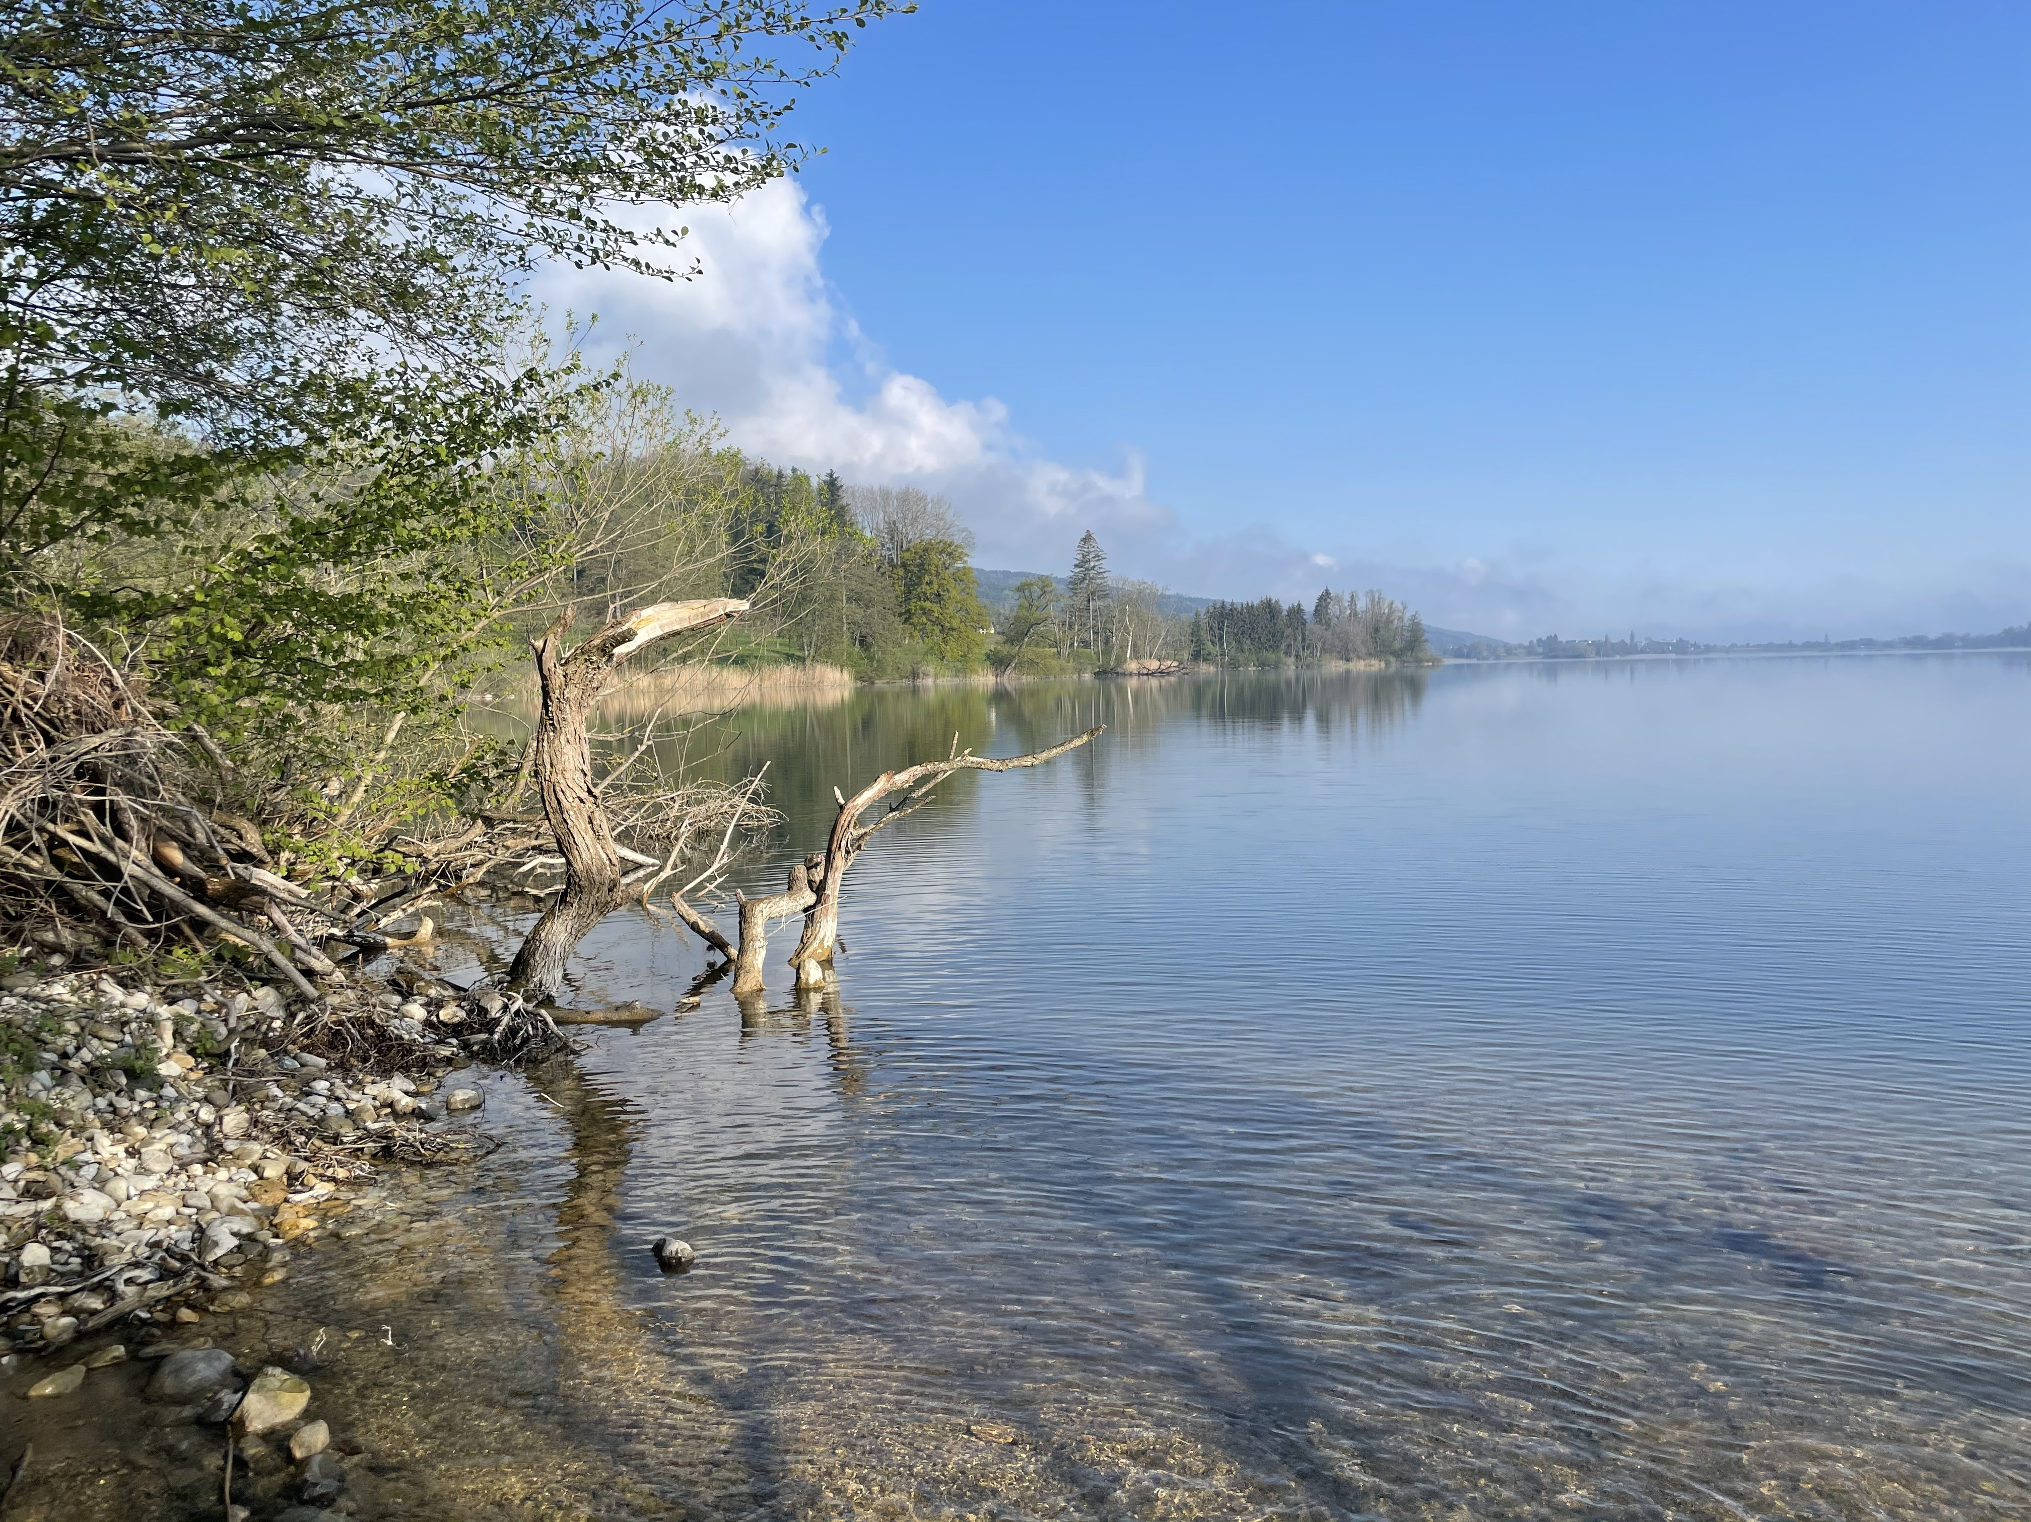
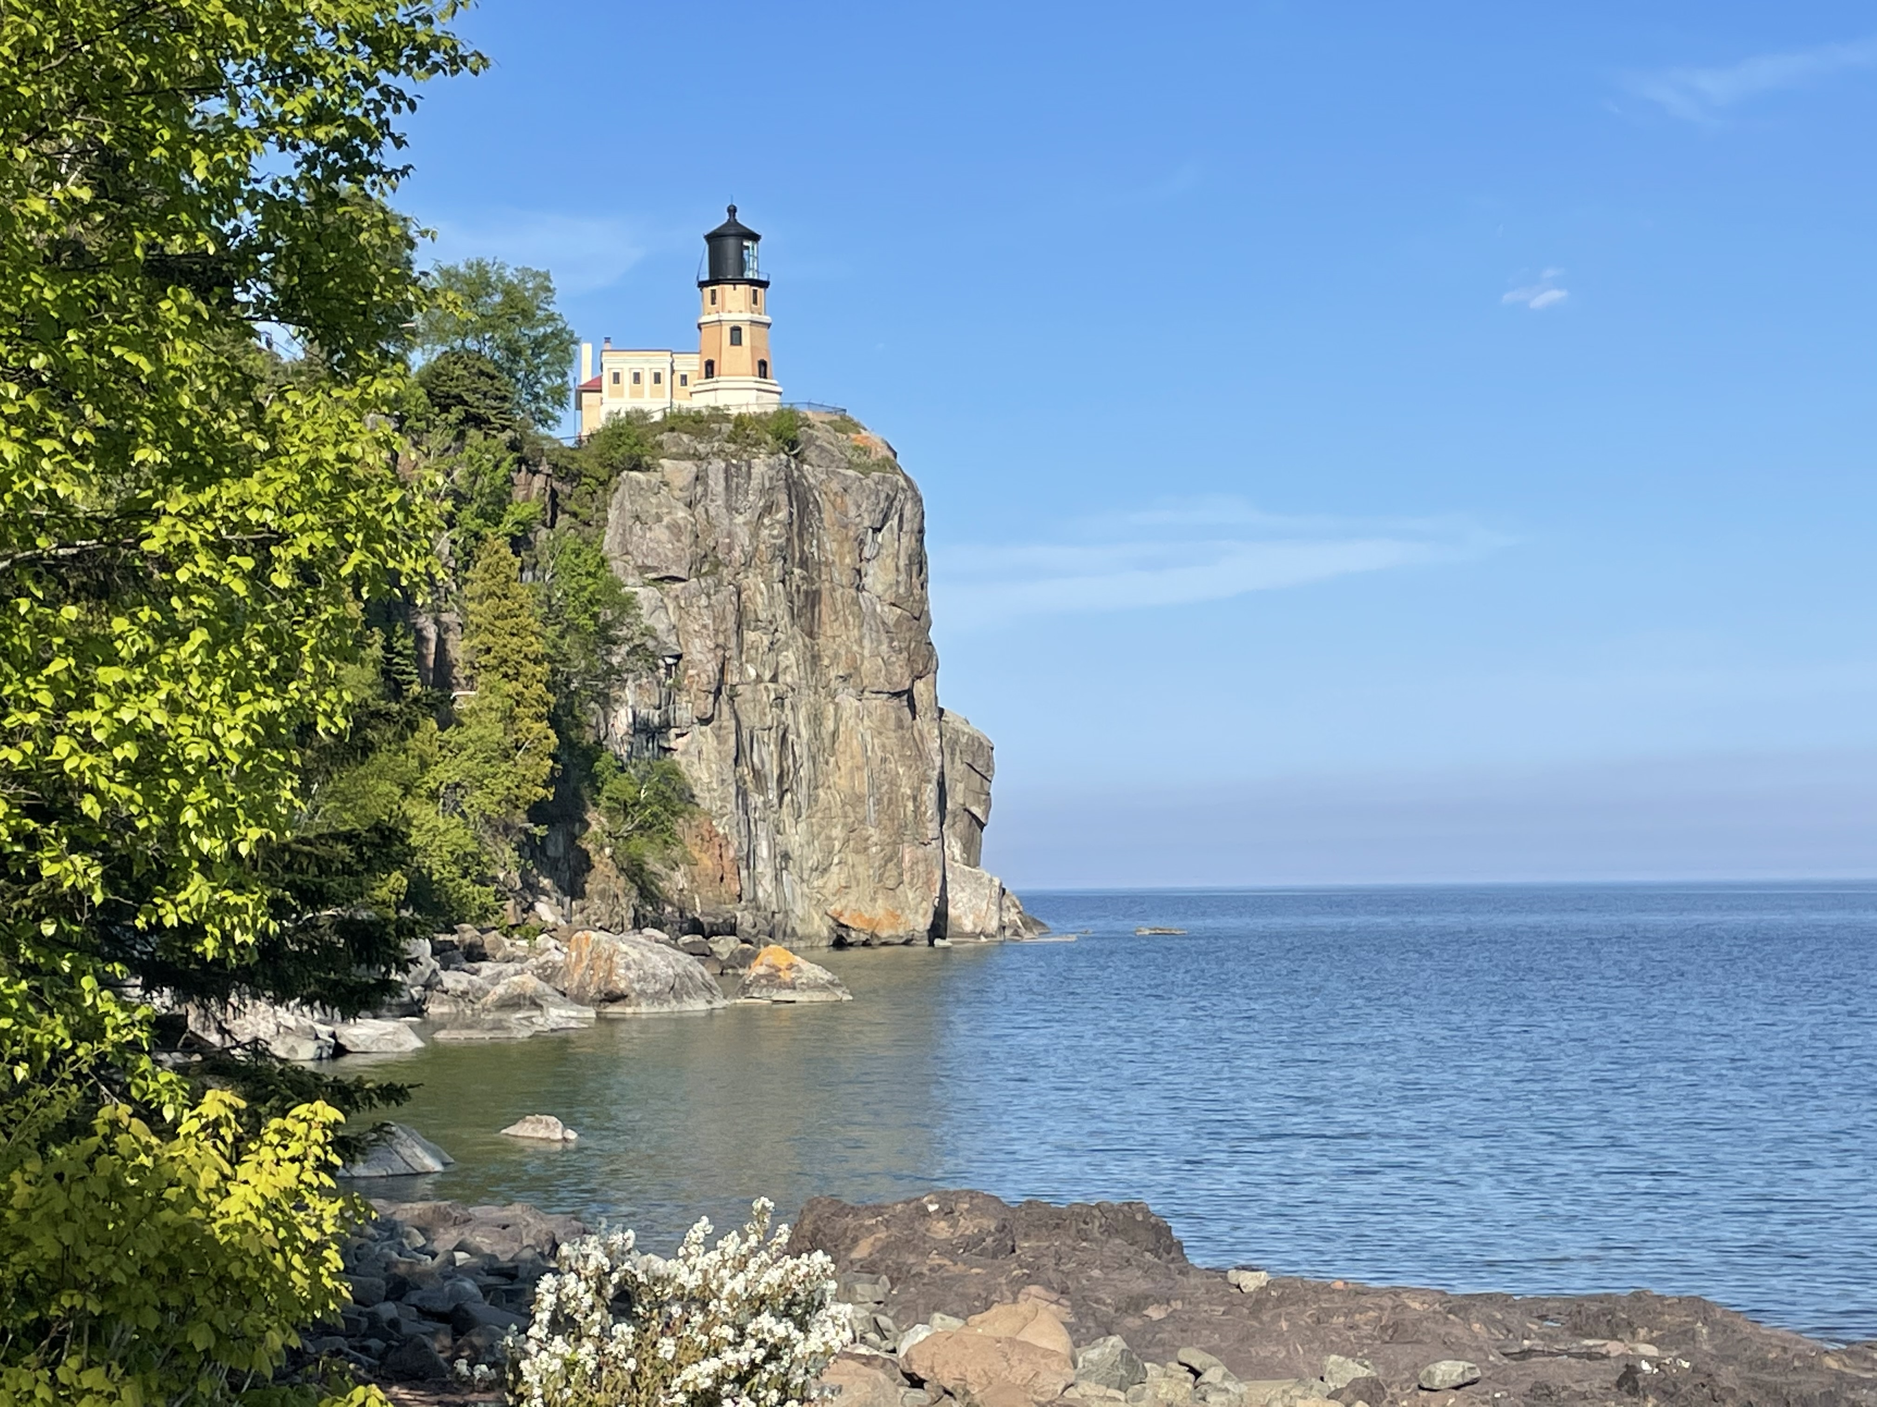

New insights into benthic nitrogen cycling using natural-abundance stable isotope measurements
Alessandra Mazzoli, Cameron M. Callbeck, Tim J. Paulus, Claudia Frey, Jakob Zopfi, Sergei Katsev, Donald E. Canfield, Moritz F. Lehmann

Slide 2

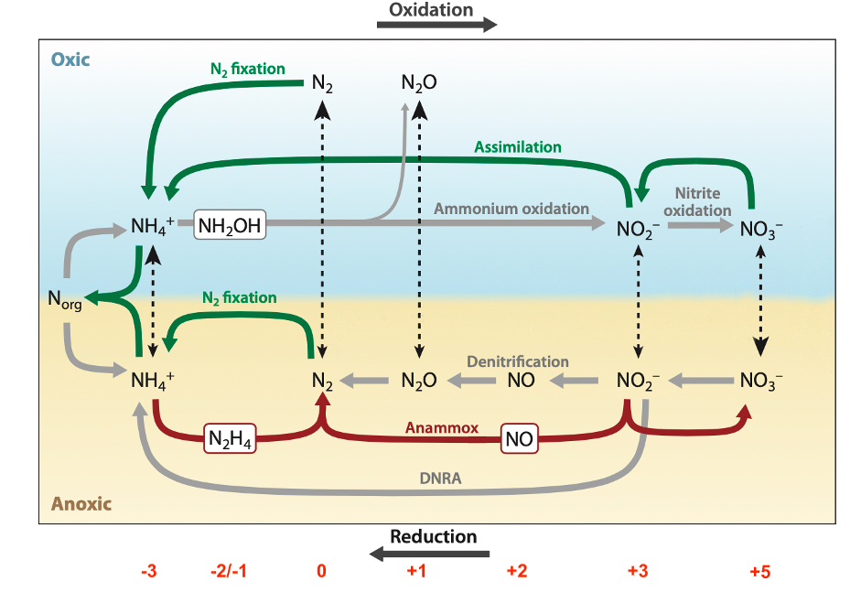
Background
N cycle
Benthic N transformations:
Simultaneous
In close proximity
At high rates
N turnover hotspot!

Slide 3
Background
N cycle
Isotope effects
N_{org}
Mineralization
(0‰)
Anammox
(-31.1‰)
NO₂⁻
Nitrification (17‰)
Anammox
(60.5‰)
Assimilation
(0-27‰)
NH₄⁺
NO₃⁻
DNRA (25‰)
Anammox
(23.5-29.1‰)
Denitrification
(up to 30‰)
N₂

Slide 4
Background
N cycle
Isotope effects
Nitrification
Incomplete nitrification
  ¹⁵N-enriched NH₄⁺
  Heavy ammonium effect
¹⁵N
¹⁴N
¹⁵N
¹⁴N
¹⁴N
¹⁵N
¹⁵N
¹⁴N
NH₄⁺ NO₃⁻
Can this effect be detected in porewater?

Slide 5

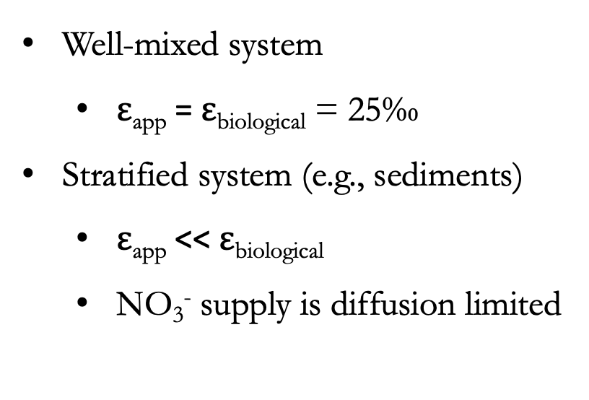



Background
N cycle
Isotope effects
Denitrification
$ε$ _{app} $\sim$ $ε$ _{biol}
$ε$ _{app}
$ε$ _{app} $\sim$ 0 ‰
Well-mixed system
  $ε$_{app} = $ε$_{biological} = 25‰
Stratified system (e.g., sediments)
  $ε$_{app} << $ε$_{biological}
  NO₃⁻ supply is diffusion limited
DL
DL
Diffusion layer (DL)
¹⁵N-NO₃⁻
Reaction layer → $ε$ _{biol}
¹⁵N-NO₃⁻
Can porewater samples bridge the gap? → $ε$_{endobenthic}

Slide 6
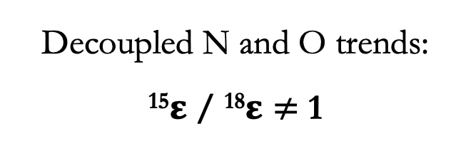
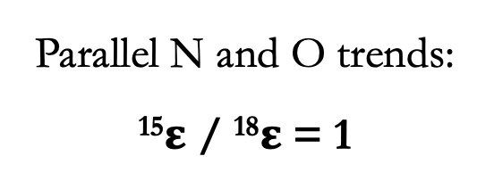
Background
N cycle
Isotope effects
Denitrification vs. anammox & nitrification
H₂O
NO₂⁻
NO₃⁻
N₂
Nitrification
Anammox
Denitrification
Decoupled N and O trends:
¹⁵$ε$ / ¹⁸$ε≠$ 1
Parallel N and O trends: ¹⁵$ε$ / ¹⁸$ε$ = 1
Can we distinguish between co-occurring N-transformation processes?

Slide 7
Background
N cycle
Isotope effects
Objective
To investigate how differences in geophysical properties and the relative contributions of simultaneously occurring processes in the chosen settings (lacustrine and marine) affect the isotope systematics of the benthic NO₃⁻ and NH₄⁺ pools.

Slide 8
