Slide 1
Post-process eddy covariance data with ease using R package openeddy
Ladislav Šigut

Slide 2
What is openeddy?
software infrastructure for eddy covariance data post-processing
main focus on streamlining quality control (QC)
simplifies creation of adaptable & reproducible processing workflows
combined with other packages -> complete processing chain
functions useful in daily work (openeddy tutorials)
even outside of eddy covariance context
all resources available at: https://github.com/lsigut/
package, workflows, tutorials
Notes:
reproducibility and sharing of methods in the form of code

Slide 3
Data processing chain
raw
processed
QCed
filled & partitioned
summarized
Notes:
+ storage processing (not in the scope of openeddy)
summary: aggregated fluxes, uncertainty, wind roses, footprint climatology, additional variables...
Meteo data is expected to undergo separate workflow prior the EC post-processing workflow
Does not explicitly support QC of CH4 and N2O fluxes (but QC scheme can be designed by user)

Slide 4
Quality assessment & control process
sampling
QA
QC
evaluation
feedback
Notes:
QA is crucial.

Slide 5
Basic openeddy QC principles
flag
combine
inspect
apply

Slide 6
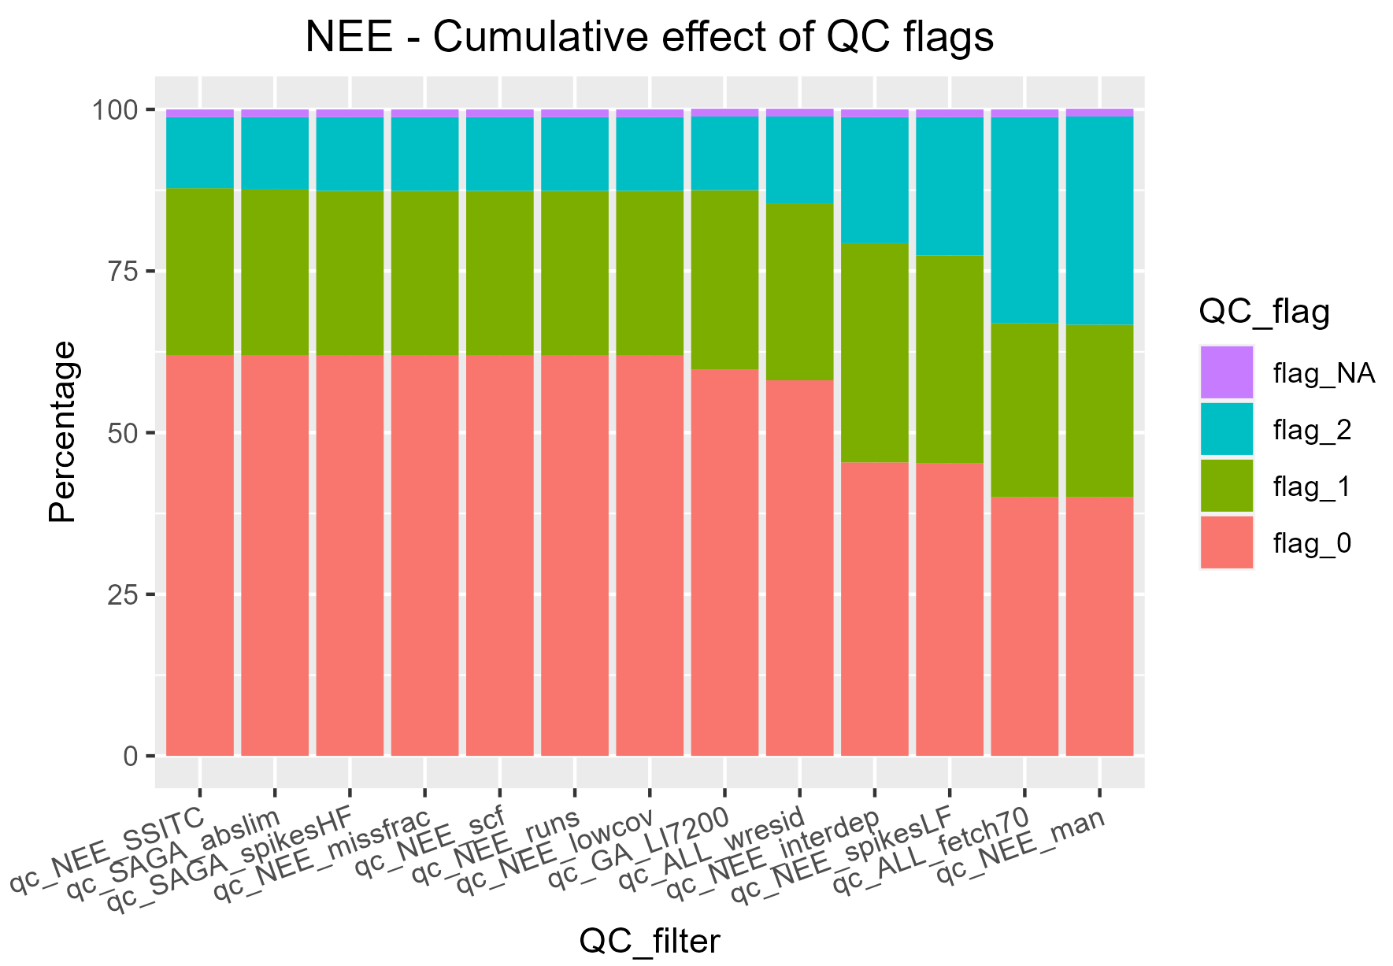
QC summary
combined effect of QC filters
reads from left to right
see how much each test refined the resulting QC
only flags 0 and 1 are used

Slide 7
Quick overview

Slide 8
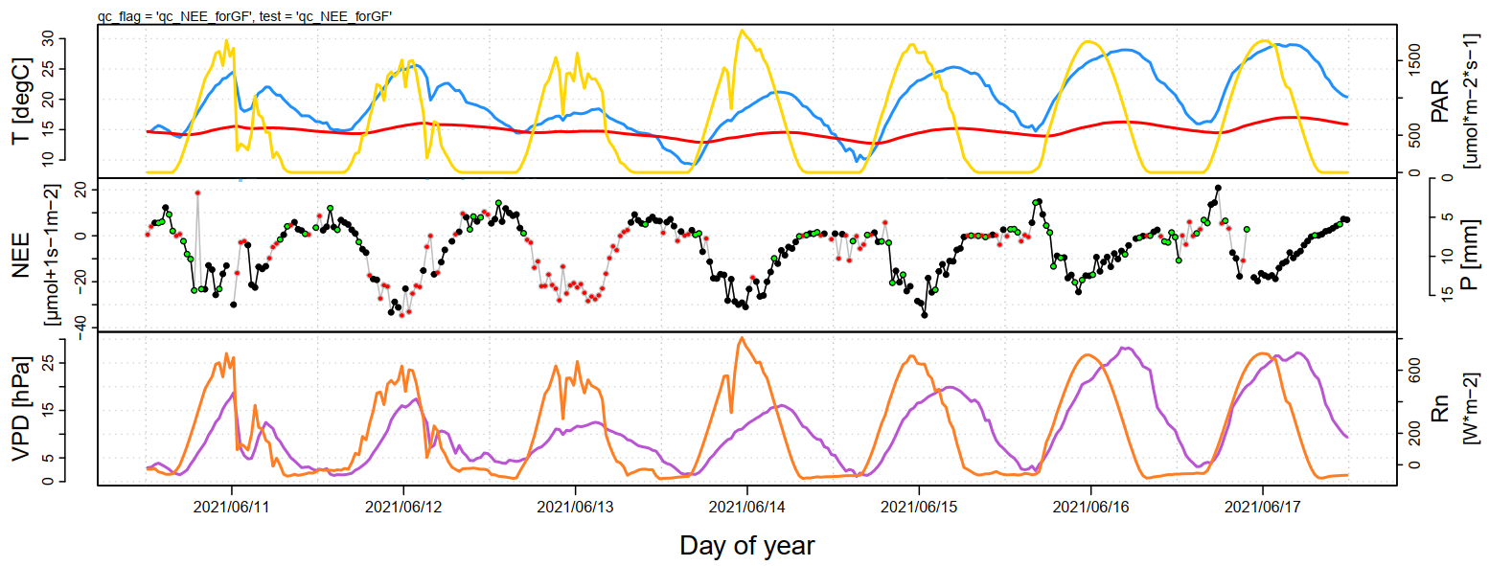
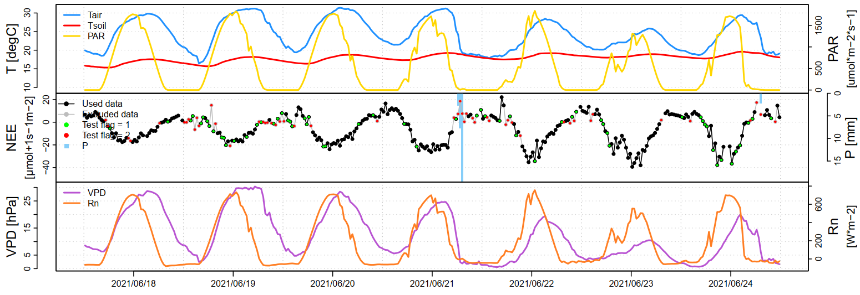
Quick overview

Slide 9
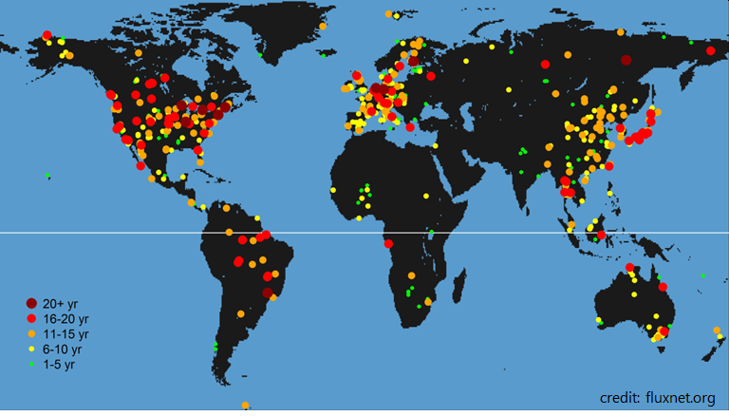
Potential collaborations
It takes a village
FLUXNET Committees
Ancillary data processing
Open source code development
Additional products/variables
Sharing your experience and expertise through commented workflows
QC, storage, footprint modelling, evapotranspiration partitioning, etc.
Acknowledgement: This work was supported by the Ministry of Education, Youth and Sports of the Czech Republic within the CzeCOS program, grant number LM2023048, and by SustES—Adaptation strategies for sustainable ecosystem services and food security under adverse environmental conditions, project no. CZ.02.1.01/0.0/0.0/16_019/0000797.
FLUXNET
Notes:
Collaborations with other fields; additional variables are typically obtained only for purposes of a particular study

