Slide 1








What is the source of CO₂ and CH₄ at 150 meters depth?
Studying CO₂, CH₄ and N₂O concentrations and carbon isotopic signatures in the air of the Vadose Zone in Spain
Enrique Echeverría Martín¹ (eechmar@gmail.com)
¹ University of Almería, Agronomy Department, Spain
Ángel Fernández-Cortés ², Andrew S. Kowalski ^{3,4}, Penélope Serrano-Ortiz ^{3,5}, and Enrique Pérez Sánchez-Cañete ^{3,4}
² University of Almería, Biology and Geology Department, Spain; ³ University of Granada, Applied Physics Department, Spain; ⁴ Andalusian Institute Earth System Research IISTA–CEAMA, Spain; ⁵University of Granada, Ecology Department,18010 Granada, Spain

Slide 2

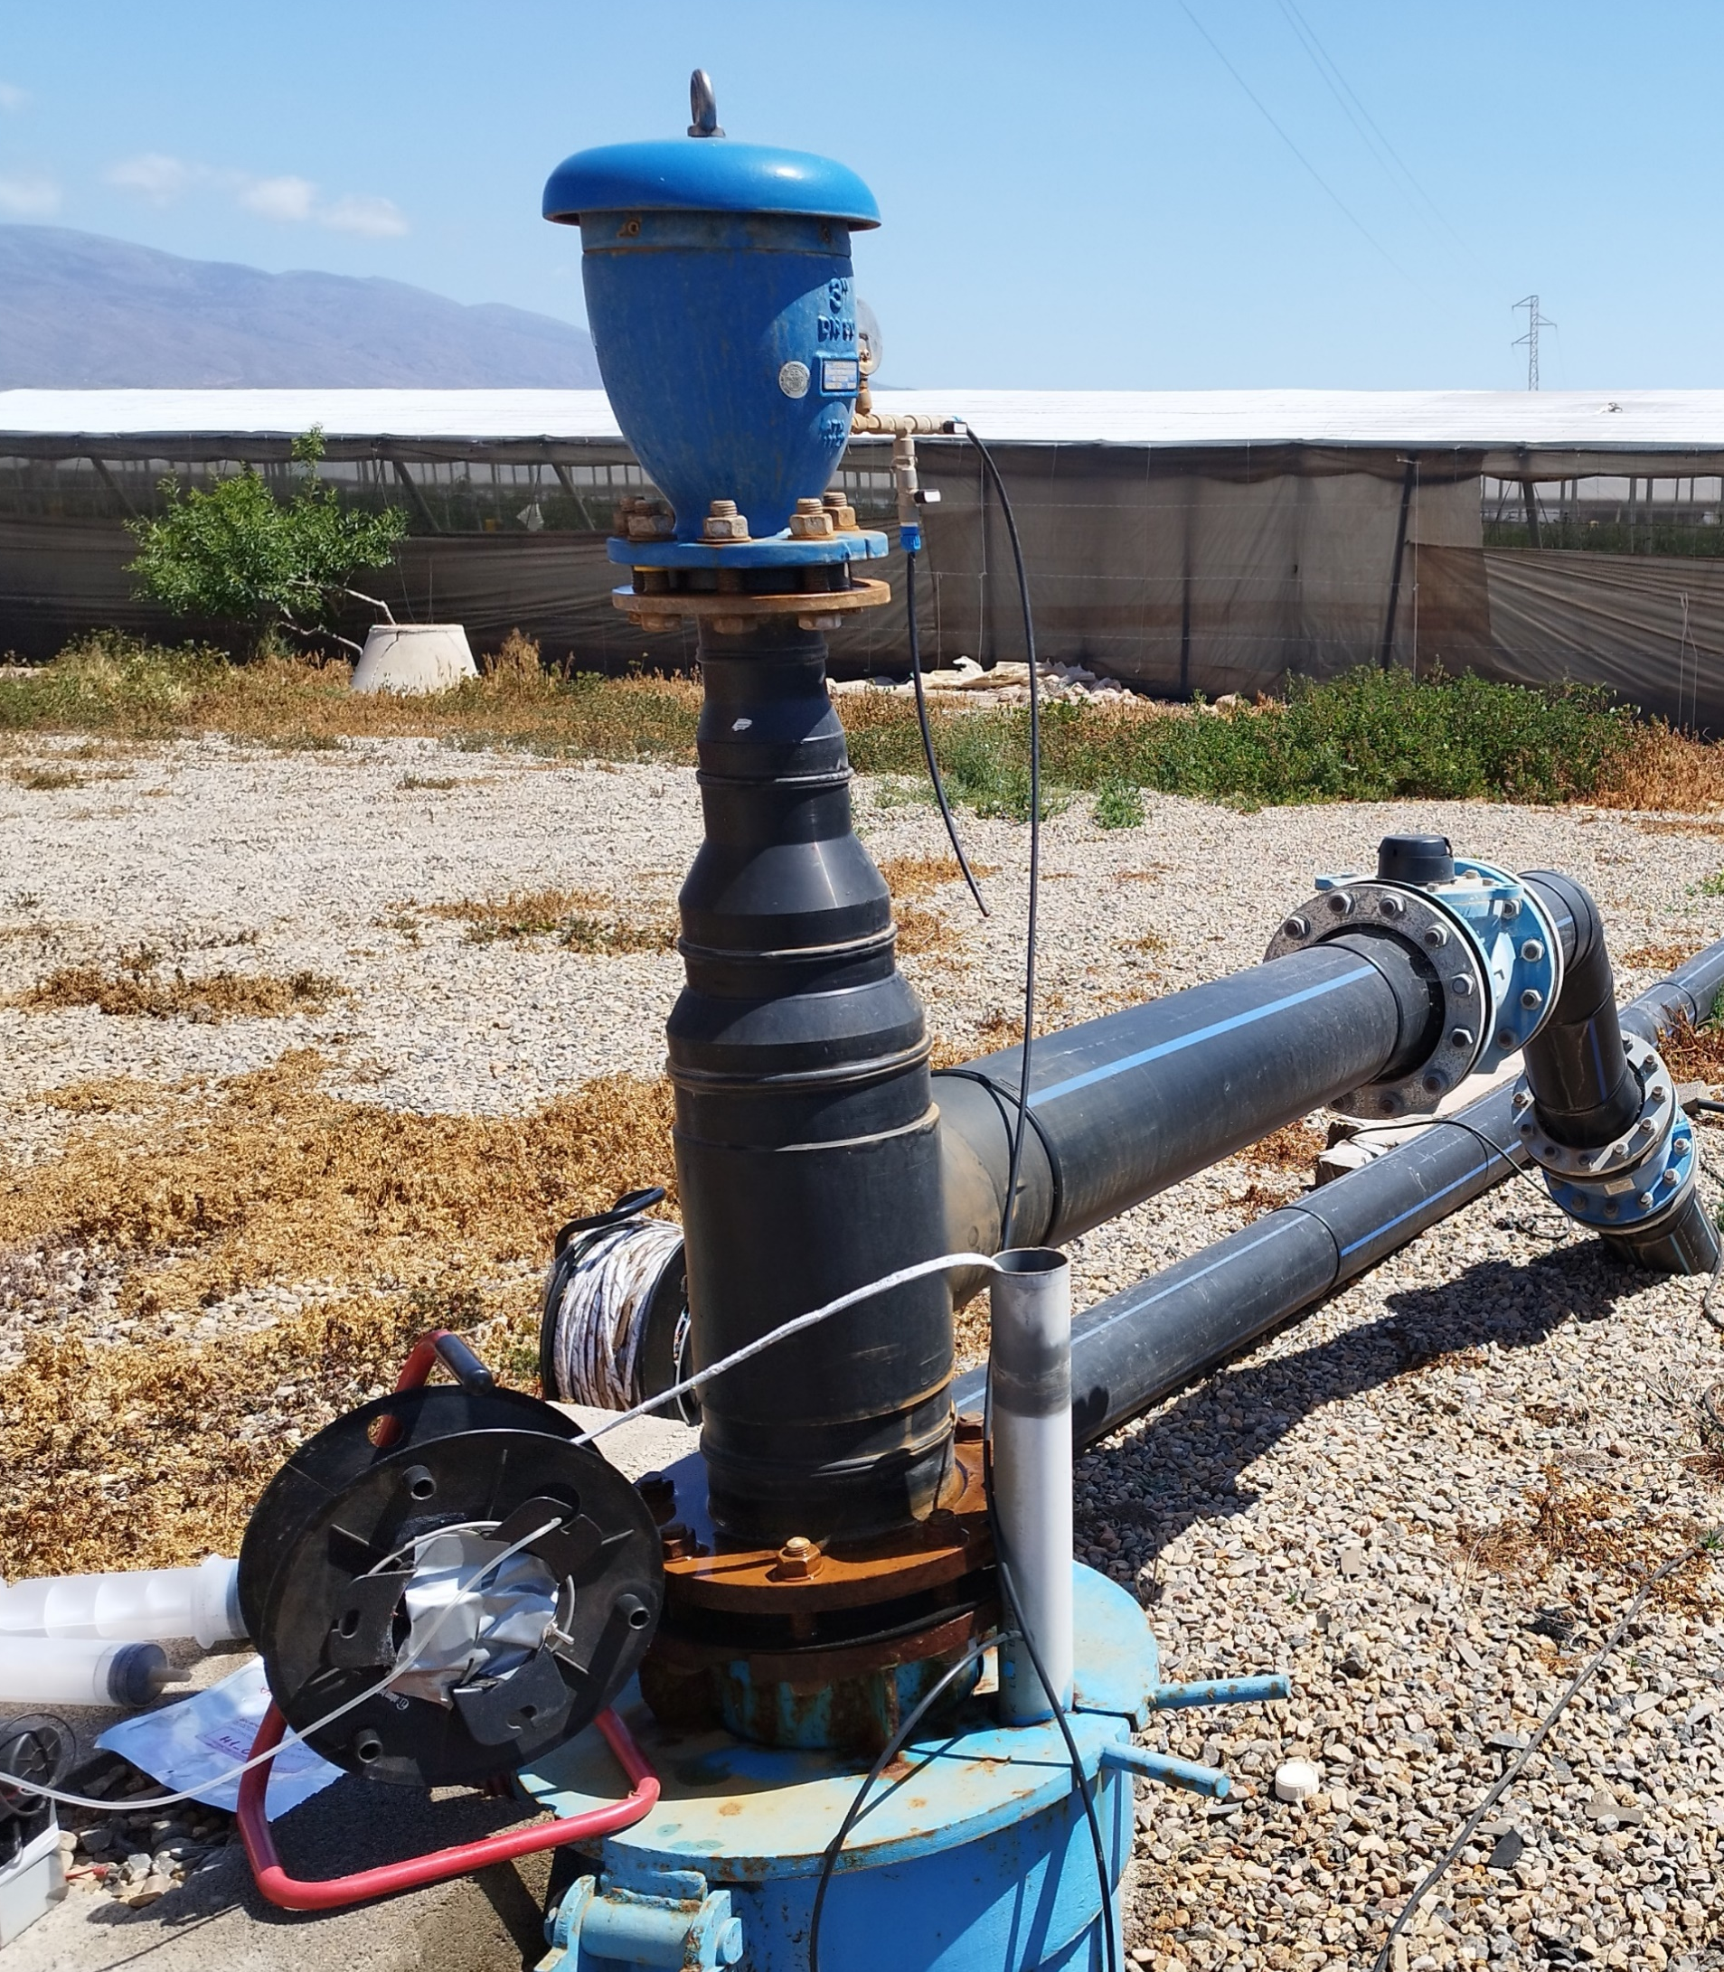
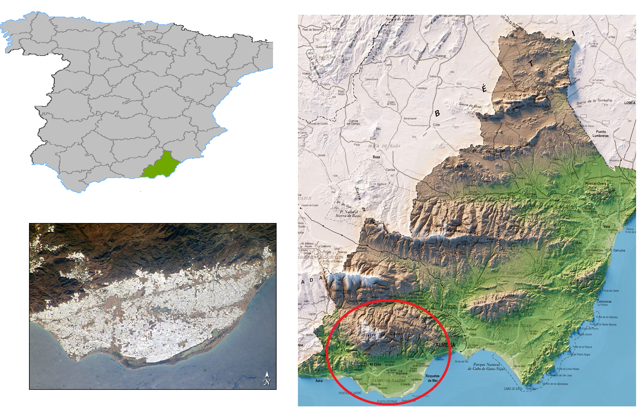
INTRODUCTION AND LOCATION:
The vadose zone can store a large amount of greenhouse gases in its pore spaces
To analyze these concentrations, samples were taken in the air column of two boreholes in Campo de Dalías, Almería, Spain. This location stands out for being a particularly productive agricultural region through greenhouse horticulture.

Slide 3
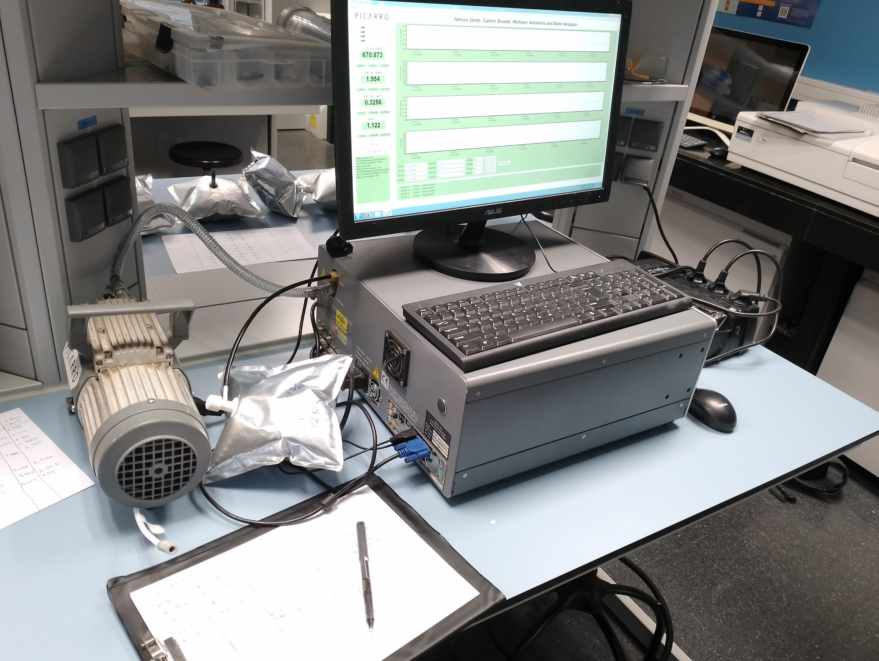
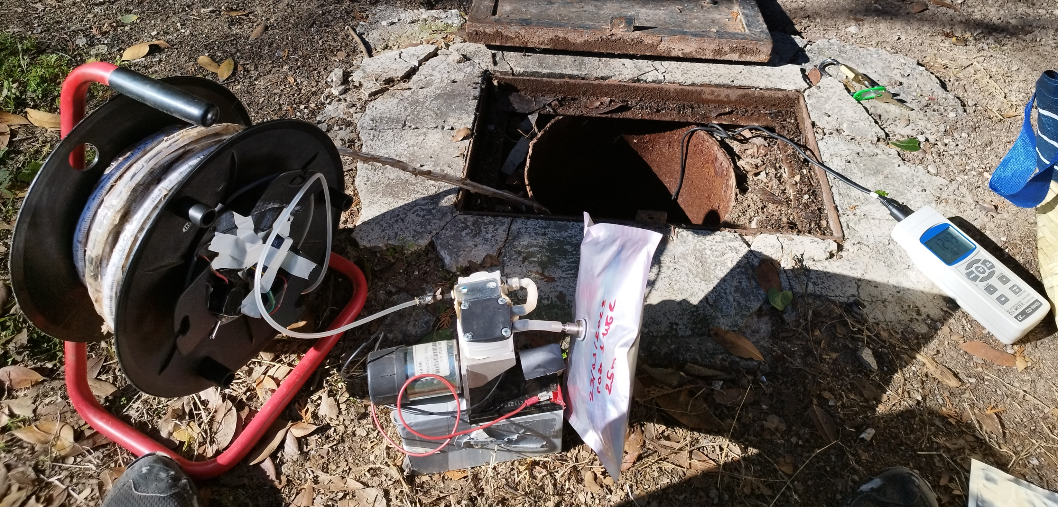
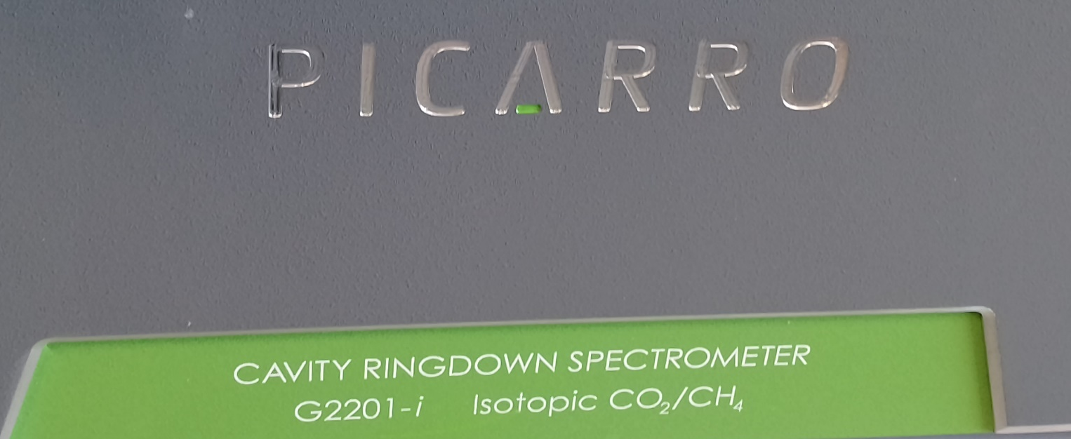
METHODOLOGY:
Gas samplings bags were taken with a vacuum pump
Samples were analyzed in the laboratory by a gas analyzer:
Picarro G2508 (CO₂, CH₄ and N₂O)
Picarro G2201-I (δ¹³C ‰, CO₂ and CH₄ ₎

Slide 4
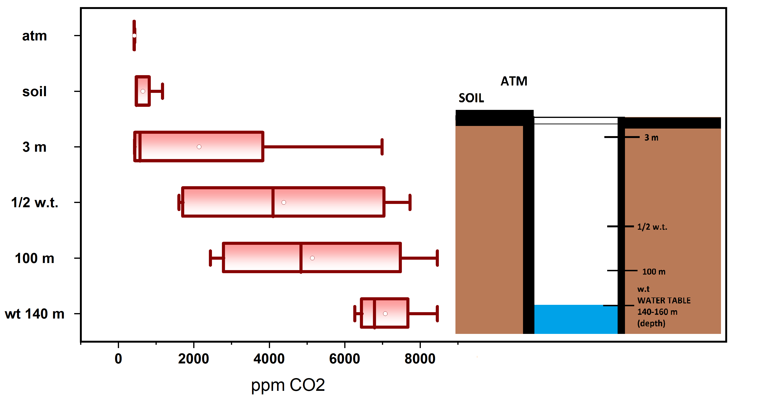
RESULTS: CO₂ in BOREHOLE DALIAS 1
Vatiation 2021a, 2022s, 2022w and 2023s Campaigns
a: Autumn; s: Spring; w: Winter

Slide 5
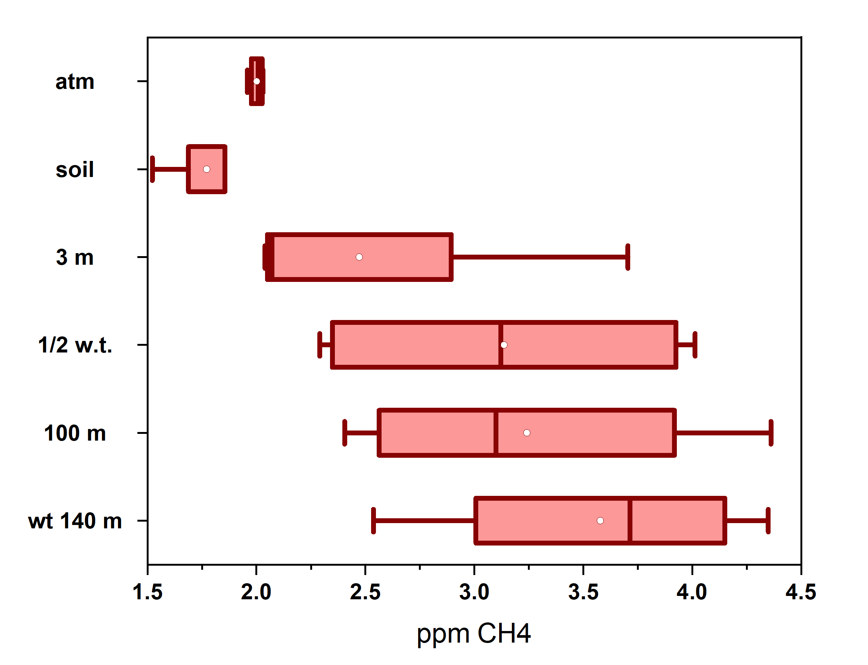
RESULTS: CH₄ in BOREHOLE DALIAS 1
Vatiation 2021a, 2022s, 2022w and 2023s Campaigns
a: Autumn; s: Spring; w: Winter

Slide 6
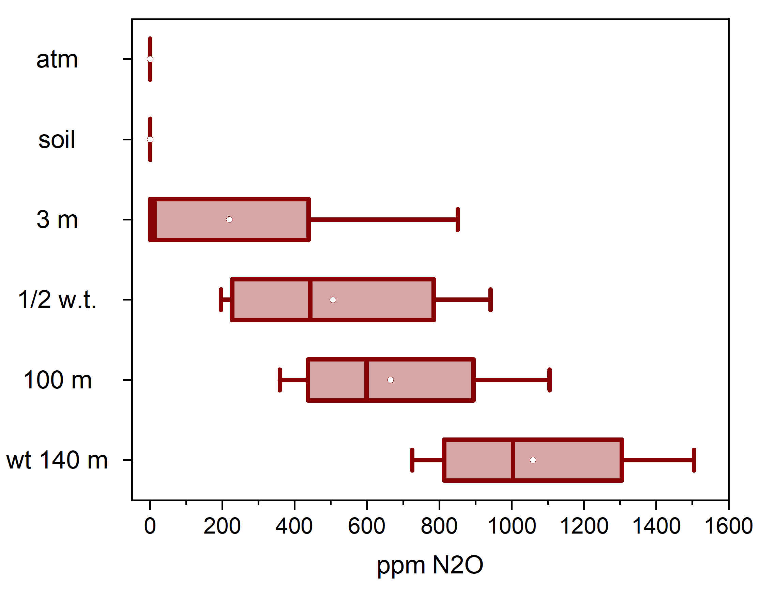
RESULTS: N₂O in BOREHOLE DALIAS 1
Vatiation 2021a, 2022s, 2022w and 2023s Campaigns
a: Autumn; s: Spring; w: Winter

Slide 7
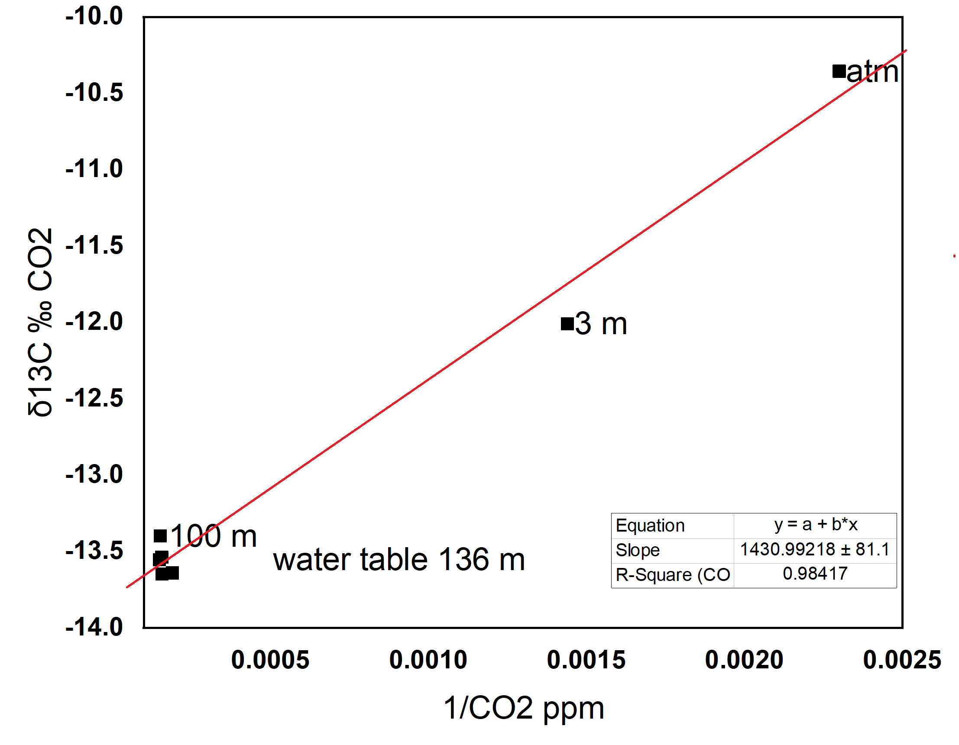
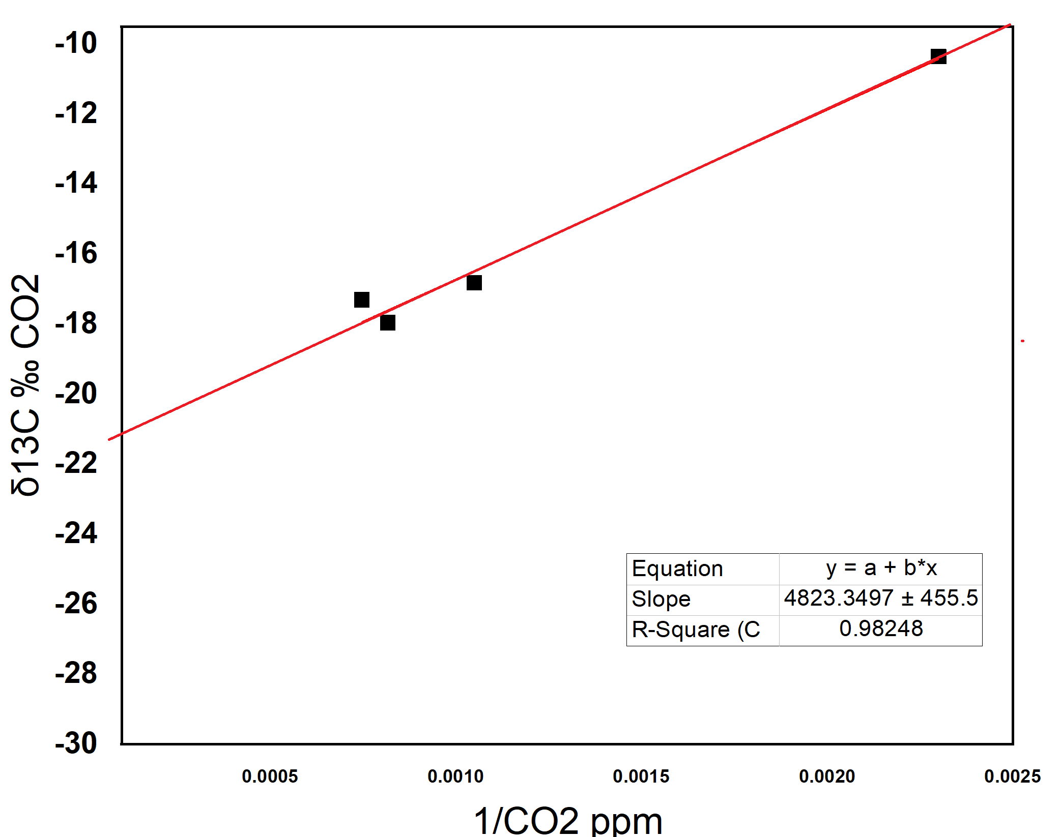
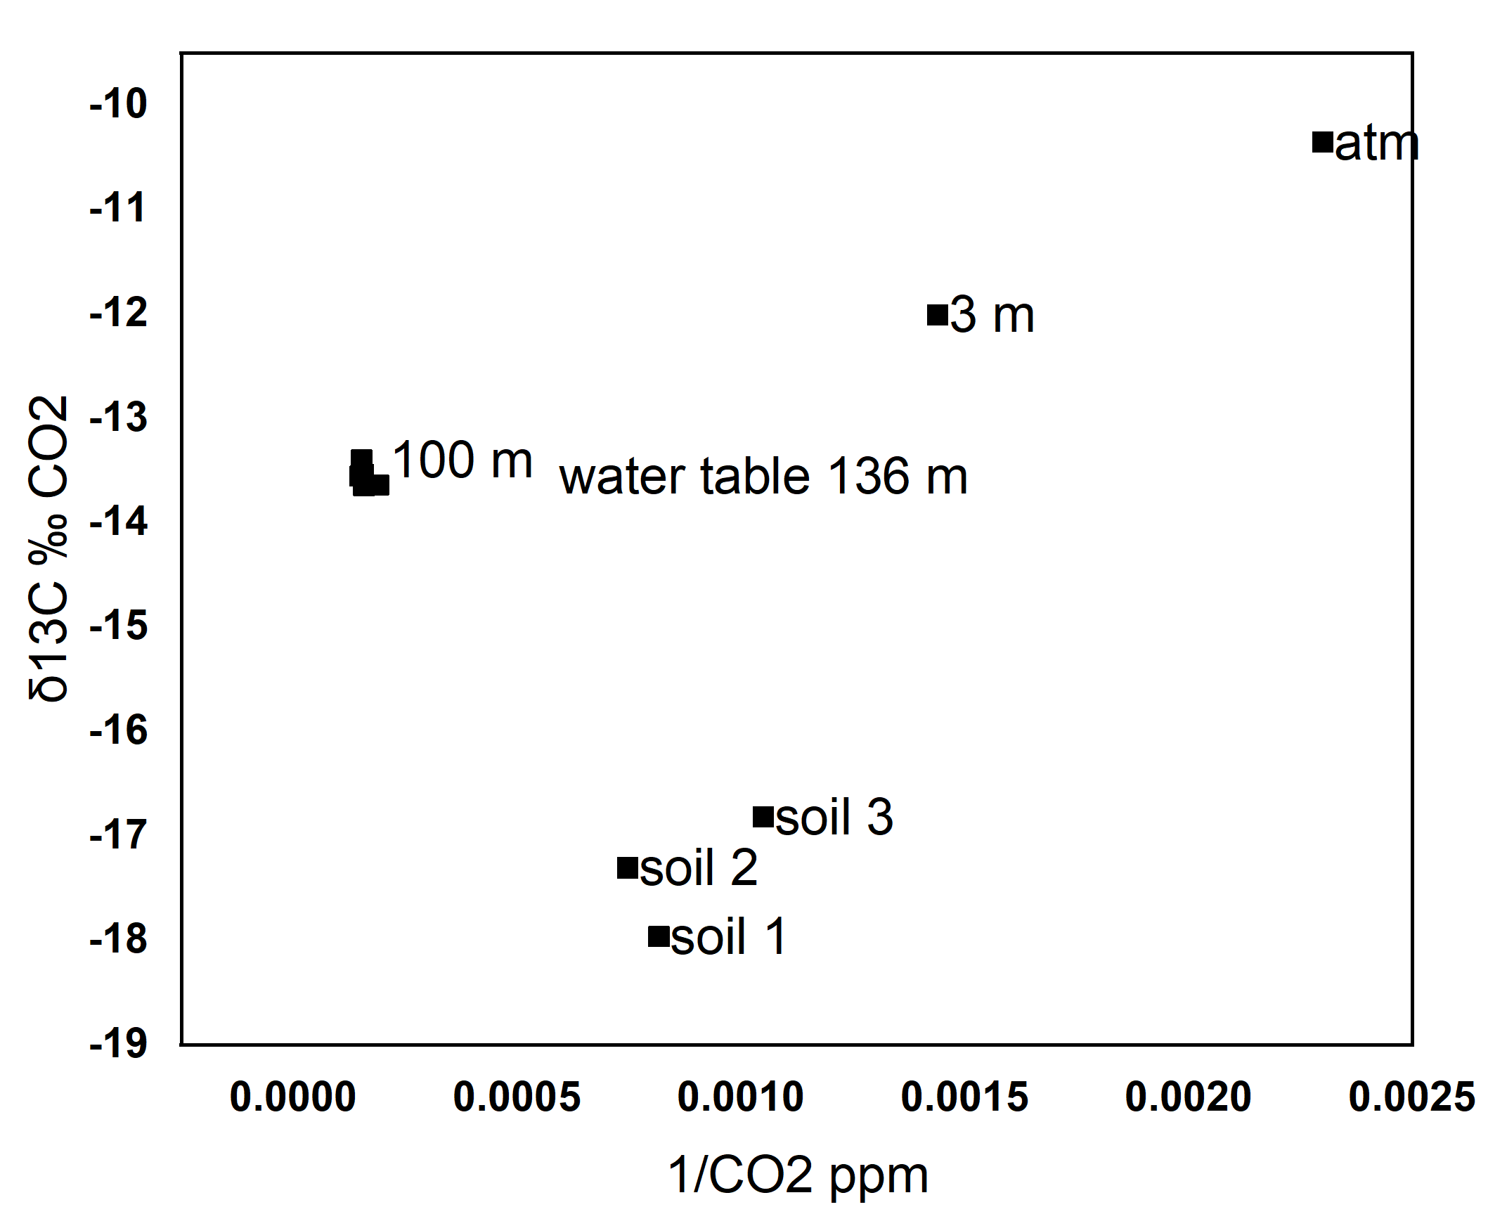
RESULTS: δ¹³C ‰ CO₂ and CH₄ DALIAS 1 2023
BOREHOLE
SOIL (10-20 cm)
ALL
atm
soil

Slide 8
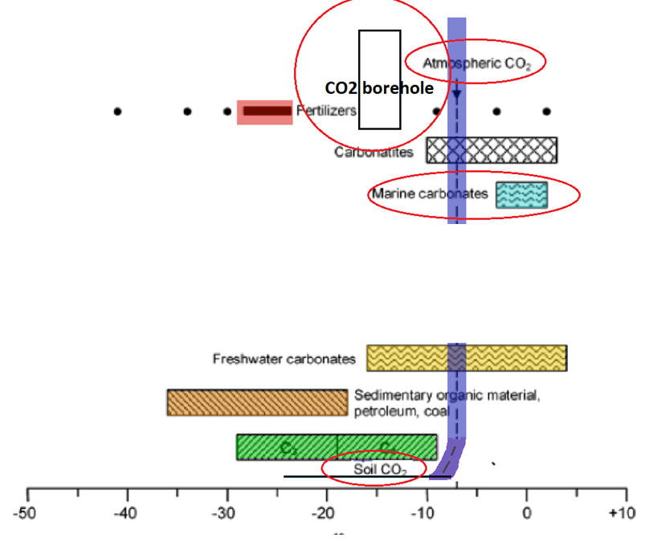
RESULTS: δ¹³C ‰ ANALYSIS DALIAS 1
δ¹³C ‰ = - 13.76 +- 1.34
GROUNDWATER BICARBONATE
δ¹³C ‰ = 1.48 +- 0.1
BEDROCK - DOLOMITE
δ¹³C ‰ = - 7.13 +- 0.12
BEDROCK - CALCARENITE
Vitoria et al.(2004)
Vitòria, L, Otero, O, Soler, A., Canals, À. (2004) Fertilizer Characterization: Isotopic Data (N, S, O, C and Sr). Environmental Science & Technology, 38, 3254-3262

Slide 9
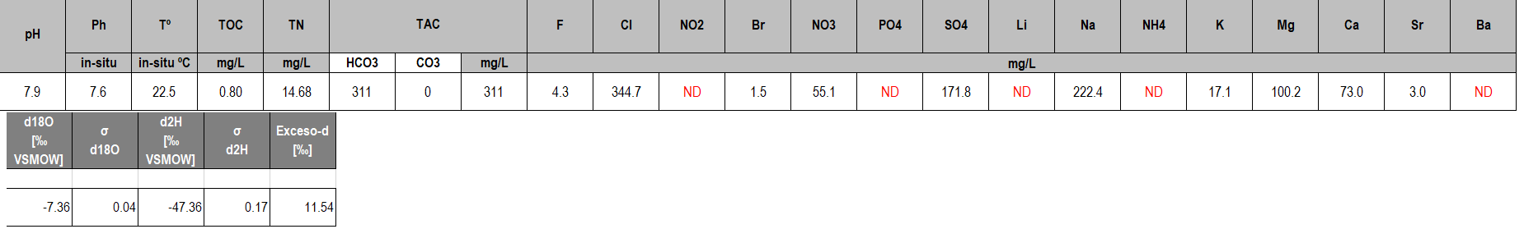
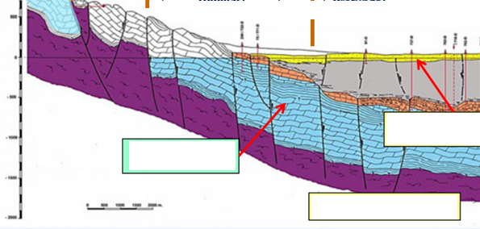
RESULTS: GROUNWATER ANALYSIS DALIAS 1

Slide 10
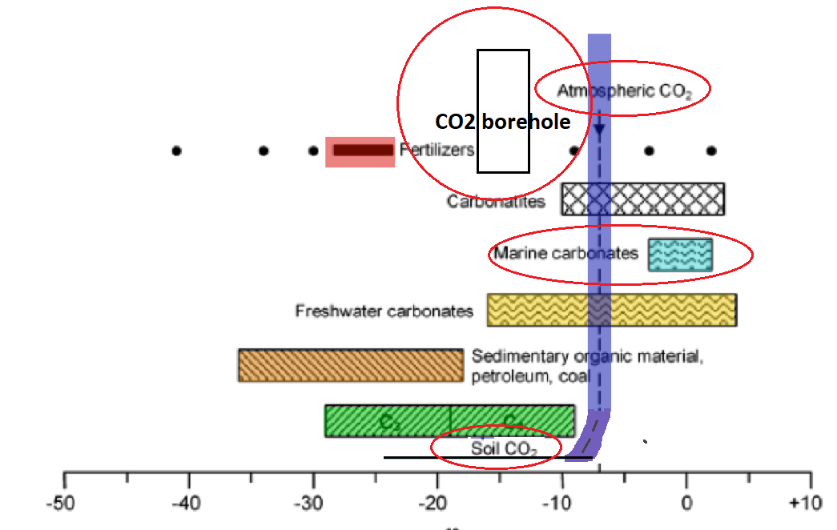
RESULTS: δ¹³C ‰ CH₄ ,DISCUSSIONS AND CONCLUSIONS :
CO₂ inside the borehole:
  No biotic origin, neither atmospheric nor magmatic degassing.
  Possible degassing of CO₂ dissolved in water maily from dissolution of the bedrock.
CH₄ inside the borehole:
  Biotic production
N₂O inside the borehole:
  Aquifer highly contaminated by nitrates
Vitoria et al.(2004)
Vitòria, L, Otero, O, Soler, A., Canals, À. (2004) Fertilizer Characterization: Isotopic Data (N, S, O, C and Sr). Environmental Science & Technology, 38, 3254-3262

Slide 11
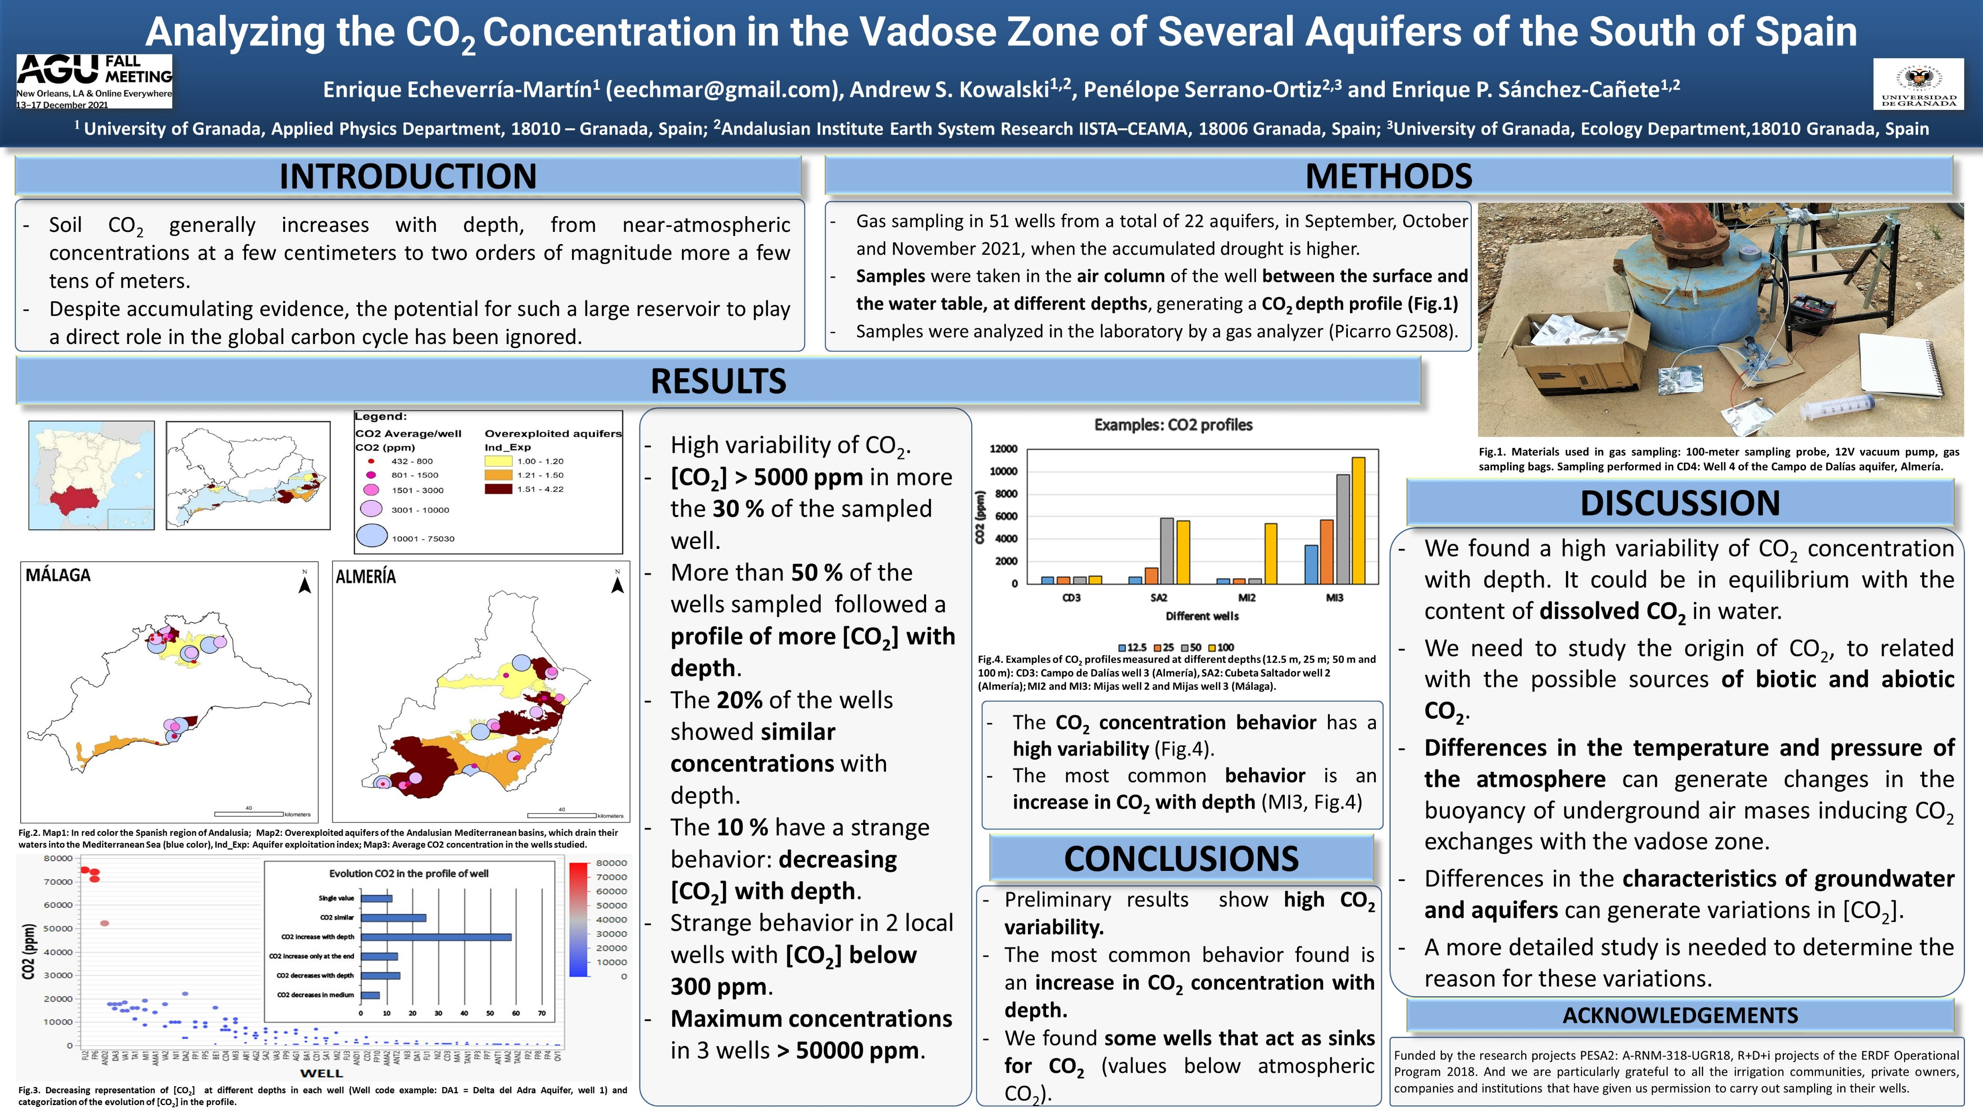
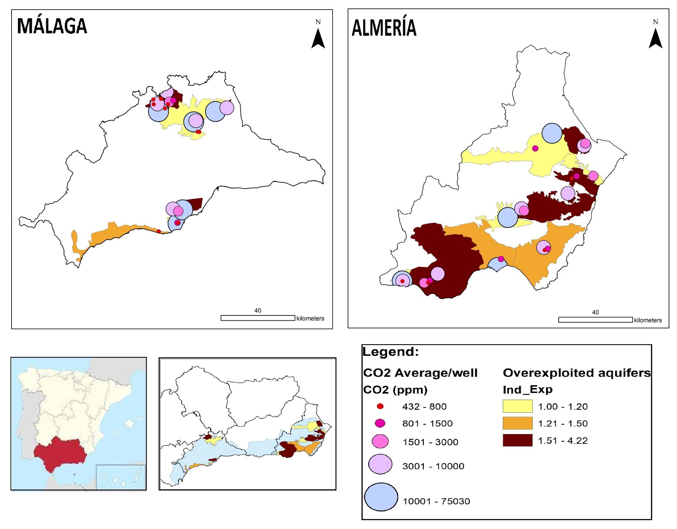
RESULTS 2021-2022: CO₂ OTRHES BOREHOLES

Slide 12
RESULTS: CO₂ OTRHES BOREHOLES

Slide 13
RESULTS: CH₄ in OTRHES BOREHOLES

Slide 14
RESULTS: N₂O in OTRHES BOREHOLES

Slide 15
DISCUSSIONS
VARIATIONS IN AIR CONCENTRATION BOREHOLES | SEASONAL VARIATIONS
-VENTILATION: PIPING SIZE AND INSULATION OF THE CASING | VENTILATION: VARIATIONS TEMPERATURE VARIATIONS PRESSURE WINDS
DIFFERENCES IN THE CHARACTERISTICS OF GROUNDWATER: TEMPERATURE, ALCALINITY - PCO2, ORP, NITROGEN SPECIES, …
DIFFERENCES IN THE AQUIFERS: LITHOLOGY, PERMEABILITY, TYPE OF VOIDS and HYDROSTATIC PRESSURE of the aquifer | VARIATIONS WATER TABLE: DISCHARGE: ANTROPHOGENIC (PUMPING) RECHARGE: NATURAL (RAINNING)
THE ORIGIN OF GREENHOUSES GASES: BIOTIC OR ABIOTIC

Slide 16
CONCLUSIONS: FUTURE RESEARCH
Study PCO2 and carbon species in groundwater
Continuous study of concentrations
Study of flux emissions
Study hydrogen isotopes of CH4
Study the composition of deep air
Study temperature inside boreholes and ventilation proces

Slide 17

ACKNOWLEDGEMENTS:
I hope you found it interesting
Thank you very much for your attention!!
This work was supported by the “Organismo
Autónomo Parques Nacionales del Ministerio para la Transición Ecológica y el Reto
Demográfico” through the project PN2021-2820s (IBERALP).

