Slide 1
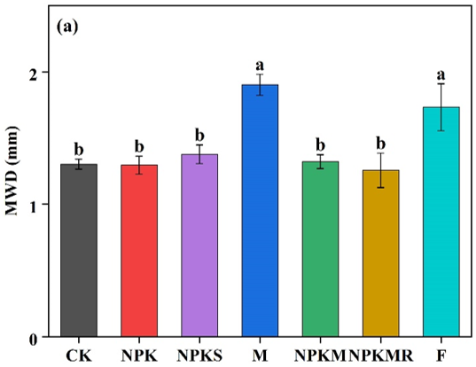
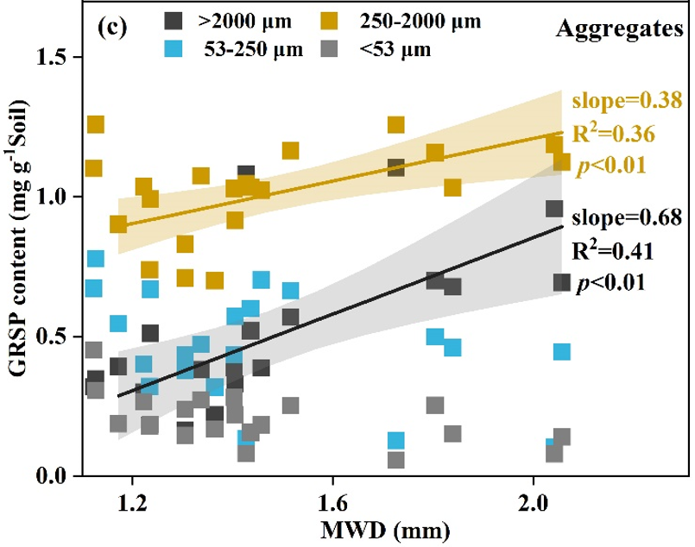
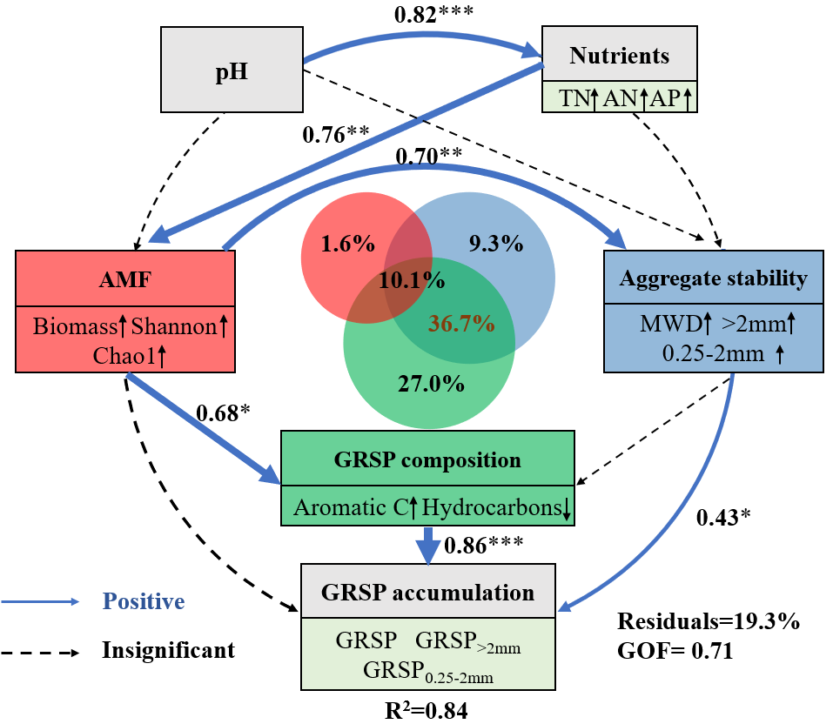
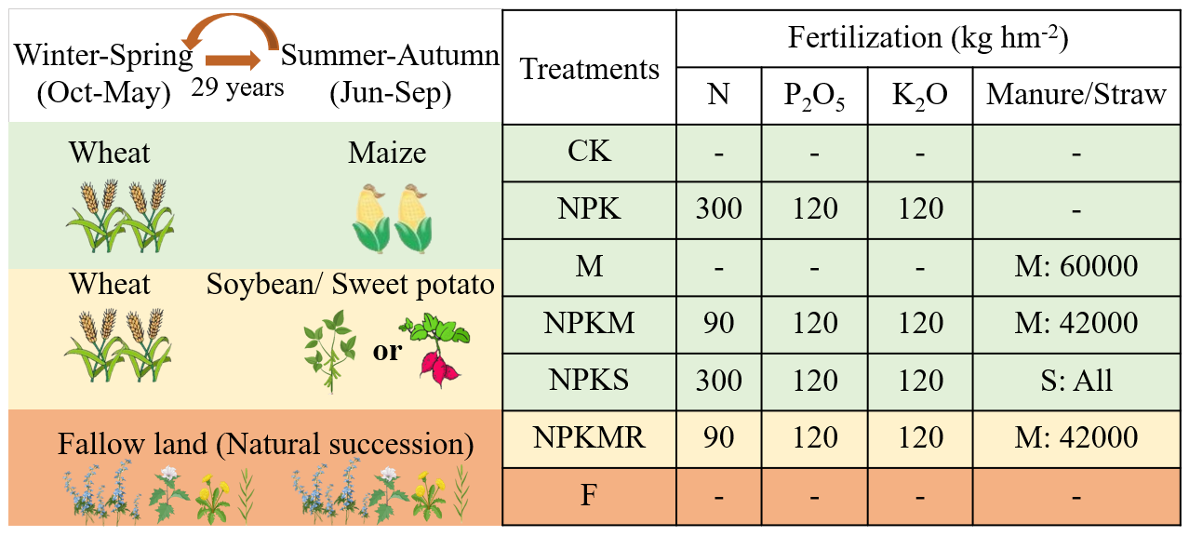
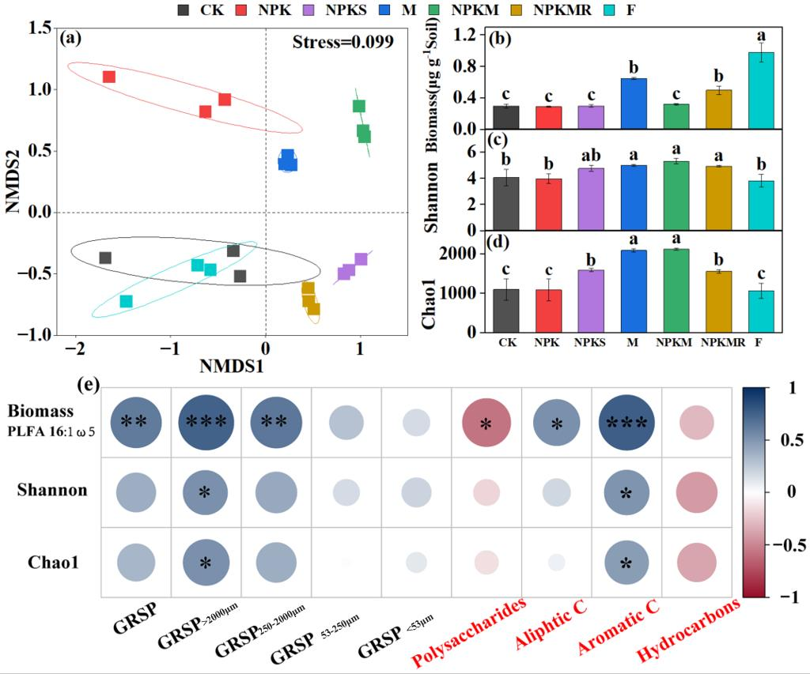
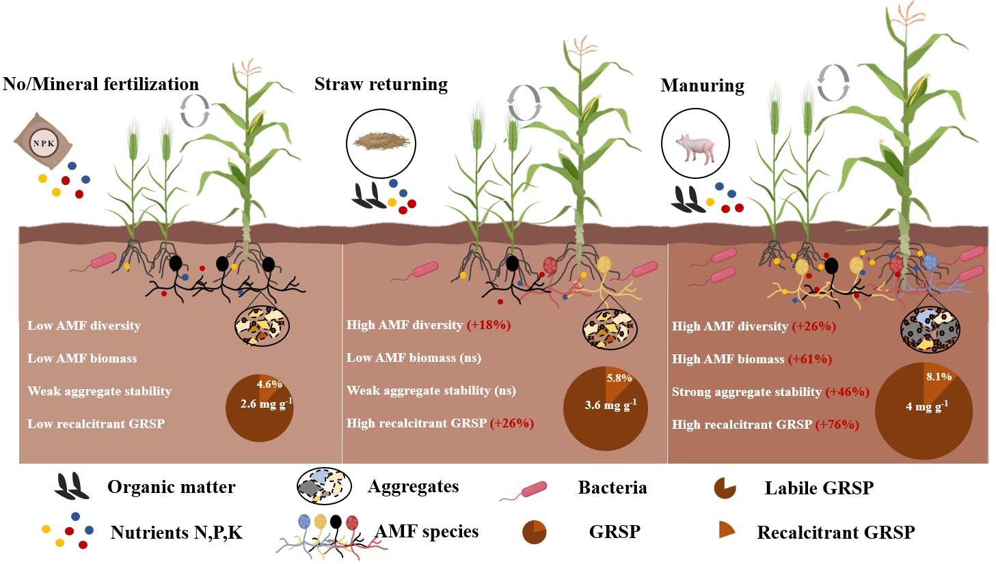
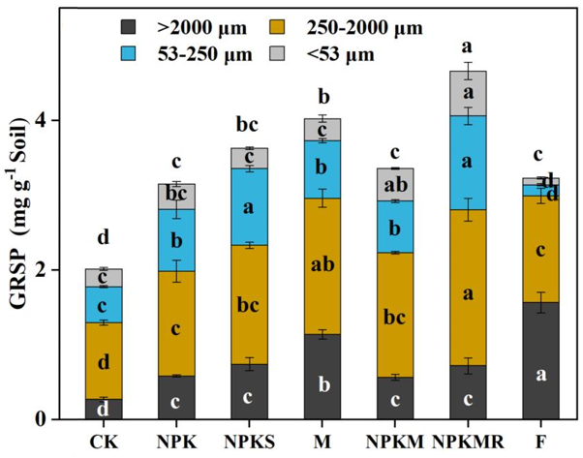
Long-term manuring facilitates glomalin accumulation by chemical composition shifts and macro-aggregation formation
Hongbo Yang ^{1,2}, Qiong Xiao ¹, Lei Wu ¹, Jeroen Meersmans², Gilles Colinet², Wenju Zhang ¹*
¹ Chinese Academy of Agricultural Sciences, Beijing, 100081, PR China
² Gembloux Agro-Bio Tech, University of Liege, Passage des deportes 2, 5030 Gembloux, Belgium
E-mail: Hongbo.Yang@student.uliege.be
Objectives
Glomalin related soil protein (GRSP) contributes to soil quality improvement and carbon sequestration. However, GRSP accumulation and its associated with AMF community and diversity in response to long-term fertilization regimes remain unclear. We investigated the content and chemical composition of GRSP, AMF biomass and diversity as well as aggregate stability under various fertilization treatments, including mineral fertilization, manuring and straw returning based on a 29-year fertilization experiment.
1. Compared to CK, manuring and straw increased GRSP. Mineral fertilization with/without straw increased GRSP in >53μm, manuring increased GRSP in all particle sizes.
2. Manuring and straw returning altered the chemical composition of GRSP by increasing the recalcitrant (aromatic) C proportion of GRSP by 73% and 21%, respectively.
4. SEM and VPA showed AMF regulate GRSP composition and aggregate stability, mediating the nutrients and pH impact on GRSP accumulation.
Materials and Methods
Conclusion
Manure (straw) application promotes GRSP accumulation due to higher biomass and diversity, more recalcitrant GRSP, stronger aggregate stability. Manure/straw increases the AMF biomass and/or diversity through improving nutrients and/or pH, and that way making its metabolites (GRSP) more difficult to decompose. In the meanwhile this way also increased the physical protection ability through the formation of macroaggregates.
Results
(a)
3. The AMF biomass and alpha diversity index (Shannon and Chao1) was positively correlated with the proportion of aromatic C in GRSP, indicating GRSP composition might be regulated by shifts in AMF community. Meanwhile, the increasing aggregate stability after manuring (i.e. MWD) increased GRSP in the >250 μm particle size fractions by facilitating macro-aggregation.
Notes:
Manuring increases the AMF biomass and diversity through improving nutrients and/or pH, and that way making its metabolites (GRSP) more difficult to decompose. In the meanwhile this way also increased the physical protection ability through the formation of large aggregates, and hence simultaneously also promoting the accumulation of GRSP.

