Slide 1
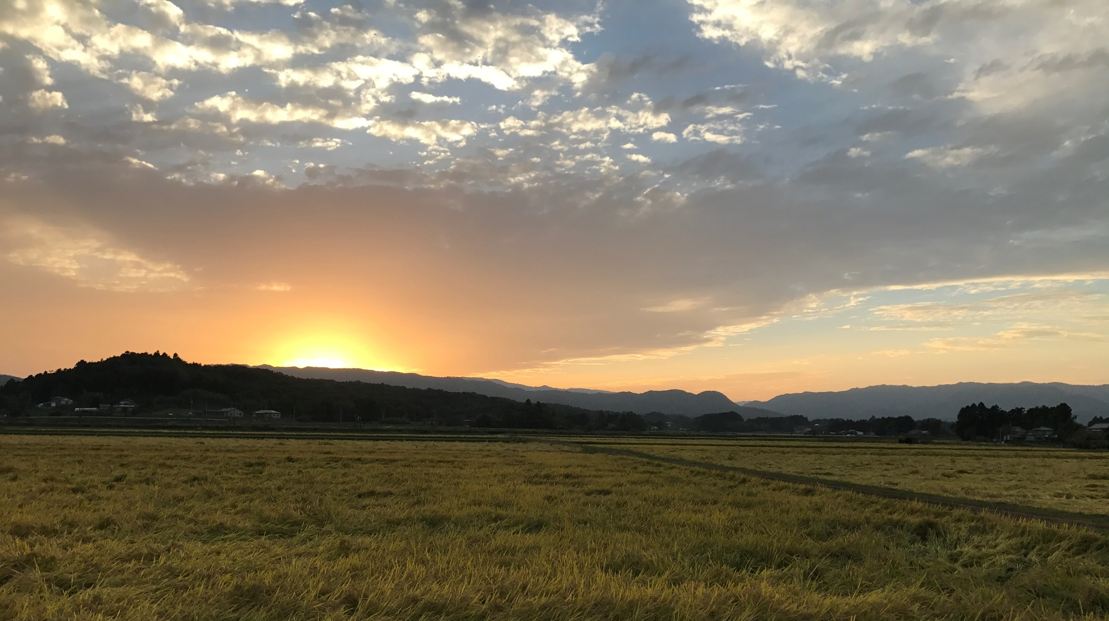
Effectiveness of an unprecedented decontamination program on river sediment and radioactive contaminant fluxes
Rosalie Vandromme, Seiji Hayashi, Hideki Tsuji, Olivier Evrard, Thomas Grangeon, Valentin Landemaine, J. Patrick Laceby, Yoshifumi Wakiyama, Olivier Cerdan

Slide 2
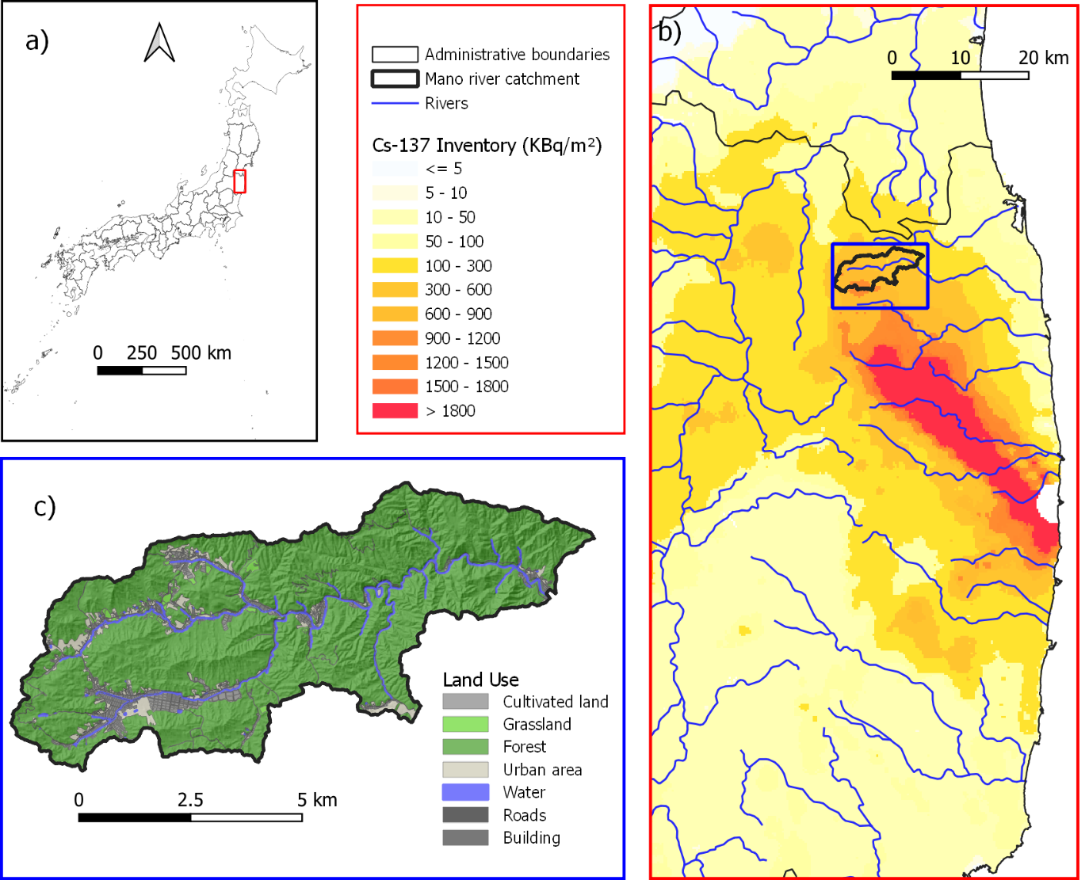
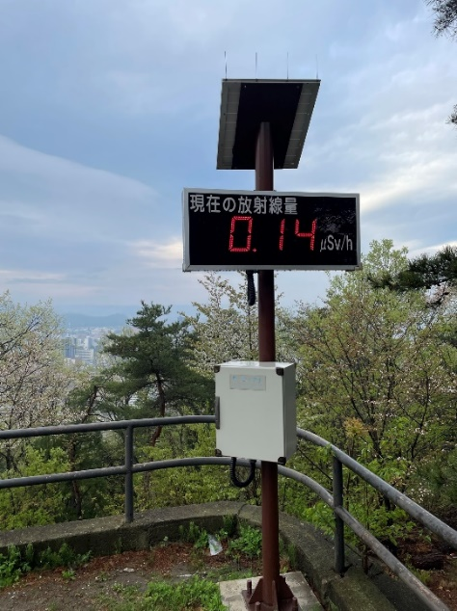
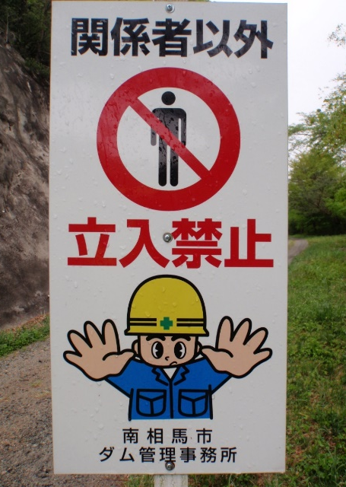
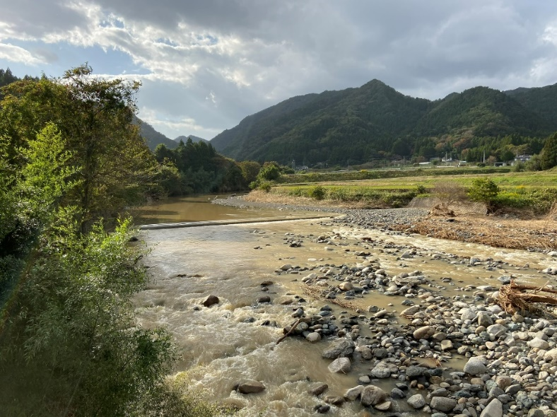
Context: Fukushima accident in 2011
Massive release of radioactive contaminants
¹³⁷Cs bound du fine soil particles and half life of 30 yrs
Dispersion by soil erosion and overland flow

Slide 3
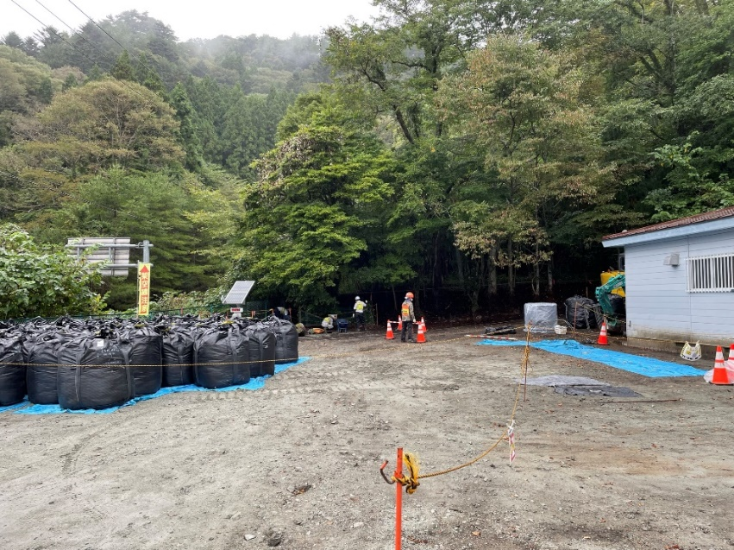
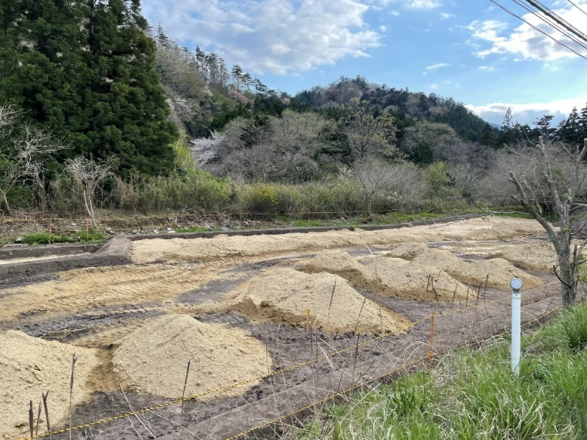
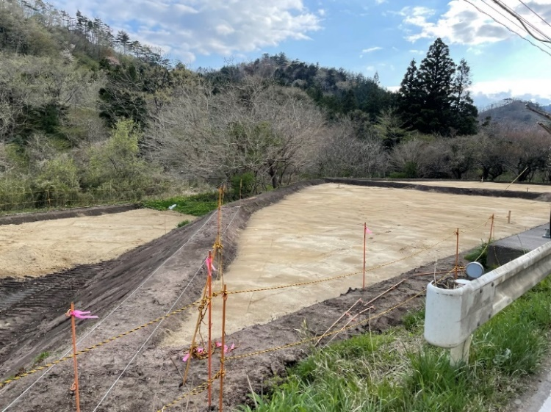
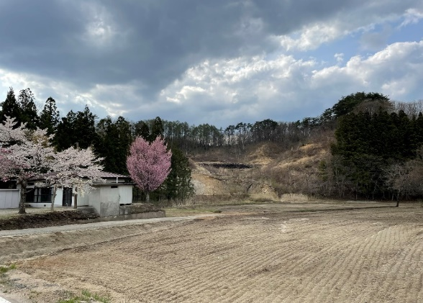
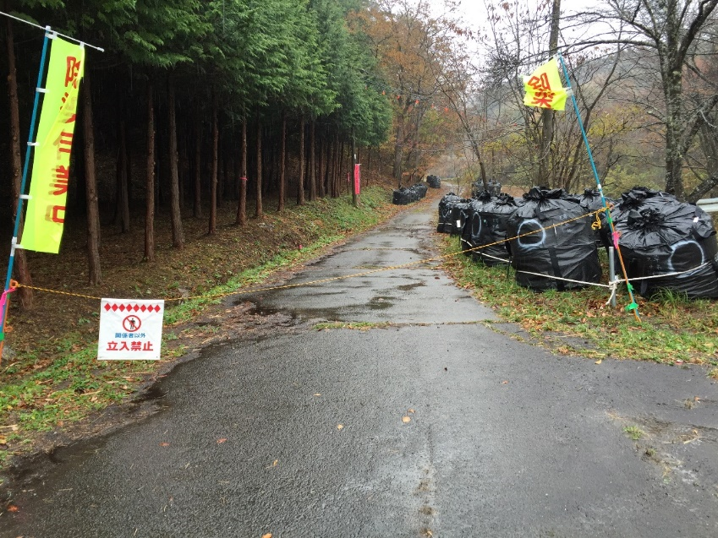
Decontamination operation
In residential areas
In cultivated areas
removal of vegetation and the replacement of topsoils with locally extracted crushed rock (granite or sandstone)
There are not many tools to simulate contaminant flux in this context
These works provide a unique playing field for:
evaluating decontamination effects
calibrating and validating of a new model
Along roads

Slide 4
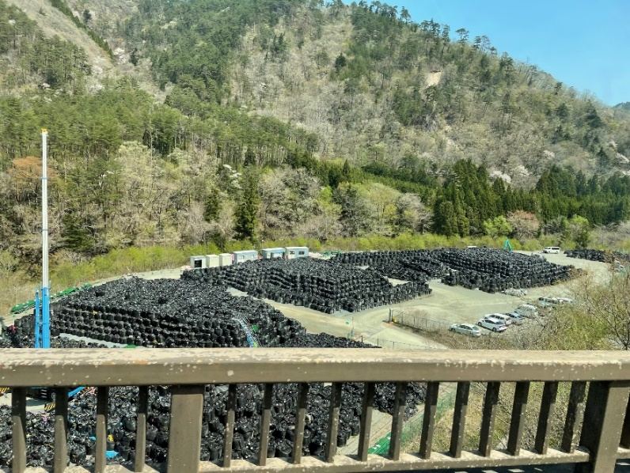
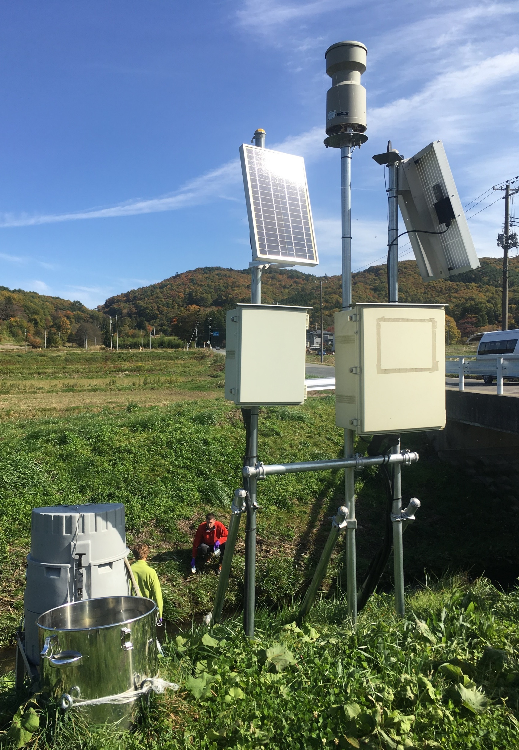
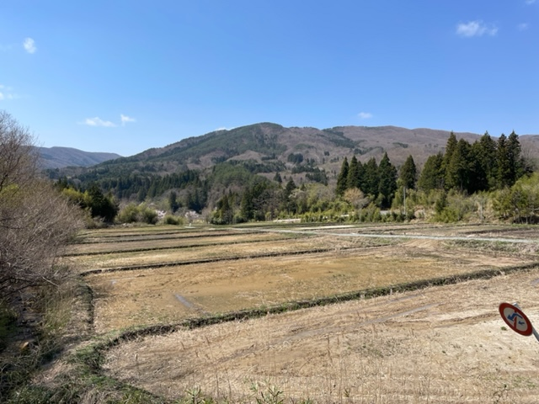
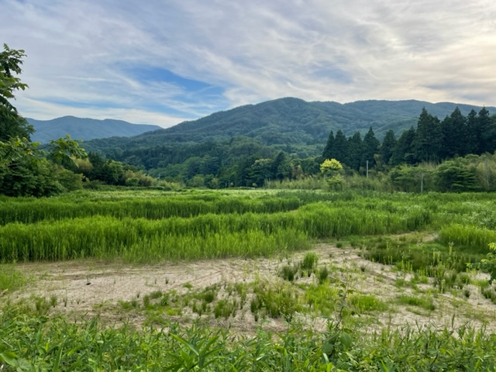
Decontamination operation
Storage during decontamination work
Sediment export
Experimental-modelling approach to study soil erosion, sediment and ¹³⁷Cs transfers
Modeling of ¹³⁷Cs transfers in a landscape
Vegetation growth after decontamination (3 months)
Evaluation of what would have been the fluxes and stocks without the implementation of decontamination
New tool for creating management strategies
Article under revision

Slide 5
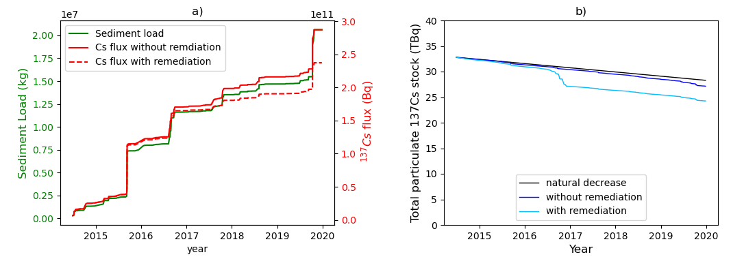
Context
Nuclear accident in 2011 in Fukushima has led to a massive release of radioactive contaminants into the atmosphere.
¹³⁷Cs is considered as one of the most serious risks for the local population :
bound to fine soil particles in the upper first few centimetres of the soil
Half life of 30 yrs
Decontamination operation to reduce air dose rate since 2014
On targeted areas (residential and cultivated areas)
removal of vegetation and topsoil replacement
Objectives
post accidental monitoring data used to calibrate and validate a modelling approach
Quantification of the impact of the decontamination program on erosion, particulate ¹³⁷Cs fluxes and remaining ¹³⁷Cs stock.

Slide 6
Figure 1. (a) Location of the Mano Dam catchment in relation to the Fukushima Daiichi Nuclear Power Plant (FDNPP) in Japan, with (b) the reconstructed initial ¹³⁷Cs fallout map (46) and the main rivers and c) a magnified view of the catchment area showing the land use type distribution.

Slide 7
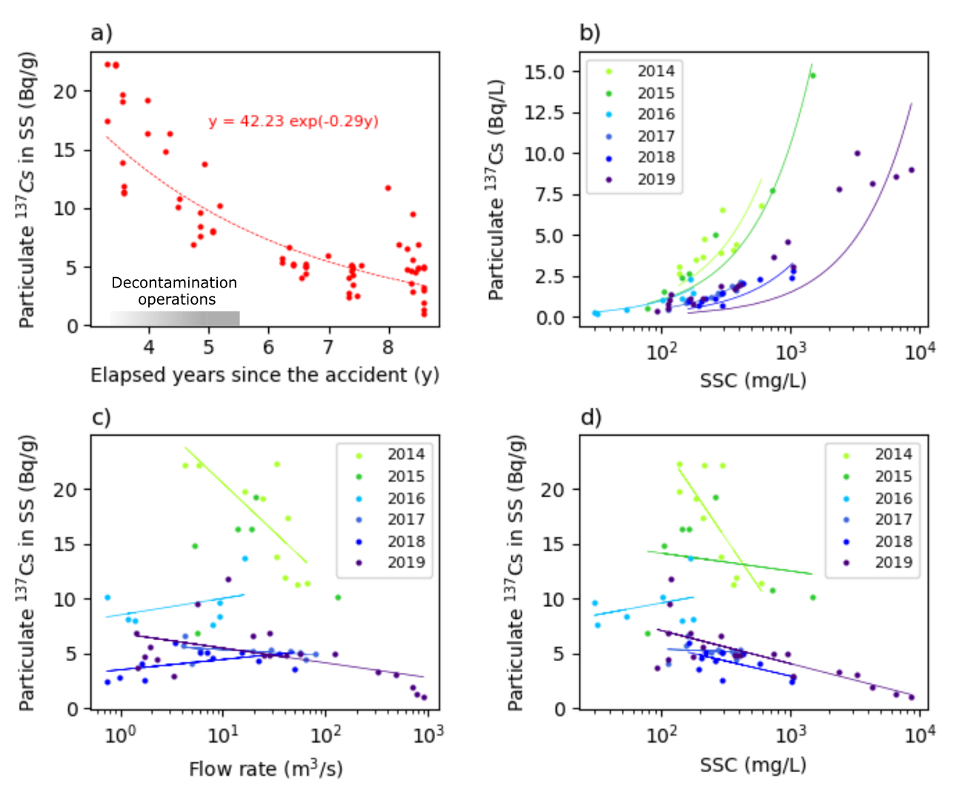
Figure 2. a) Measurements of particulate ¹³⁷Cs concentrations in suspended sediment (SS) over time, obtained from SS samples collected both during (storm flow) and between (baseflow) floods, b) ¹³⁷Cs concentrations (in Bq/L) as a function of SS concentration (SSC) during storm flow, c) ¹³⁷Cs concentrations (in Bq/g) as a function of the flow rate during storm flow, and d) ¹³⁷Cs concentrations (in Bq/g) as a function of the SSC during storm flow.

Slide 8
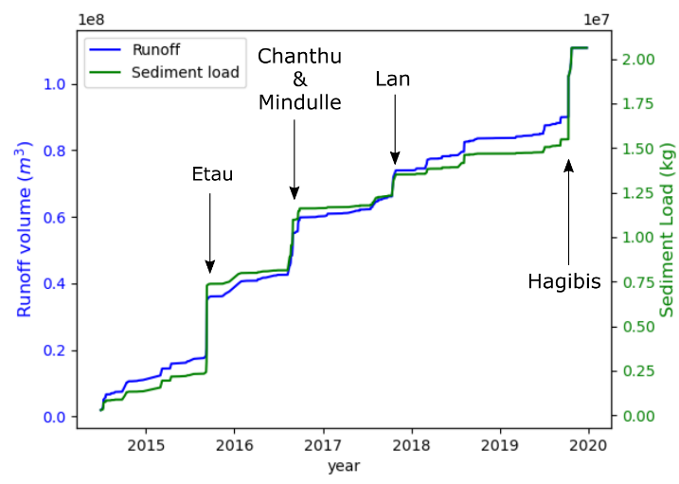
Figure 3. Cumulative water runoff volume and sediment load modeled from June 2014 to December 2019. The main typhoons are identified by their names on the graph.

Slide 9
Figure 4. Modeled proportions (%) of a) eroded sediments according to land use and erosion type (i.e., rill or interrill erosion) with decontamination, b) “eroded” radiocesium according to land use and erosion type without decontamination and c) “eroded” radiocesium according to land use and erosion type with decontamination.

Slide 10
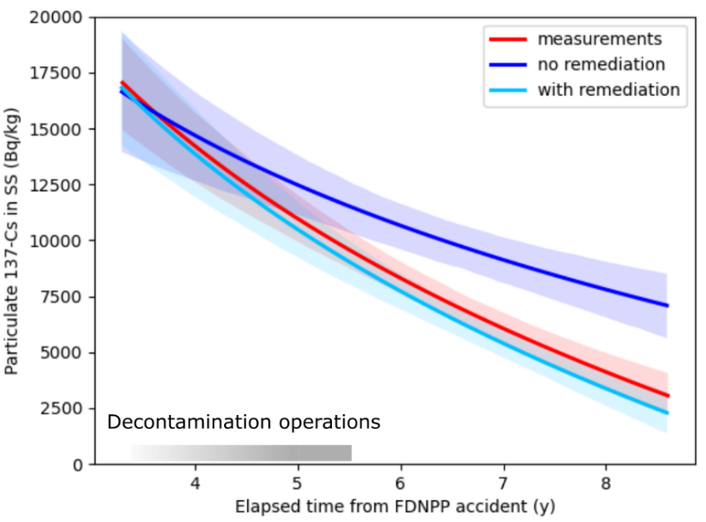
Figure 5. Evolution of ¹³⁷Cs concentrations in SS as a function of time: fitting curves (exponential) of model outputs (decontamination vs. the absence of decontamination) and river monitoring measurements. The shaded areas represent the 95% confidence intervals around the fitting curves (solid lines). The duration of decontamination operations is indicated by a grey bar above the x-axis.

Slide 11
Figure 6. Modeling results from June 2014 to the end of 2019: a) accumulated sediment and ¹³⁷Cs exports and b) the ¹³⁷Cs stock evolution in the catchment.

Slide 12
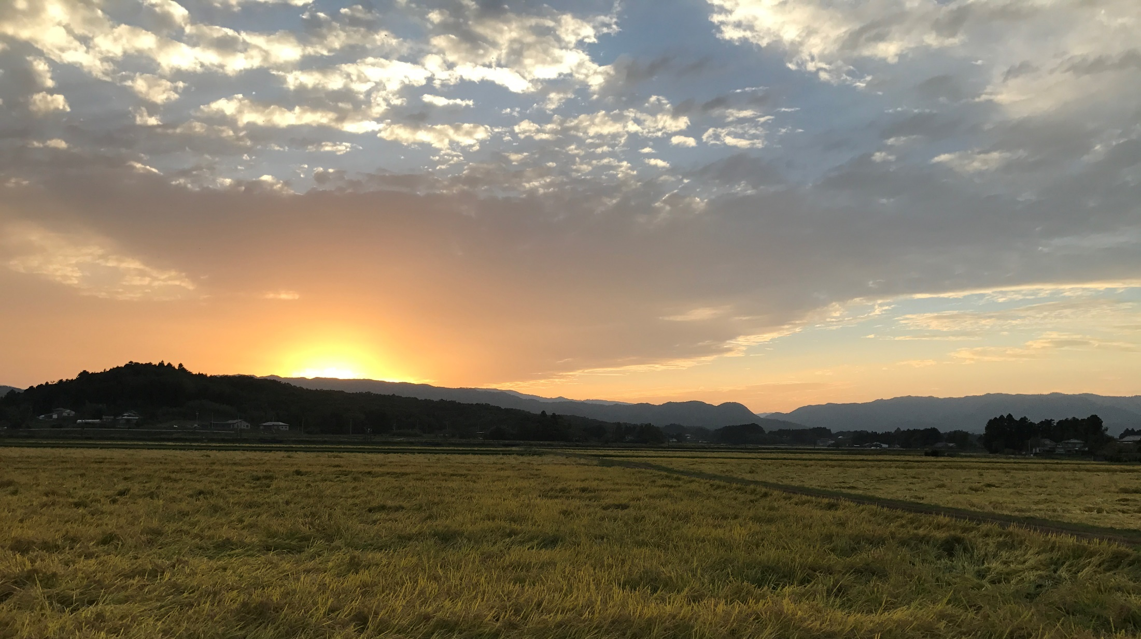
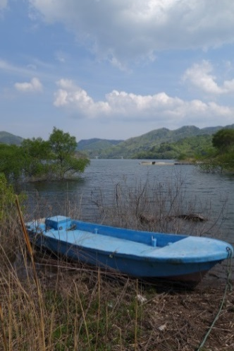
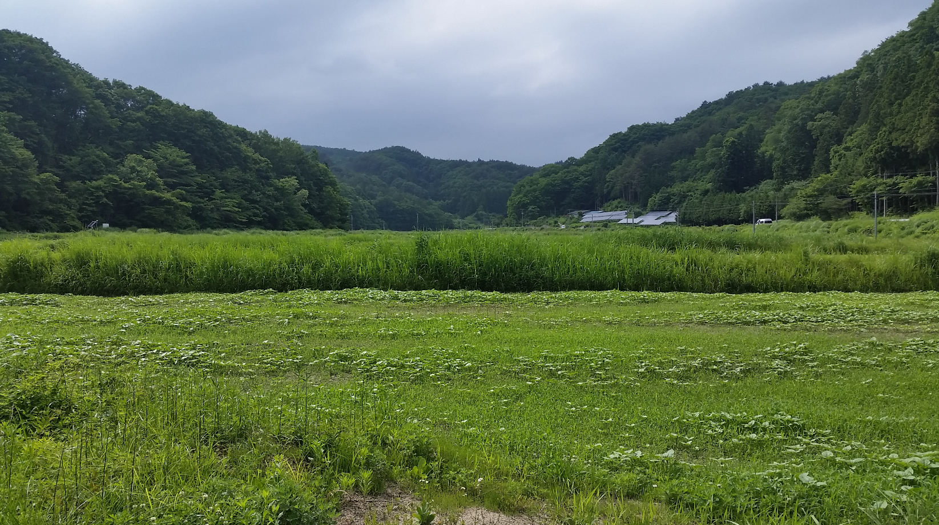

Slide 13
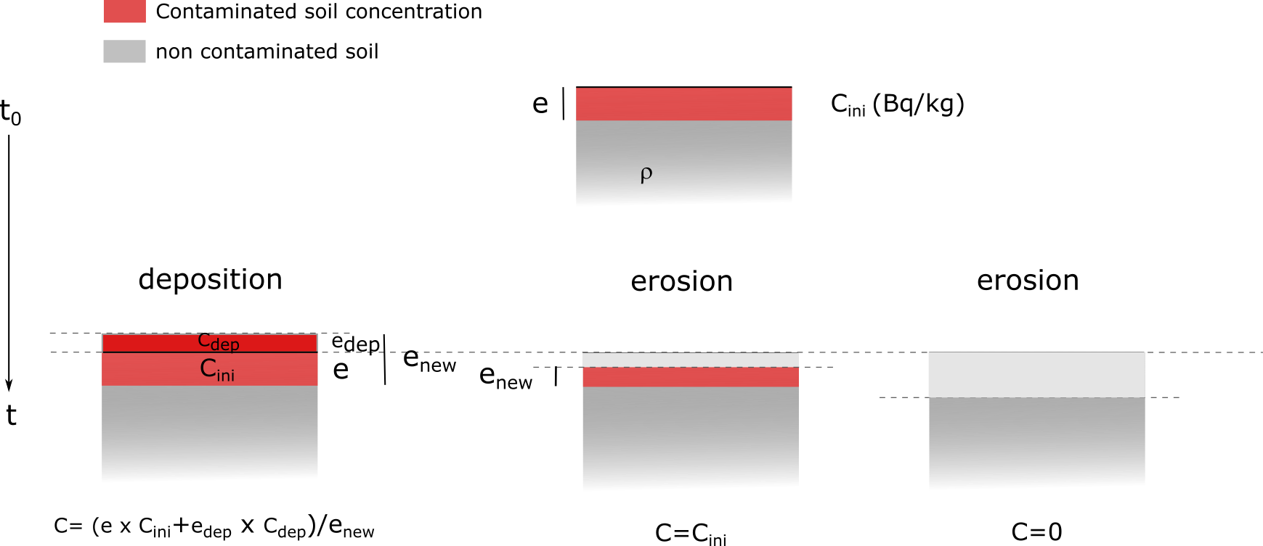
Supplementary Figure 1:
Fig. S1. Calculation of ¹³⁷Cs concentrations in diffuse erosion and deposition areas legend.

Slide 14
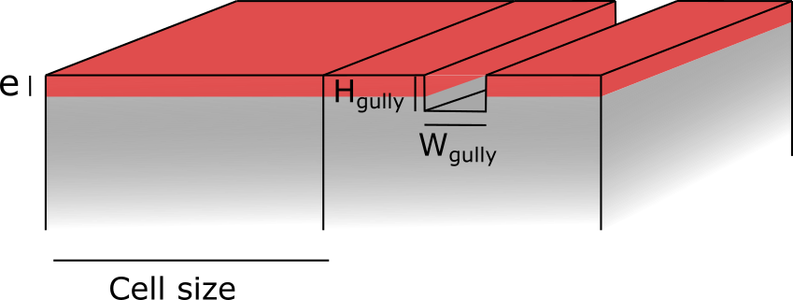

Slide 15
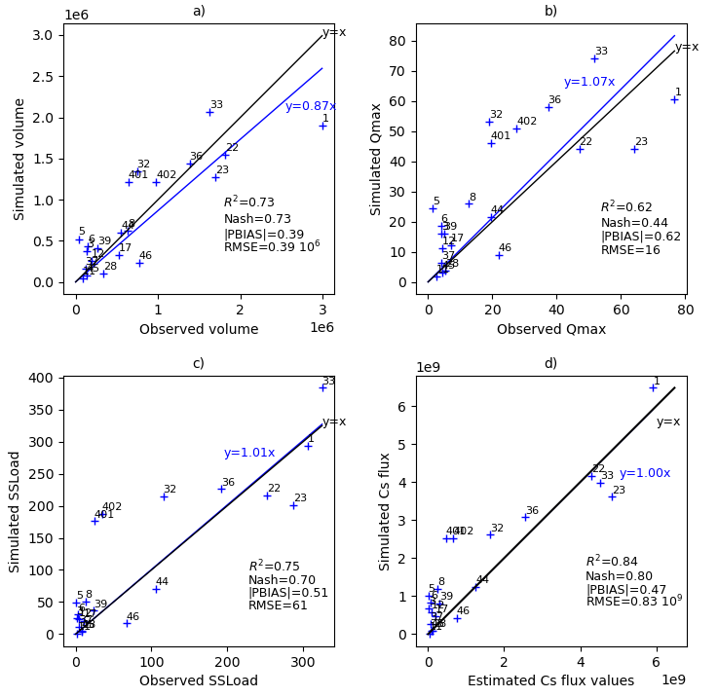
Fig. S2. Results for the 21 calibration floods for a) water volume (m³), b) peak flow (m³/s), c) sediment load (t) and d) particulate ¹³⁷Cs flux (Bq/event)

Slide 16
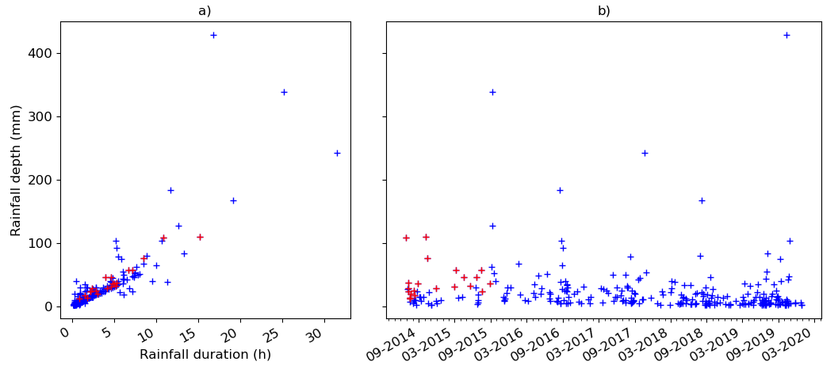
Fig. S3. a) Relationship between cumulative and duration of rainfall events between June 2014 and December 2019 and b) rainfall depths as a function of time. The red crosses represent calibration events.

Slide 17
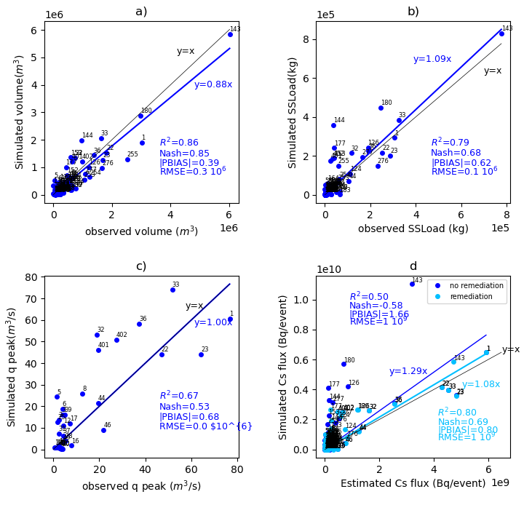
Fig. S4. Modeling results for a) water volumes, b) sediment loads and c) particulate ¹³⁷Cs flux

Slide 18
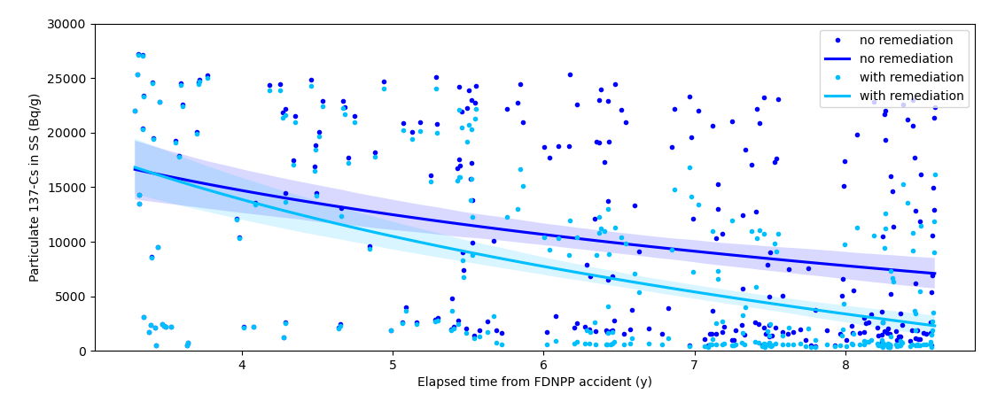
Fig. S5. Modeling results without taking decontamination operations into account (dark blue) and with taking remediation into account (light blue).

Slide 19
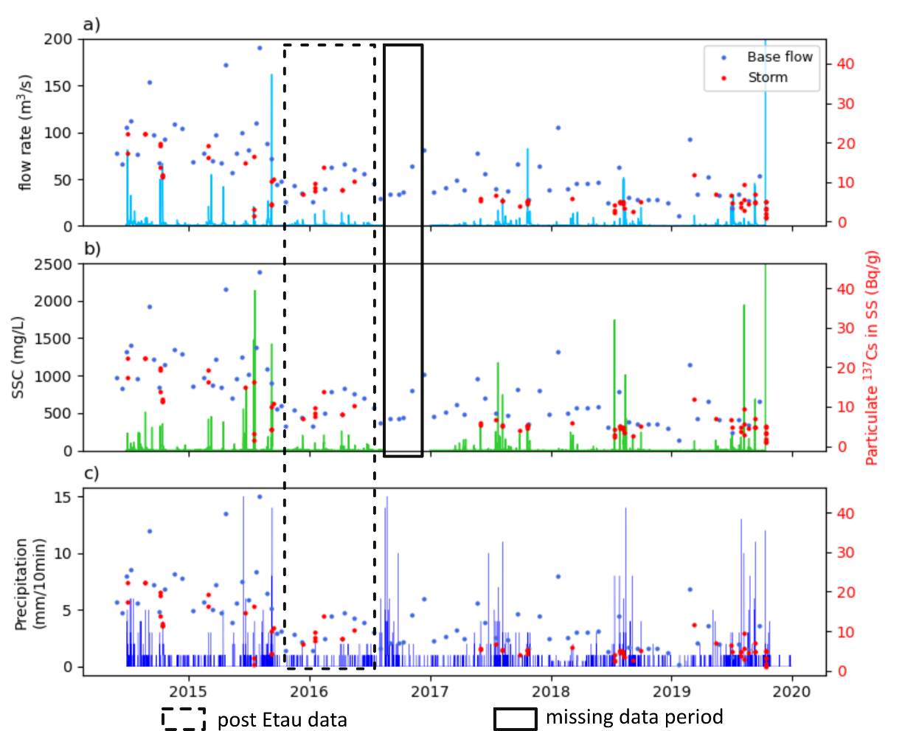
Fig. S6. Time series of a) flow rate, b) SSC and c) rainfall depths from September 2014 to December 2019 of the Mano River (time step 5 min before 2017 and 10 min after). The point data of particulate ¹³⁷Cs concentrations are represented in red (right axis) by dots for flood events and crosses for baseflow

Slide 20
Fig. S7. a) Representation of the decontaminated areas in the Mano catchment. The colour corresponds to the date of decontamination, b) evolution of decontaminated surface

Slide 21
Fig. S8. a) Vegetation growth after decontamination, pictures taken by the authors in Namie Town, Fukushima Prefecture, on April 20, 2022 (left) and June 29, 2022 (right)

Slide 22
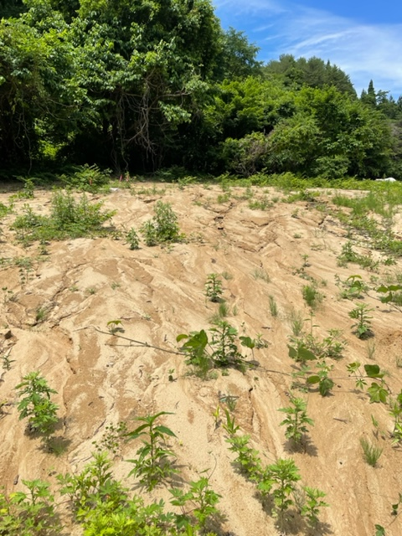
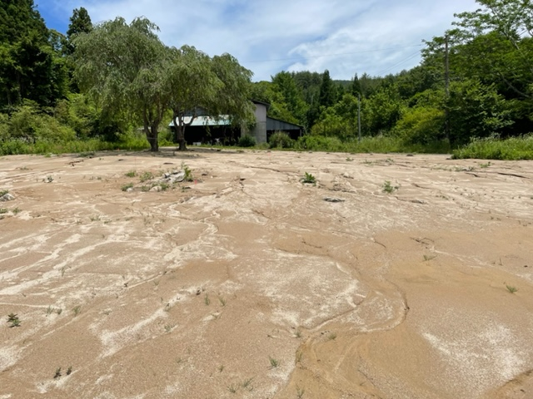
Fig. S9. Erosion after decontamination (picture taken by the authors in Namie Town, Fukushima Prefecture, on April 20, 2022)

Slide 23
WATERSED MODEL PRESENTATION
Initial datasets
Preprocessing
Inputs of the WaterSed model
Outputs
DEM (1m)
Stream burning
DEM
Runoff
Excess rainfall
Infiltration
Runoff volume
Runoff velocity
Peak discharge
Time of concentration
Expert tables
Derive erosive and hydrodynamic soil properties
Hydrodynamic properties
Infiltration capacity
Imbibition
Water storage
Land use
Soil
Erosive properties
SSC
Cohesion
Erosion
Gross erosion and deposition
Sediment load
Soil erosion rate
Rainfall event
Depth
Effective duration
Rainfall data
Q and SSC data
Calibration
Parameters

Slide 24
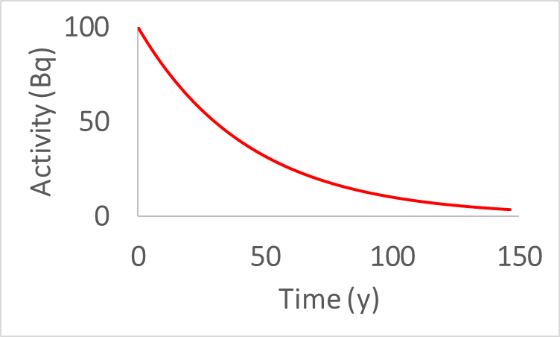
WATERSED AND CESIUM
Initial datasets
Preprocessing
Inputs of the WaterSed model
Outputs
DEM (1m)
Stream burning
DEM
Runoff
Excess rainfall
Infiltration
Runoff volume
Runoff velocity
Peak discharge
Time of concentration
Expert tables
Derive erosive and hydrodynamic soil properties
Hydrodynamic properties
Infiltration capacity
Imbibition
Water storage
Land use
Soil
Erosive properties
SSC
Cohesion
Erosion
Gross erosion and deposition
Sediment load
Soil erosion rate
Cesium decay between events
Initial contamination map (Bq/m²)
Cs concentration map
Contaminated depth map
Cesium
New Cs concentration map (Bq/kg)
New contaminated depth (mm)
Cs load (in Bq)
Rainfall event
Depth
Effective duration
Rainfall data
Q and SSC data
Calibration
Parameters

Slide 25
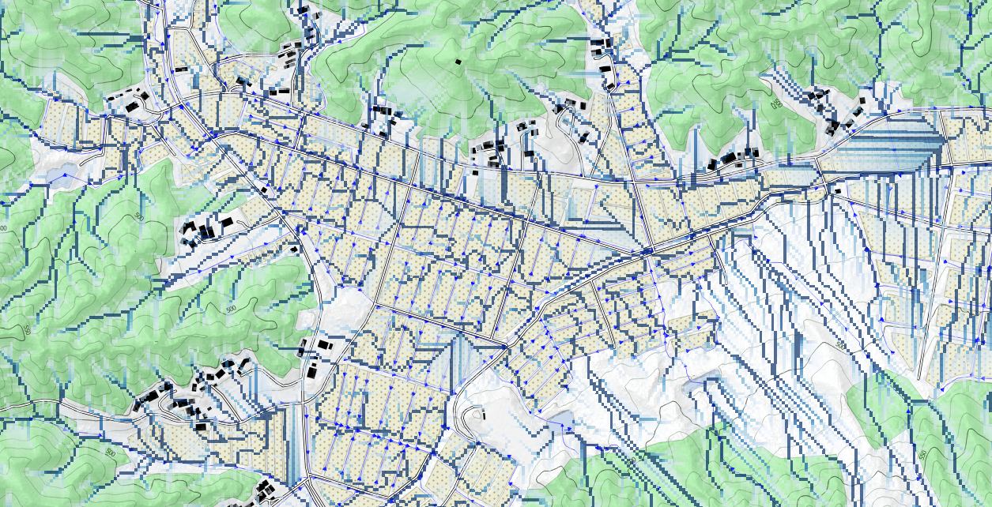
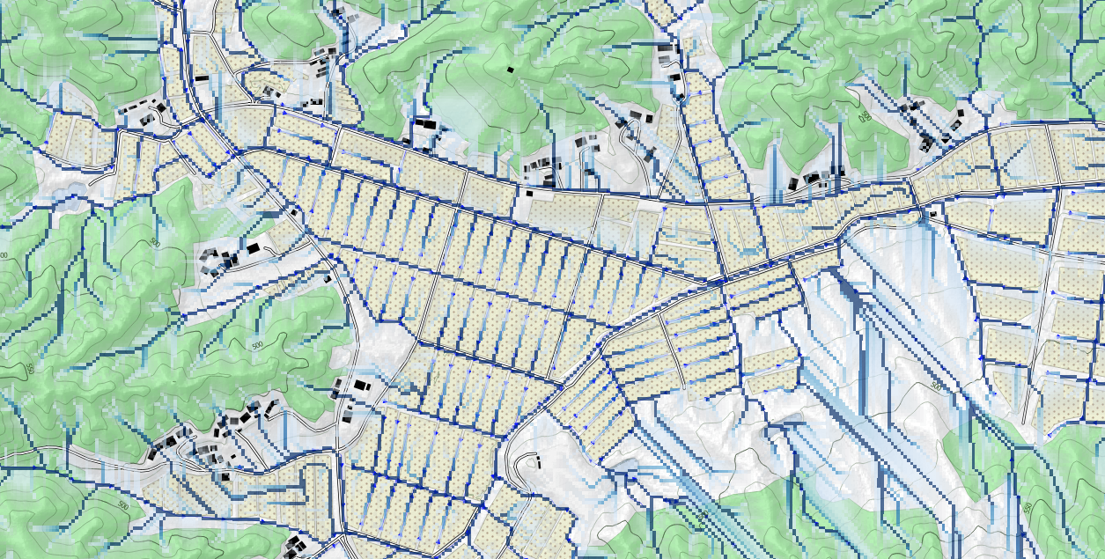
DEM burning according to field observations and image interpretation
For instance to take into account manmade modifications
Paddy fields is a typical illustration
Flow paths before DEM burning
Flow paths after DEM burning

