Slide 1
Toroidal Exospheres
Supplementary Material

Slide 2
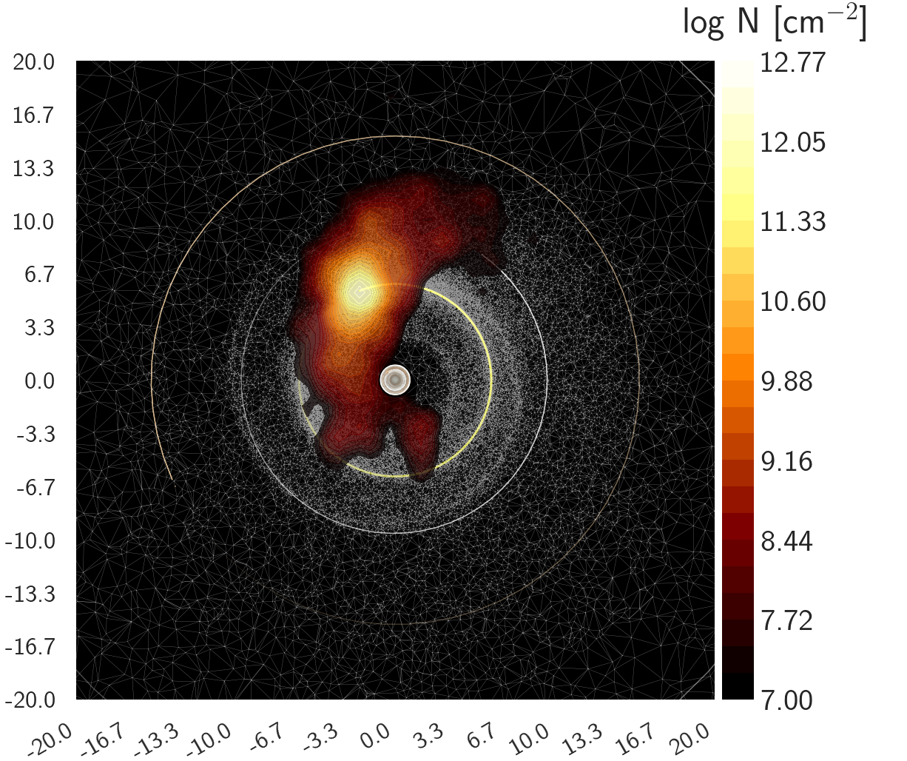
Io and Jupiter
We reproduce Io’s famous “banana cloud” of neutral sodium outgassed by Io.
Other Galilean moons included
Underlying Delaunay tessellation for density calculations

Slide 3
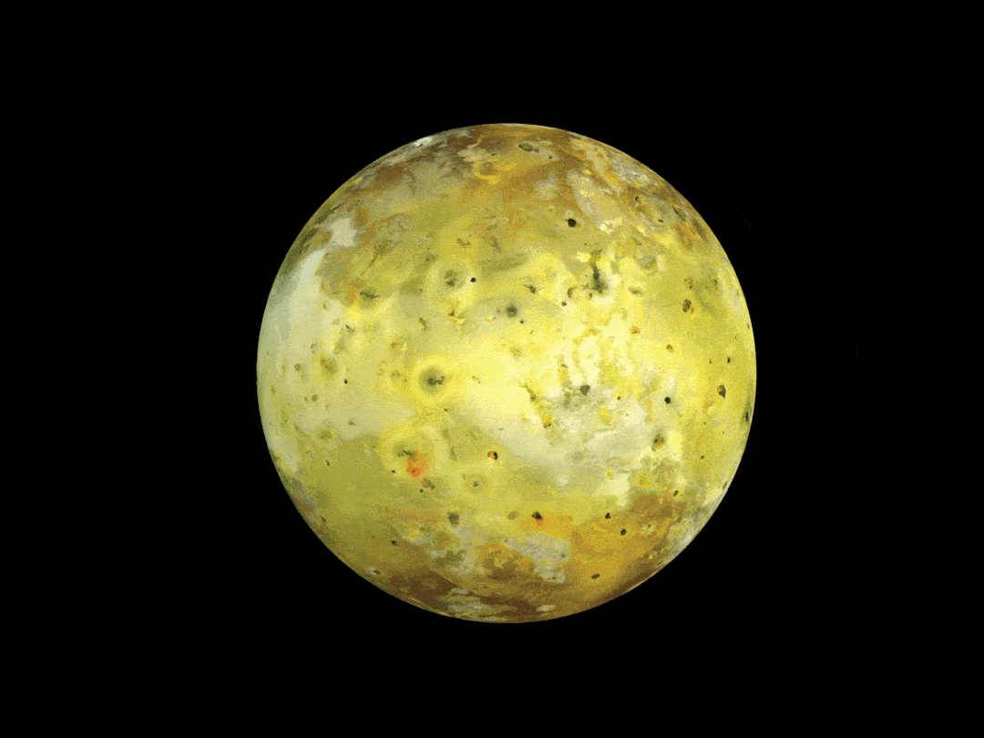
DISHOOM – Outgassing Model
Desorbing Interiors via Satellite Heating to Observe Outgassing Model
The code estimates several known atmospheric escape mechanisms (dM/dt_plasma, dM/dt_energy-limited, dM/dt_surface-jeans, dM/dt_thermal-outgassing) benchmarked to DSMC simulations and observations at Jupiter's moon Io.
Oza A. V. et al., 2019b, ApJ, 885, 168
https://github.com/apurvaoza/dishoom

