Slide 1
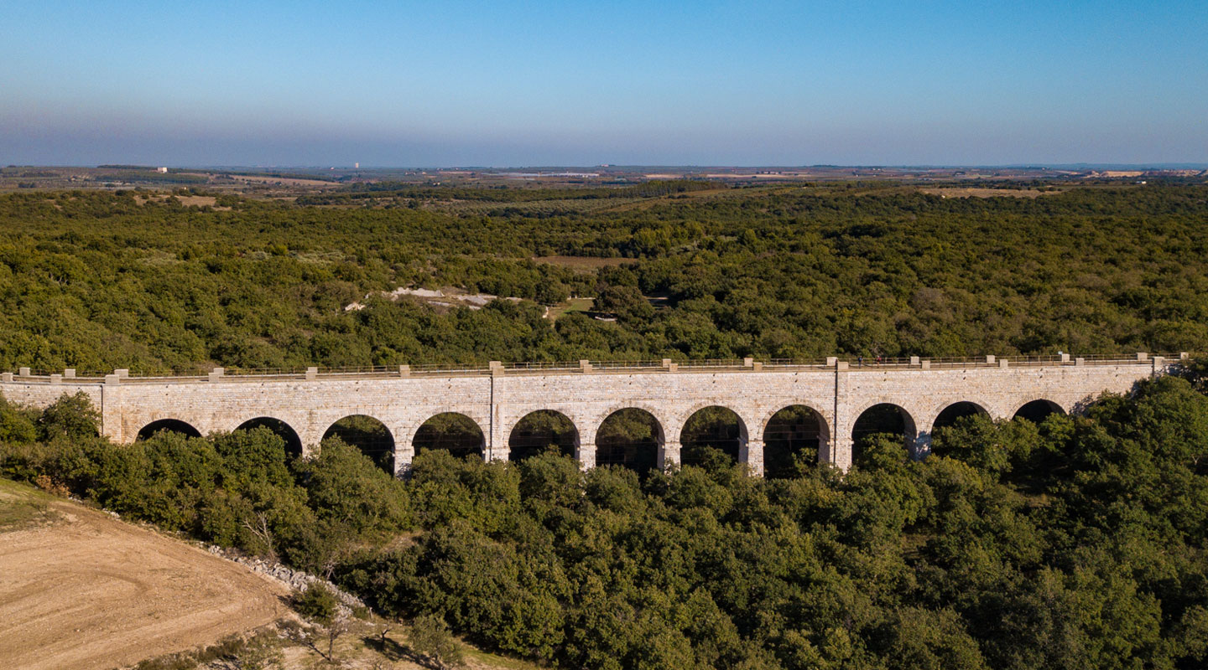
CLIMATE CHANGE ADAPTATION THROUGH INTEGRATED MANAGEMENT OF WATER REUSE TECHNOLOGIES
Matteo Sangiorgio, Enrico Weber, Davide Cananzi, Jazmin Zatarain Salazar, Marco Micotti and Andrea Castelletti
Notes:
How we can evaluate the climate change adaptation potential of water reuse technologies

Slide 2
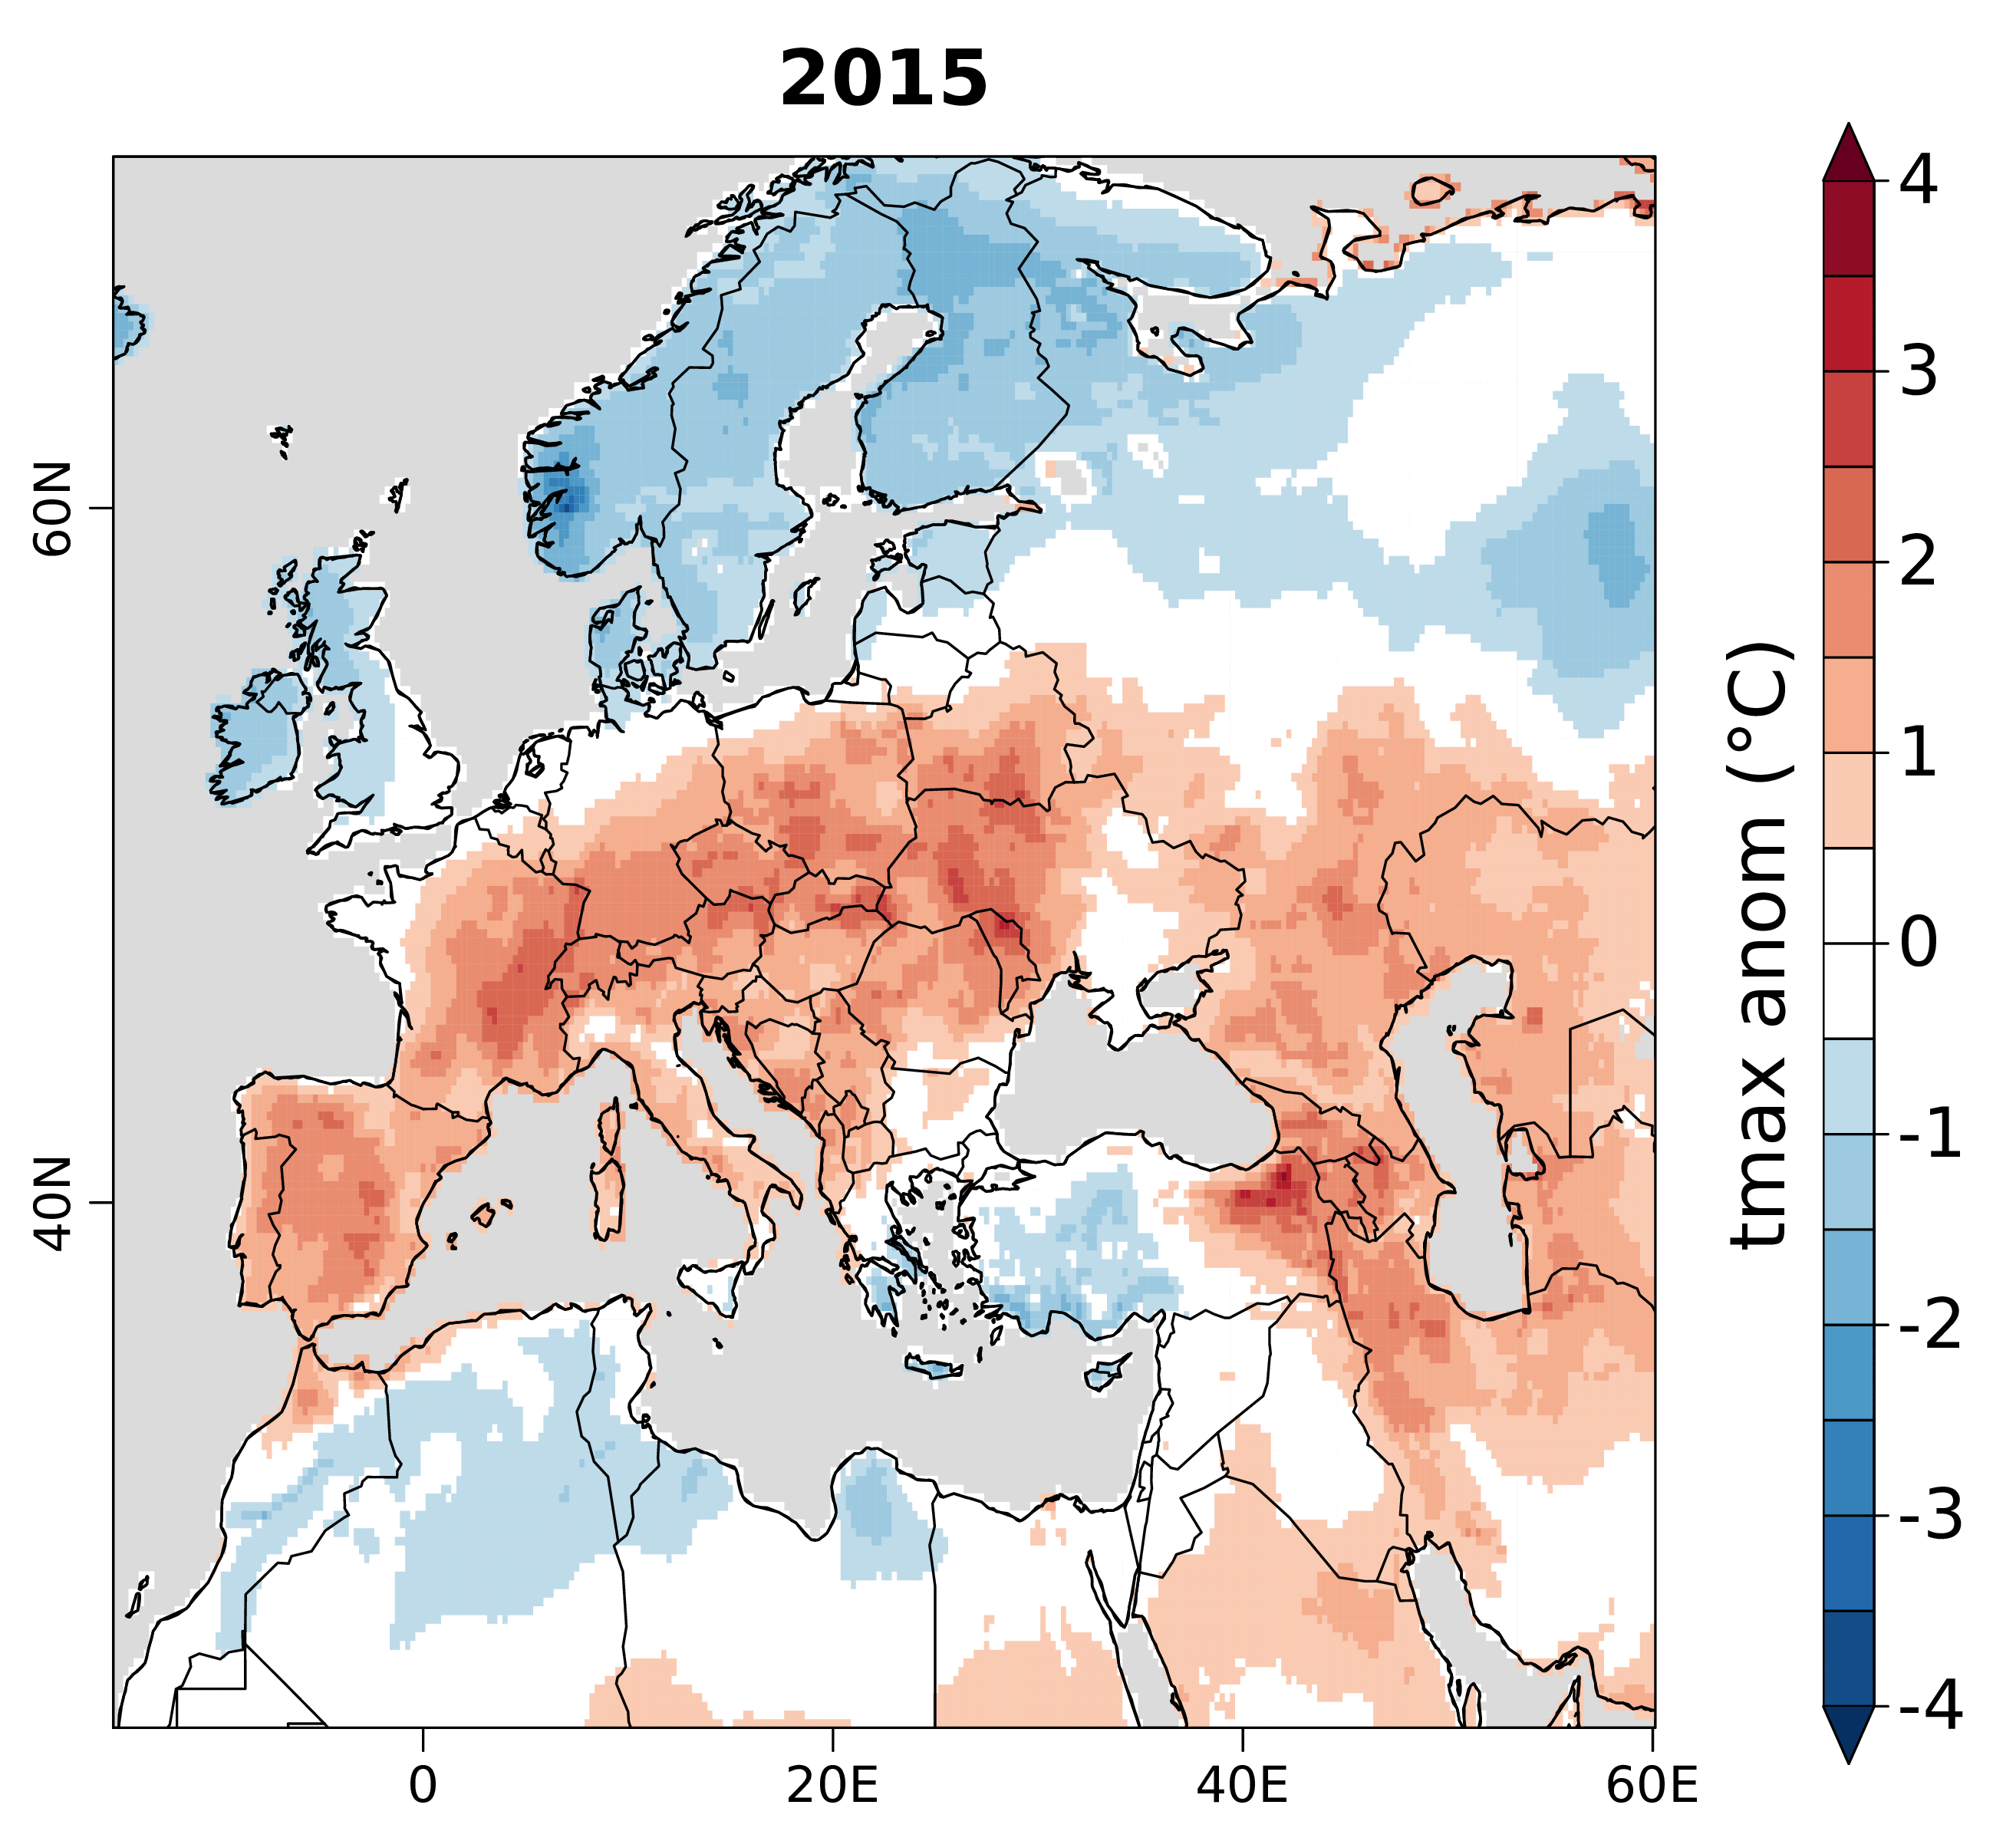
CONTEXT
Climate change is increasing the frequency and intensity of extreme events.
Notes:
Example of heatwaves that strongly affect the water availability

Slide 3
CONTEXT
Climate change is increasing the frequency and intensity of extreme events.
Notes:
Example of heatwaves that strongly affect the water availability

Slide 4
FROM SITE-SPECIFIC WATER REUSE
Project targets:
Efficiency
Durability
Maintenance costs
…
Treatment Plant
Notes:
In this context, a key role is that of treatment plants that allow to reuse water. However, the criteria used to design these plants are usually limited to features such as …

Slide 5
TO INTEGRATED WATER REUSE
Water
Sources
Coordination of the water reuse technologies management with the operations of the other water system components.
Treatment Plant
Distribution
Network
Assessment of the Impacts on the final users at the system scale.
Final
Users
Notes:
We propose to look at the problem ad a larger scale, taking into account coordination of …

Slide 6
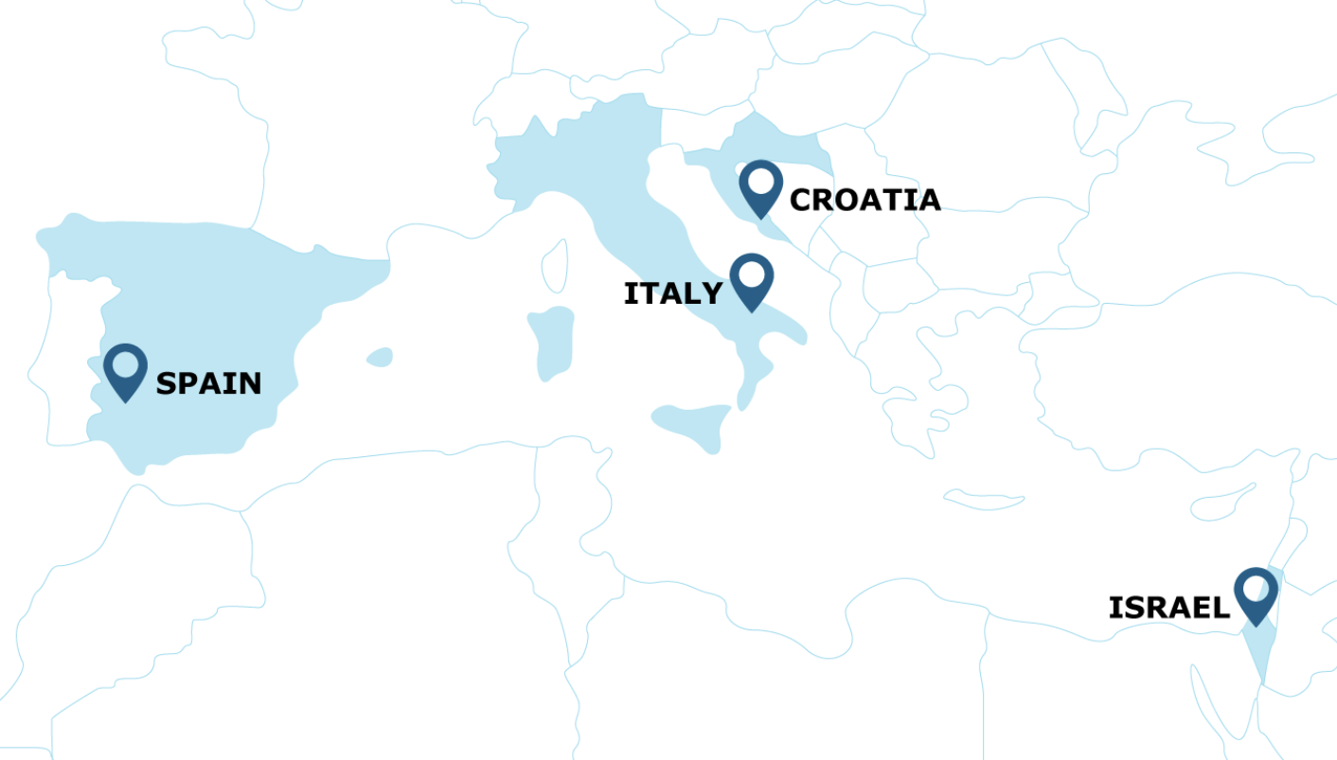
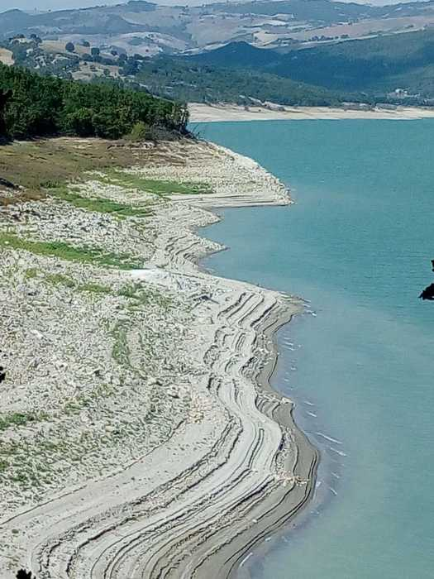
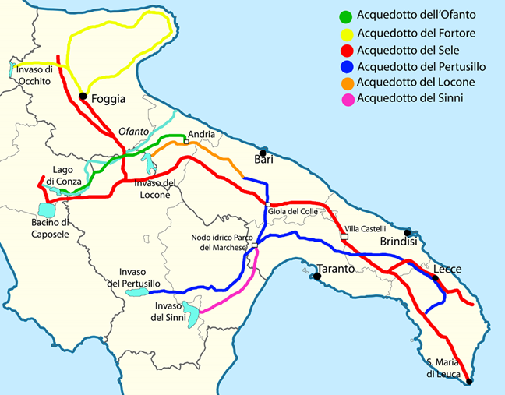
THE APULIAN WATER SYSTEM
Water-scarce region
Complex water distribution network
Multiple conflicting users sharing strategic reservoirs
Irrigation districts
Industry
Apulian aqueduct (AQP)
Notes:
As a case study, we considered the Apulian system, in the southern italy, that is a demo site of ProjectO.

Slide 7
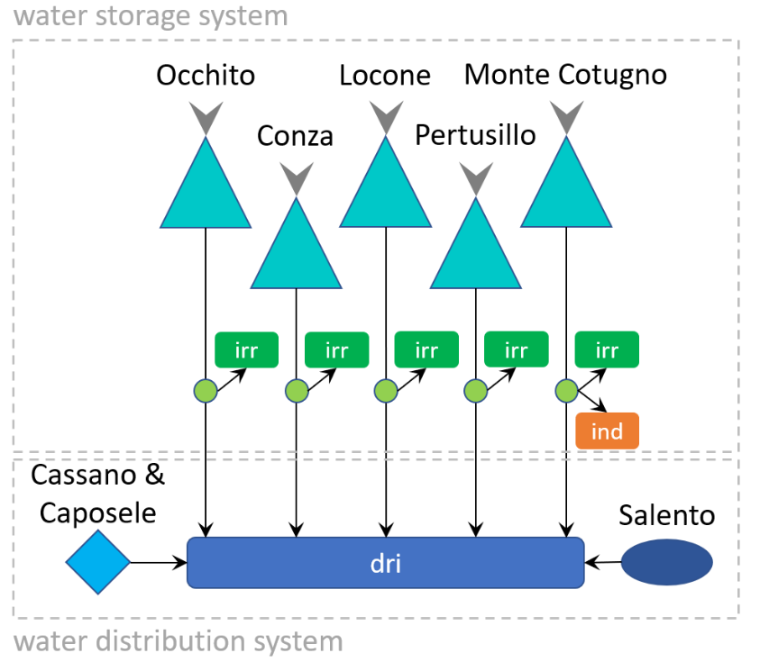
THE STRATEGIC MODEL OF THE SYSTEM
Model formulation:
Water availability
Water demands
Reservoirs
Diversions
Objectives:
Irrigation deficit AQP deficit
Industrial deficit AQP cost
Notes:
We built a simulation model of the water system and defined 4 objectives representing the interests of the stakeholder mentioned so far…

Slide 8
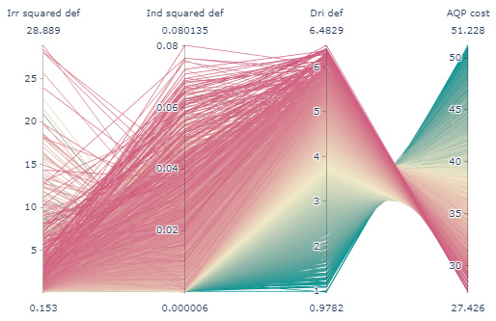
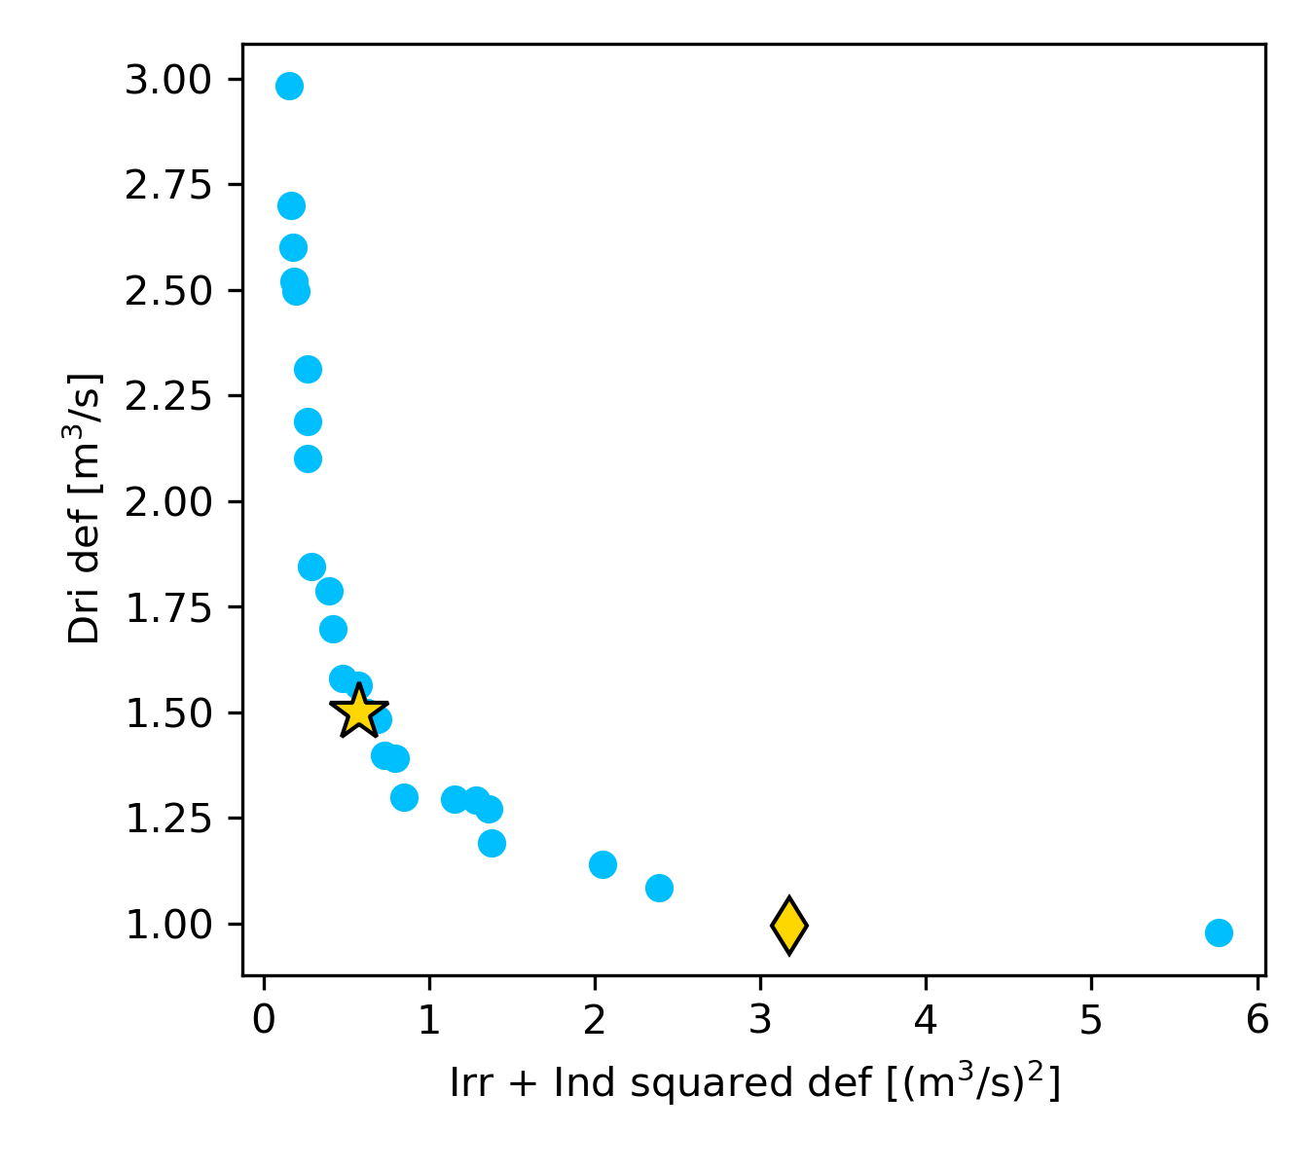
BASELINE SCENARIO
Identification of the optimal management strategies for the historical period:
Efficient policies
Compromise policy
Best drinking policy
Direction of preference
Notes:
To this point, we adapted EMODPS to derive the optimal management strategies for the historical scenario, used as a baseline for the analysis on future scenarios that we are considering in a while.
The parallel plot shows the trade off between the 4 objectives, but for the sake of simplicity we produced a 2D visualization by aggregating irrigation and industrial deficit (x axis) and considering only the deficit for the drinking sector-

Slide 9
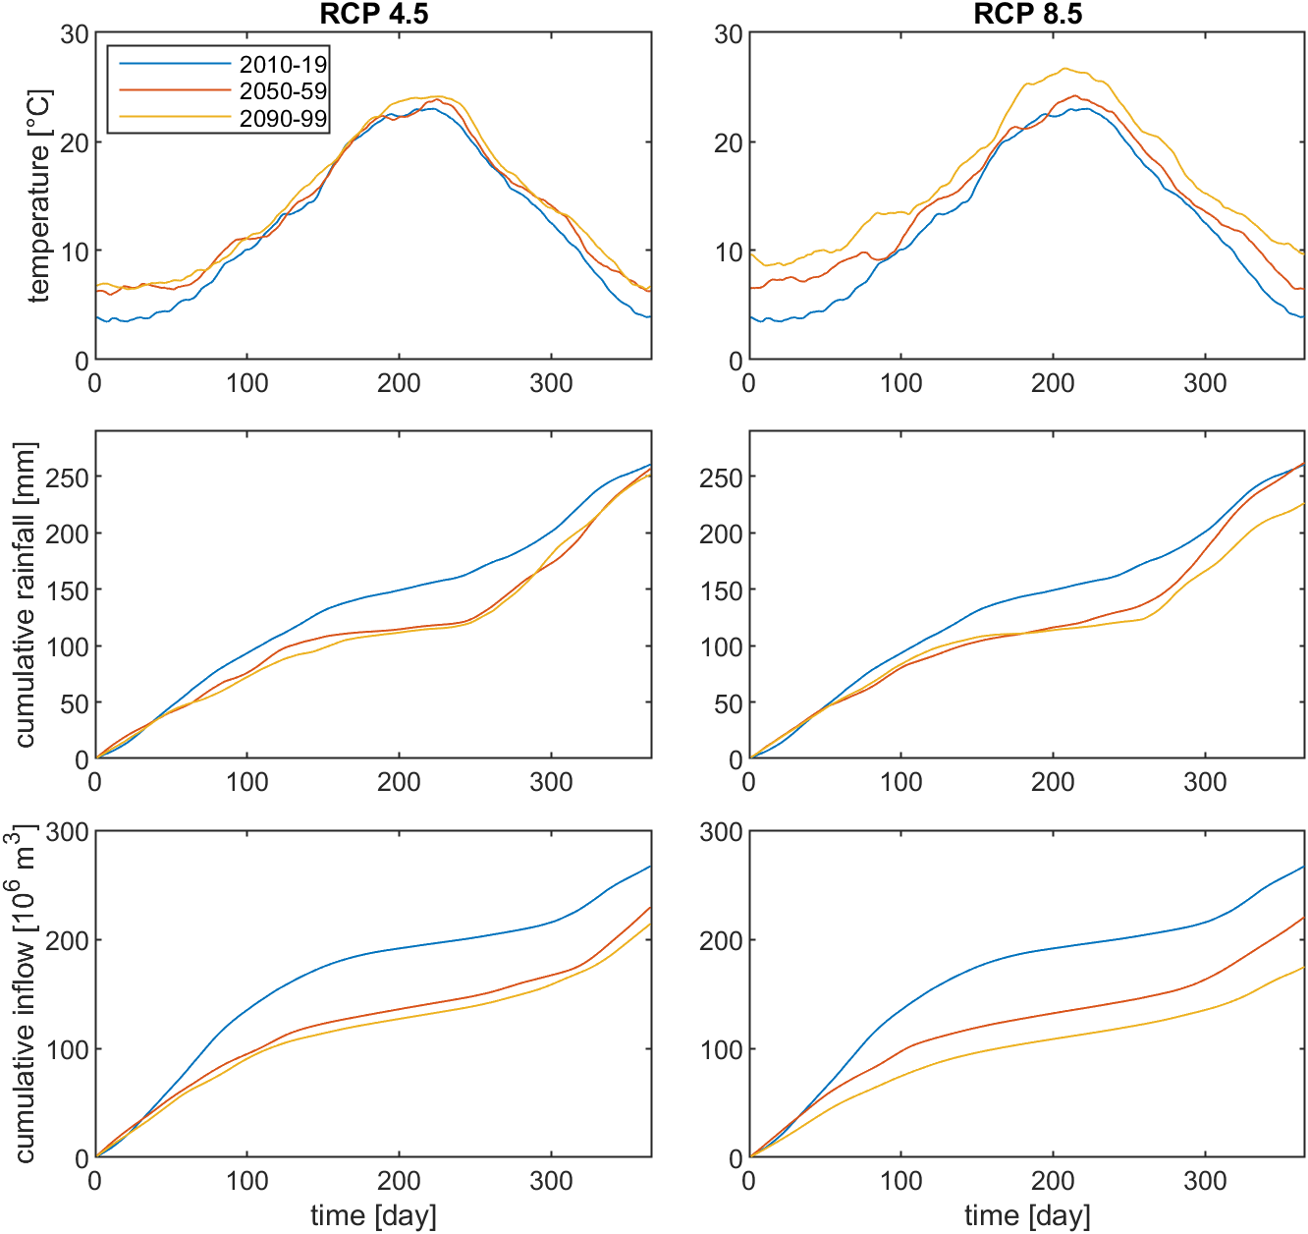
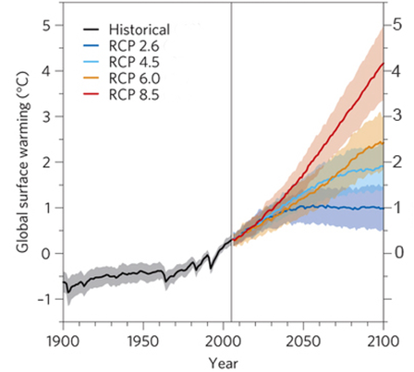
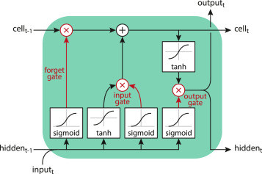
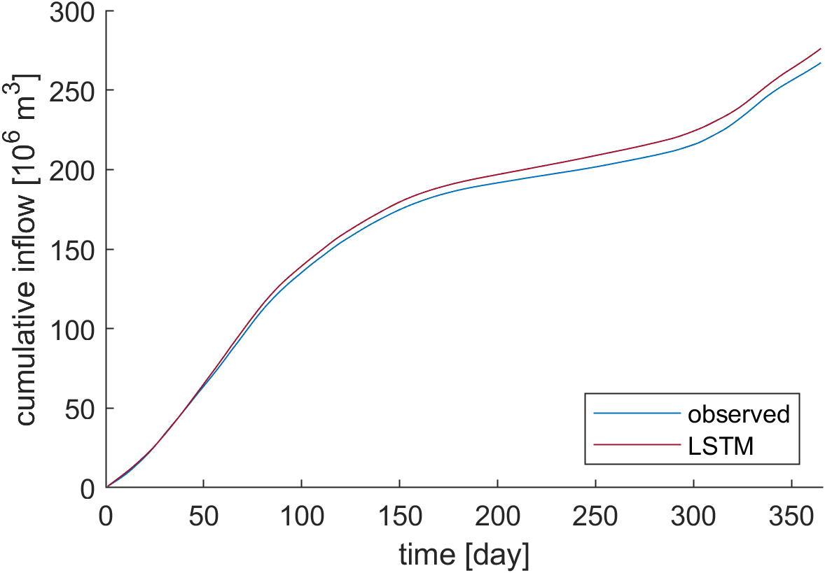
SCENARIO-BASED ROBUSTNESS ANALYSIS
HYDRO-METEOROLOGICAL ASPECTS
Downscaling to the local scale
Meteorological projections at the basin scale
IPCC projections of temperature and precipitation
Rainfall-runoff modeling
Notes:
We then perform a robustness analysis defining different scenarios. The first aspect of these scenarios is relative to the hydro meteorological aspects which define the water availability.

Slide 10
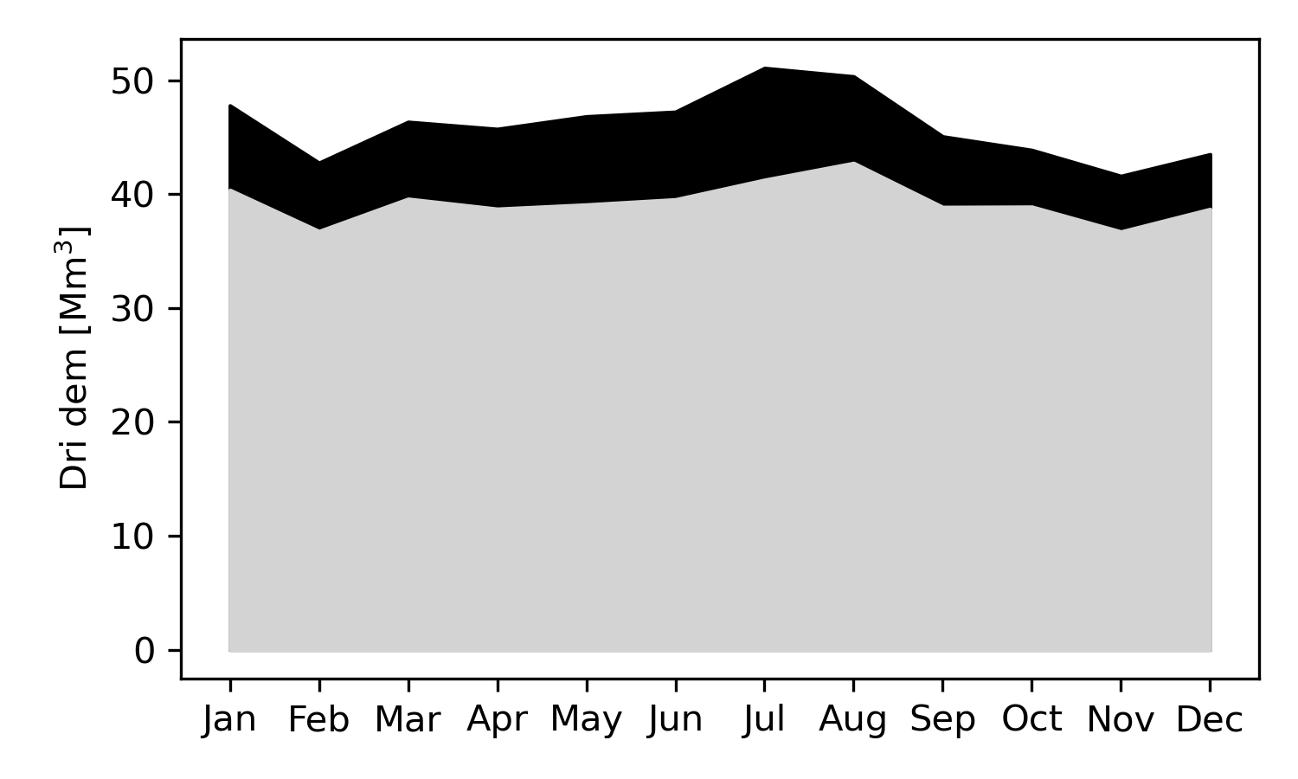
SCENARIO-BASED ROBUSTNESS ANALYSIS
SOCIO-ECONOMIC ASPECTS
Future drinking demand patterns (driven by the tourist development) estimated by the Apulian water authority.
increase of the demand on the coastline
concentration of the request during summertime
estimated annual increase of 80.9 Mm³
Notes:
We also considered the projections of th

Slide 11
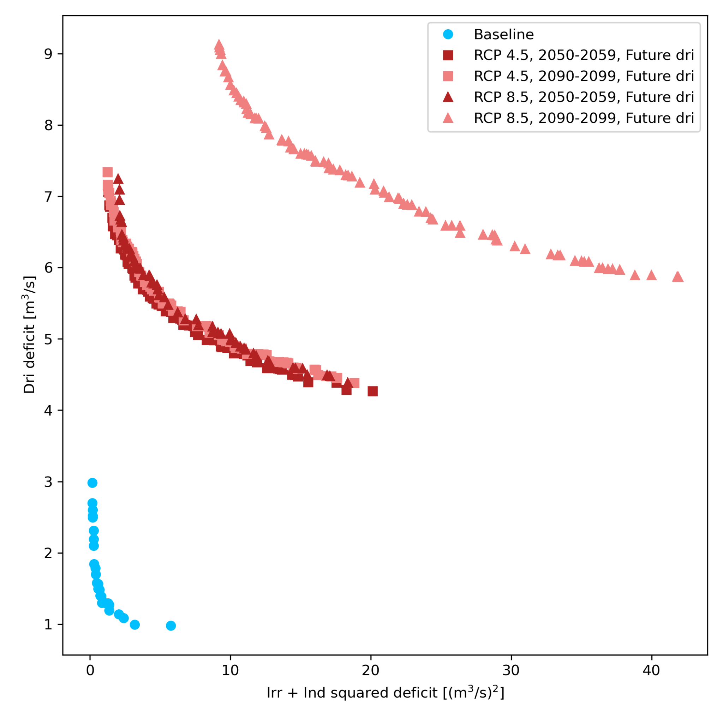
EFFECT OF CLIMATE AND SOCIO-ECONOMIC CHANGES
Unsustainable pressure on freshwater resources.
Exacerbated conflict between the water users.
Extreme CC
Moderate CC
Notes:
The combined effect of climate and socio-economic changes will dramatically affect the Apulia water system.
drinking deficit growth between +300% (moderate) and +500% (extreme climate change).

Slide 12
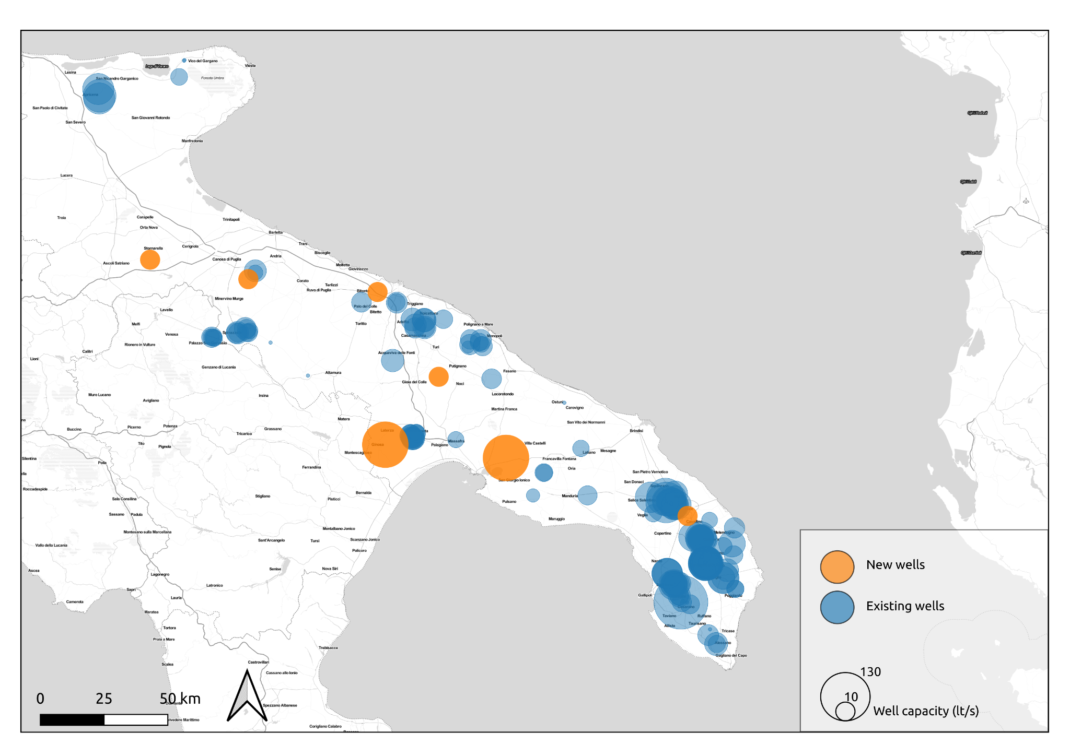
SCENARIO-BASED ROBUSTNESS ANALYSIS
TECHNOLOGICAL ASPECTS
Water reuse implementation:
Wastewater reclamation
Irrigation districts
+49.46 Mm³/year
Industry
+12.61 Mm³/year
Reactivation of
dismissed well-fields
7 well-fields
+9.45 Mm³/year

Slide 13
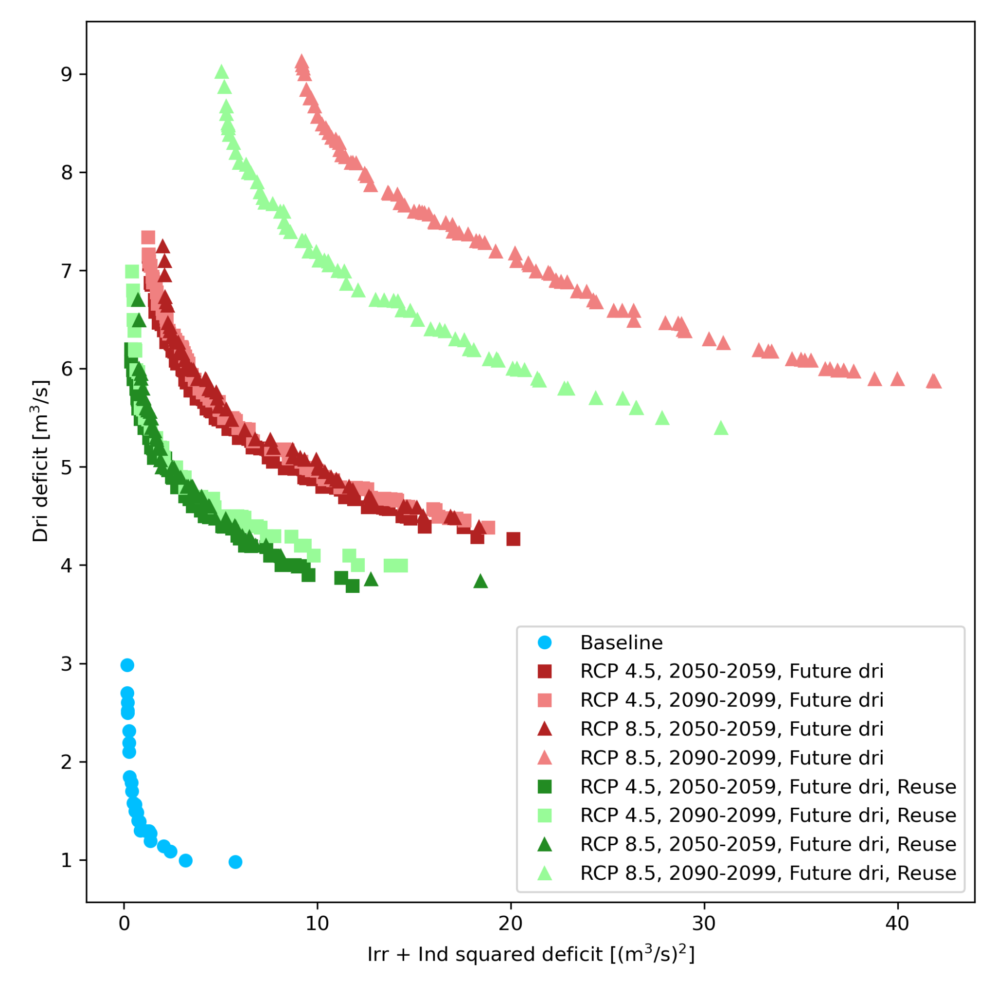
CLIMATE CHANGE ADAPTATION THROUGH WATER REUSE
The reuse actions implemented are far from entirely closing the gap with the current situation.
The proposed framework can operatively support the decision-making process.
Notes:
We are able to provide a quantitative assessment of the water loops effect

Slide 14
POLITECNICO DI MILANO
DEPARTMENT of ELECTRONICS, INFORMATION,
and BIOENGINEERING
Matteo Sangiorgio
matteo.sangiorgio@polimi.it

