Slide 1
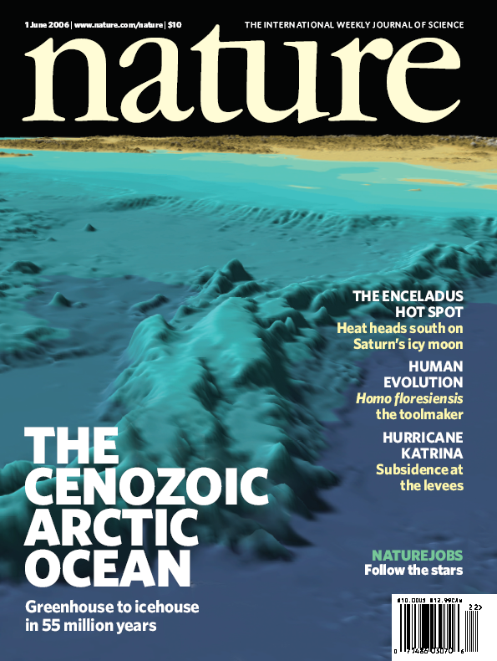
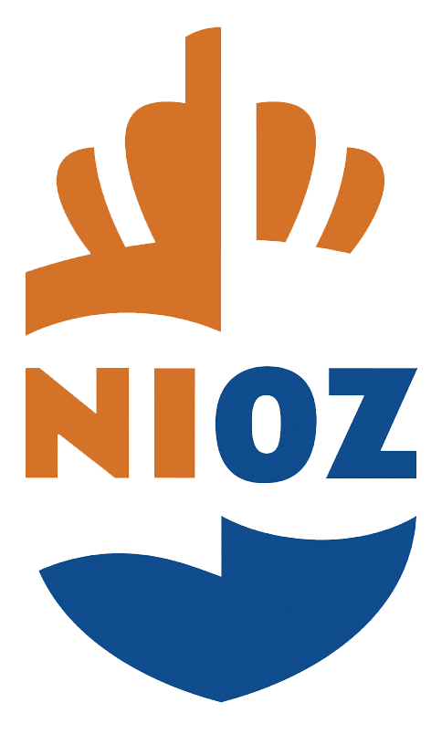
IODP 302: Dating 'Zebra’: was the Lomonosov Ridge a central Arctic Ocean Island in the Oligocene?
Henk Brinkhuis, Francesca Sangiorgi, Evi Wubben, and Matt O’Regan
Utrecht University

Slide 2
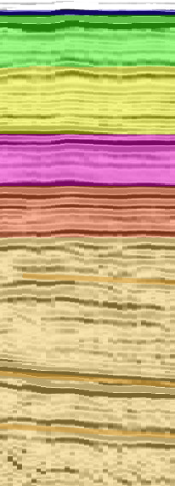
Lomonosov Ridge Seismic Stratigraphy
Jokat et al. (1995)
ACEX
Opening of a deep water connection to the North Atlantic (10 Ma)
LR6 (1.8 km/s, 80 m)
LR5 (1.8 km/s, 150 m)
Sea floor spreading in the Fram Strait Started (33 Ma)
LR4 (2.0 km/s, 120 m)
LR3 (2.2 km/s, 150 m)
Lomonosov Ridge close to sea level (22n, 49 Ma)
Jakobsson et al., 2007 - Nature

Slide 3
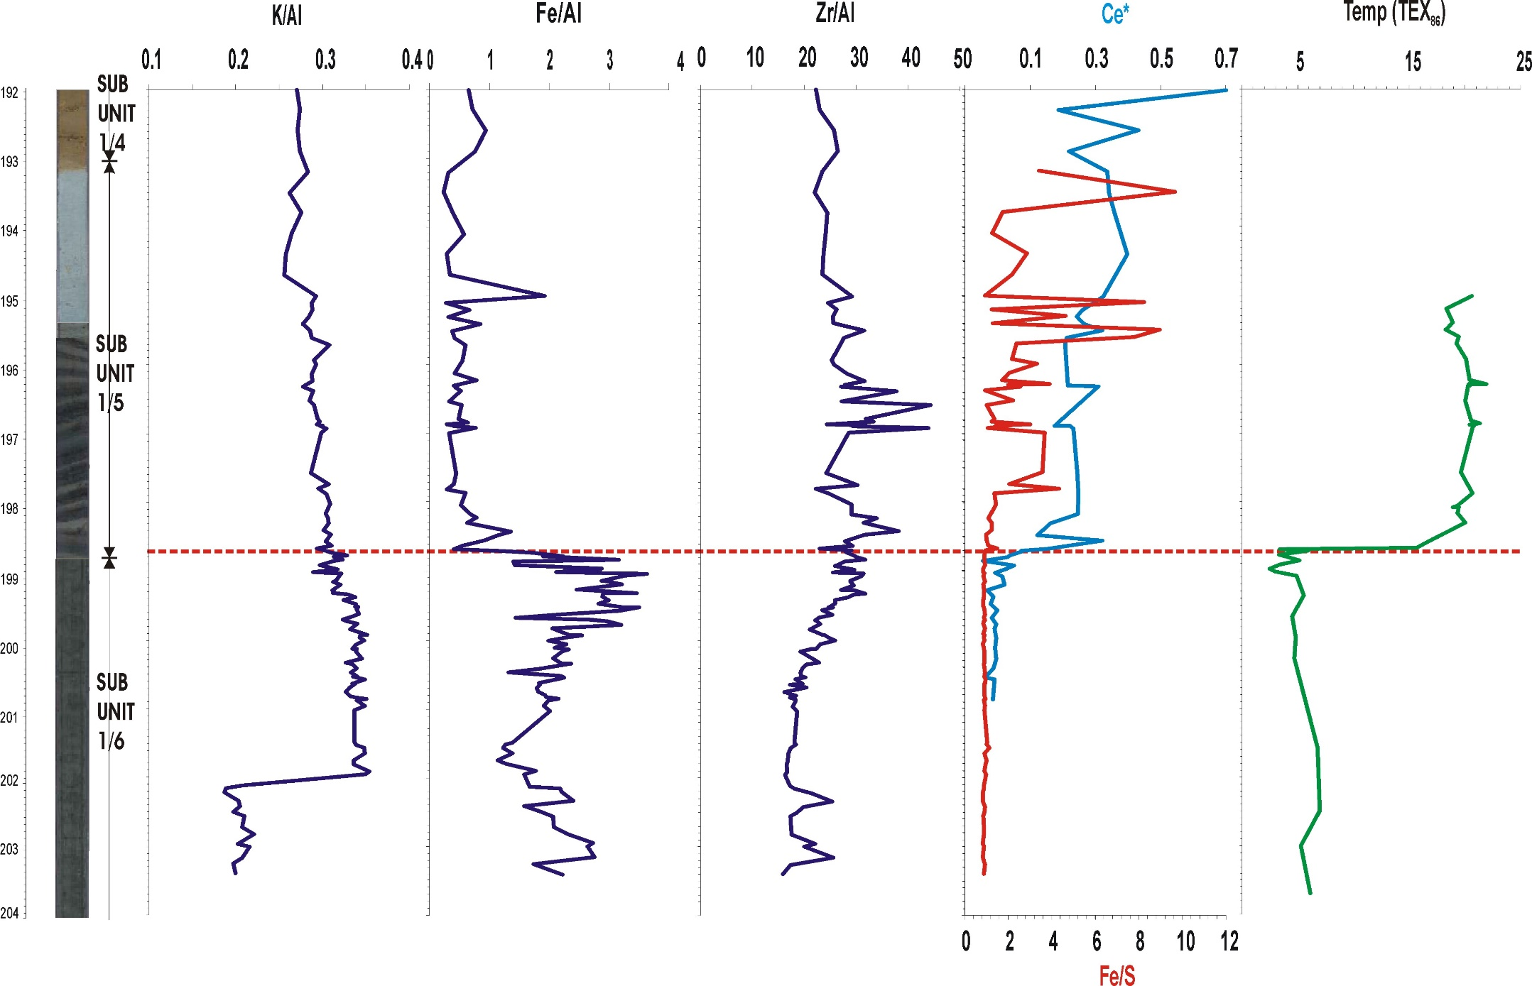
Geochemistry: Maertz et al., 2011
< diatom age 36,7 Ma?
Provenance changes
> Riverine input
Increased energy

Slide 4
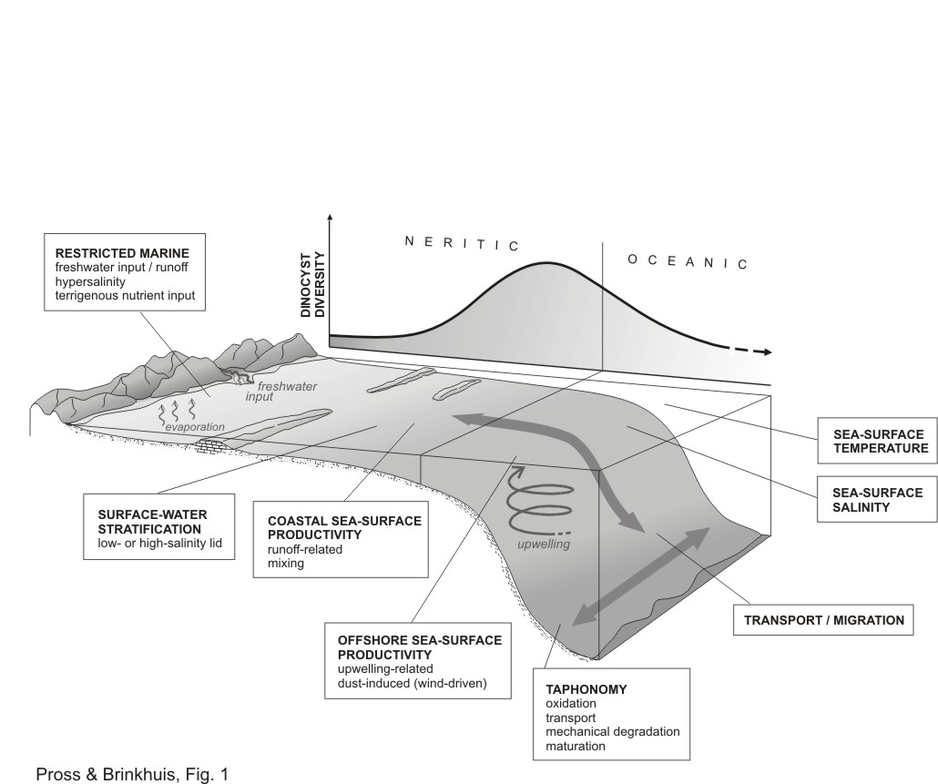
Organic dinocysts: ecology
Zebra environment??
Pross & Brinkhuis 2005

Slide 5

Possible Mechanisms
Tectonics a gogo?
Basin wide Compression?
Migration of Euler pole results
in compression along
Laptev shelf (C13 - C6)
Northward motion of
Greenland until C13
Compression
ends in early Miocene
(Brozena et al., 2003)
(Drachev et al., 1998, 2001)
O’Regan et al., 2008, Paleoceanography

Slide 6
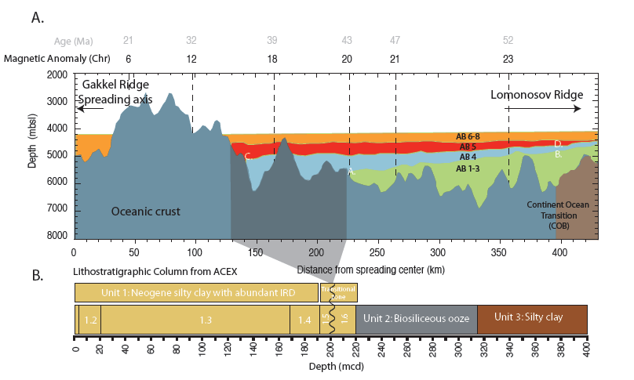
Nature of the unexpected hiatus: the pancake seismic …
> 46 Ma 800m inclination
> 34 Ma 350m inclination
O’Regan et al., submitted
O’Regan et al., 2008, Paleoceanography

Slide 7
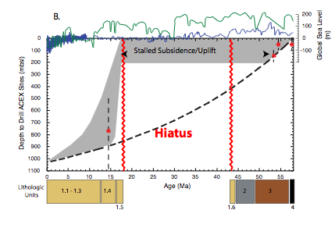
O’Regan et al., 2008, Paleoceanography

Slide 8
Maerz et al., 2011 EPSL

Slide 9
Maerz et al., 2011 EPSL

Slide 10
Maerz et al., 2011 EPSL

Slide 11
Maerz et al., 2011 EPSL

Slide 12
Maerz et al., 2011 EPSL

Slide 13
Maerz et al., 2011 EPSL

