Slide 1
This presentation is a part of the PhD Thesis on
Variability of photospheric granulation
over solar activity cycle
“Relative variation of granulation size as a function of global solar parameters”
DI Dr. Alexey Sharov, Prof. Dr. Arnold Hanslmeier
presented as the EGU23-1378 poster, online 24.04.2023

Slide 2
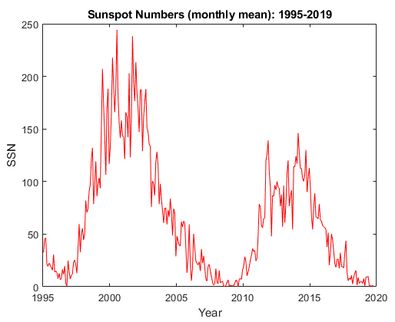
Presentation Outline
I. PhD status & Progress
Two EGU articles
Other publications
Research question
Research characteristics
II. Statistical properties
Granulation size distribution
SSA distribution
SSN distribution
Central limit theorem
Normalization
Ergodic hypothesis
Granulation size variability
III. Adaptation
Solar figure in relation to sunspot activity
Surface area conservation equation
BC formation level
Local variation of granular size
Variation in single cell size
Global variation of granular size
Magnitudes of relative variations
IV. Granular extent and statistics
Variation in mean granular extent
Variation in mean granular extent vs PAR
Variation in mean granular extent vs SSN
Time lag between granular extent and SSN
V. Empirical evidence and validation
Validation of granular extent in active regions
Extent of split granules
Intervalidation: bright and dark rings
VI. Conclusions
Summary
Acknowledgements and thanks
Equations to go
Annex: No-show slides
VII. Lessons learned
Stereo A, B for the back side SSN
Check correlation with 28-day lag.
Solar cycle
24

Slide 3
Two articles … out of three

Slide 4
An article in between
Initially, it was a disappoint-ment due to A&A article preparation based on my diploma thesis. Then I found many positive aspects in this publication:
Solid research presented by serious astrophysisists
There are several short-comings I could improve.
A kind of confirmation / validation of my work.
The topic is still actual.
There is new SDO data.
Motivation to work, to finish, to publish (M.F).
May, 2020 vs May, 2021; May, 2022 vs April, 2023

Slide 5
Granulation scale vs SSN (Ballot et al. 2021)
The granulation size distribution is statistically spatially homogeneous... [Ballot et al. 2021; Hinode-SOT + SDO-HMI, 2010-19].
Granulation size variation (2010-2019): mean area 2.5% (3%) in antiphase, mean number density 2% (1%) in phase with SSN.
N-maximum is delayed by 300 ∼ 400 days compared to the activity maximum (14 and 378 days in 1- and 27-day image series).

Slide 6
Research Characteristics and Outcomes
Parameter / Source | (Ballot et al. 2021) | (Sharov & Hanslmeier 2022) | (Sharov & Hanslmeier 2023)
Structural element | Granule | Granule, granular cell | Granular cell
Morpho-parameter | Mean area, number density | Mean area, perimeter-to-area | Mean area, mean extent
Distribution | Skewed | Skewed | Normal
Variation (area, numb) | 2.5 %, 2 % | 3 %, 1.5 % | 3 %, 1 %
Time lag to SSN | 300 ∼ 400 days | 14 days (1-day), 378 days (27-d) | 14 days (1-day), 378 days (27-d)
Data source | SDO-HMI, Hinode-SOT (bc) | Hinode-SOT (bc) | Hinode-SOT (bc), SOHO-MDI
Cadence | 30 days [1 hour] | 1-, 27-, and 30-day | 1- and 27-day [6 hours]
Pixel scale | 0.25 arcsec / pix | 0.054 arcsec / pix | 0.108 arcsec / pix
Observation period | 2010 - 2019 | 2006 - 2016 | 2011 – 2015
Segmentation method | Convexity detection | Watershed | Controlled watershed
Intensity invariance | yes | yes | yes
Scale invariance | no | no | yes
Magnetic effects | no influence on results | not treated | impact on results in active regs

Slide 7
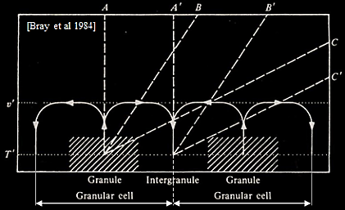
Research question: Granulation size variability
Aside from different instrumentation and different definitions of granules vs granular cells, the lack of consolidated analytical formulations linking granulation size changes to global solar variability complicates verification of empirical results and makes them difficult to reproduce and use in other studies. It is significant that over the past 70 years, the observed value of the relative changes in the average size of granular cells associated with the solar magnetic cycle has declined by an order of magnitude from 22% to 2% (see below).
History of observations on granule size variability:
Mean number of granules: 22% (Macris et al. 1950s)
Mean size of granules: 4% (Macris et al. 1984)
Mean area in active regions: 10% (Schmidt et al. 1987)
Mean area of granules: 21% (Pötzi 2009)
Mean area of granules in 2006-2016: 8% (Muller et al. 2010)
Mean area of granular cells in 2006-2016: 3% (Muller et al. 2018, Sharov 2020)
Peak-to peak mean density 2.5% in 2010-2019 (Ballot et al. 2021)
Perimeter-to-area ratio in 2011-2015: 1.5% (Sharov & Hanslmeier 2022) Granules vs granular cells (Bray 1984)
Due / expected variation in mean granular extent: 0.2 – 1.0% (Sharov & Hanslmeier 2023)

Slide 8
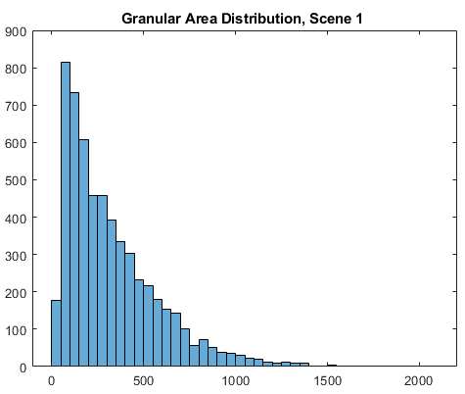
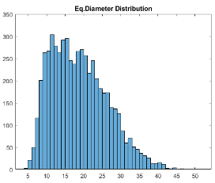
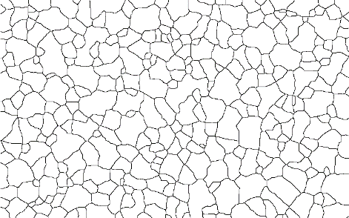
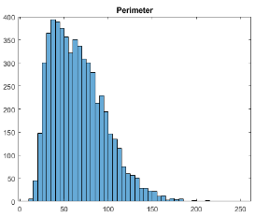
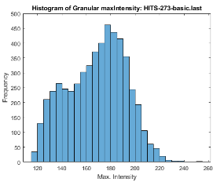
Granulation Size Distribution
One of the main statistical shortcomings of previous studies is that the mean granular area or mean equivalent radius cannot represent the characteristic scale of solar granulation even on a long-term basis, due to the essentially skewed non-normal distribution of the granular size (c.f. Muller 1989).
$\overline{Ag}$
Mean area: skewed
distribution
Mean value ≠ Peak value
Identified granular cells
$\overline{Cg}$
Bi-modal
distribution
The measured mean size of granules or granular cells is particularly susceptible to the influence of outliers due to occasional irregularities in image time series, unsuitable image quality, e.g. local blurring, and flaws in automatic image processing (Sharov 2020). The strongest outliers correspond to images affected by magnetic structures (Ballot et al. 2021).

Slide 9
Distribution of sunspot area and intensity
Quiet-sun intensity distribution
SSA exponential distribution
Periods of medium activity are of interest.

Slide 10
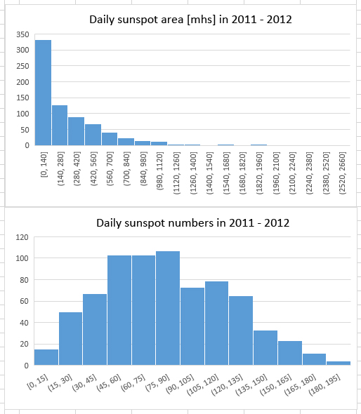
Distribution of sunspot numbers
SSA exponential distribution
SSN distribution model
Medium-term periods of average activity are of interest.

Slide 11
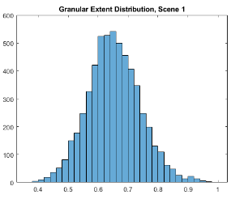
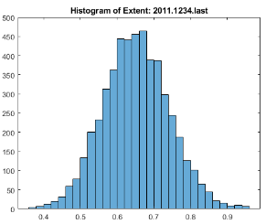
Central Limit Theorem → Normalization
Following the central limit theorem, which states that the sum of properly normalized random variables tends to have a normal distribution, we introduce the normalized version of the mean granular area called mean granular extent, which is defined as the area of a granular cell divided by the area of the smallest bounding box containing the cell with subsequent averaging over all cells in the observation frame. In contrast to other known granulation properties, the proposed dimensionless parameter has a normal distribution, is less scattered and is invariant to scaling effects, e.g. due to defocus. Its use mitigates the problem of truncated granules at the edges of the image and does not require much computing time. Another significant advantage is that the mean granular extent varies in phase with the sunspot indices.
$$\overline{A_{g}}=π∙{\overline{r_{g}}}^{2}$$
$$\overline{E_{g}}=\overline{\left(\frac{A_{g}}{A_{b}}\right)}$$
$$\overline{E_{g6}}≅0.65$$
Normalization: at data processing level, e.g. Sun-Earth distance or contrast normalization (reduction); at parameter level, e.g. perimeter-to-area ratio; at statistical level, e.g. variance adjustment to a new value; at integration (validation) level, e.g. normalized tendency, alignment; at spatiotemporal level, local or global. Appropriate selection of the observ. Interval.

Slide 12
Research Question & Objectives
The present study aims to solve one of arduous scientific problems in heliophysics… the problem of surface convection variability as a subject to solar activity.
The main goal of the study is to investigate the cause-effect relationship between the size distribution of solar granulation and the sunspot activity with the aid of new high-resolution optical images obtained from Hinode and Solar Orbiter satellites, and simultaneous time series of daily sunspot number (SSN), area (SSA) and field strength (SFS) data.
New additional specific objectives are
to verify the surface area conservation equation;
to write basic formulations for the relative variation in global and regional granulation extent and determine the magnitudes of the relative changes in the horizontal size of granular cells as a function of global solar parameters;
to test the specific behavior of mean extent versus mean area and contrast of granular cells using Hinode-SOT, SOHO-MDI and SDO-HMI image sequences obtained over descending and ascending phases of the 24th activity cycle in comparison to corresponding sunspot indices;
to reestimate magnitudes of relative changes in the horizontal size and shape of granular cells in both quiet and active regions and validate the impact of magnetic effects on morphometric parameters;
to validate the results by measuring changes in the solar radius from regional granulation measurements.

Slide 13
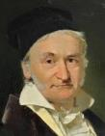
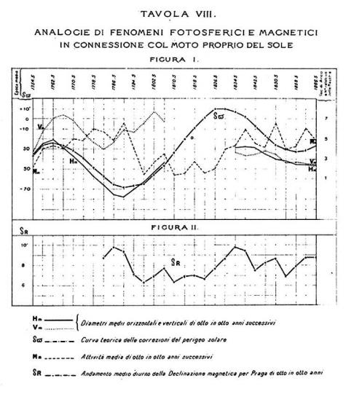
Solar figure in relation to sunspot activity
Rosa-Secchi law (Studii intorno ai diametri solari, 1873, c.f. R.Wolf)
The equatorial and polar radii of the Sun “converge” at minimum and “diverge” at maximum sunspot activity.
R_{eq} increases while R_{pol} decreases with growing activity.
The total volume of the Sun remains unchanged.
The amplitude of radii variations is extremely small, being not more than 0.2‘‘.
K-F. Gauß
1777-1855
A. Secchi
1818-1878
$A_{}=6087176.0 Mm^{2}, { R}_{}=695.990 Mm,$ $θ=0.999965535$
$$\left(=500 nm\right) −oblateness parameter. {δθ}/{θ ≈}4∙{10}^{−5}$$
$$A_{}={2πa}^{2}+ π\frac{b^{2}}{e}∙\ln\left(\frac{1+e}{1−e}\right)≅4πθ∙R_{}^{2};{ e}^{2}=1−{\frac{b^{2}}{a^{2}}} , a>b.$$
Theorema Egregium (K-F.Gauss) establishes that the curvature or radius of the Sun can be determined from the finite elements that make up its surface. This means that we can determine $R_{ }$by counting the finite number of granular cells n and measuring their mean area in the given sufficiently large polygon. Conversely, this means that we can prove the measured mean granular area by counting the number of granular cells n in the given polygon and using the radius value corresponding to the bc formation level (695.956 Mm, TRF).

Slide 14
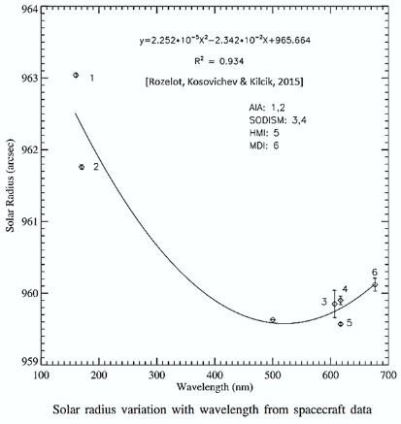
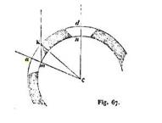
Surface area conservation equation
Sunspot
BGE1 refers to global values of (solar granulation) parameters
BGE 1
Granular
cells
Zw
Bright ring
Granules
$A_{}=A_{g}+A_{s}$
$$4πθR_{}^{2}=N{∙π\overline{r_{g}}}^{2}+ 4πθR_{}^{2}∙{SSA}_{t}$$
N – total number of granular cells; both $A_{g} and A_{s}$ include pores.
Pore
R_{c}
R
$R$ - var. 0.025% at max.
Wilson depression
(not to scale)
$$R_{}=±\frac{\overline{r_{g}}}{2}∙\sqrt{\frac{N}{θ\left({1−SSA}_{t}\right)}}$$
$≅0.993$ aspect factor
$\overline{r_{g}}=2R_{}\sqrt{{θ\left({1−SSA}_{t}\right)}/N}$
$$R_{ }$$
- global mean equivalent radius of granular cells
canonical
↓ value
blue continuum level?
$$\frac{R^{2}}{{\overline{r_{g}}}^{2}}=\frac{N}{4θ(1−{SSA}_{t})}$$

Slide 15
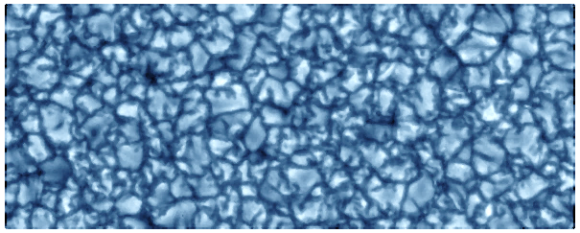
Local variation of granular size (frame)
Based on the ergodic hypothesis (Hanslmeier et al. 2009), we assume that the morphometric properties of the granular cells identified in the Hinode frame represent the average statistical properties of the granulation process over the entire solar surface and define the global number of granules as the number of cells in the frame multiplied by the Hinode instrument factor of 473,0.
Hinode-SOT BFI pixel scale: 0.108“/pix (after 01.2008)
Frame size (FOV): 2048 x 1024 pix² = 221.2 x 110.6 arcsec², A_{FOV} = 12867.0 Mm²,${ A}_{bc}=$6086371.57 Mm² , SSA_{FOV} = 0
Local mean equivalent radius of granular cells measured in the Hinode frame
Hinode-SOT instrument bc-factor at 1AU s = 12.767 [pix/Mm] - linear scale factor
n - frame number of granular cells, including truncated.
BGE 2
$$4θR_{}^{2}∙(1−{SSA}_{t})=\text{η}∙n∙{\left({\overline{r}}/s\right)}^{2}$$
$\overline{r} ≅s∙\overline{r_{g}} /\sqrt{1−{SSA}_{t}}$ [pix]
${\text{η}=\text{A}}/{\text{A}\text{FOV}}\text{ = }\text{473.0}$ $N=\text{η}∙n$
$\overline{r}={ 2s∙R}_{bc}∙\sqrt{θ/{\text{η}∙n}}$ [pix] or
$$R_{bc}= \frac{\overline{r}}{2s}∙\sqrt{\frac{\text{η}∙n }{θ}}$$
- good proof or even measurement of $R_{bc}$under “cellular flat-top” assumption. So far there is no data on $R_{bc}$ …
$n∙{π\overline{r}}^{2}$ - measurant

Slide 16
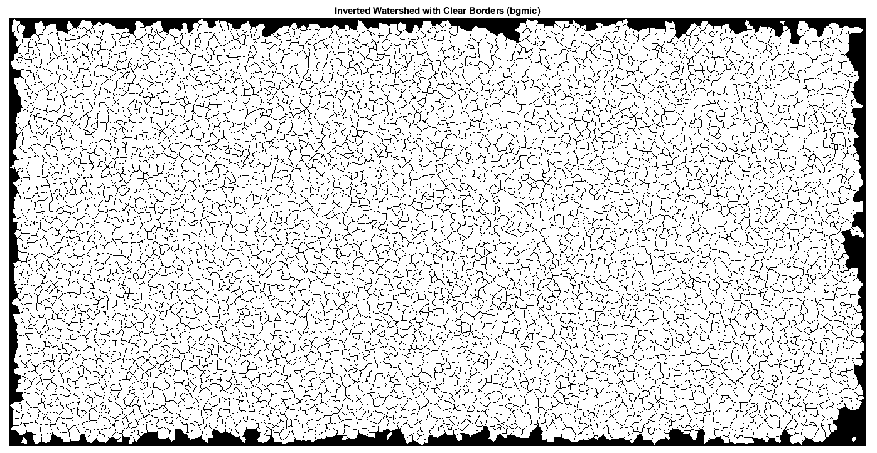
R$bc$ "measurement" and validation
Selection criteria for test images: FG20070405_180755.9 … FG20071030_174657.4
1 AU distance (about 1 April, 2007 and 5 October, 2007)
high resolution / pixel scale: 0.054“/pix (before 01.2008)
frame size (FOV): 4096 x 2048 pix² = 221.2 x 110.6 arcsec², A_{FOV} = 12867.0 Mm²
sharp images taken at ∼ 18:00 out of eclipse season, e.g. III-IV.2007
Hinode images with X_{cen}, Y_{cen} > 0.2“ were rejected from the analysis
low magnetic activity: zero SSN / SSA: 2/4 - 16/13 April 2007 (7 imgs), 9/8 October – 05/15 November 2007 (23 imgs)
Removal of cut-by-frame (truncated) granules from the test polygon with subsequent reduction to $\text{A}\text{FOV}$ . Counting the finite number of granular cells n₀ and measuring their mean equivalent radius $\overline{r}$ in the given sufficiently large polygon.
The repeated measurements (5) are within 1% of the expected value of $R_{bc}=\text{695.956} Mm$, i.e. good precision!
$$R_{bc}= \frac{\overline{r}}{2s}∙\sqrt{\frac{{\text{η}}_{0}∙{\text{n}}_{0}}{θ}}$$
$\overline{r} ≅s∙\overline{r_{g}}$[pix, 1AU]
$${{\text{η}}_{0}=\text{A}}/{\text{A}\text{0}}$$
SSA_{t} = 0

Slide 17
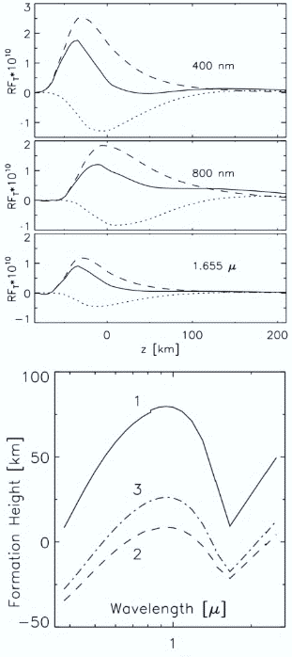
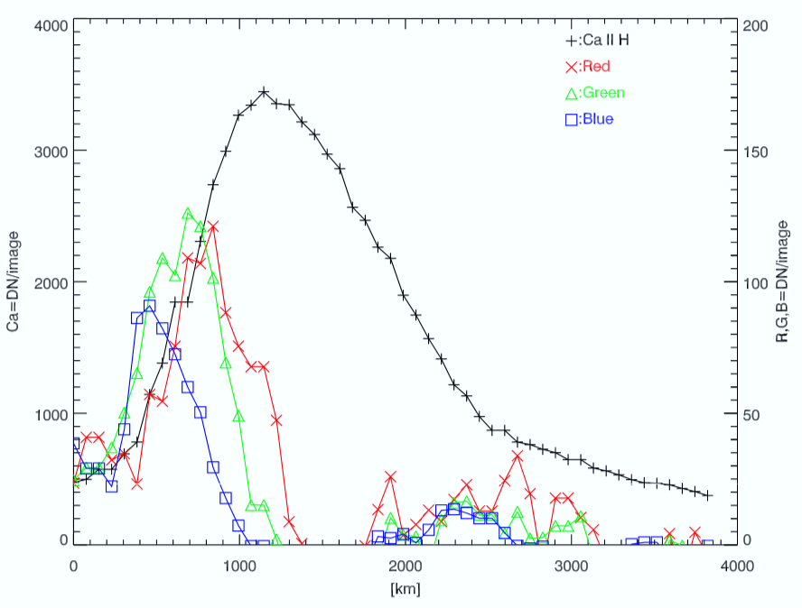
BC Formation Level (Hinode BFI)
__ B(λ) + k(λ)
↓ 0 km (λ=500 nm, τ =1)
$A_{bc}$ = 6086371.57 Mm²
$$R_{gc}=\text{695.990} Mm$$
$R_{bc}=\text{695}\text{.956} Mm \text{:}$ 1AU, 450 nm
- 41 km (Watanabe et al. 2013, obs)
- 26 km (Pérez & Kneer 2002, TRF)
+ 13 km (Kuehner et al. 2018, FT)
- 18 km … - 34 km (average, ε < 1)

Slide 18
Variation in single cell size
d_{h}
Mass conservation equation
Single cell
V_{h}
$$π∙r^{2}∙ρ∙v_{v}≅2π∙r∙ρ∙vh∙H_{ρ}$$
H_{P}
$$r≅2∙\frac{vh}{vv}∙H_{p}$$
(Stein & Nordlund 1998)
$$d_{h}≅2π∙\frac{vh}{vv}∙H_{ρ}$$
(Nelson & Musman 1978)
V_{v}
$t=\frac{vh}{vv}≅\frac{r}{{2H}_{p}}$ , ${ H}_{p} =\frac{k∙T}{g∙μ∙m_{H}}$ $=$ $H_{ρ}$,
r
where H_{p} is the pressure scale height, ρ is the local density, v_{v} - local vertical velocity, v_{h} - local horizontal velocity, g – local gravity, $μ∙m_{H}$- particle average mass, d_{h} is the horizontal size of the granular cell, r – local equivalent cell radius. Set of scaling relationships becomes more difficult →
$d_{h}=0.5π∙r≠f\left(ρ\right)$, r $≅ \overline{r}$
$ρ=const$; incompressible convection

Slide 19
Global variation of granular size vs R, L, N, T_{eff}
We write basic expressions for the global variation of granular size, number and time scale as a function of the total sunspot area and global solar parameters $R_{}$, $L_{}$ , $Teff$ and $g$ :
Horizontal size of granular cells decreases with growing SSA_{t} (Macris et al. 1954, 1984)
Solar radius increases with sunspot activity (Rosa 1873, et al.)
Solar luminosity increases with sunspot activity (Ulrich & Bertello 1995, et al.)
Total number of cells decreases with growing SSA_{t} does not fit (Macris Elias 1955)
Granulation time scale increases with growing SSA_{t} (Kjeldsen & Bedding 2011).
Effective temperature increases with sunspot activity (Fröhlich 2013, et al.)
Surface gravity decreases with growing SSA_{t} (Mathur 2011 – 2021).
All these equations do not account for the shape (change) of granular cells.
$$\overline{r_{g}}≅2R_{}∙\sqrt{{θ\left({1−SSA}_{t}\right)}/N}$$
$$R_{}≅± \frac{\overline{r_{g}}}{2}∙\sqrt{N/{θ\left({1−SSA}_{t}\right)}}$$
$$L_{}=\frac{N∙π{\overline{r_{g}}}^{2}∙σ∙T_{eff}^{4}}{1−{SSA}_{t}}$$
$$N=\frac{4R_{}^{2}}{{\overline{r_{g}}}^{2}}∙\left(1−{SSA}_{t}\right)$$
$$τ≅\frac{\overline{r_{g}}}{v_{h}∙\sqrt{1−{SSA}_{t}}}$$
$$Teff=\frac{v_{v}}{v_{h}}∙\frac{μ∙m_{H}}{2k}∙\frac{\overline{r_{g}}∙g}{\sqrt{1−{SSA}_{t}}}$$
$$g≅\frac{v_{h}}{v_{v}}∙\frac{2k}{μ∙m_{H}}∙\frac{T_{eff}}{\overline{r_{g}}}∙\sqrt{1−{SSA}_{t}}$$

Slide 20
Magnitudes of relative variations
Parameter | $${1−SSA}_{t}$$ | N | Ω [rad/s] | R [Mm] | $Teff$ [K] | g [m/s²] | $\overline{r_{g}}$ [Mm] | $$\overline{E}$$
Mean value, $\overline{X}$ | 0.9975 | $$3.10∙{10}^{6}$$ | $$2.86∙{10}^{−6}$$ | $\text{695.95}$6 | 5800 | 273.98 | 0.75 | 0.65
Variation, δX | 0.005 | 3720 | $$2.86∙{10}^{−9}$$ | 0.348 | 0.6 | $$5.5∙{10}^{−3}$$ | 0.0041 | $$8∙{10}^{−3}$$
Relative variation δX / X, maximum | $$5∙{10}^{−3}$$ | $$1.2∙{10}^{−3}$$ | $$1∙{10}^{−3}$$ $$3∙{10}^{−2∗}$$ | $$5∙{10}^{−4}$$ | $$\text{1}\text{⋅10}\text{−4}$$ | $$2∙{10}^{−5}$$ $$5∙{10}^{−4∗}$$ | $$5.5∙{10}^{−3}$$ | $$1.1∙{10}^{−2}$$
$$\frac{δ{\overline{r}}_{g}}{{\overline{r}}_{g}}=2\frac{δR}{R}+\frac{δT_{eff}}{T_{eff}}−\frac{δ{SSA}_{t}}{{1−SSA}_{t}}$$
$$\frac{δR}{R}=\frac{δN}{N}+2\frac{δ{\overline{r}}_{g}}{{\overline{r}}_{g}}+\frac{δ{SSA}_{t}}{{1−SSA}_{t}}$$
$$\frac{δT_{eff}}{T_{eff}}=−\left(\frac{δR}{R}+\frac{δN}{2N}\right)$$
$$\frac{δL}{L}=2\frac{δR}{R}+4\frac{δT_{eff}}{T_{eff}}$$
$$\frac{δn}{n}=−2\frac{δ\overline{r}}{\overline{r}}=−2\frac{δ{\overline{r}}_{g}}{{\overline{r}}_{g}}−\frac{δ{SSA}_{t}}{{1−SSA}_{t}}$$
$$\frac{δN}{N}=\frac{δR}{R}−2\frac{δ{\overline{r}}_{g}}{{\overline{r}}_{g}}−\frac{δ{SSA}_{t}}{{1−SSA}_{t}}$$
$$\frac{δ{\overline{r}}_{g}}{{\overline{r}}_{g}}=\frac{δR}{R}−\frac{δN}{4N}−\frac{δ{SSA}_{t}}{{4(1−SSA}_{t})}$$
$$\frac{δT_{eff}}{T_{eff}}=\frac{δ{\overline{r}}_{g}}{{\overline{r}}_{g}}−\frac{δg}{g}−\frac{δ{SSA}_{t}}{{2(1−SSA}_{t})}$$
As a proof-of-concept the magnitudes of the relative variations in global parameters were directly determined using the typical sunspot area variation of 0.001, without resorting to facular models of solar radiation. However, all these equations do not account for the shape (change) of granular cells. The values of most parameters are not normally distributed. The parameter of average granular extent can assist in this matter. The relative variation of $\overline{E}$ is expected to be ∼1% (maximum value).
$δL$/ $L$= 0.1% at $δ$SSA_{t} = 0.001 - ☺

Slide 21
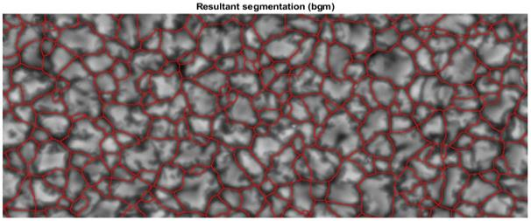
Variation in mean granular extent
The variation in the total SSA has a dominant influence on the mean size and extent of granular cells. The measured relative variation of the mean granular extent is at least twice that of the mean equivalent radius.
$$\overline{E}≅\frac{π{\overline{r}}^{2}}{\overline{δx}∙\overline{δy}}=\frac{π{\overline{r}}^{2}}{\overline{a}}=\frac{π{\overline{r_{g}}}^{2}∙s^{2}}{\overline{a}∙\left(1 − SSA_{t}\right)} , \overline{a_{g}}={\overline{a}}/{s^{2}} and \overline{E_{g}}=\overline{E}∙\left(1−SSAt\right)=\frac{4πθR_{}^{2}}{N∙\overline{a_{g}}}∙\left(1−SSAt\right)$$
The frame value of the mean granular extent$\overline{E}$ increases while the global granular extent $\overline{E_{g}}$ decreases with increasing daily SSA_{t} . This theoretical construct corresponds to our practical observations.
$$\frac{δ\overline{E} }{\overline{E} }=2\frac{δ\overline{r_{g}}}{\overline{r_{g}}}−\frac{δ\overline{a_{g}}}{\overline{a_{g}}}+\frac{δ{SSA}_{t}}{{1−SSA}_{t}}$$
${δ\overline{E}}/{\overline{E}}≤1.1÷1.6\%$ at $δ$SSA_{t} = 0.005 (maximum value)
Measured values of mean granular extent range from 0.30 to 0.95, with the extents of triangular, rhombic, pentagonal, hexagonal, circular and octagonal cells being less than 0.32, 0.5, 0.59, 0.65, 0.78 and 0.83. $\overline{E}$ long-term average was measured at 0.65 corresponding to the predominantly hexagonal shape of the granular cells. Note that the orientation of a bounding box used to calculate $\overline{E}$ is fixed in the image coordinate system; it is not arbitrary.
↑ exploding granule

Slide 22
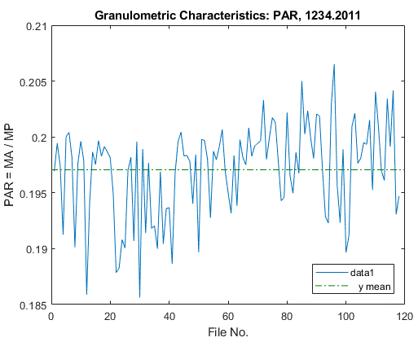
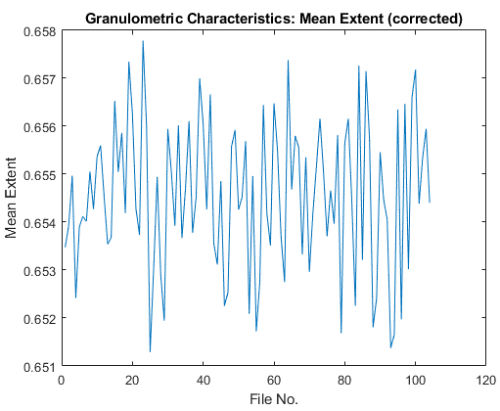
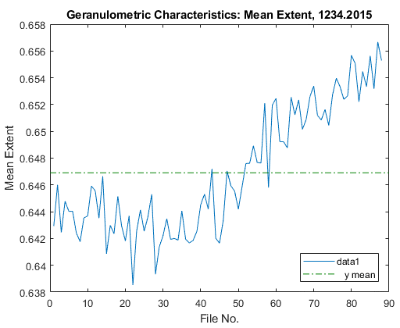
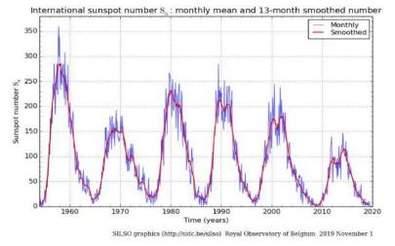
Variation in mean granular extent vs PAR & SSN
1-day cadence
27-day cadence
1-day cadence
10% scattering in mean PAR: HITS with 1-day cadence (1234.2011)
1% scattering in mean granular extent HITS with 27-day cadence (2006-2016).
Mean granular extent varies in phase with SSN: daily HITS (1234.2015).

Slide 23
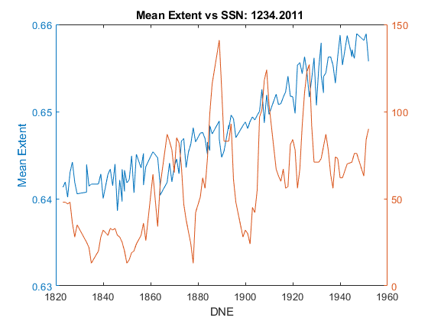
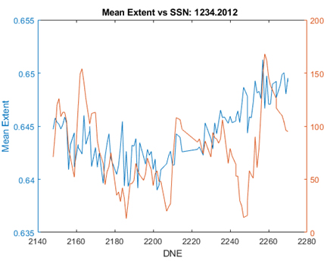
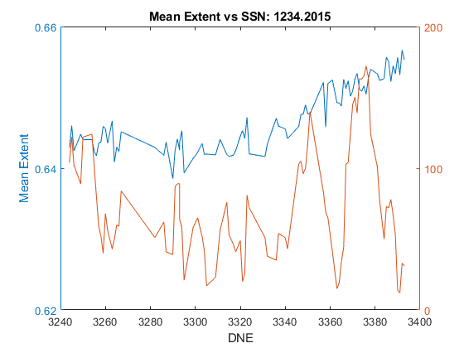
Variation in mean granular extent vs SSN
The mean granular extent frame values vary in phase with the daily SSN during the winter seasons 2011, 2012, 2015 characterized by a homogeneous image quality. The consistent 14- and 378-day delays in the cause-and-effect relationship between SSN and granular extent were detected in the daily and synoptic time series, respectively, and explained by rotational effects and asymmetric distribution of sunspots in visible and invisible hemispheres. The minimum values of global granular extent $\overline{E}g$ are found in the regions of extended and curved "J-shaped" granules.

Slide 24
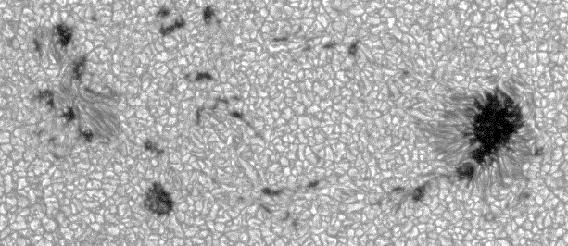
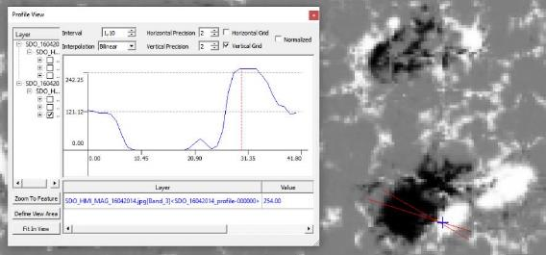
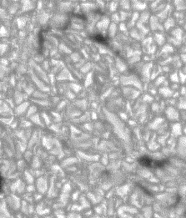
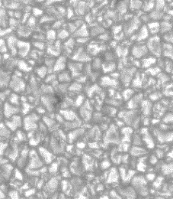
Granular extent in active regions: split granules
Between sunspots and pores with opposite polarity, granulation parameters vary locally, showing:
elongated granular cells with an increased length up to 3.3 MED and reduced width,
areas of „split“ granules with oriented arrangement, sharp angles, and low values of $\overline{Eg}$ $≤$ 0.5,
very large granular cells with ED ≥ 4MED.
Validation of Hinode outcomes with magnetograms from SOHO-MDI (2007) and SDO-HMI (2014): tile pattern, bw?
Hinode FG20140416
SDO-HMI-MG20140416
0.5“/pix
‘split’ granules
‘quiet’ granules

Slide 25
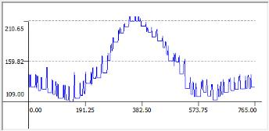
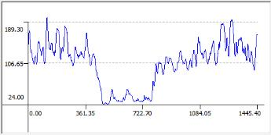
dark ring
↓
Validation: dark vs bright rings
sunspot
sunspot
↑
bright ring
The pictorial representation of the magnetic field strength around alpha sunspot NOAA 10935. 2”/p
The validation of the Hinode SOT results was performed with SOHO-MDI and SDO-HMI data: 17 continuum images and LOS magnetograms taken over the 150-km formation level of the Ni I line (676.8 nm) during the period of low activity in I-V, 2007 and IV-IX, 2014. I discovered the existence of “dark rings” around unipolar sunspots with the northern (outward) polarity of MF which corresponded to bright rings in Hinode filtergrams. The radii of both the dark and bright rings match outside of the penumbra.
SOHO_MDI_IMG_06012007 (2“/pix)

Slide 26
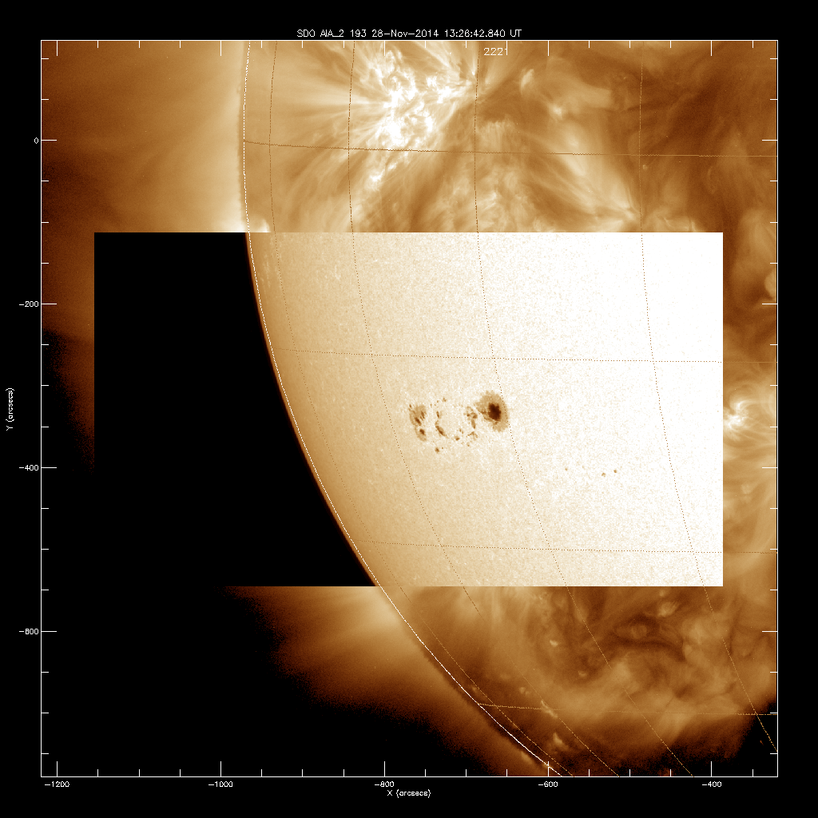
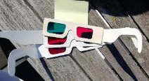
Conclusions & Thanks
The specific behavior of mean extent versus mean area and contrast of granular cells was tested using Hinode image sequences obtained in the blue continuum channel with a 27- and 1-day cadence over descending and ascending phases of the 24th activity cycle, and compared to corresponding sunspot indices. The consistent 14- and 378-day delays in the cause-and-effect relationship between sunspot number and granulation scale were revealed in the daily and synoptic time series, respectively, and explained by rotational effects. We conclude that the mean size and extent of granular cells measured at the disk center could become a reliable index of solar convection and an indicator of global magnetic activity, although the mean granulation size in polar regions remains somewhat uncertain, worthy of further study with high-resolution optical data from extra-ecliptic missions.
Solar eclipse 251022

Slide 27
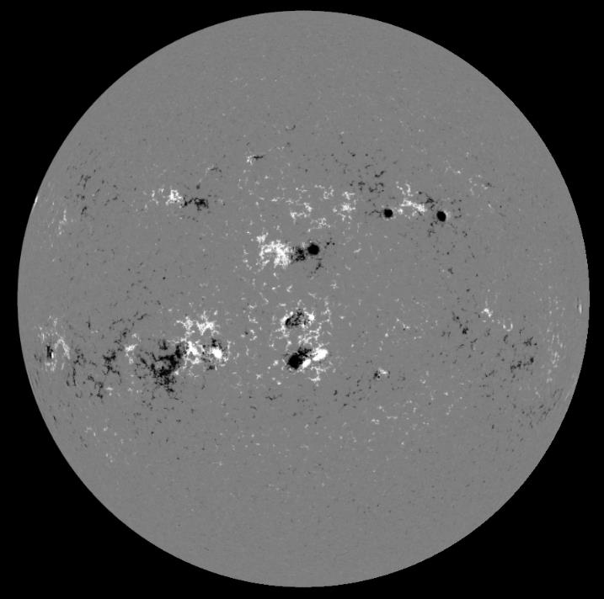
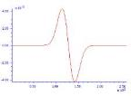
Acknowledgements & Thanks
SDO-HMI-MG20140416
With this I warmly thank my supervisor, teachers, colleagues and all of you for the kind audience and sincere interest in this work.
Hinode image data (IGAM Database, © JAXA) were made available by Prof. A.Hanslmeier from the University of Graz. MWO MFS strength data for sunspots were provided by Dr. A.Pevtsov from the National Solar Observatory, USA.
MDI data were purchased from SOHO Scientific Archive. HMI data were downloaded and visualized with ESA Jhelioviewer. Daily and monthly mean SSN time series were derived from the SILSO archive at the Royal Observatory of Belgium. Daily SSA time series were downloaded from the web-site of the NASA / Marshall Center for Solar Physics, USA.
It is my understanding that strong MFs of opposite polarity must attract each other and cannot be adjacent in a stationary configuration as shown in this magnetogram. Or can they?

Slide 28
Hinode Image Segmentation
Quiet vs Active Sun (visualis)
҉
In the close vicinity of sunspots, the mean size of granular cells decreased by a few percent, while the width of intergranular lanes decreased by 60%, indicating the existence of bright rings with higher temperatures around these sunspots (note ҉ shape).

Slide 29
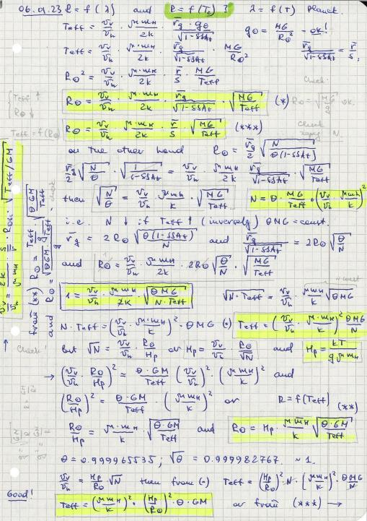
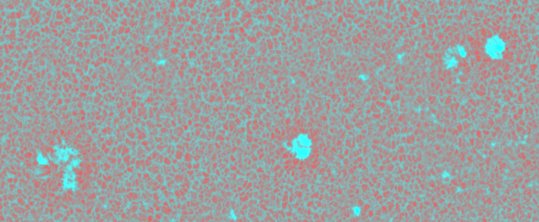
Frozen surface (spherical segments) Equations to go
The mean granular extent $\overline{E}$ exhibits the greatest relative variation among all granular morphometric parameters.
Is it true that the formation height of the Ni I line (676.8 nm) is about 150 km, i.e. in the middle of the photosphere?

Slide 30
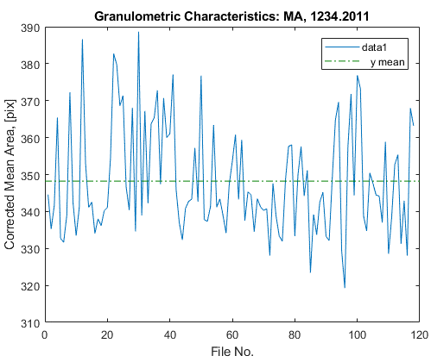
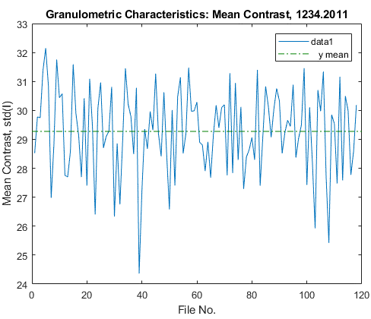
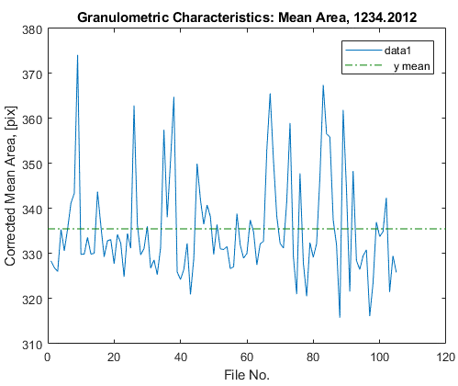
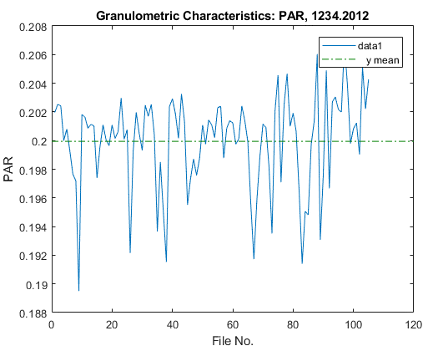
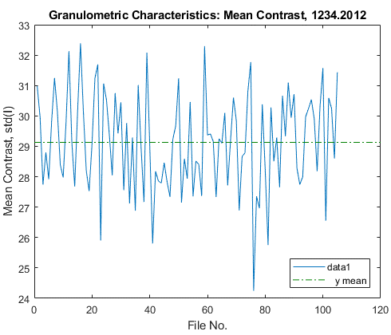
Daily time series of granulation parameters: 2011 vs 2012
$\overline{SSN}$_{2011w} = 60.5
$\overline{SSN}$_{2012w} = 79.3
-3%
☺
+20% ☺

Slide 31
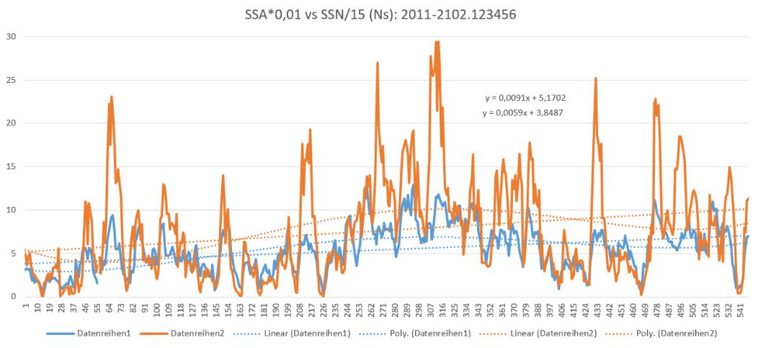
Daily Sunspot Numbers vs Sunspot Areas
Total sunspot area: ${SSA}_{t}≅\left({SSA}_{vis}+ {SSA}_{+14}\right)\text{/ 2 }∙106≅\left({SSA}_{−7}+ {SSA}_{+7}\right)$/ 2 $∙106$ - average of the SSA on visible and back solar hemispheres
SSA = f (SSN) paradox: $SSA=0 while SSN≠0.$
$$SSA is rounded to the nearest 10 millionths.$$
${SSA}_{t}≤$ 5000 (0.5% at max) is more relevant than SSN.
Small single pore with SSA < 5·10⁻⁶ is „lost“.
NASA-Marshall Data Center: SSA
Royal Observatory, Belgium: SSN

