Slide 1
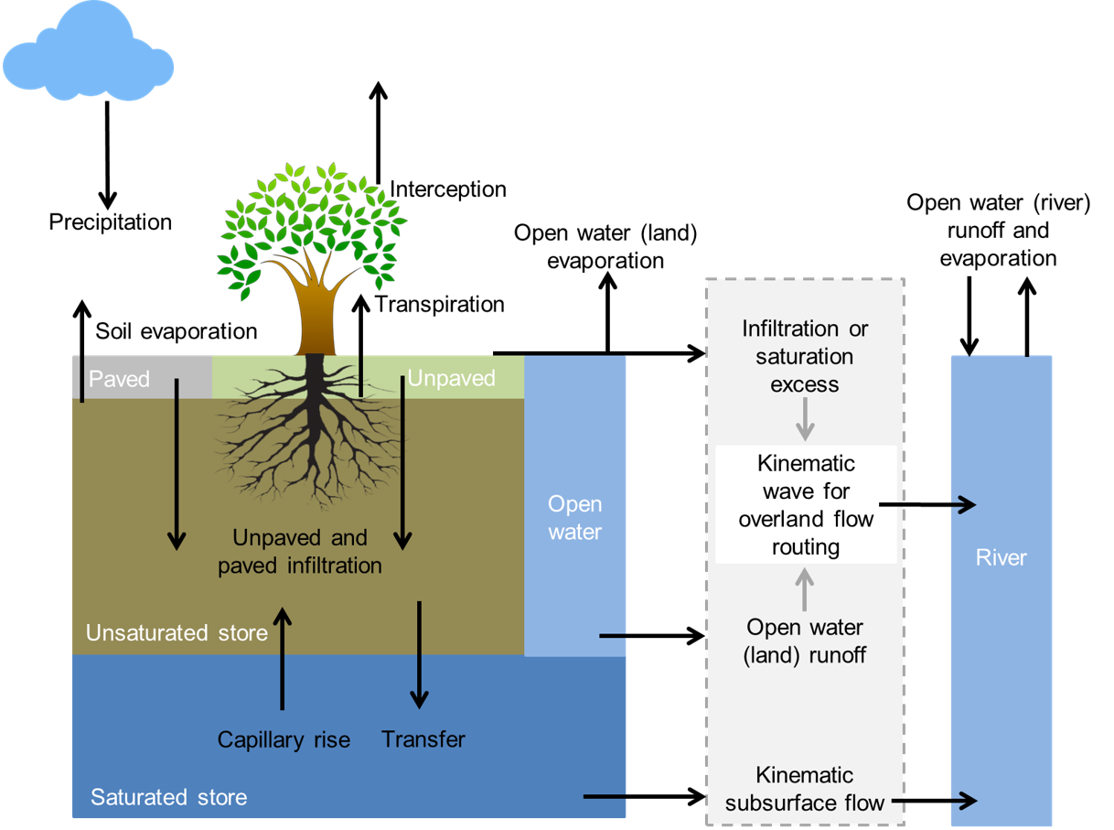
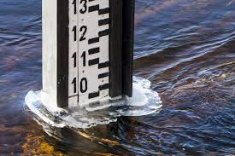
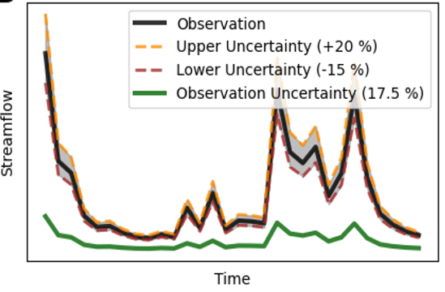
On the importance of observation uncertainty when evaluating and comparing numerical models
Model Experiments
Streamflow Estimates
Observation Uncertainty Analyses
Conclusions
Jerom Aerts, Jannis Hoch, Gemma Coxon, Rolf Hut, Nick van de Giesen

Slide 2
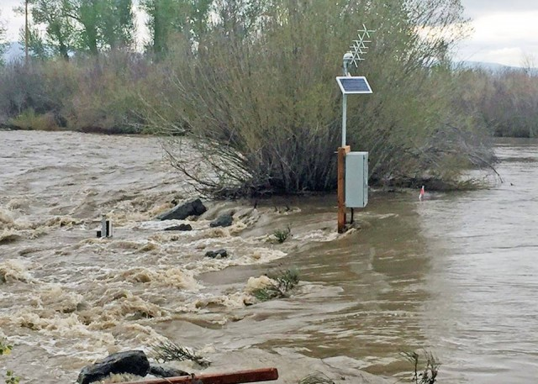
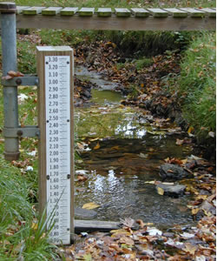
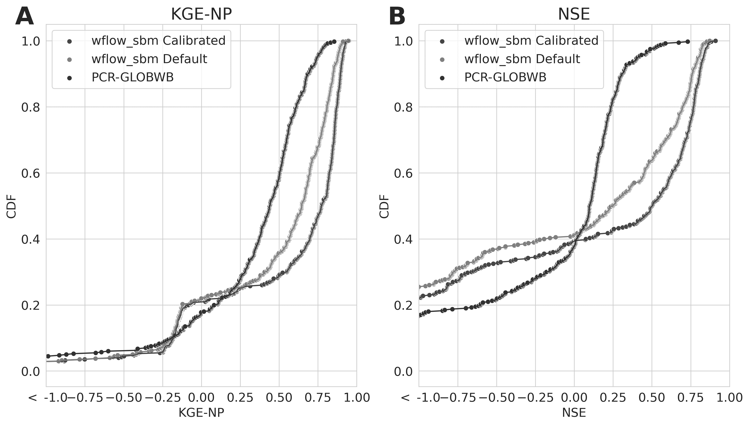
Motivation
The importance of observation uncertainty is often overlooked in (large-sample) studies
USGS

Slide 3
CAMELS-GB
Experiment 1
Experiment 2
1
2

Slide 4
On the importance of observation uncertainty when evaluating and comparing numerical models
Model Experiments
Streamflow Estimates
Observation Uncertainty Analyses
Conclusions
Jerom Aerts, Jannis Hoch, Gemma Coxon, Rolf Hut, Nick van de Giesen

Slide 5
Model Experiments
Hydrological Models
CAMELS-GB
Model Experiments

Slide 6
Hydrological Models
PCR-GLOBWB 2.0
1km2 distributed hydrological models
Similar process descriptions
Different model refinement approaches with respect to scale
wflow_sbm.jl
Van Verseveld et al. (2023)
Sutanudjaja et al. (2018)
Hydrological Models

Slide 7
CAMELS-GB Info
Created by Coxon et al. (2020)
671 catchments
1km2 gridded daily Temp (CEH-GEAR), Precip & PET (CHESS-PE)
Streamflow data, UK National River Flow Archive
Steamflow Observation Uncertainty Estimates by Coxon et al. (2015)
400 catchments used in this study
Hydrological Models
CAMELS-GB

Slide 8
Model Experiments
CAMELS-GB
Mimic two use-cases for model evaluation:
Model comparison between two models (inter-model experiment)
Model refinement of a single model, with and without additional streamflow calibration (intra-model experiment)
Experiment 1
Experiment 2
1
2
Hydrological Models
CAMELS-GB
Model Experiments

Slide 9
Streamflow Estimates
Streamflow Performance
Hydrological Models
CDFs
Flow Separation

Slide 10
2
1
Wflow_sbm Calibrated
Wflow_sbm default
Delta(Wc-Wu)
Click for more detail!
Click for more detail!
Streamflow Performance

Slide 11
Objective Function CDF
Close agreement on KGE-NP bottom 20%
Smaller differences between wflow_sbm default & calibrated (Exp. 2)
Larger differences between wflow_sbm & PCR-GLOBWB (Exp. 1)
Streamflow Performance
CDF

Slide 12
Flow Separation
Objective functions vary with flow category
Provides insight in model performance
Streamflow Performance
CDF
Flow Separation

Slide 13
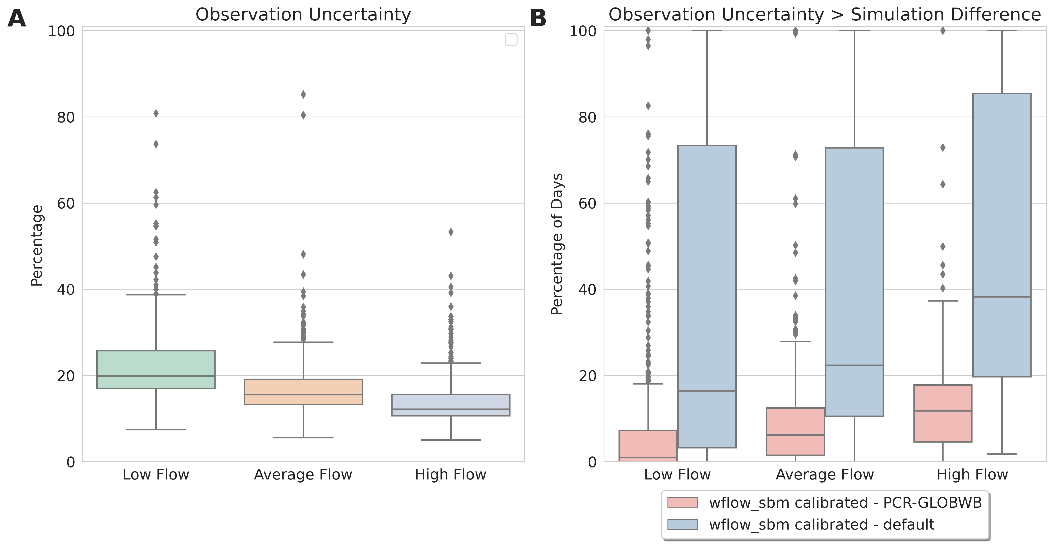
Observation Uncertainty
1
2
Methodology
Hydrological Models
Observation Uncertainty
Results

Slide 14
Methodology
Calculate difference between simulation time series
Calculate observation uncertainty time series based on observations and uncertainty percentages
Perform t-test to determine significant difference
Methodology

Slide 15
Observation Uncertainty
High percentage of observation uncertainty estimates throughout sample
Large difference between model experiments in percentages of days that observation uncertainty exceeds simulation differences
Methodology
Observation Uncertainty

Slide 16
CAMELS-GB – 400 Catchments
T-test: Observation Uncertainty > Simulation Difference
1
2
Model Comparison
Model Refinement
Low Flow
Avg. Flow
High Flow
Low Flow
Avg. Flow
High Flow
6 Catch.
4 Catch.
3 Catch.
116 Catch.
114 Catch.
138 Catch.
Methodology
Observation Uncertainty
T-test Results

Slide 17
Conclusions
Observation uncertainty analyses provide important context to the relevance of differences in model performance
High observation uncertainty indicate that model performance should not be based on single source (model fidelity)
Observation uncertainty analyses should be included in benchmark efforts
Conclusions

Slide 18
On the importance of observation uncertainty when evaluating and comparing numerical models
Model Experiments
Streamflow Estimates
Observation Uncertainty Analyses
Conclusions
Jerom Aerts, Jannis Hoch, Gemma Coxon, Rolf Hut, Nick van de Giesen

Slide 19
KGE-NP Decomposition
wflow_sbm calibrated
KGE-NP
Bias
Flow Variability
Correlation
Back

Slide 20
KGE-NP Decomposition
PCR-GLOBWB KGE-NP
Bias
Flow Variability
Correlation
Back

Slide 21
On the importance of observation uncertainty when evaluating and comparing numerical models
Model Experiments
Streamflow Estimates
Observation Uncertainty Analyses
Conclusions
Jerom Aerts, Jannis Hoch, Gemma Coxon, Rolf Hut, Nick van de Giesen

