Slide 1
Spatial-temporal modeling of COVID-19
in Italy and the role of urban settings
Massimiliano Alvioli⁽¹⁾, Daniel fowler ⁽²⁾, Samsung Lim ⁽²⁾
⁽¹⁾ Istituto di Ricerca per la Protezione Idrogeologica
Consiglio Nazionale delle Ricerche (Perugia, Italy)
⁽²⁾ School of Civil and Environmental Engineering, Faculty of Engineering
The University of New South Wales (Sydney, Australia)

Slide 2
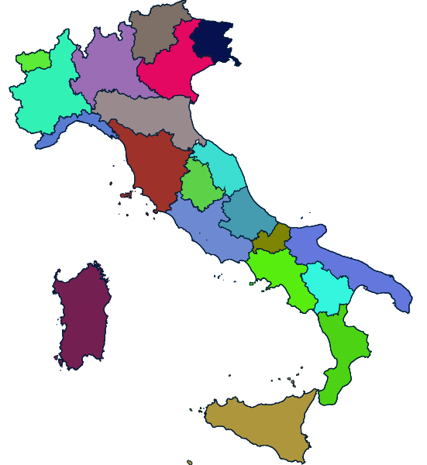
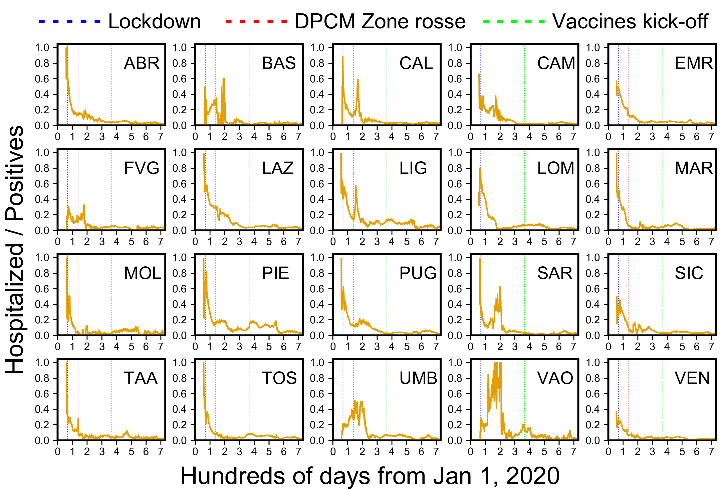
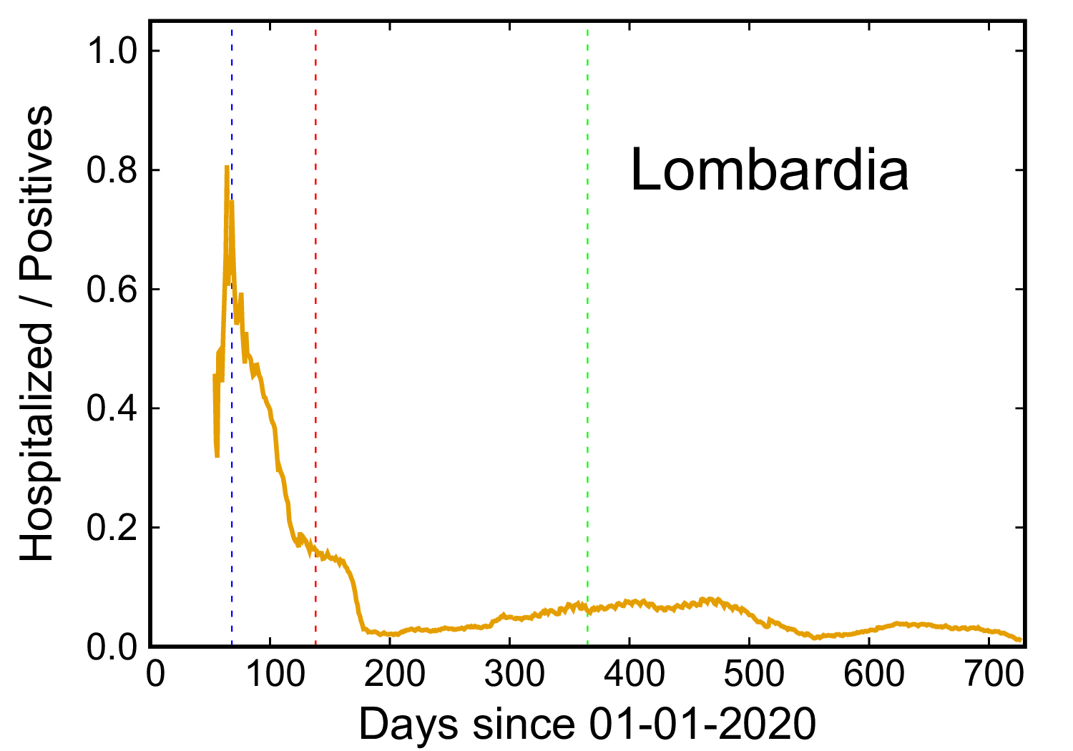
Introduction
Italy was one of the first countries affected by COVID-19
Notes:
Figure merely descriptive of the data

Slide 3
Spatial-temporal modeling with public data
Number of infections/day/province (two years/107 provinces)
Environmental data: temperature, humidity, greenness (NDVI)
Socio-economic data: population/province, education, employment rate , # beds in high-care
Spatial/topographic data: elevation, province neighbors
Notes:
We use public data

Slide 4
Spatial-temporal modeling with public data
Number of infections/day/province (two years/107 provinces)
Environmental data: temperature, humidity, greenness (NDVI)
Socio-economic data: population/province, education, employment rate , # beds in high-care
Spatial/topographic data: elevation, province neighbors
Can we do better, on the spatial distribution of people?
Notes:
We use public data

Slide 5
Spatial-temporal modeling with public data
Number of infections/day/province (two years/107 provinces)
Environmental data: temperature, humidity, greenness (NDVI)
Socio-economic data: population/province, education, employment rate , # beds in high-care
Spatial/topographic data: elevation, province neighbors
Can we do better, on the spatial distribution of people?
Urban indicators: city size, number of cities, % of urban areas, roads
Spatially distributed urban areas
Notes:
We use public data

Slide 6
The hhh4 endemic-epidemic model
The hhh4 model incorporates case data stratified by space and time
Infections spread across administrative boundaries using a neighbourhood matrix
considers the lag between the onset of infection and reporting of infection
Include different covariates, either uniform, static, or varying over both space and time
The hhh4 model involves three components:
  autoregressive effects (transmission of disease within a single area – provinces, here)
  neighbourhood effects (transmission of disease from other areas)
  endemic effects (sporadic events caused by unobserved sources of infection)
Meyer et al., 2017
D. Fowler, M. Alvioli, V. Costantino, D. Gurdasani, S. Lim (under review)
Notes:
We test the hhh4 model – three components to describe the spatial-temporal spread of the infection

Slide 7
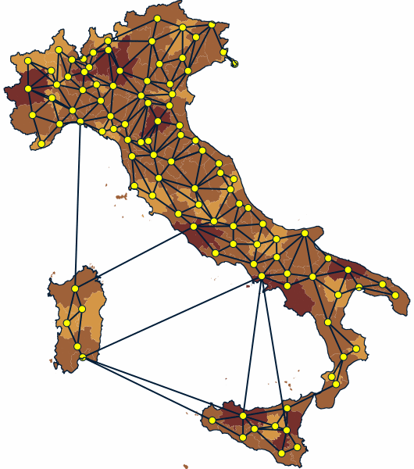
Neighbourhood order (shortest path calculation via adjacent provinces from one province to another province) matrix was calculated
We added extra links between Sicily and Sardinia to the mainland to simulate the likely movement of people
This is how Italy looks like in this approximation
D. Fowler, M. Alvioli, V. Costantino,
D. Gurdasani, S. Lim (under review)

Slide 8
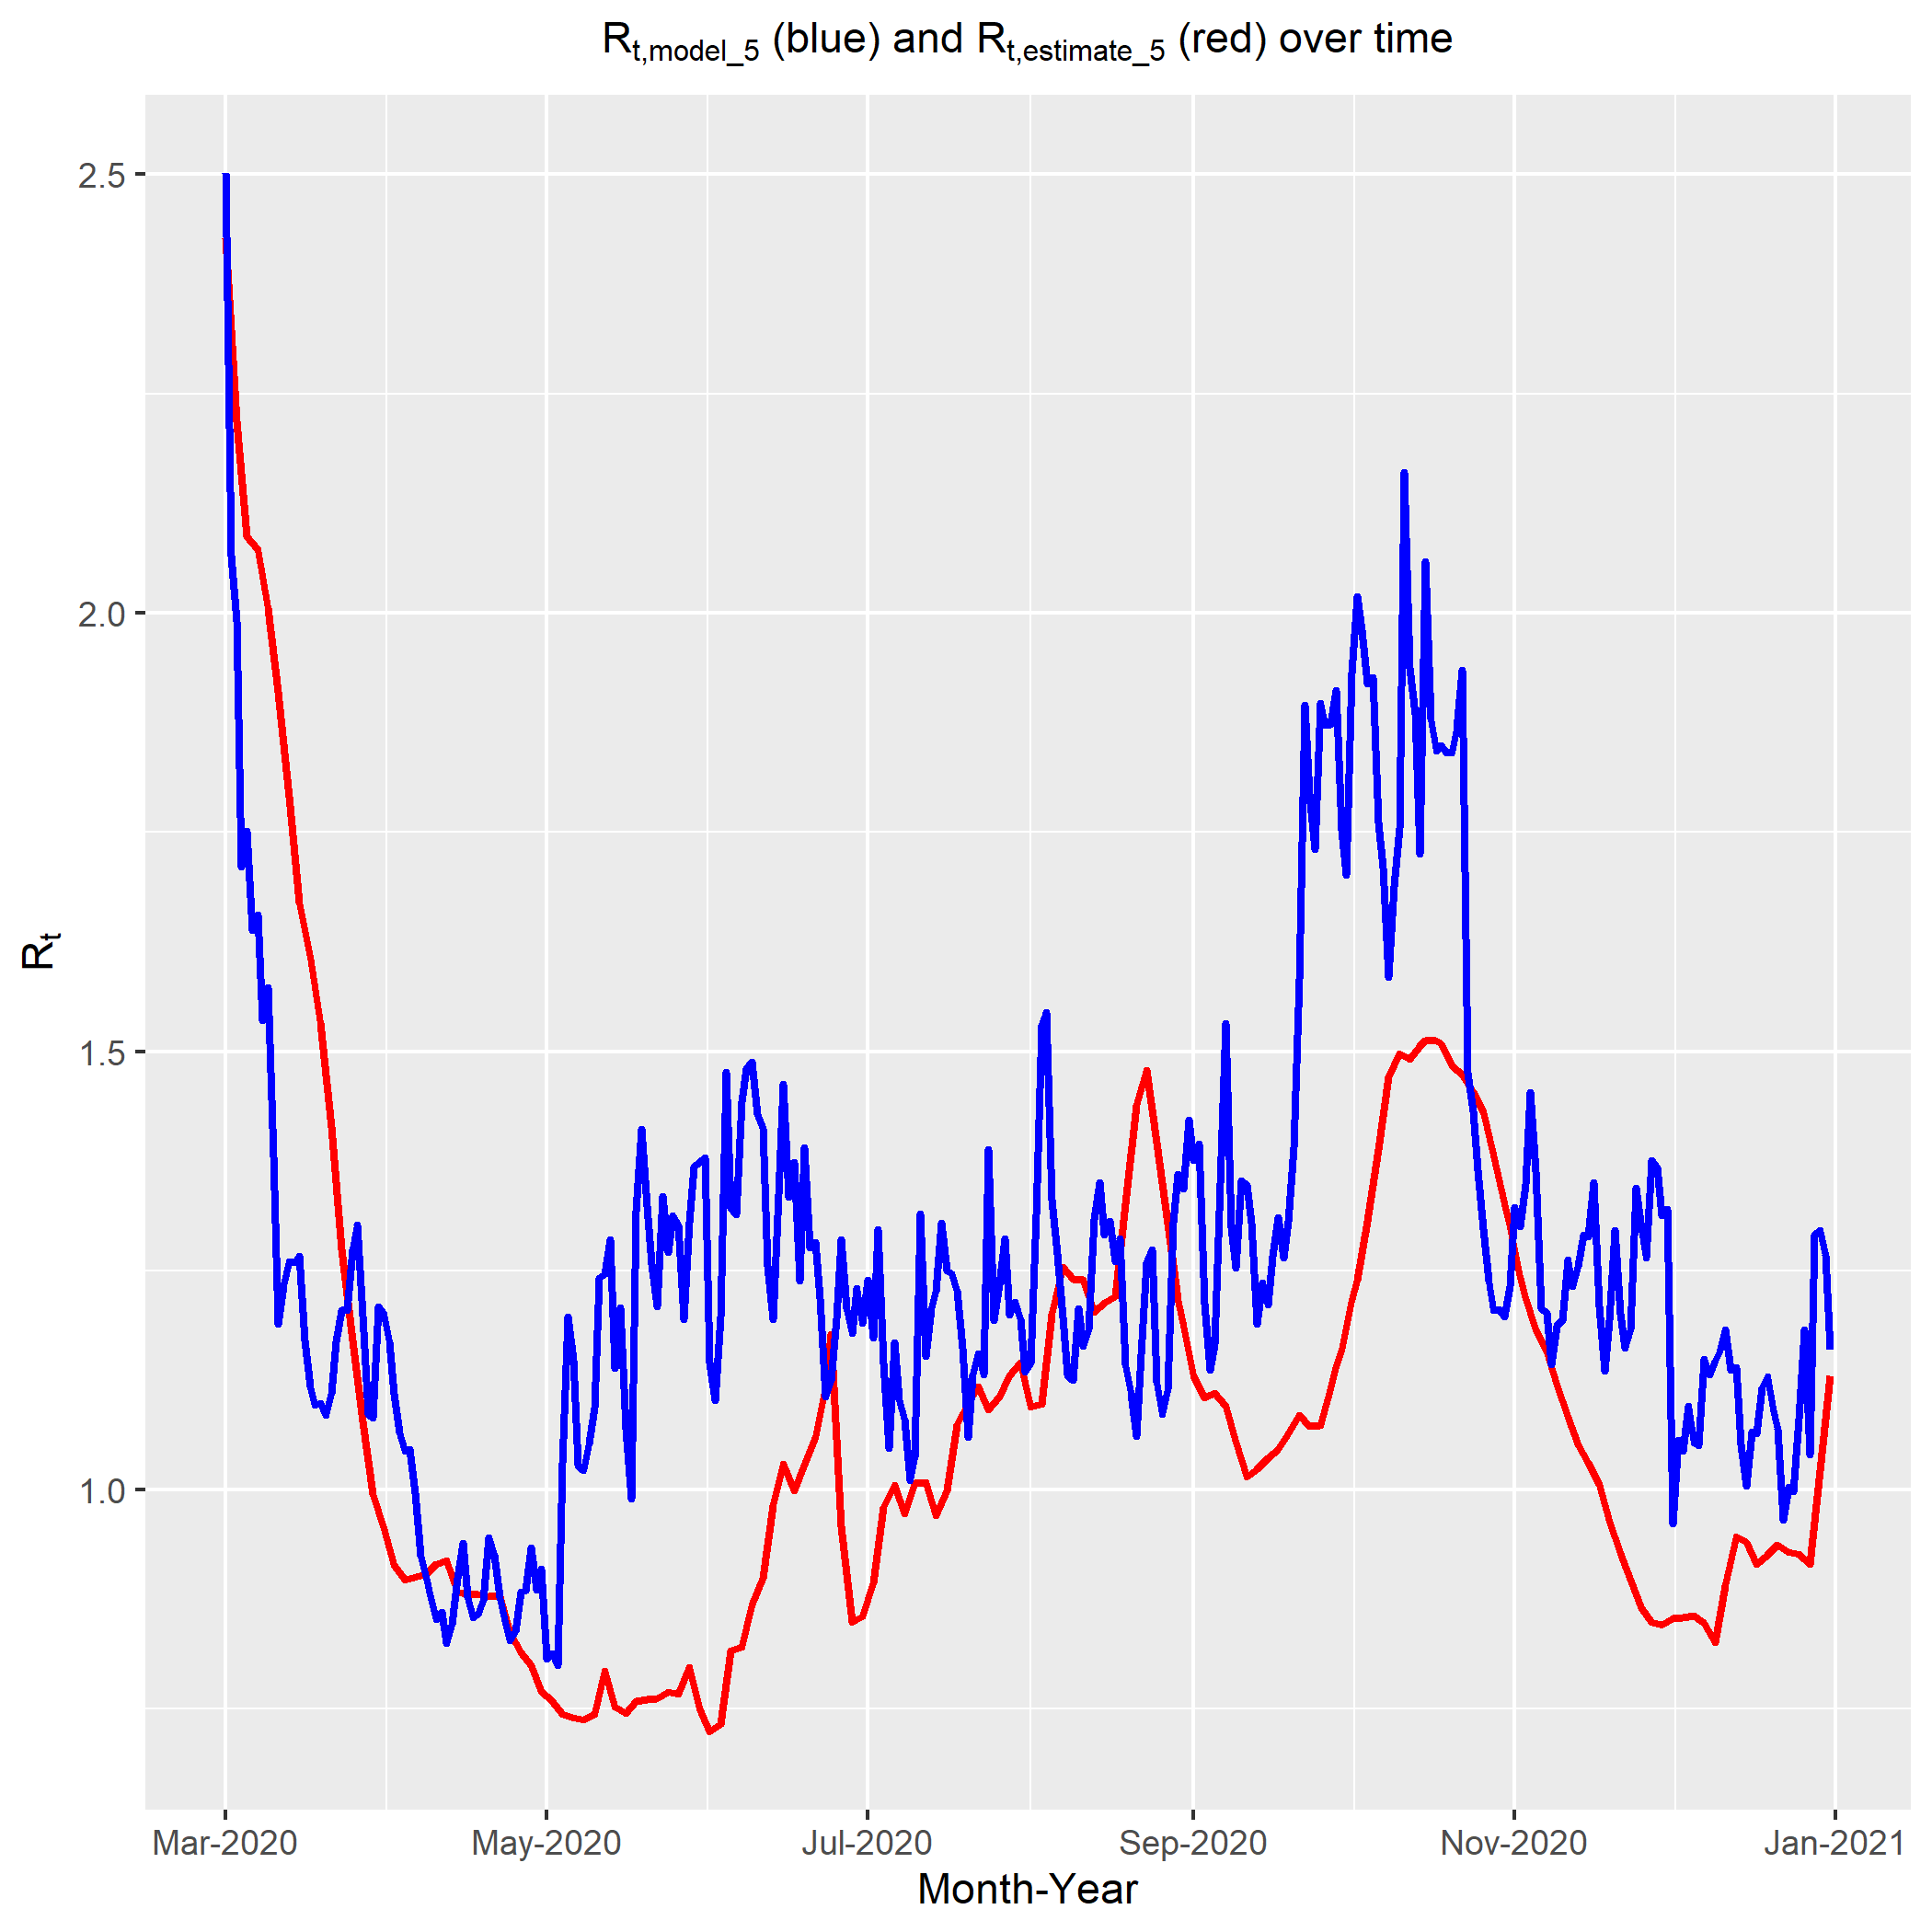
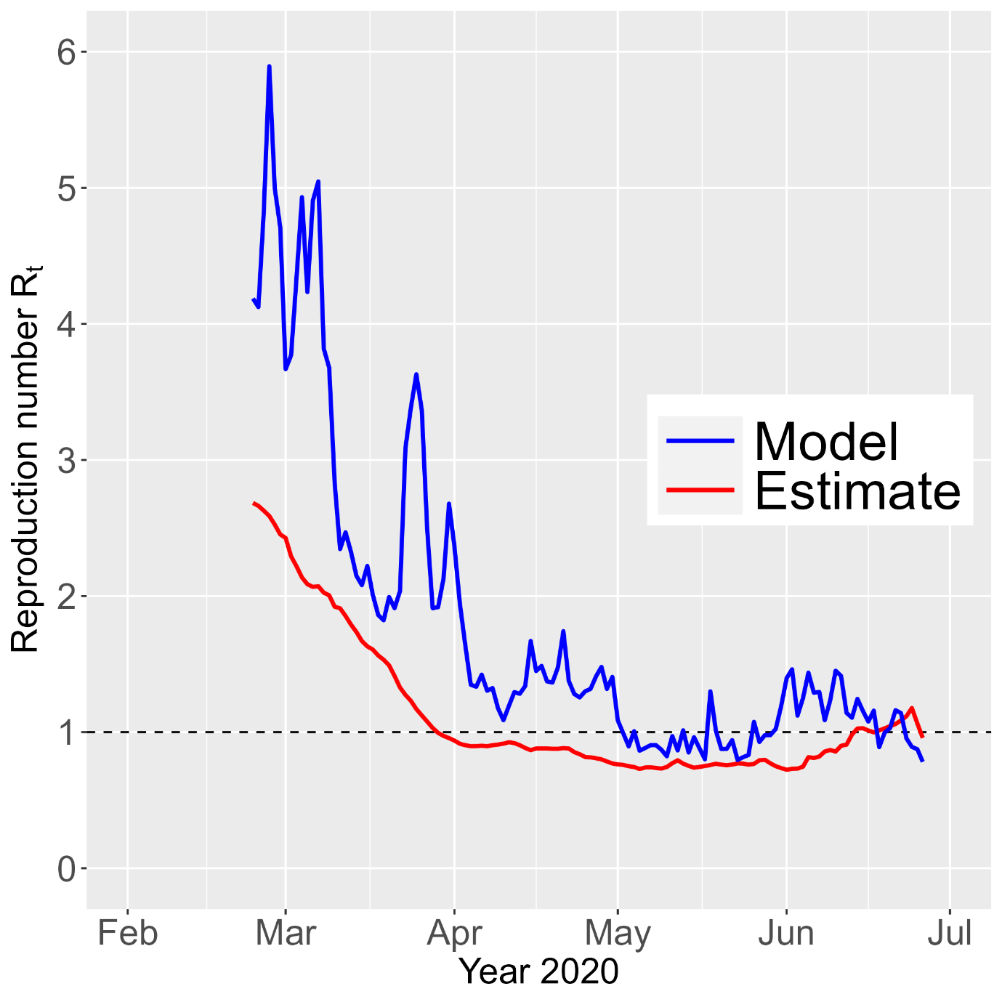
The hhh4 endemic-epidemic model: results for R_{t}
Use of neighborhood matrix to describe spatial-temporal relationship
Use of mobile phone data published by
Pepe at al., Sci. Data 7:230 (2020)
Arroyo-Marioli et al., PloS One 16 e0244474 (2021)
Fowler, Alvioli, Costantino, Gurdasani, Lim (under review)

Slide 9
The hhh4 endemic-epidemic model: covariate importance
Results of hhh4 model. Bold RR/p-value indicates statistical significance. RRs based on 1 unit change except NDVI (0.1 unit).
Component | Covariate | Estimate | Standard error | RR | 95% CI | p-value
Autoregressive (AR) - within province transmission | Temp_Ave | -0.050 | 0.007 | 0.951 | (0.938, 0.965) | 0.000
 | Humidity_Ave | 0.006 | 0.003 | 1.006 | (1.000, 1.011) | 0.040
 | NDVI | -0.252 | 0.453 | 0.777 | (0.711, 0.849) | 0.000
 | dem_average | 0.000 | 0.000 | 1.000 | (1.000, 1.000) | 0.870
 | max_area_city | 0.000 | 0.000 | 1.000 | (1.000, 1.001) | 0.352
 | num_cities | 0.000 | 0.000 | 1.000 | (1.000, 1.001) | 0.384
 | pop_dens | 0.000 | 0.000 | 1.000 | (1.000, 1.000) | 0.836
 | ISTAT_Bed | 0.091 | 0.057 | 1.095 | (0.980, 1.224) | 0.110
 | ISTAT_Edu | 0.088 | 0.057 | 1.091 | (0.976, 1.220) | 0.124
 | ISTAT_Grn | -0.109 | 0.058 | 0.896 | (0.800, 1.005) | 0.060
 | Intercept | 1.031 | 0.343 | 2.802 | (1.431, 5.489) | 0.002
Neighbourhood (NE) - across province transmission | Temp_Ave | -0.150 | 0.009 | 0.861 | (0.846, 0.876) | 0.000
 | Humidity_Ave | 0.000 | 0.003 | 1.000 | (0.994, 1.007) | 0.932
 | NDVI | -0.352 | 0.570 | 0.703 | (0.629, 0.787) | 0.000
 | dem_average | 0.000 | 0.000 | 1.000 | (1.000, 1.001) | 0.814
 | max_area_city | -0.001 | 0.001 | 0.999 | (0.997, 1.000) | 0.014
 | num_cities | 0.000 | 0.001 | 1.000 | (0.999, 1.002) | 0.574
 | pop_dens | 0.000 | 0.000 | 1.000 | (1.000, 1.001) | 0.298
 | ISTAT_Bed | 0.053 | 0.098 | 1.054 | (0.870, 1.277) | 0.588
 | ISTAT_Edu | -0.191 | 0.107 | 0.826 | (0.670, 1.018) | 0.074
 | ISTAT_Grn | -0.121 | 0.105 | 0.886 | (0.720, 1.089) | 0.250
 | Intercept | 5.446 | 0.475 | 231.892 | (91.361, 588.587) | 0.000
Endemic (END) | Intercept | -12.987 | 0.123 | 0.000 | (0.000, 0.000) | 0.000
Most urban indicators are slightly relevant in a few cases, and irrelevant in most cases
A 1°C increase in average temperature suggested:
4.9% decreased contribution to within province transmission of cases
[RR: 0.951, 95% CI: (0.938, 0.965)]
-13.9% decreased contribution to across province transmission of cases
[RR: 0.861, 95% CI: (0.846, 0.876)]
Fowler, Alvioli, Costantino, Gurdasani, Lim (under review)

Slide 10
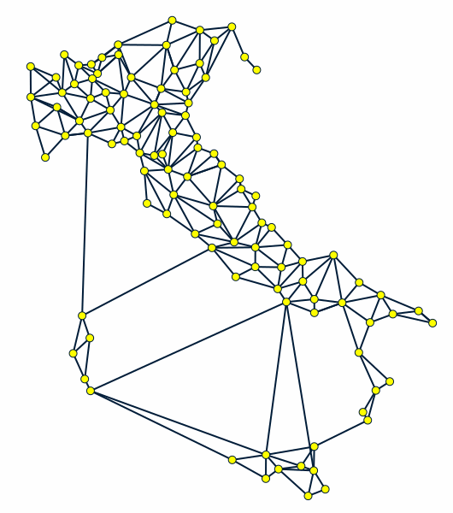
The neighborhood matrix represents Italy, in this approximation
The hhh4 model has been applied so far with spatial granularity of provinces – 107 polygons
Is the approximation good enough? Does it help to go to municipality level, or census unit level?
D. Fowler, M. Alvioli, V. Costantino,
D. Gurdasani, S. Lim (under review)

Slide 11
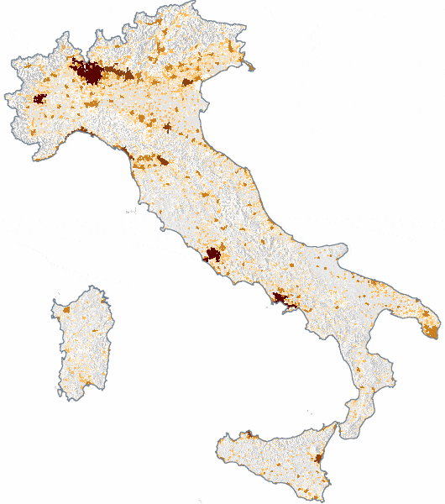
We proposed investigating the use of different spatial units
One such a description can be provided by urban areas
Urban areas by the quoted reference are built to represent human presence in a parameter-free way
M. Alvioli, Land. Urb. Plan. (2020)

Slide 12
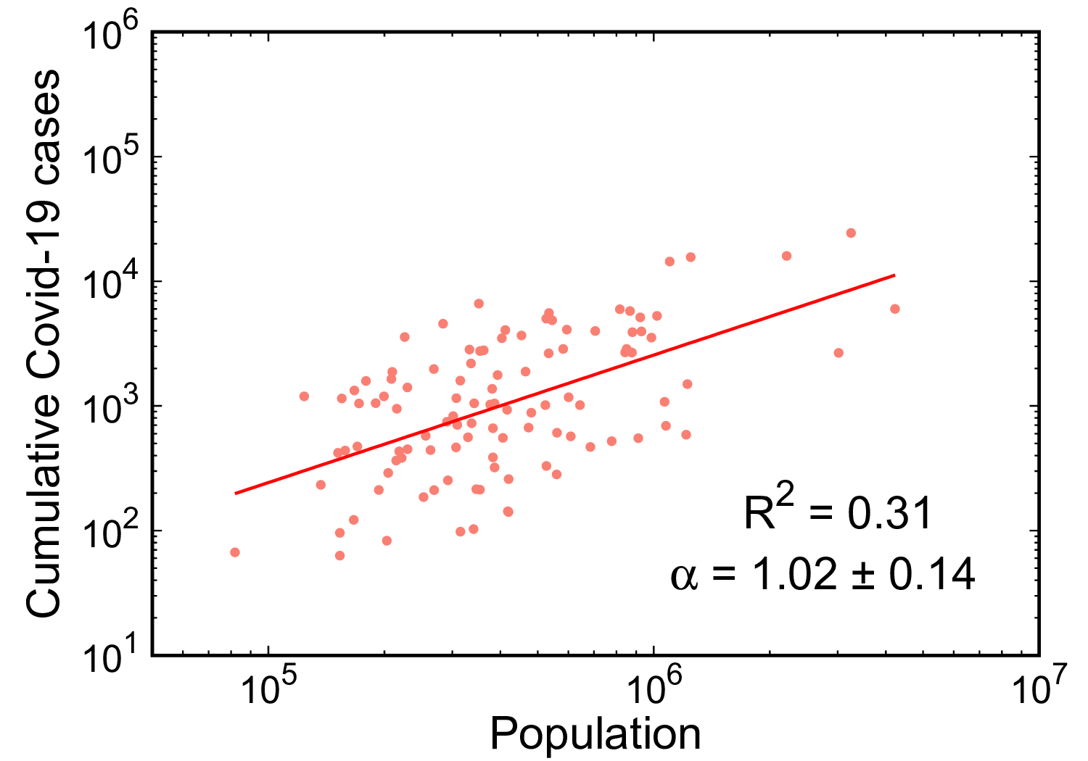
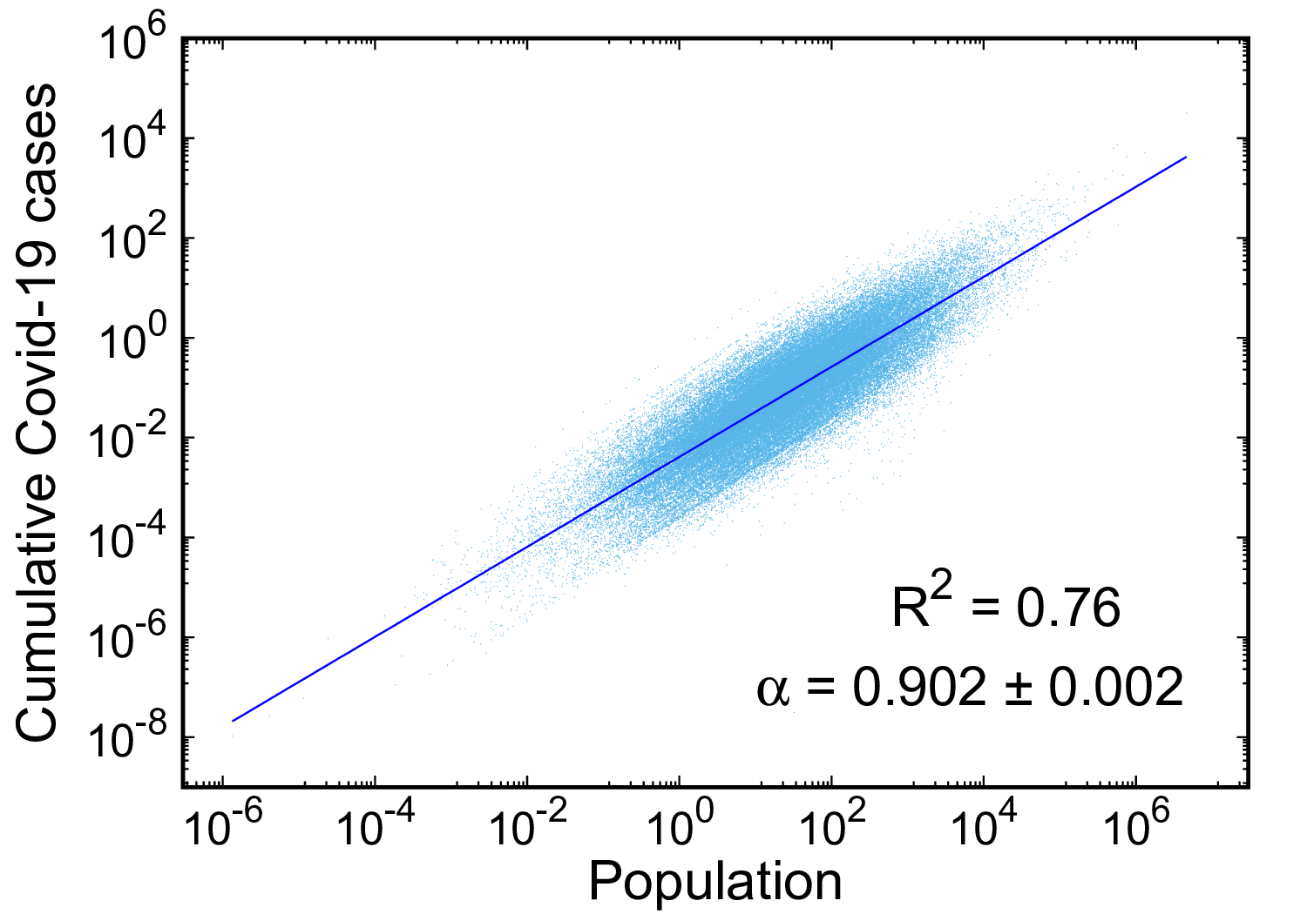
Preliminary analysis
Data about first Covid Wave in 2020 (about March-July)
107
Provinces
80k
Urban areas
Number of Covid cases distributed to urban areas proportionally to the surface

Slide 13
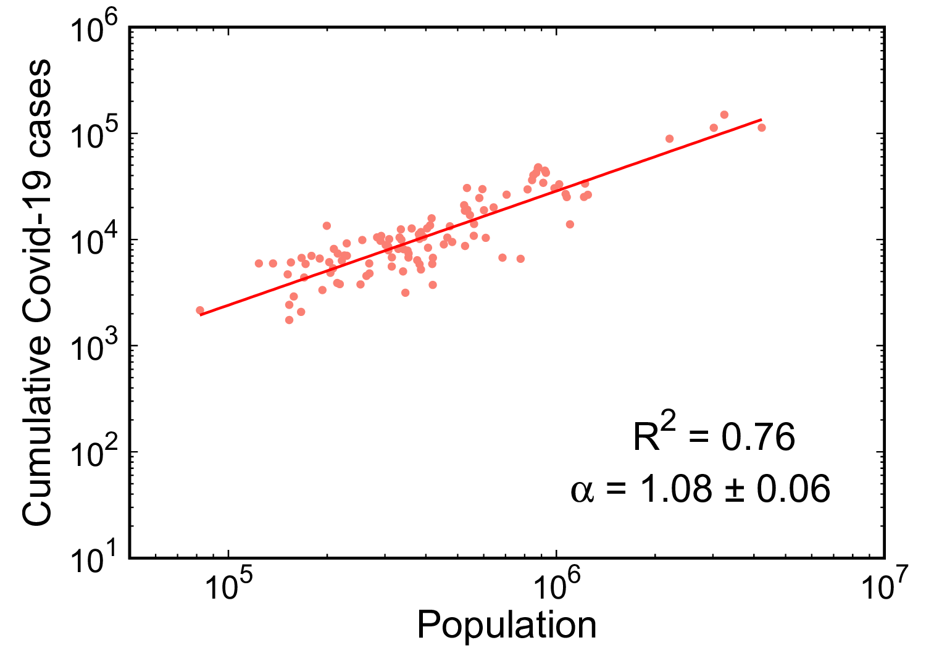
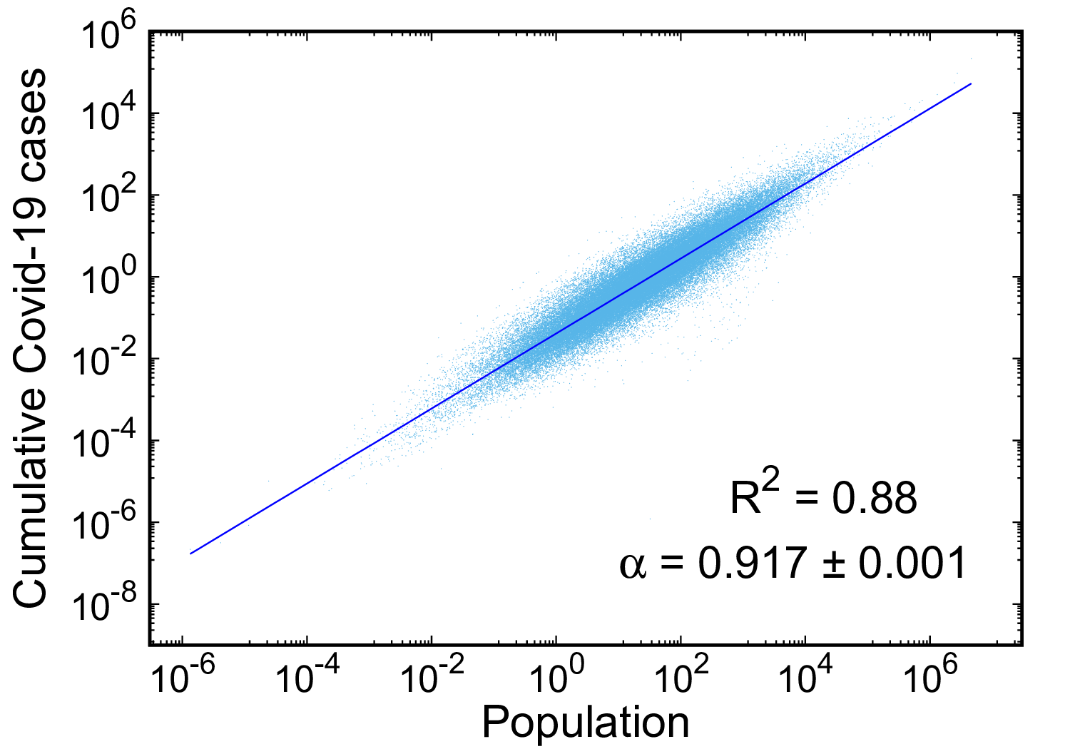
Preliminary analysis
Data about second Covid Wave in 2020 (about September-December)
107
Provinces
80k
Urban areas
Number of Covid cases distributed to urban areas proportionally to the surface

Slide 14
Conclusions
We tested the hhh4 endemic-epidemic model with spatial-temporal data about Covid19 in Italy – province level, daily infection data – open data
We used both a neighborhood matrix and real mobile phone data to model spatial relations
Explicit inclusion of urban indicators in the statistical analysis produce modest results, as far as the effect of such indicators is concerned
We argue that explicit use of urban areas as a spatial description of population presence in Italy would be more effective than using (coarse) administrative boundaries

Slide 15
Acknowledgments
Work presented here and in the submitted paper developed within:
MA partially supported by the research project “FISR SIRENE COVID-19 Sistema Informativo per la Risposta alle EmergeNzE COVID-19”, funded by MIUR under contract FISR2020 IP_04884 COVID-19 SIRENE
DF is supported by an Australian Government Research Training Program (RTP) Scholarship

Slide 16
…That’s all.
Thank you!

Slide 17
Essential BIBLIOGRAPHY – Part I
M. Agnoletti, S. Manganelli, F. Piras: “Covid-19 and rural landscape: The case of Italy”. Landscape and Urban Planning 204, 103995 (2020). https://doi.org/10.1016/j.landurbplan.2020.103955
M. Alvioli: “Administrative boundaries and urban areas in Italy: a perspective from scaling laws”. Landscape and Urban Planning 204, 103906 (2020). https://doi.org/10.1016/j.landurbplan.2020.103906
F. Arroyo-Marioli, F. Bullano, S. Kucinskas, C. Rondón-Moreno: “Tracking R of COVID-19: A new real-time estimation using the Kalman filter”. PloS One 16, e024474 (2021). https://doi.org/10.1371/journal.pone.0244474
J. Liu et al. : “Impact of meteorological factors on the COVID-19 transmission: A multi-city study in China”. Science of the Total Environment 726, 138513 (2020). https://doi.org/10.1016/j.scitotenv.2020.138513
S. Meyer, L. Held: “Power-law models for infectious disease spread”. The Annals of Applied Statistics 8, 1612 (2014). https://doi.org/10.12I4/14-AOAS743
E. Pepe, P. Bajardi, L. Gauvin, F. Privitera, B. Lake, C. Cattuto, M. Tizzoni: “COVID-19 outbreak response, a dataset to assess mobility changes in Italy following national lockdown”. Scientific Data 7:230 (2020). https://doi.org/10.1038/s41597-020-00575-2
K. T. L. Sy, L. F. White, B. E. Nichols: “Population density and basic reproductive number of COVID-19 across United States counties”. PloS One 16, e0249271 (2021). https://doi.org/10.1371/journal.pone.0249271

Slide 18
ADDITIONAL SLIDES

Slide 19
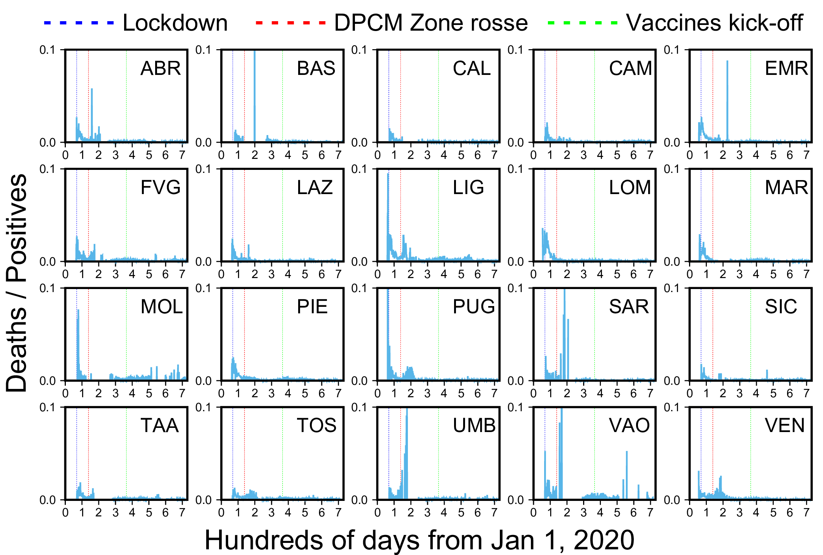
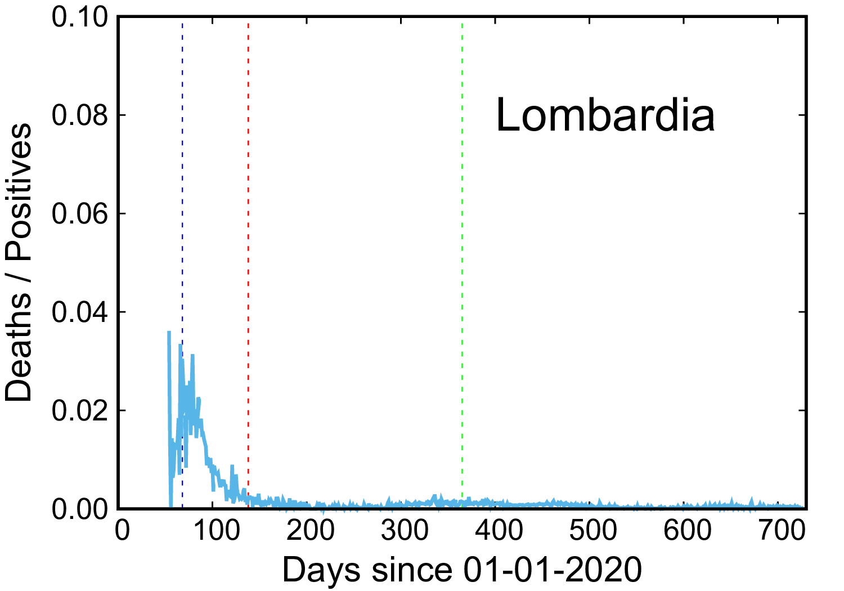
Introduction
Italy was one of the first countries affected by COVID-19

Slide 20
The hhh4 endemic-epidemic model: results for R_{t}
Arroyo calculated R_{t} using a SIR (susceptible, infectious, recovered/removed) model. In a SIR model, R_{t} is linearly related to the growth rate of the number of infected individuals. Using data from new cases, this growth rate varies with time and is estimated using the Kalman filter (a mathematical algorithm that processes data with noisy measurements).
The hhh4 model calculates a next generation matrix which represents how one generation of infected individuals is mapped onto a subsequent generation. The largest eigenvalue of this matrix is the local Rt. (Bauer & Wakefield, 2018)
Arroyo-Marioli et al., PloS One 16 e0244474 (2021)
Fowler, Alvioli, Costantino, Gurdasani, Lim (under review)

