Slide 2
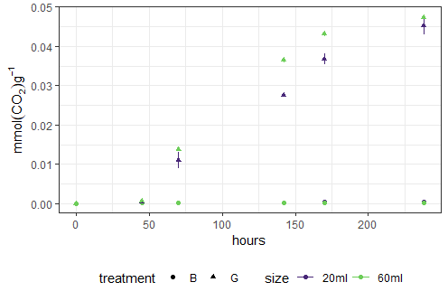
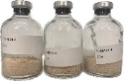
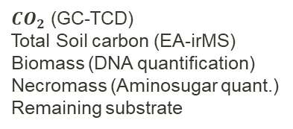
Incubation setup and comparability
Mass Balance | Energy Balance
12 g dw, 60 ml | 4 g dw, 20 ml
Triplicates,
5 sampling days
Triplicates,
Online measurement
${CO}_{2}$ (GC-TCD) Total Soil carbon (EA-irMS) Biomass (DNA quantification) Necromass (Aminosugar quant.)
Remaining substrate
Heat Flow (Calorimeter) Total Heat
B = blank, G = glucose
Tempture = 20 ℃,
water content = 14.4% [water(ml)/soil dry weight(g)],
Initial glucose-C addition: 800 µg Glu-C/g dw

Slide 3
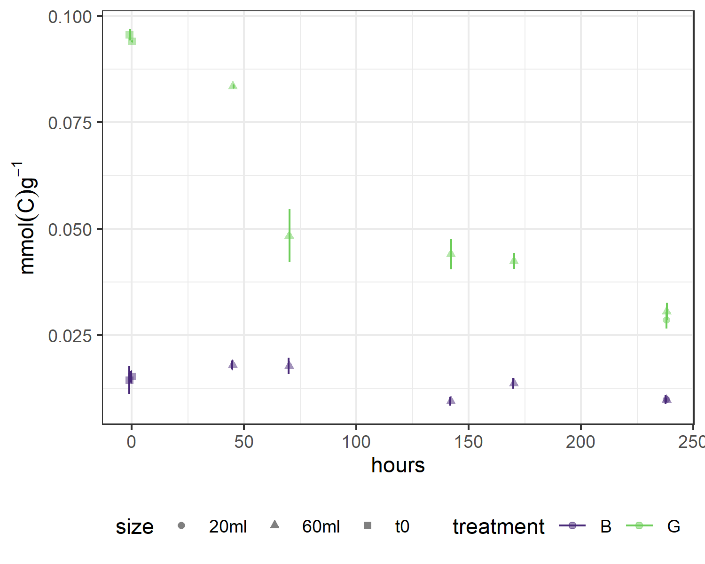
Incubation setup and comparability
Mass Balance | Energy Balance
12 g dw, 60 ml | 4 g dw, 20 ml
Triplicates,
5 sampling days
Triplicates,
Online measurement
${CO}_{2}$ (GC-TCD) Total Soil carbon (EA-irMS) Biomass (DNA quantification) Necromass (Aminosugar quant.)
Remaining substrate
Heat Flow (Calorimeter) Total Heat
B = blank, G = glucose
B = blank, G = glucose
Tempture = 20 ℃,
water content = 14.4% [water(ml)/soil dry weight(g)],
Initial glucose-C addition: 800 µg Glu-C/g dw

Slide 4
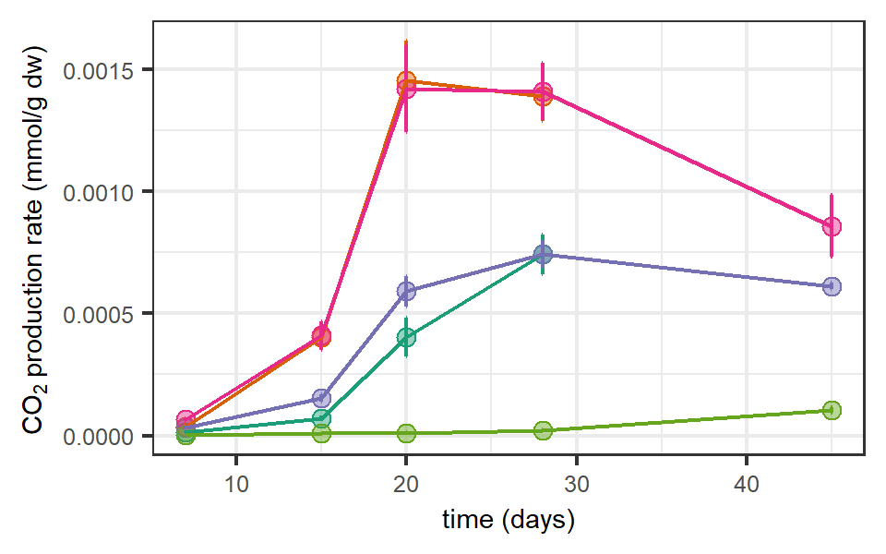
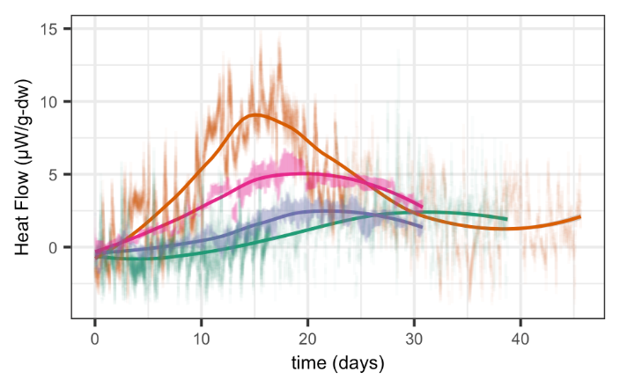
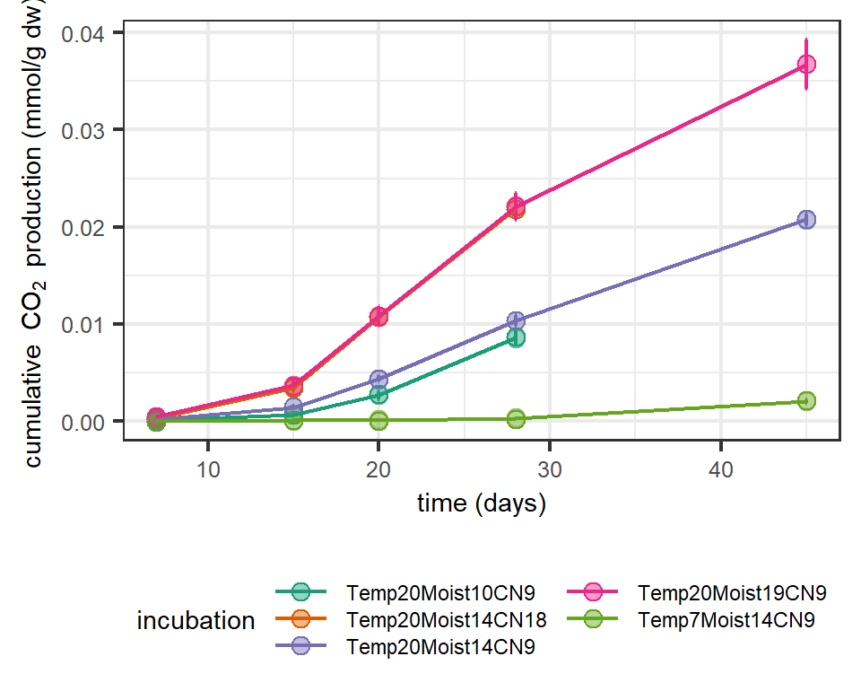
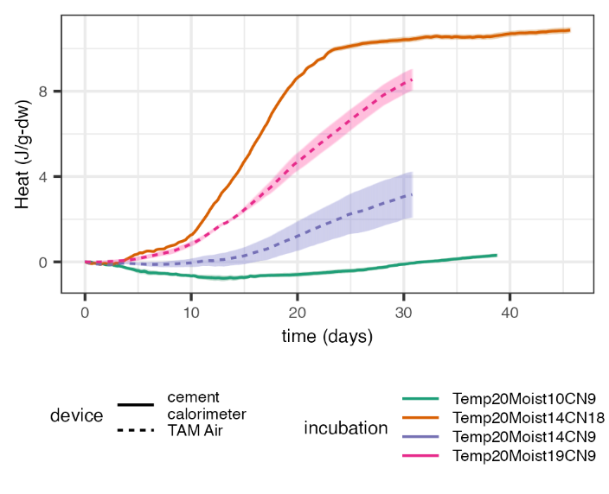
Artificial Soil Incubations - First Results
Fig 3: Comparison of CO₂ production and heat flux at different temperatures, moistures and C/N ratios.
Initial cellulose-C addition:
0.104 mmol/g dw
combustion enthalpy of added cellulose:
48 J/g dw
)
Moisture
CO₂ and heat release
N supply
CO₂ and heat release
Temperature
CO₂ release

