Slide 1

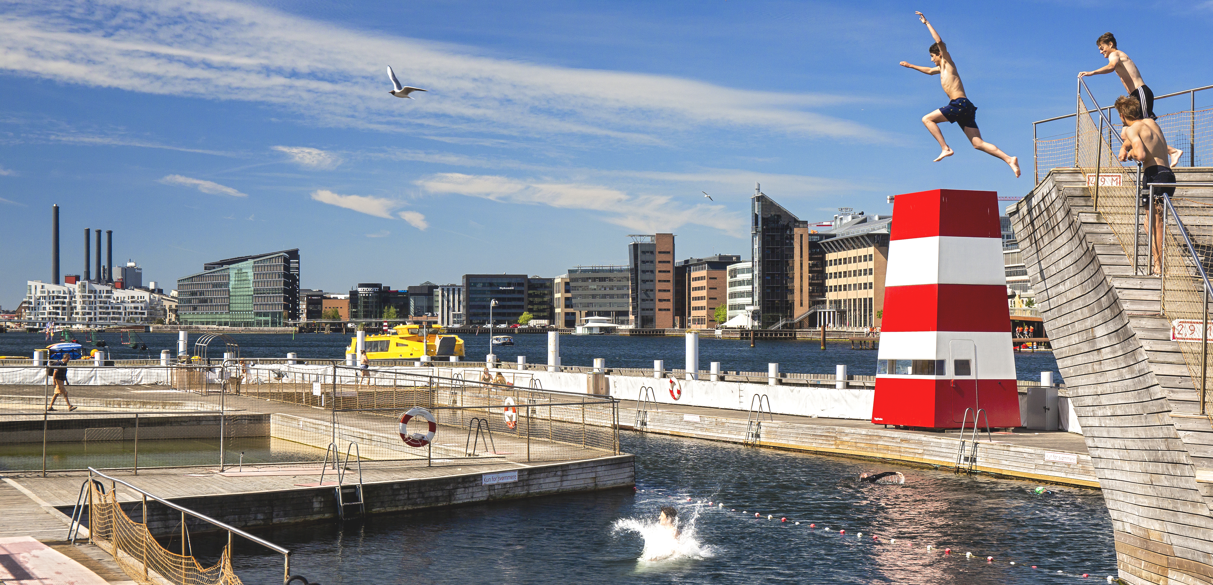
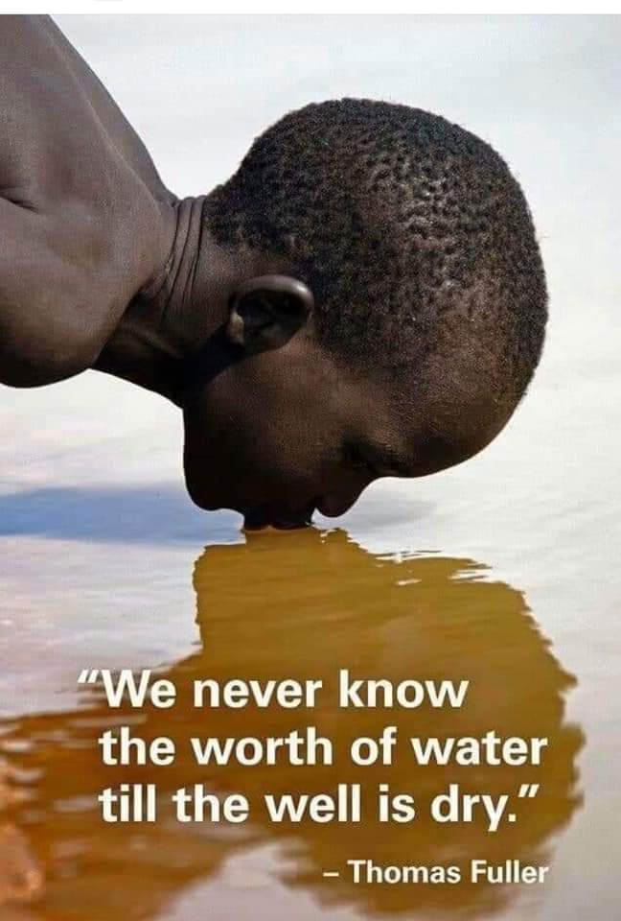
EGU GENERAL ASSEMBLY, 2023
23 – 28 April 2023 | Vienna, Austria
Lowering of Groundwater Levels and their Effect on Water, Sanitation and Hygiene Services in the Savelugu District, Northern Region of Ghana
Albert Acheampong, PhD Candidate (World Vision, Ghana)

Slide 2
PRESENTATION OUTLINE
Introduction
Objective
Materials & Methods
Results & Discussion
Conclusions

Slide 3
SUMMARY
Water holds a prominent place, particularly because of its importance for human livelihood
Savelugu district is characterized by unpredictable rainfall patterns with periodic and perennial water shortages
People travel long distances to fetch water and the person-hours spent in search for water affect productivity, economic livelihood, and health and education benefits
Provision of potable water supply to these communities is expected to bring not only health, education benefits but also increase in sanitation and hygiene practices
To look at and address the possible causes of the drying up of wells at Savelugu district and its associated cross cutting issues to WASH

Slide 4
SUMMARY
Static water levels (SWLs) of 19 wells in the study area were collected, analyzed and compared to the initial SWLs measured when the wells were immediately drilled and constructed
The SWL data was subjected to paired samples T-test (with α = 0.05). From the results, there was significant difference in the SWL immediately after drilling and construction (µ = 12.15, σ = 7.50) and SWL after at least 10 years (µ = 17.81, σ = 10.29); t (18) = -3.7, P = 0.002
For hypothesis test: α-value (=0.05) H₀: µ₁ = µ₂, H₁: µ₁ ≠ µ₂
since P-value (=0.02) is less than α-value (=0.05) we reject H₀, and conclude that
there is significant difference in the SWL of the wells
Lowered groundwater levels were recorded in all wells measured. This can lead to drying up of some of the wells whose difference between the current SWL and well depth is close
There must be strong advocacy, development and implementation of IWRM plans to help address the problem of inadequate WASH in the study area

Slide 5
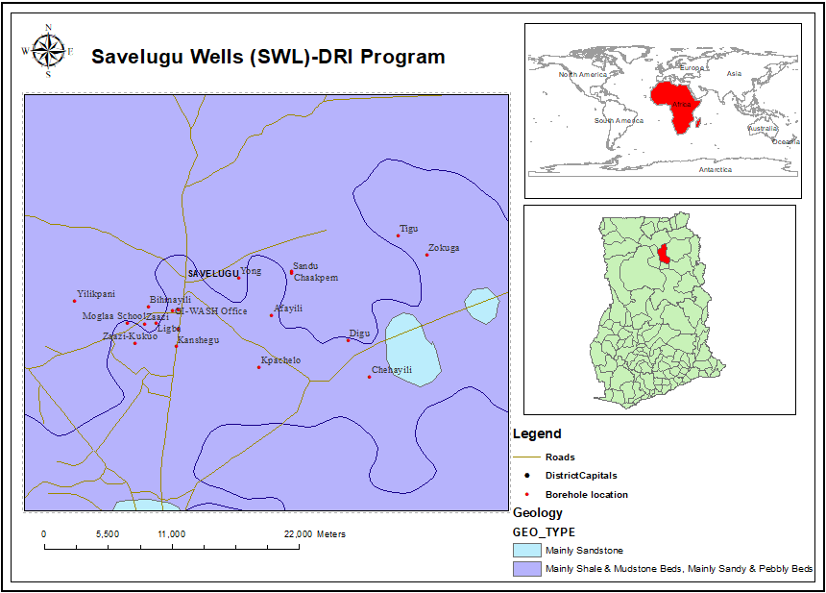
introduction
Water holds a prominent place, particularly because of its importance for human livelihood
Provision of water through drilling of wells or boreholes helps to increase access to water
The link between inadequate access to safe and affordable water and public health problems, cannot be over-emphasized
Map of study area with drilled boreholes

Slide 6
justification
Availability of adequate water or improved WASH reduces and prevents the myriad WASH associated problems
Water scarcity represents the single greatest threat to food security, human health, education and the natural ecosystem
As high as 89.3% of households in the Savelugu district are engaged in agriculture, 97.0% out of this are involved in crop farming (Ghana Statistical Service, 2010)
WASH affects many other development sectors such as health and healthcare facilities, education, environment, agriculture and livelihood

Slide 7
objective
To look at and address the possible causes of the drying up of wells at Savelugu district and its associated cross cutting issues to WASH

Slide 8
Materials & methods
Static water levels (SWLs) of 19 wells in the study area were collected, analyzed and compared to the initial SWLs measured when the wells were immediately drilled and constructed
Rainfall data were collected and analyzed
The SWL data was subjected to paired samples T-test (with α = 0.05) using the SPSS statistical software

Slide 9
Results & discussion
Change in SWL of drilled wells over time

Slide 10
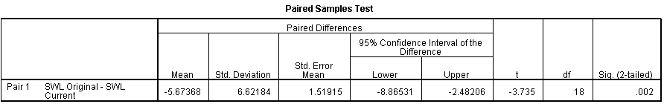
results
There was significant difference in the SWL immediately after drilling and construction (µ = 12.15, σ = 7.50) and SWL after at least 10 years (µ = 17.81, σ = 10.29); t (18) = -3.7, P = 0.002. Lowered groundwater levels were recorded in all wells measured
For hypothesis test: α-value (=0.05)
H₀: µ₁ = µ₂, H₁: µ₁ ≠ µ₂
since P-value (=0.02) is less than α-value (=0.05) we reject H₀, and conclude that there is significant difference in the SWL of the wells

Slide 11
conclusions
There was significant difference in the SWL immediately after drilling and construction. Lowered groundwater levels were recorded in all wells measured
Limited and unreliable access to water for domestic, industrial and irrigation use due to dried up wells and surface waters would greatly hinder agricultural productivity
The lowering of SWLs are attributed to reducing tree-cover, the harsh harmattan and rampant vegetation removal, which contributes to desertification, increase surface runoffs, less percolation to recharge the underground waters after rainfall in the area

Slide 12
recommendations
Technique can be used to potentially map out districts with similar challenges, and to aid mitigate drying up of wells
Strong advocacy, development and implementation of IWRM plans to help address the problem of inadequate WASH in the study area
Need to replace existing wells in the area that showed greater potential of drying up with time as revealed by the study findings

Slide 13
Thank you
acheampongalbert@gmail.com
+233-244960594
“The 3rd world war is at our gate, and will be about water, if we don’t do anything about this crisis” (Rajendra Singh)

