Slide 1
Elevation dependence of biases and trends of climatic indices in the EURO-CORDEX ensemble over the European Alps
Michael Matiu⁽¹⁾, Anna Napoli^{(1,3)}, Sven Kotlarski⁽²⁾, Dino Zardi^{(1,3)}, Alberto Bellin⁽¹⁾, and Bruno Majone⁽¹⁾
(1) Department of Civil, Environmental and Mechanical Engineering (DICAM), University of Trento, Trento, Italy (2) Federal Office of Meteorology and Climatology MeteoSwiss, Zurich-Airport, Switzerland (3) Center Agriculture Food Environment (C3A), Trento, Italy
Session CL5.1 - Monday, 24 Apr 2023, 09:35–09:45 - Room F1

Slide 2
Introduction
Aim: Climate change assessment in mountainous regions
Study area: European Alps
Questions: To what extent are GCM-RCMs biased?
What is the impact of the observational data set in the evaluation?
Is there a dependency on elevation (of biases and trends)?
What is the impact of bias adjustment (CORDEX-Adjust)?

Slide 3
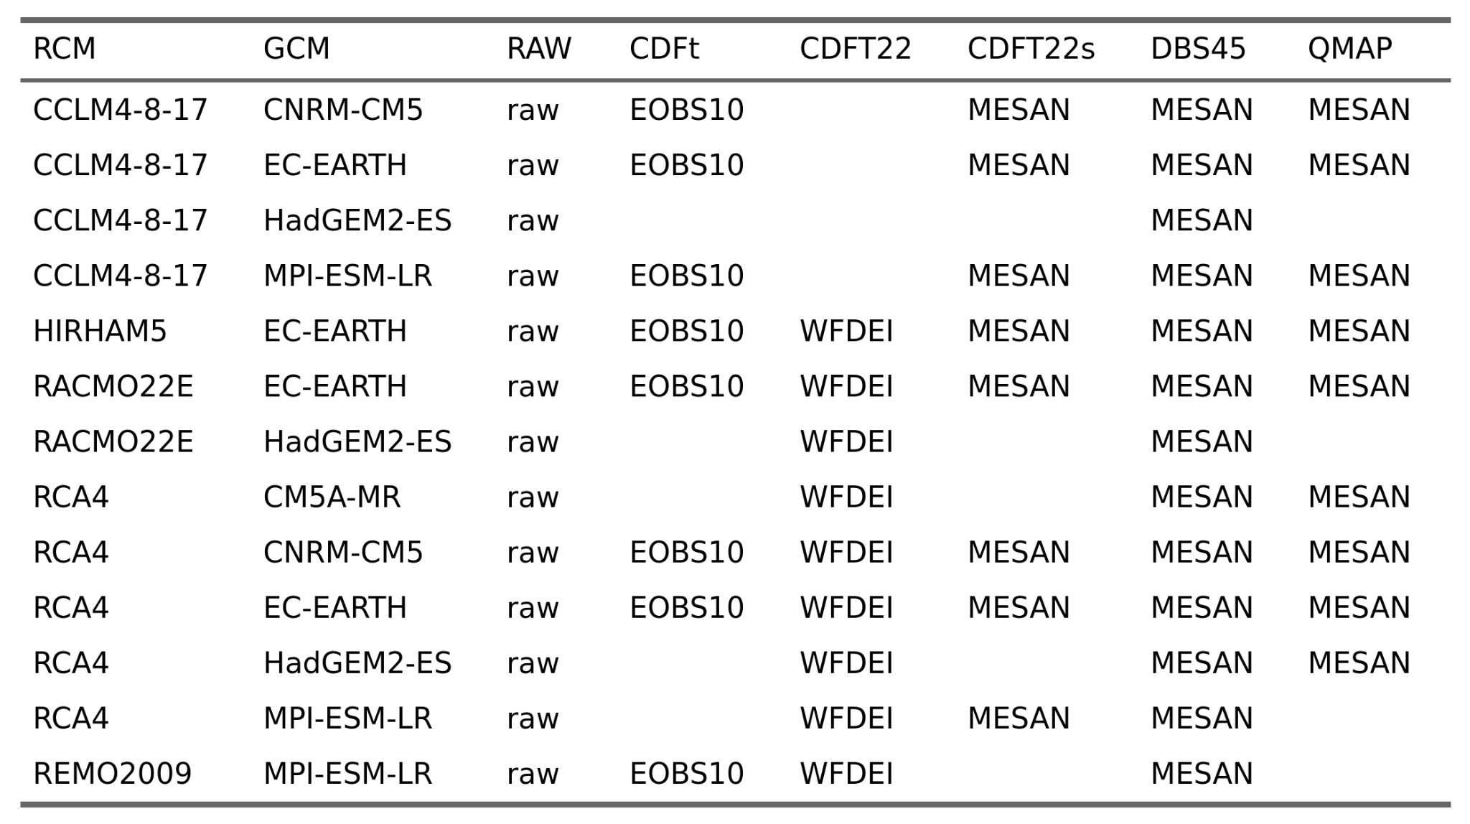
Data (models)
Common GCM-RCMs in CORDEX and CORDEX-Adjust (domain EUR-11)

Slide 4
Data (observation-ish)
Common to all: daily, min/mean/max temperature & precipitation
Alpine-wide: E-OBS v26 (0.11°)
APGD (5.5 km, precip only)
WFDEI (0.44°)
MESAN (5 km)
HISTALP (5 km, monthly)
Sub-regions: SPARTACUS (Austria, 1 km)
METEOSWISS (Switzerland, 1 km)
SLOCLIM (Slovenia, 1 km)
CRESPI (region in NE Italy, 250 m)
ISPRA (Italy, monthly, only temp, 1 km)
HYRAS (Germany, daily, 1 km precip and 5 km temp)

Slide 5
Methods
Remapped all observations to rotpole 0.11° EURO-CORDEX grid
Only used conservative remapping because of strong spatial resolution mismatch (1, 5, 12 km)
Exploratory analysis of horizontal and elevational bias
Annual and seasonal averages and percentiles, climatic indices (subset of ETCCDI)
30-year climatological average (1971-2000)
Elevation: spatial averages of 200m elevation bins: (200, 400], (400, 600], …
Differences always between RCM and OBS

Slide 6
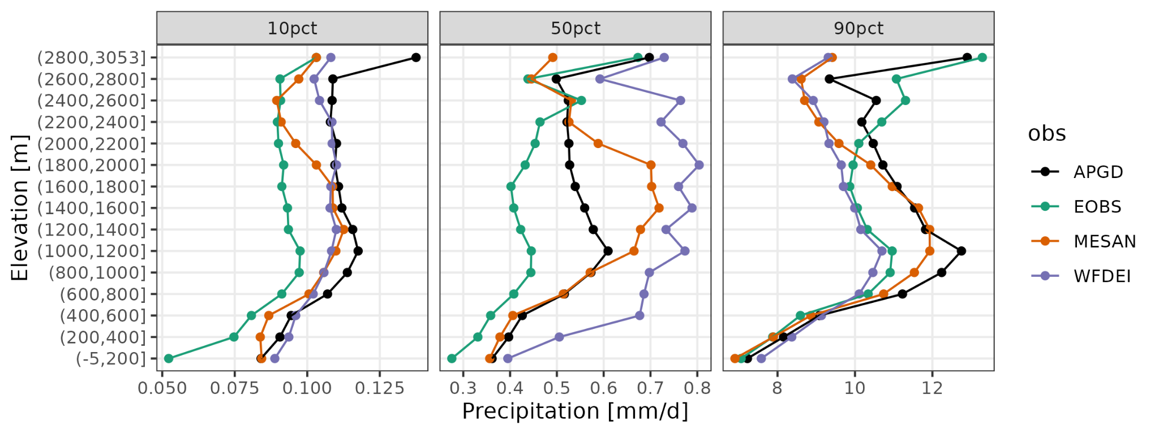
Observation intercomparison
Annual precipitation climatology

Slide 7
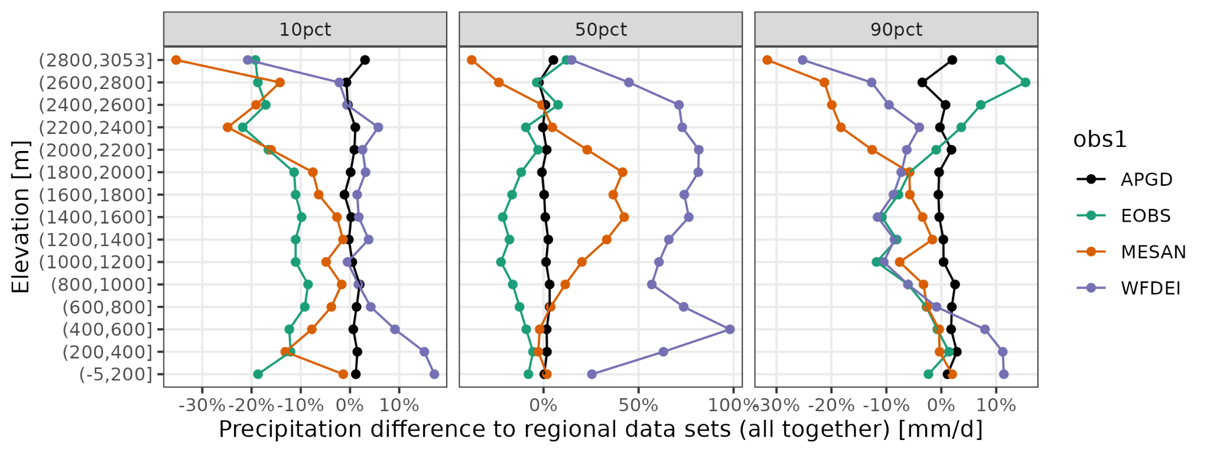
Observation intercomparison
Difference in annual precipitation climatology

Slide 8
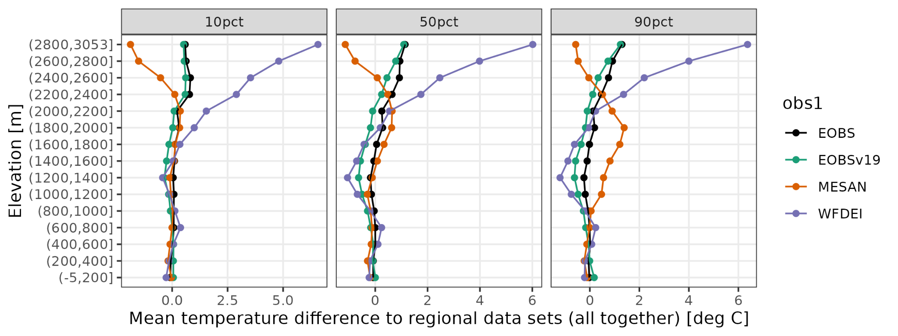
Observation intercomparison
Difference in annual mean temperature climatology
Observations matter.
IF: we assume regional datasets as “best” estimate
THEN: APGD for precip and E-OBS for temperature

Slide 9
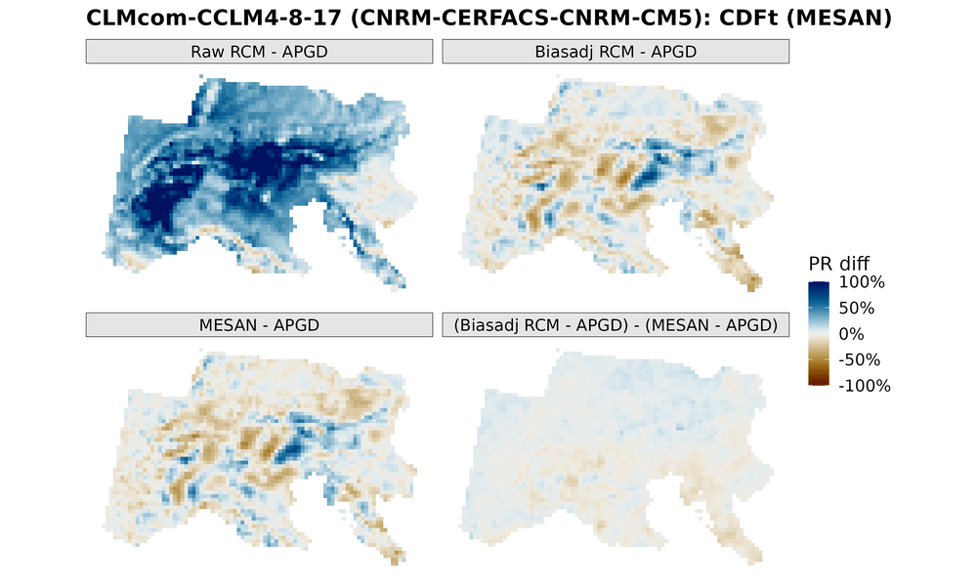
Observations
Used in bias adjustment vs. as evaluation reference
values are moved towards dataset used in bias adjustment

Slide 10
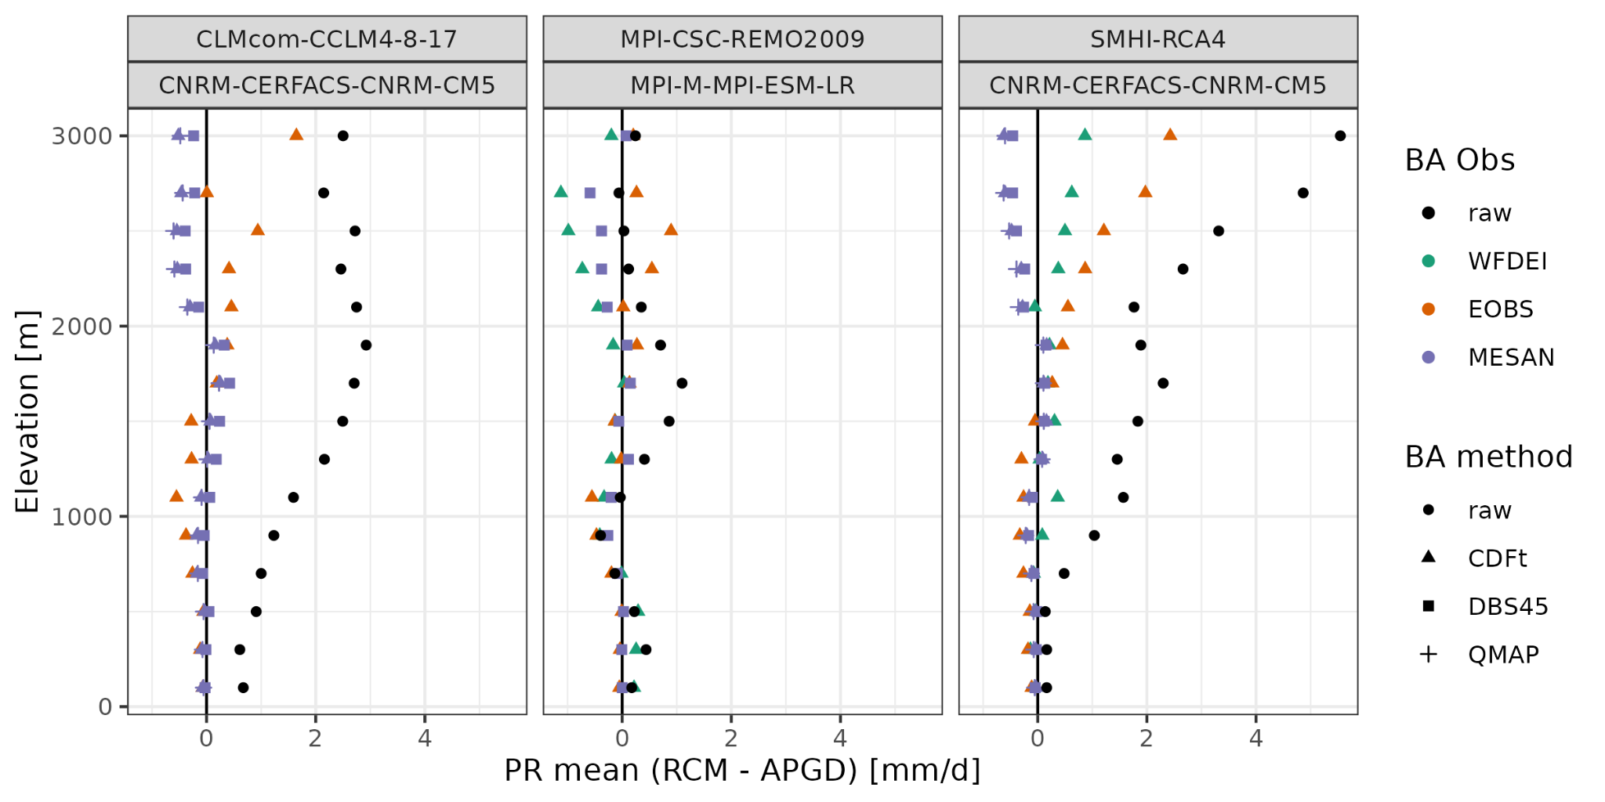
Elevation dependent biases (precipitation)

Slide 11
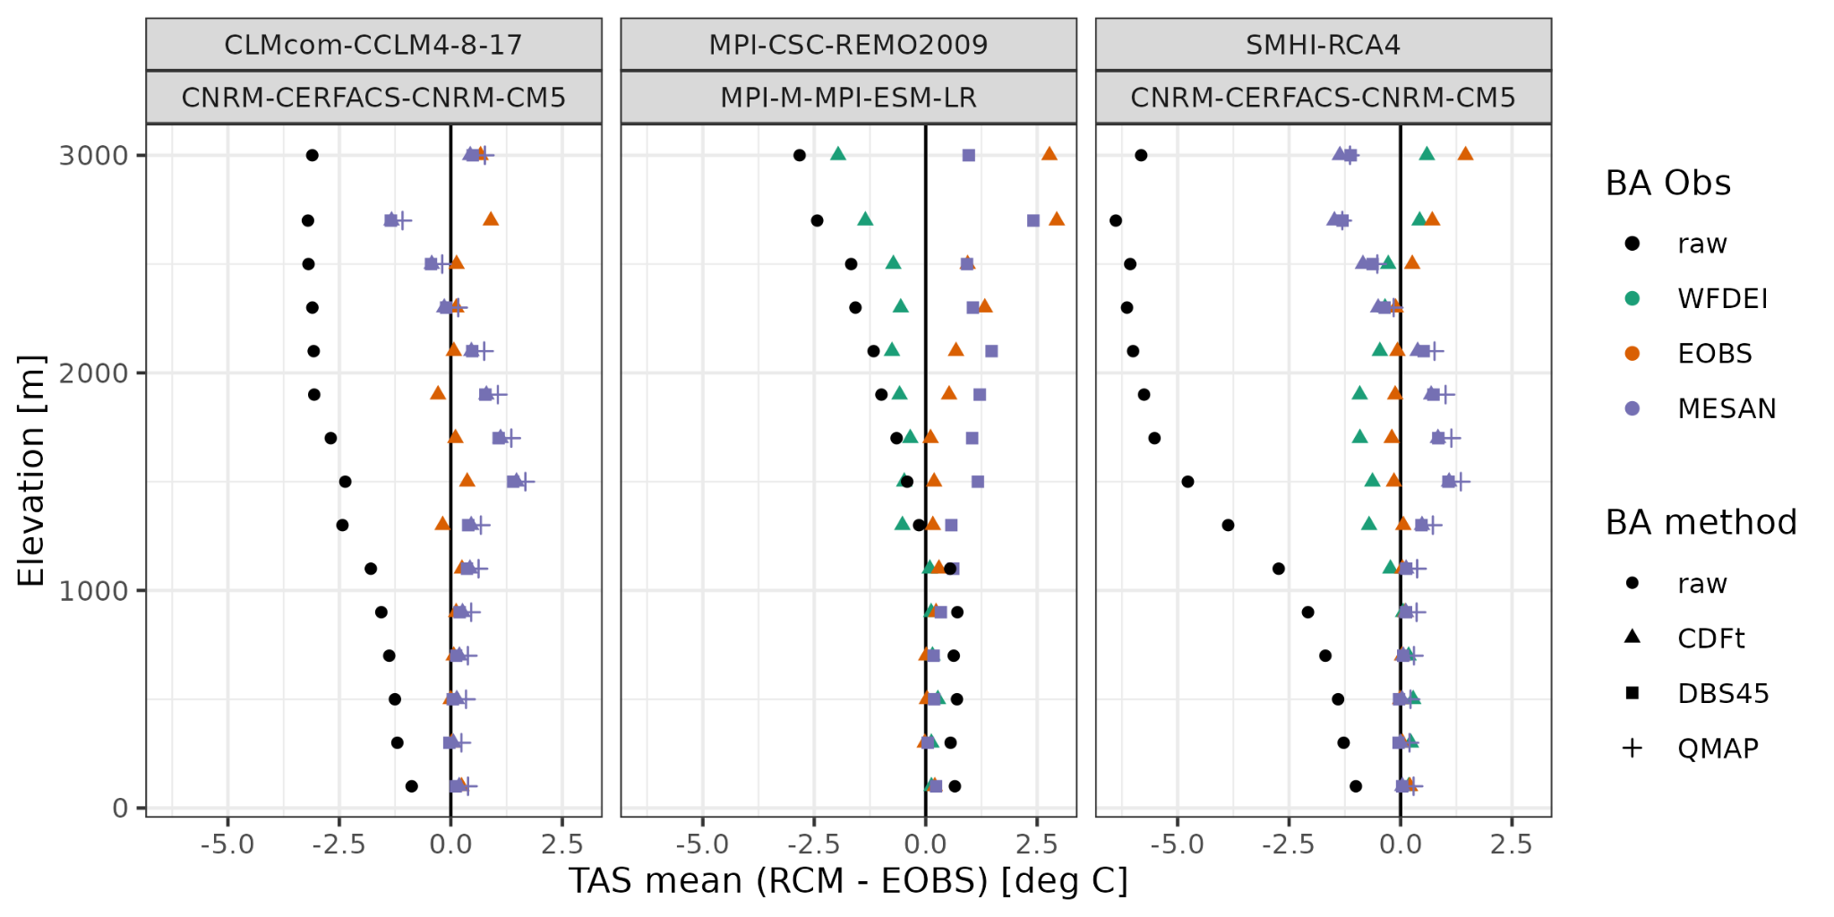
Elevation dependent biases (temperature)
raw RCMs have overall wet bias (increasing with elevation) and cold bias (increasing with elevation)
bias-adjustment generally reduces biases
some raw RCMs already have little bias -> bias-adj with “unsuitable” dataset can induce more errors (increase bias, change sign of bias)

Slide 12
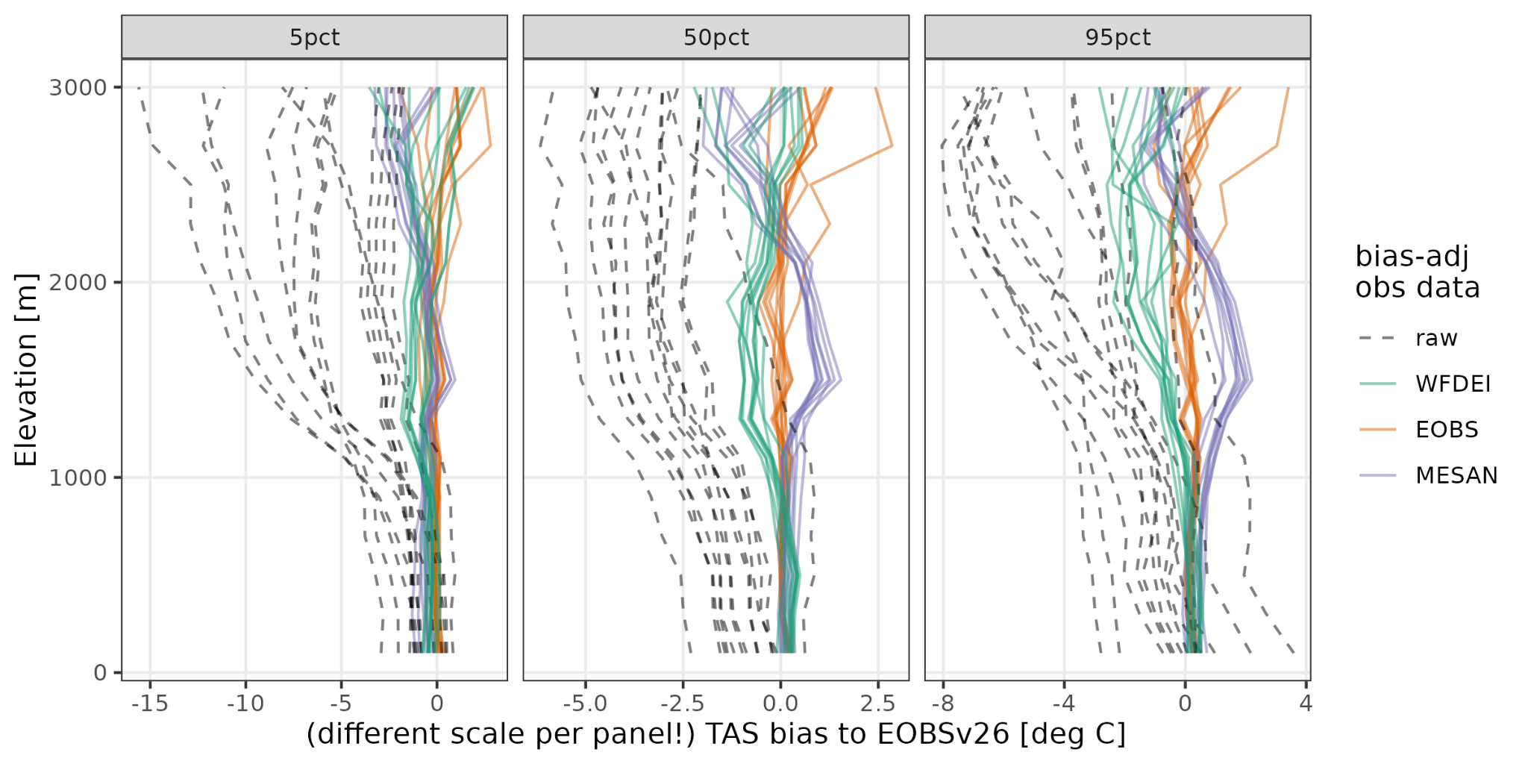
ED biases TAS: impact of BA dataset (CDFt method)

Slide 13
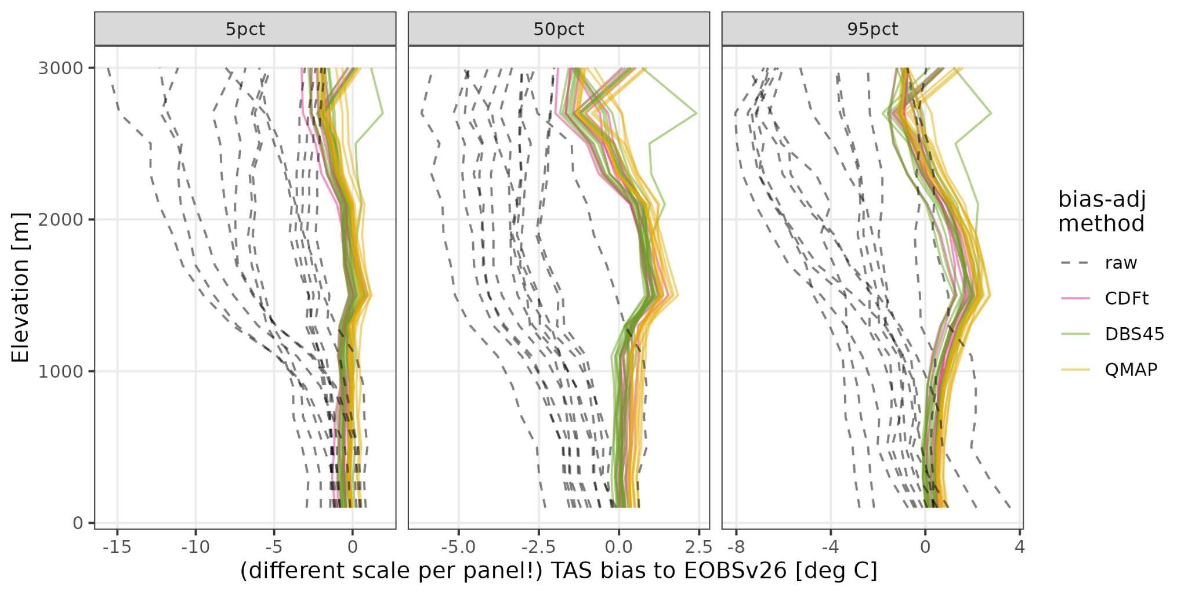
ED biases TAS: impact of BA method (MESAN BA data)
bias-adjustment dataset has strong impact (values are moved towards bias-adj-dataset)
bias-adjustment method has little impact

Slide 14
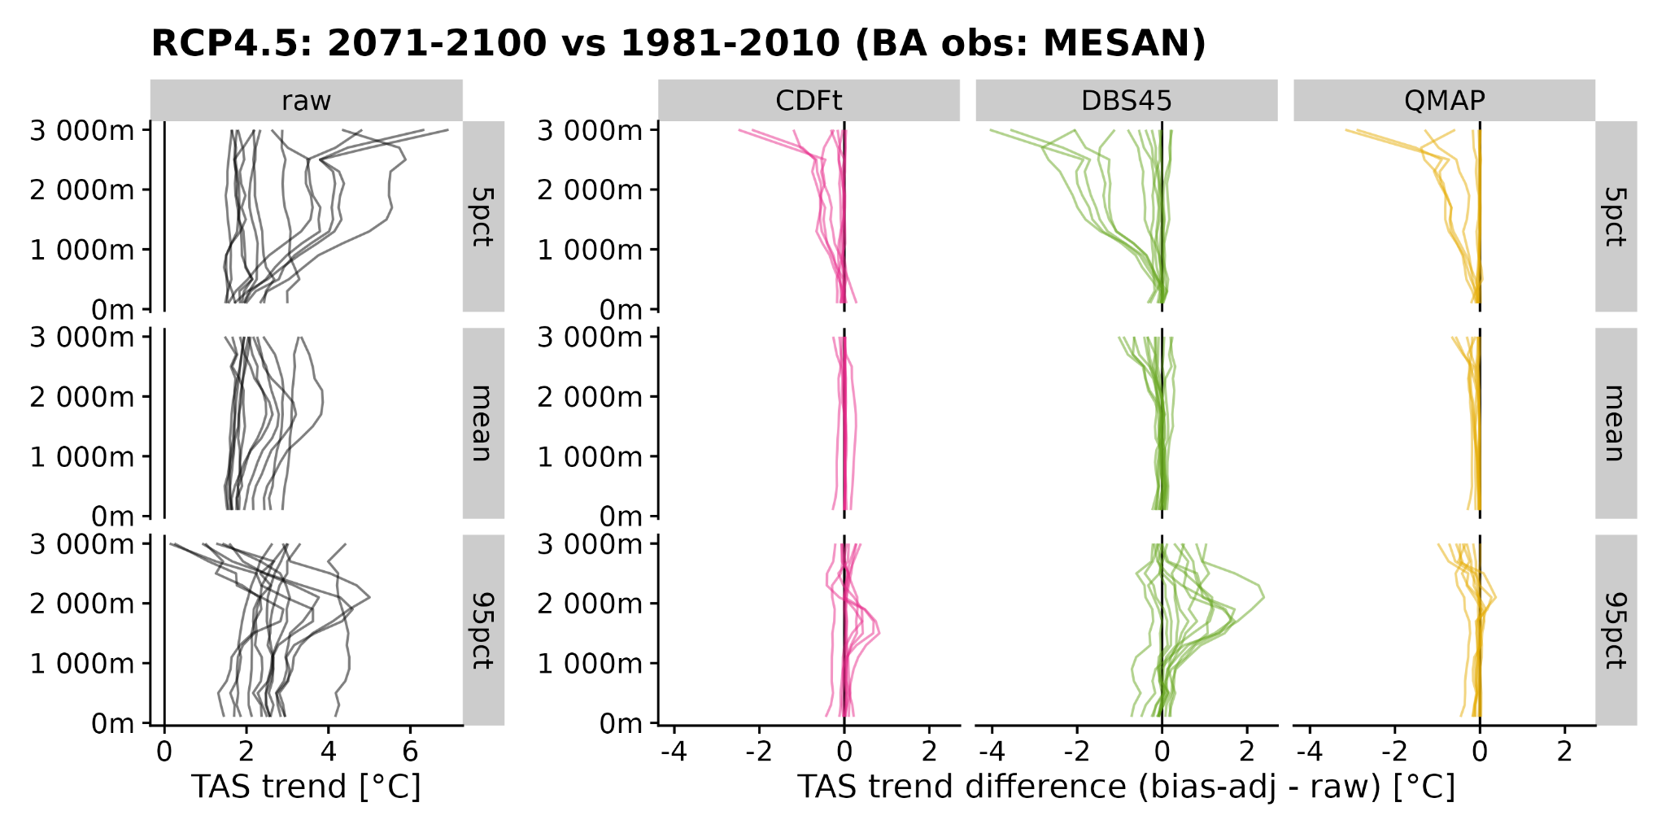
Elevation dependent trends (temperature)

Slide 15
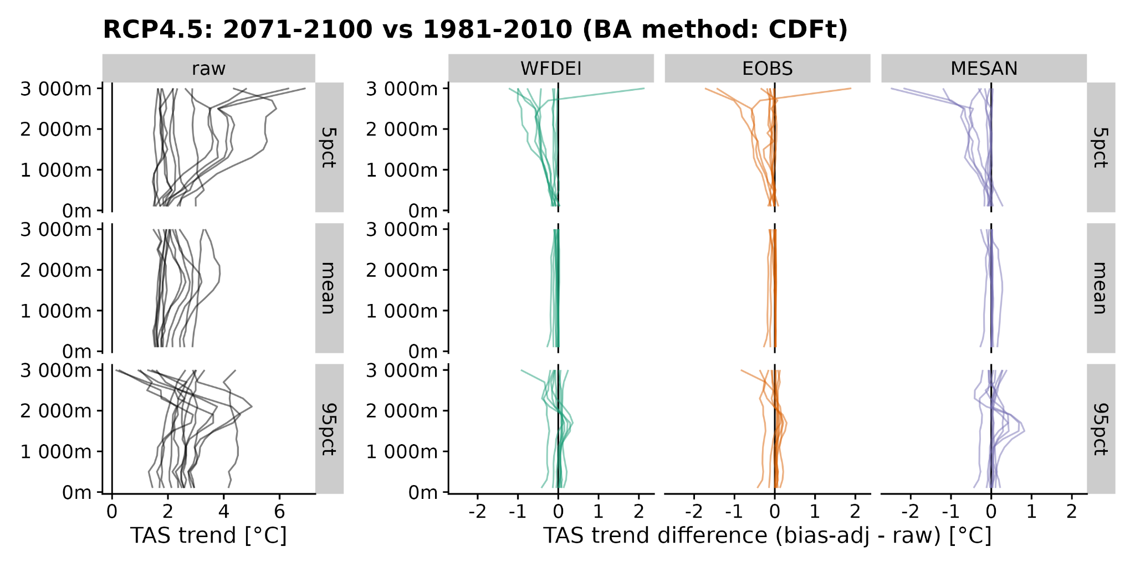
Elevation dependent trends (temperature)
mixed EDW signal in raw RCMs
all BA methods trend-preserving in mean, but not in low&high percentiles
BA obs data has little impact (beyond BA method)

Slide 16
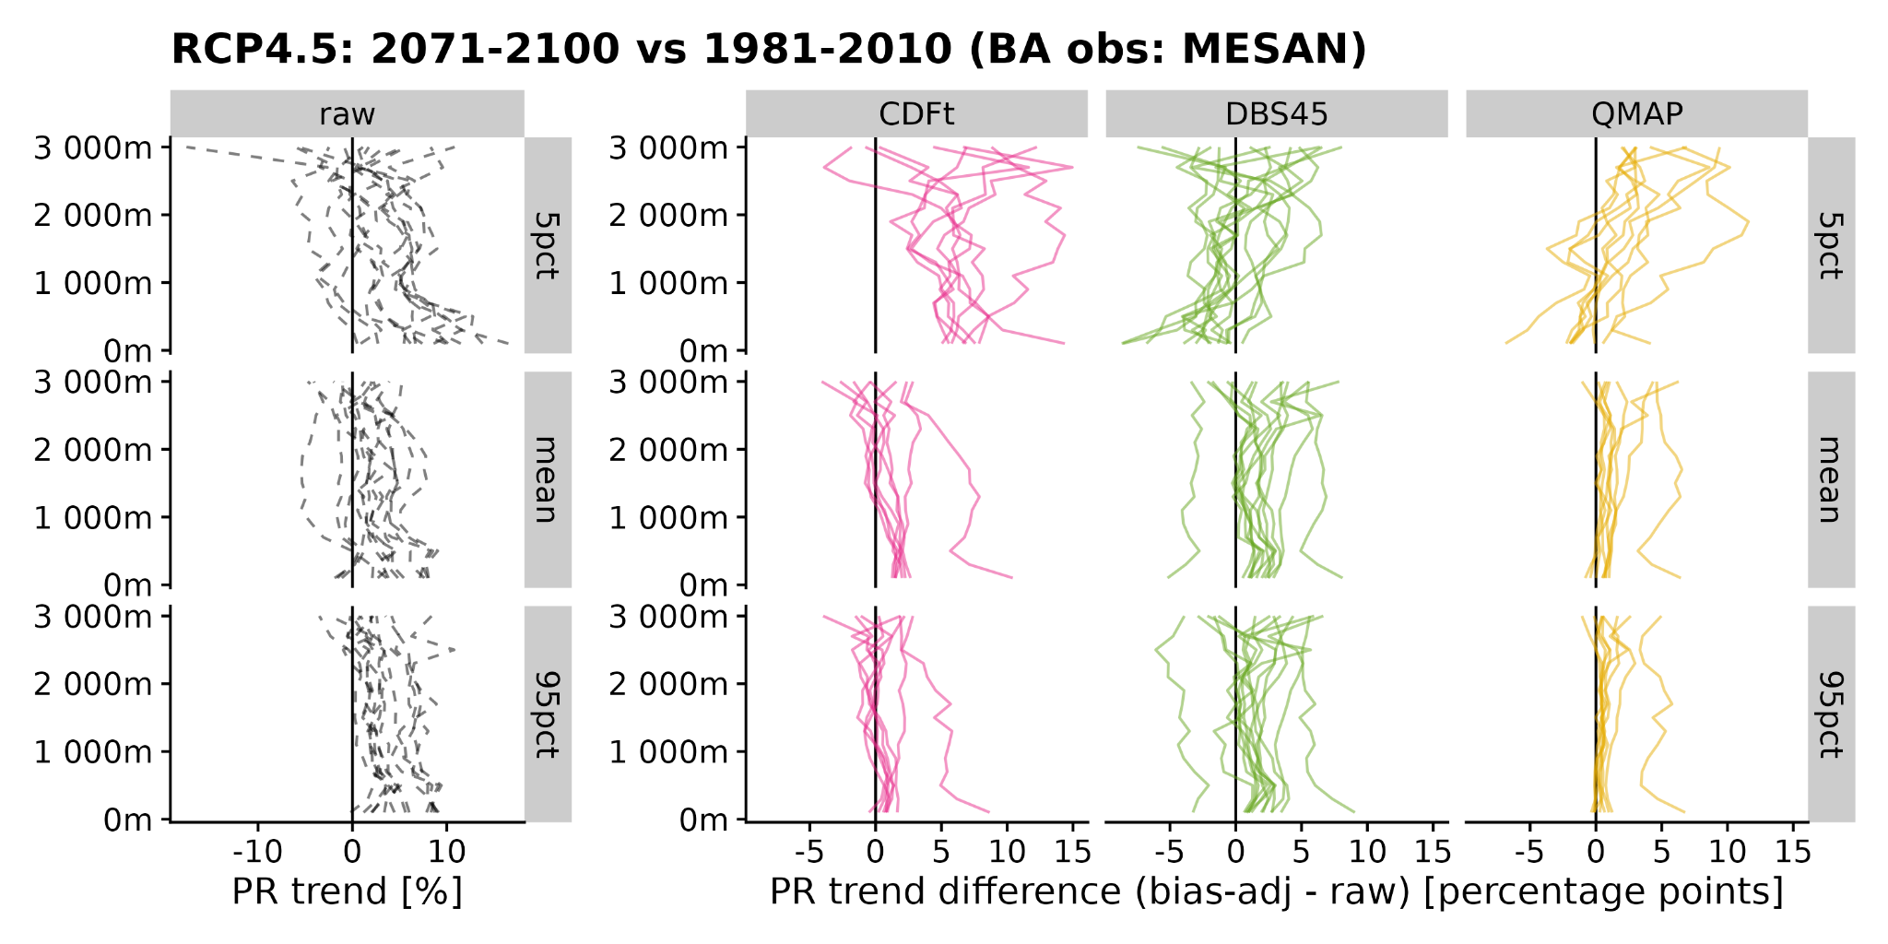
Elevation dependent trends (precipitation)

Slide 17
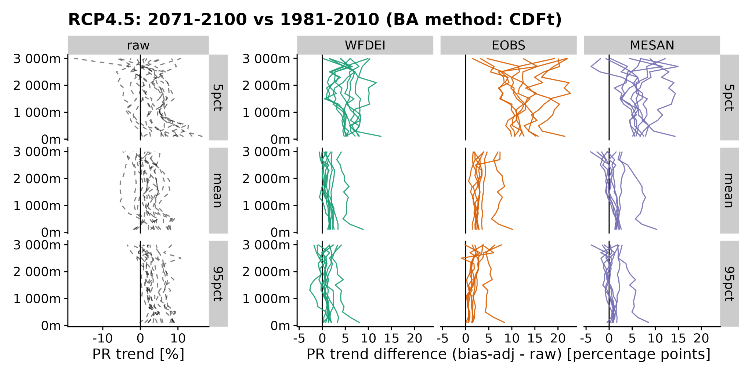
Elevation dependent trends (precipitation)
no clear EDCC signal in raw RCMs
trends modified by BA method and BA obs
BUT complicated: precip trends in general low and subject to high internal climate variability

Slide 18
Contact:
Michael Matiu: michael.matiu@unitn.it
Anna Napoli: anna.napoli@unitn.it

