Slide 1
Using basin-scale physiographic attributes to improve river routing in JULES
Athanasios Tsilimigkras¹, Douglas Clark², Andrew Hartley³, Eleanor Burke³, Manolis Grillakis¹, and Aristeidis Koutroulis¹
¹ Technical University of Crete, Chania, Greece
² UK Centre for Ecology & Hydrology, Wallingford, UK
³ Met Office, Exeter, UK

Slide 2
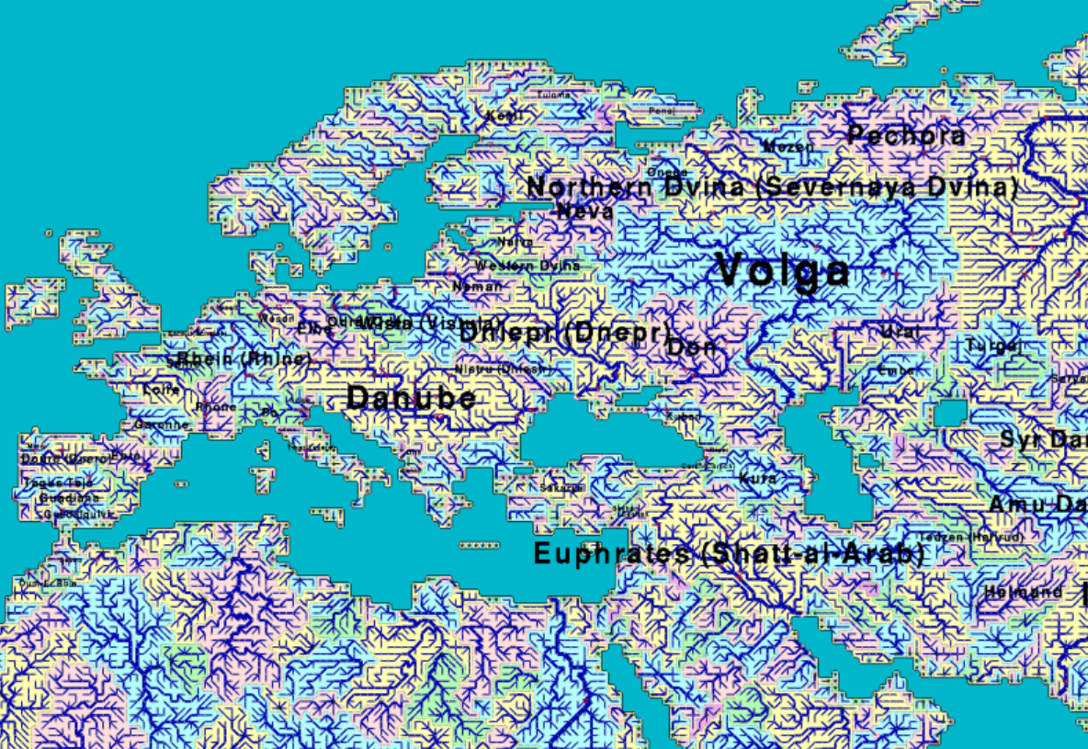
Two-Minute Madness
JULES (Joint UK Land Environment Simulator) is a process-based LSM (Land Surface Model) simulating many processes which show significant parametrization and complexity.
However, the parametrization of some processes is not sufficiently developed. One of these processes is the routing of surface runoff as simulated by the TRIP scheme (Total Runoff Integrating Pathways).
In its current global parametrization, TRIP uses uniform velocity and meandering characteristics for the entire land surface regardless of the actual physiographic characteristics of each river basin.
μ

Slide 3
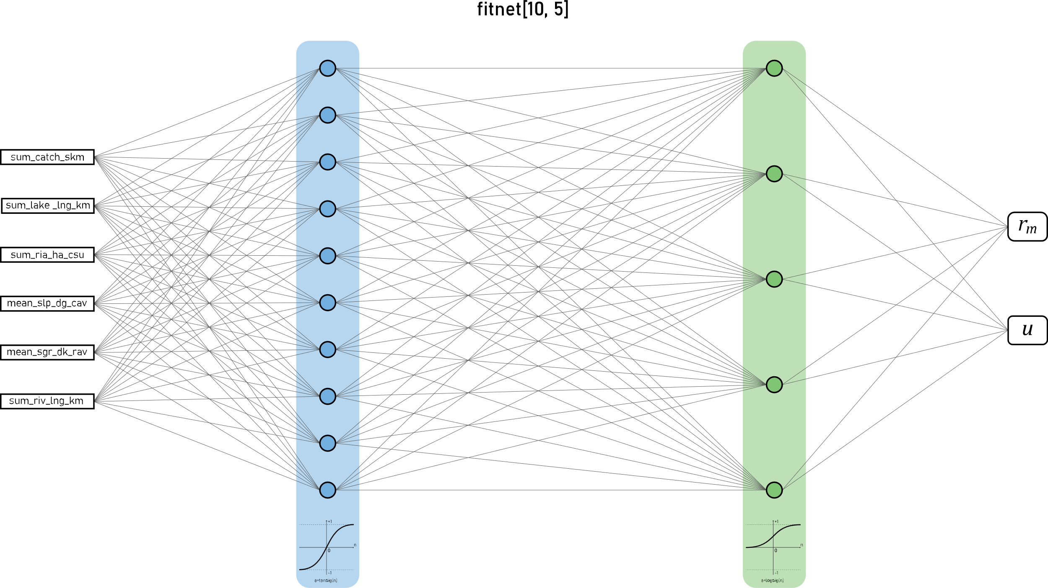
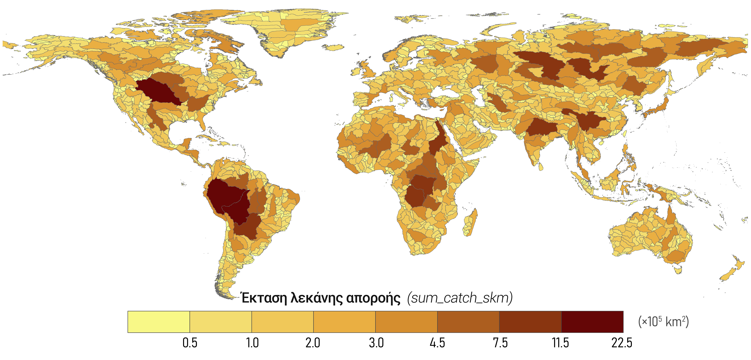
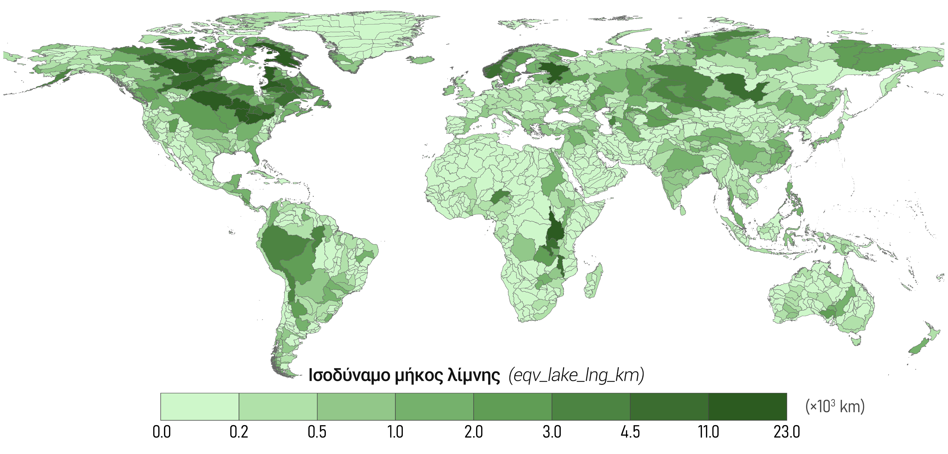
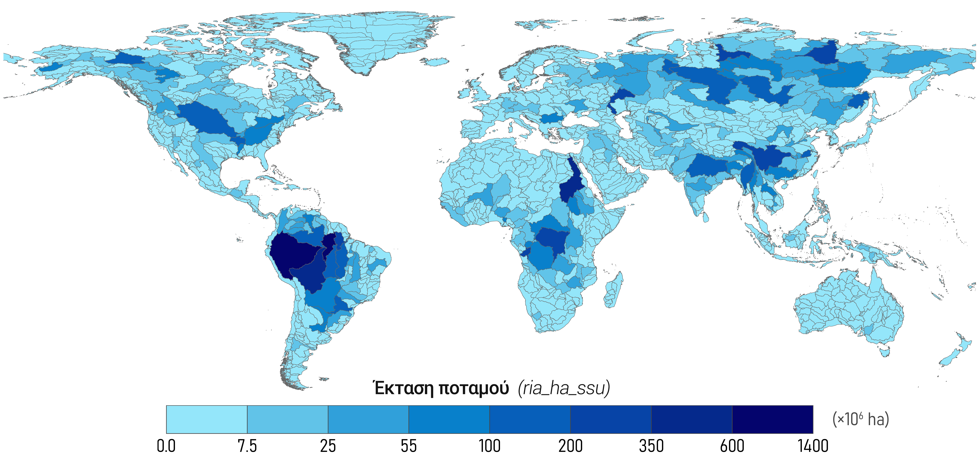
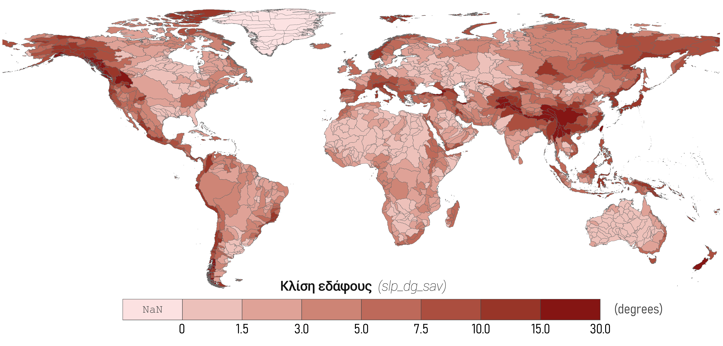
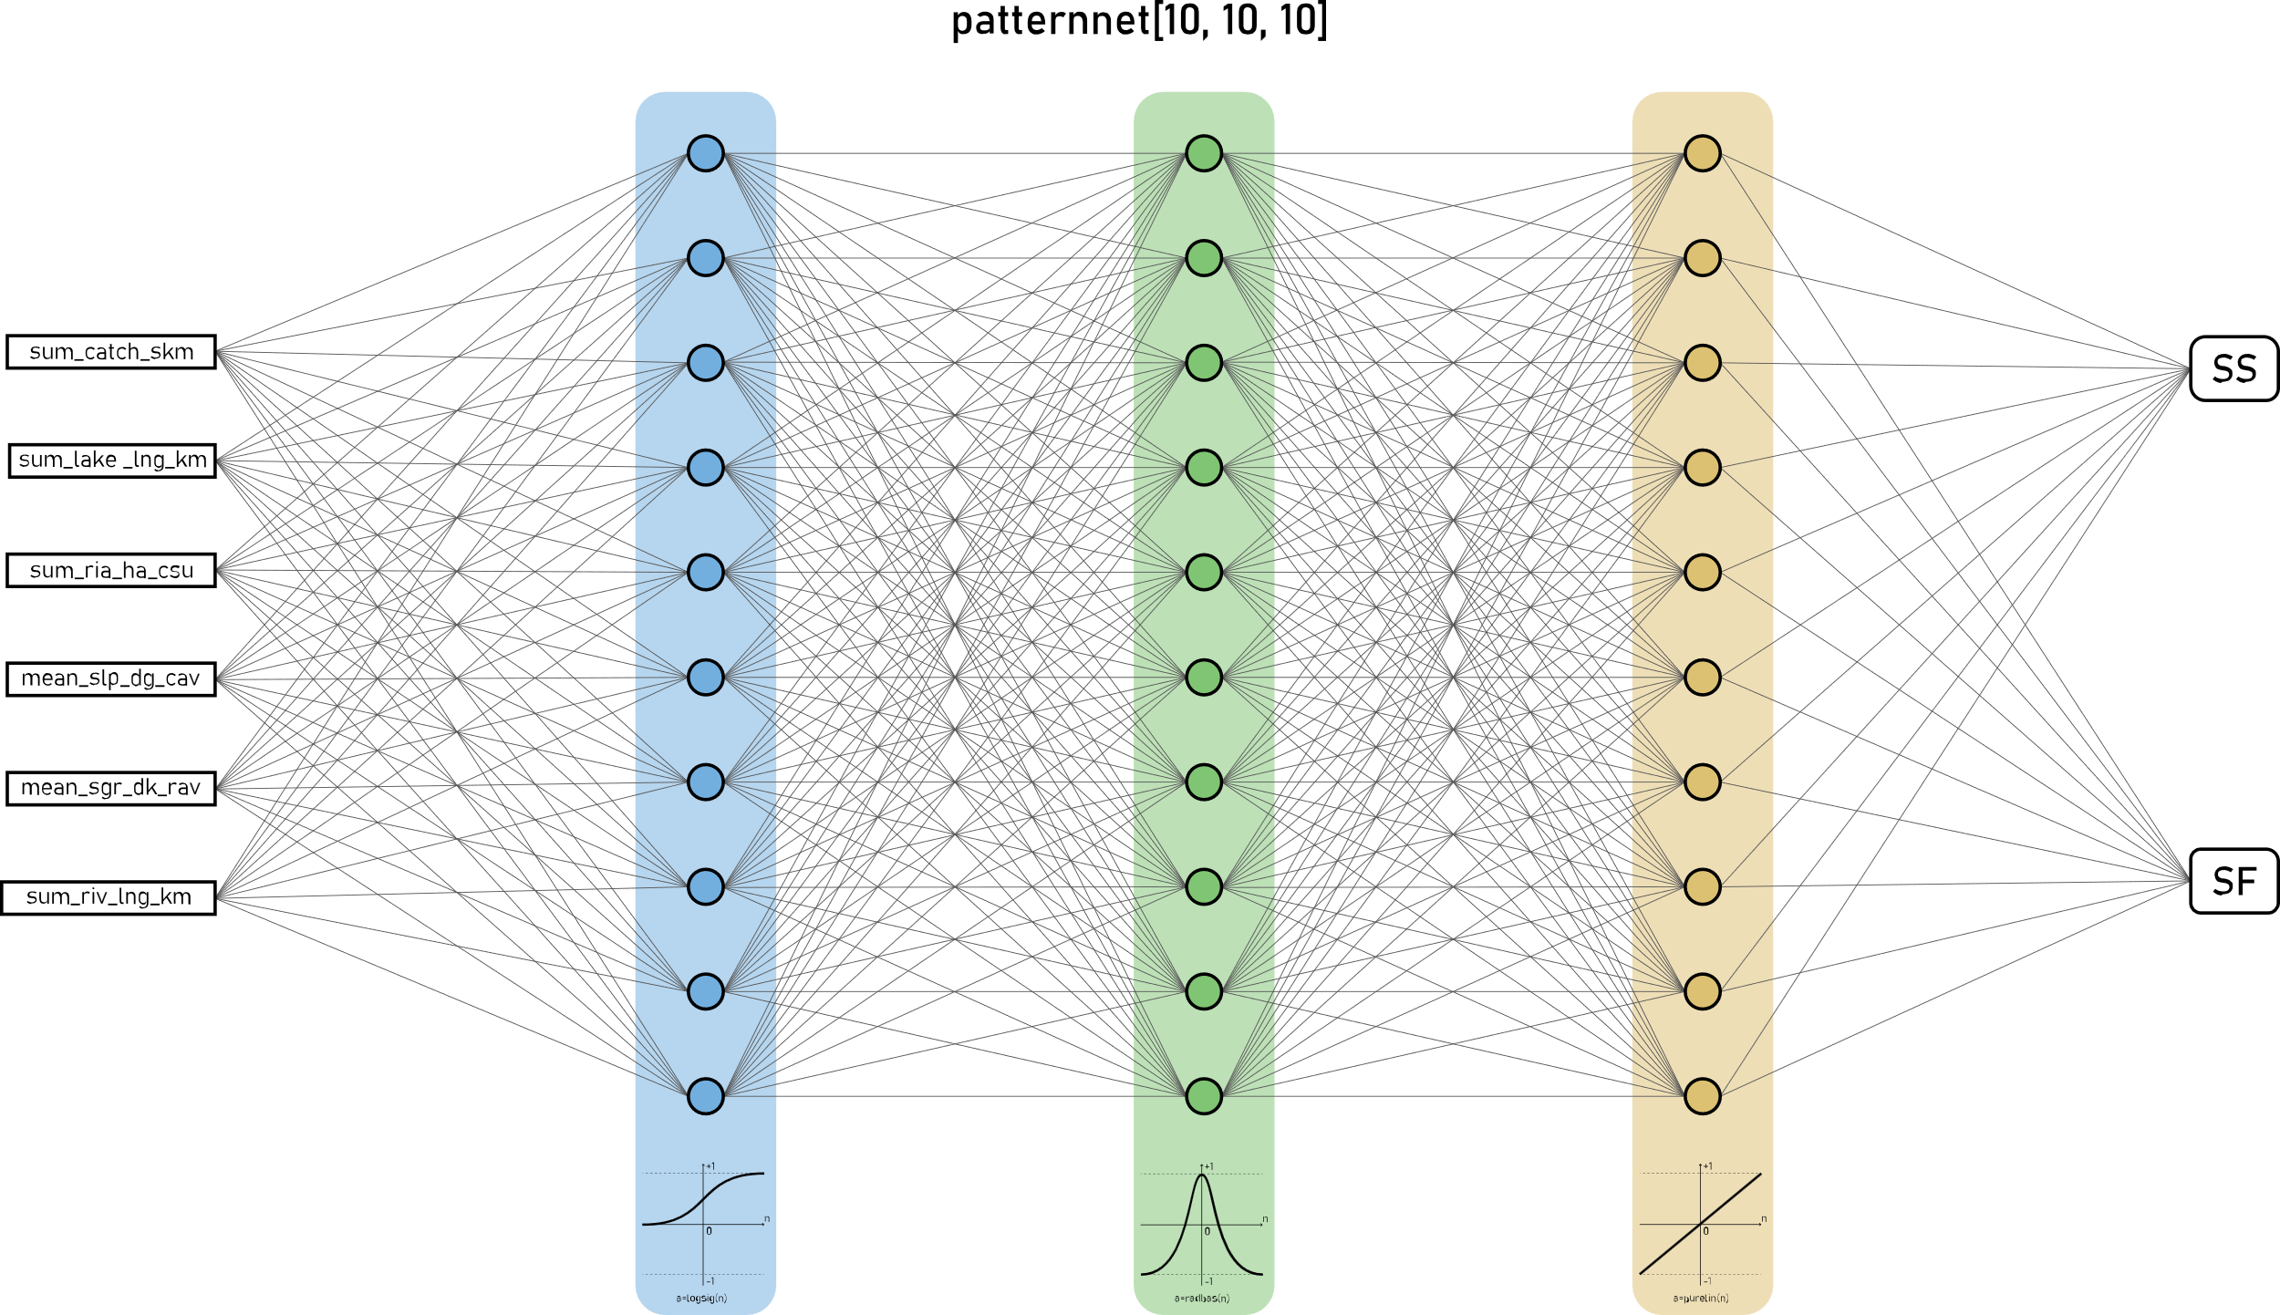
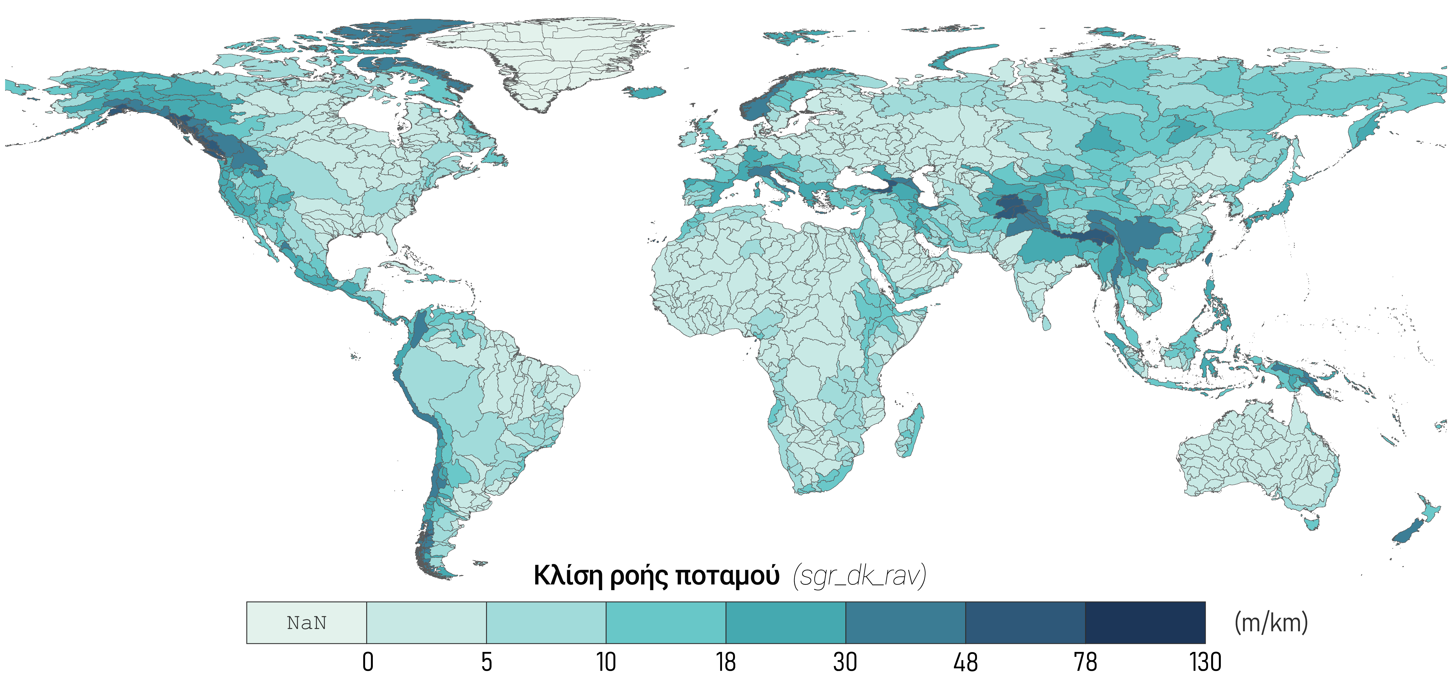
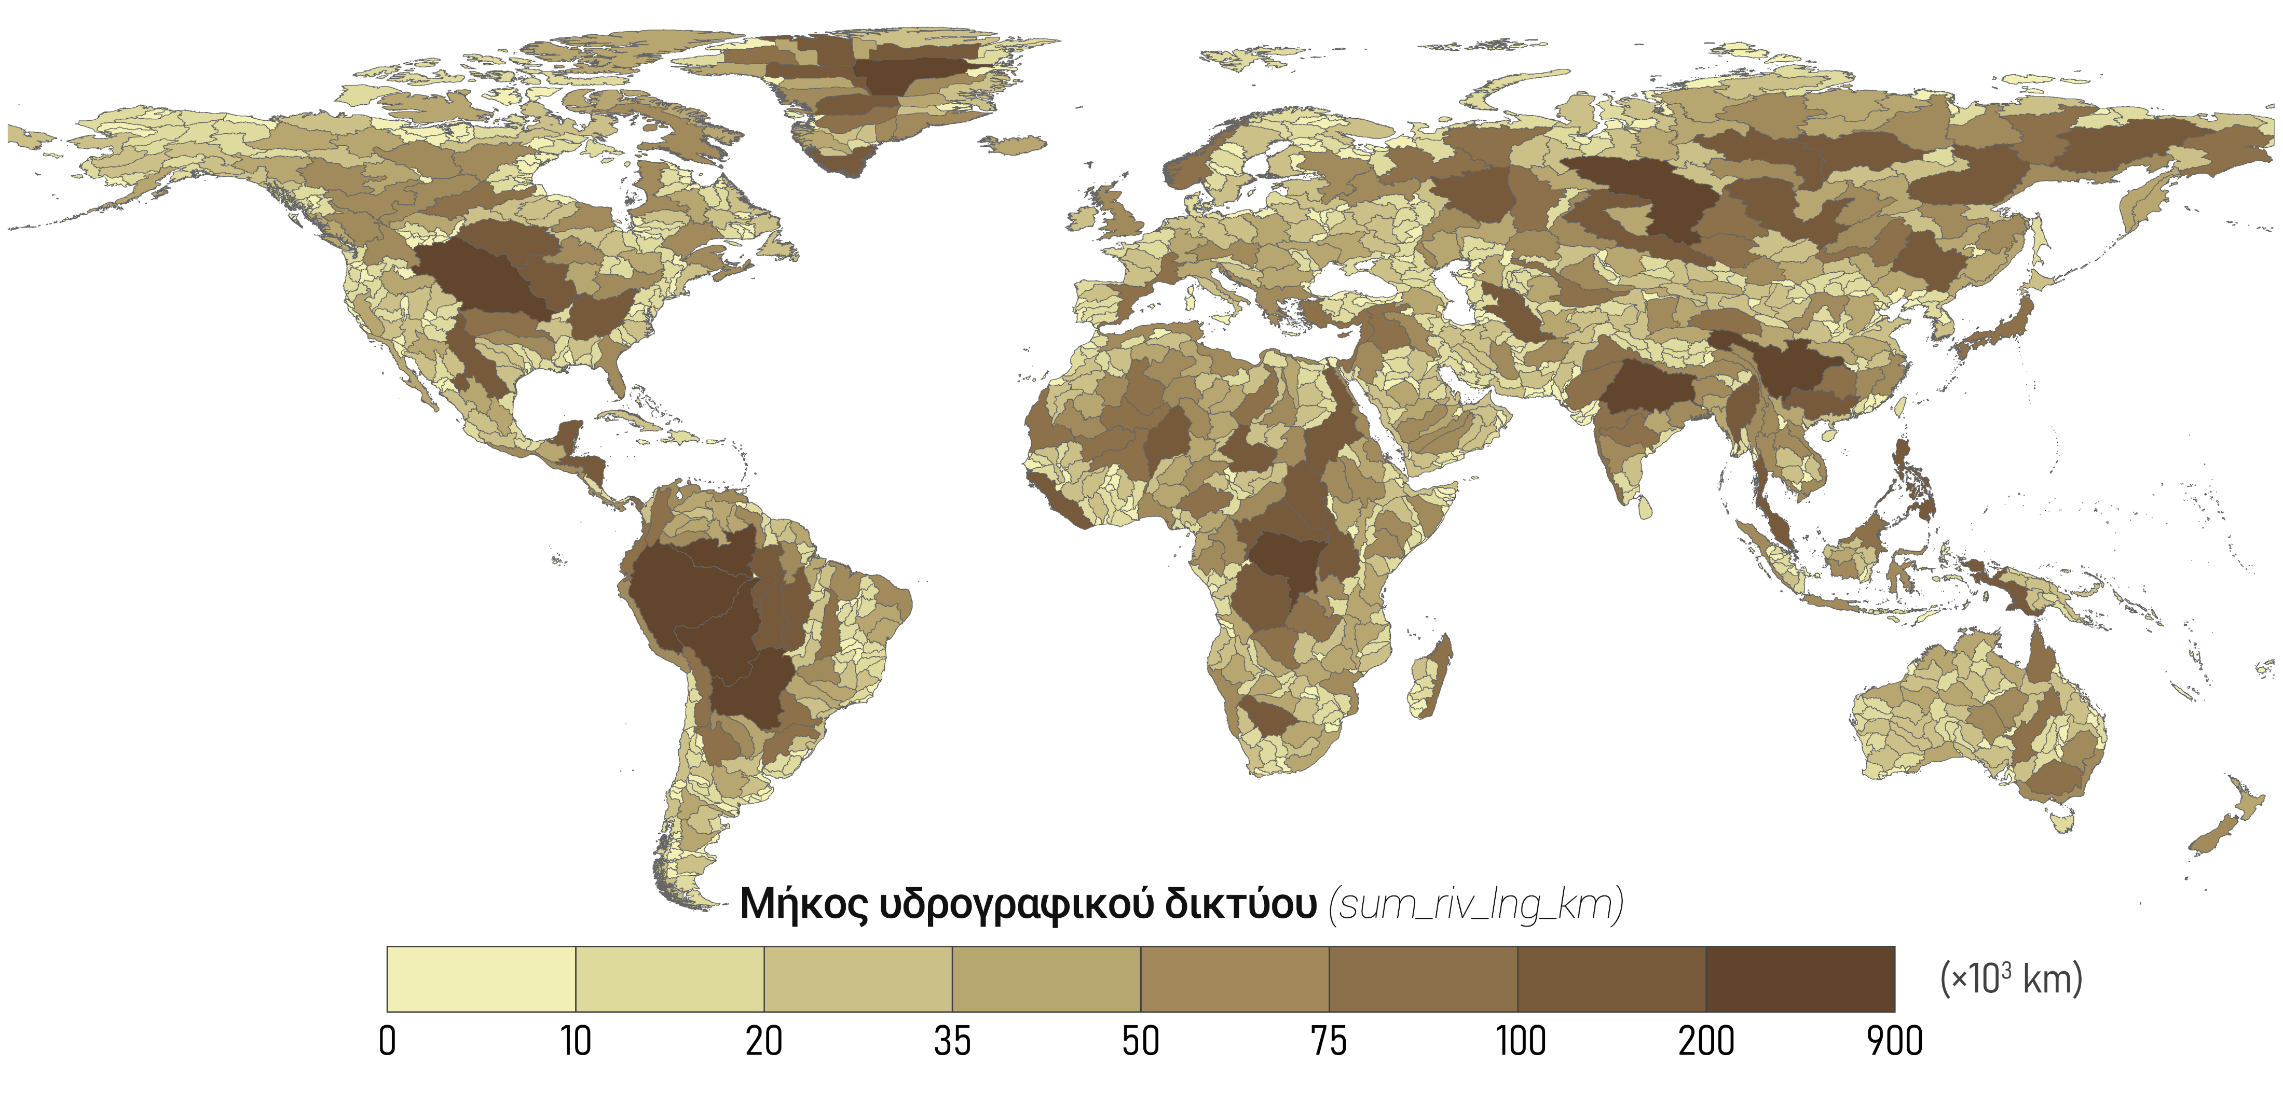
Two-Minute Madness
μ
The improvement of river routing,
by, firstly, optimizing the routing parameters, flow velocity and meander ratio, based on a sample of 360 river basins,
(ii) and, secondly, correlating them with the physiographic properties of each _. basin,
with the ultimate goal of extrapolating at the global scale.

Slide 4
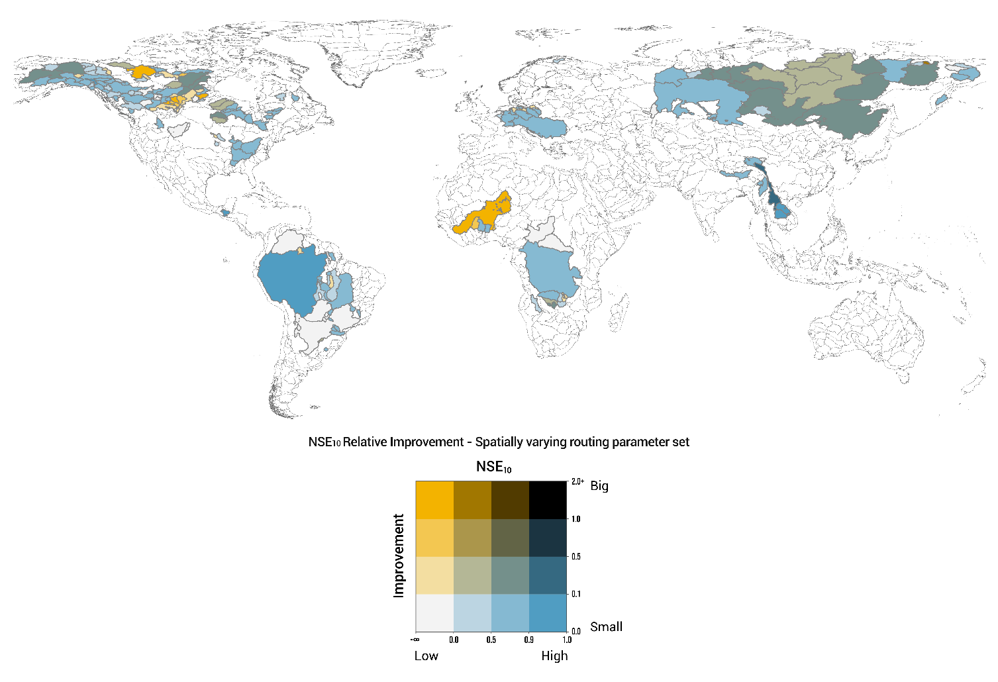
Two-Minute Madness
Simulations of the newly developed river routing configuration showed improved skill in simulating river discharge at the global scale, especially with regard to the temporal response of the routed flow.
μ

Slide 5
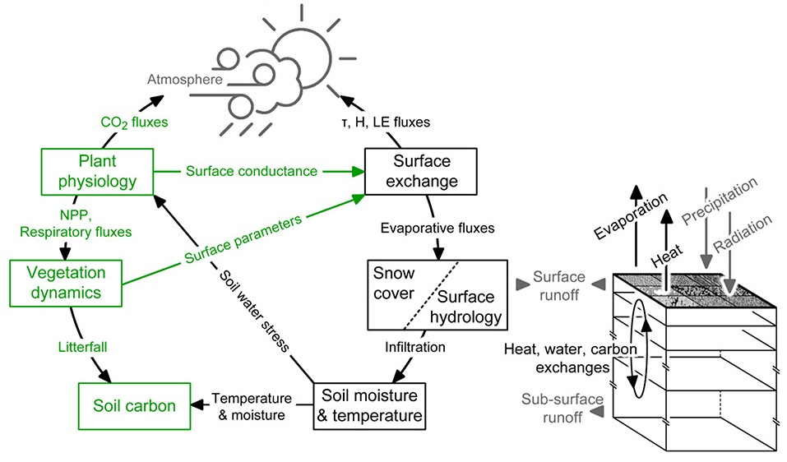
Land Surface Model The Joint UK Land Environment Simulator (JULES)
Community land surface model that is used both as a standalone model and as the land surface component in the Met Office Unified Model
JULES provides a framework to assess the impact of modifying a particular process on the ecosystem as a whole, e.g., the impact of climate change on hydrology, and to study potential feedbacks.
$0.5°×0.5°$ spatial resolution
The simulation of the different processes is done by various modules, which show significant parameterization and complexity.
However, the parameterization of some processes is not sufficiently developed.

Slide 6
ROUTING SCHEME Total Runoff Integrating Pathways (TRIP)
Global river channel network, calculating the cell-to-cell river flow.
Simple advection method to route surface and subsurface runoff along the prescribed channels.
In its current global parameterization, TRIP uses uniform velocity and meandering characteristics for the entire land surface regardless of the actual physiographic characteristics of each river basin.
Routing Parameters:
Meander Ratio (r_{m})
Flow Velocity (u)

Slide 7
Methodology

Slide 8
Methodology – Flowchart

Slide 9
1.
GRDC
RIVER
BASINS

Slide 10
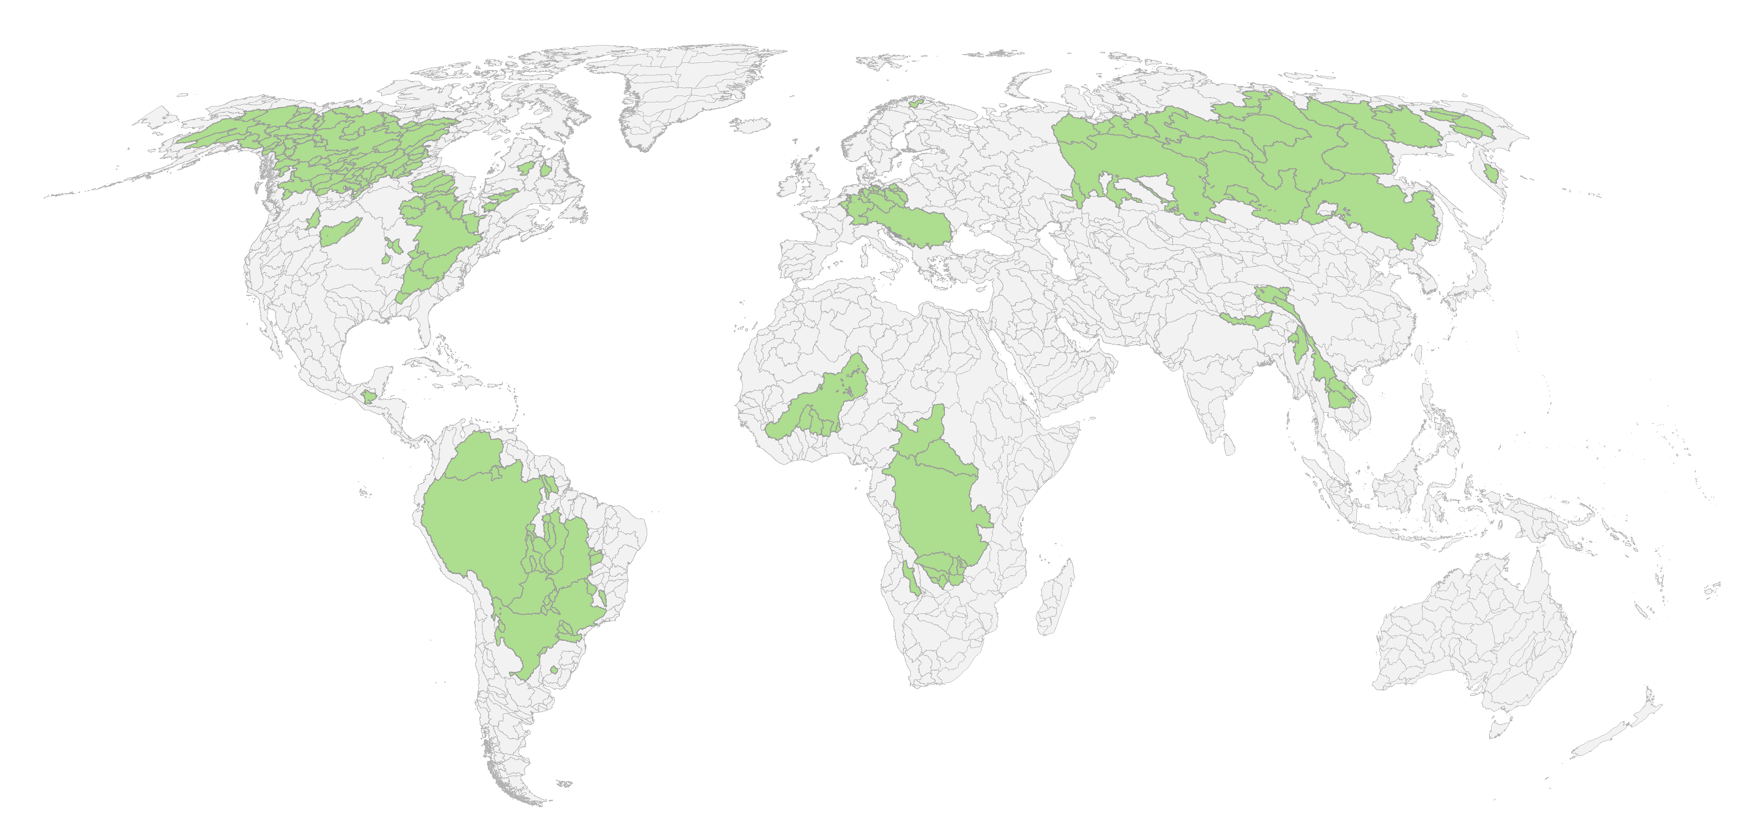
1.
GRDC
RIVER
BASINS
Sample of 360 global river basins
Near natural conditions (Zhao et al, 2018)
At least 10 years of data
At least 13000 km² ( 5+ grid boxes)

Slide 11
2.
HydroATLAS
PHYSIOGRAPHIC
CHARACTERISTICS

Slide 12
2.
HydroATLAS
PHYSIOGRAPHIC
CHARACTERISTICS
Basins’ properties from the HydroATLAS database (Level 4, 1321 river basins)
Catchment area
Equivalent lake length
River area
Terrain Slope
Stream Gradient
River Length

Slide 13
3.
JULES
FACTORIAL
EXPERIMENT

Slide 14
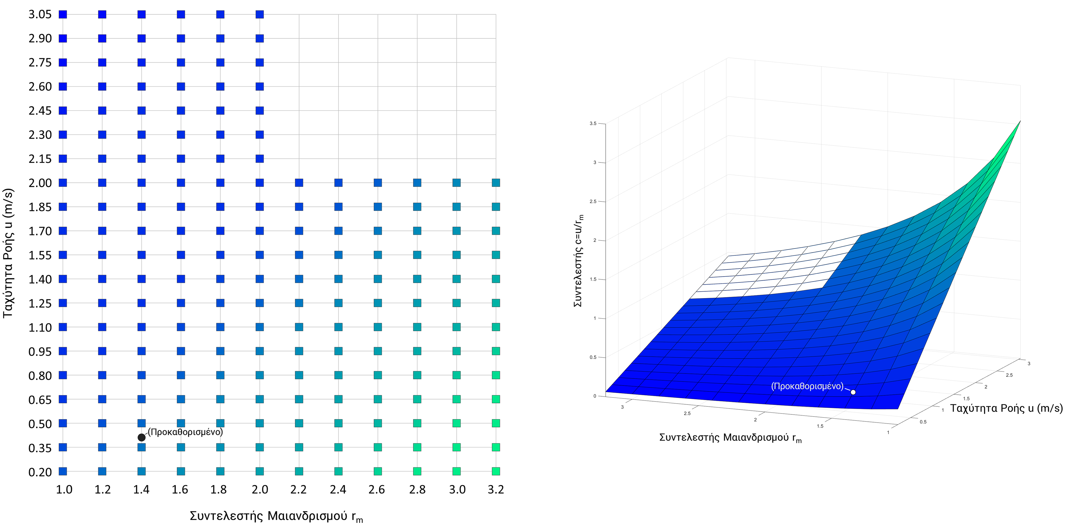
3.
JULES
FACTORIAL
EXPERIMENT
198 simulations with variable set of routing parameters
Flow Velocity, u (m/s)
Coef c=u/r_{m}
20 flow velocity values (u)
12 meander ratio values (r_{m})
The input of the routing parameters in JULES is the ratio c=u/r_{m} (effectively one parameter)
Flow Velocity,
u (m/s)
Meander Ratio r_{m}
Meander Ratio r_{m}

Slide 15
4.
SIMULATIONS’
EVALUATION

Slide 16
4.
SIMULATIONS’
EVALUATION
Hydrological metric
Nash-Sutcliffe Efficiency (NSE)
Assessment of the JULES’ efficiency to simulate discharge, against the measured GRDC stations’ discharge.
For global scale hydrological simulations:
NSE>0, «bad» performance
0.3<NSE<0.5, weak to satisfactory
NSE>0.5, «good» performance
bad
weak
satisfactory
good

Slide 17
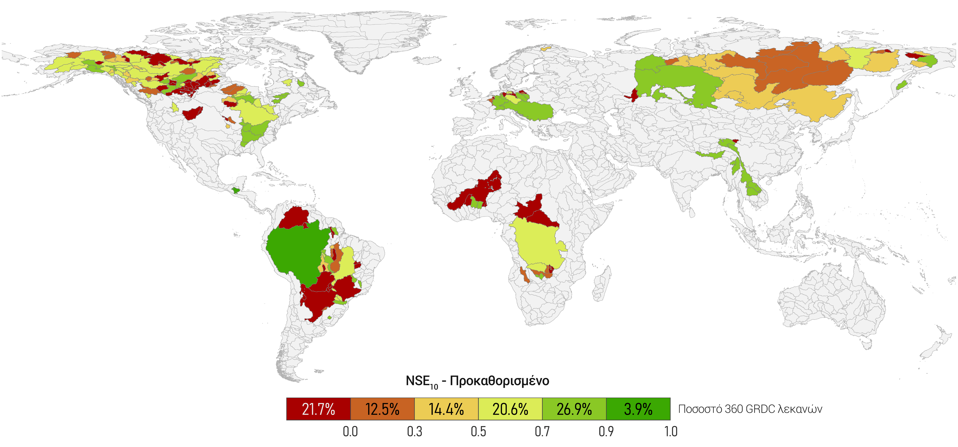
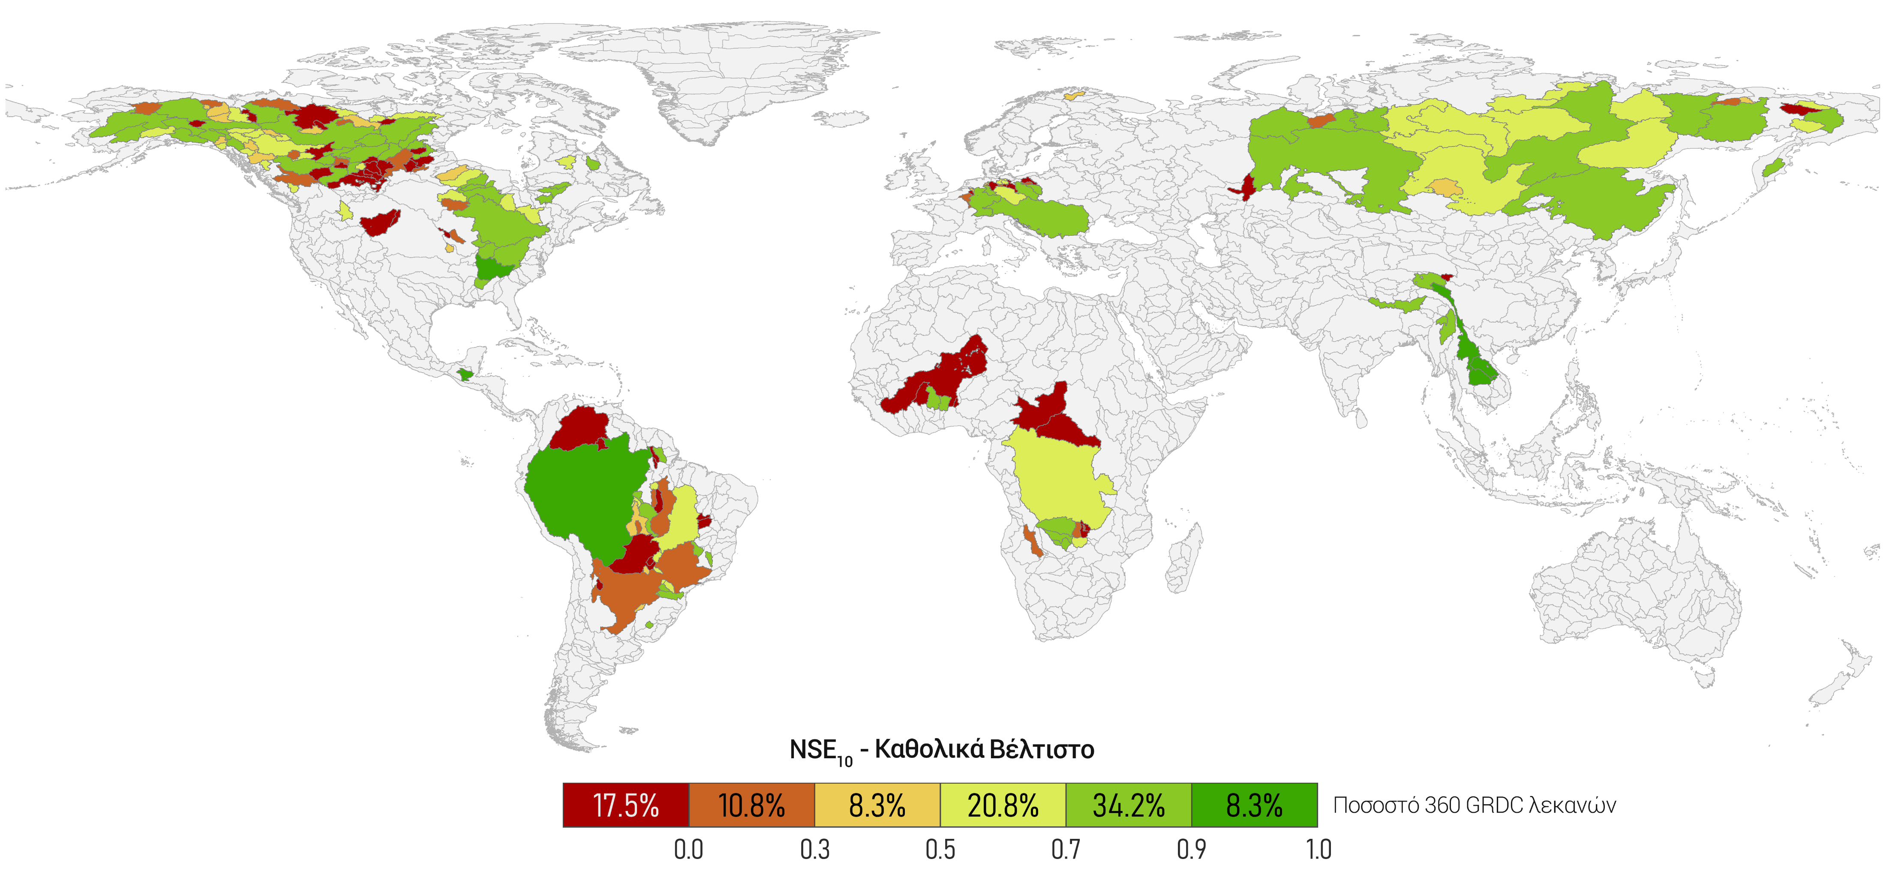
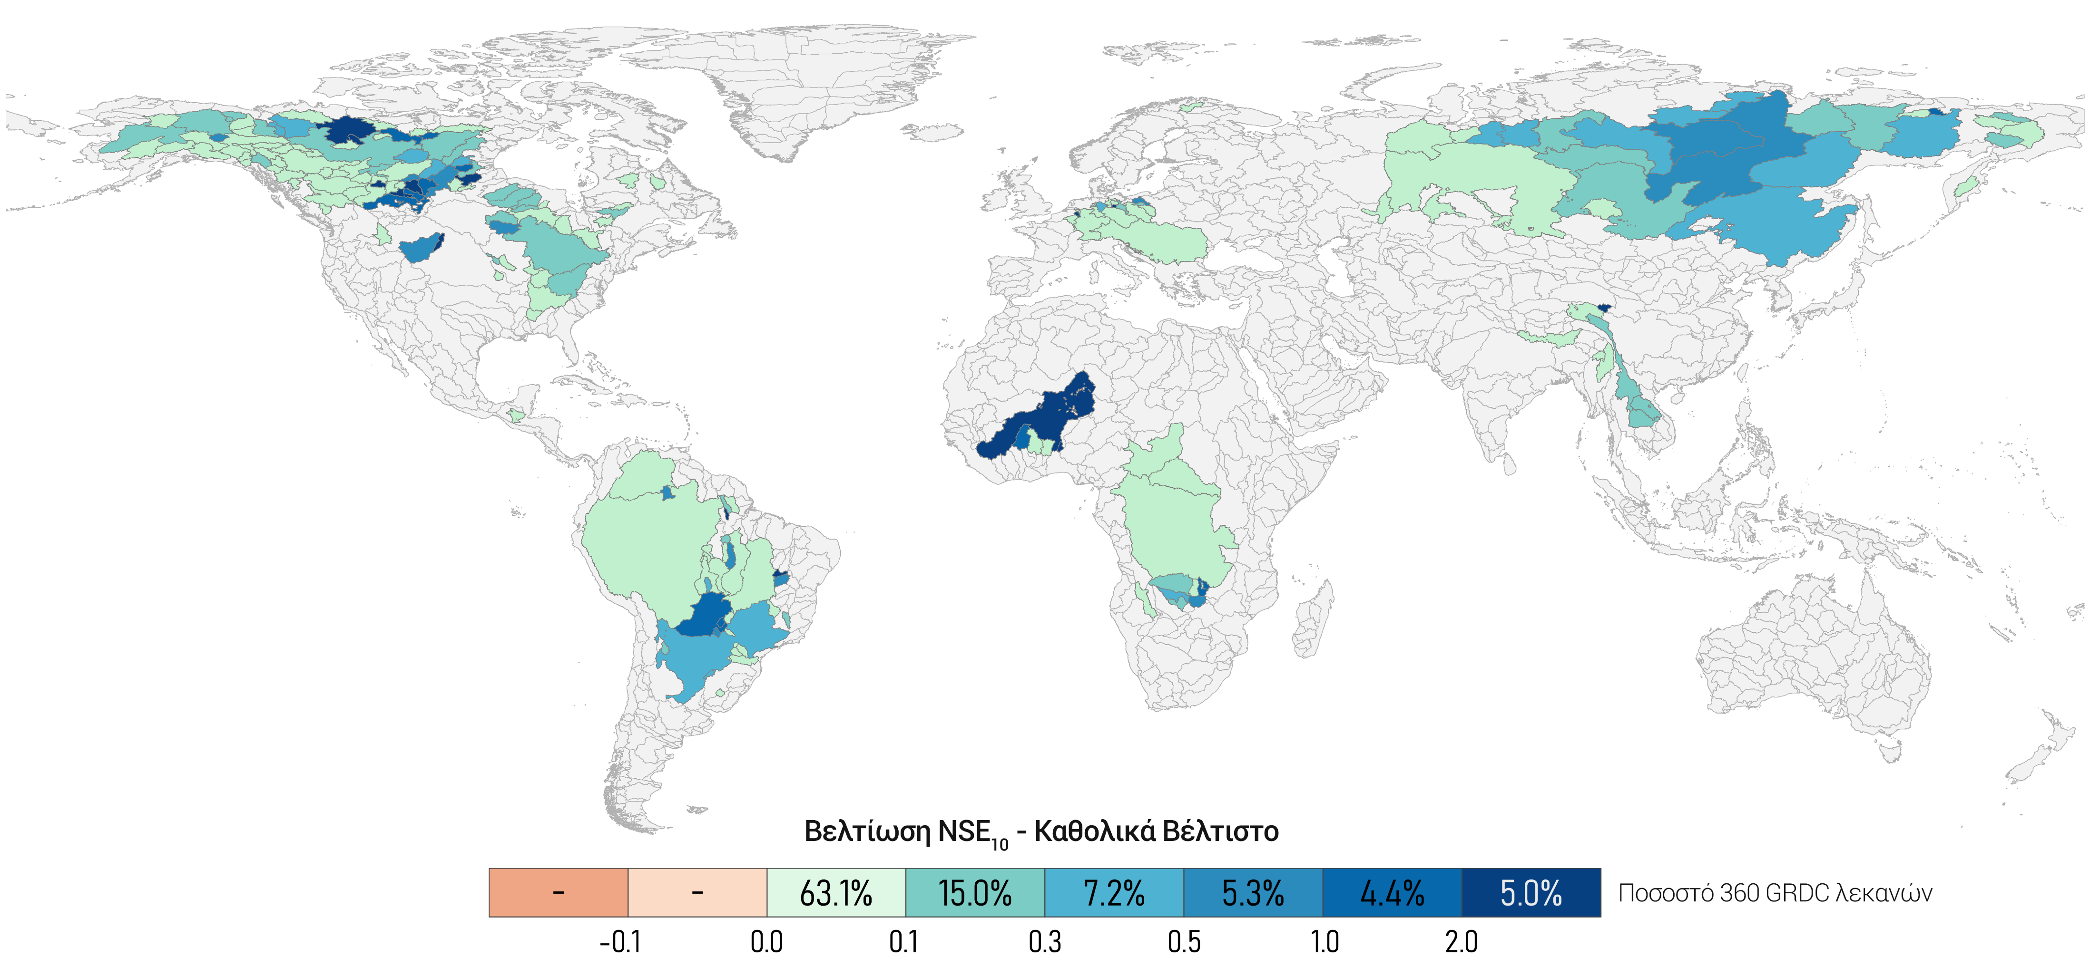
Maximum theoretical improvement
NSE₁₀ Improvement – Absolute Best Set
NSE₁₀ – Absolute Best Set
NSE₁₀ – Default Set
% out of the 360 sample GRDC basins

Slide 18
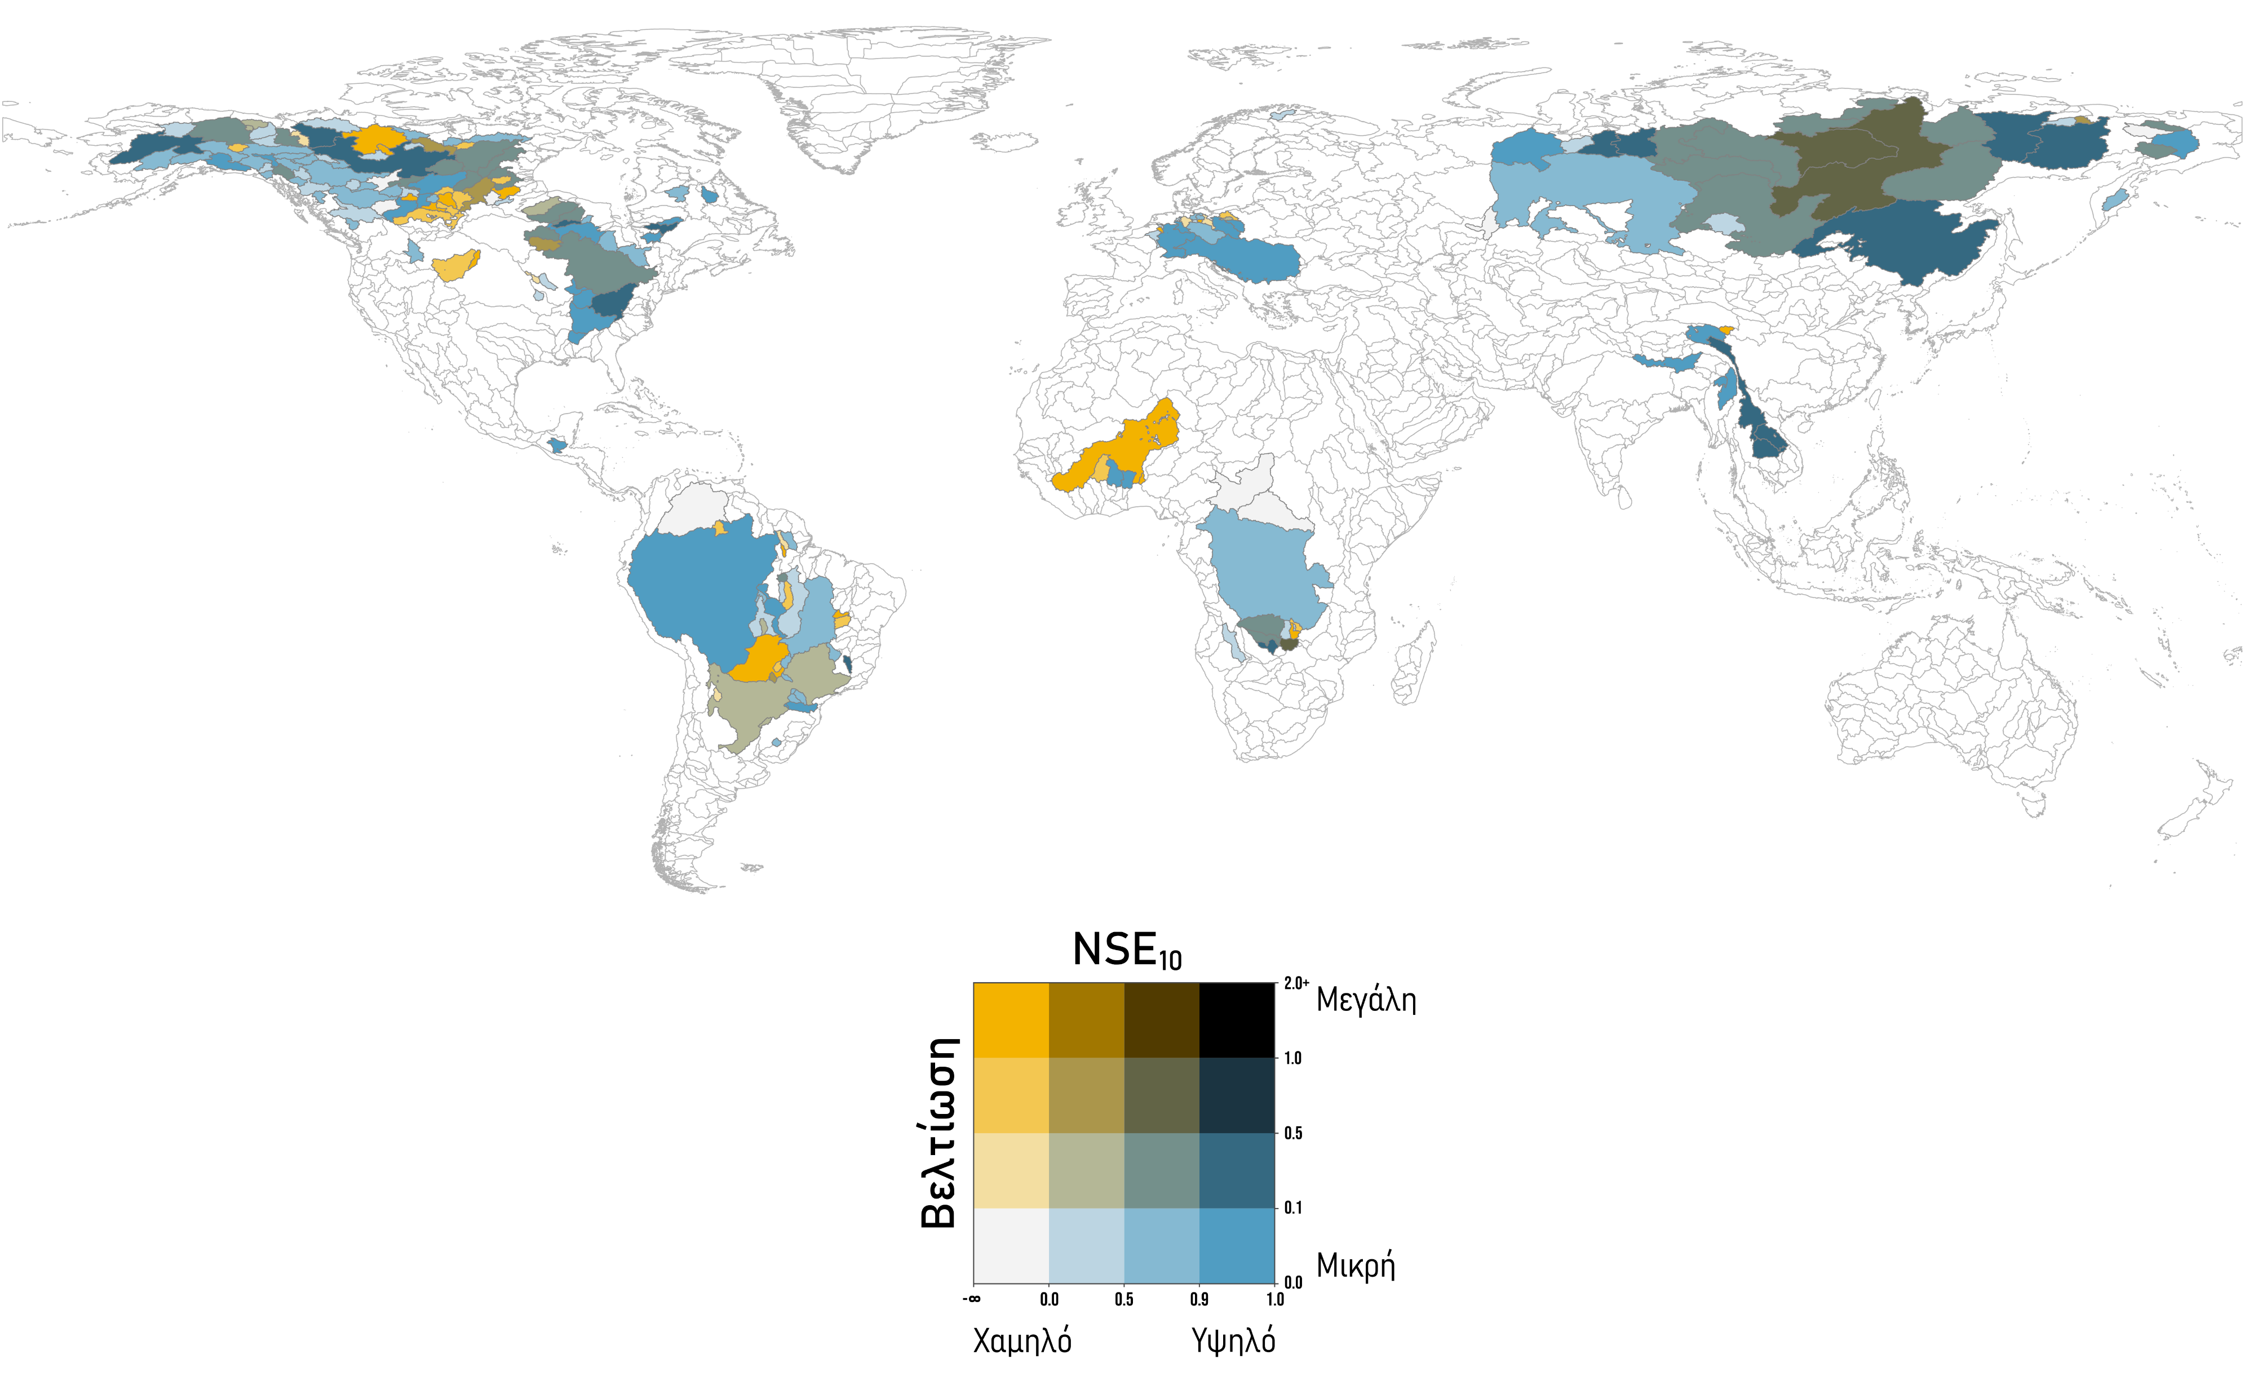
Relative Improvement
high
Best Improvement
low
low
high

Slide 19
5.1.
METHOD A
OPTIMAL ROUTING
PARAMETERS
(OPT)

Slide 20
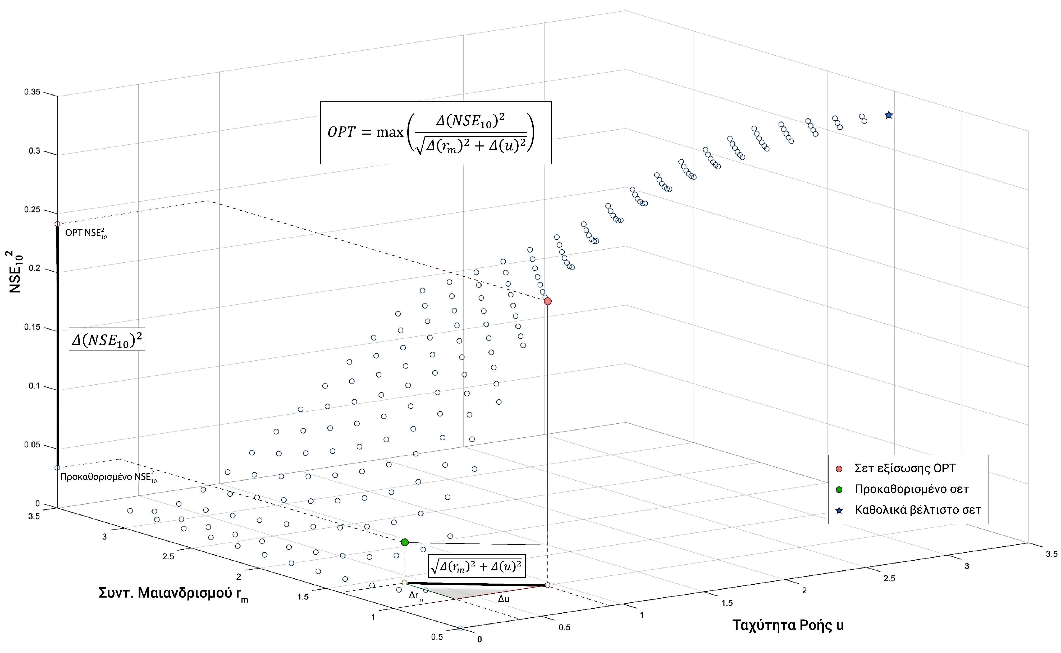
5.1.
METHOD A
OPTIMAL ROUTING
PARAMETERS
(OPT)
OPTIMIZATION STAGE
OPT equation:
NSE₁₀²
Logarithmic growth with asymptotic trends
Selection of the set with the best ratio of NSE improvement and least deviation from the predefined/default set
_{OPT}
_{Default}
_{Abs. Best}
Meander Ratio r_{m}
Flow Velocity, u (m/s)

Slide 21
5.2.
METHOD B
BASIN TYPE
ASSIGNMENT
(SLP)

Slide 22
5.2.
METHOD B
BASIN TYPE
ASSIGNMENT
(SLP)
OPTIMIZATION STAGE
SS – Sinuous Slow – Basins characterized by high meander ratio values and low river speeds.
SF – Straight Fast– Basins characterized by low meander ratio values and high river speeds
Fixed routing parameter set assignment, for each basin type, based on the average parameter value of each type
SLP equation:
Basins of type SS
Basins of type SF

Slide 23
6.1.
FUNCTION FITTING
ANN
(Method A - OPT)

Slide 24
6.1.
FUNCTION FITTING
ANN
(Method A - OPT)
CORRELATION STAGE
Input
Basins’ physiographic characteristics
Output
Optimal routing parameter set

Slide 25
6.2.
CLASSIFICATION
ANN
(Method B - SLP)

Slide 26
6.2.
CLASSIFICATION
ANN
(Method B - SLP)
CORRELATION STAGE
Input
Basins’ physiographic characteristics
Output
Basin Type (SS/SF)

Slide 27
7.
EXTRAPOLATION
AT THE GLOBAL
SCALE

Slide 28
7.
EXTRAPOLATION
AT THE GLOBAL
SCALE
μ

Slide 29
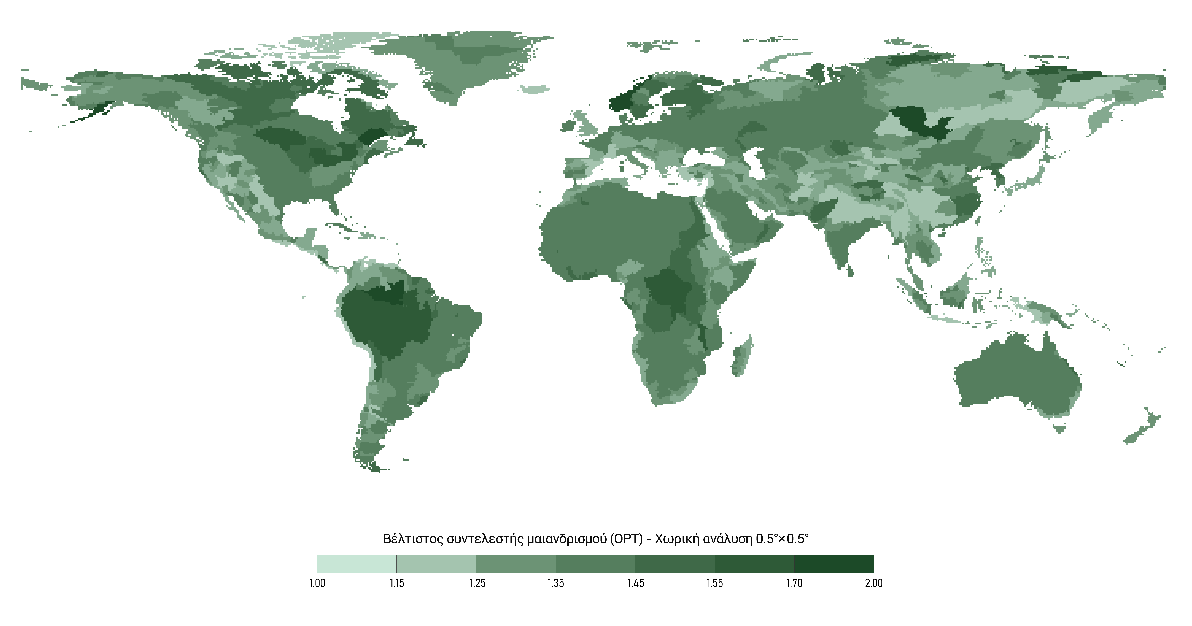
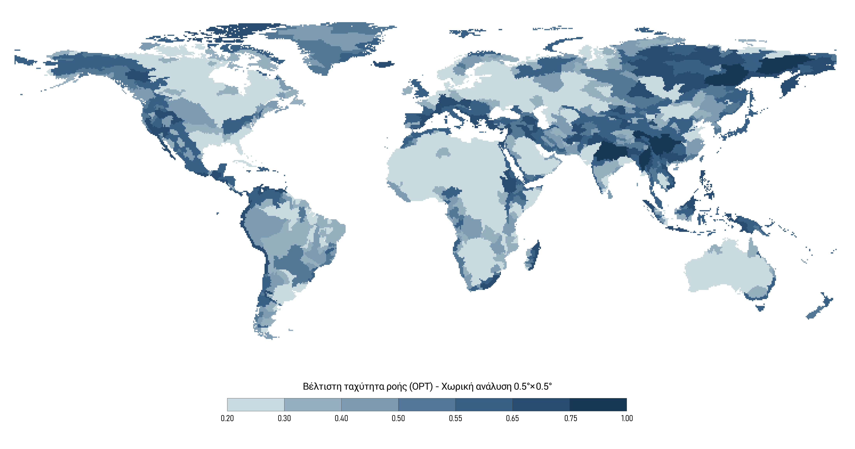
OPT routing parameters (Method A)
Res. 0.5°× 0.5°
Optimal flow velocity (OPT) – Spatial resolution 0.5°× 0.5°
Optimal meander ratio (OPT) – Spatial resolution 0.5°× 0.5°

Slide 30
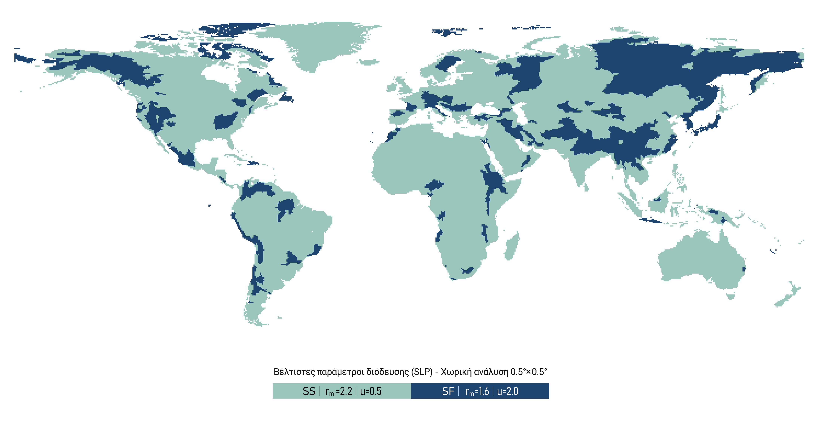
SLP routing parameters (Method B)
Res. 0.5°× 0.5°
Optimal routing parameters (SLP) – Spatial resolution 0.5°× 0.5°

Slide 31
RESULTS

Slide 32
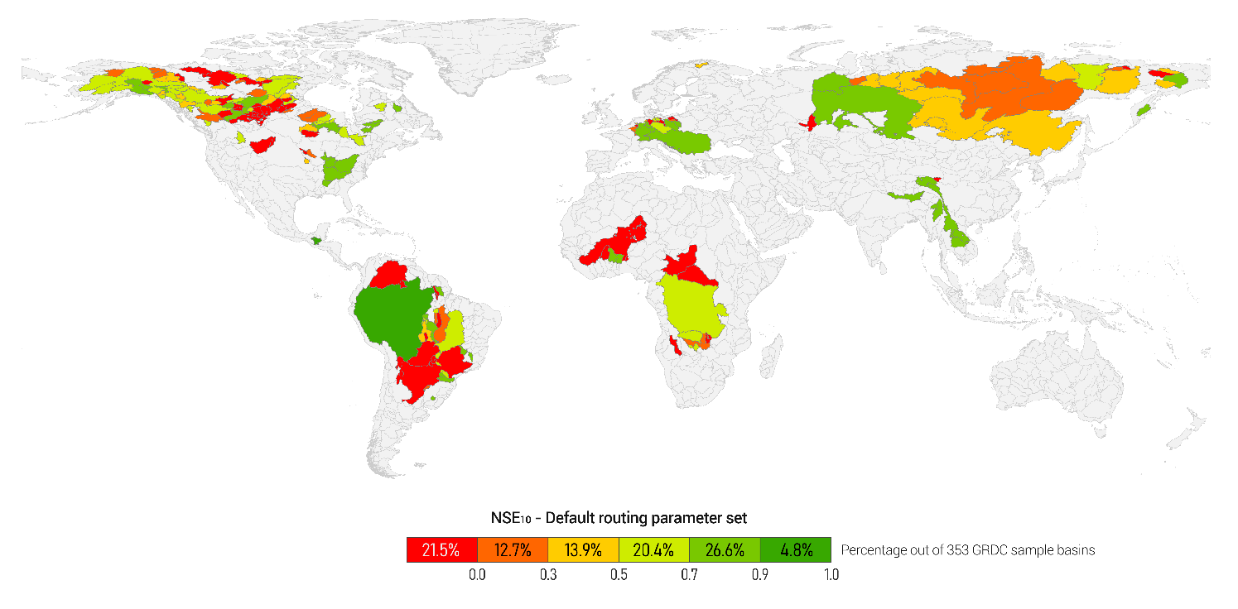
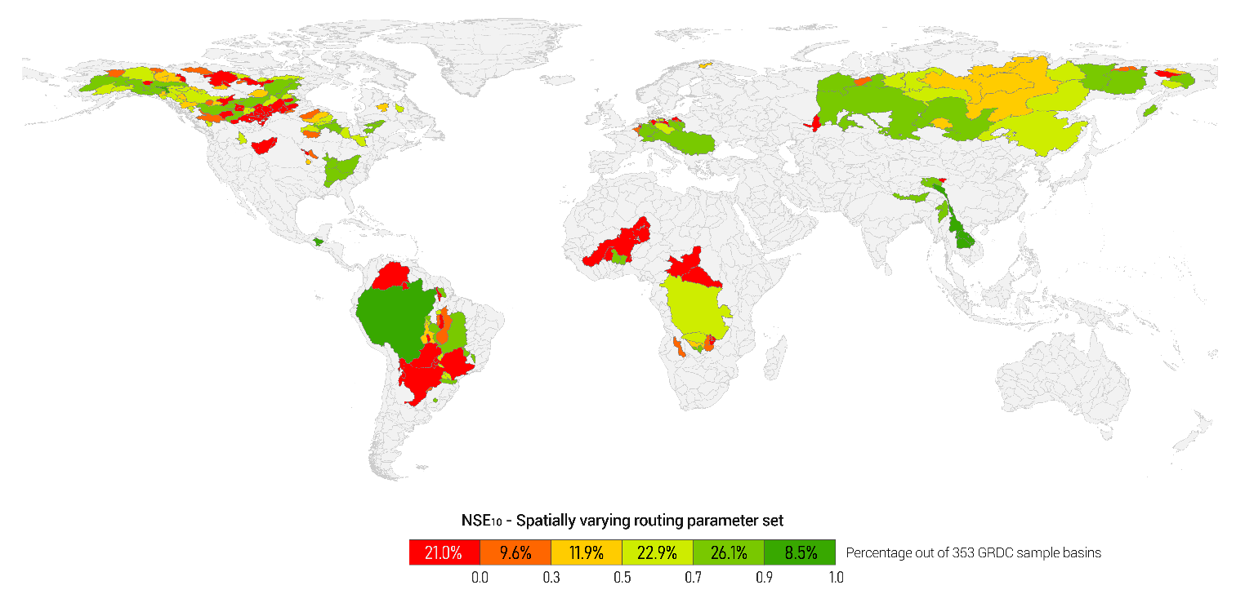
Improvement of NSE₁₀ for the new configuration over default parameter set

Slide 33
Improvement of NSE₁₀ for the new configuration over default parameter set

Slide 34
Relative Improvement
The improvement of the NSE₁₀, in relation to the achieved NSE₁₀, thus providing a better image of the actual improvement.

Slide 35
Improvement in temporal response
The change of the temporal response in six significant river basins

