Slide 1
Supplementary material
Morphology, distribution and origin of soil biogenic carbonates “queras” present in Loess-palaeosols of Ebro Valley

Slide 2
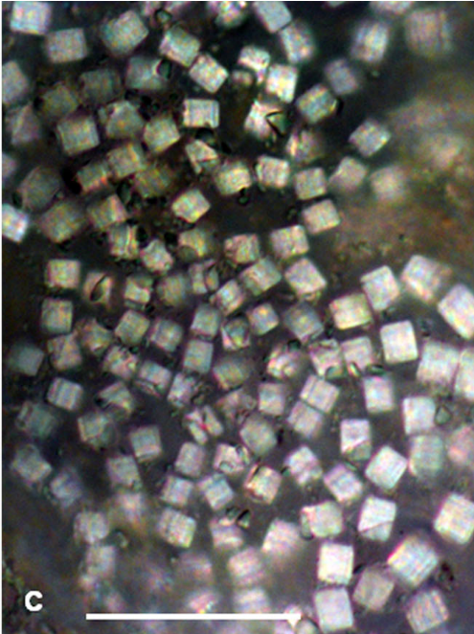
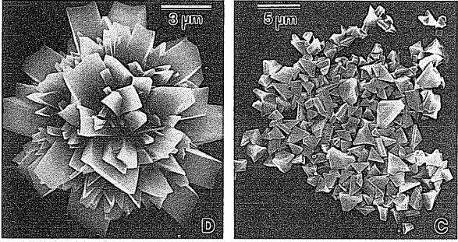
Ca-oxalate vs bioesparite
Supplementary material
The crystalline forms are considerably different (Horner and Wagner, 1995)
The experimental root-tip biomineralizations obtained by Verrechia (1992) was calcite
The FTIR analysis from the Chiprana profile did indeed correspond to calcite (Plata et al., 2022)
Calcium oxalate in biological systems/ Horner and Wagner, 1995
Vijayasankar et al., 2014

Slide 3
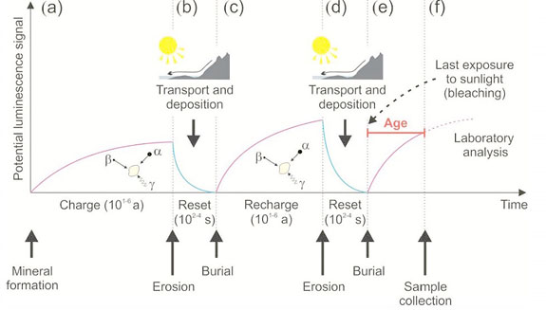
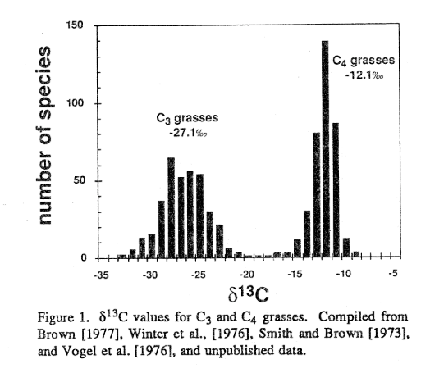
Principles of Luminescence Dating
Isotopic signature different type of plants
Fig. 2: Processes associated with OSL dating. (a) Luminescence is acquired in mineral grains with exposure to ionizing radiation and trapping of electrons. (b) The luminescence for grains is zeroed by exposure to sunlight with erosion and transport. (c) With burial and exposure to ionizing radiation free electrons are stored in charge defects within grains crystal lattice. (d) Further light exposure of grains with erosion and transport zeros the luminescence. (e) The grains are buried again and luminescence is acquired with exposure to ionizing radiation. (f) Careful sampling without light exposure and measuring of the natural luminescence, followed by a normalizing test dose (Ln/Tn) compared to the regenerative dose to yield an equivalent dose (De) (from Mellet, 2013).

Slide 4
Supplementary material
δ¹⁸O
Information on the type of meteoric water and the palaeotemperatures during its formation
Values between [-5 ‰ and -6‰]
Extrapolation of Tª (Cerling & Quade, 1993): 12ºC -17ºC
δ¹³C
Predominant palaeovegetation from C3/C4 ratio (Bayat et al., 2017)
Values between [-9‰ and -13‰]
C4 and CAM type plants
¹⁴C dating
Marine isotope stages (MIS) + pollen record in the Iberian Peninsula + paleoclimatic literature available
Bioaccumulations younger than loess deposit
Different ages from >43 ka to <2 ka
Palaeoenvironmental reconstruction

Slide 5
Palaeoenvironmental reconstruction
MIS3 – Hengelo Interestadial (43.1-41.1 ka)
(Vandenberghe and van der Plicht, 2016)
1º stage
Palaeoclimate: warmer and humid condicions
Palaeovegetation (pollen records I.P.): C4 plants, mainly Artemisia and Poaceae
(Camuera et al., 2019)
MIS2 (29 ka - 14 ka) – 2 subgroups of queras (28-29ka // ± 20 ka)
Palaeoclimate: MIS2 defined as cold and dry but there are two moments (28-29ka//± 20 ka) reported as warmer and drier
2º stage
Palaeovegetation (pollen records I.P.): Steppe taxa, such as Artemisia and Asteraceae
(Camuera et al., 2019; Vaquero et al., 2013)
MIS1 (< 14 ka) – Holoceno
The youngest queras < 5 ka
3º stage
Palaeoclimate: in general, favourable conditions for the development of life. Reported, 3 sub-stages of increased aridity (Valiño et al., 1999)
Palaeovegetation (pollen records I.P.): Growth of steppe vegetation: Poeaceae, Ericaceae, Cichorioideae, Chenopodia y Cyperaceae (Pérez-Obiol et al., 2011; Camuera et al., 2019) (Valiño et al., 1999)
Notes:
Por un lado, la composición isotópica del oxígeno nos ha permitido evaluar las condiciones climáticas generales y junto con las dataciones de radiocarbono nos permite realizar una primera aproximación del paleoambiente que exitía en el momento de la formación de las queras.
Con la firma isotópica del carbono hemos podido además relacionar el tipo de paleovegetación que las originó
On the one hand, the oxygen isotopic composition has allowed us to evaluate the general palaeoclimatic conditions related to the temperature during the formation of the queras. These formation temperatures, together with the radiocarbon dating, have allowed us to place them at a specific time and thus to make a first approximation of the palaeoenvironment that existed at the time of their formation. With the carbon isotopic signature, we have also been able to relate the type of palaeovegetation that gave rise to them.
The δ¹⁸O values, between -5 ‰ and -6‰, have permitted us to extrapolate the approximate temperatures that prevailed during its formation, giving values >12ºC, with small variations reaching up to 17ºC
The δ¹³C isotopic signal allows us to estimate the ratio of C3/C4 palaeovegetation that predominated at each moment.
These values, between -9‰ and -13‰, are associated with C4 and CAM type plants, whose development is favoured by warm and dry conditions, with low CO₂ pressure, high light availability and some risk of salinity in soil
The ¹⁴C dating of the carbonate of the queras has allowed:
to know that these bioaccumulations are later than the loess deposit where they are found
that they have different ages, finding specimens of >43 ka and very young specimens, with <2 ka.
These ages permit us to correlate them with the climatic stages reported in the literature and, therefore, to use them as a palaeoenvironmental proxy to reconstruct the palaeoenvironment of the area, differentiating stages of formation associated with a specific climate
The first stage - MIS3, concretely in the Hengelo Interstadial (43.3-41.4 ka) (Vandenberghe and van der Plicht, 2016), defined as a warm and humid - that is consistent with the pollen record (Iberian Peninsula), where C4 plants were predominant, mainly Artemisia and Poaceae-type plants (Camuera et al., 2019).
MIS2 usually defined as a cold and dry stadium, permits the differentiation of two subgroups of queras, associated with two climatically most favourable moments for the development of vegetation.
A first moment - limit between MIS3 and MIS2 (28-29ka)- and a second peak -around 20 ka-, both moments reported in the literature as warmer and drier, favouring the development of steppe taxa, such as Artemisia and Asteraceae (Camuera et al., 2019; Vaquero et al., 2013). Finally, the youngest queras, < 5 ka old, are included in the Holocene, a period with a generalised development of life, where sub-stages of greater aridity can be differentiated (Valiño et al., 1999), which are more favourable for the growth of this steppe vegetation.

Slide 6
INDEX
Introduction
Geography situation
Main charactersitics
Importance study os Loess
Objetives
Materials and Methods
General and particular
Results and discusion
Analysis macro-micro-cathodoluminiscence
Isotopic composition and radiocarbon dating
Palaeoenviromental reconstruction
Conclusions

