Slide 1
Sectoral water usage in the Community Earth System Model
Ioan Sabin Taranu, David Lawrence, Yoshihide Wada, Ting Tang, Yi Yao, Inne Vanderkelen, Steven De Hertog, Wim Thiery

Slide 2
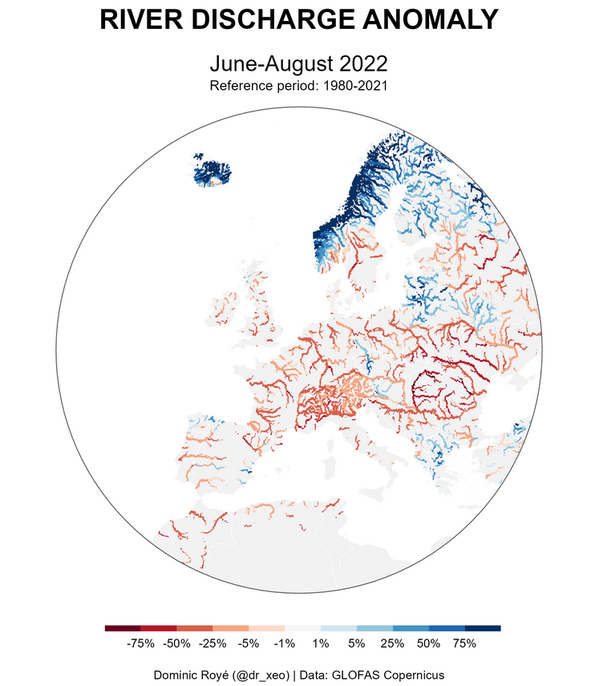
Overview of the problem
Water scarcity
Key Point:
Climate change is making heat extremes and droughts more common and severe.
Reliable projections become critical for efficient water management.

Slide 3
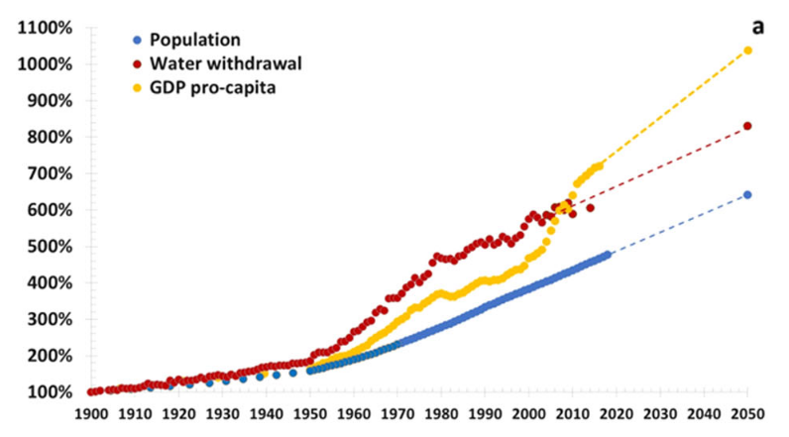
Overview of the problem
Global water use
Population
Key Point:
Population and standard of living are driving the increase in water withdrawal.
Water withdrawal
GDP per-capita
Boretti, A. & Rosa, L. Reassessing the projections of the World Water Development Report. npj Clean Water 2, 15 (2019).

Slide 4
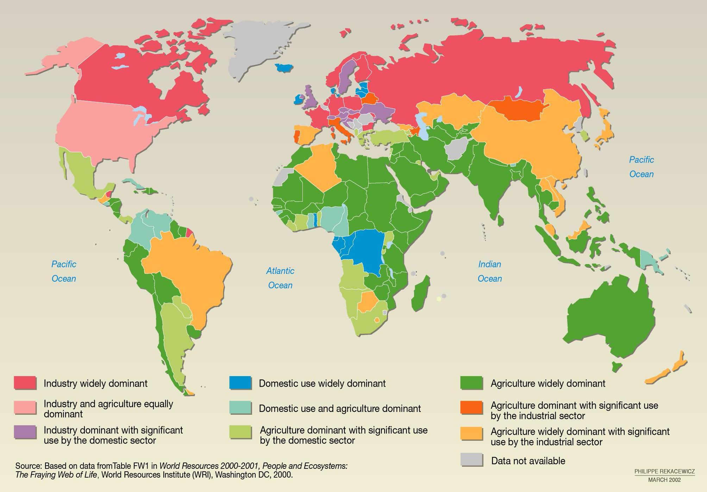
Overview of the problem
Complex water usage patterns
Key Point:
Complex spatial and temporal variability of sectoral water usage patterns to consider.

Slide 5
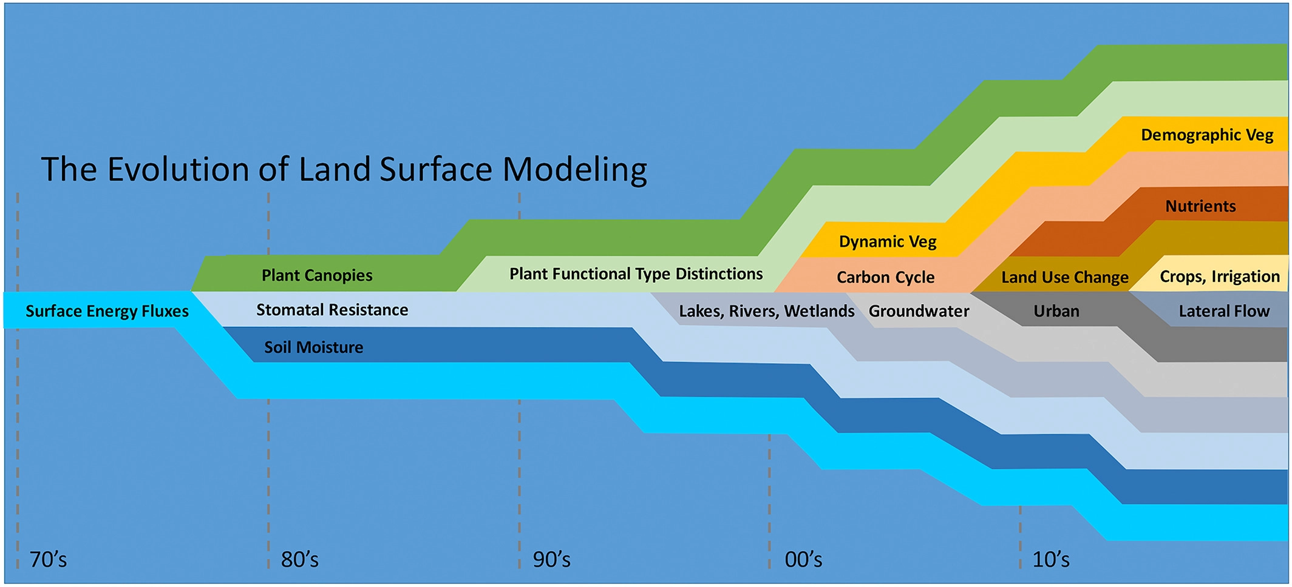
Current models limitations
Human-water interaction not captured in Earth System models
Key Point:
Human-water interactions not captured in current Land Surface Models.
Important limitation in achieving effective water management in a changing climate.
Fisher, R. A., & Koven, C. D. (2020). Perspectives on the future of land surface models and the challenges of representing complex terrestrial systems. Journal of Advances in Modeling Earth Systems, 12, e2018MS001453. https://doi.org/10.1029/2018MS001453

Slide 6
Implementation of sectoral water usage in CESM
Daily process
CTSM
Land Model
MOSART
Routing Model
Domestic
Monthly process
River Water
Supply
Irrigation
Livestock
Competition
for water
Input
Data
Sectoral withdrawal and consumption
Mining
Electric
Consumed Flow (sector/country dependent)
Ingested data based on Huang et al., 2018
Recycled Flow
(sector/country dependent)
Manufacturing
Water
Recycling
Surface Water
Energy Exchange

Slide 7
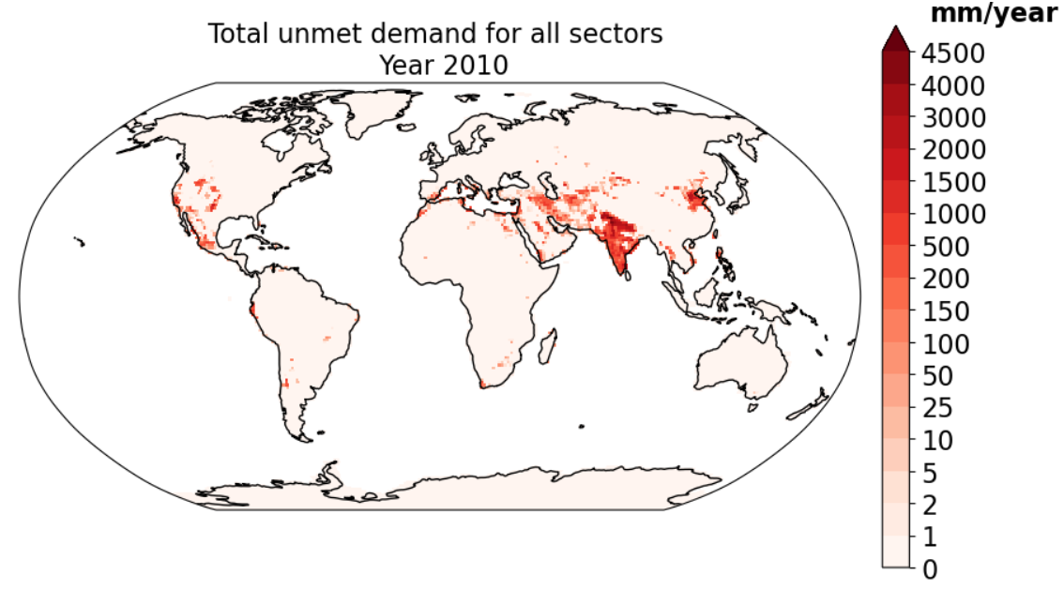
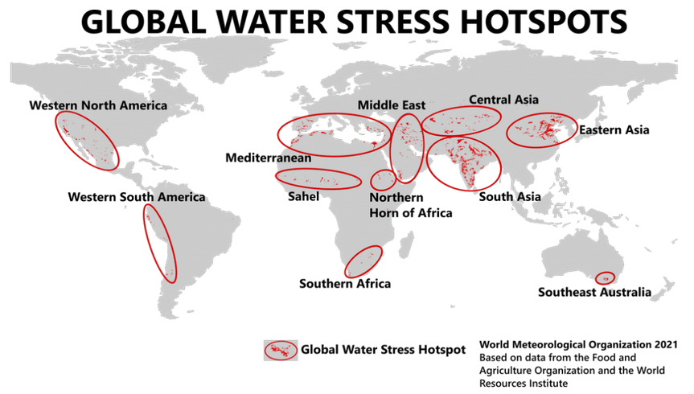
Application
Model performance in identifying water scarcity
Our model can identify the water scarcity hotspots, but through directly accounting the dynamics between the sectoral demand and supply on a day-to-day basis.

Slide 8
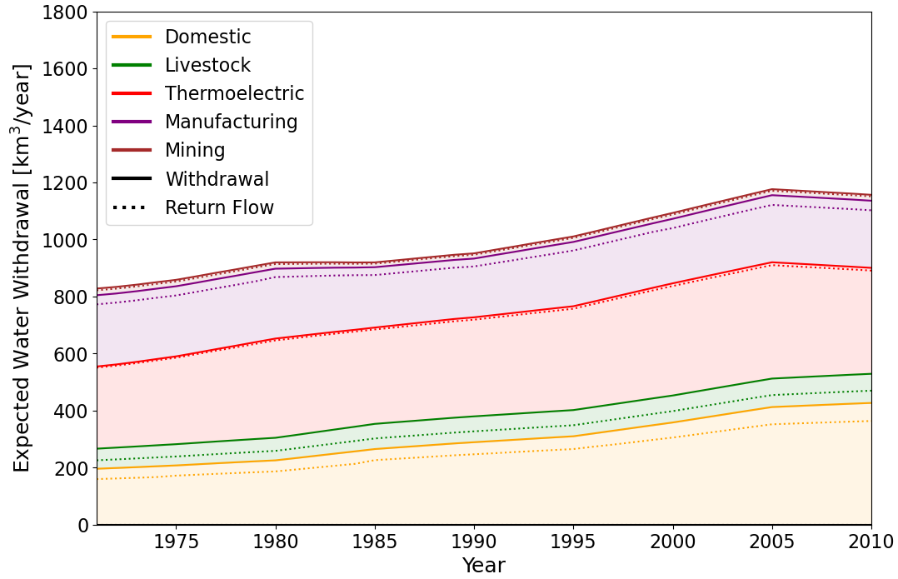
Methodology
Input data
Data source | Huang et al, 2018
Time frequency | Monthly
Spatial resolution | 0.5x0.5 deg
Provided variables | Withdrawal, Consumption
Used sectors | Domestic, Livestock, Thermoelectric, Manufacturing, Mining
How the data was generated | Reconstruction based on subnational and national statistics. But also complemented through modelling
Total sectoral withdrawal (except irrigation) in 2010 is: 1152.0 km3/year
Total sectoral consumption (except irrigation) in 2010 is: 171.0 km3/year
Total increase in sectoral withdrawal (except irrigation) between the period 1971-2010 is about: 334.0 km3/year. A relative increase of 41.0%

Slide 9
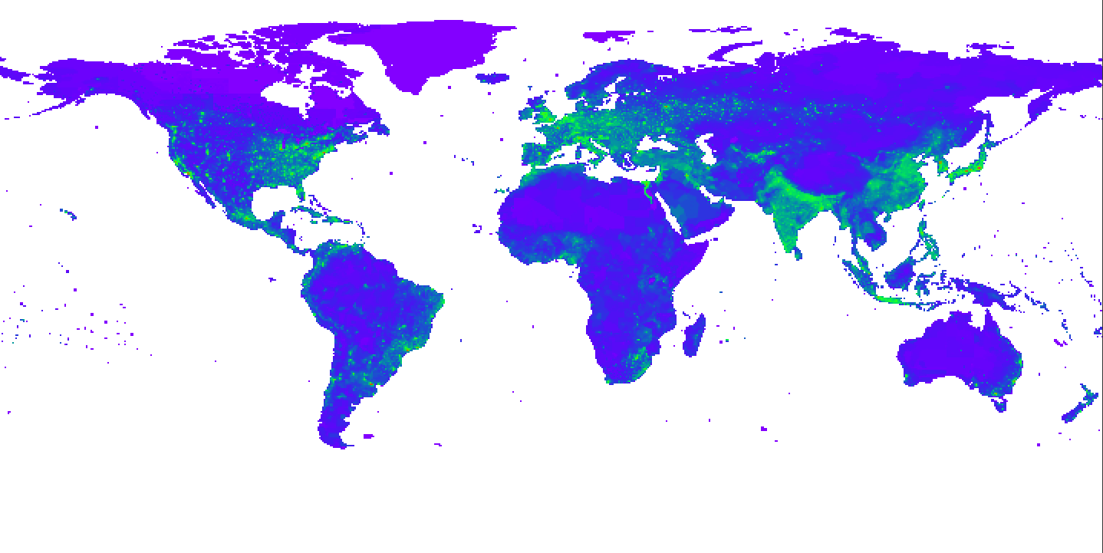
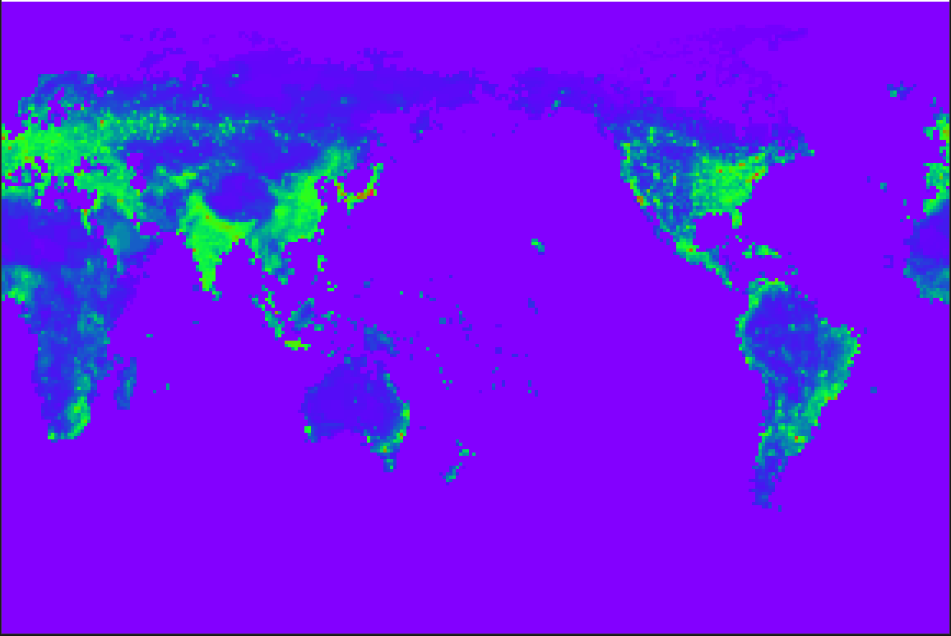
Methodology
Input data
Conservative remapping from original grid to CLM land grid for given resolution
0.5x0.5deg -> 0.9x1.25deg
With correct land mask definition

Slide 10
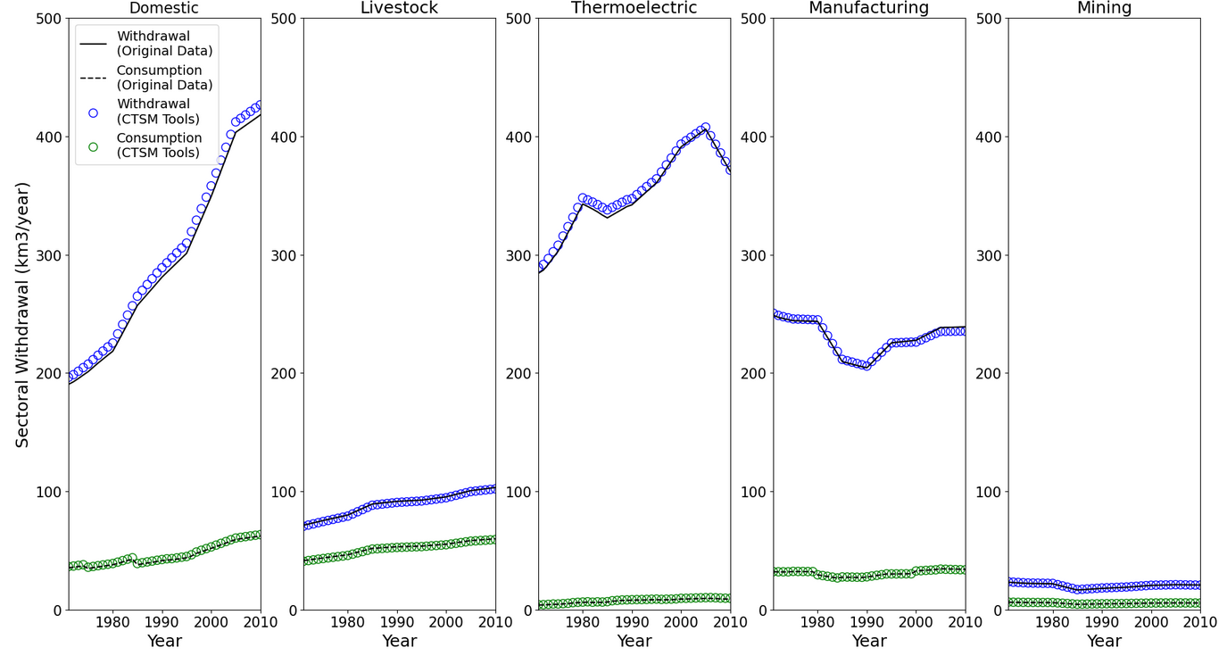
Methodology
Input data ingestion method
Key Point:
Before ingesting the input data, remapping is required to the model land grid.
The plots show that a relatively conservative remapping was achieved, despite difference in resolution and grid.

Slide 11
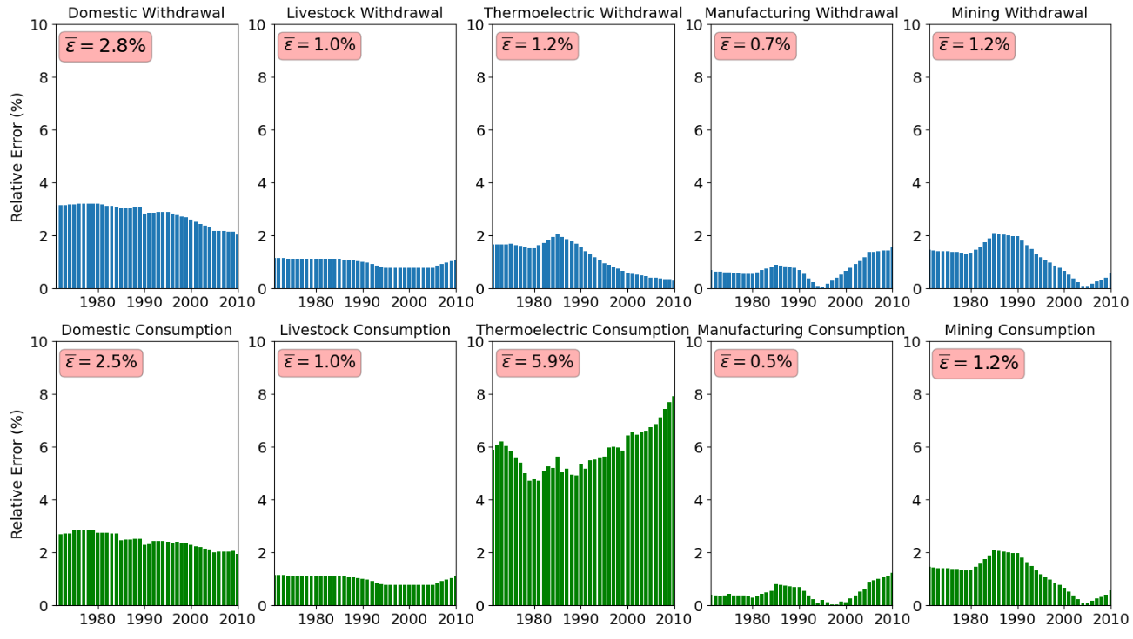
Methodology
Input data ingestion method
Key Point:
Relative error from remapping bellow 3% globally.

Slide 12
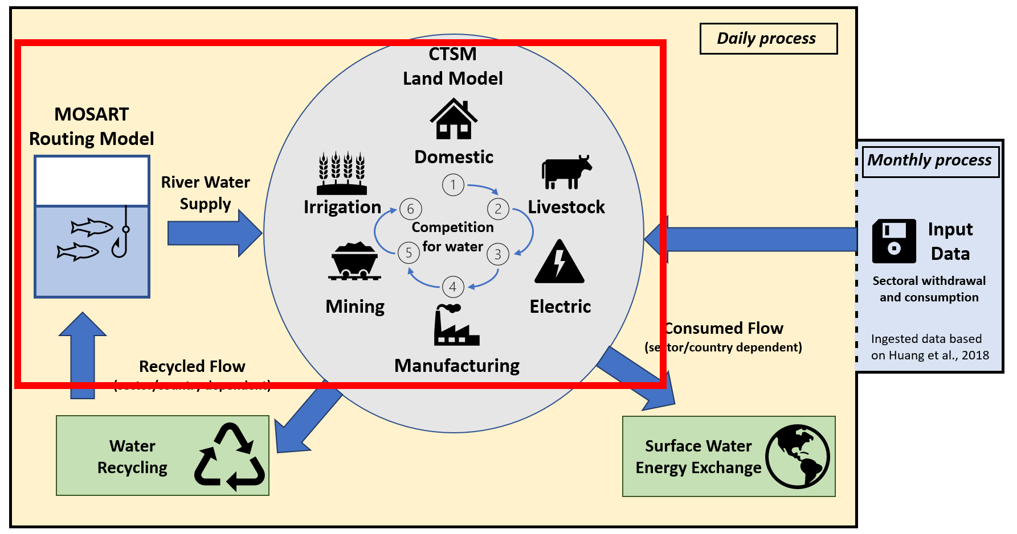
Daily fluxes from input data
How we compute daily expected abstractions fluxes?
Let’s follow a hypothetical scenario of a gridcell located in a small urban area.
We will analyze the dynamics between demand and supply at daily basis for one summer season.

Slide 13
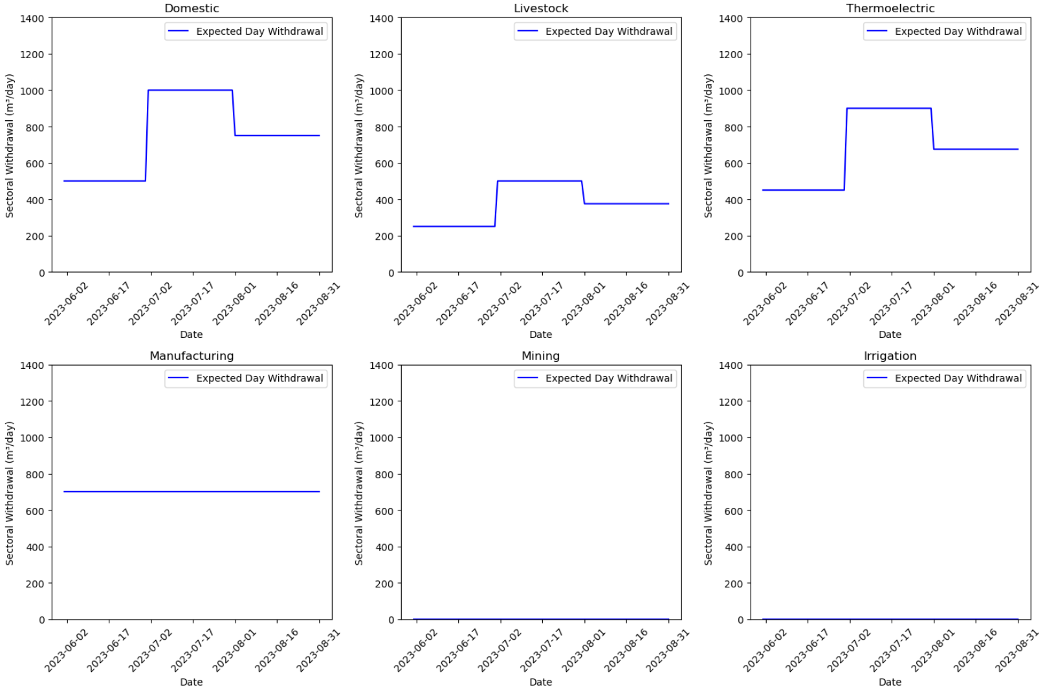
Daily fluxes from input data
Expected Monthly -> Daily fluxes obtained assuming uniform distribution
Seasonality is usually not strong (manufacturing or mining) or is not well modelled (livestock)
At gridcell level, some sectors may not be represented (e.g., no irrigation fields, or livestock production)

Slide 14
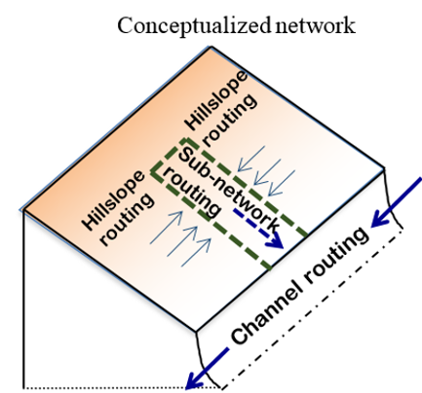
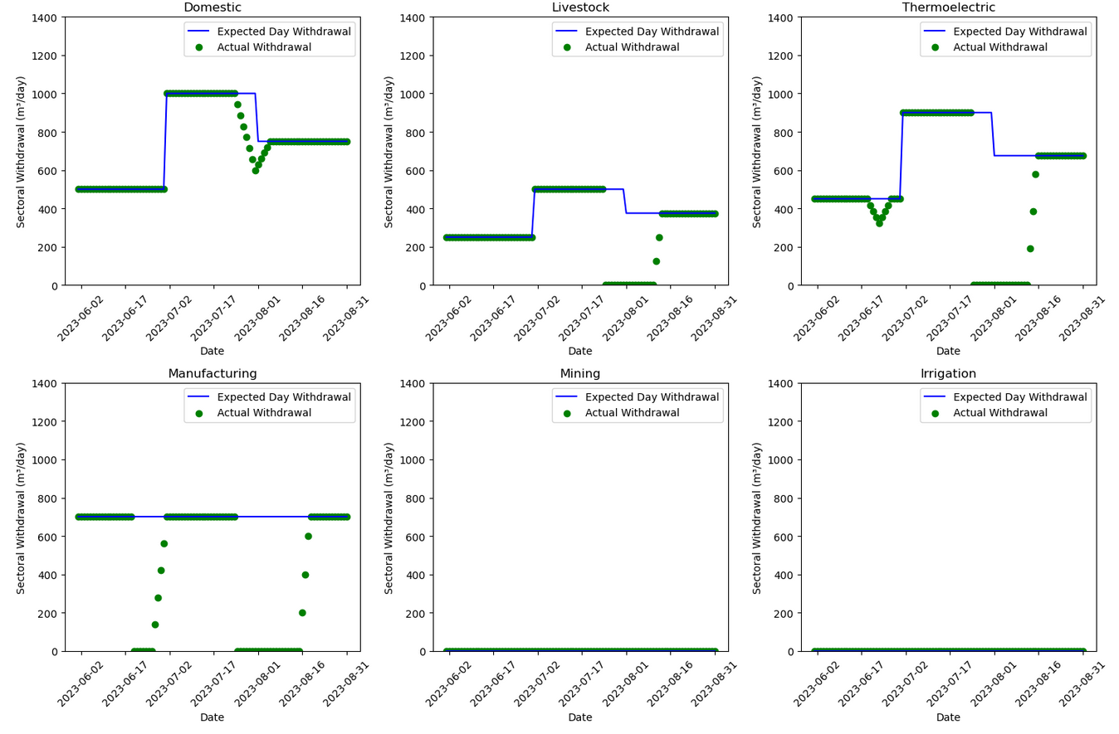
Daily fluxes from input data
Expected fluxes
VOLR (river water storage)
Sectoral competition order
Actual fluxes

Slide 15
Daily fluxes from input data
Small drought in June. There is enough water for domestic and livestock, but thermoelectric use is reduced.
The recovery of lower priority sectors happens only after the upper ones are satisfied.
Is this realistic?

Slide 16
Daily fluxes from input data
Bigger drought in July-August. Even domestic supply is reduced (first in priority).
Remaining sectors start recovering gradually one after another.

Slide 17
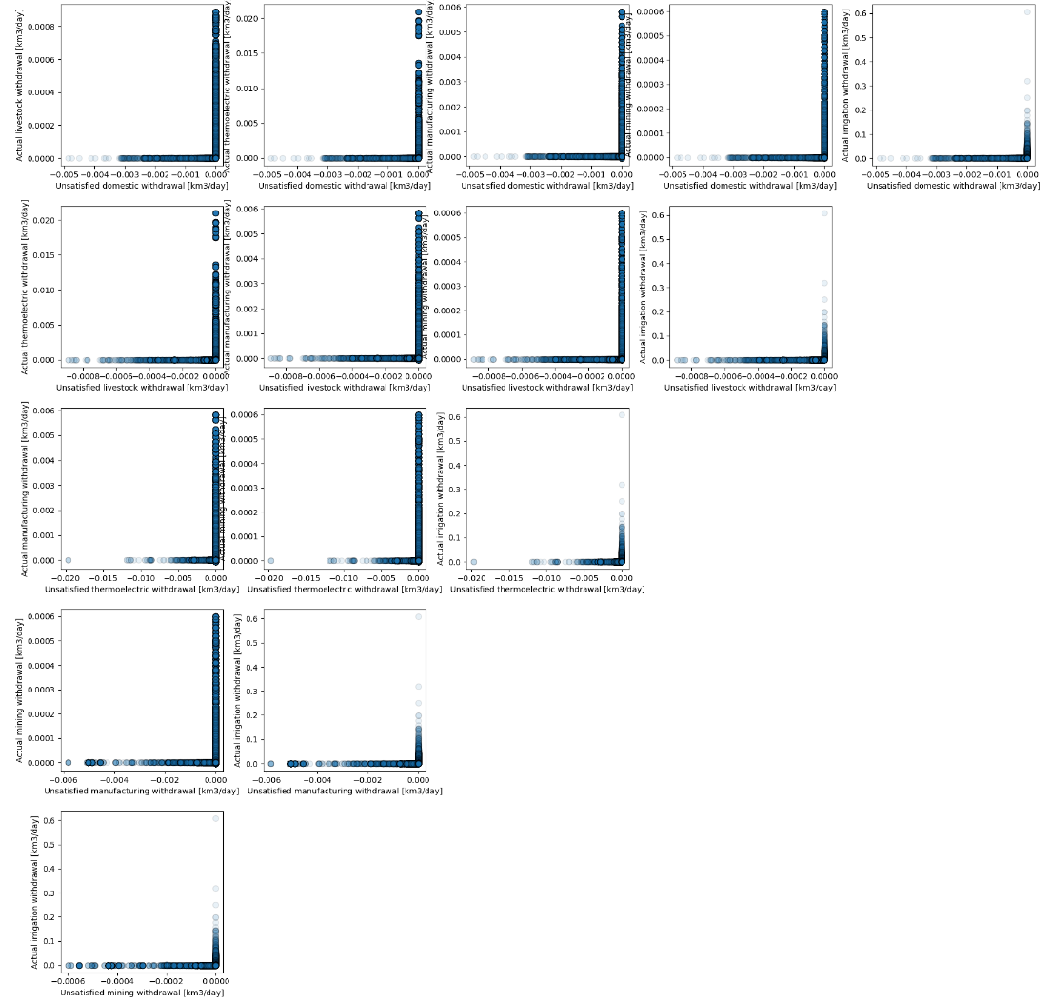
Daily fluxes from input data
When withdrawal is unsatisfied for a sector higher in priority, no actual withdrawal is possible for the sectors lower in priority.

Slide 18
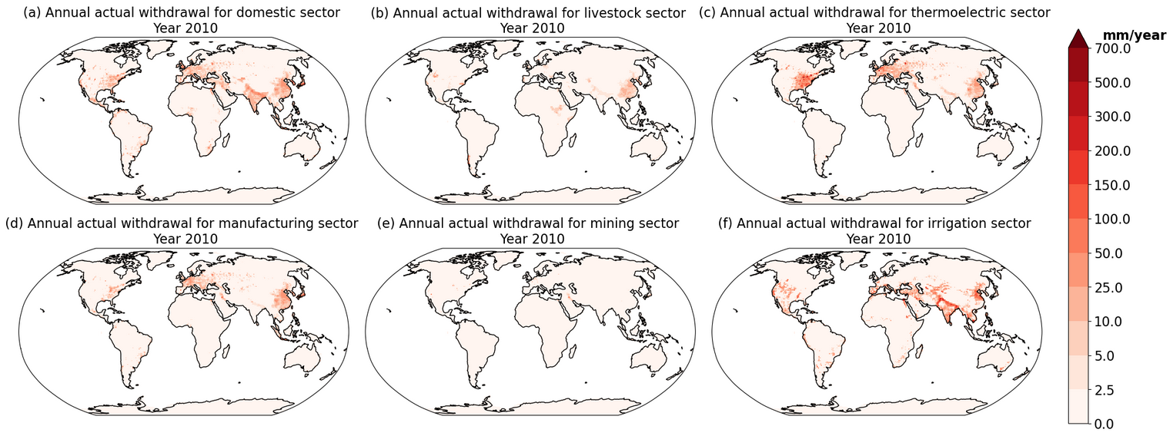
Application
Spatial Patterns of sectoral water usage

Slide 19
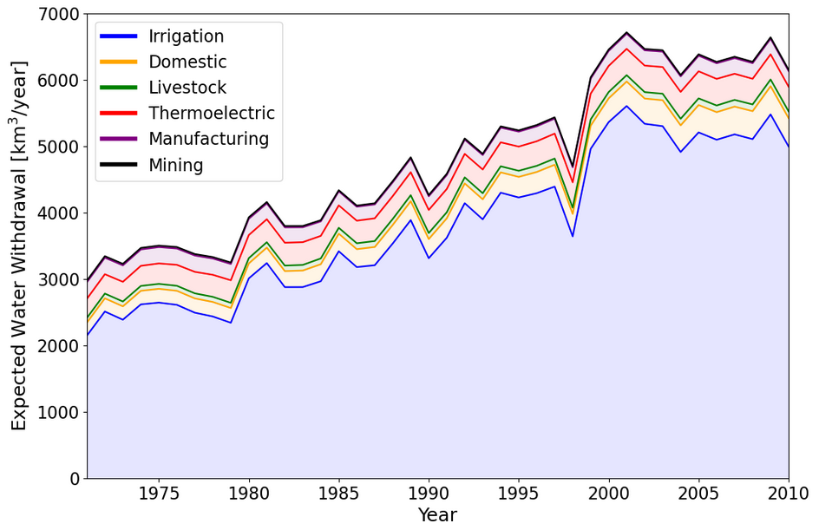
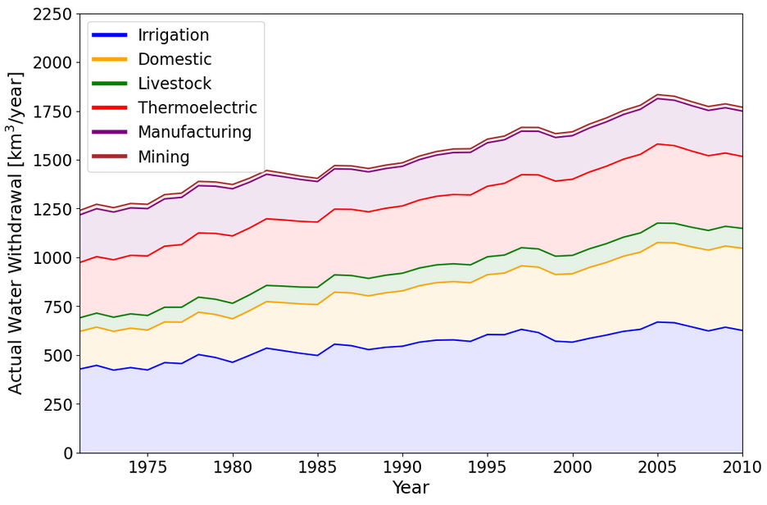
Application
Expected vs actual water withdrawal
Globally we can satisfy most of the sectoral demand, except for irrigation.
According to FAO, in 2010, the total actual withdrawal was about 2800km3. The inability of the model to reproduce these results is indicative of some of the missing elements in our approach: groundwater abstraction, and water management (e.g., usage of reservoirs and lakes).

Slide 20
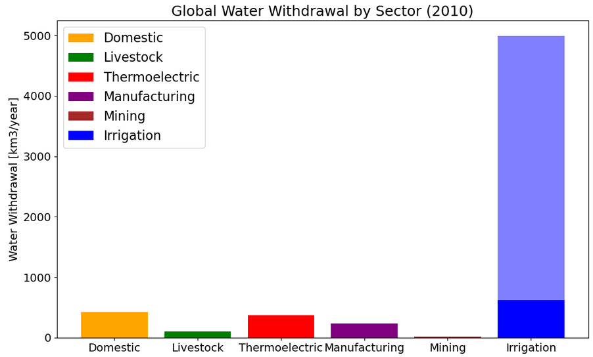
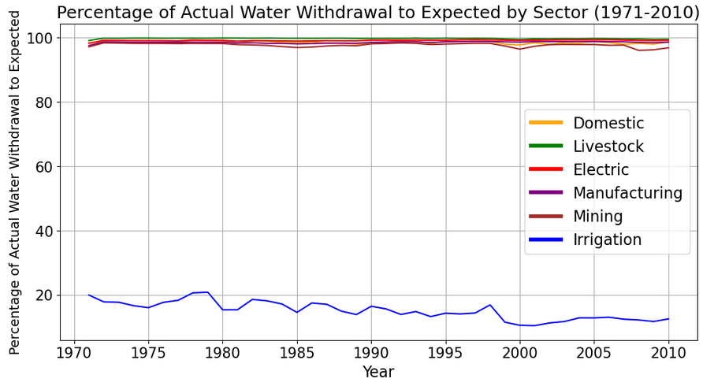
Application
What fraction of water Demand can be supplied
from rivers at grid cell level?

Slide 21
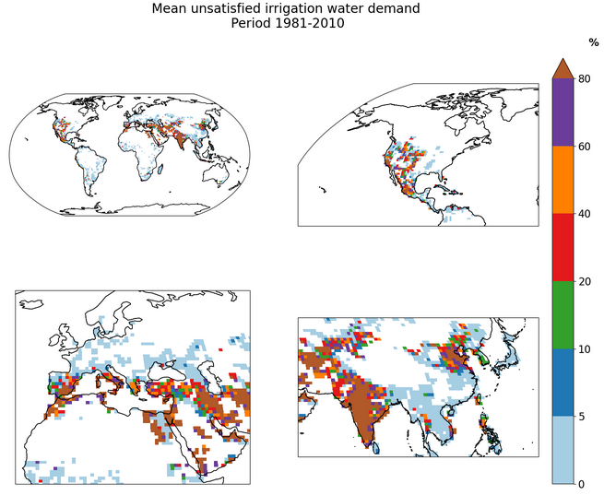
Application
More detailed Look into irrigation supply problem
Irrigation is typically required in arid and semi-arid regions, as well coastal areas with humid/dry seasonality.
Irrigation is also seasonal and may request a lot of water on specific days.
It is therefore not surprising that the model struggles to supply the water from same gridcell alone.
At the same time, this result is indicative of current model limitations. We need to expand model possibilities for supply from groundwater and reservoirs.

Slide 22
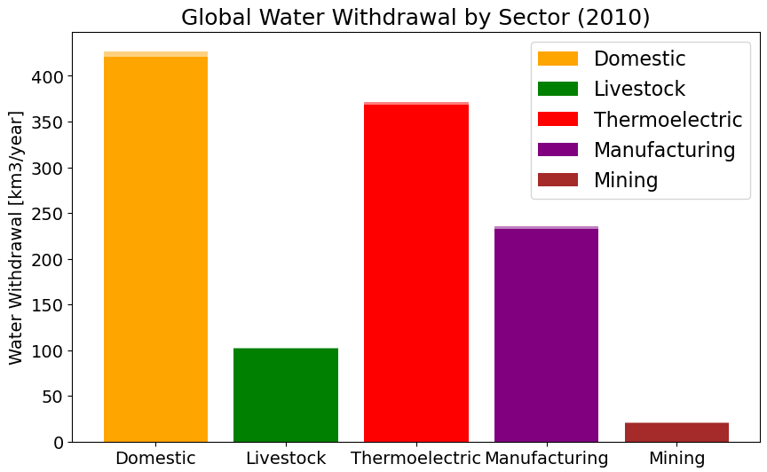
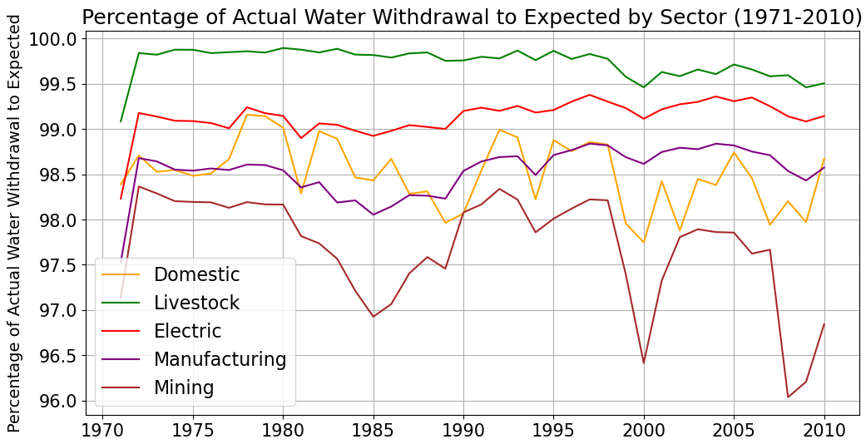
Application
What fraction of water Demand can be supplied
from rivers at grid cell level?

Slide 23
Application
Model performance in identifying water scarcity
Our model can identify the water scarcity hotspots, but through directly accounting the dynamics between the sectoral demand and supply on a day-to-day basis.

Slide 24
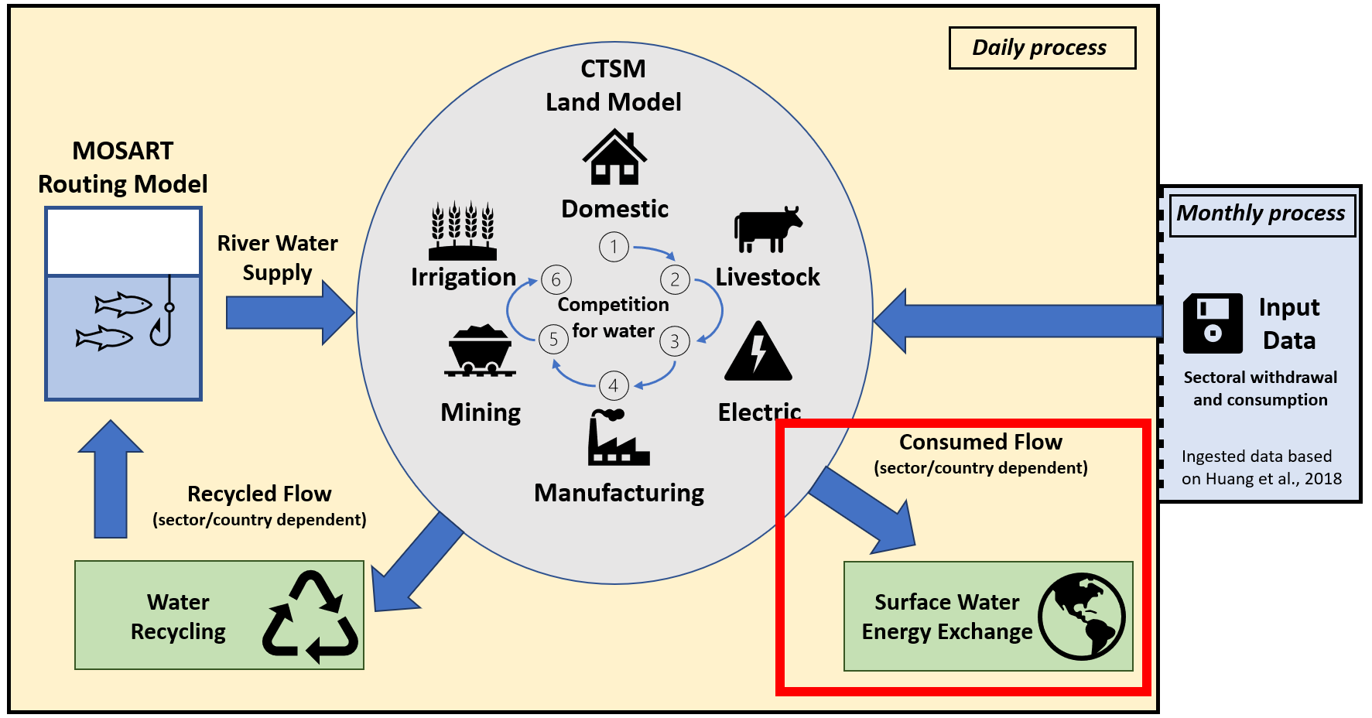
Consumption Flow
Can have an impact on land surface water-energy budget.

Slide 25
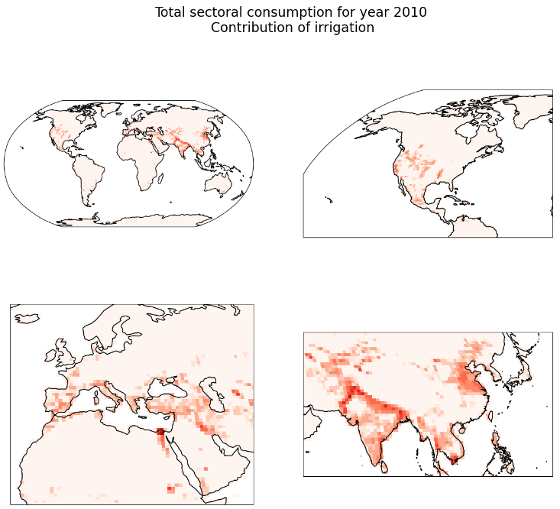
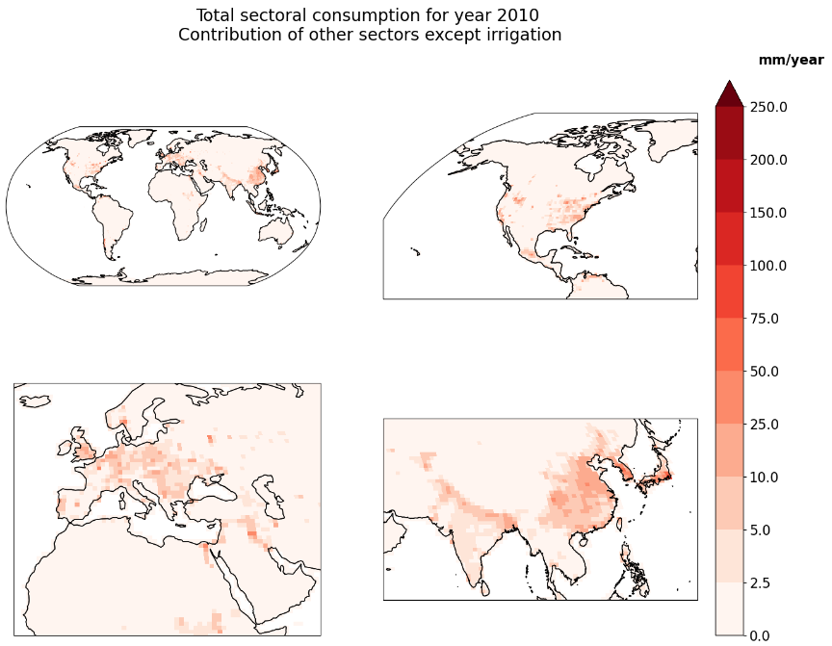
Application
Total consumption from irrigation and other sectors

Slide 26
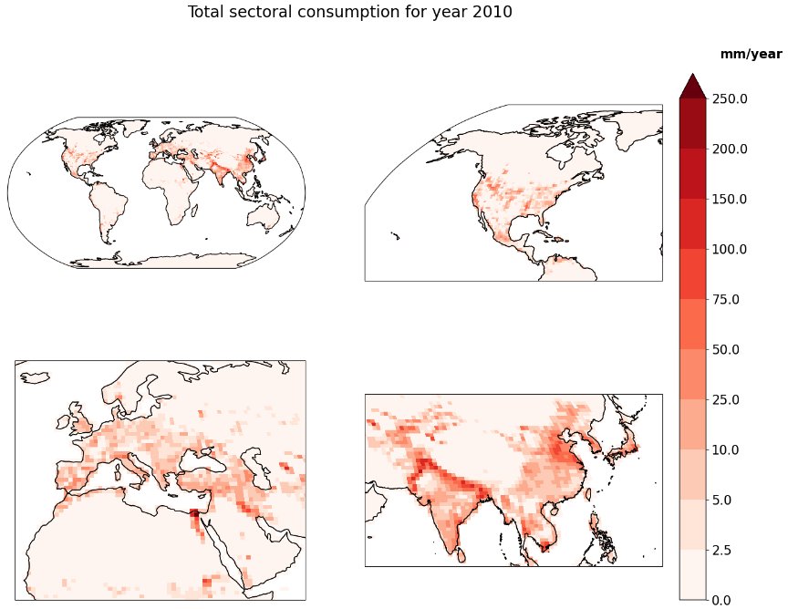
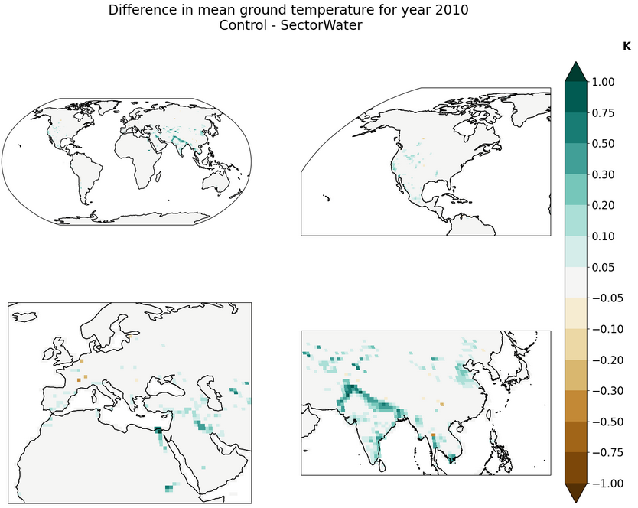
Application
Effect of sectoral consumption on ground temperature

Slide 27
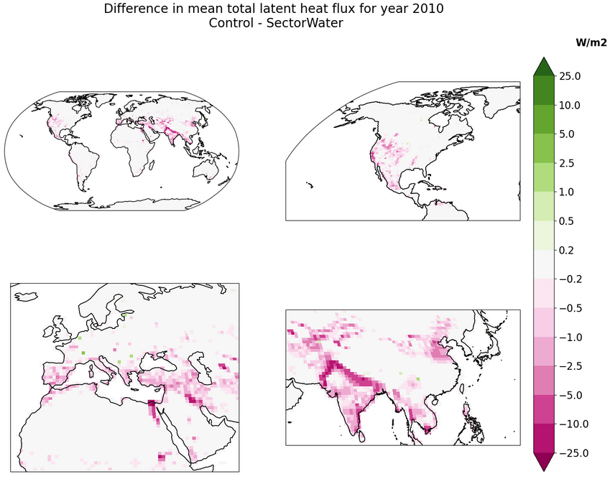
Application
Effect of sectoral consumption on latent heat flux

Slide 28
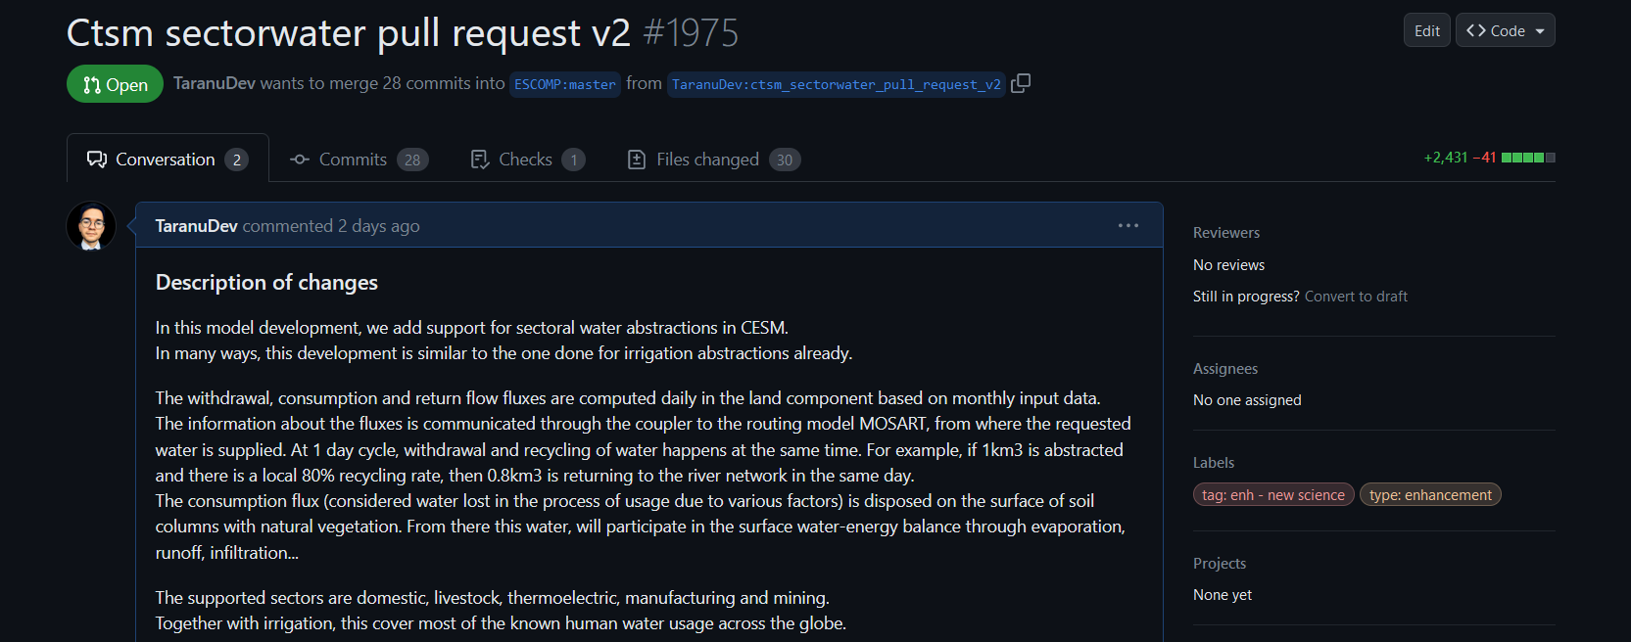
Pull request
Potentially soon to become officially available
for the main model distribution
46 affected modules, with a few new modules created from scratch.
Around 5500 lines of code to integrate. Everything is open source.
Contact me: Sabin.Taranu@vub.be

