Slide 1
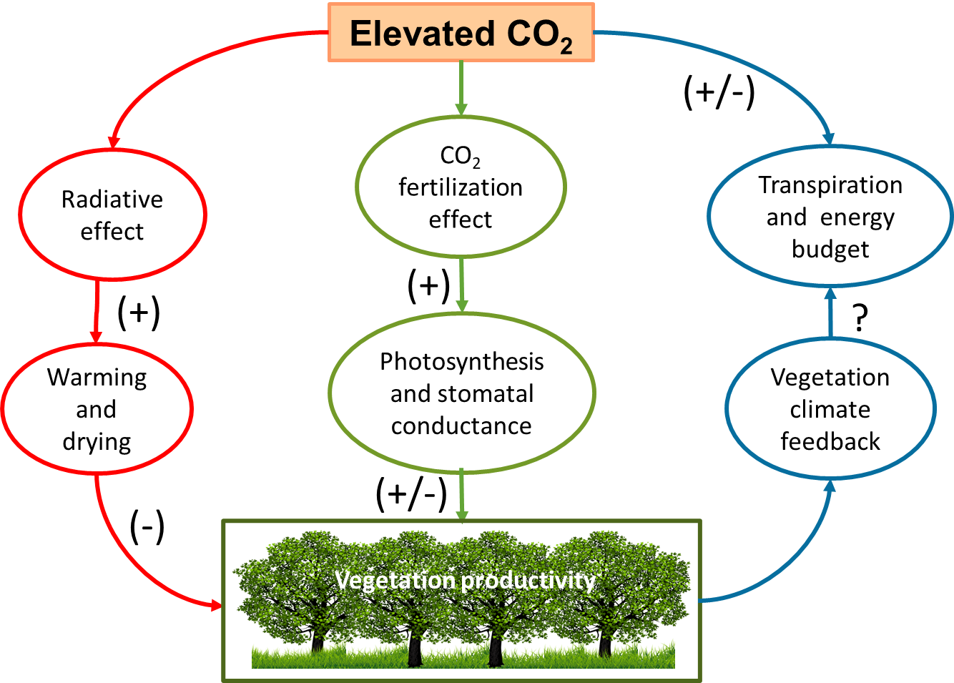
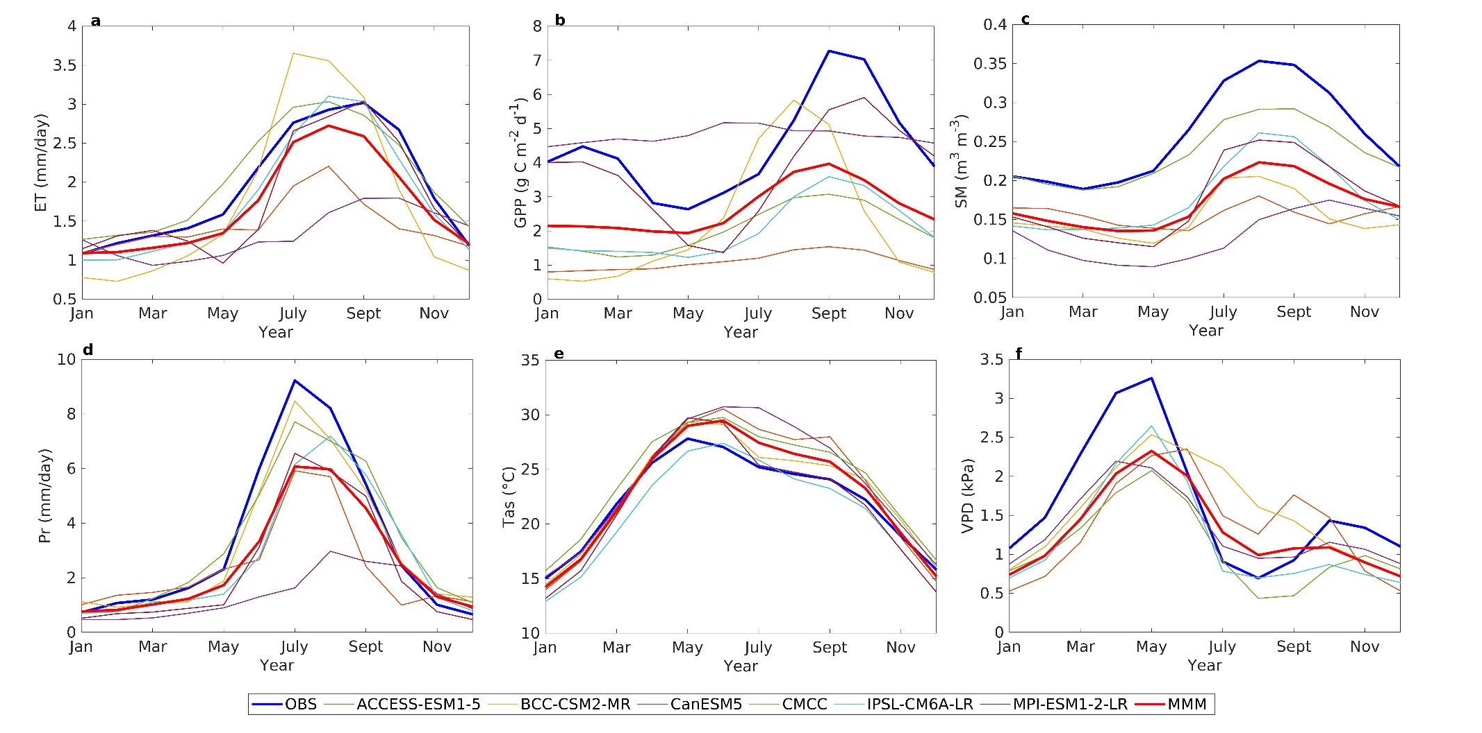
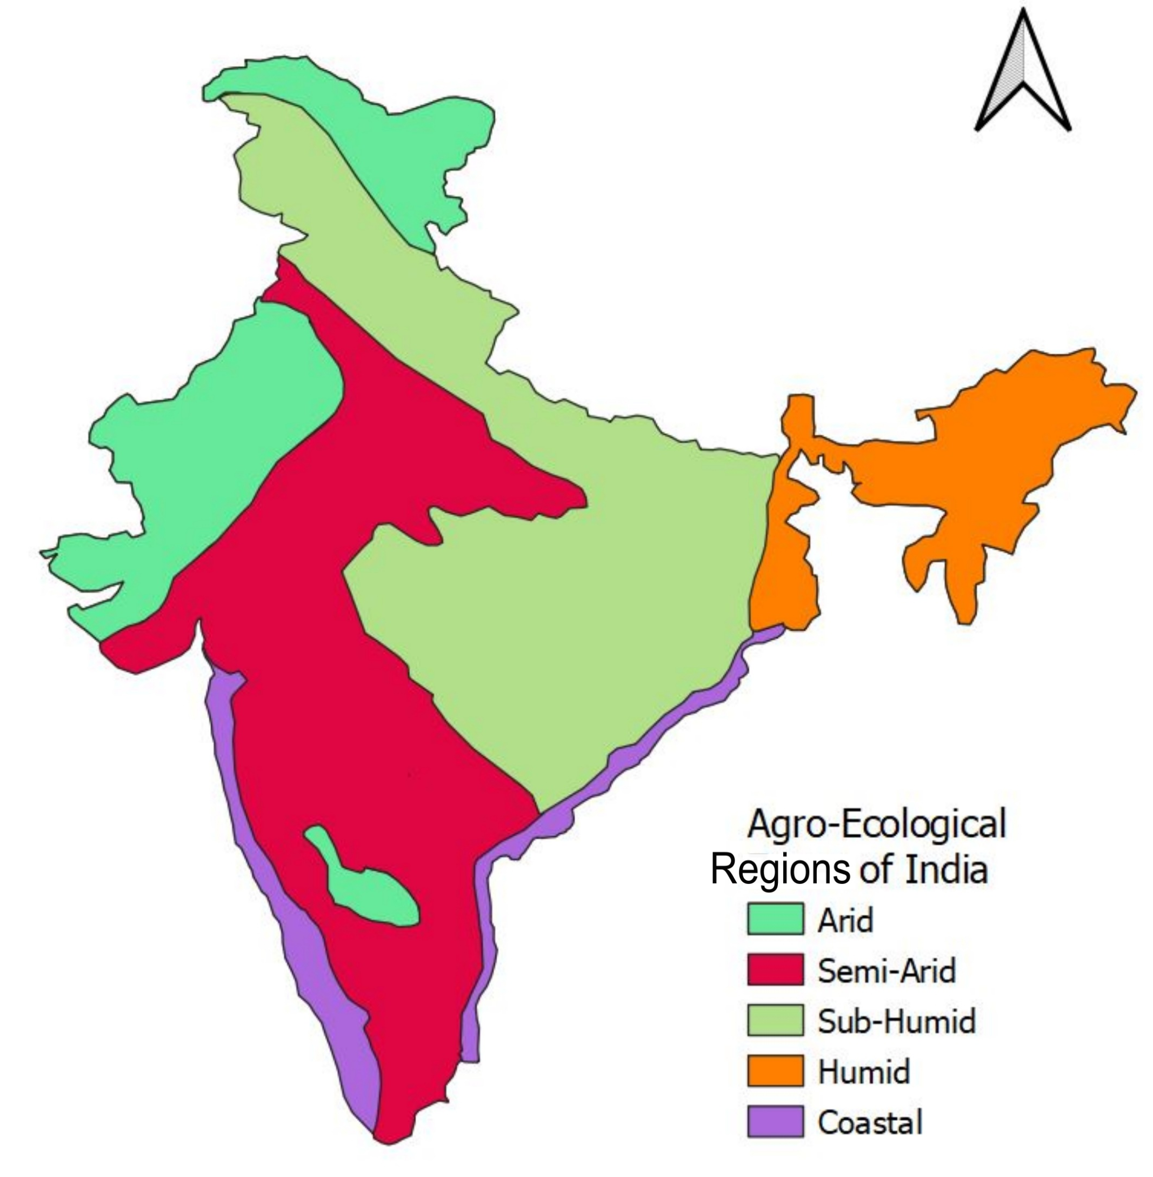
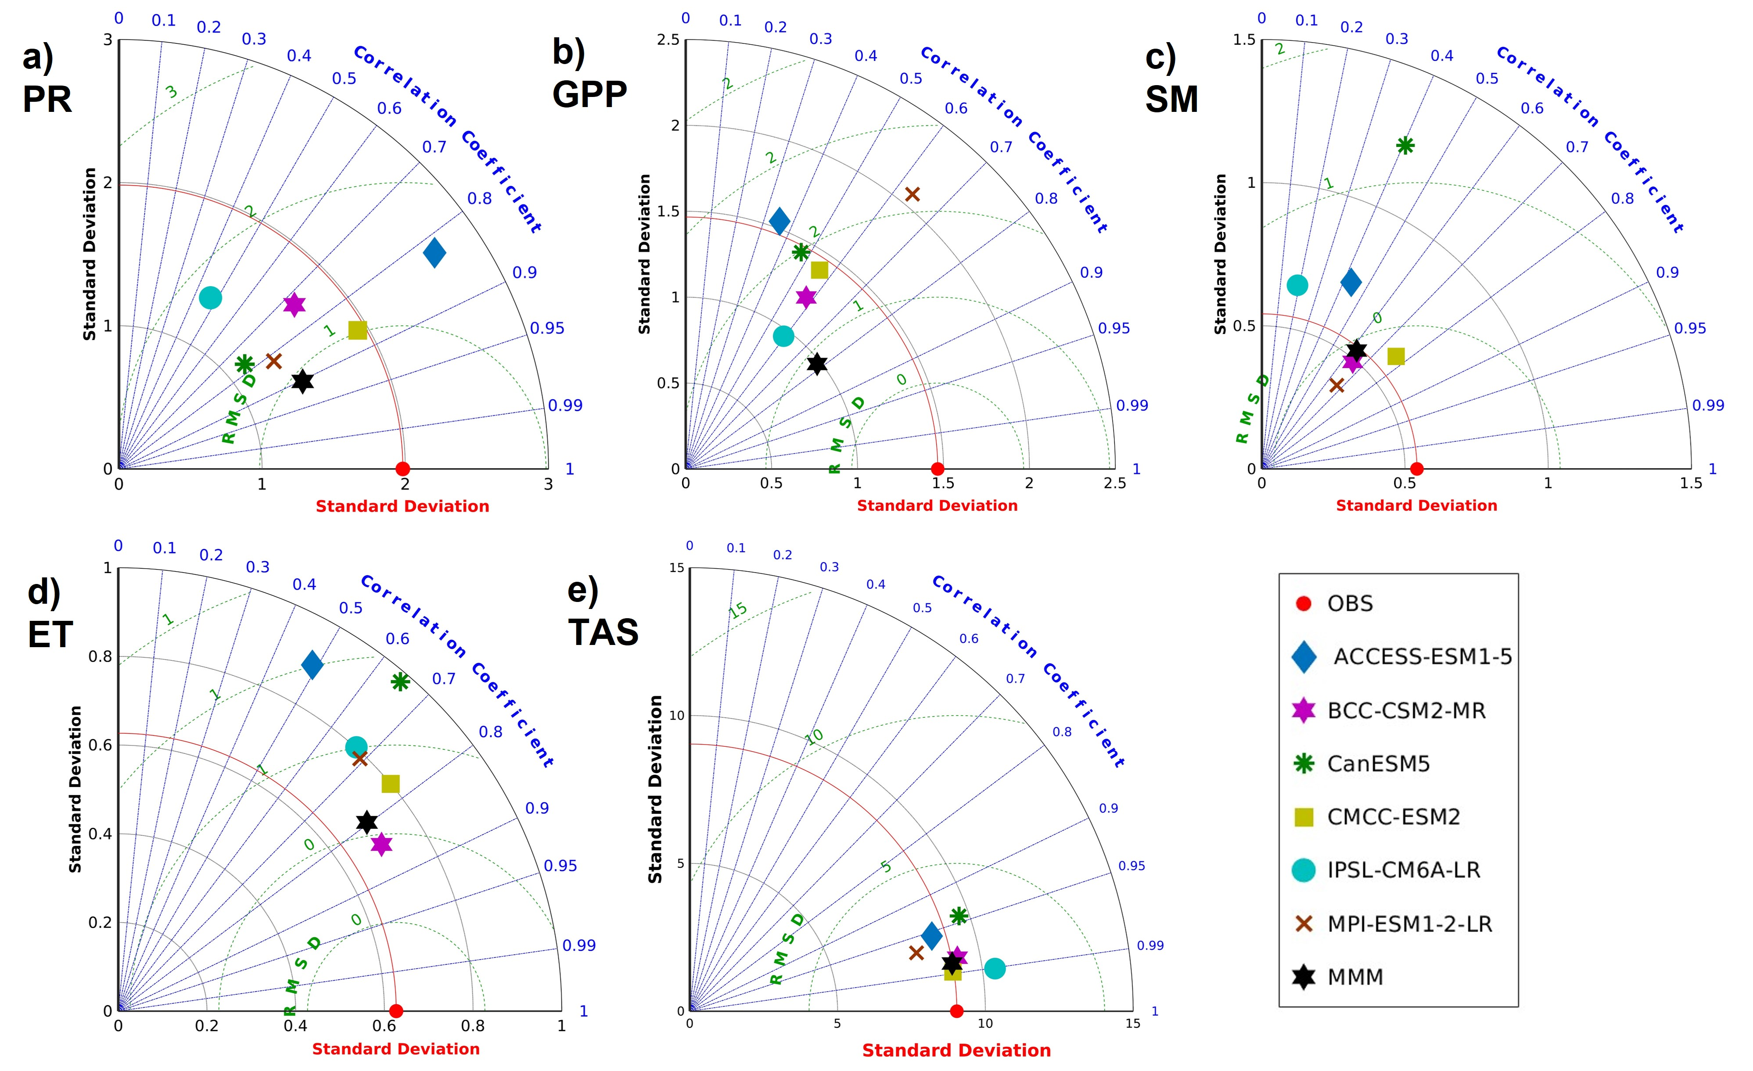
Changes in Indian vegetation productivity under increasing CO₂ concentration
Nivedita Dubey¹, Subimal Ghosh^{1,2}
¹Department of Civil Engineering, Indian Institute of Technology Bombay, Mumbai 400076, India.
²Interdisciplinary Programme in Climate Studies, Indian Institute of Technology Bombay, Mumbai 400076, India.
Email: dubeynivedita14@gmail.com, subimal@civil.iitb.ac.in
Introduction
Performance of ESMs in capturing the Climatology
6
Spatial changes in eco-hydrological variables
High atmospheric CO₂ concentration benefits the plant through CO₂ fertilization effect by increasing water use efficiency (WUE).
CO₂ warming effect and high leaf area index due to CO₂ fertilization effect cause water loss in plants.
The trade-off between these effects is critical.
Models can represent the meteorological variables such as precipitation (PR) and temperature (TAS) well, but uncertainty exists for gross primary productivity (GPP) and soil moisture (SM).
GPP increases over all the regions of India, along with PR, evapotranspiration (ET), and WUE.
However, there is a very clear west-east asymmetry.
WUE is projected to increase more in the humid, sub-humid forested regions than in the arid and semi-arid dry parts of India.
Precipitation has a similar spatial trend as ET, ensuring water availability for high ET and, thus, positive WUE.
GPP
PR
Agroecological regions of India
WUE
ET
The agroecological regions are classified based on soil, climate, physiographic, and length of the growing period by the national bureau of soil survey and land use planning (NBSS and LUP), India.
These agroecological zones are grouped into five ecosystems based on the climate zones (arid, semi-arid, sub-humid, humid, and coastal).
Trajectories of GPP and WUE
GPP
WUE
Figure shows the increase in GPP and WUE with the increasing CO₂ for different agroecological zones of India (1pctCO₂).
The black circles at low CO₂ concentrations are the simulated values from the piControl experiment (285 ppm).
The end circles at high CO₂ present the simulated values from the abrupt-4×CO₂ (1140 ppm) experiment. All the values are standardized with the piControl simulated values.
Monthly evolution of WUE
Except for the CanESM5, all other models show an increase in the WUE, whereas the seasonality varies across the models.
Thus, the seasonal evolution of the changes in WUE is still uncertain. However, the sign of change is positive in three out of four models.
Performance of ESMs in capturing the spatial variability
Outputs of six Earth system models (ESMs) from Coupled Model Intercomparison Project, phase 6 (CMIP6), were used to see how models simulate the eco-hydrological variables over India.
References
Acknowledgments
The work is financially supported by the Department of Science and Technology Swarna Jayanti Fellowship Scheme, through project no. DST/SJF/E&ASA-01/2018-19; SB/SJF/2019-20/11, and Strategic Programs, Large Initiatives and Coordinated Action Enabler (SPLICE) and Climate Change Program through project no. DST/CCP/CoE/140/2018.
1. Eyring V, Bony S, Meehl G A, Senior C A, Stevens B, Stouffer R J and Taylor K E 2016 Overview of the Coupled Model Intercomparison Project Phase 6 (CMIP6) experimental design and organization Geosci Model Dev 9 1937–58
2. Greve P, Roderick M L and Seneviratne S I 2017 Simulated changes in aridity from the last glacial maximum to 4xCO2 Environmental Research Letters 12
3. Lemordant L, Gentine P, Swann A S, Cook B I and Scheff J 2018 Critical impact of vegetation physiology on the continental hydrologic cycle in response to increasing CO2 Proc Natl Acad Sci U S A 115 4093–8
4. Zhu, P., Zhuang, Q., Ciais, P., Welp, L., Li, W., & Xin, Q. (2017). Elevated atmospheric CO2 negatively impacts photosynthesis through radiative forcing and physiology- mediated climate feedback. Geophysical Research Letters, 44(4), 1956–1963. https://doi.org/10.1002/2016GL071733

