Slide 1
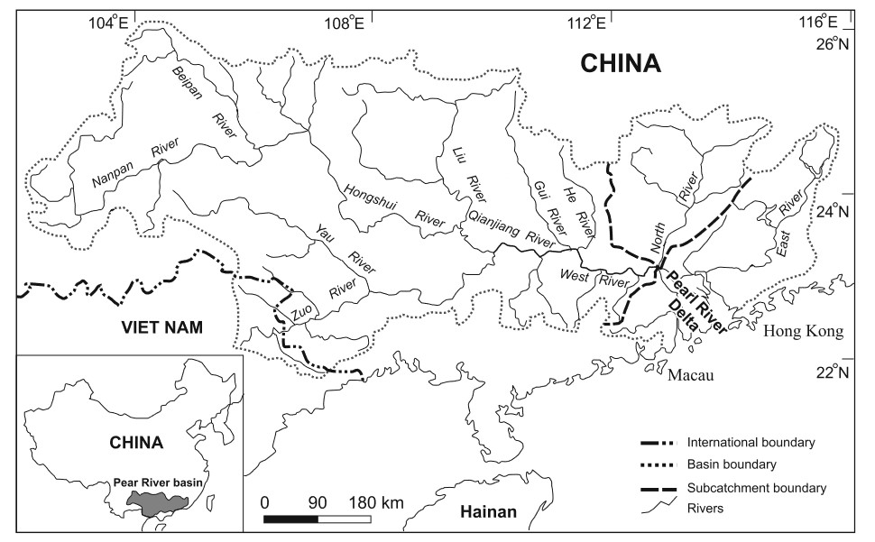
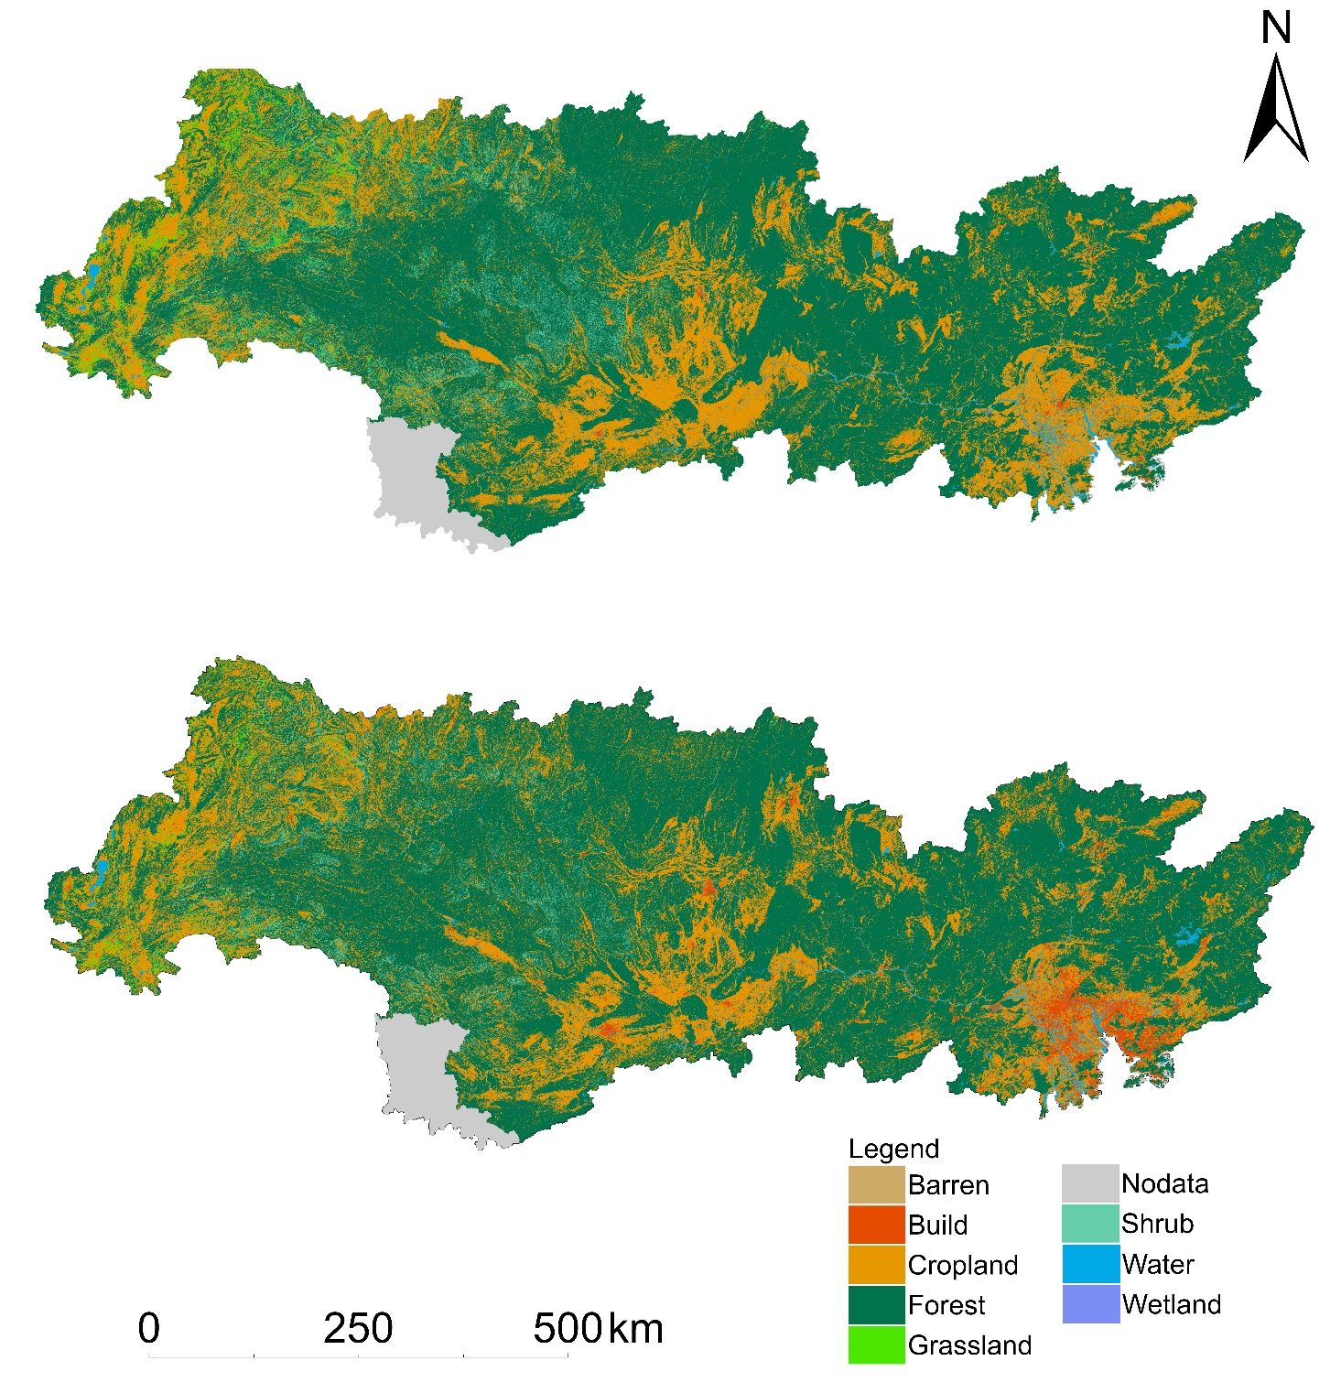
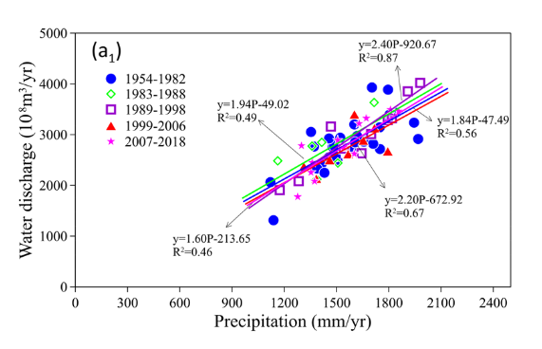
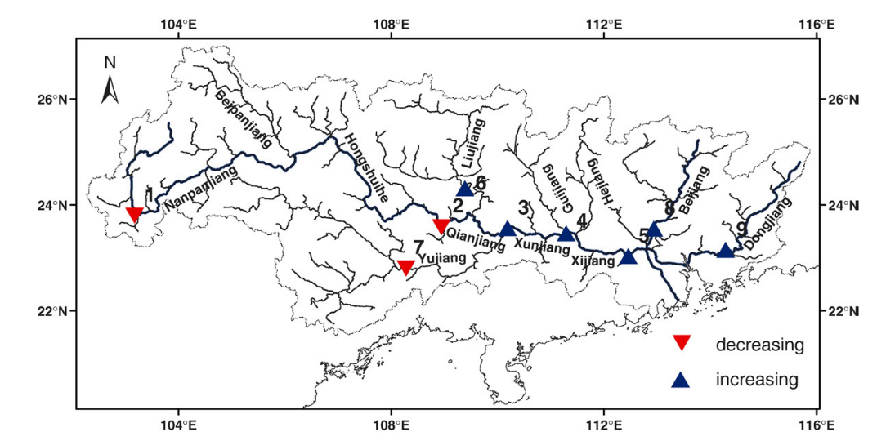
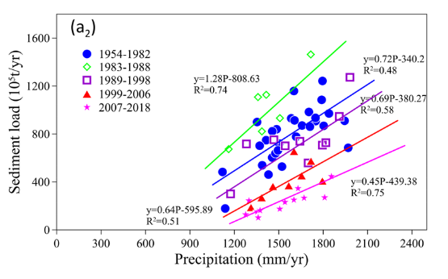
Sustaining the Pearl River: Problems, Challenges, and Opportunities
Haidong Ou¹,Xiankun Yang^{1,2,*}
1 School of Geography and Remote Sensing, Guangzhou University, Guangzhou 510006, China
2 Rural Non-Point Source Pollution Comprehensive Management Technology Center of Guangdong Province, Guangzhou University, Guangzhou 510006, China
Introduction
Climate Change
Economic and Policy Development
The Pearl River is a large water system, which is the second largest river (in terms of mean annual water discharge) in China. The Pearl River Basin consists of three major rivers, the West River, the North River and the East River. Of these, the largest is the West River, involving Nanpan River, Hongshui River, Qianjiang River and West River. Its main tributaries are: Beipan River, Liu River, Yu River and Gui River .It is about 2075 km long with a drainage area of 353,120 km², accounting for 77.8% of the total drainage area of the Pearl River Basin. The North River is the second largest tributary, having length of 468 km and drainage area of 46,710 km². The East River is about 520 km long with a drainage area of 27,000 km², accounting for 6.6% of the total area of
Average temperature changes:
Since 1954, annual average temperature in the Pearl River Basin has significantly increased, with the most significant increase observed in June. Winter warming rate is faster than that of summer, while temperature increase during the flood season is smaller than that of the non-flood season. The average spring temperature has decreased in small areas, mainly concentrated in the Nanpan, Hongshui, Liu River upstream, and the central area of You River. The monthly average temperature in coastal areas has increased at a faster rate, with September showing an increase in almost all areas. The average temperature in the Pearl River Delta and the East River Basin has significantly increased.
Extreme temperature changes:
There is an increasing trend in extreme high-temperature events and a decreasing trend in extreme low-temperature events in the Pearl River Basin. The trend of extreme high-temperature changes shows significant spatial variability, increasing from the west to the east, with a significant upward trend observed in the eastern part. The number of hot days in the Pearl River Basin is increasing, while the number of cold days is decreasing, showing significant and consistent changes in most regions.
Rainfall changes:
The distribution of rainfall varies in different regions of the Pearl River Basin. In the southeastern part, rainfall is relatively abundant, while in the western part, the annual precipitation is decreasing. Meanwhile, most of the region has witnessed an increasing trend in the number of rainy days. These regions exhibit an increase in rainfall intensity.
For extreme rainfall:
There is no significant change in the total amount of extreme rainfall, but the intensity of extreme rainfall has slightly increased. The downstream areas of the basin are more prone to heavy rainfall than the upstream areas.
The management of the Pearl River Basin has gradually shifted its focus from restoration, consolidation, and foundation laying to enhancing flood control capacity and solving irrigation and drainage issues. The construction of projects mainly emphasizes small and medium-sized projects with a focus on developing large and medium-sized projects.
1949-1965: Reconstruction
During the early years of the People's Republic of China, the Pearl River Basin was in a state of destruction due to war and internal conflicts, and was in urgent need of reconstruction and development. At that time, the national policies were mainly focused on restoring and building infrastructure, strengthening agricultural production, and supporting local industries. The Chinese government implemented a series of reforms, including land reform and rural collectivization.
1965-1978: Socialist Construction
The Pearl River Basin focused on light industry and infrastructure during socialist construction, modernizing through plans like "the Third Line Construction." The Pearl River Delta became a key industrial base and center of national light industry. However, political struggle from 1966 to 1976 led to the closure of private enterprises and factories, hindering economic development and halting land and water projects.
Due to the disturbance of the Cultural Revolution, the water conservancy construction and management were in chaos, resulting in the highest number of dam collapses in history. In the later stage of the Cultural Revolution, some rectification measures were taken, and a number of large and medium-sized water conservancy and hydropower projects were resumed or newly built. Small hydropower projects in mountainous areas also developed significantly.
the Pearl River Basin. The Pearl River Basin nourishes nearly 200 million people, and China's “open door and reform” policy and the “Belt and Road Initiative”. Nine cities in the Pearl River Delta contribute to approximately 10% of China's GDP in 2021. The Pearl River Delta is a crucial gateway for China's foreign trade, boasting numerous ports and industrial parks. In 2020, its total import and export value reached 4.57 trillion yuan, accounting for 21.5% of the country's total. The region's urbanization and industrialization processes are accelerating, attracting large amounts of domestic and foreign investment. Therefore, the Pearl River Delta is one of the most active regions in China in terms of attracting foreign investment and is also one of the world's most popular investment destinations. However, despite its important economic and regional environmental status, the Pearl River Basin is facing serious sustainable development issues.
Over the past decades, many studies have been performed on the Pearl River Basin. In this study, regarding the integrated study results in the Pearl River Basin on climate change, land use change, river channel change and human activities, we investigated the changes, challenges and impact factors of the eco-environment in the Pearl River Basin.
The investment in water conservancy has been increasing year by year, and the focus of water conservancy work has shifted to improving economic efficiency. The work combines the elimination of hazards with the promotion of benefits, and the integration of services with operations, consolidation with development, management with governance, and construction with management.
1978-1992: The Initial Stage of Reform and Opening Up
Transformation of Land Use
During the early stage of reform and opening up, China implemented an open-door policy, which provided new development opportunities for the economy in the Pearl River Basin. During this period, the government focused on developing industries such as light industry, textiles, and food processing, while encouraging foreign investment in the development zones and industrial parks of the Pearl River Basin. The development of these industries promoted the urbanization process in
the Pearl River Basin, with a rapid increase in the
urban population and expansion of the urban area.
In recent years, the Pearl River Basin has undergone significant changes in land use trends due to the rapid development of urbanization and industrialization. In the case of the Pearl River Delta, since the 1980s, there has been a tremendous transformation in land use due to the rapid economic growth. Agricultural land has gradually decreased, while the demand for urban and industrial land has increased. Consequently, the areas of urban and industrial land have expanded rapidly, while agricultural land has gradually decreased. Additionally, research has indicated a decreasing trend in the water surface area of the Pearl River Delta. Due to its geographical location and economic characteristics, the industrialization process in the Pearl River Delta region has been even more rapid, resulting in the expansion of industrial land use and leading to the degradation of the ecological environment and wastage of resources. In addition to the Pearl River Delta region, the land use changes in the West, North, and East River Basin have been relatively consistent:
Change of River Channels
1992-2008: The Middle Stage of Reform and Opening Up
West River Basin:
The mean discharge of the Liu River and Yujiang River displays a declining trend. In the Nanpan River, Beipan River, and Liu River basins of the West River Basin, the proportion of rocky desertification area accounts for 81% of the total rocky desertification area in the Pearl River Basin. The severe soil erosion and high sediment concentration in the rocky desertification areas lead to a riverbed aggradation and a noticeable upward trend in water levels for most tributaries in the West River Basin.
North River Basin:
In the North River Basin, the sediment trapping effect of dam construction partially offsets the sediment deposition caused by soil erosion. However, with climate change and large-scale water usage, the water levels of North Basin rivers exhibit a declining trend.
East River Basin:
The East River is located in Guangdong Province and runs through an area heavily influenced by human activities. The basin contains the two largest reservoirs in Guangdong Province, namely Xinfengjiang Reservoir (138.96 billion m³) and Fengshuba Reservoir (19.40 billion m³), which significantly impact the sediment load of the East River. Research has shown that human activities contribute 80% of the sediment discharge rate in the East River Basin. In recent years, the rivers in the East River Basin have undergone channel narrowing and deepening, and the riverbeds have significantly deepened, leading to a marked decrease in water levels.
a) 1990
in the early 1990s, the industrialization process in the Pearl River Basin gradually reached a bottleneck, and the problem of environmental pollution became increasingly prominent. In 1995, the CPC Central Committee and the State Council officially proposed the strategy of "sustainable development," and the Pearl River Basin gradually embarked on the path of sustainable development. The government strengthened its attention to environmental issues and intensified the formulation and implementation of environmental protection regulations.
2008-present: The later stage of reform and opening up
The theme of high-quality development guides the management of the Pearl River Basin with the aim of sustainable development, emphasizing the principles of governance, development, utilization, management, and protection. The goal is to reduce water and drought disasters, achieve comprehensive and efficient use of water resources, and protect the ecological environment.
b) 2020
Land use in the Pearl River Basin in different years
the areas of urban and industrial land have gradually expanded, while the areas of farmland and forest have gradually decreased.
Management Advice
Dam Construction and Urbanization
Establish a comprehensive collaborative management supervisory institution and enhance the enforcement credibility of the river basin management agency.
Strengthen the establishment of a unified dispatch system for reservoirs in the river basin to improve the efficiency of water resources utilization.
Establish a shared data platform to make information on water conservancy and meteorological engineering construction within the river basin more transparent and accessible.
Promote the establishment of a remote sensing monitoring system and increase technological investment.
Formulate specialized measures and establish dedicated institutions for drought, flood control, and salt tide prevention.
Develop more detailed and specific pollution prevention and control laws and punishment systems.
Enhance the participation of river basin residents in water resources management and expand public participation methods.
Since the implementation of China's reform and opening-up policy in 1978, all towns in the Pearl River Basin have undergone remarkable development. In particular, in the Pearl River Delta region, research indicates that urban construction land increased nearly twofold between 1990 and 2020.
Since the 1950s, more than 9,000 reservoirs have been constructed in the Pearl River Basin, with a total storage capacity accounting for approximately 21% of the annual average flow of the Pearl River Basin. Recent water level decreases at some monitoring stations in the North, East, and West River Basins are partly attributed to the construction of water conservancy projects in the Pearl River Basin.
Large-scale reservoir construction in the Pearl River Basin
River basin | Reservoir name | Storage capacity/*10⁸ m³ | Completion time
West River Basin | Dawangtan | 5.85 | 1960
 | Mingjiangnaban | 7.02 | 1960
 | Xijin | 30.00 | 1964
 | Chengbihe | 11.30 | 1966
 | Dahua | 9.64 | 1982
 | Yantan | 33.80 | 1992
 | Tianshengqiao | 108.00 | 1997
 | Baise | 56.00 | 2006
 | Longtan | 273.00 | 2006
North River Basin | Nanshui | 12.43 | 1971
 | Changhu | 1.49 | 1973
 | Jinjiang | 1.90 | 1990
 | Feilaixia | 19.50 | 1999
East River Basin | Xinfengjiang | 138.96 | 1969
 | Fengshuba | 19.40 | 1973
 | Baipengzhu | 12.20 | 1985
Water discharge compared to precipitation during different periods
References
[1] Chen Y D, Zhang Q, Chen X, et al. Multiscale variability of streamflow changes in the Pearl River basin, China[J].
Stochastic environmental research and risk assessment, 2012, 26: 235-246
[2] Zhang S, Lu X X, Higgitt D L, et al. Recent changes of water discharge and sediment load in the Zhujiang (Pearl River) Basin, China[J]. Global and
Planetary Change, 2008, 60(3-4): 365-380
[3] Wei X, Cai S, Ni P, et al. Impacts of climate change and human activities on the water discharge and sediment load of the Pearl River, southern
China[J]. Scientific Reports, 2020, 10(1): 16743.
The change trends of water discharge in the Pearl River Basin
Sediment load compared to precipitation during different periods

