Slide 1
Downscaling with a machine learning–based emulator of a local-scale UK climate model
Henry Addison, Elizabeth Kendon, Suman Ravuri, Laurence Aitchison, Peter Watson
Notes:
Hello, I’m Henry
a PhD student at Interactive AI CDT at University of Bristol
I’m interested in how AI can be used to help people interested in climate data like climate scientists

Slide 2
The problem
Can we learn hi-res precipitation from coarse, GCM climate variables?
High-resolution climate simulations are expensive
New probabilistic ML methods could emulate hi-res, CPM simulator
Notes:
More specifically I’m trying to use machine learning to learn a mapping from coarse climate model variables to high-resolution precipitation.
Why?
For a global climate simulation computational feasible, it must be limited to 25km resolution at best but that’s just too low resolution for a lot of use-cases.
One solution is dynamical downscaling and regional climate models. And this approach is starting to get to local-scale resolutions that open up these use-cases.
For example, the Met Office produced the first national-level, convection-permitting 2.2km projections
but these were really expensive so required some trade-offs in terms for spatial and temporal domain, ensemble size and emission scenarios.
My aim is to apply recent advances in probabilistic ML to these high-resolution projections and learn a stochastic mapping from the coarse variables of a global model in order to create more high-resolution samples much much more cheaply.

Slide 3
Data: Met Office UKCP18
Low resolution Global Climate Model (GCM) @ 60km
High resolution Convection-Permitting Model (CPM) @ 2.2km (using 8.8km)
Daily
Notes:
Explain the different CPM/hi-res/2.2km and GCM/lo-res/60km terms
Here’s some more detail about the dataset I’m using for this downscaling problem:
60km global model and 2.2km convection-permitting model covering UK & Ireland. To ease the computational requirements at this stage I’m using a reduced 8.8km resolution on a patch covering England and Wales
I’m starting on daily data over the 60 years initially available for the hi-res simulation but sub-daily is also available

Slide 4
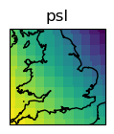
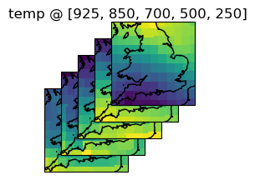
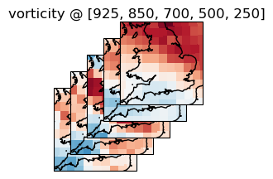
Input
Lo-res climate variables
AI
Output
Hi-res precipitation
Notes:
So to summarise our aim: we want to take low resolution climate variables like temperature, relative vorticity and sea-level pressure to generate samples of plausible high resolution rainfall using machine learning

Slide 5
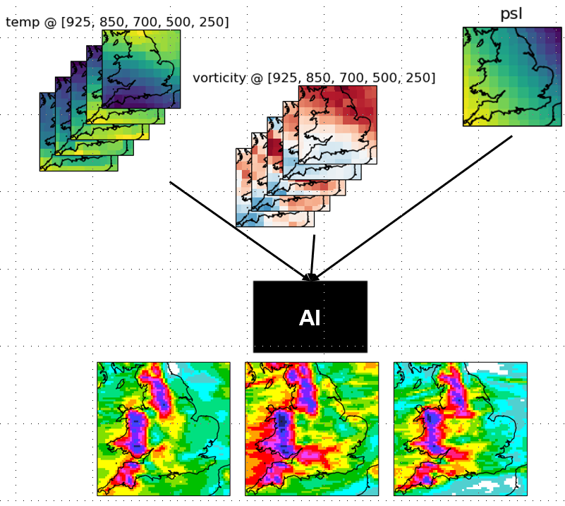
Approach
Training: coarsened CPM variables → hi-res CPM precip
Evaluating: coarsened CPM variables or GCM variables → hi-res CPM-like precip
Make sure to use variables which are well-represented in GCMs and cause rainfall
Wind
Temperature
Pressure
Notes:
So how do we fit and evaluate an ML model?
Ideally we’d like to match GCM data to CPM rainfall but the outputs of the CPMs and GCMs aren’t completely aligned in time– it’s quite possible for the GCM to think it’s going to wet in the West and the CPM to think it’s going to be wet in the East on any day and both to be correct due to natural variability
This means it doesn’t make sense to train using GCM data as our input and CPM data as our target.
Instead I’m following a perfect model approach and training using coarsened CPM data as the input so I know it will be aligned temporally with the output.
Once the model is trained, I can then use the GCM data as input to generate samples using the ML model. This means I need to be careful with the variables I use as the conditioning input as ideally they should be as well-represented in a GCM as a CPM and also I don’t want to throw away human expert knowledge so I want to use variables that are known to cause rainfall. This means I’m starting off looking at variables related to wind, temperature and pressure.
In both cases, the ML model can be evaluated in terms of climatological statistics, so things like mean and over large areas and time ranges.
In the case of samples using coarsened CPM input we can also see how well the samples output by the ML model match the corresponding hi-res CPM precipitation, which means using weather-forecasting type metrics is possible

Slide 6
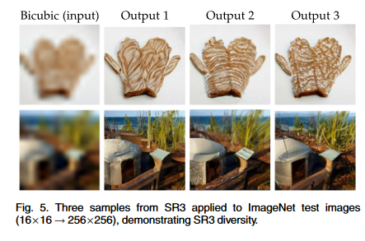
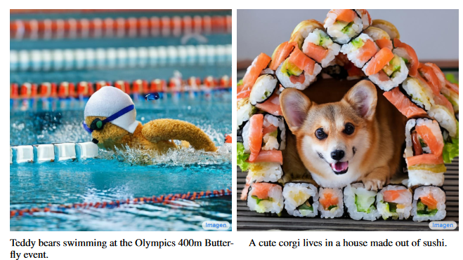
Diffusion models
From Figure 1 of Saharia, Chitwan, et al. "Photorealistic text-to-image diffusion models with deep language understanding." Advances in Neural Information Processing Systems 35 (2022)
Saharia, Chitwan, et al. "Image super-resolution via iterative refinement." IEEE Transactions on Pattern Analysis and Machine Intelligence (2022).
Notes:
I’m not going to go into detail here but the sort of machine learning I’m using is based on SOTA deep generative models known as score-based generative models or diffusions models. They are used for image generation systems that you may have come across in the news like Stable Diffusion, DALLE-2 or Google Imagen and that includes being used for the related problem of image super-resolution as we can see on the right.

Slide 7
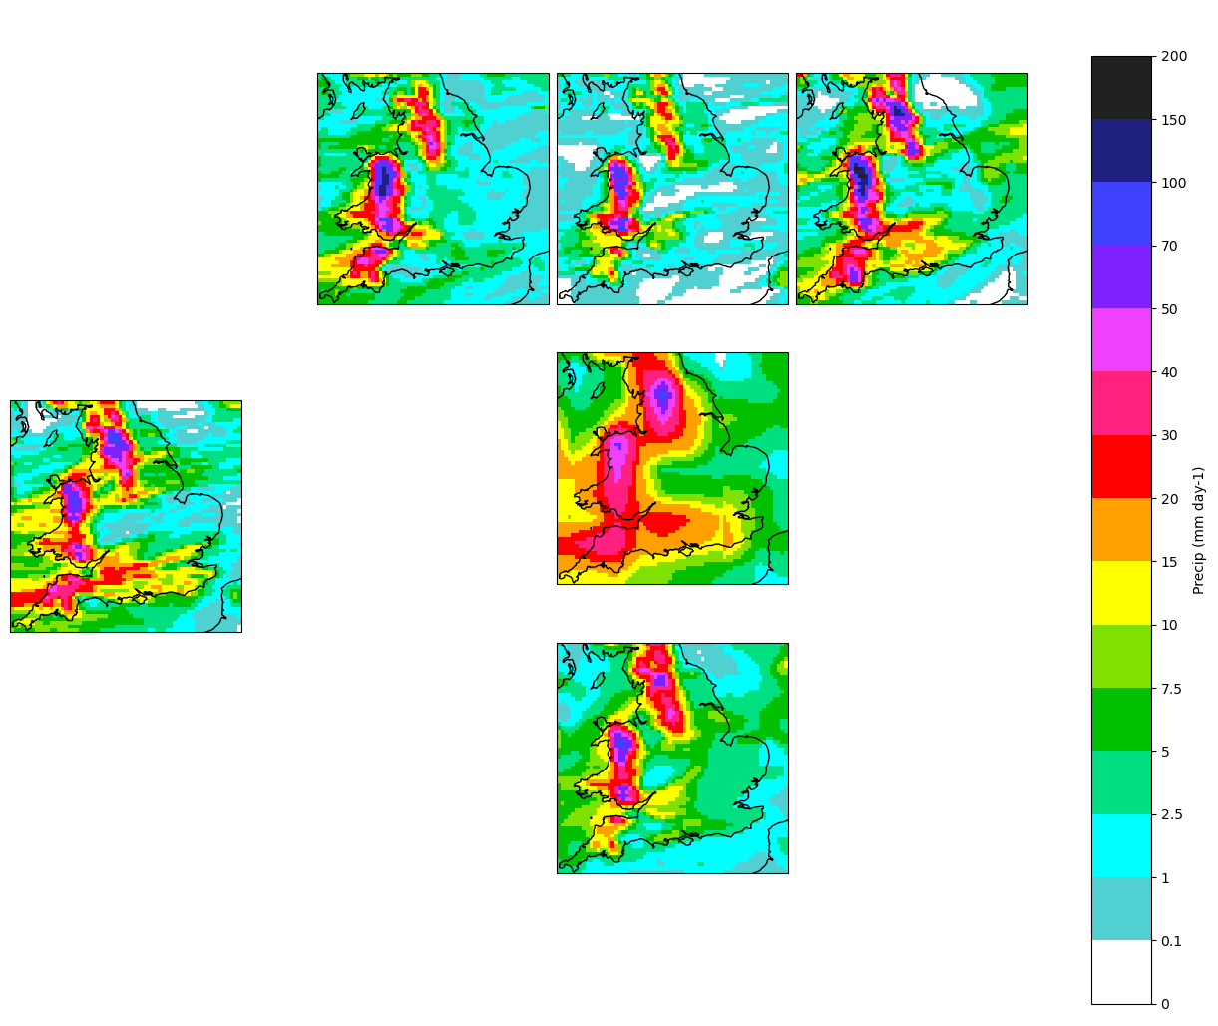
Coarsened CPM → 8.8km CPM rainfall
Diffusion
Lo-res precip (interpolated)
Simulation
U-Net
Notes:
Let’s look at some results.
First of all, we consider the case of using coarsened CPM inputs.
Here are some samples. One the left is the CPM simulation output for context. The top row on the right are some samples from the diffusion model. We can get lots of samples for the same conditions, covering the full range of plausible rainfall given the coarse conditions.
And for comparison we have some baselines: a simple linear interpolation of coarse rainfall and a U-Net. These are both deterministic methods so we only get once sample for each point.

Slide 8
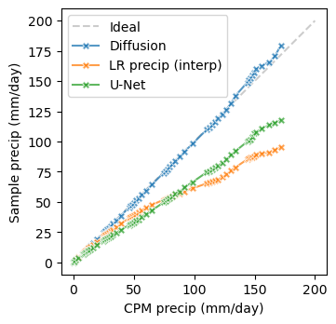
Are we capturing the distribution of rainfall?
Diffusion
U-Net
Lo-res precip
Normalized mean bias
QQ plot
10th to 99.99999th centile
Notes:
Pixel-level distribution of samples matches distribution of target well. This is based on a validation set of about 4000 days from randomly selected seasons
The mean bias of the diffusion model is looking good at each location , particularly compared to our baselines.
Q-Q plot is upto 99.99999th centile and our diffusion models lies on lies on that ideal y=x line meaning the quantiles of the samples match the quantiles of the CPM simulation well

Slide 9
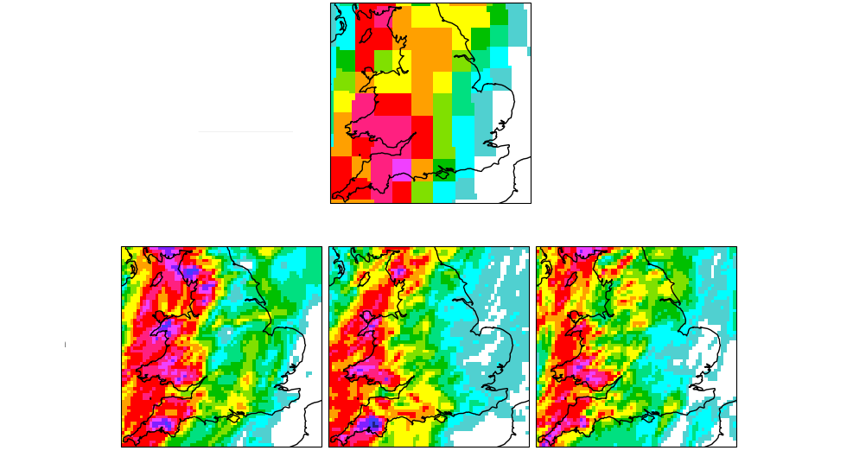
GCM → 8.8km CPM rainfall
Simulation
Diffusion
Notes:
But remember what we really care about is downscaling a GCM and being able to generate hi-res rainfall from a simulation from which we only have lo resolution versions.

Slide 10
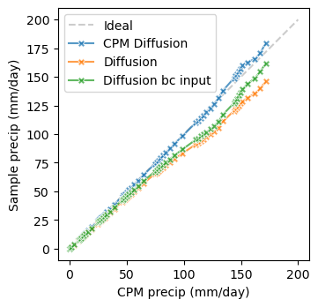
GCM → 8.8km CPM rainfall
Original
CPM driven
Original
Bias corrected inputs
GCM driven
QQ plot
10th to 99.99999th centile
Normalized mean bias
Notes:
Needs a bit of help when fed GCM data rather than coarsened CPM data as inputs. The quantiles don’t quite match the CPM quantiles as well as in the CPM-driven use case, the mean bias doesn’t look so good)
Had success with bias-correction of inputs to make the distribution of the GCM data a bit more like the CPM data used for training (change mean and variance of GCM data to match the mean and variance of training set CPM data).
Can see here how it helps with the mean bias in the bottom right map and with quantiles in the QQ plot

Slide 11
Summary
Using SOTA diffusion model to emulate Met Office’s hi-res UK climate model
Reproduces realistic spatial structure and variability of rainfall
Coarsened CPM driven: good match in mean and quantiles
GCM driven: extra bias correction of inputs required
Any questions or suggestions?
henry.addison@bristol.ac.uk

Slide 12
Key references
Gutiérrez, J. M. et al. 2019. 'An intercomparison of a large ensemble of statistical downscaling methods over Europe: Results from the VALUE perfect predictor cross-validation experiment', International Journal of Climatology, 39: 3750-85.
Kendon, E. J. et al. 2021. ‘Update to the UKCP Local (2.2km) projections: Science report’, Met Office Hadley Centre, Exeter, UK.
Luo, C. 2022. "Understanding diffusion models: A unified perspective." arXiv preprint arXiv:2208.11970.
Ravuri, Suman et al. 2021. 'Skillful Precipitation Nowcasting using Deep Generative Models of Radar’. Nature.
Song, Y. et al., 2021. Score-Based Generative Modeling through Stochastic Differential Equations’, International Conference on Learning Representations.
Vandal, T. et al. 2018. 'Intercomparison of machine learning methods for statistical downscaling: the case of daily and extreme precipitation', Theoretical and Applied Climatology, 137: 557-70.
Met Office Hadley Centre, UKCP18 Local Projections at 2.2km Resolution for 1980-2080, Centre for Environmental Data Analysis, 2019. [Online]. Available: https://catalogue.ceda.ac.uk/uuid/d5822183143c4011a2bb304ee7c0baf7 (visited on 09/06/2021).
Met Office Hadley Centre, UKCP18 Global Projections at 60km Resolution for 1900-2100, Centre for Environmental Data Analysis, 2018. [Online]. Available: https://catalogue.ceda.ac.uk/uuid/97bc0c622a24489aa105f5b8a8efa3f0 (visited on 09/06/2021).

Slide 13
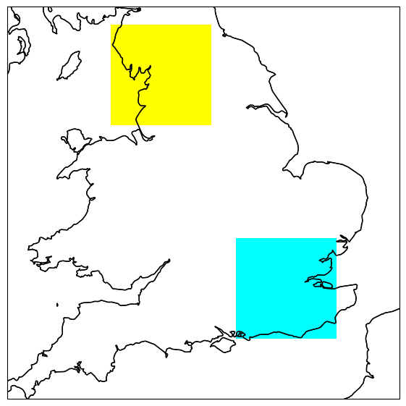
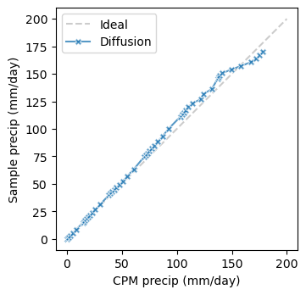
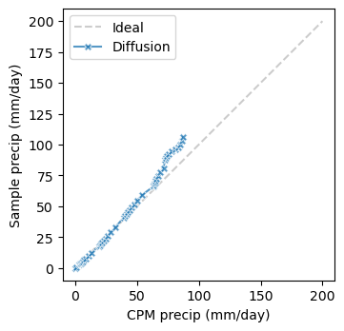
Subregions
NW Winter
SE Summer
Notes:
Take a closer look at different parts of the country and in different seasons because rain has different patterns and causes in different parts of UK at different times of year – the SE Summer is interesting since it has convective storms which are better modelled by the CPM

Slide 14
Future work
Evaluation
Spatial structure
Conditioning
Probabilistic element
Generalizing to (large ensembles of) other climate models, time periods, locations
More extreme Extremes: 1-in-100 years
Sub-daily frequency and temporal sequences (video)
Flood modelling applications

